Slide 1
TANGO New Developments New features
Reynald Bourtembourg

Slide 2
TANGO 9 New Features
DevEnum Attributes
Forwarded Attributes
Pipes
Dynamic commands
New event types
New Polling Algorithm

Slide 3
TANGO 9 New Features: DEV_ENUM Attributes
New IDL Tango type: DevEnum (29) ~ C++ enumeration
The enumerated values always start at 0
Values are consecutive
It is transferred on the network as DevShort data type
Attributes like the others (name, properties, polling,.....)
+
The Enum definition ( enum _MyEnum { XX, YY, ..} )
Labels for enum fields ( vector<string> )

Slide 4
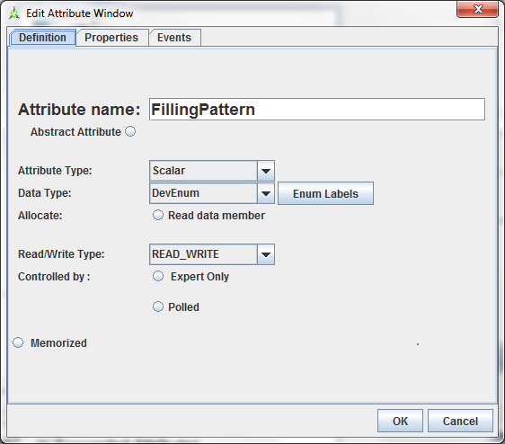
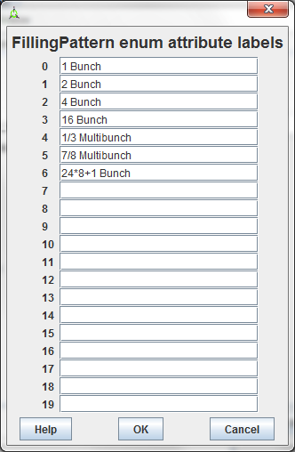
TANGO 9 New Features: DEV_ENUM Attributes
Example using POGO:

Slide 5
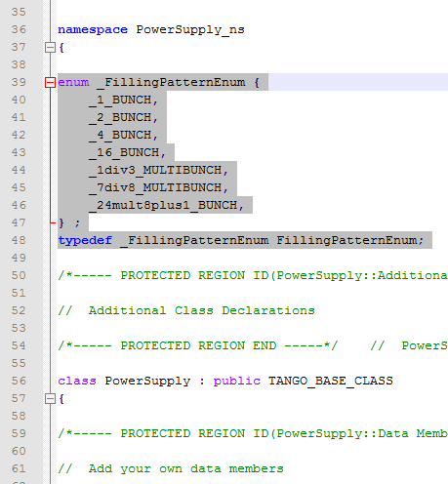
TANGO 9 New Features: DEV_ENUM Attributes
Example using POGO (generated code):

Slide 6
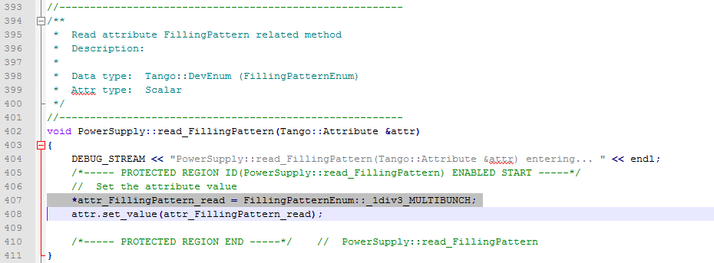
TANGO 9 New Features: DEV_ENUM Attributes
Example using POGO (generated code):

Slide 7
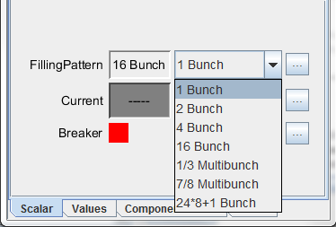
TANGO 9 New Features: DEV_ENUM Attributes
ATKPanel

Slide 8
TANGO 9 New Features: DEV_ENUM Attributes
The enumeration labels can be set dynamically after the attribute creation:
1 void MyDev::init_device()
2 {
3 ...
4
5 Attribute &att = get_device_attr()->get_attr_by_name("TheEnumAtt");
6 MultiAttrProp<DevEnum> multi_prop;
7 att.get_properties(multi_prop);
8
9 multi_prop.enum_labels = {/* your fancy enum labels */}; 10 att.set_properties(multi_prop);
11 ....
12 }

Slide 9
TANGO 9 New Features: DEV_ENUM Attributes
Setting the attribute value:
1 enum Card points
2 {
3 NORTH = 0,
4 SOUTH,
5 EAST,
6 WEST
7 };
8
9 void MyDev::read_TheEnum(Attribute &att)
{
...
12 points = SOUTH;
13 att.set_value(&points);
14 }

Slide 10
TANGO 9 New Features: DEV_ENUM Attributes
Setting the attribute value:
1 enum Card points
2 {
3 NORTH = 0,
4 SOUTH,
5 EAST,
6 WEST
7 };
8
9 void MyDev::read_TheEnum(Attribute &att)
{
...
12 points = 1; // SOUTH == 1
13 att.set_value(&points);
14 }

Slide 11
TANGO 9 New Features: DEV_ENUM Attributes
Usage in a Tango client:
1 DeviceAttribute da = the_dev.read_attribute("TheEnumAtt");
2 Card ca;
3 da >> ca;
OR
1 DeviceAttribute da = the_dev.read_attribute("TheEnumAtt");
2 DevShort sh;
3 da >> sh;

Slide 12
TANGO 9 New Features: Forwarded Attributes
Forwarded Attribute = device attribute mapping an attribute of a root device.
A forwarded attribute is defined by:
A name
A label to overload the root attribute label
An attribute property __root_att in database to set root attribute name

Slide 13
TANGO 9 New Features: Forwarded Attributes
A forwarded attribute gets its configuration from its root attribute
It forwards to its root attribute:
Its read / write / write_read requests
Its configuration change
Its event subscription
Its locking behavior

Slide 14
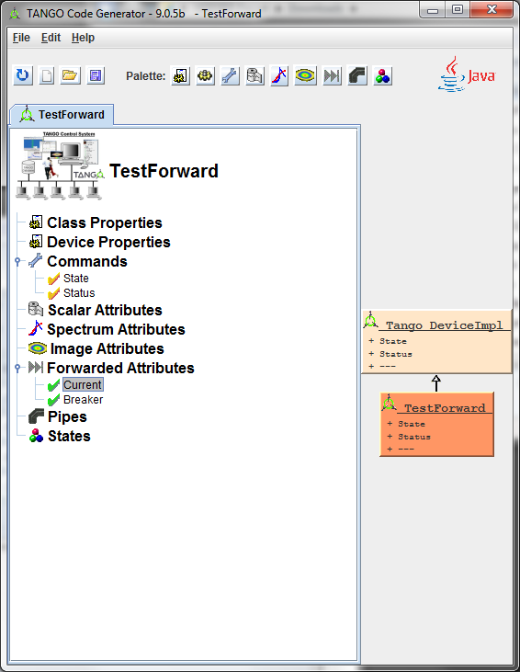
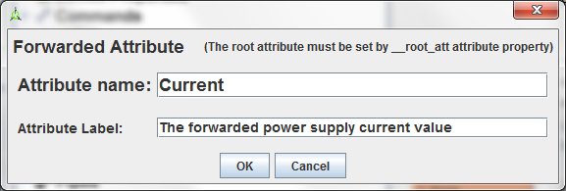
TANGO 9 New Features: Forwarded Attributes

Slide 15
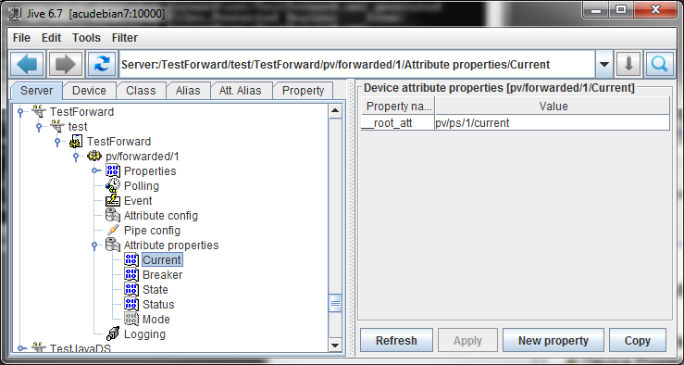
TANGO 9 New Features: Forwarded Attributes

Slide 16
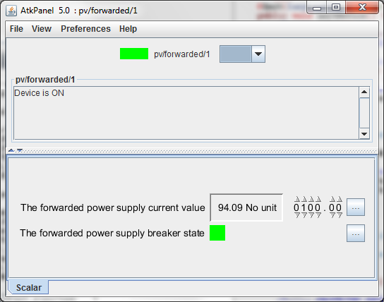
TANGO 9 New Features: Forwarded Attributes

Slide 17
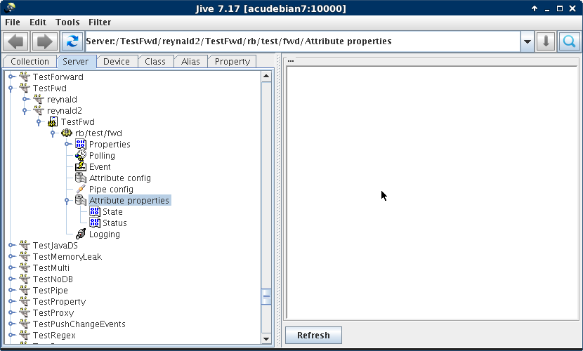
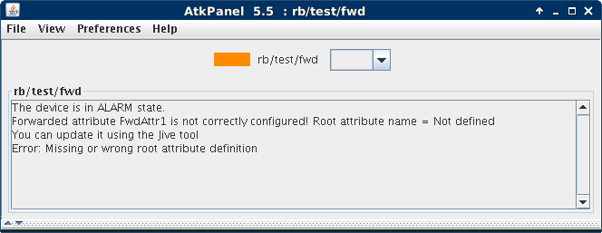
TANGO 9 New Features: Forwarded Attributes

Slide 18
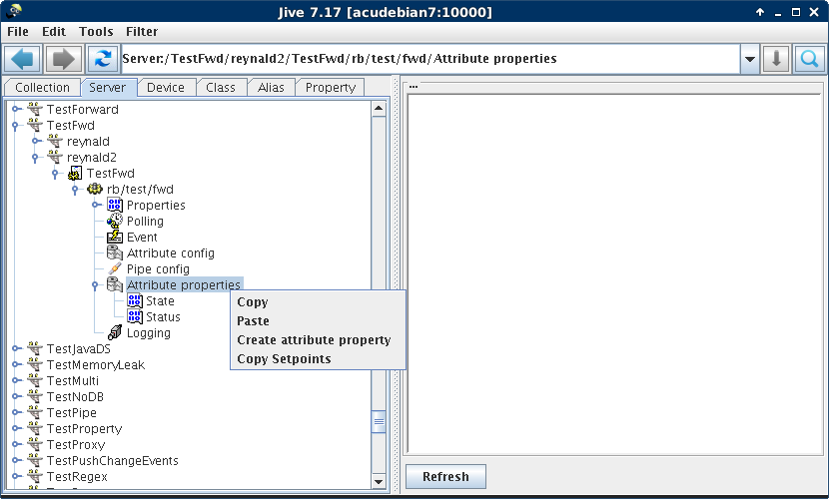
TANGO 9 New Features: Forwarded Attributes

Slide 19
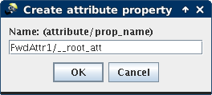
TANGO 9 New Features: Forwarded Attributes

Slide 20
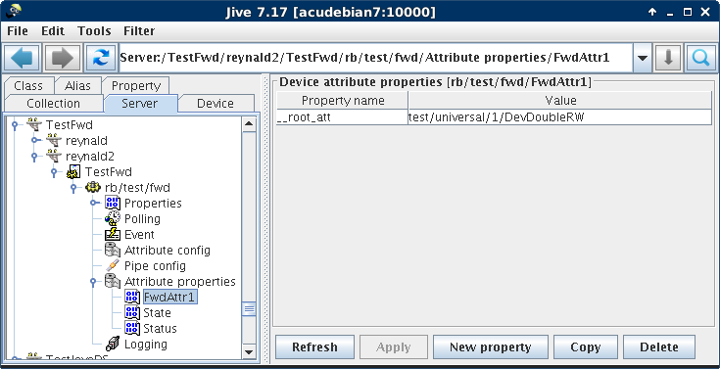
TANGO 9 New Features: Forwarded Attributes

Slide 21
TANGO 9 New Features: Forwarded Attributes
__root_att can point to an attribute in another control system ( different TANGO_HOST):
e.g: __root_att=tango://somewhere:20000/my/super/dev/attr

Slide 22
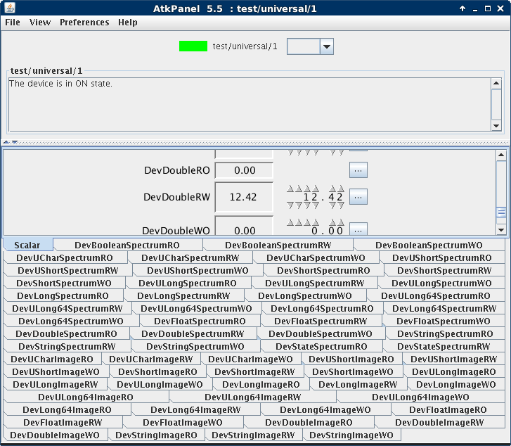
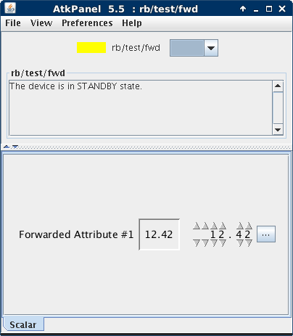
TANGO 9 New Features: Forwarded Attributes

Slide 23
TANGO 9 New Features: Forwarded Attributes

Slide 24
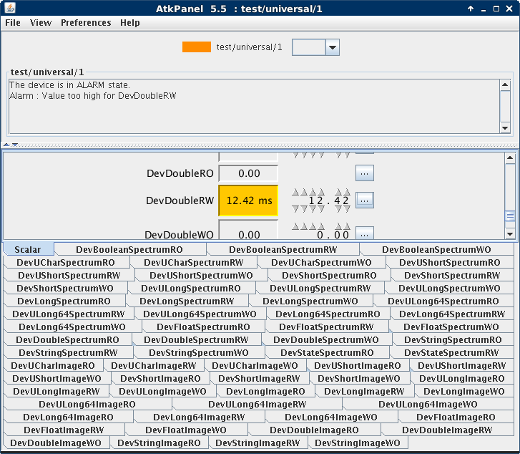
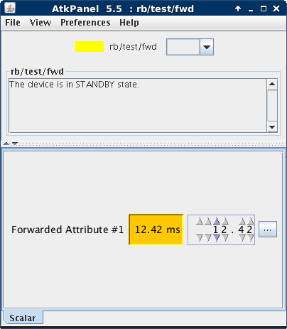
TANGO 9 New Features: Forwarded Attributes

Slide 25
TANGO 9 New Features: Forwarded Attributes
If the root device is not running, the device will be in ALARM
Error message in Status: ''Forwarded attribute xxx not reachable'‘
It will become reachable again as soon as the root device attribute is exported again

Slide 26
TANGO 9 New Features: Forwarded Attributes
Current limitations:
Alarm quality factor not reflected in State and Status attributes when the fwd and root attributes are in alarm
Can be created dynamically but works with only one exported device/server
Forwarded events sometimes contain the previous attribute value https://github.com/tango-controls/JTango/issues/44
Attribute value not directly accessible from server exporting the forwarded attribute (Need to do a read own attribute using DeviceProxy on itself)

Slide 27
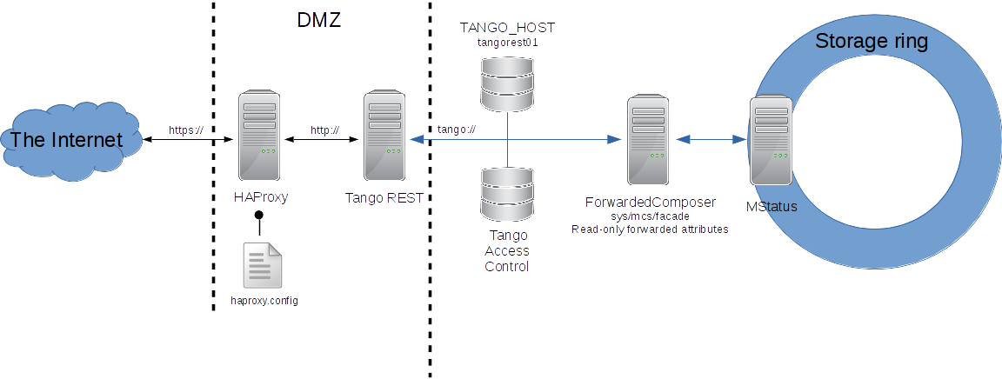
TANGO 9 New Features: Forwarded Attributes
https://github.com/tango-controls/ForwardedComposer

Slide 28
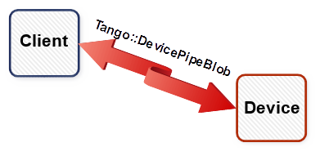
TANGO 9 New Features: Pipes
Pipes = new way to communicate between client and device
Transports in one call, data with different types
The pipe transports a blob (Tango::DevicePipeBlob)

Slide 29
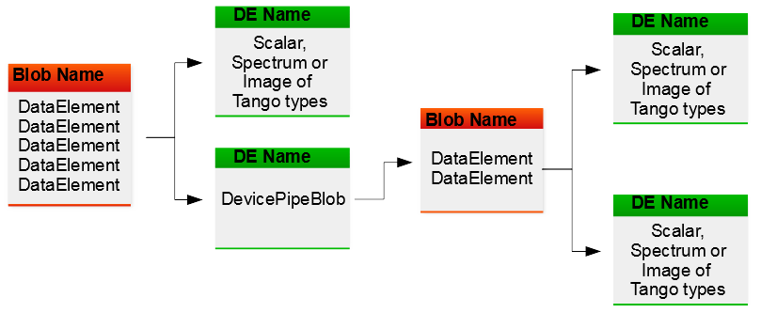
TANGO 9 New Features: Pipes
The pipe transports a blobs (Tango::DevicePipeBlob).
The transported blob structure could change at each call.
A blob is defined by a name and a sequence of Tango::DataElement
A DataElement is defined by a name and a piece of data.
data = of a Tango data type or a blob.

Slide 30
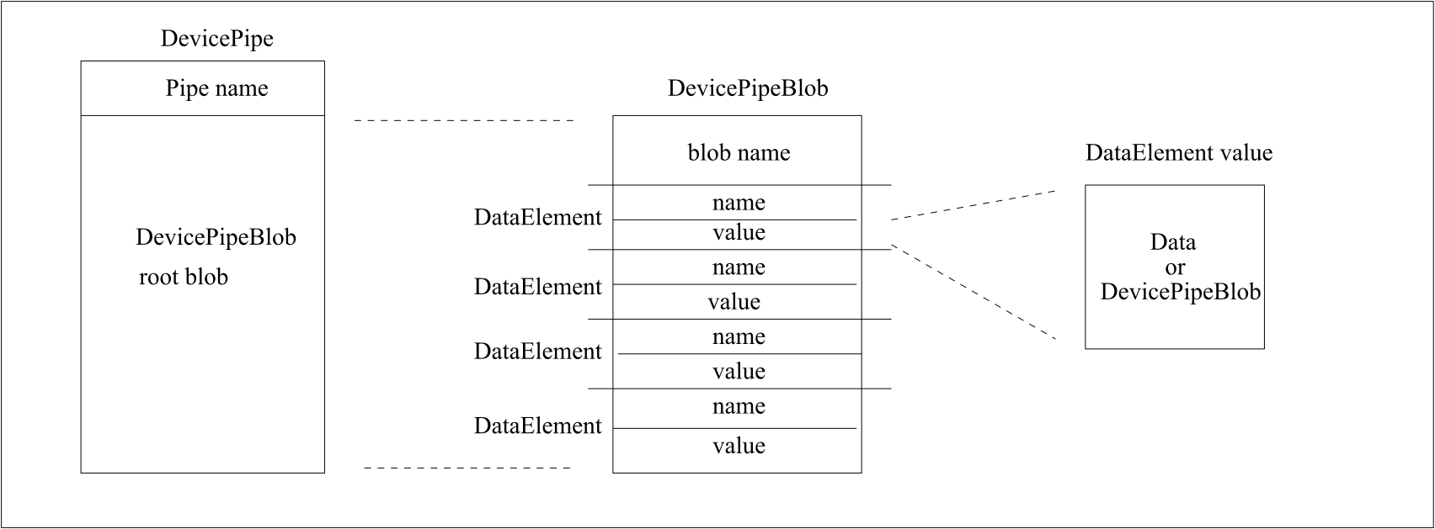
TANGO 9 New Features: Pipes
The transported blob structure could change at each call.
A blob is defined by a name and a sequence of Tango::DataElement
A DataElement is defined by a name and a piece of data.
data = of a Tango data type or a blob.

Slide 31
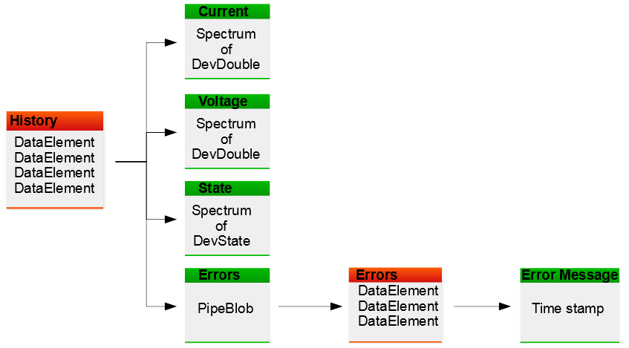
TANGO 9 New Features: Pipes

Slide 32
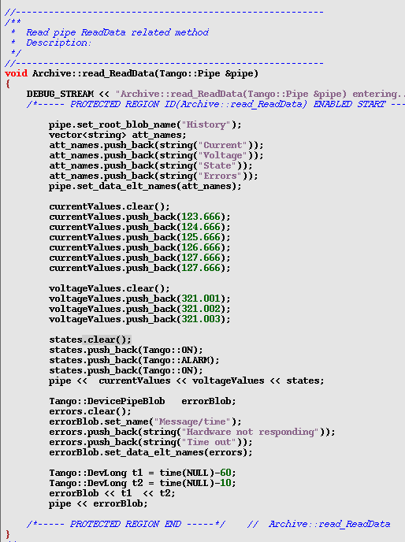
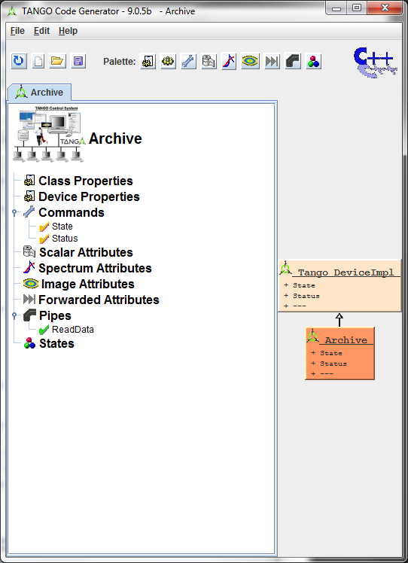
TANGO 9 New Features: Pipes

Slide 33
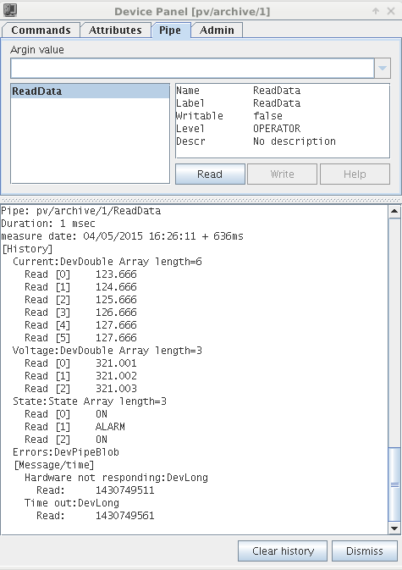
TANGO 9 New Features: Pipes

Slide 34
TANGO 9 New Features: Pipes
Client side: Extracting data with prior content knowledge:
1 DevicePipe dp = mydev.read_pipe("MyPipe");
2
3 DevLong dl;
4 vector<double> v_db;
5 DevVarUShortArray *dvush = new DevVarUShortArray();
6
7 dp >> dl >> v_db >> dvush;
8
9 delete dvush;

Slide 35
TANGO 9 New Features: Pipes: Client side: Extracting data with prior content knowledge
1 DevicePipe dp = mydev.read_pipe("MyPipe");
2 size_t nb_de = dp.get_data_elt_nb();
3 for (size_t loop = 0;loop < nb_de;loop++) {
5 int data_type = dp.get_data_elt_type(loop);
6 string de_name = dp.get_data_elt_name(loop);
7 switch(data_type) {
9 case DEV_LONG:
10 {
11 DevLong lg;
12 dp >> lg;
13 }
14 break;
15 case DEVVAR_DOUBLEARRAY:
16 {
17 vector<double> v_db;
18 dp >> v_db;
19 }
20 break;
23 ....
24 } ...
26 }

Slide 36
TANGO 9 New Features: Pipes
Client side: writing a pipe (2nd Method)
1 DevicePipe dp("MyPipe");
2
3 vector<string> de_names {"FirstDE","SecondDE","ThirdDE"};
4 db.set_data_elt_names(de_names);
5
6 DevLong dl = 666;
7 vector<double> v_db = {1.11,2.22};
8 unsigned short *array = new unsigned short [100];
9 DevVarUShortArray *dvush = create_DevVarUShortArray(array,100);
10
11 dp["SecondDE"] << v_db;
12 dp["FirstDE"] << dl;
dp["ThirdDE"] << dvush;
mydev.write_pipe(dp);

Slide 37
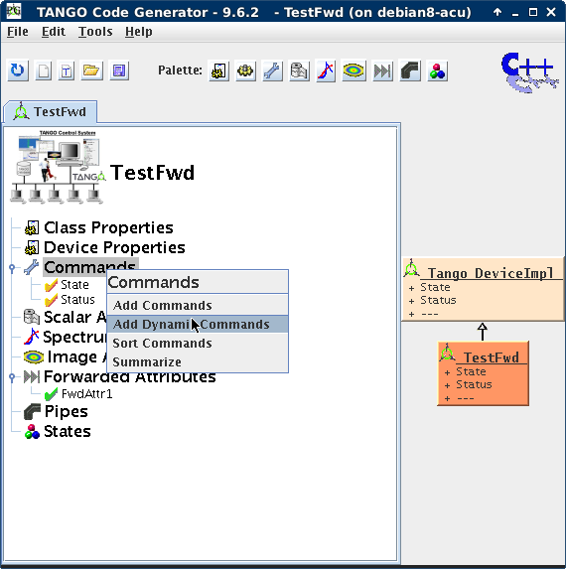
TANGO 9 New Features: Dynamic commands

Slide 38
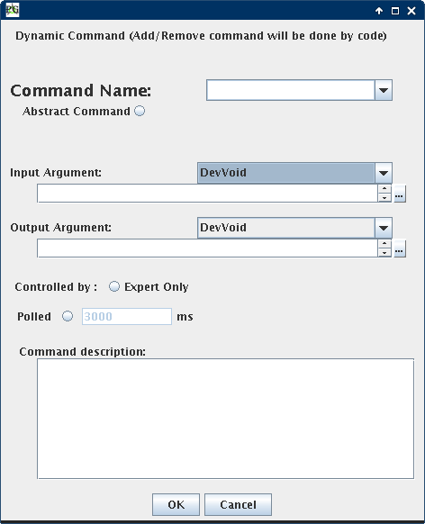
TANGO 9 New Features: Dynamic commands

Slide 39
TANGO 9 New Features: DEVICE INTERFACE CHANGE EVENT
Special Event to be notified when the device interface changes
when attribute(s) added/removed
When command(s) added/removed
Linked to a device (not attribute)
The event is sent after a small delay (50 mS) to eliminate the risk of events storm in case several attributes/commands are added/removed in a loop
Same structure as when requesting the device interface from the admin device + a boolean flag used to warn that their might be no change in the interface (Device was restarted or event reconnection occurred)

Slide 40
TANGO 9 New Features: DEVICE INTERFACE CHANGE EVENT
void MyCallBack::push_event(Tango::DevIntrChangeEventData *ev)
{
cout << “device interface change event received" << endl;
cout << "Device name = " << ev->device_name << endl;
if (ev->err == true)
cout << "The att change event is an error" << endl;
else {
if (ev->dev_started == true)
cout << "Device has been started" << endl;
cout << ev->cmd_list.size() << " commands" << endl;
for (const auto &elem:ev->cmd_list)
cout << "Command name = " << elem.cmd_name << endl;
cout << ev->att_list.size() << " attributes" << endl;
for (const auto &elem:ev->att_list)
cout << " Attribute name = " << elem.name << endl;
}
}

Slide 41
TANGO 9 New Features: Pipe events
Used when the user want to push data through a pipe
Sent by user code by using a specific DeviceImpl::push_pipe_event() method
There is no way to ask the Tango kernel to automatically push this kind of event.

Slide 42
TANGO 9 New Features: Polling threads improvements
Goal: limit the famous error ''Polling thread is late'' when event system used
2 improvements:
When attributes belong to same device and are polled at same frequency, Replace read_attribute by read_attributes in the polling thread
Pro: Improve the efficiency (only one call to read_attr_hardware())
Con: Diagnostic on attribute execution time lost
Do not send error if thread is late just once

Slide 43
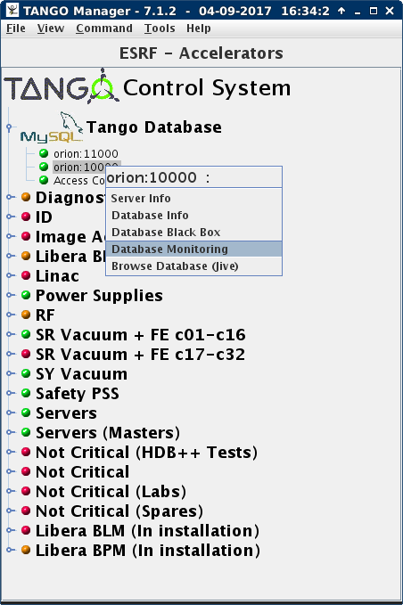
New Features: DBBench

Slide 44
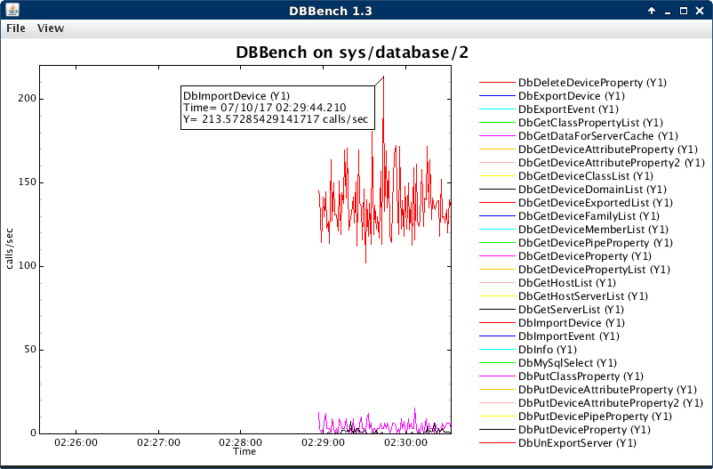
New Features: DBBench

Slide 45
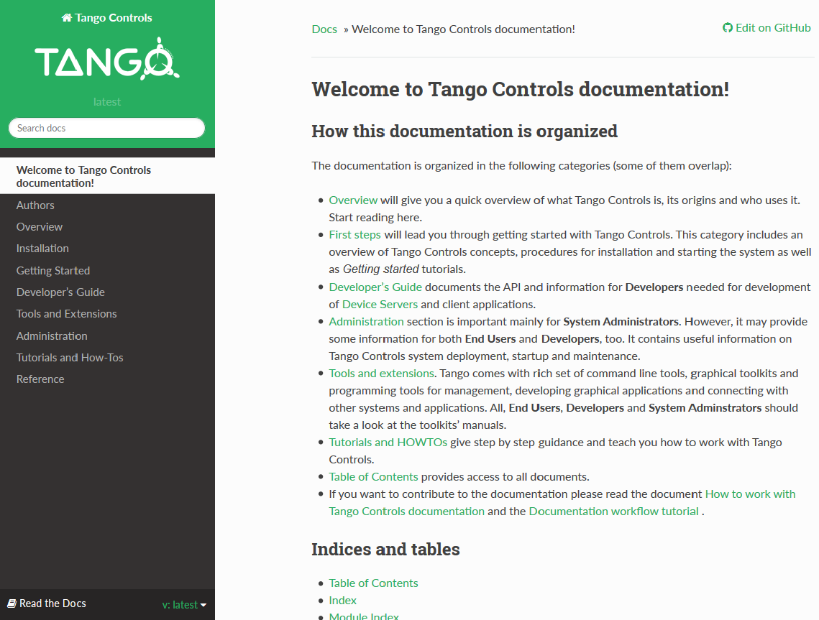
Documentation
http://tango-controls.readthedocs.io

Slide 46
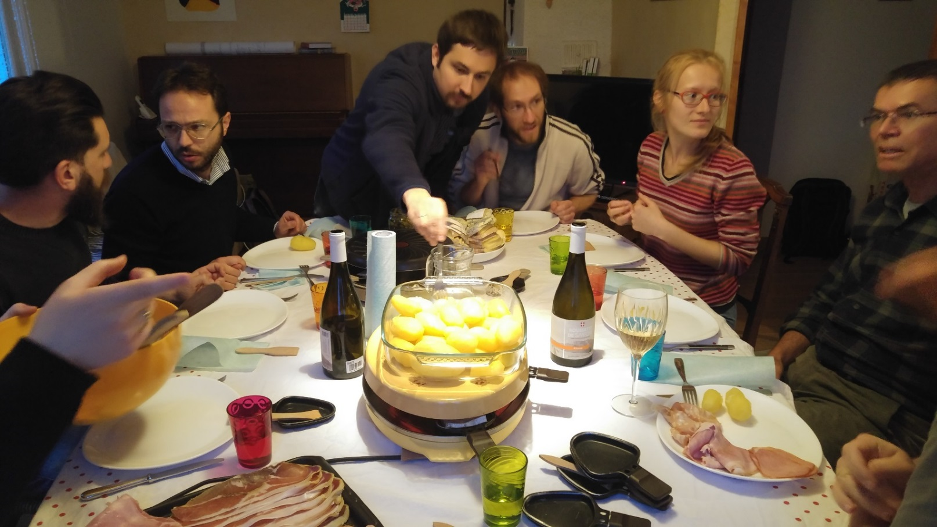
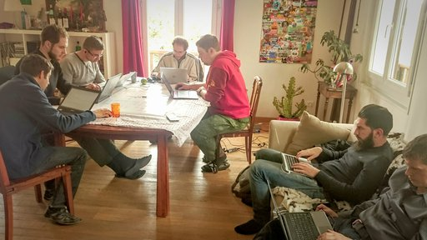
documentation
1st Tango write-the-doc camp
–
May 2017
Photos: Olga Merkulova - Lukasz Zytniak

Slide 47
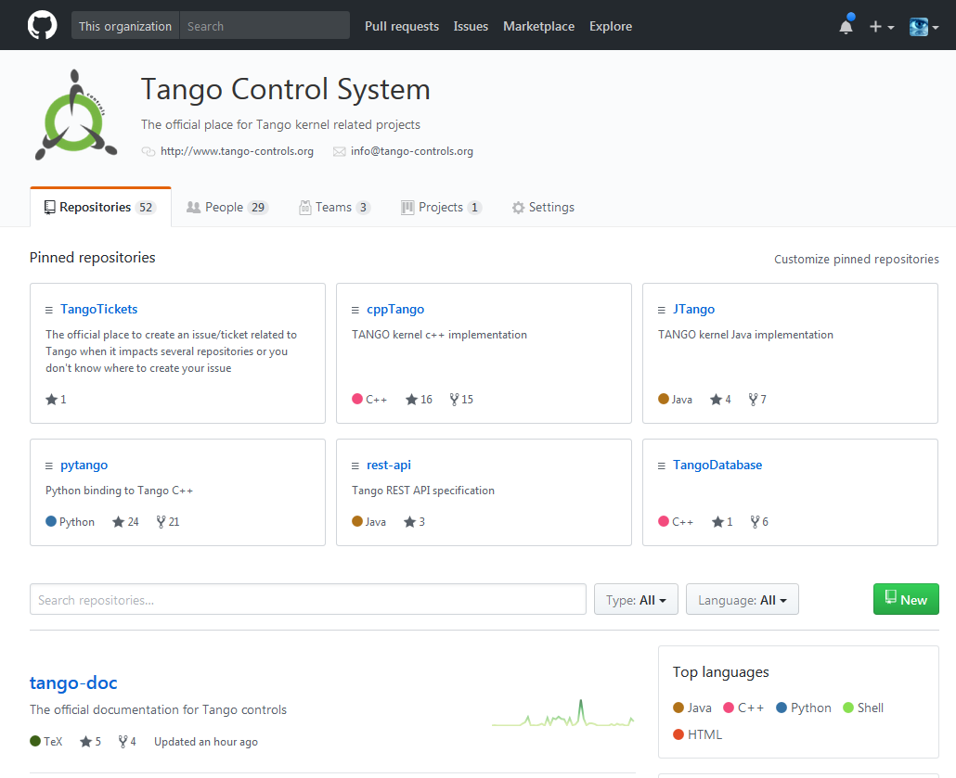
Roadmap #2: Move to Git
Sourceforge / subversion
Github / git
http://sourceforge.net/projects/tango-cs/
https://github.com/tango-controls

Slide 48
Roadmap #2: Move to Git
3rd party tools for free!
Codecov

Slide 49
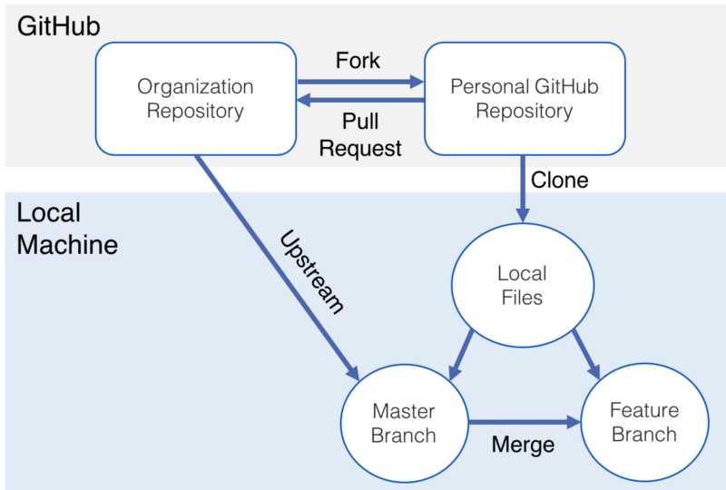
Roadmap #2: Move to Git
Pull Requests
Push
Source: https://medium.com/@swinkler/git-workflow-explained-a-step-by-step-guide-83c1c9247f03

Slide 50
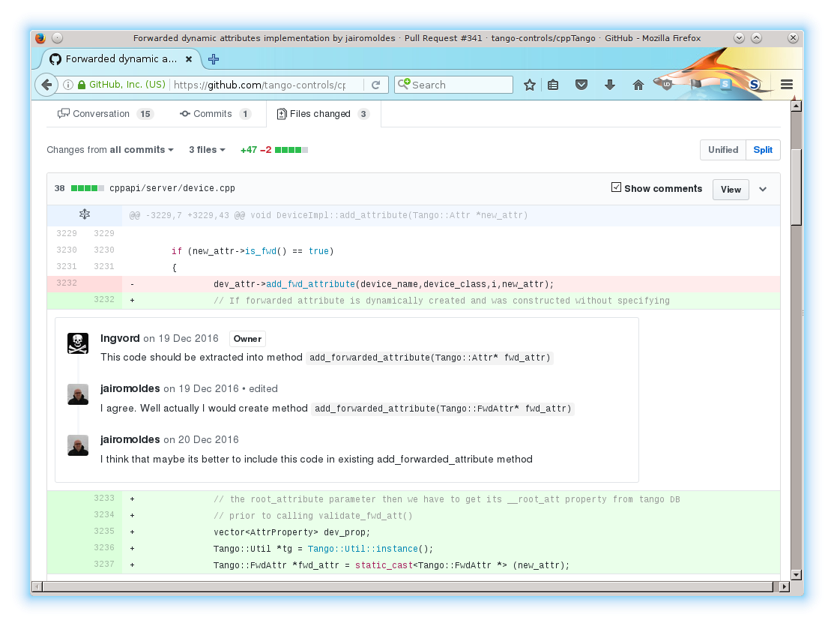
Roadmap #2: Move to Git
Pull Requests

Slide 51
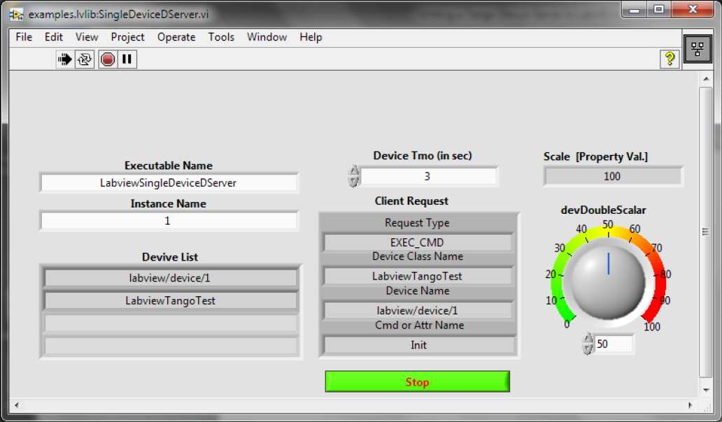
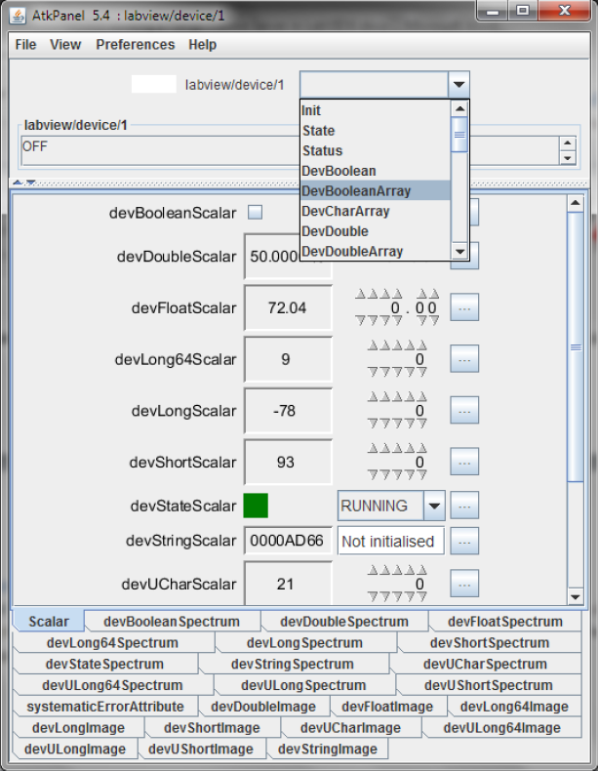
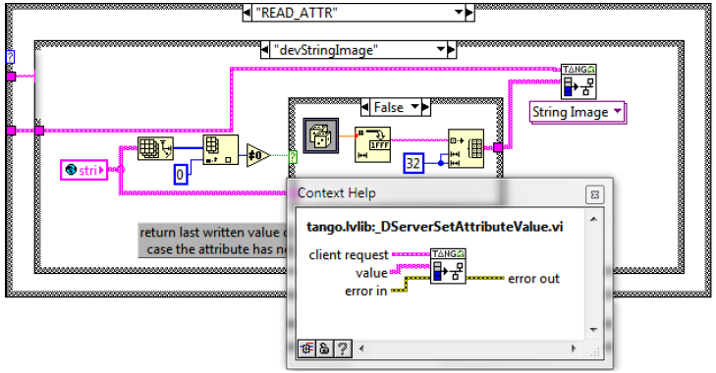
LabVIEW binding
https://github.com/tango-controls/labview-binding

Slide 52
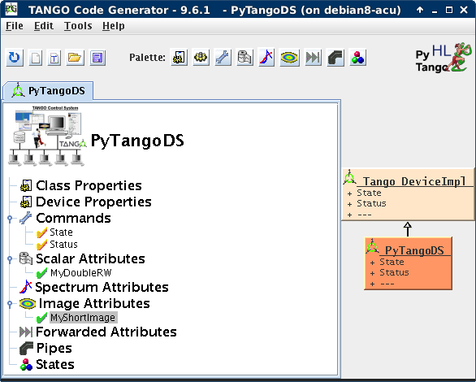
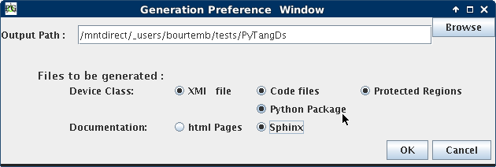
Roadmap #12: Auto-generate Unit Tests
POGO to generate unit tests automatically

Slide 53
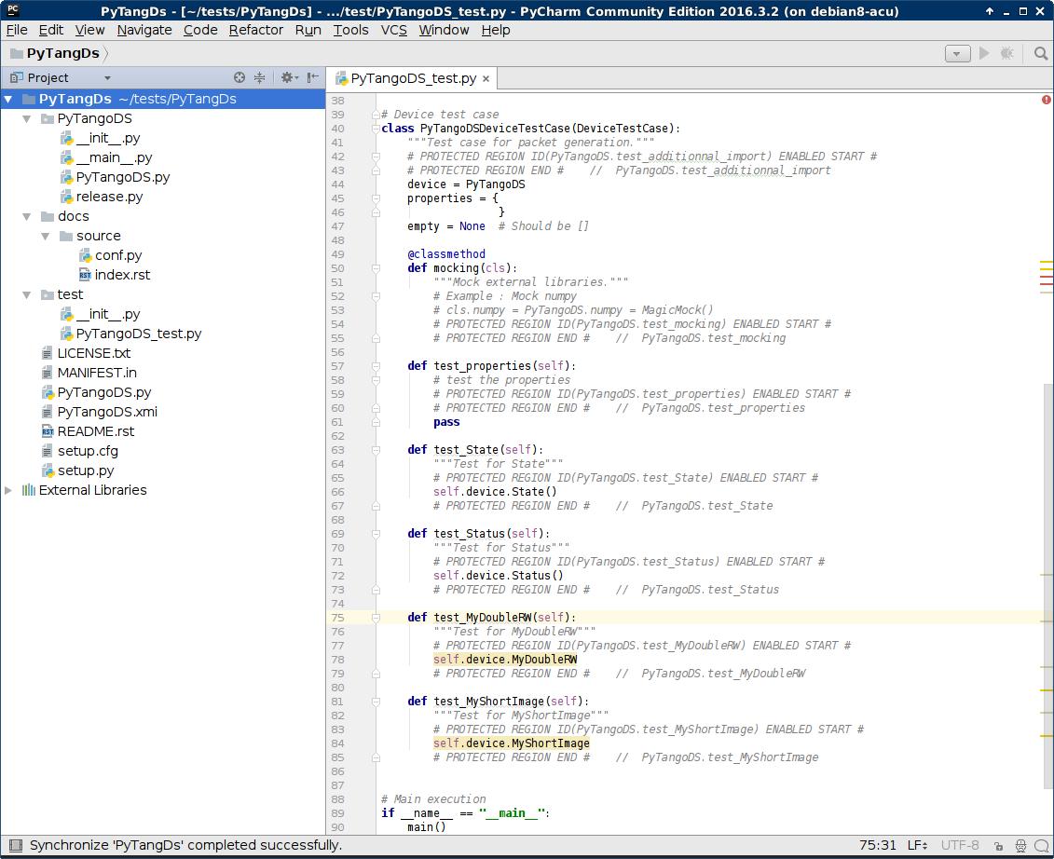
Roadmap #12: Auto-generate Unit Tests

Slide 54
Roadmap #12: Auto-generate Unit Tests
JTango Maven archetype
Simple Unit tests

Slide 55
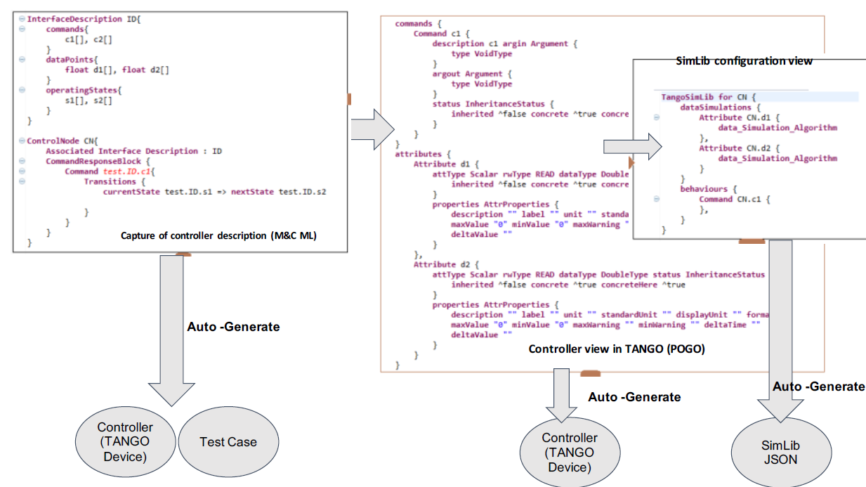
Roadmap #12: Auto-generate Unit Tests

Slide 56
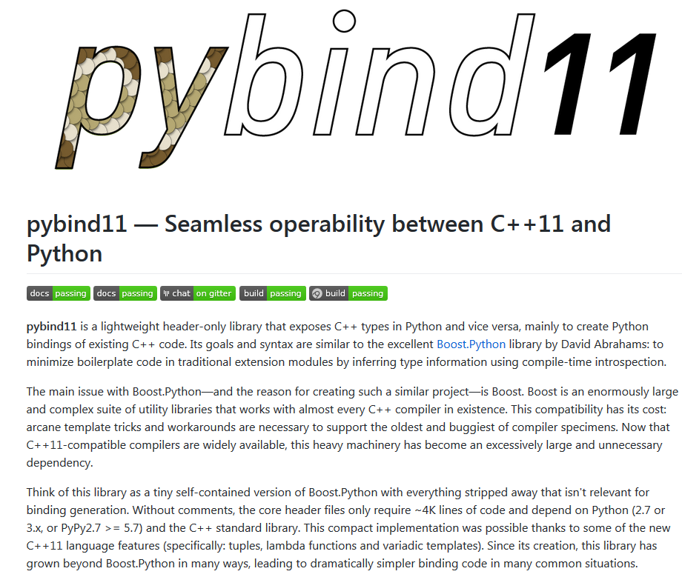
Roadmap #14: Replace Boost.Python
Replace Boost.Python in PyTango with a lighter weight solution
Proof of Concept tests in progress
https://github.com/pybind/pybind11

Slide 57
C++ Tango library status
Code restructured
Autotools
Continuous integration with Travis CI, using docker containers
Continuous integration with AppVeyor for Windows
Bug fixes
New features:
DevEnum labels for DevEnum command parameters
DevPipeBlob in command parameters
Tango 10 frequent development releases to Bintray (www.bintray.com/tango-controls) as Debian packages for Tango
Major releases packaging will go to official repositories

Slide 58
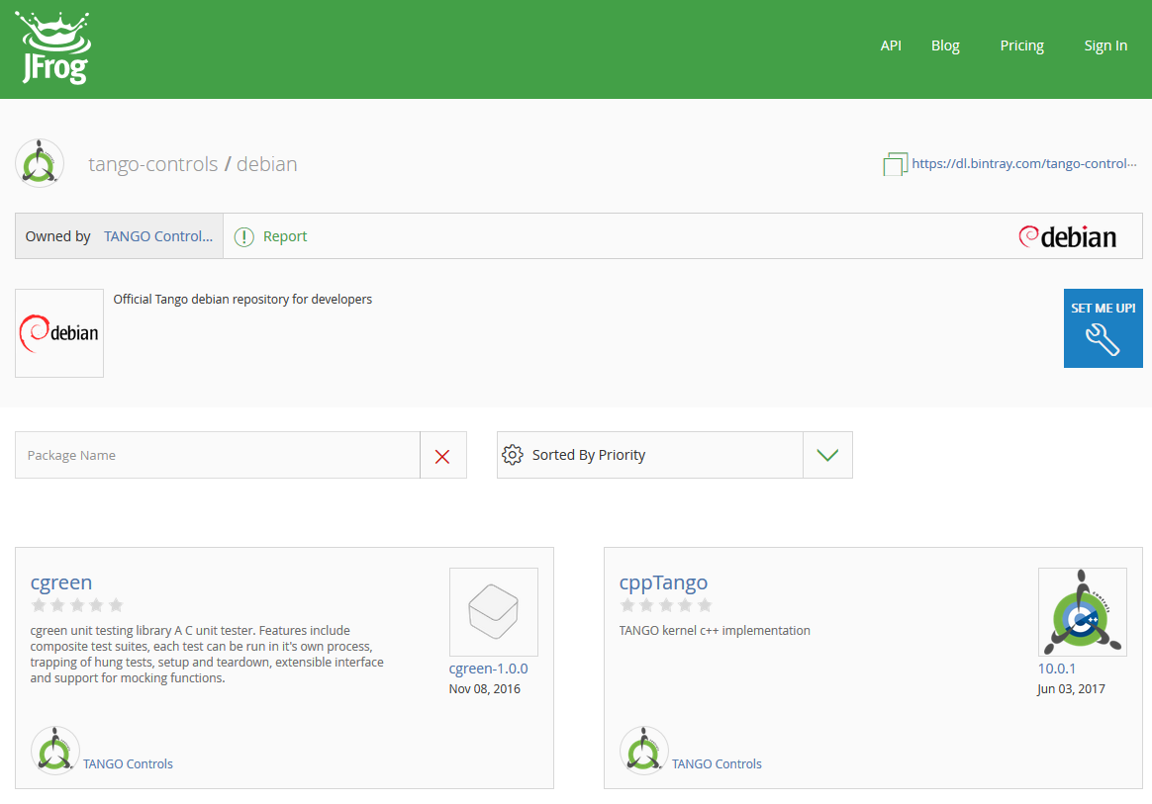
C++ Tango library status

Slide 59
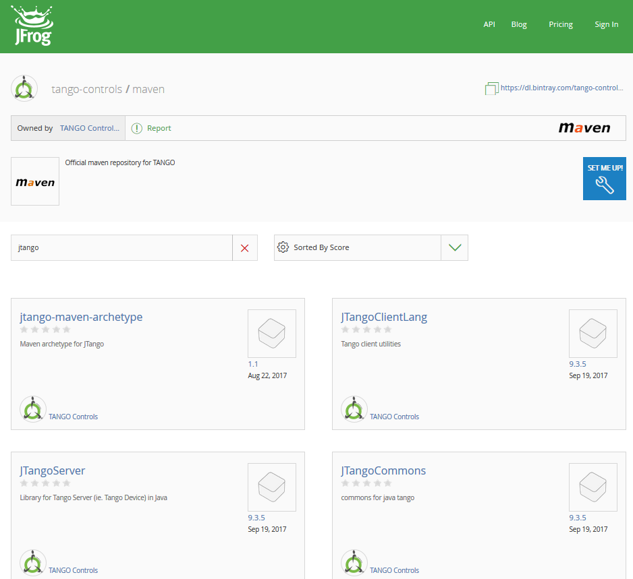
JTango status
Code restructured
Bug fixes
Mavenization
Automatic deployment on Bintray
www.bintray.com/tango-controls

Slide 60
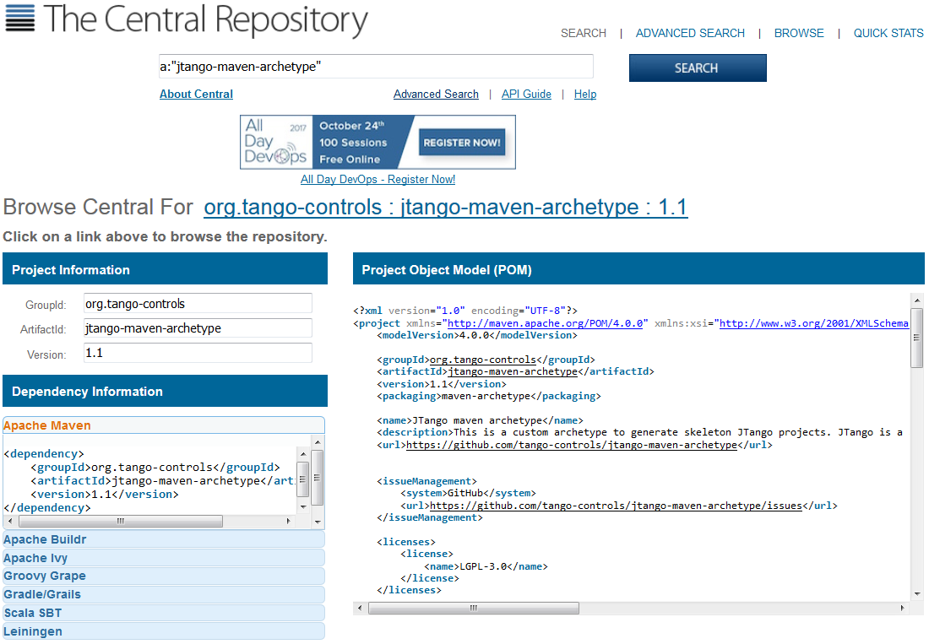
JTango status
Soon on Maven Central

Slide 61
PyTango status
News since latest ICALEPCS
PyTango 9.2.2 released in September 2017:
Pipes
Dynamic commands
Forwarded Attributes
Mandatory properties
Interface Change Events
2 modules for unit-testing added
Bug fixes
Code refactoring
More Unit Tests
Code quality check with pylint and flake8
official tango-controls conda channel
https://github.com/tango-controls/pytango

Slide 62
Roadmap #3: Remove CORBA completely
Introduce an abstract transport layer
Replace CORBA as synchronous communications protocol with a pluggable protocol layer
remove all dependencies on CORBA
serialisation library
data types
use as first implementation

Slide 63
Roadmap #3: Remove CORBA completely
cppTango (C++ Tango library):
Code restructured
CORBA notifd events related code purged in Tango V10
Proof of concept refactoring to:
Isolate CORBA code
Implement DevVarDoubleArray type using an architecture allowing plugins
Replace omni_threads with C++ 11 threads
Compatibility will be preserved all along the way!
Runtime compatibility
Source code compatibility with minor changes
Setup CI for cross-version checking
IMPORTANT

Slide 64
Roadmap #10 Long Term Support
Provide upgrades for older versions
Long Term Support for Tango 9 (min 5 years after 1st Tango V10 stable release)
Bug fixes
Simple new features
tango-9-lts branch on Github: https://github.com/tango-controls/cppTango/tree/tango-9-lts

Slide 65
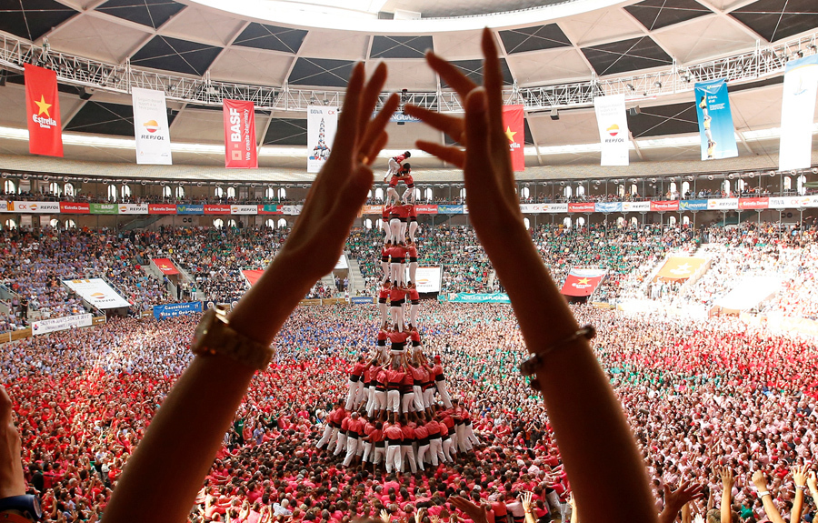
Conclusion
Photo: Albert Gea / Reuters

Slide 66
Many thanks to the TANGO Controls community and kernel team! Thank you for your attention!
Questions?
www.tango-controls.org

