Slide 1
Technical overview
Community
Use cases
Gouvernance
http://www.tango-controls.org/
EUROPEAN SYNCHROTRON RADIATION FACILITY

Slide 2
TANGO: What is it?
Topology independent
Development
tools
Generic Services
User environment
Matlab,Labview Igor, Python
Data
Analysis
Monitoring
Synoptics
GUI
GUI Tool-Kits
Config
Sequencing
Archiving
API Library + Protocol + Device Model
TANGO Software Bus distributed on a network
Interface
Generator
Device
Device
Device
Device
Device
Hardware
Hardware
Software
Hardware
Hardware
Catalog of
device servers

Slide 3
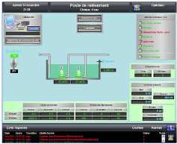
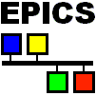
TANGO as a bridge
TANGO
JAVA/C++/Python
clients
Industrial SCADA
Tango
binding
Tango
binding
Tango binding
Object oriented layer above EPICS…
TANGO Software Bus
Device
Server
Device
Server
Device
Server
Device
Server
Device
Server
server
Hardware
electronic
Modbus
server
Data socket
server
PLC network
PLC or
embedded
system
acquisition
system
Build a TANGO object from a set of channels

Slide 4
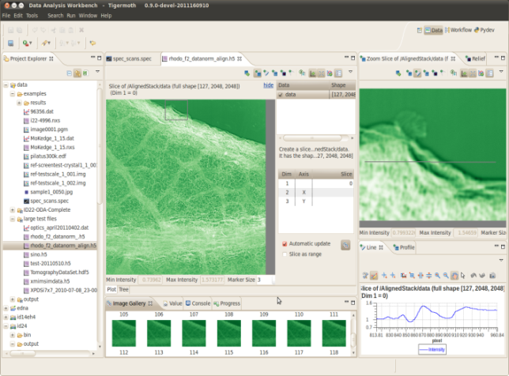
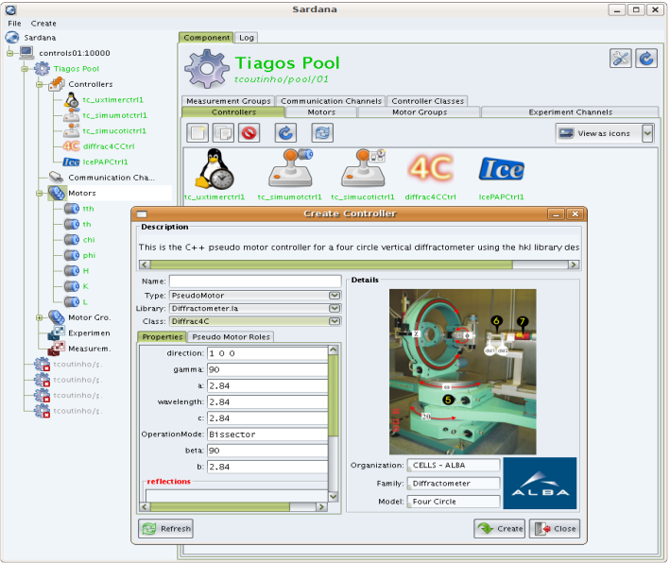
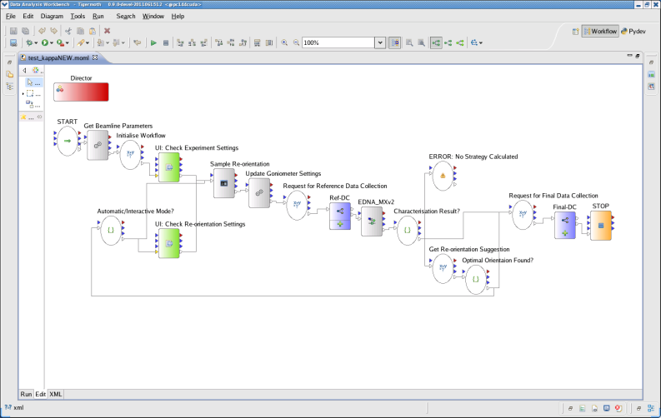
A step further with workflow tools
Sequencing tool
Workflow editor
Your plugin

Slide 5
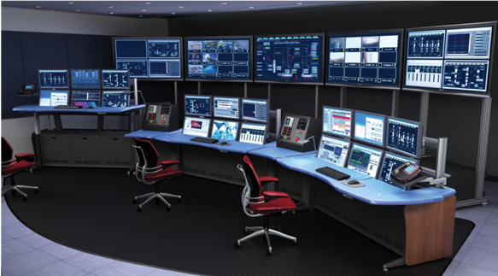
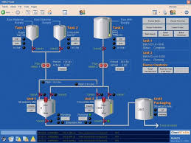
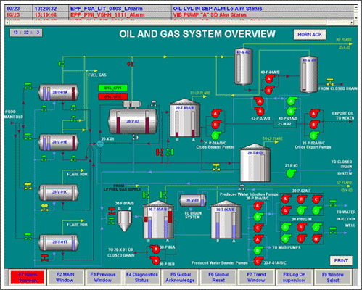
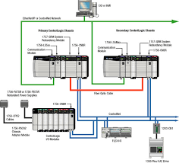
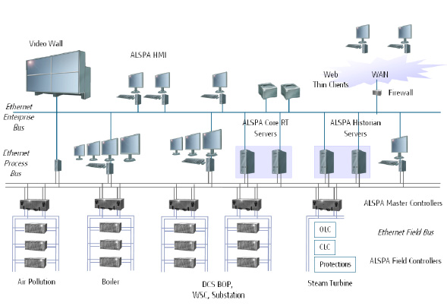
A factory: Aggregation of different SCADAS
Several sub-systems from different suppliers to supervise
Building automation, process, safety systems….
Heterogenic system (languages, machines…)
Compatibility issues, central control room

Slide 6
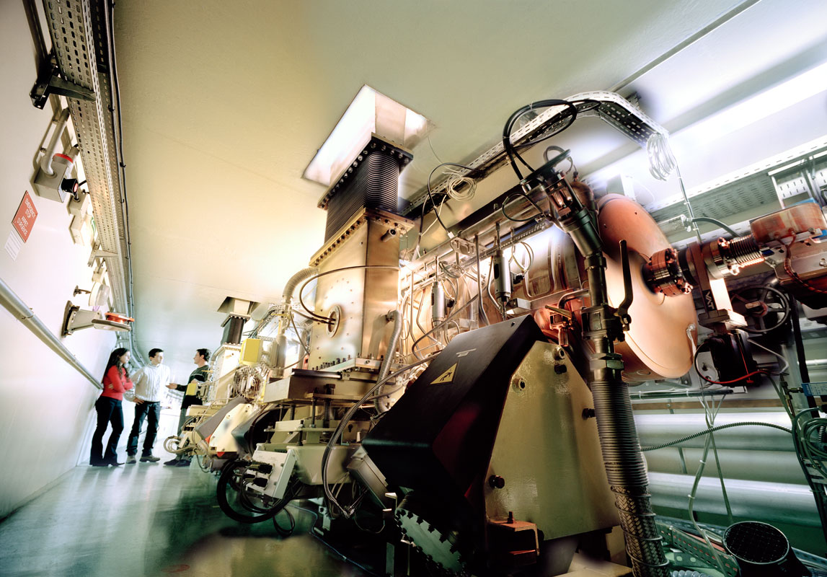
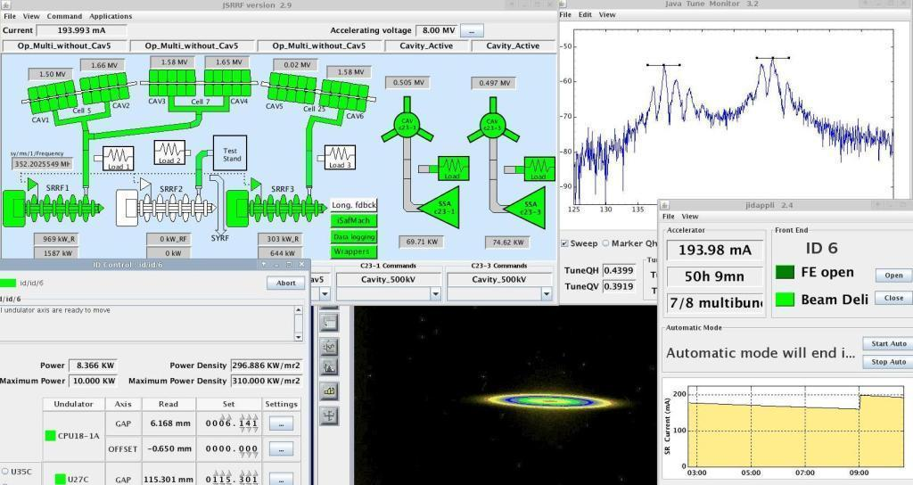
A European Control System framework «Remote control anything and everything»
A mature Open Source product
> 100 man years of development
Used in 15+ big instruments
Active community
Object oriented, topology independent, highly scalable,
Operating system independent
Multi language

Slide 7
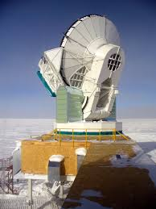
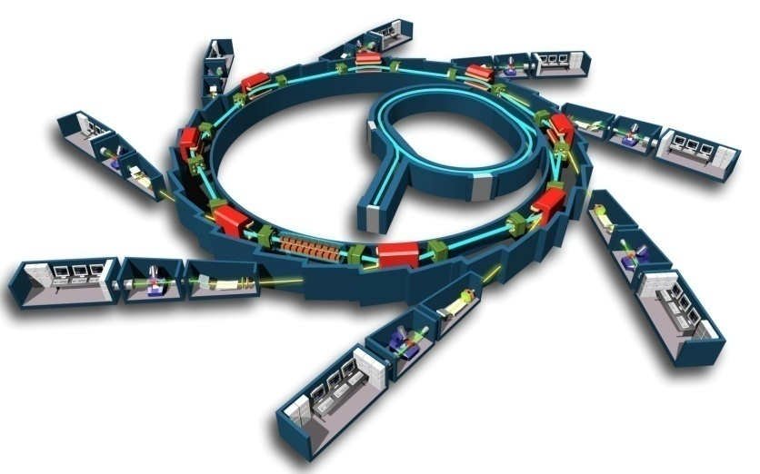
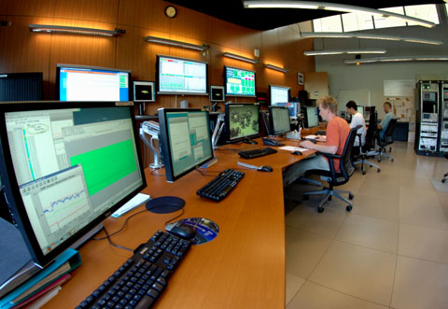
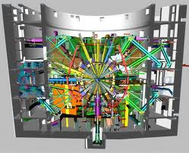
big scientific instruments
> 1 000 000 signals and actuators

Slide 8
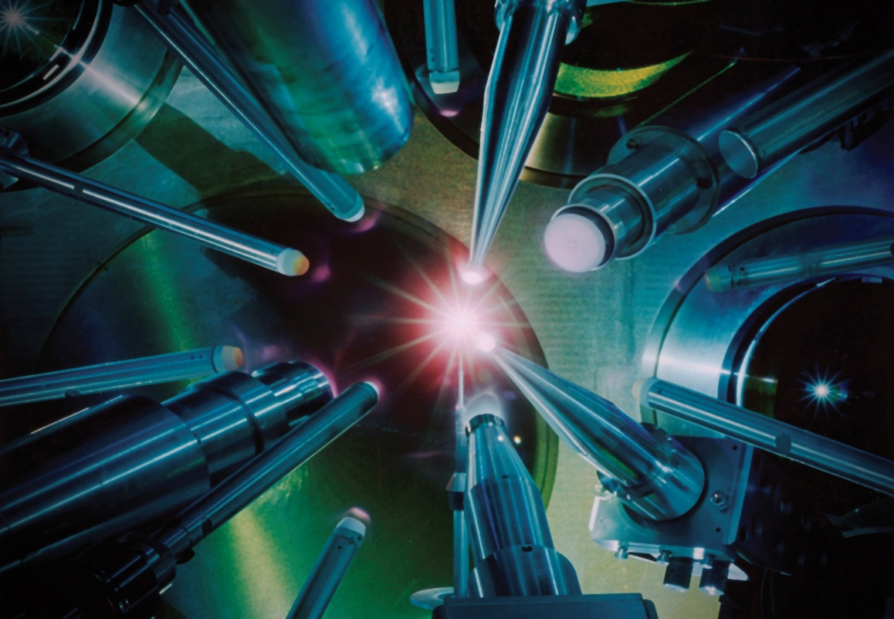
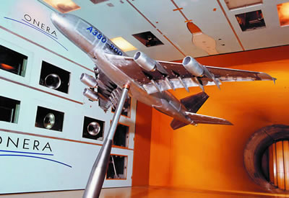
Use cases
TANGO was born in particle accelerator world, however …
TANGO is a generic solution for any collection of objects
Used also in other scientific domains like
Wind tunnels e.g. ONERA
Neutron source experiments (FRM2 + Julich in Germany)
Large laser installation
LMJ, PETAL, APOLLON
Free Electron Laser (Fermi)
Small instruments
Thomx (art and medecine)
Small installations
Embedded systems
Industrial supervision

Slide 9
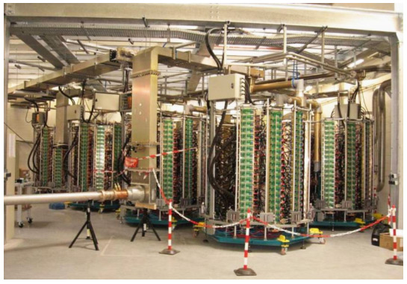
Managing complexity simply
Hierarchical structures ideal for managing complex systems
GUI
Sequencer
High Level
SSA
Python Sequences
4x
SSA
Low Level RF
Driver
Dummy Load
280V PS
ADC
Measurements
Interlocks
fast
Interlocks
slow
Wave Guide
Switches

Slide 10
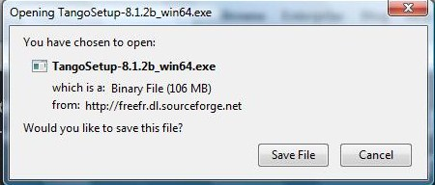
How to try it?
TANGO is available free of charge
Source code distribution
Downloadable on http://www.tango-controls.org/download
Binary Packages
Available for Ubuntu + Debian Linux in the standard distributions
sudo apt-get install tango-common tango-db python-pytango
Available for Windows on http://www.tango-controls.org/download
The Tango Box
An Ubuntu virtual machine with Tango installed and configured for easy testing
Runs on VMware and Virtualbox

Slide 11
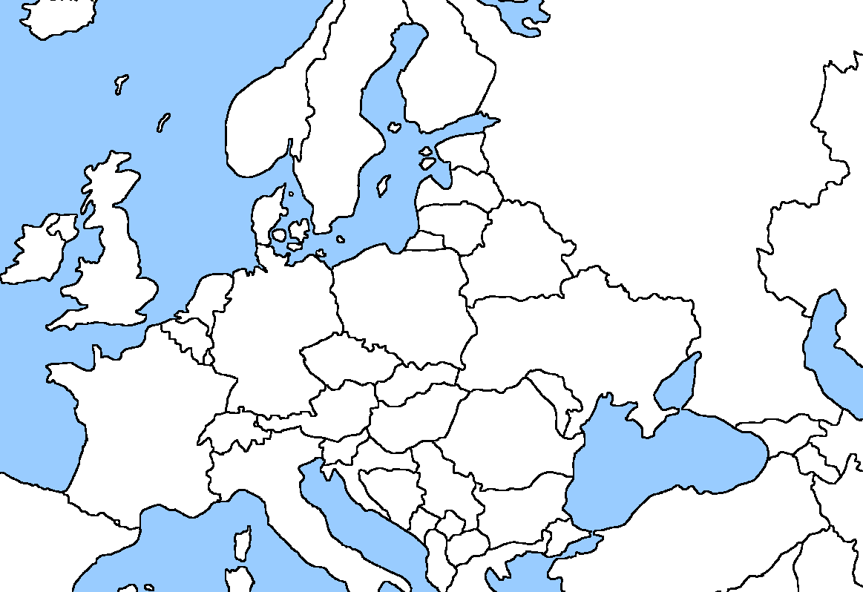
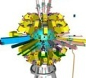
Distribution over Europe
Particle accelerators
Laser installations
Other labs
Industry service
JINR

Slide 12
Some recent projects using TANGO
J I N R

Slide 13
… more and more industrial partners …

Slide 14
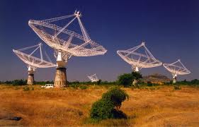
Snowball effect :
projects in construction with TANGO
and others not mentioned here …

Slide 15
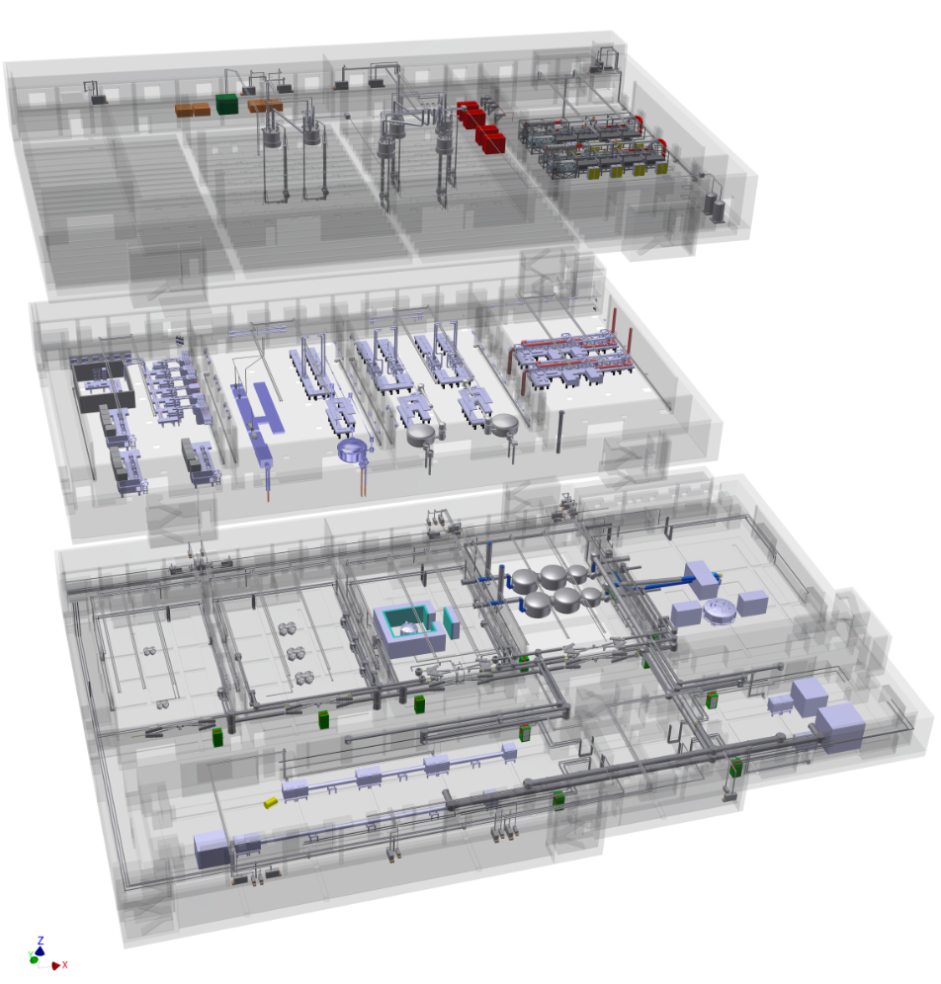
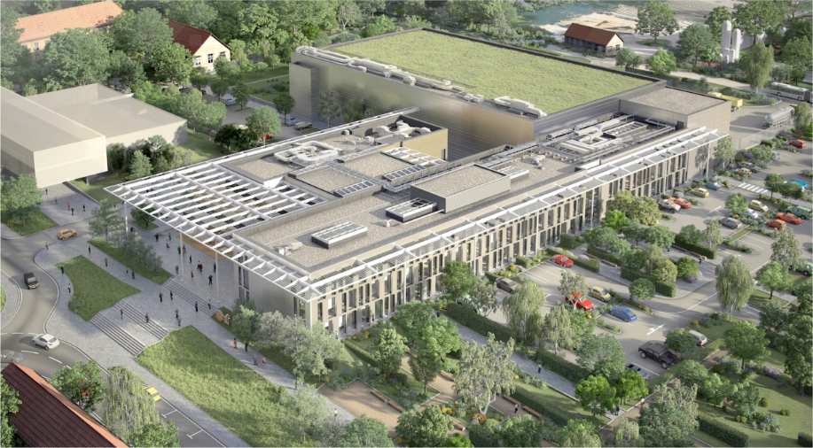
Growing community
Recently adopted by several big installations over the world
ELI projects in Hungary, Romania and Check republic.
900 M€ project
3 distinct centers of around 300M€ each
Ultra high power pulsed lasers
100 TeraWatt to 10 PetaWatt pulsed lasers

Slide 16
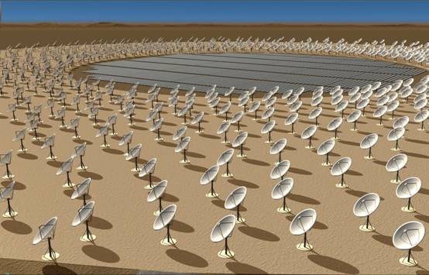
Growing community
Recently adopted by several big installations over the world
SKA project (world biggest astronomic project)
Controlling 131000 antenas in in Australia
200 dishes of 15m diameters each in south Africa
Head quarters in UK (Manchester)
Contributors from India, China, Japan, Canada, Italy (11 countries)
1 Billion dollars project,
10 Millons of control points over 2 continents
50 PetaBytes of data
Nano seco synchronisation and time stamping

Slide 17
Managing the growing community
>30 sites depending on Tango => need a structured governance to guaranty long term availability and sustainability
TANGO consortium created end 2016 (following a first MoU signed early 2000’s)
Guarantee that TANGO remains free and open source
Help industrial partners to generate sustainable revenues
Stimulate the development and manage repositories
Represent the community, collect funds
Animate the community
Listen the partners requests, complains, proposals
Propose evolutions
Increase interoperability
Promote a catalogue of standard solutions
Organize Tango community meetings.
Legal status
The consortium is hosted by the ESRF.
Multilateral contract between ESRF and partners
Steering committee decide the strategy, follow-up actions and vote budget.

Slide 18
Stimulate the snowball effect Enhance the eco-system
Welcome new users and industrial partners
Increase the number of trained people
Ease the first steps with TANGO
Help system integrators to access new markets in industry
Getting more TANGO enabled hardware
Provide industrial standard quality + support
Make it a de-facto standard
…

Slide 19
Tango consortium
10 major scientific instruments signed a contract for co-financing the development:
ESRF (European light source in Grenoble: 350000 process units) (core member)
SOLEIL (French light source: 250000 parameters) (core member)
ALBA (Spanish national synchrotron light source) (core member)
ELETTRA (Italian national synchrotron light source) (core member)
DESY (German research center, several synchrotrons + lasers)
INAF (Astronomy center in Italy),member of SKA
MAXIV ( Swedish national synchrotron light source)
SOLARIS ( Polish national synchrotron light source)
SKA-Organisation (joined in 2017)
SKA-South Africa (joined in 2017)

Slide 20
Tango consortium
The 10 partners provide man power contribution + budget.
10k€ and in kind development man power
The number of partners is growing
2 new partners in 2017 (SKA-O + SKA-SA),
1 candidate in 2018 (ELI Beamlines)
Possibility for industry to become sponsor partner in exchange of visibility
More budget -> More services, better support, better quality

Slide 21
Actions done thanks to common budget
Improve the communication :
New web site (design, development, maintenance and hosting)
Github repository
Device server catalog
Forum, FAQ
Tutorials, virtual machine
New documentation online (doc camp…)
Travel costs for meetings
Sponsor and/or organize Tango meetings (Florence, Moscow…)
Promotion in industry
Development
Continuous integration
Refactor the code
Tango V9 LTS
New features in future Tango V10
Windows packaging
PyTango for tango 9
TangoWebapp
And other things

Slide 22
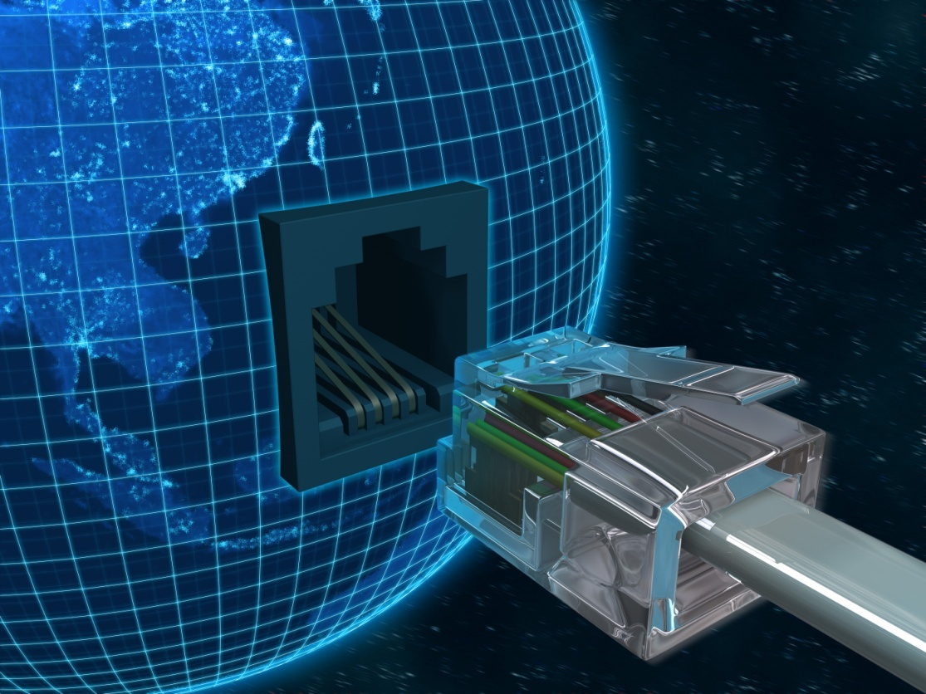
TANGO = a control system for the future
join the TANGO community

