Slide 1
SKA Project Management
Planning for the SKA, contractual and politic aspects.
Nick Rees
Head of Computing and Software
5th April 2018

Slide 2

Square Kilometre Array
3 sites; 2 telescopes + HQ
1 Observatory
Design Phase: > €170M; 600 scientists+engineers
Phase 1
Construction: 2018 – 2024
Construction cost cap: €674.1M (inflation-adjusted)
Operations cost: €80-100M/yr
Phase 2:
start mid-2020s
~2000 dishes across 3500km of Southern Africa
Major expansion of SKA1-Low across Western Australia

Slide 3
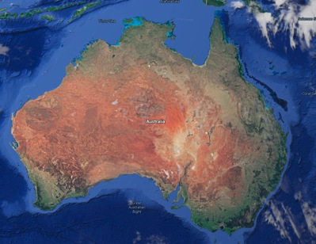


HQ in UK; telescopes in AU & SA
SKA1-LOW: 50 – 350 MHz
Phase 1: ~130,000 antennas
across 65km
SKA1-Mid: 350 MHz – 24 GHz
Phase 1: 200 15-m dishes across 150 km
Construction: 2018 – 2024; Cost cap: €675M

Slide 4

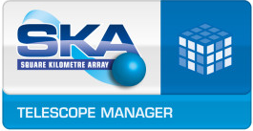

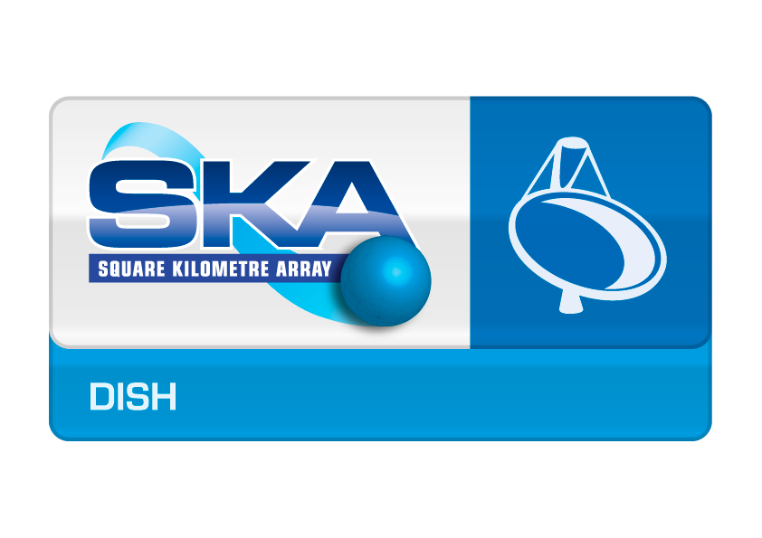

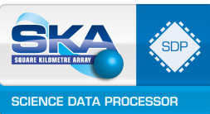
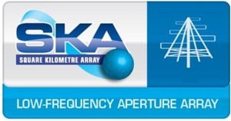
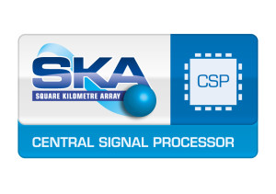


SKA Pre-construction Consortia

Slide 5
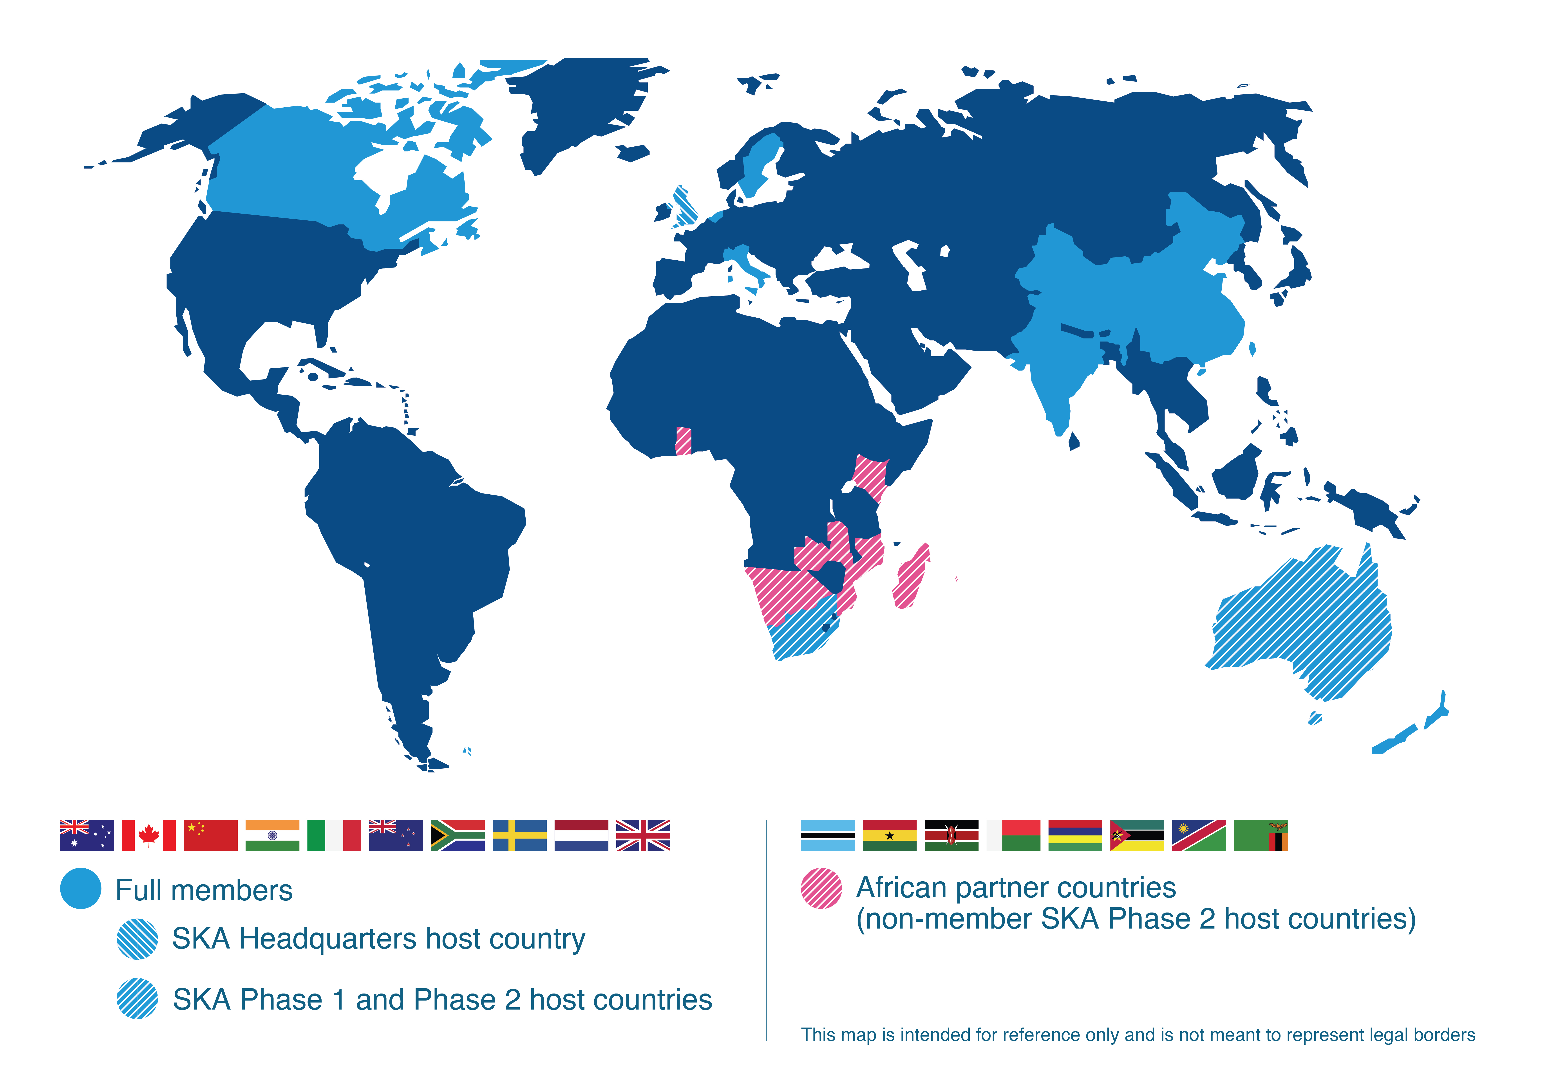
SKA Organisation: 10 countries, more to join
Interested Countries:
France
Germany
Japan
Korea
Malta
Portugal
Spain
Switzerland
USA
Contacts:
Mexico
Brazil
Ireland
Russia
Australia (DoI&S)
Canada (NRC-HIA)
China (MOST)
India (DAE)
Italy (INAF)
Netherlands (NWO)
New Zealand (MED)
South Africa (DST)
Sweden (Chalmers)
UK (STFC)

Slide 6
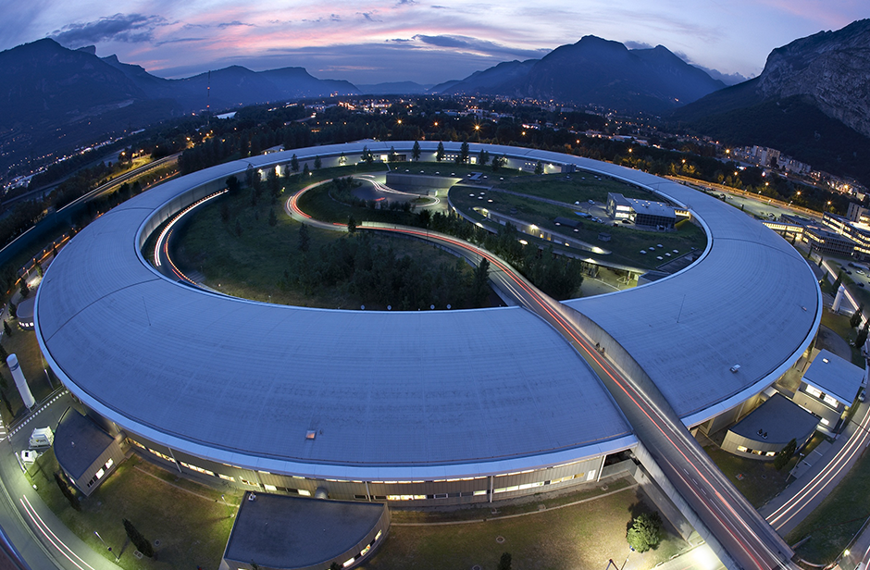

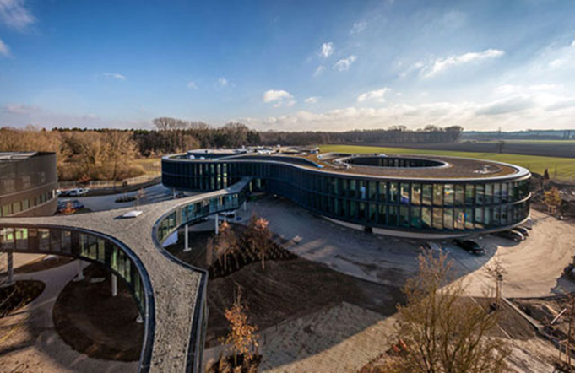
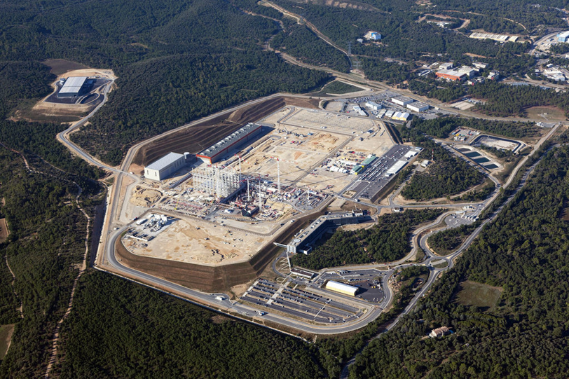


Future SKA governance structure
IGO = ‘Convention’ agreed between governments
  Government commitment: Long-term political stability, funding stability
  A level of independence in structure
  Availability of ‘supporting processes’ through Privileges and Immunities from members: functional support for project
  ‘Freedom to operate’, specifically through procurement process, employment rules and so on

Slide 7
Timelines
2018 |  |  |  | 2019 |  |  |  | 2020 |  |  |  | 2021 |  |  |  | 2022
1 | 2 | 3 | 4 | 1 | 2 | 3 | 4 | 1 | 2 | 3 | 4 | 1 | 2 | 3 | 4 | 1 | 2 | 3 | 4
Design
Element CDRs
Project Development
System CDR
Const. Prop
Proc. Prep.
Procurement
Construction
Initialing
Negotiation
Signing
IGO Development
Ratification
Enters into force
Transition
Construction Approval

Slide 8
SKA Software Construction

Slide 9
SKA work breakdown structure
SKA Observatory
Project Office
MID Telescope
LOW Telescope
Computing and Software
Image Processing
Management and Controls
Non-image Processing
Verification
ILS
Agile Teams
Agile Teams
Agile Teams

Slide 10
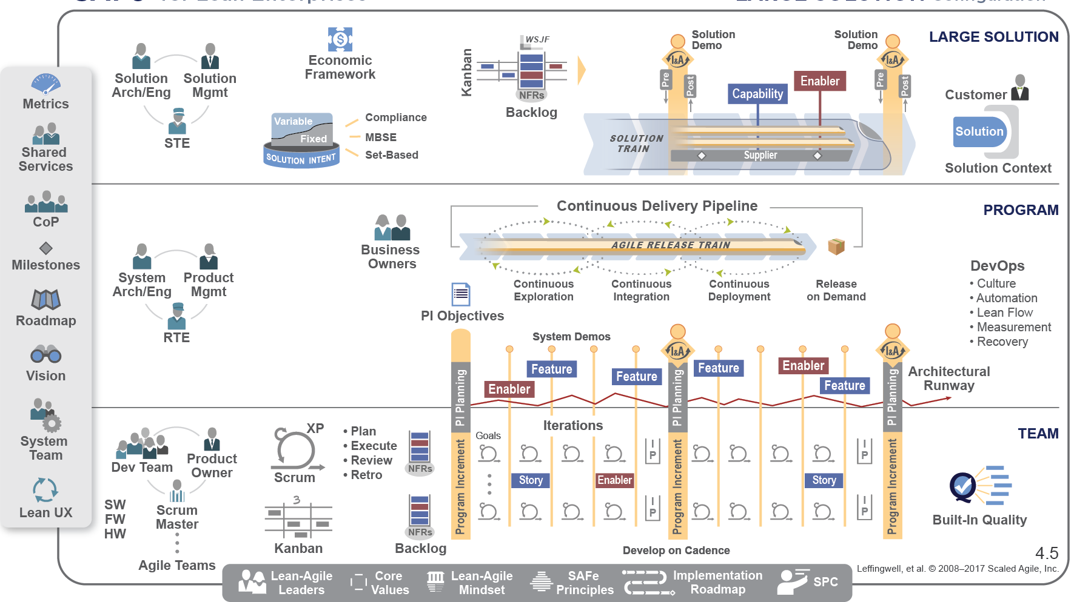
Software Construction
Computing and Software
Image Processing
Management and Controls
Non-Image Processing
Agile Teams
Agile Teams
Agile Teams
See: https://www.scaledagileframework.com

Slide 11
Software and computing costs

Slide 12
Software procurement:
Based on lean/agile procurement principles.
Must also satisfy IGO fair work return principles.
Time and materials service procurement based on collaboration and trust but verify principles
  Highly aligned with NEC4 (our preferred contracting suite) which emphasizes “acting in a spirit of mutual trust and co-operation”.
Risk largely held by the SKA.
  Hence, all contracts, with minimal exceptions, are directly with SKA.
Aim is to procure co-located teams of ~7 people with broad skills in key areas:
  High performance data processing
  Control systems
  Web applications
  Software processes, CI, deployment, machine provisioning.
Specific domain skills provided by product owners and architects

Slide 13
Computing procurement
Procurement delayed until last reasonable time
This allows SKAO to manage risk, work return etc.
Software teams are responsible for developing final system specifications and procuring test hardware to demonstrate behavior.
Procurement done collaboratively between software teams and SKAO procurement.
Procurement bundled and negotiated with major vendors to ensure consistent approach and best pricing.

Slide 14
Questions?

