Slide 1
SKAO Software Supply Chain
Pete Prior – DevOps Engineer, System Team
March 2024 – Tango Security Workshop

Slide 2
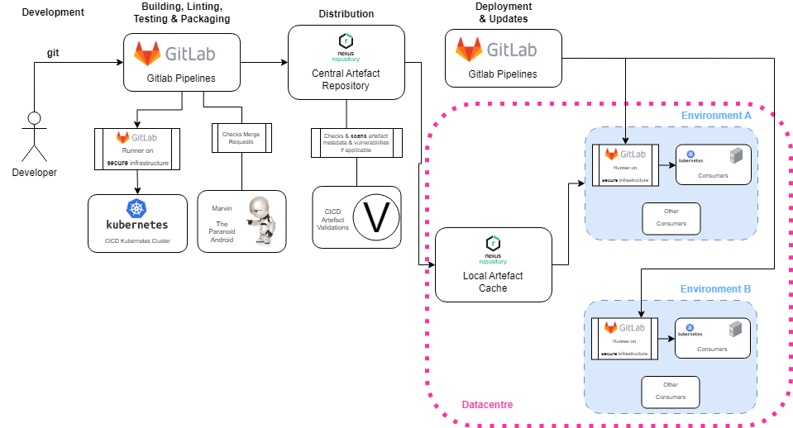
SKAO General Artefact Software Supply Chain (SSC)

Slide 3
Artefact Types
APT Packages
C/C++ Libraries
Python Packages
Helm Charts
Raw Packages
OCI Images

Slide 4
Current Protections
Development: Developers have specific permissions in Gitlab to be able to contribute to specific projects, as well as 2FA protection
Building, Linting, Testing & Packaging: For the packaging, only (if using pipeline machinery) secure runners are used, running on our own infrastructure so that the secret information exposed to Gitlab pipelines is secured
Marvin - checks the merge requests for overall compliance with the SKA Guidelines

Slide 5
Recent changes to the OCI artefact SSC
OCI artefacts signed with Notary
Switched Custom Artefact Repository (CAR) for OCI artefacts from Nexus to Harbor
Provides a nicer interface to view signatures
Allows us to block images from being used when they have critical vulnerabilities or haven’t been signed
Kyverno policy agent checks signature is valid before deploying on Kubernetes (and enforces other policies)

Slide 6
OCI artefact SSC with Signature Verification

Slide 7
Notary Overview
Relies on a Private Key Infrastructure (PKI). Other solutions like Cosign are capable of working with keyless signatures using a public ledger
Why Notary over Cosign?
Cloud Native Computing Foundation (CNCF) Incubating Project
Supports OCI Registry As Storage (ORAS) artefacts
Allows storing / discovering referenced artefacts for a SBOM

Slide 8
Notary Setup
Setup a CA, an intermediate CA and a (leaf) certificate for signing
Distribute the CA certificate to our systems, to validate the signature
Issue the leaf certificate from an intermediate so that we can control and rotate these certificates more often

Slide 9
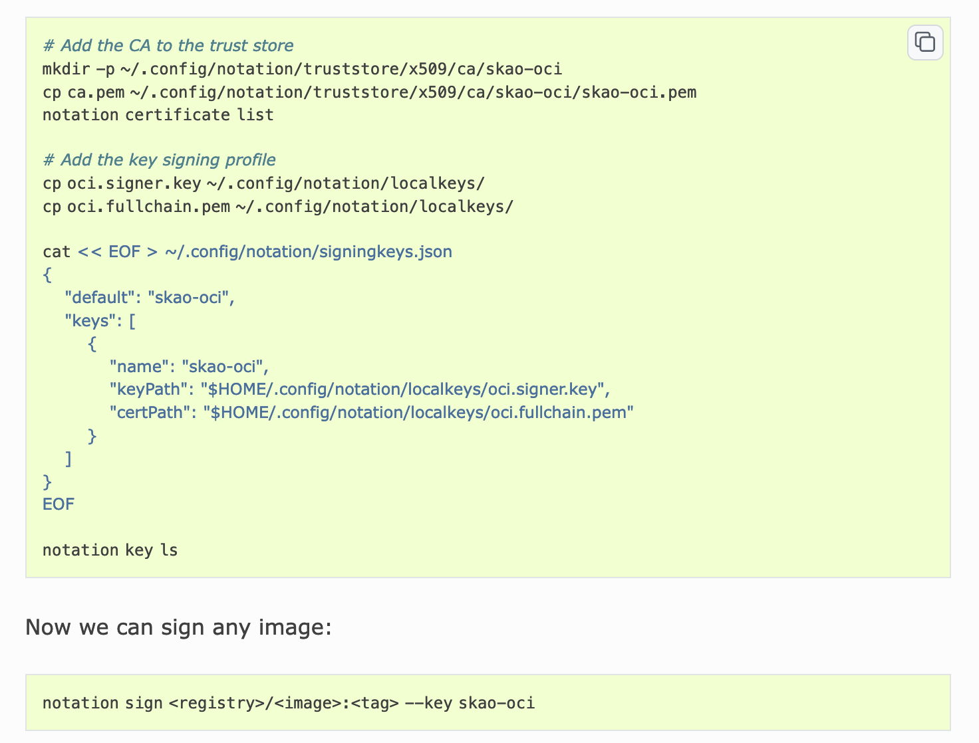
Signing with Notary / notation

Slide 10
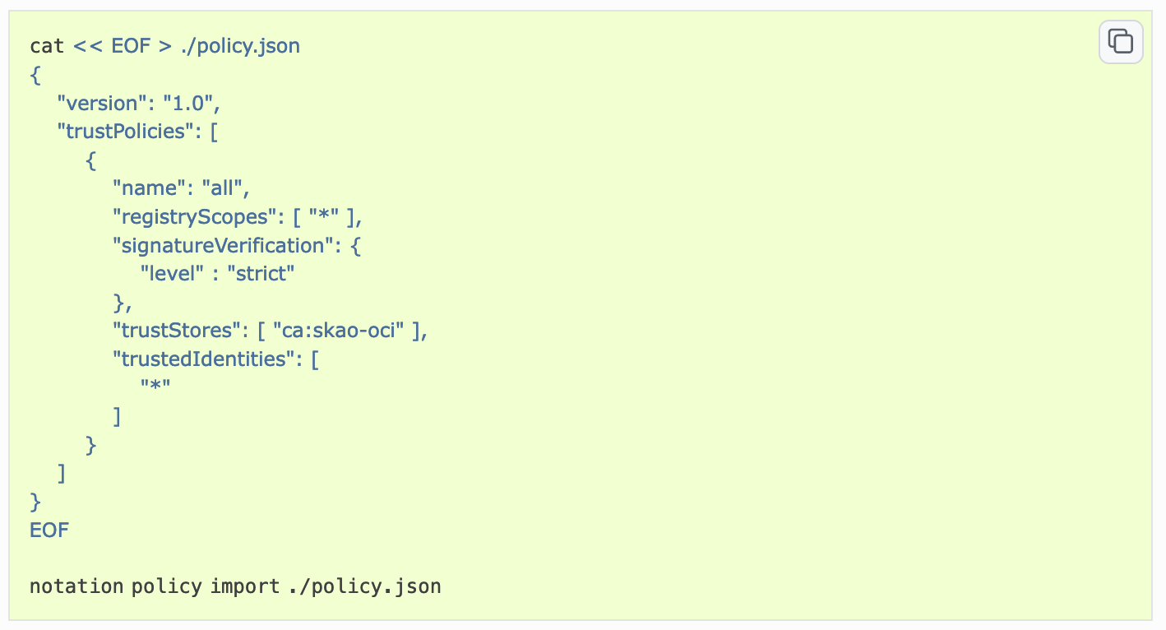
Verifying signature with Notary / notation

Slide 11
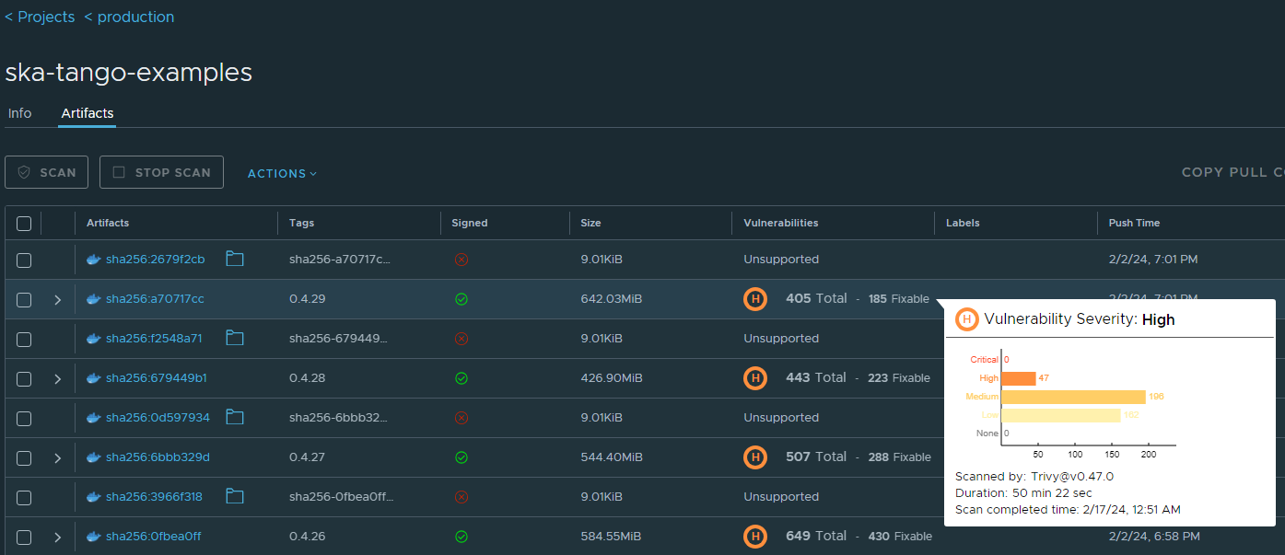
Harbor Interface (with appropriate example)

Slide 12
Kyverno Policy Agent
Dynamically applies behaviours based on static configurations, which are created as regular Kubernetes objects. These behaviours can be classified into three types:
Validation - Verifies the conformity of objects (such as pods and services) submitted to the API
Mutation - Modifies objects submitted to the API
Generation - Generates new objects in response to the submission of other objects to the API

Slide 13
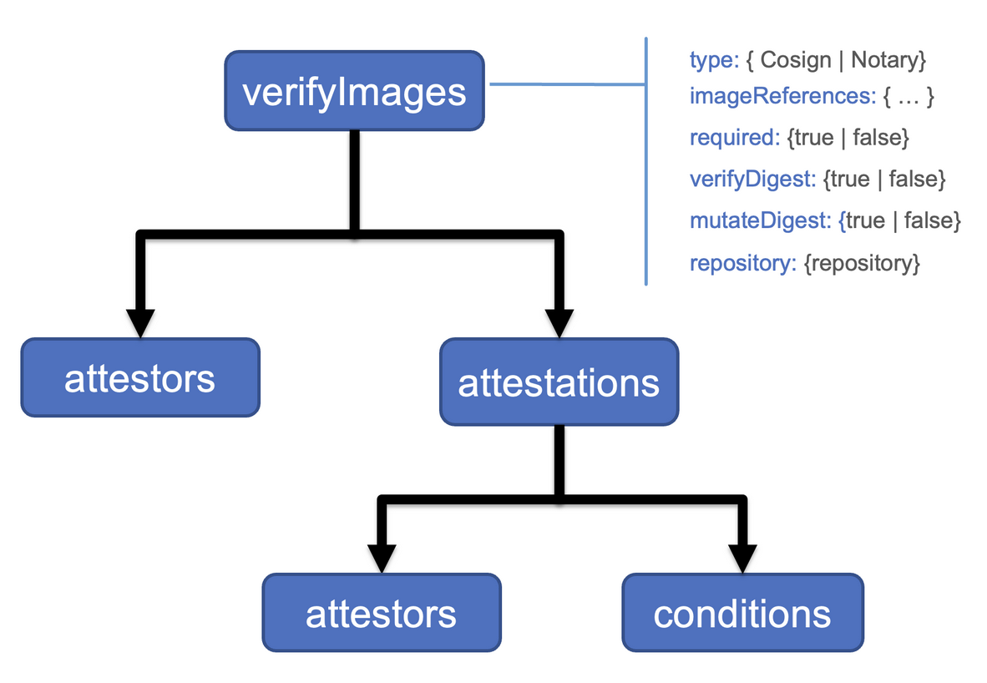
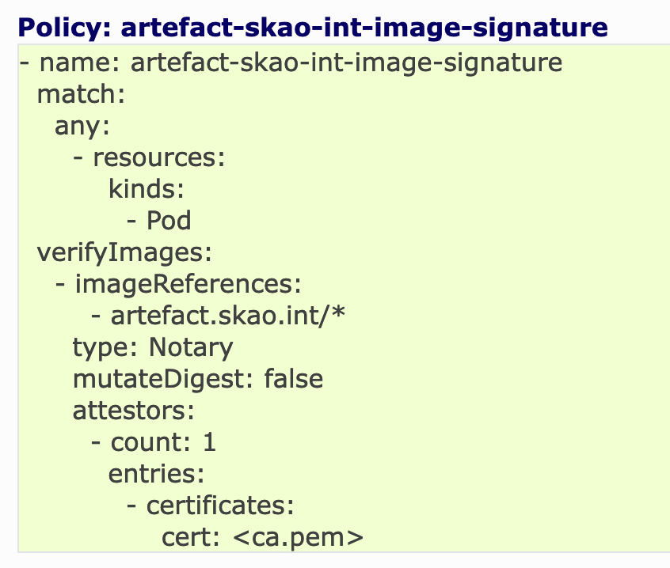
Active Policies on STFC cluster
ingress-host-not-allowed
artefact-skao-int-image-signature

Slide 14
Enforcing an unsigned deployment

Slide 15
Next Steps: What are we working on now?
Enable OCI image signing on pipelines
Create API to offload signing from the pipelines
Update OCI validation with oci-scan job and enable Gitlab's container scanning security config
Add Gitlab authentication to Harbor
Investigate vault PKI signing for certificates
Enforce GPG signing of git commits to SKAO repositories?

Slide 16
Questions and further reading
https://developer.skao.int/en/latest/explanation/software-supply-chain.html
https://developer.skao.int/en/latest/explanation/oci-supply-chain.html
https://github.com/oras-project/artifacts-spec

