Slide 1
ALBA MagnetLab
Mateusz Celary

Slide 2
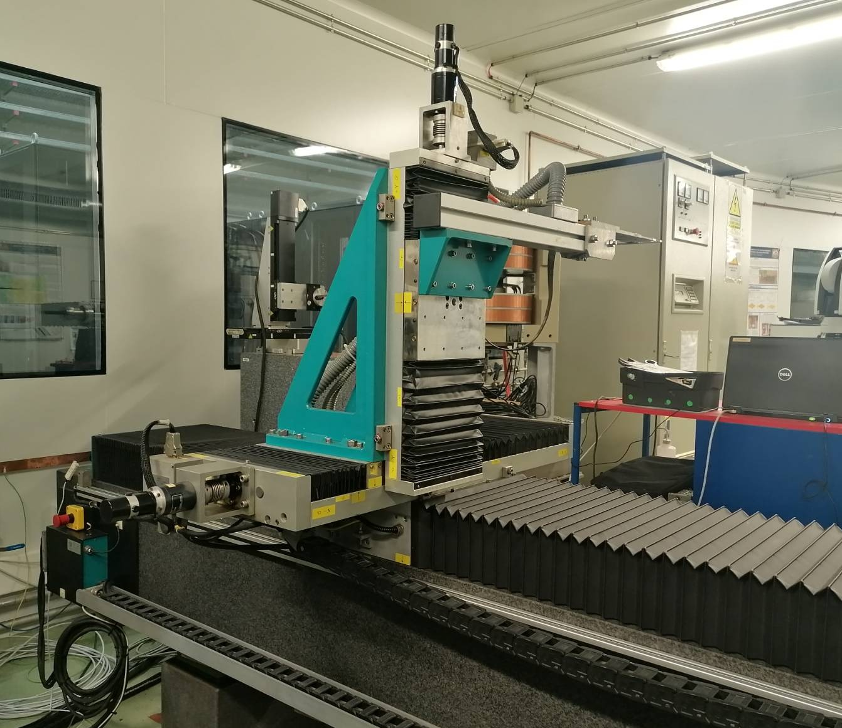
Laboratory Setup
3D Movable Hall Bench with probe
Free movement
Step scan (lines, grid)
Continuous scan (triggers)
Calibration

Slide 3
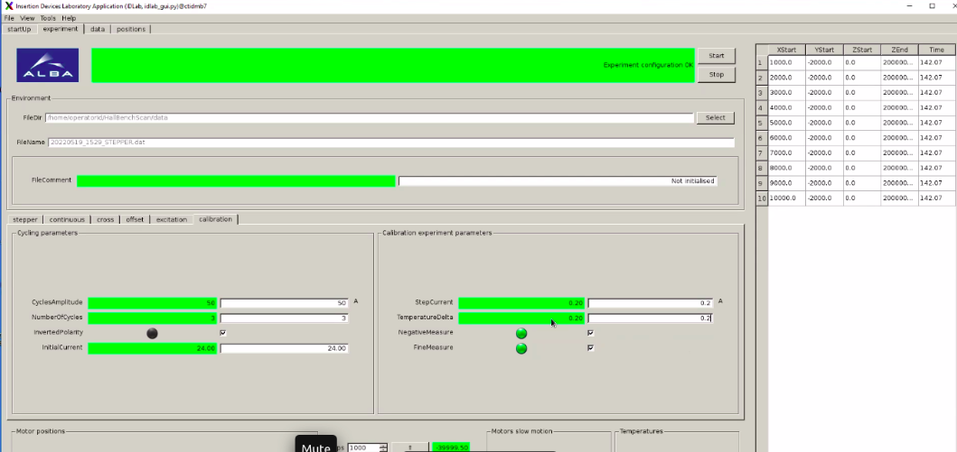
Motivation for the new system
Previous system developed by the student (~8 months of development)
High rate of failures (failure rate of 5 hours scans was 10-20%)
Hard to recover after the failure (manual reset of Devices and Sardana controllers required)
Device servers written in Python 2.7 and C++, using old tango low-level server API
GUI design refreshment (not top priority)

Slide 4
EPU model Mini preparation project

Slide 5
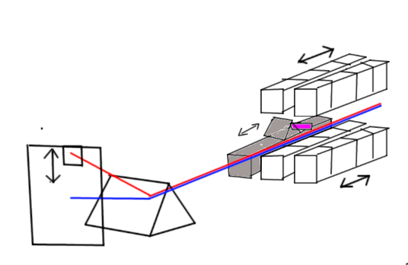
EPU Project
Few weeks to begin the main project
Promotional materials needed

Slide 6
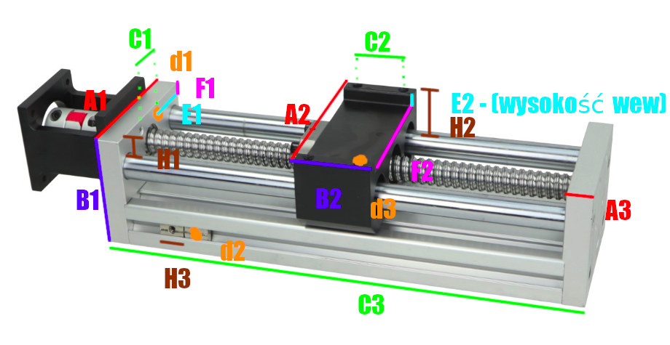
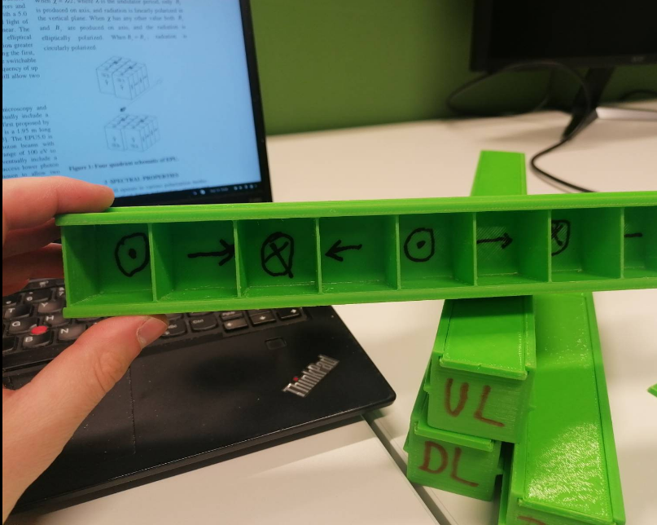
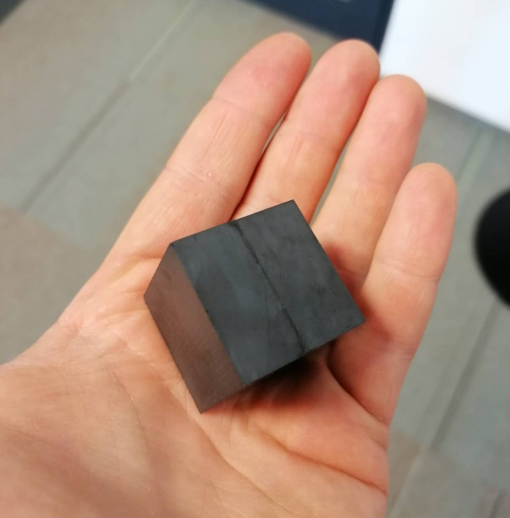
Shopping list
Two stepper motors (+drivers)
Power supply
Arduino
Hall probe sensor
Ferrite Magnets... many
3D printed frames and holdings
3D printer parts for runners

Slide 7
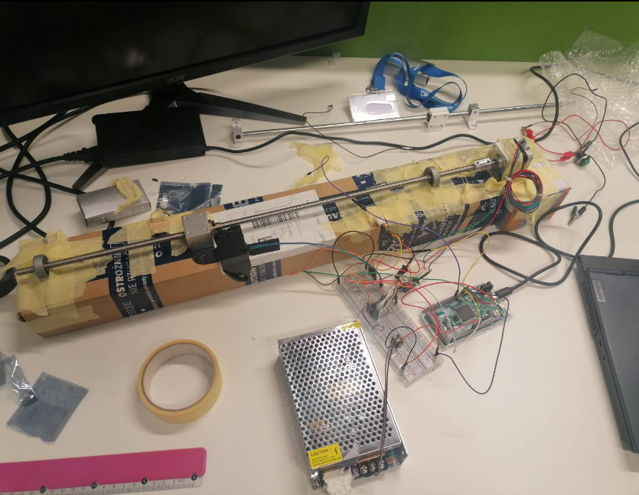
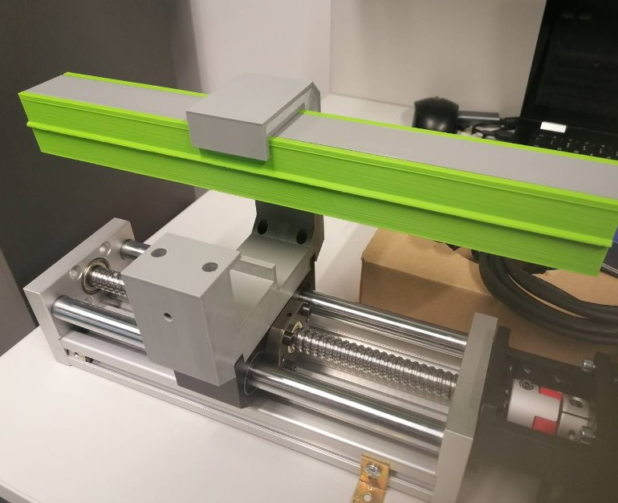

Slide 8
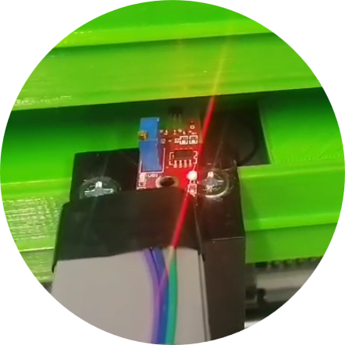
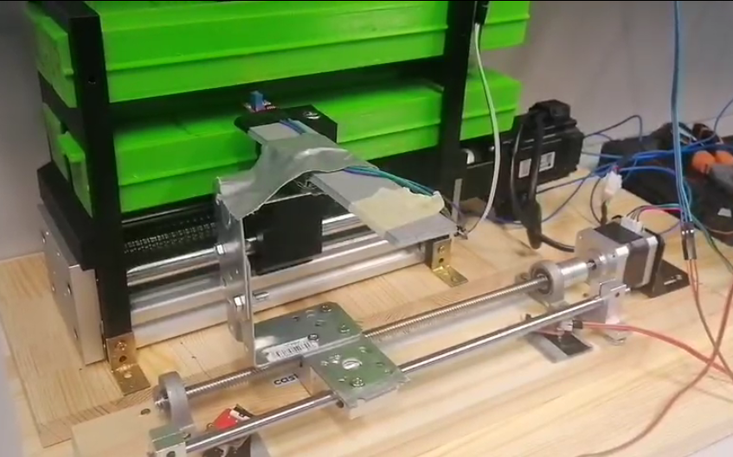
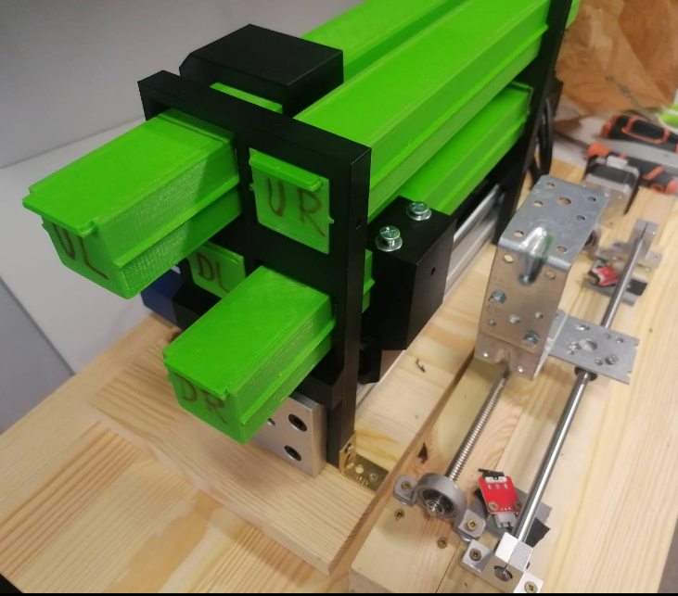

Slide 9
Back to ALBA Project

Slide 10
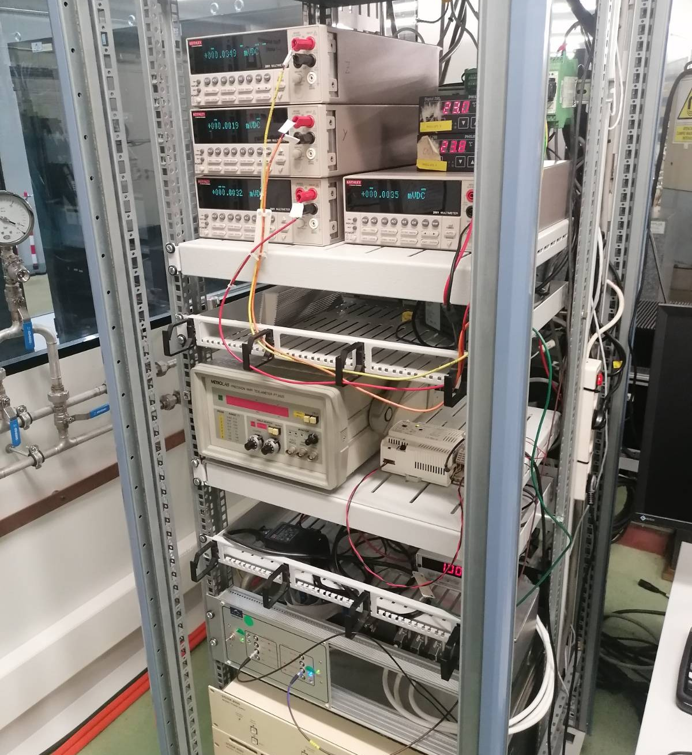
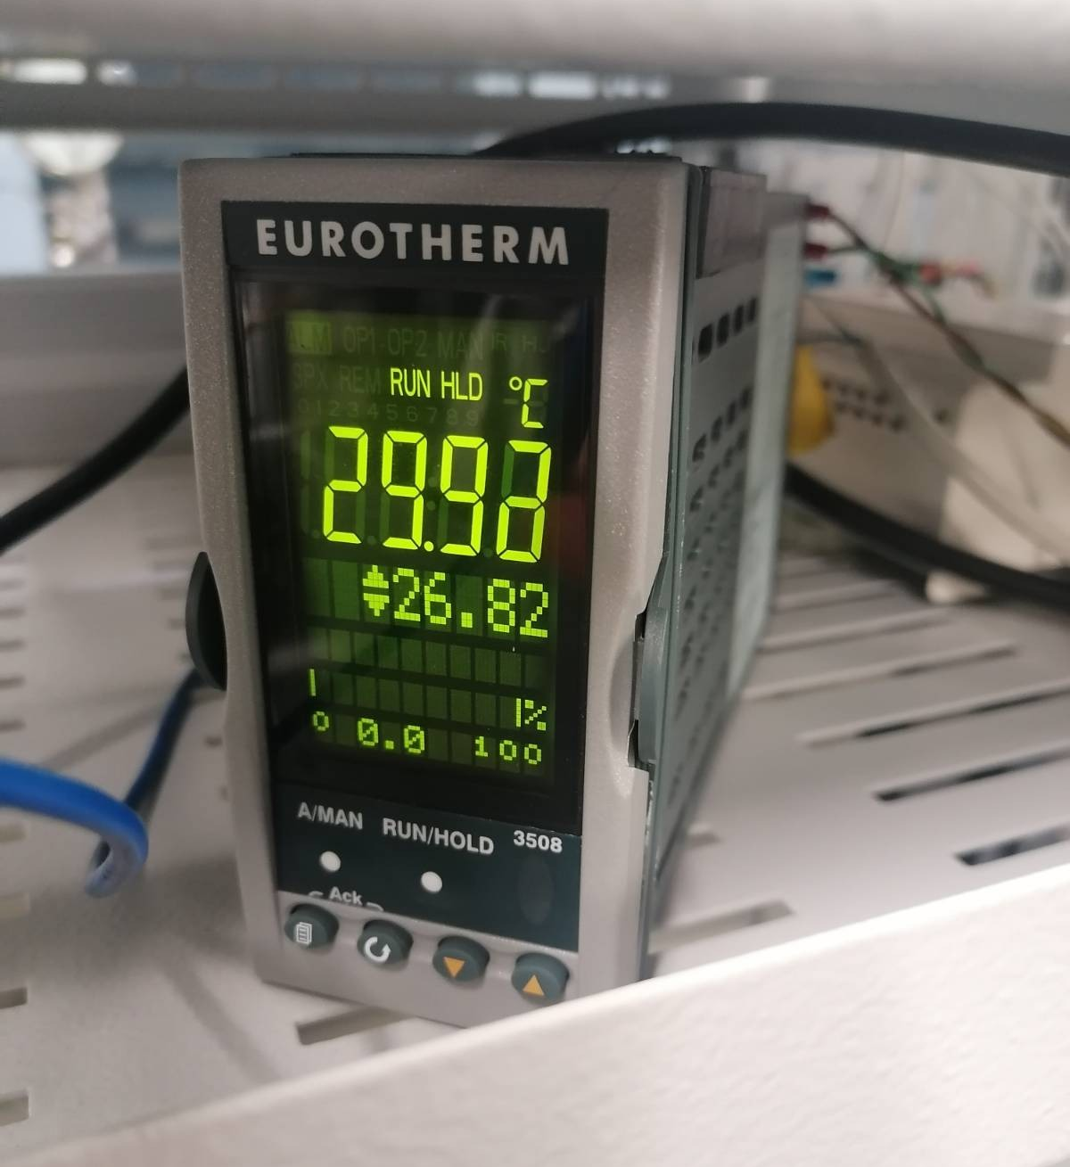
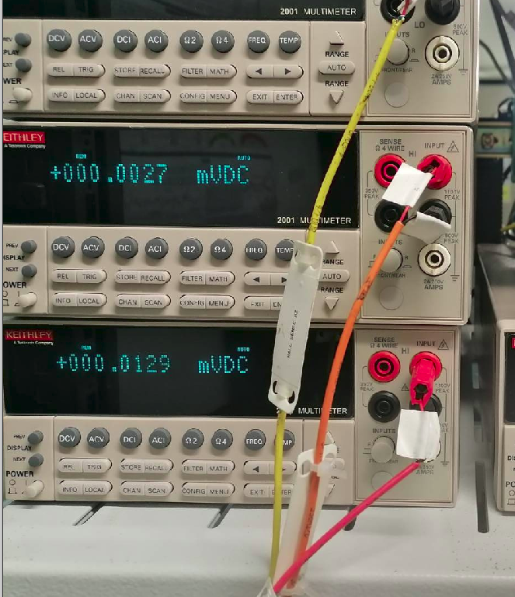
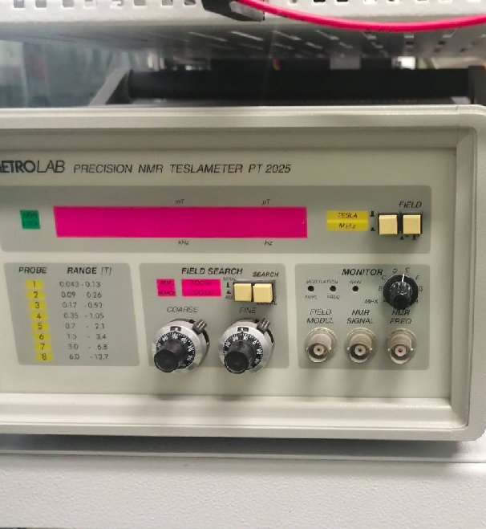
Equipment (Device Servers)
8 Device Servers to create/refactor
PowerPMAC Motion controler
Keithley Voltometers
Power supplies (Lakeshore, Danfysik)
Thermometers
Teslameters
Electromagnet
Requirement no. 1 - robustness

Slide 11
Sardana or not?
Previous code used Sardana extensively
Previous code used more "exotic" classes – triggers
Previous code looked good, apparently without mistakes – I had to do something different
It's an additional level of abstraction, complicating simple logic (move, measure, repeat) - can be implemented in pure python
No synchronization of multiple devices required
I had a blessing from Zbigniew Reszela
No Sardana in ALBA – bold move

Slide 12
Project Workflow
Connection to the devices (on-site)
Device Servers implementation/refactoring (on-site)
Preparation for remote work (on-site):
Photo documentation of hardware and connections
Installation of camera in the laboratory
Development of GUIs (remote)
Acceptance testing (cooperation on-site + remote)

Slide 13
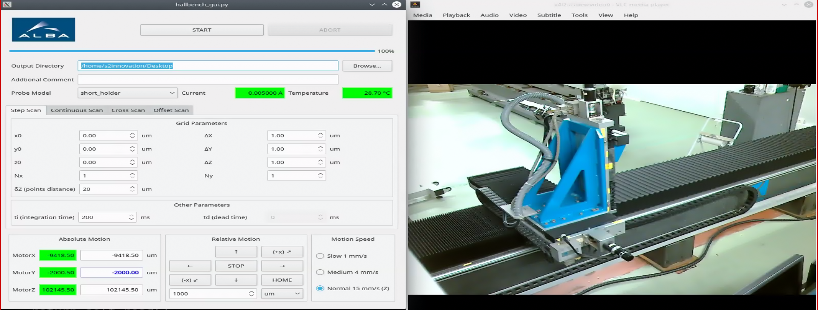
New GUI
All required functionalities implemented
No software-induced failures
Immediate recovery after hardware problem (missing triggers)

Slide 14
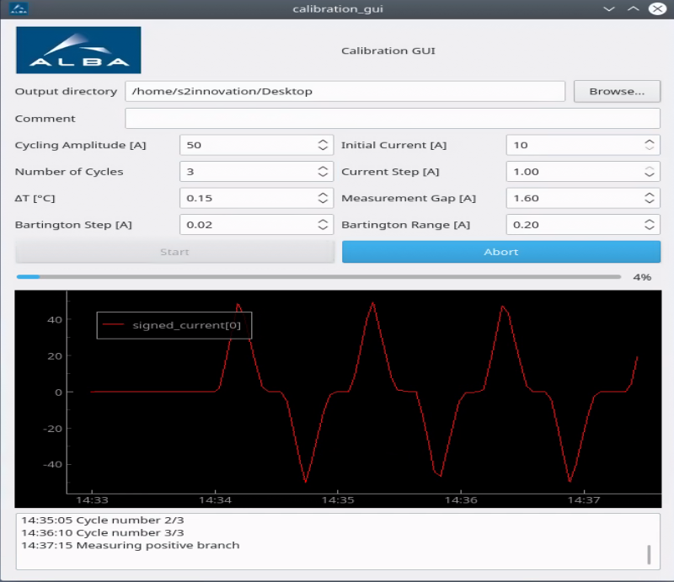
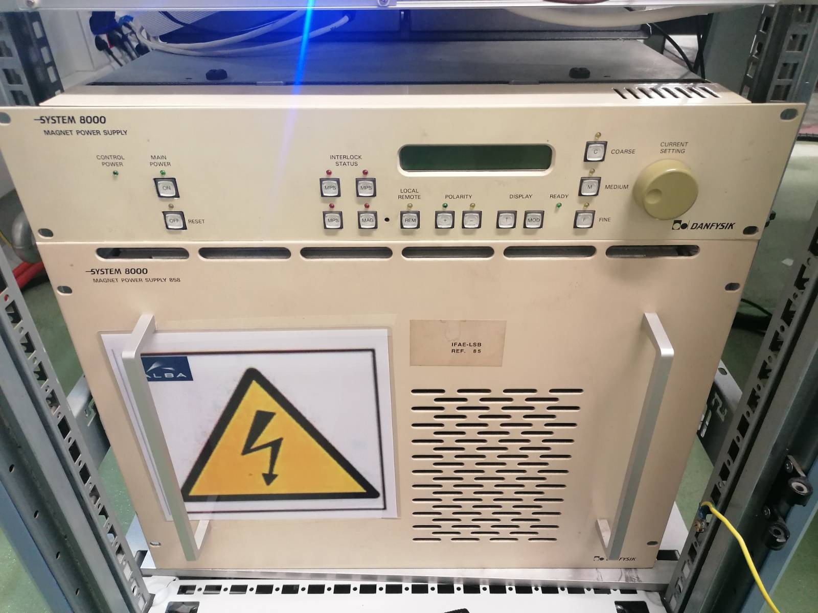
Calibration GUI
Cycling electromagnet
Measurement of stabilized values

Slide 15
Thank you

