Slide 2
SOLARIS State Grid Update
Synchrotron SOLEIL, 29.05.2023
Joanna Wajda
Michał Fałowski
SOLARIS National Synchrotron Radiation Centre
Notes:
Hi, my name is Joanna Wajda and I’m software (frontend) developer in SOLARIS Synchrotron Control system team. (TUTAJ Vek możesz się przedstawić chyba….) Today, We present update of our web version of Max IV State Grid Aplication.

Slide 3
Agenda
Introduction of Max IV State Grid and United States Applications
Recent Updates in SOLARIS State Grid's Web Application
Uniform Themes and Styles in SOLARIS Web Applications
Future Development Plans for State Grid's Web Application
Notes:
I would like to show you the agenda for our presentation.
First, we will begin with a short introduction of application which was our inspiration – State Grid developed by Max VI and United States device server which is used by both Max IV and our applications.
Next, we will report about progres in our version of application and talk over features we implemented
In the third part, we will focus on styles and themes used in SOLARIS Web Applications.
At the end, we will talk about the next steps of our project.
After we cover the main topics, we will have a Q&A session.

Slide 4
State Grid & United States
By MAX IV
Notes:
Let's begin with a introducing the solution developed by Max IV.

Slide 5
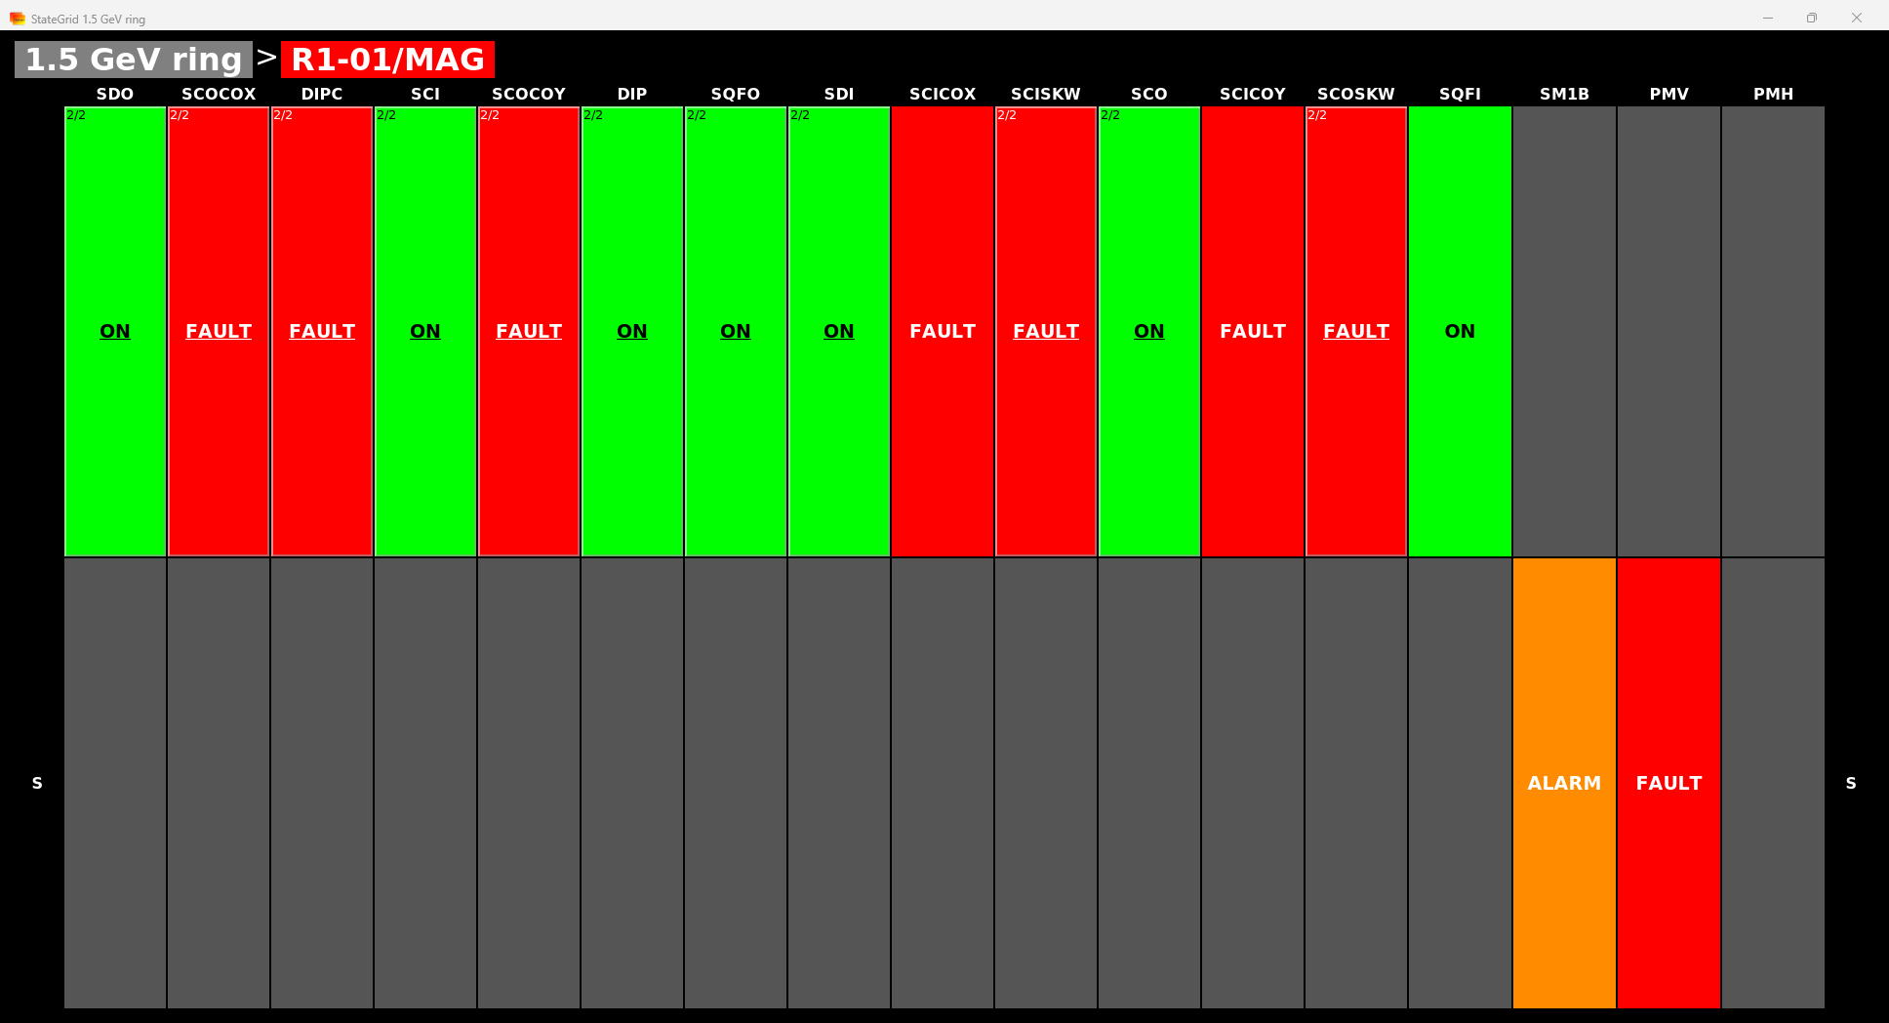
State Grid – MAX IV
Displays grouped states of the accelerator devices
Displayed state value is the most important state of the group
States are retrieved from the United States device
Notes:
State Grid is application which displays states of all devices declarated in United States DS. Each cell in grid represents the most important state of group defined by keys in row and column. Is possible to click in the cells and then is displayed another grid with selected group of devices but categorised again by another keys.

Slide 6
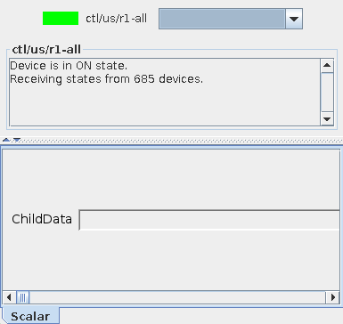
United States
Device aggregates states of defined devices
Device has one string attribute – ChildData, which contains JSON encoded States of monitored devices
ChildData sends event at every device state change
Notes:
Mentioned in previous slide United States DS is device which subscribe devices’ states defined in property as list. The server can both subscribe to devices and other United States device server instances, what creates tree topology. Device server return ChildData attribute which is stringify JSON and contains information about devices and their states

Slide 7
SOLARIS State Grid
Notes:
Since I gave you a brief overview of foundations of Max IV application, I will now introduce our solution.

Slide 8
SOLARIS State Grid

Slide 9
SOLARIS State Grid
Vue.js application is connected to United States device server
Filtering devices by the following categories:
system,
location,
subsystem,
sublocation,
device type,
device name
3 display types: tile, grid and details view

Slide 10
Tile View
Devices are categorized by one category and displayed individually as tiles

Slide 11
Grid View
Devices are categorized by two categories in columns and rows, displayed in a grid format

Slide 12
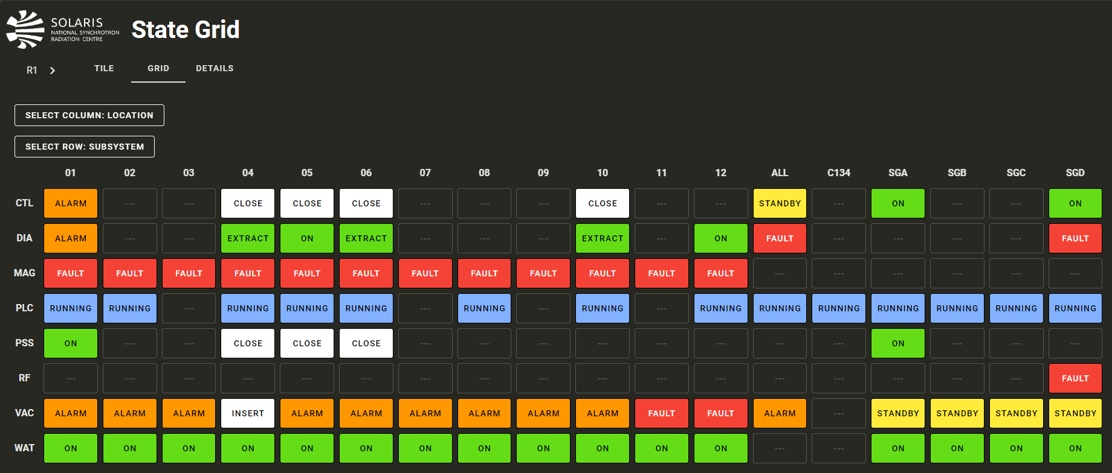
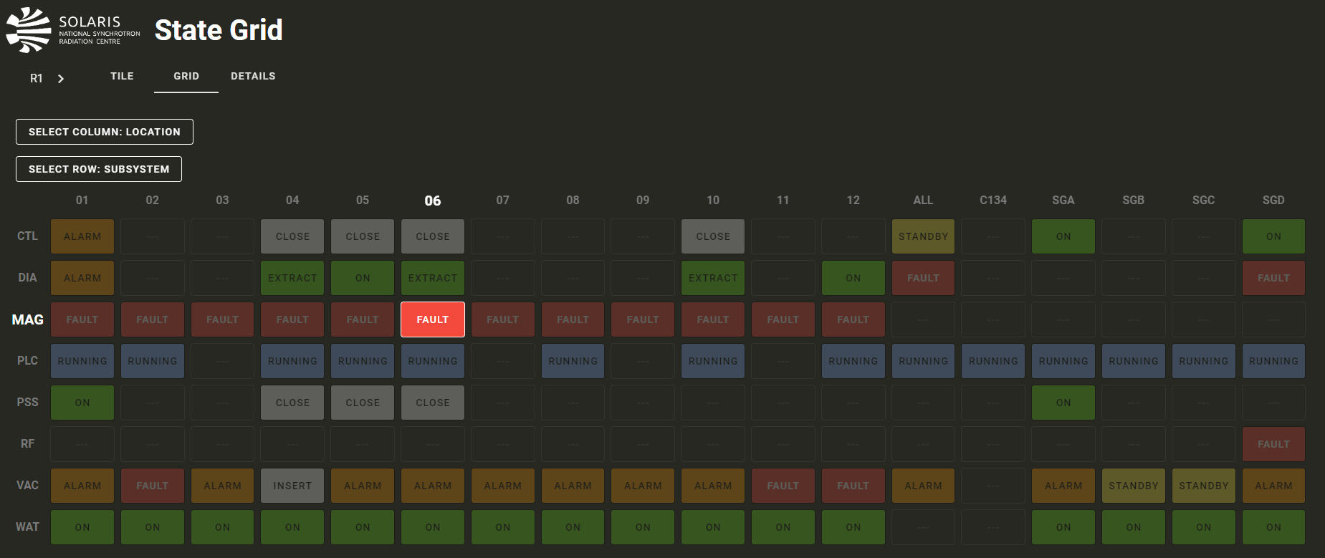
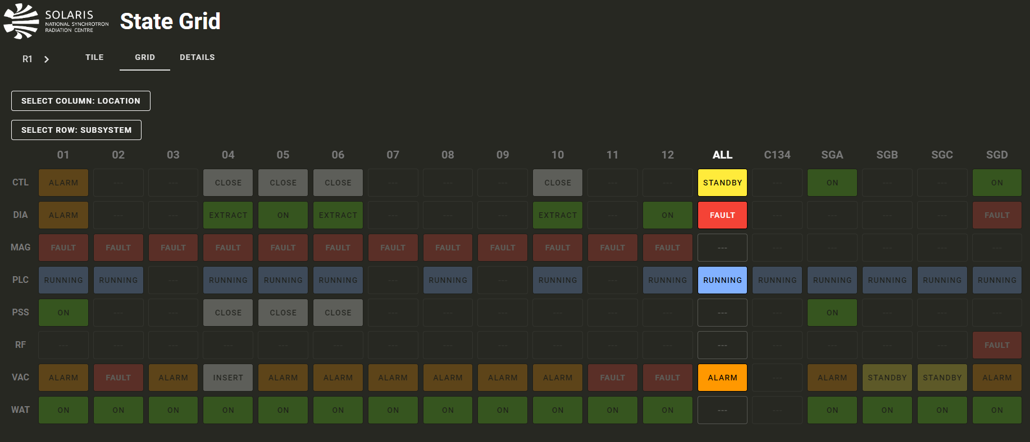
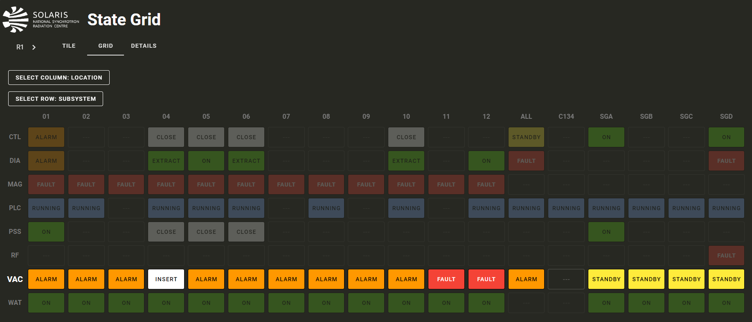
Grid View – Focus mode

Slide 13
Grid View – Focus mode

Slide 14
Grid View – Focus mode

Slide 15
Grid View – Focus mode

Slide 16
Details View
Display list of all devices (optionally filtered in previous steps)

Slide 17
SOLARIS Web Applications
Uniform Themes and Styles

Slide 18
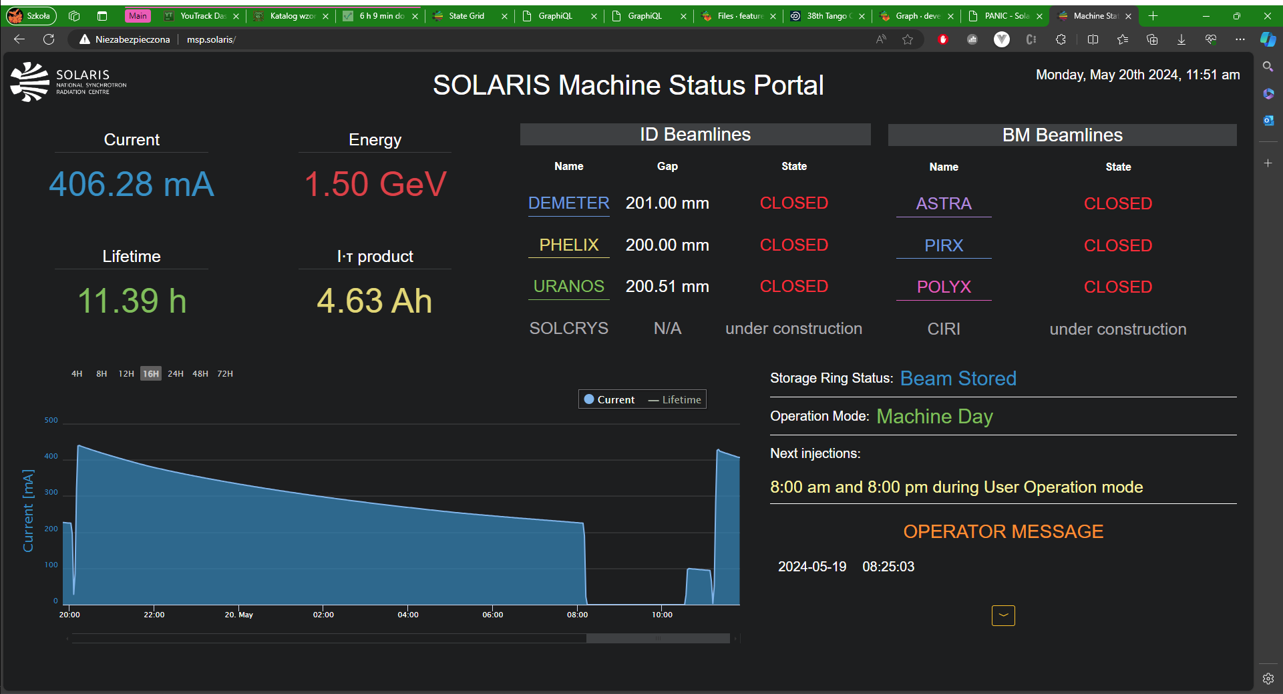
Machine Status Portal

Slide 19
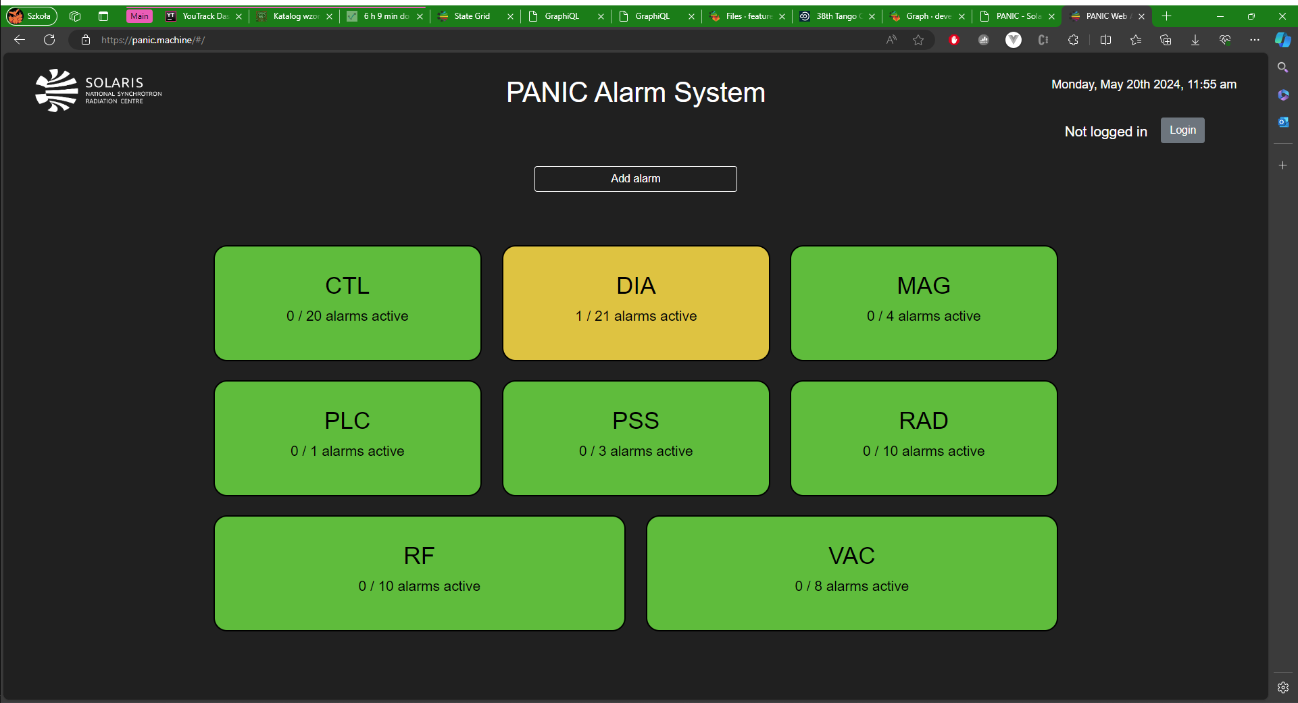
PANIC Alarm System
Notes:
PANIC is a suite used to manage the configuration, triggering and acknowledgement of alarms in a TANGO control system. At SOLARIS it is used for notifying about alarms via e-mail/SMS messages whilst logging them into Logbook and archiving database. The most crucial part of alarm system are PyAlarm devices, which are in charge of evaluating every alarm and store the necessary configuration. Each PyAlarm device is responsible for alarms in a specific subsystem (DIA, CTL, MAG etc.):

Slide 20
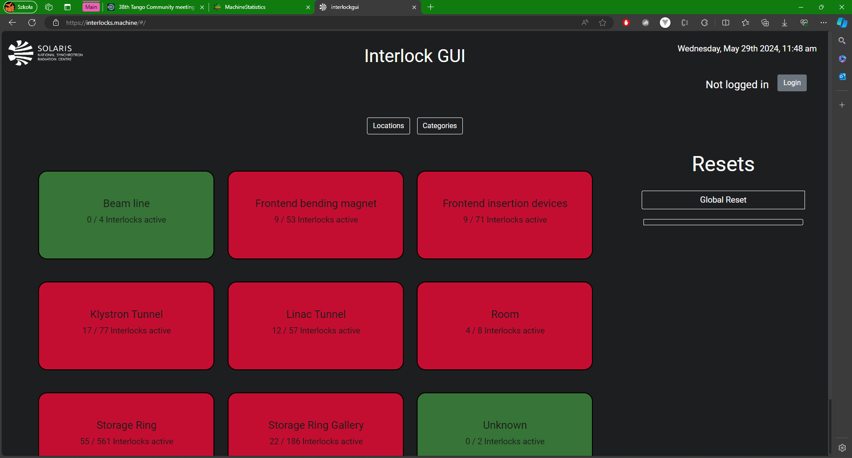
Interlock Gui

Slide 21
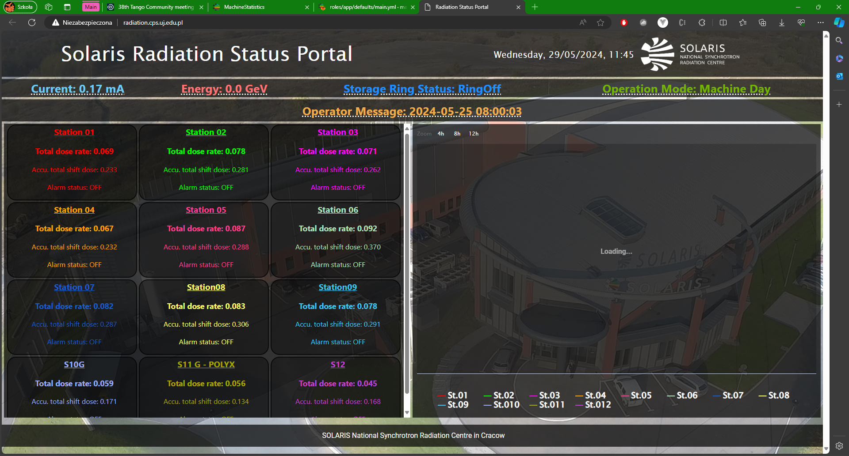
Radiation Status Portal

Slide 22
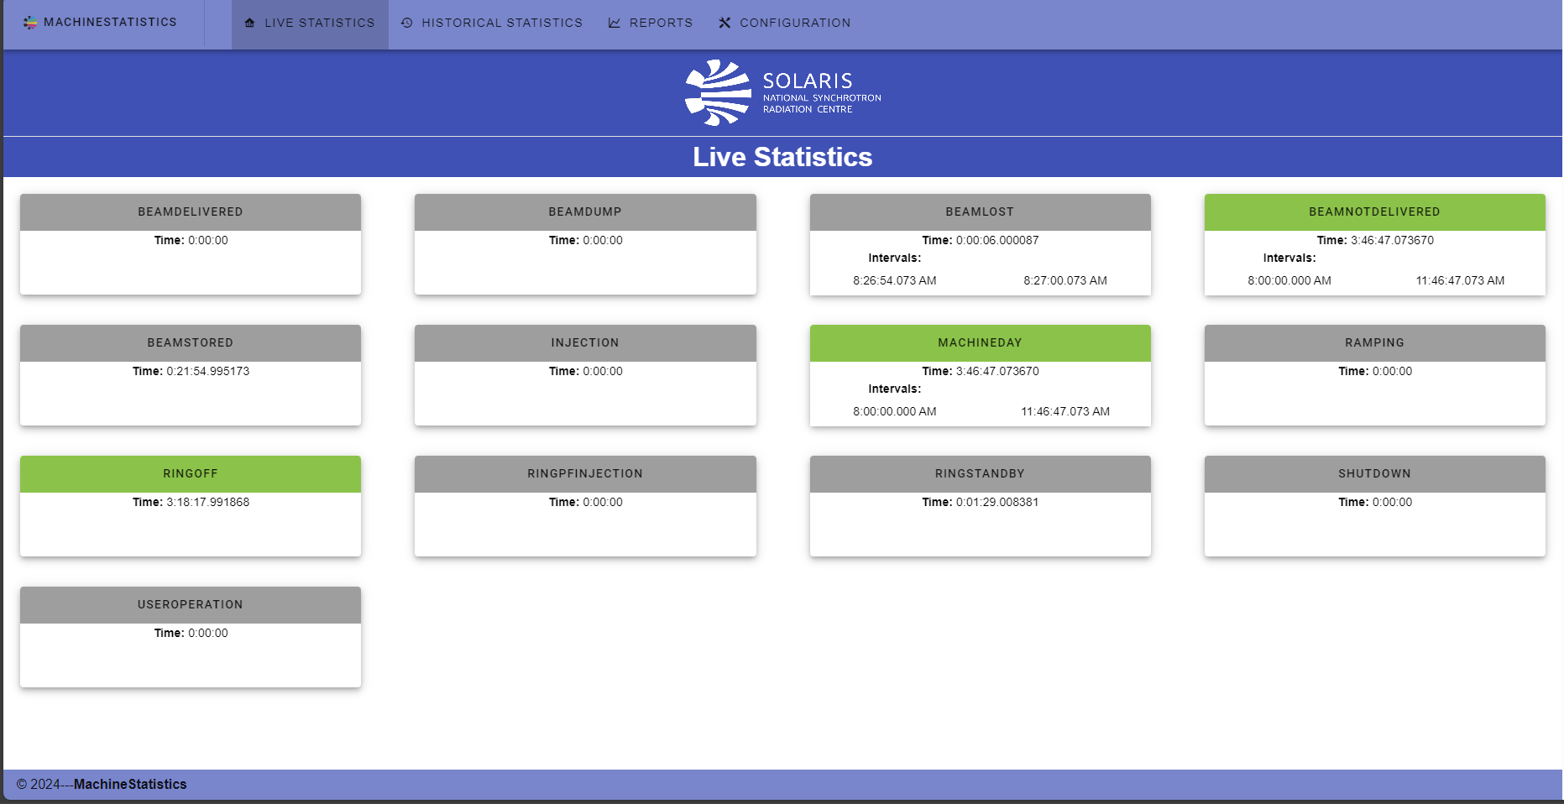
Machine Statistics

Slide 23
Future Development Plans for Web State Grid Application
Configurable Dashboards
Tooltip showing all states in the tile
Add backend service which will replace United States Device
Add most important attributes in the detailed view
Device management from frontend app

Slide 24
Future Development Plans for other Web Application
Unify themes of all apps
Create light and dark modes
User Login with SSO based on Keycloack
Improve getting data from archiving
Deploy apps for all beamlines
Share code on external repository

Slide 25
Summary:

Slide 26
Thank you for attention
Joanna Wajda
SOLARIS National Synchrotron Radiation Centre
joanna1.wajda@uj.edu.pl
Michal Falowski
SOLARIS National Synchrotron Radiation Centre
michal.falowski@uj.edu.pl

