Slide 1
Tango meeting 2024
On-site participants information

Slide 2
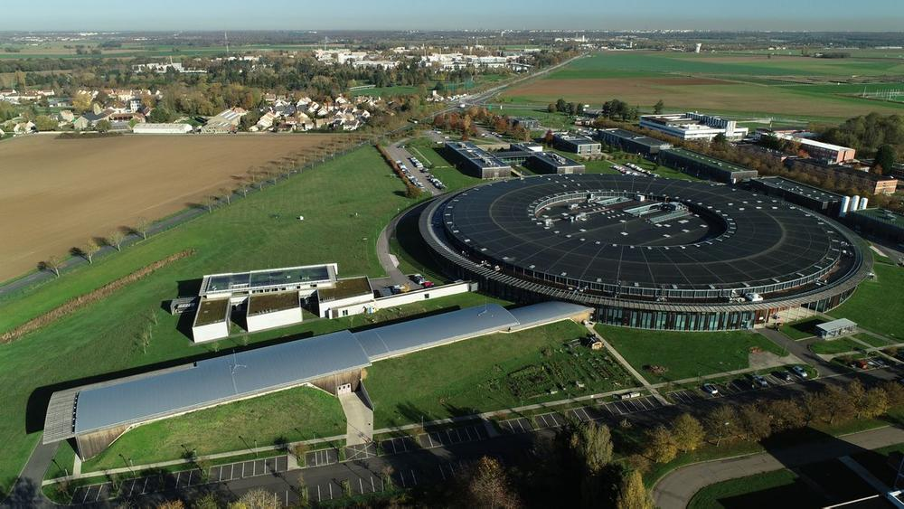
Welcome to SOLEIL!

Slide 3
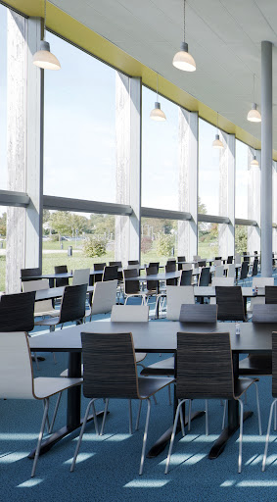
Practical information
Coffee breaks in the morning and in the afternoon next the conference room
Breakfasts, lunches and dinners can be taken at SOLEIL canteen; you can pay by card or cash.
Conference room will be locked during lunches
Wi-Fi code provided with your
registration

Slide 4
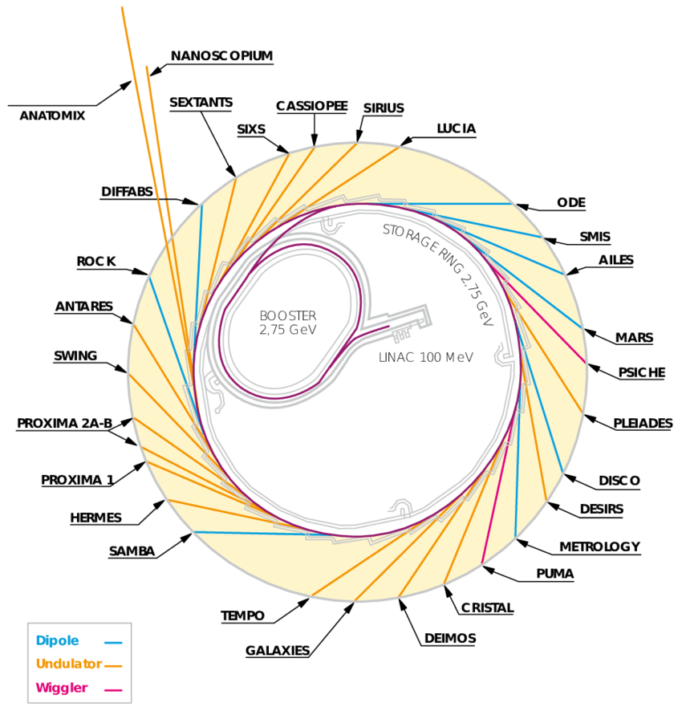
SOLEIL Visit on the Wednesday 29th afternoon
Managed by Brenna Connin from the communication team.
Program:
30’ presentation by Brenna in the conference room
Visit of 1h in 4 groups:
Stéphanie: Accelerators Control room, NANOSCOPIUM, SIXS
Isabelle: SIXS, NANOSCOPIUM, Accelerators Control room
Loïc: PROMIXA1, CRISTAL, Accelerators Control room
Brenna: Accelerators Control room, CRISTAL, PROMIXA1
The beam is up, so it will not be possible to visit the accelerators tunnels or beamlines hutches.

Slide 5
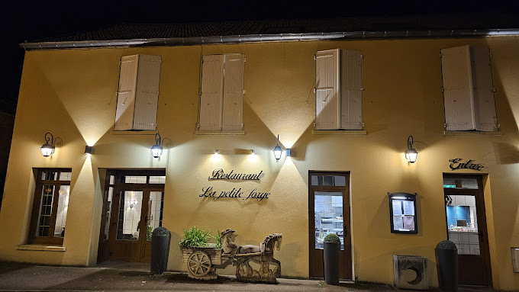
Restaurant on the Wednesday 29th night
Restaurant at 19:00
Bus leaves SOLEIL at 18:45
The bus will then go back to:
Hôtel les Chevaliers de Balances
SOLEIL
B&B hôtel Paris Saclay
MASSY TGV avenue Carnot
Restaurant La petite forge
https://www.restaurantlapetiteforge.com/contact
1 route de Gif
91190 Villiers-Le-Bâcle

Slide 6
Taxi booking
SOLEIL can book taxis for the end of the meeting (not paid by SOLEIL)
Please book one day in advance
A sheet is available at the entrance of the conference Room

Slide 7
Program
Workshops at 9:30:
Taurus: stay here with Jade and Florent
Taranta: go to Phoenix room with Cyrille and Gwen
Meeting presentations, starting at 14:00, here:
Don’t forget to upload your contributions on Indico before your session
We will download them on the conference room laptop
If you prefer to present from your laptop, please share your screen with Microsoft Teams.

Slide 8
Any questions during the meeting?
Have a good 38th Tango community meeting!
Please ask:
Florent Langlois
Jade Pham
Cyrille Kouassi
Gwenaëlle Abeillé

