Slide 1
Synchrotron SOLEIL
How it works and what it does

Slide 2

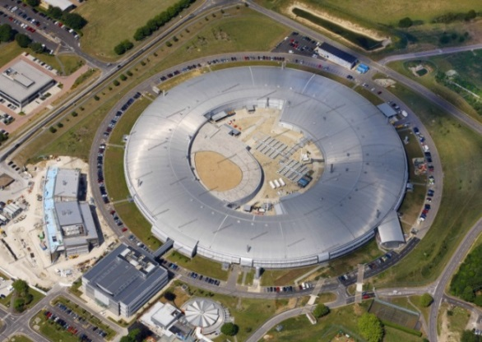
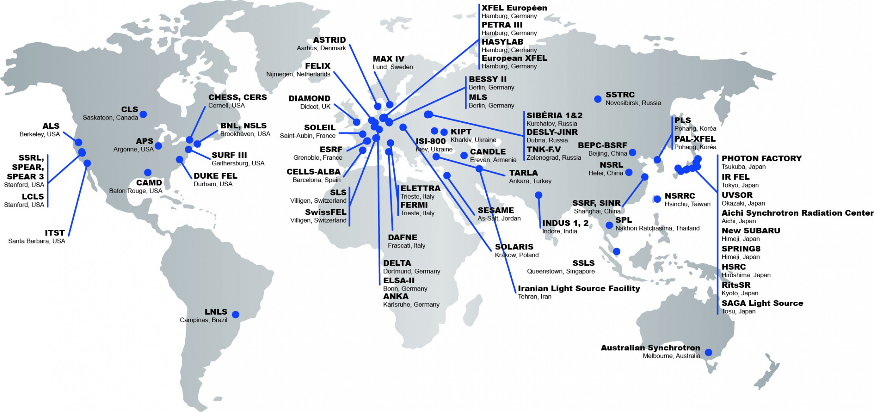


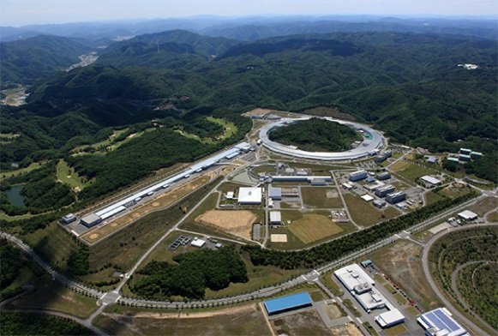
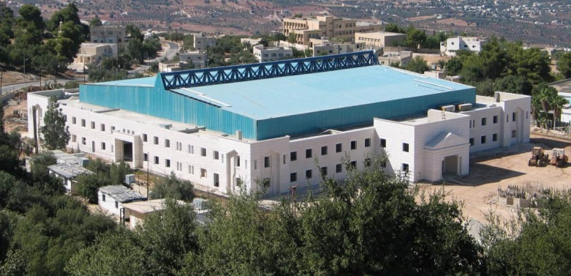
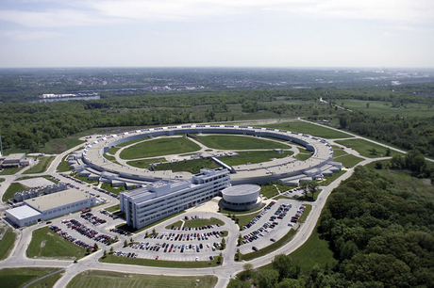


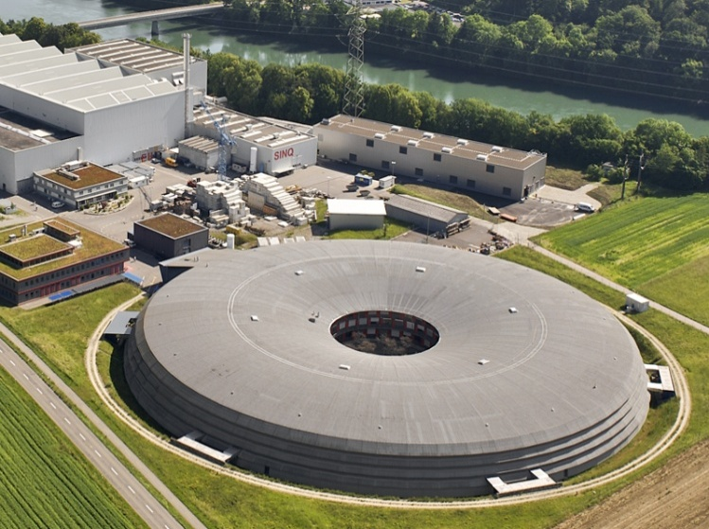
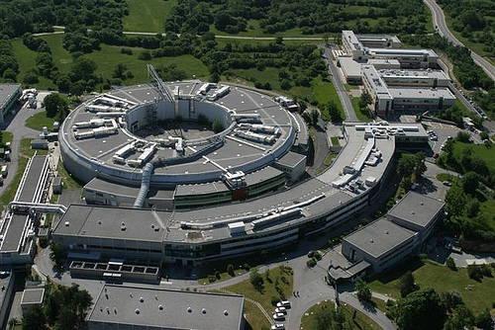

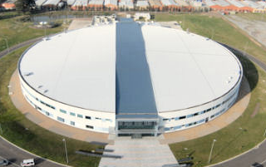


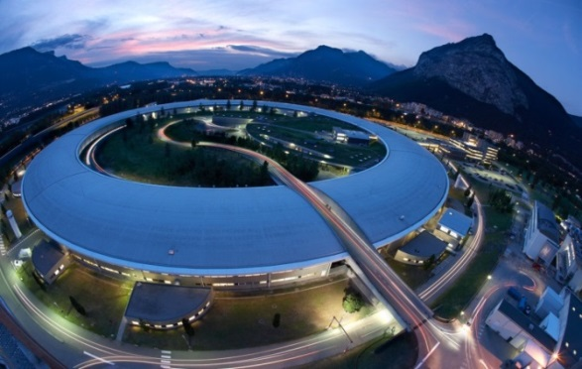
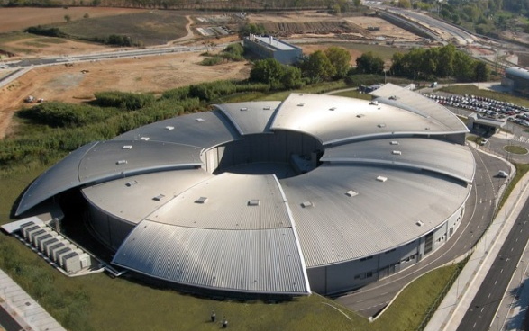

Synchrotron around the world

Slide 3
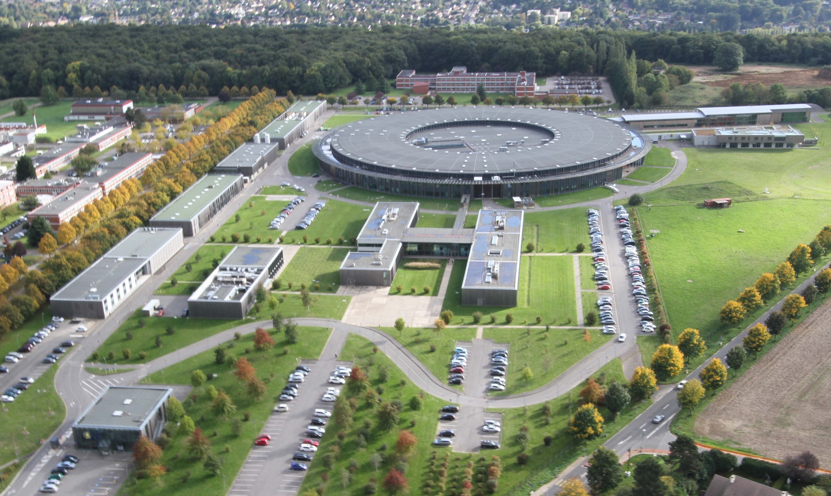
SOLEIL
Source Optimisée de Lumière d’Energie Intermédiaire du LURE (Laboratoire d’Utilisation de Rayonnement Electromagnétique)
Optimized Light Source of Intermediate Energy for LURE
(Laboratory of the Use of Electromagnetic Radiation)

Slide 4


SOLEIL
Source Optimisée de Lumière d’Energie Intermédiaire du LURE (Laboratoire d’Utilisation de Rayonnement Electromagnétique)
Optimized Light Source of Intermediate Energy for LURE
(Laboratory of the Use of Electromagnetic Radiation)
72%
28%

Slide 5
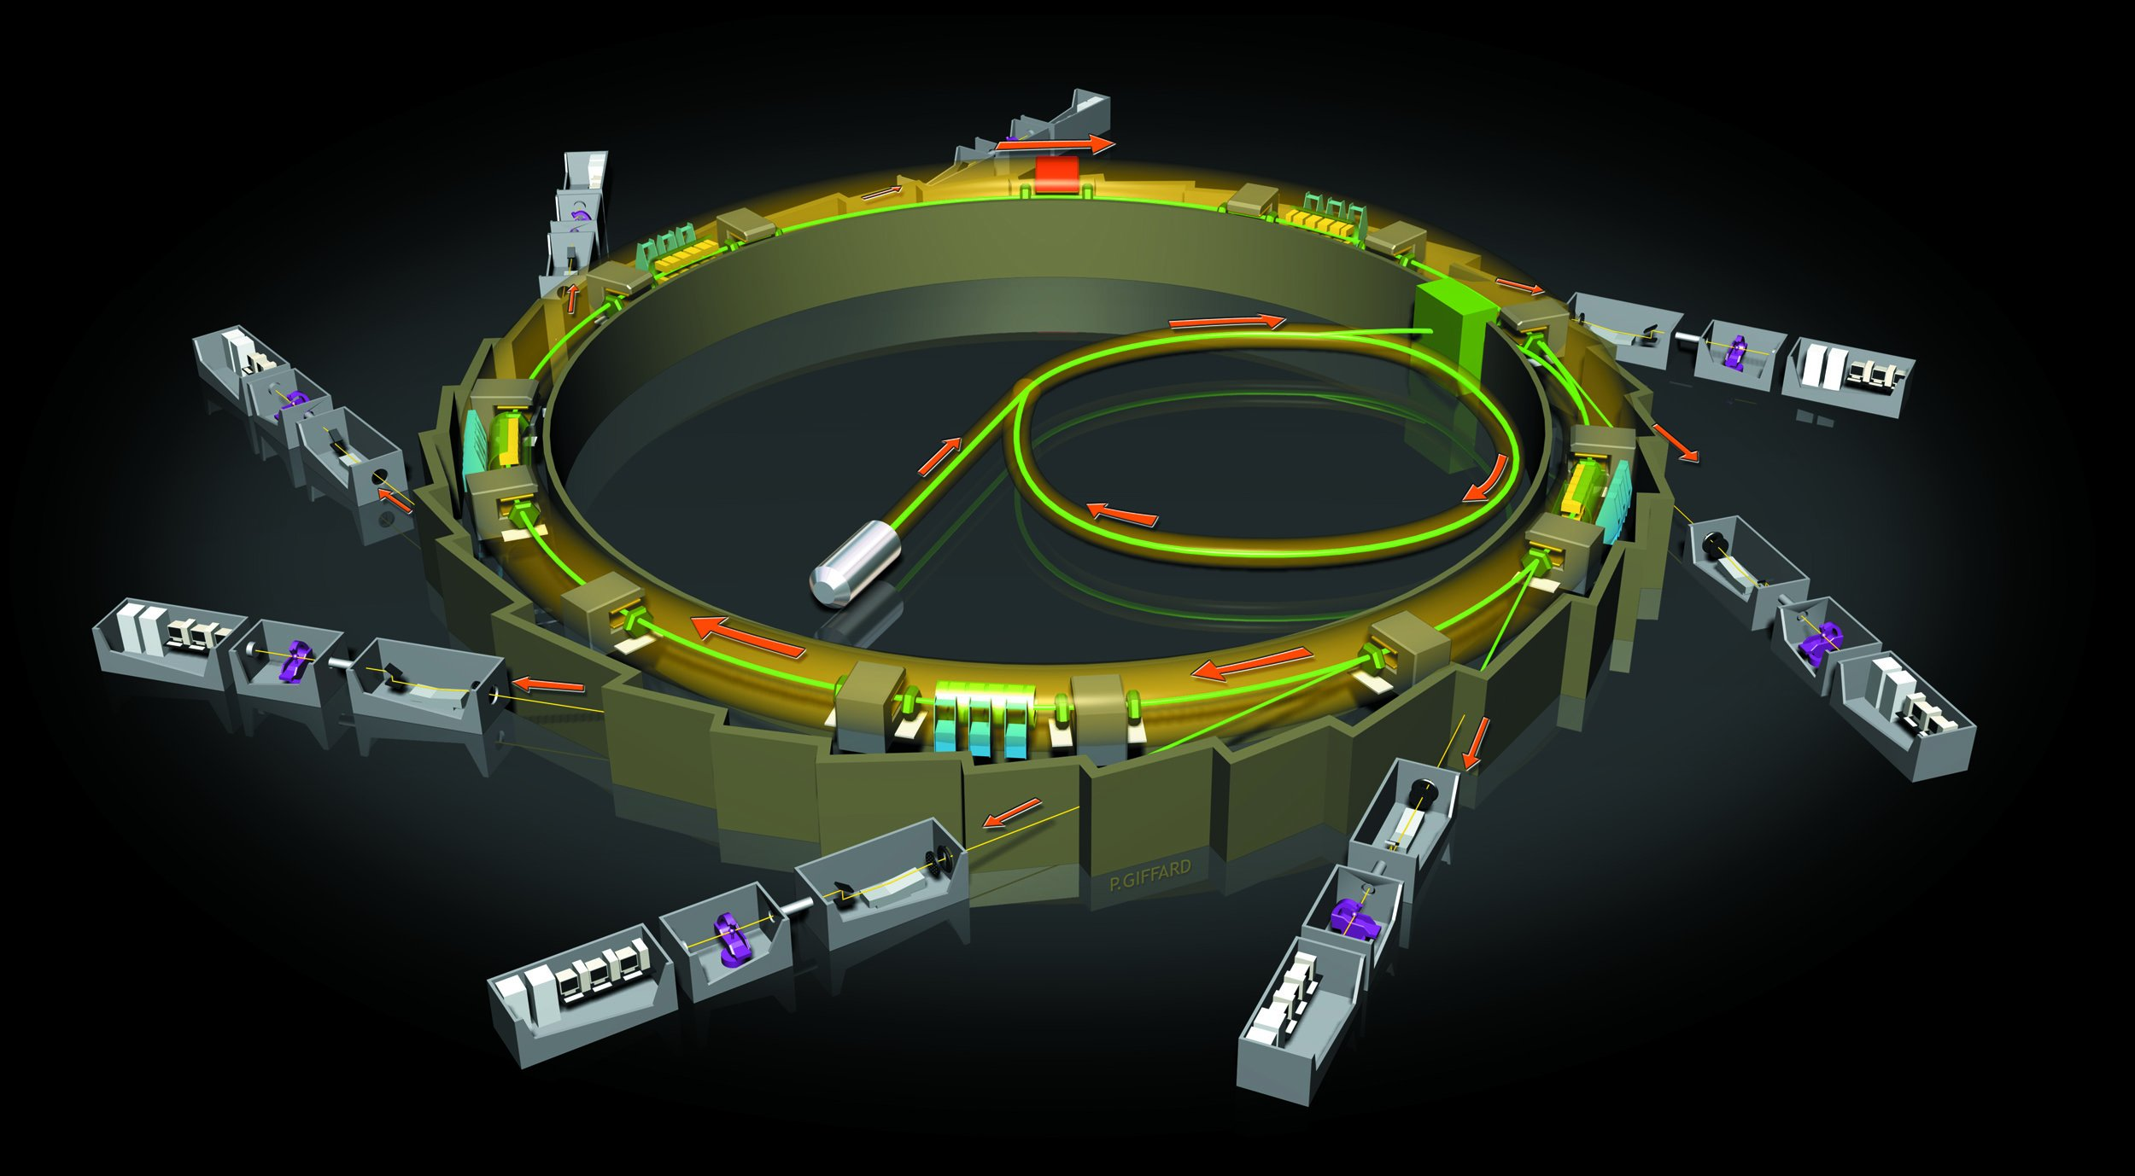
SOLEIL, a light source
Storage ring
Beamlines
LINAC
Booster
Electron gun

Slide 6
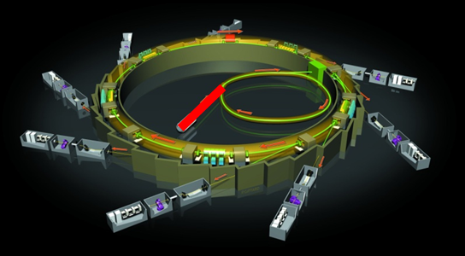
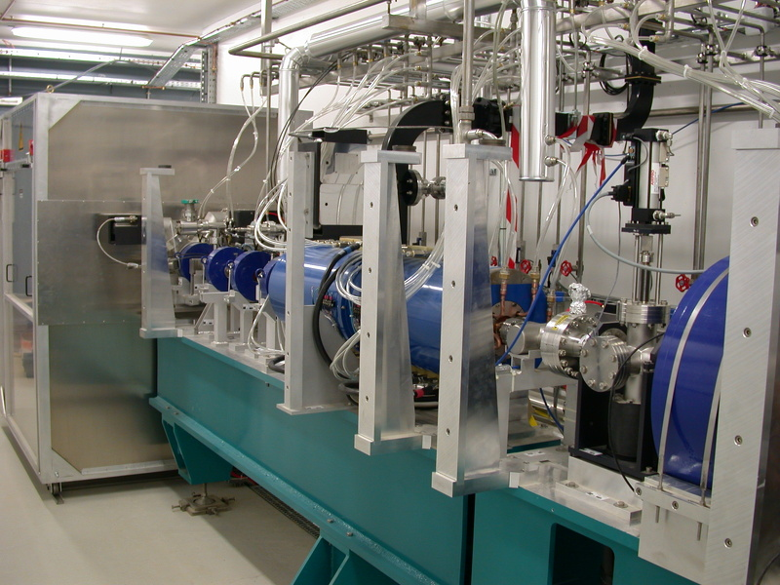
The Linac

Slide 7

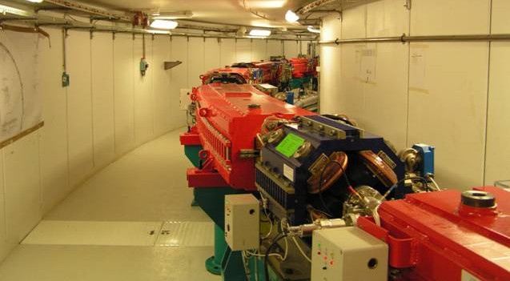
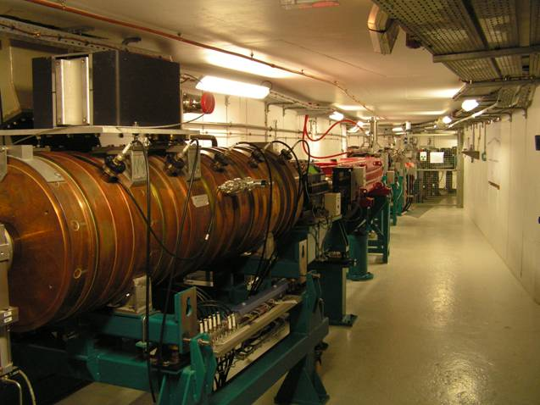
The booster

Slide 8
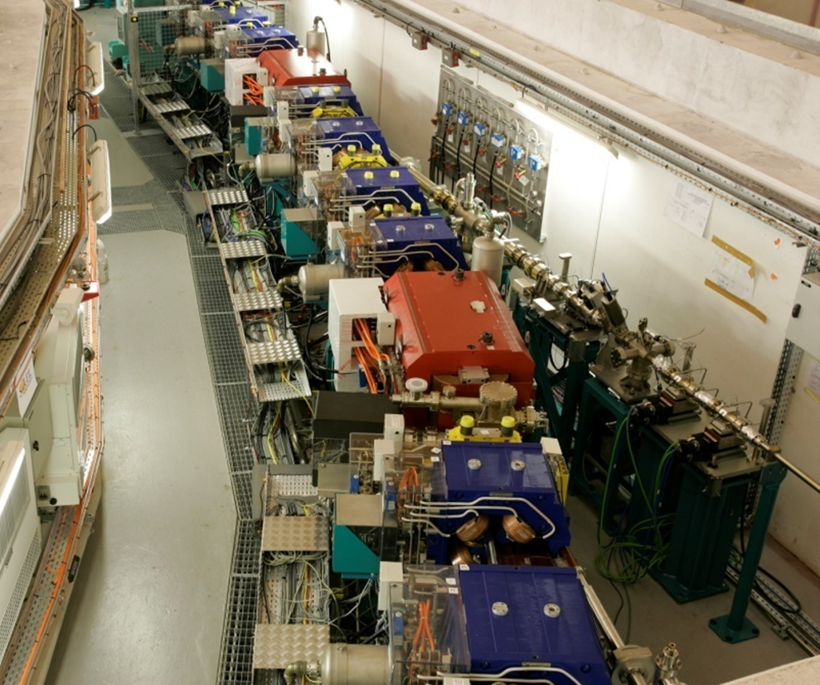
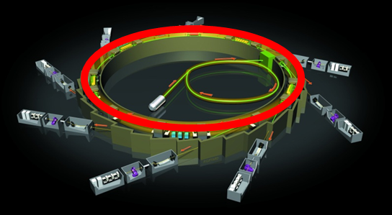
The storage ring
32 bending magnets : 600A power each : 1.7 Telsa

Slide 9
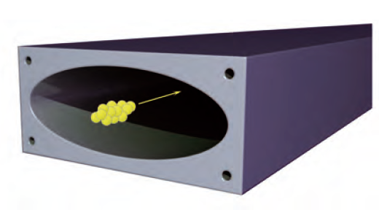
The storage ring
Vacuum Pump
Vacuum chamber for photons
Bending magnet
32 bending magnets : 600A power each : 1.7 Telsa
Hexapole
Quadrupole

Slide 10
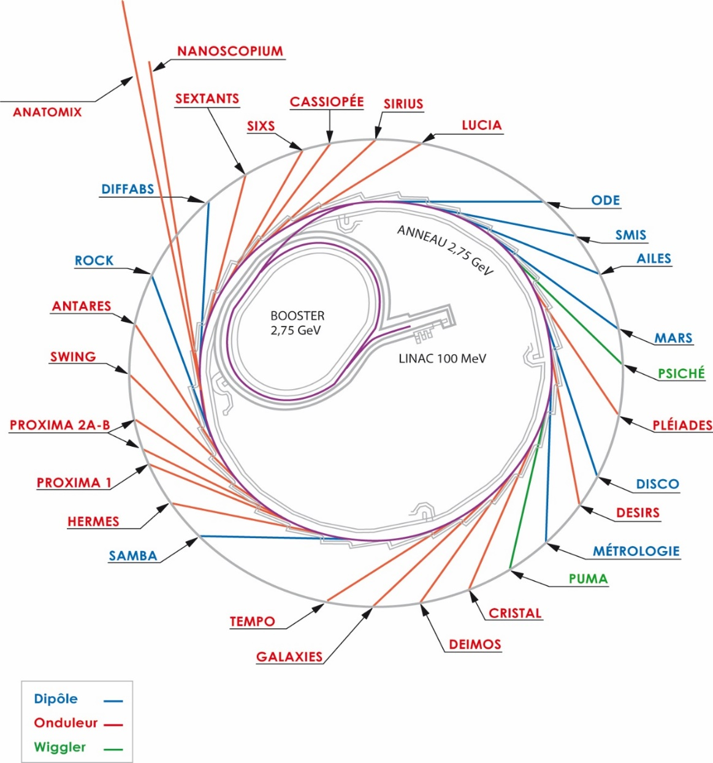
Ondulators and wigglers

Slide 11
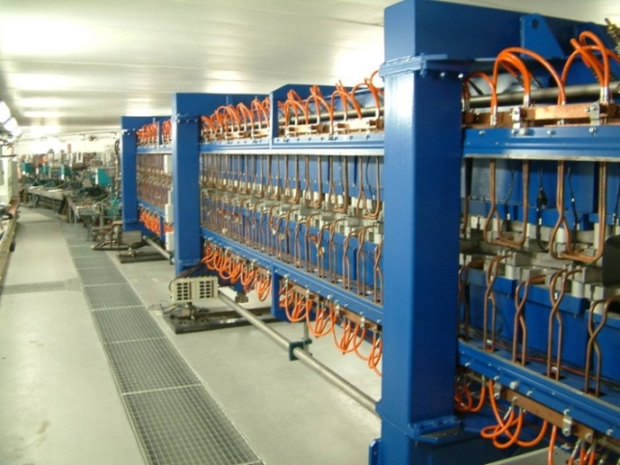
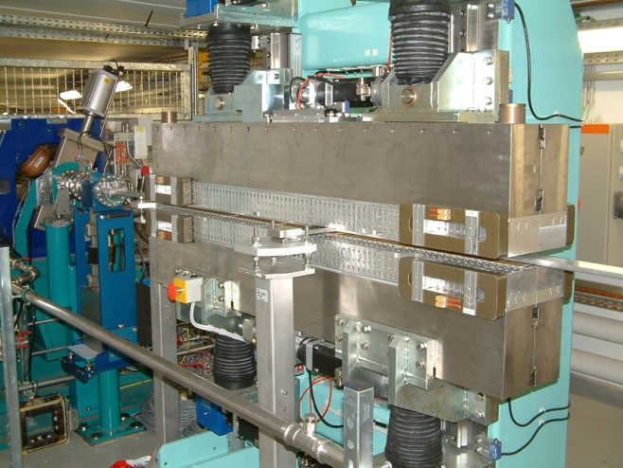
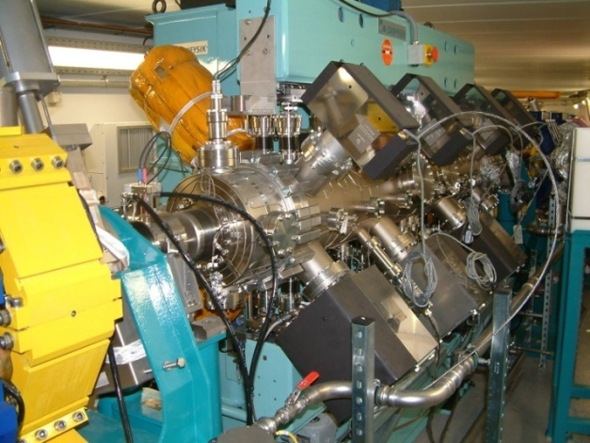
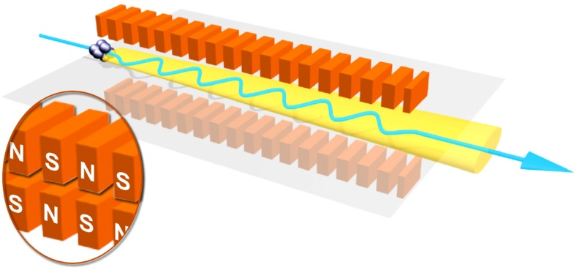
Ondulators and wigglers
HU 640 : ligne DESIRS
(5 eV – 50 eV : Ultra Violet)
HU 80 : TEMPO
(100 eV - 3 keV : Soft X rays)
U 20 : ligne PROXIMA
(4 keV - 30 keV : Hard X rays)

Slide 12
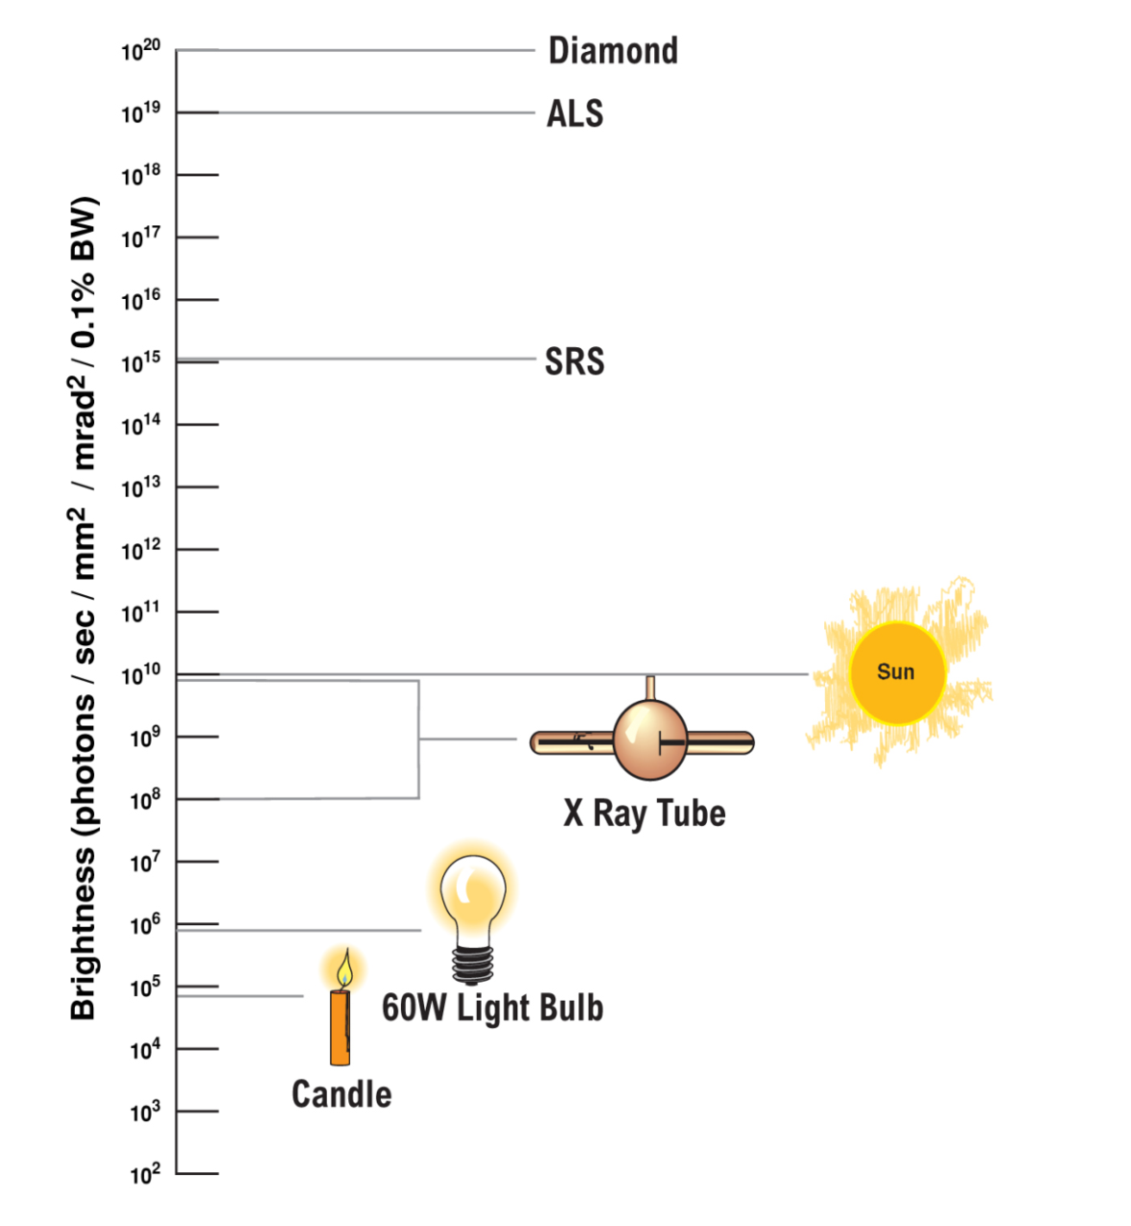
Light source characteristics
SOLEIL
SOLEIL photon beam :
Very bright
Pulsatility (50 ps every 3 ns)
Polarization
Adjustable wavelength (broad spectrum)
Stability (position and intensity)
Size of the beam : 15µm height and 150 µm width (brush of light)
Low divergence (microfocusing)

Slide 13
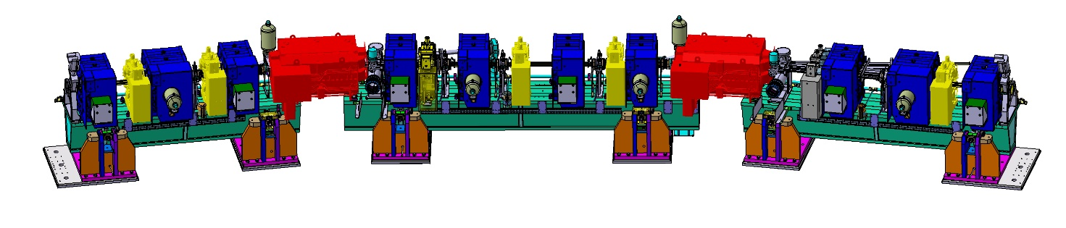
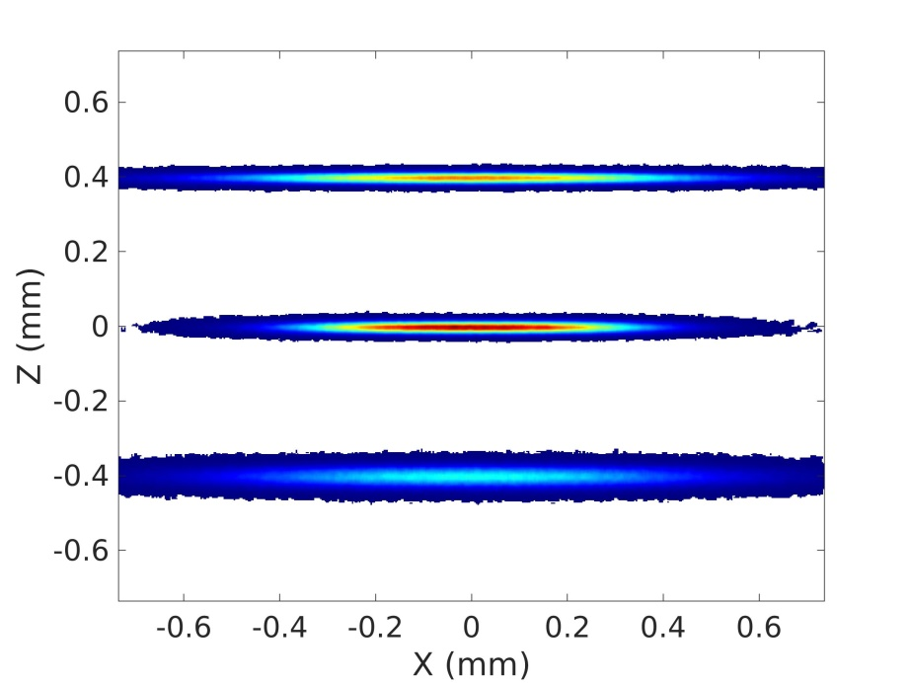
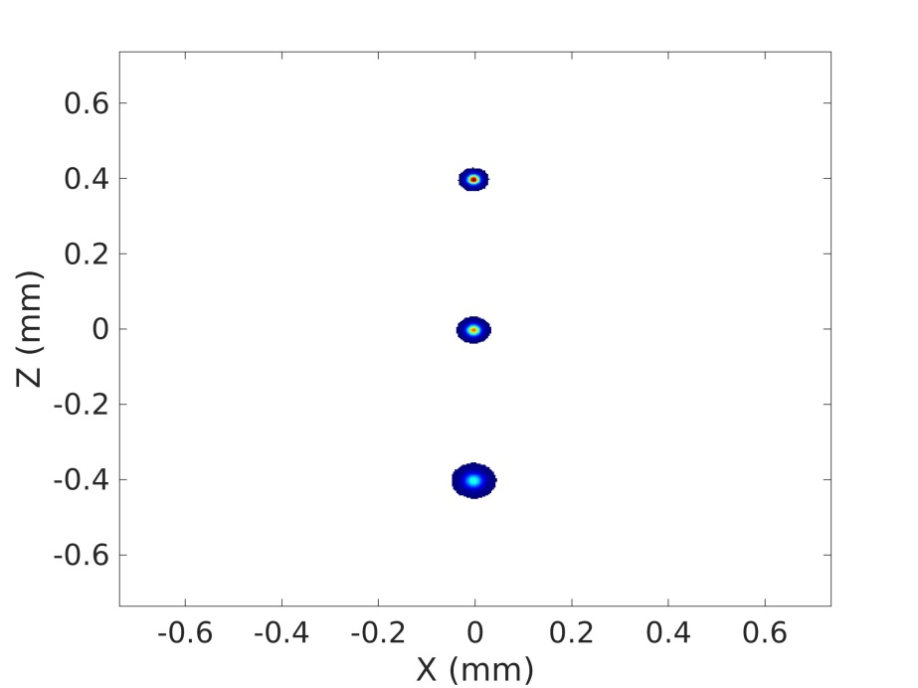
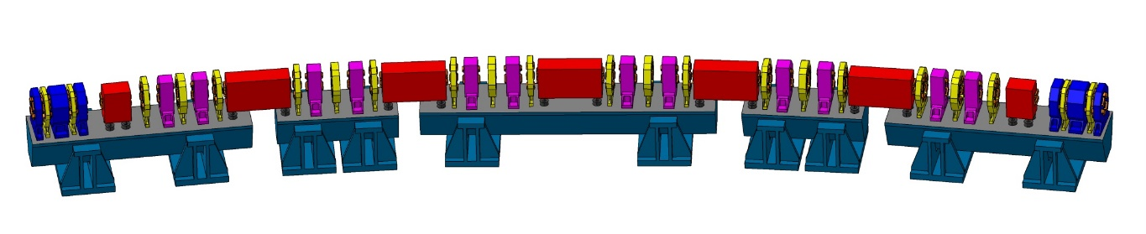
In the near future
SOLEIL II : an upgrade of the accelerators, the beamlines and their environment
SOLEIL
SOLEIL II
< 10 μm x 10 μm
Size of the electron beam
Modification of the storage ring
SOLEIL II

Slide 14
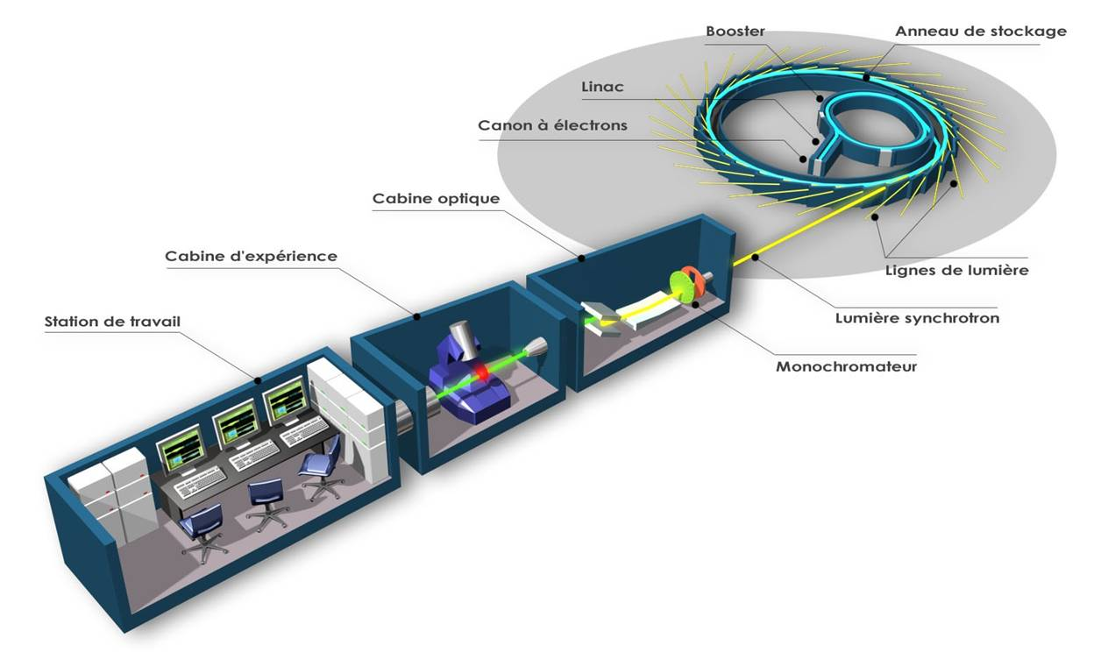
Beamline organisation
Booster
Storage ring
LINAC
Electron gun
Optical hutch
Experimental Hutch
Beamlines
Life station
Synchrotron radiation
Monochromator

Slide 15
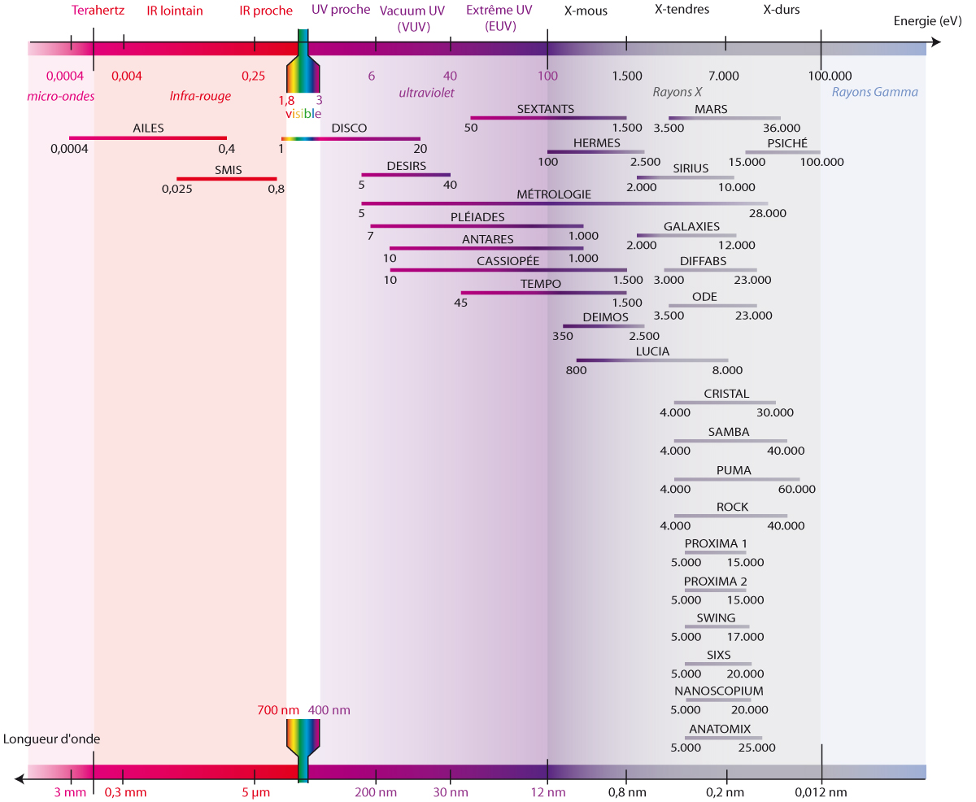
The beamlines at SOLEIL

Slide 16
The beamlines at SOLEIL compared to the ESRF

Slide 17
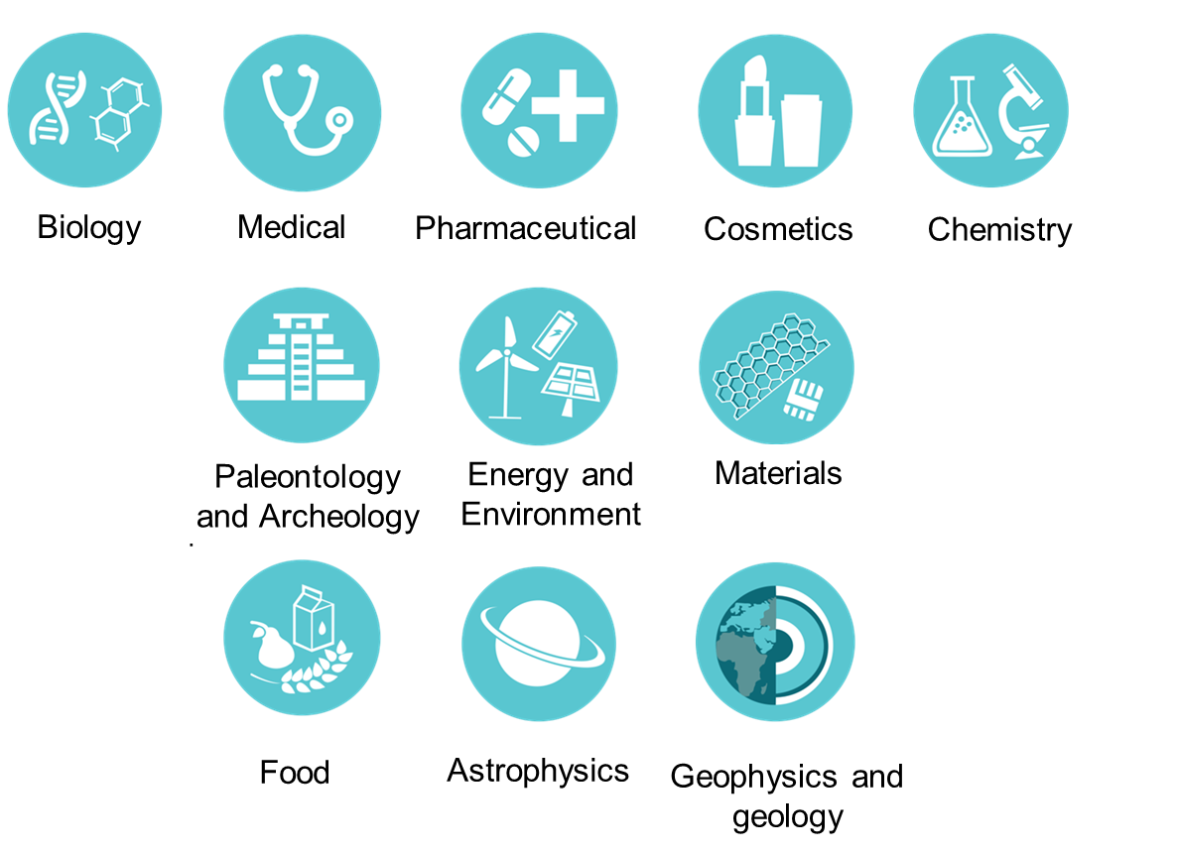
SOLEIL, a multidisciplinary light source

Slide 18

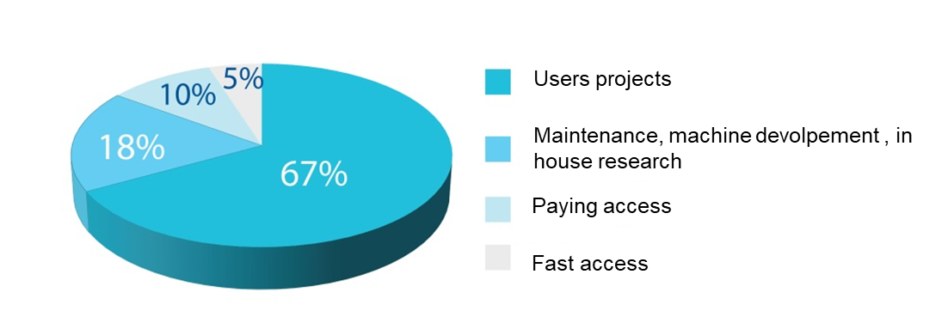
Who comes at SOLEIL ?
Free access : researchers
67% of beamtime
Conditions : publication of results and mention of SOLEIL in publications
Two call for projects per year
Submission of a project
Peer review by an external expert committee (about 58% acceptance rate)
Scheduling of the beamtime
Experiments between 4 to 6 days
About 6 month to 1 year wait
Paying access : industrials
About 5000 euros
10% of beamtime
Conditions : paying beamtime, confidentiality of results

Slide 19



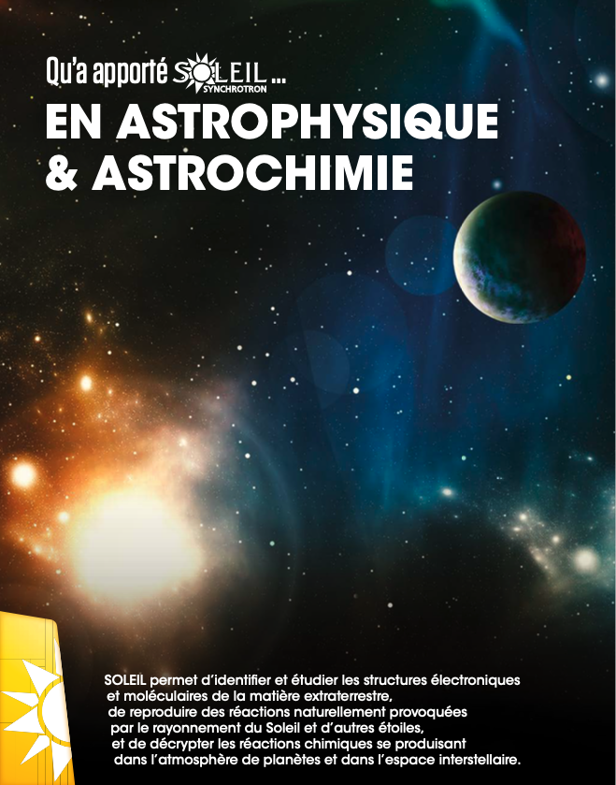

Impact of SOLEIL in different fields
To be continued …

Slide 20
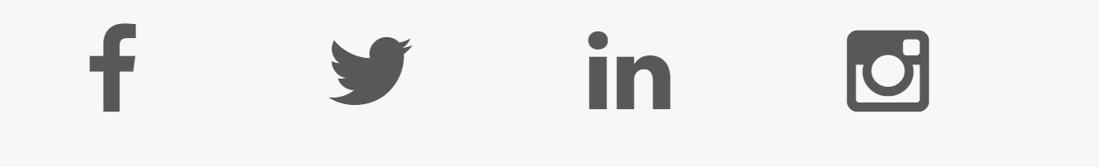
Follow us ☺
@synchroSOLEIL

Slide 21
For the tour
Visits are prohibited for people with electronic equipment that have an impact on their health (pacemaker, insulin pump, neurostimulator for epileptic seizures, etc.), due to the presence of powerful magnets. Note that cochlear implants are authorized, even if the magnetic fields can cause crackling sounds without consequence.
You can take pictures and videos ☺
Please stay with your guide, you are not allowed to be on your own in the synchrotron
If you are not feeling well, tell your guide and we will take care of you !
Be careful of your surroundings (emergency stop buttons, equipment, etc..)

Slide 22
Thank you !

