Slide 1
Tango HDB++
a high performance archiver

Slide 2
HDB++ Overview

Slide 3
HDB++ Archivers & Configurators

Slide 4
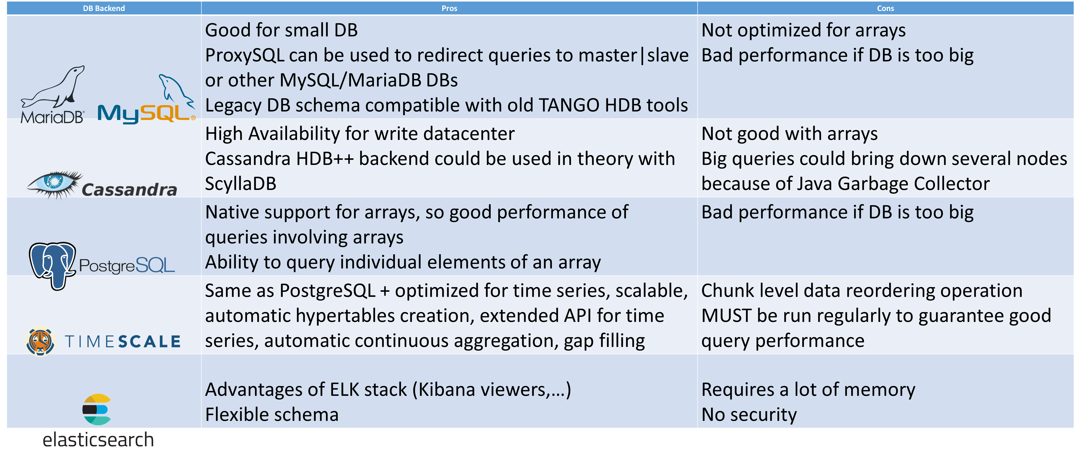
HDB++ Backends comparison

Slide 5
Demo

Slide 6
HDB++ Metrics
https://github.com/tango-controls-hdbpp/HdbppMetrics

Slide 7
HDB++ Collaboration
HDB++ meeting @ ESRF 18th-20th September 2019
https://github.com/tango-controls-hdbpp/meeting-minutes/blob/master/2019-09/Minutes.md

Slide 8
Thank you!
https://github.com/tango-controls-hdbpp
https://tango-controls.readthedocs.io/en/latest/tools-and-extensions/archiving/HDB++.html
https://bintray.com/tango-controls

Slide 9
HDB++@ESRF
Notes:
Number of archive events (and archive error events in blue) received by the HDB++ event subscribers around the moment when the beam was killed at the ESRF on 10/12/2018, marking the start of the ESRF long shutdown. One can notice that the number of error events increased a few hours after the beam was killed, when some hardware got powered off.

Slide 10
HDB++@ESRF
Notes:
Decision has been taken to move away from Cassandra in favour of Timescale DB

Slide 11
Why moving away from Cassandra?

Slide 12
Why moving away from Cassandra?
Max recommended node density for smooth operation:
3-5 TB per node using SSD
1-2 TB per node using spinning disks
Garbage collector => not well suited for large queries which can bring down a datacenter (High availability was one of the main Cassandra strong points) – We didn’t try with G1GC
Difficulties to tune the partition size in a transparent manner for the applications
Notes:
This is the max recommended node density. In some use case, it could be fine to go above, according to some Cassandra experts.
Sadly, it’s not clear what are these use cases

Slide 13
Why moving away from Cassandra?
Difficult to delete data and free disk space
Performance for queries with arrays
Performance for queries with arrays on specific array index
Manpower required to maintain the cluster, especially if it is decided to keep all the data and expand the cluster (⬄ more Cassandra nodes to maintain)

Slide 14
Why moving away from Cassandra?
Still on time to choose an alternative for EBS (New ESRF accelerator)
Monitoring and maintain a big cluster is a full time job and if not done well can lead to difficult situations difficult to recover
You need to be able to cope with the cluster growth

Slide 15
Is Cassandra a bad choice for HDB++?
Very reliable for writing data without downtime, even when upgrading Cassandra version
It depends on the use case and on the manpower (and skills) available
Still some areas of potential improvements for the HDB++ Cassandra backend
Find a way to maintain reasonable partitions size
<=> key to get a cluster running smoothly and with fast maintenance operations
Notes:
At the ESRF, some partition sizes where too big, slowing down some queries and some maintenance operations (like when adding nodes for instance)

Slide 16
Is Cassandra a bad choice for HDB++?
ScyllaDB (Cassandra compatible C++ version) might be a good alternative too?
Explore ways to limit/forbid/throttle big queries from users

Slide 17
If you use Cassandra
Use Cassandra-reaper if you have more than 3 nodes to automate repair process
Use at least 2 data centers to minimize the impact of users big queries on the archiving of the data

