Slide 1
TANGO CONTROLS concepts
A brief introduction to the Tango Controls Concepts
by
Andy Götz (vocals) +
Reynald Bourtembourg (keyboards)
1
Tango Controls Concepts – 5 October Tango Workshop @ ICALEPCS 2019

Slide 2
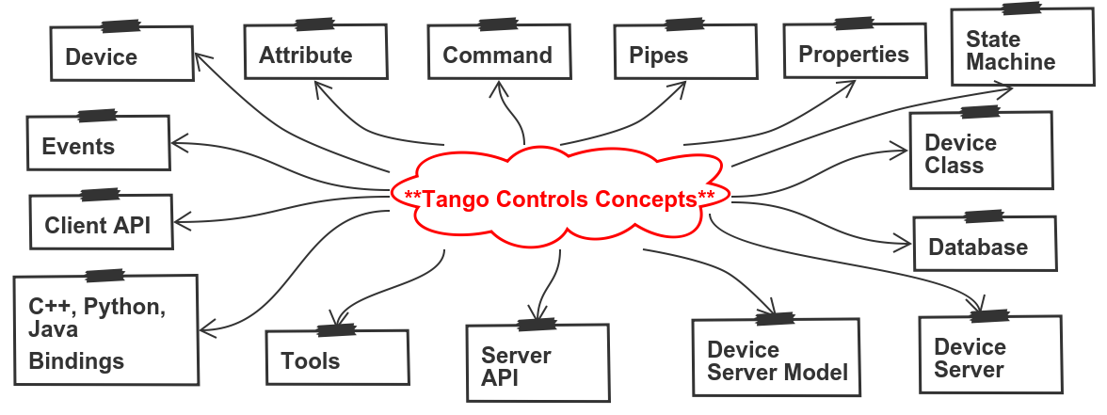
Tango basic concepts
2
Tango Controls Concepts – 5 October Tango Workshop @ ICALEPCS 2019

Slide 3
Tango = actors + microservices
Tango is based on the concept of Distributed Devices
This is an implementation of the Actor Model
Device servers implement Microservices
Tango = Actors + Microservices
Actors + Microservices are in fashion today
TANGO is based on MODERN concepts !
Tango Controls Concepts – 5 October Tango Workshop @ ICALEPCS 2019

Slide 4
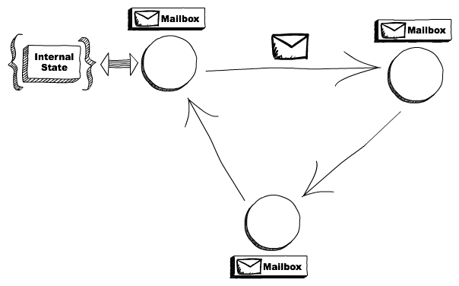
Actor model
http://www.brianstorti.com/the-actor-model/
The actor model in computer science is a mathematical model of concurrent computation that treats "actors" as the universal primitives of concurrent computation. In response to a message that it receives, an actor can: make local decisions, create more actors, send more messages, and determine how to respond to the next message received. Actors may modify private state, but can only affect each other through messages (avoiding the need for any locks). Proposed in 1973 by Carl Hewitt and others
https://en.wikipedia.org/wiki/Actor_model
Tango Controls Concepts – 5 October Tango Workshop @ ICALEPCS 2019

Slide 5
Distributed objects
When I wrote Patterns of Enterprise Application Architecture, I coined what I called the First Law of Distributed Object Design: "don't distribute your objects". In recent months there's been a lot of interest in microservices, which has led a few people to ask whether microservices are in contravention to this law, and if so why I am in favor of them?
Martin Fowler
https://martinfowler.com/articles/distributed-objects-microservices.html
Tango Controls Concepts – 5 October Tango Workshop @ ICALEPCS 2019

Slide 6
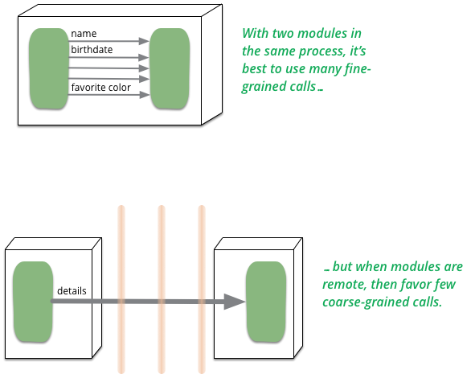
Distributed objects
Tango implements Microservices not Distributed Objects !
Tango Controls Concepts – 5 October Tango Workshop @ ICALEPCS 2019

Slide 7
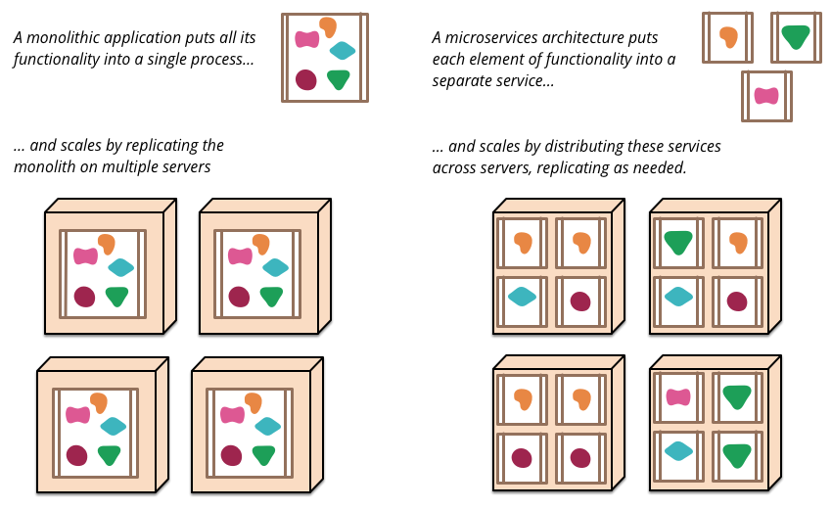
Microservices
https://martinfowler.com/articles/microservices.html
Tango Controls Concepts – 5 October Tango Workshop @ ICALEPCS 2019

Slide 8
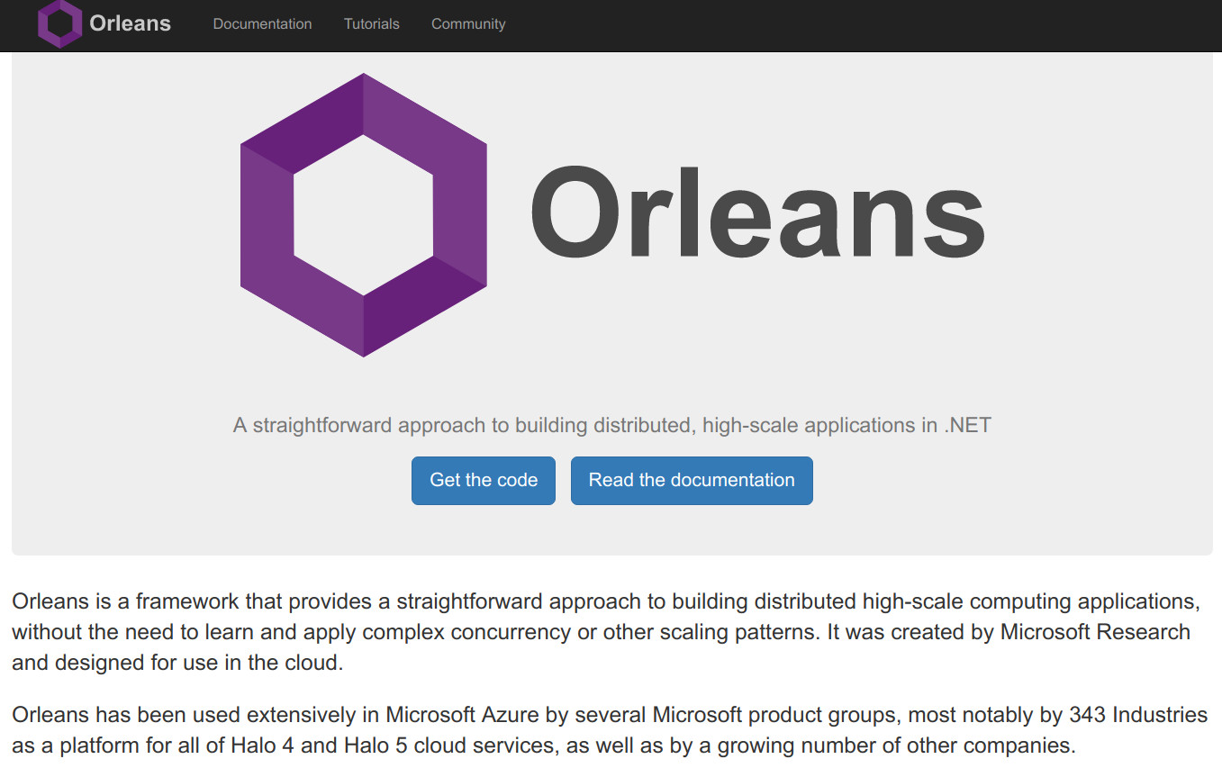
Microservices by Microsoft
Tango Controls Concepts – 5 October Tango Workshop @ ICALEPCS 2019

Slide 9
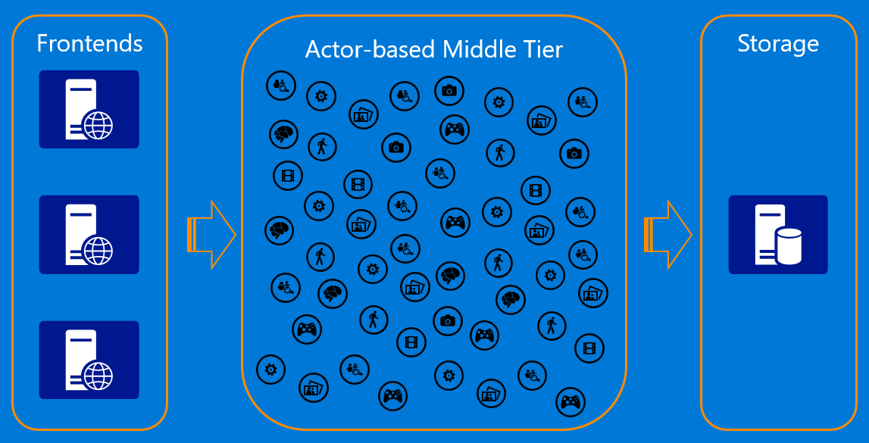
Microservices by Microsoft
Tango Controls Concepts – 5 October Tango Workshop @ ICALEPCS 2019

Slide 10
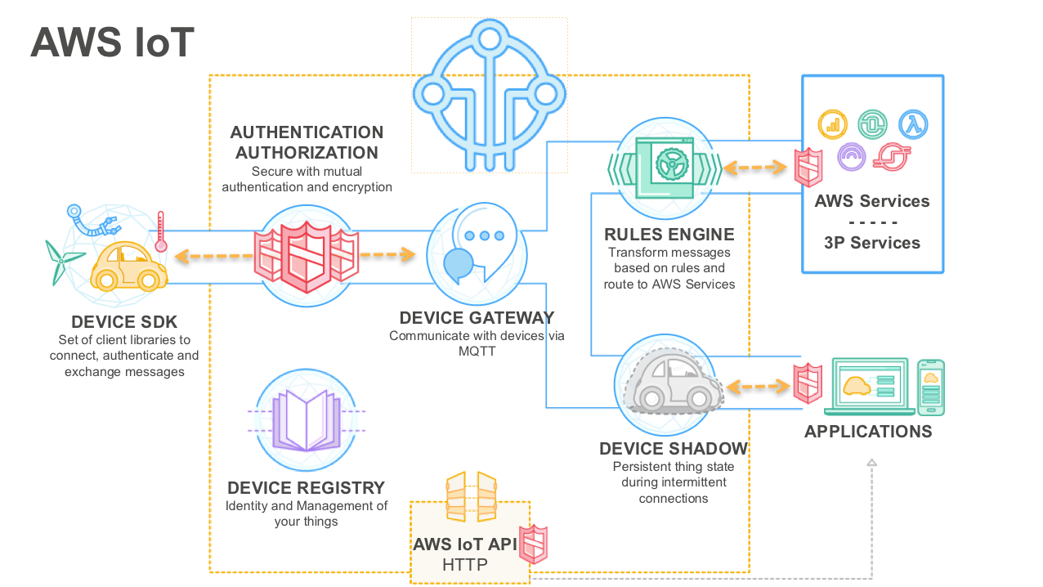
Microservices by AWS (but no Agents)
Tango Controls Concepts – 5 October Tango Workshop @ ICALEPCS 2019

Slide 11
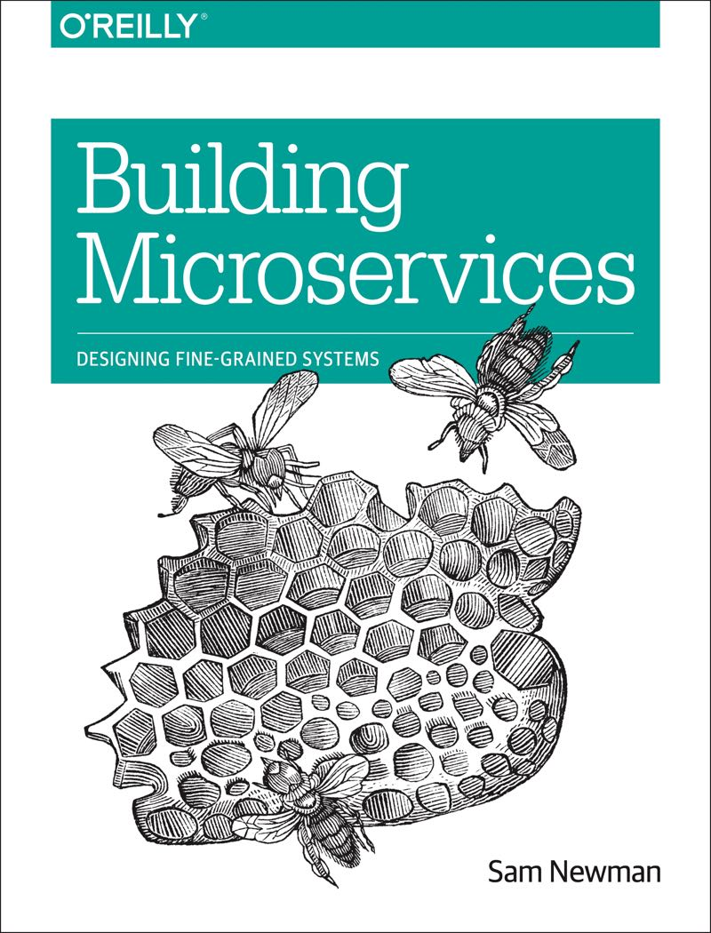
Building Microservices
Sam Newman’s book reads as if it was describing Tango Controls systems !
Tango Controls Concepts – 5 October Tango Workshop @ ICALEPCS 2019

Slide 12
Tango Turing test
12
Tango Controls Concepts – 5 October Tango Workshop @ ICALEPCS 2019

Slide 13
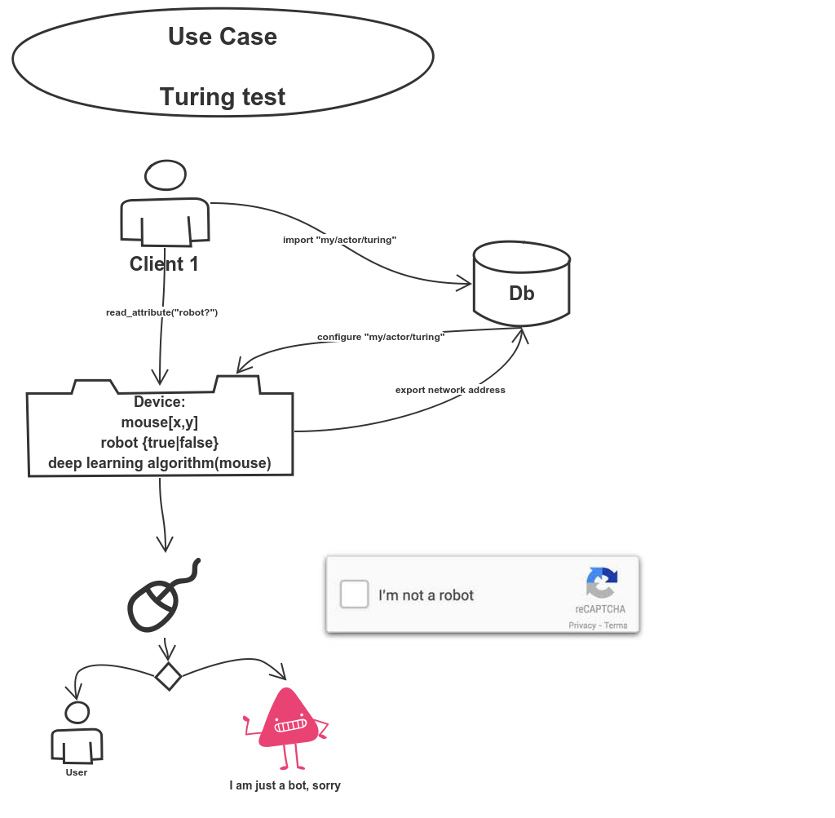
Tango Turing test
13
Tango Controls Concepts – 5 October Tango Workshop @ ICALEPCS 2019

Slide 14
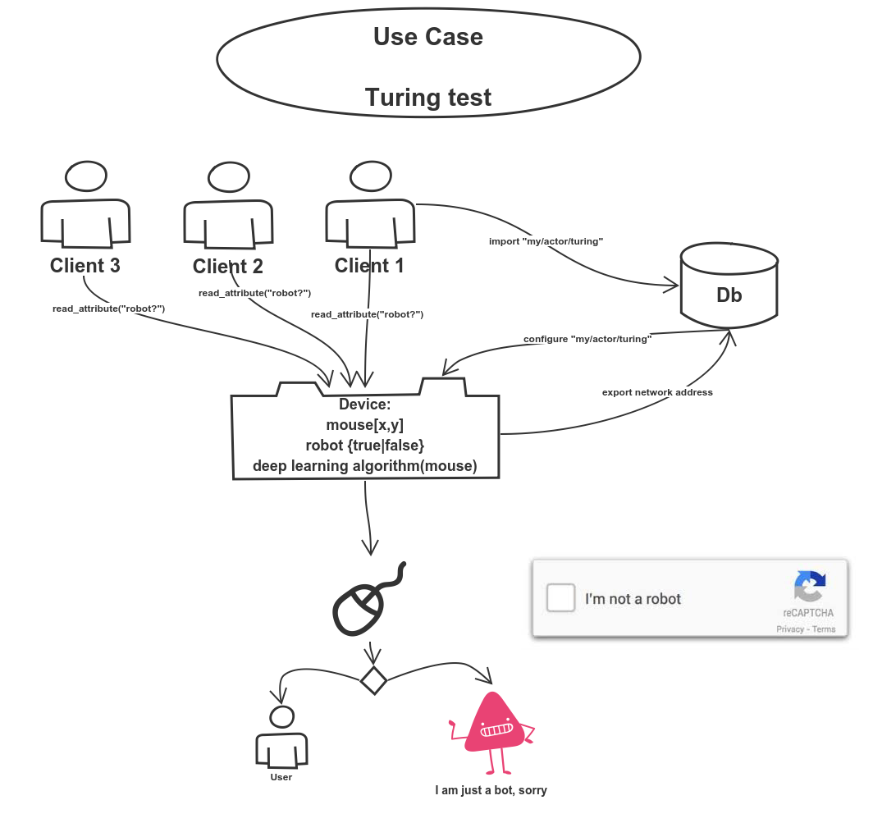
Tango Turing test - MULTIPLE clients
14
Tango Controls Concepts – 5 October Tango Workshop @ ICALEPCS 2019

Slide 15
Device concept #1
15
Tango Controls Concepts – 5 October Tango Workshop @ ICALEPCS 2019

Slide 16
Device concept #1
Tango Devices are the objects which implement the microservices of a Tango System. Devices implement the sensors and actuators. Devices can be any piece of hardware or software.
Examples : Modbus controller, motor, powersupply, camera, data analysis service, ...
Devices belong to a Device Class and are in a Device Server. They are stateful i.e. have State. Accessed via a common API. Have a unique 3 field name (D/F/M)
Device Classes can be implemented in Python, C++ or Java
Devices can be built on top of other Devices
16
Tango Controls Concepts – 5 October Tango Workshop @ ICALEPCS 2019

Slide 17
Device thought experiment
How would you decompose your system into Devices?
What naming convention to use?
How many hierarchies of Devices? Is there a limit?
What are the equivalent of Devices in other systems e.g. EPICS, Spring Boot, your system ?
How would you run a control system in the cloud?
QUESTIONS?
17
Tango Controls Concepts – 5 October Tango Workshop @ ICALEPCS 2019

Slide 18
Attribute concept #2
18
Tango Controls Concepts – 5 October Tango Workshop @ ICALEPCS 2019

Slide 19
Attribute concept #2
Tango Attributes represents the data fields a Device wants clients to Read or Write or receive Events.
Examples : modbus register, interlock bit, read/set value, spectrum, image, …
Attributes can be scalar, spectrum (1D) or images (2D) and are self describing (units, min, max, alarms, display,...)
All Device data should be provided as attributes (well almost all!). Attributes can be read one by one or many. Device developers have hooks for optimising attributes. Attributes read/write check the State Machine.
19
Tango Controls Concepts – 5 October Tango Workshop @ ICALEPCS 2019

Slide 20
Attribute thought experiment
What Attributes would you implement? Number? Size?
What are the limitations of attributes?
How would you name your Attributes?
Would it be useful to have serverless Attributes?
QUESTIONS?
20
Tango Controls Concepts – 5 October Tango Workshop @ ICALEPCS 2019

Slide 21
Command concept #3
21
Tango Controls Concepts – 5 October Tango Workshop @ ICALEPCS 2019

Slide 22
Command concept #3
Tango Commands are the actions of a Device the clients needs to execute. Commands can change the State of a Device (Attributes don’t)
Examples : On, Off, Calibrate, Move, ...
Commands take one input and one output parameter. Parameters can be of any of the 20+ Tango data types.
Commands always check the State Machine before and after execution (Attributes only before).
22
Tango Controls Concepts – 5 October Tango Workshop @ ICALEPCS 2019

Slide 23
Command thought experiment
What Commands would you implement? Are you sure your command should not be an attribute (get/set)?
Are there any Tango Data Types missing for your case?
QUESTIONS?
23
Tango Controls Concepts – 5 October Tango Workshop @ ICALEPCS 2019

Slide 24
Pipe concept #4
24
Tango Controls Concepts – 5 October Tango Workshop @ ICALEPCS 2019

Slide 25
Pipe concept #4
Tango Pipes are data streams or channels for exchanging a stream of any Tango data type. Data types can be sent individually or grouped together in a Blob.
Examples : scanning data stream of mixed data types
Also used to circumvent the fixed data type set of Tango by sending mixed data types or a JSON blob.
DO NOT only use Pipes (except in special cases)! Pipes were added to Tango in V9.x
DO use Attributes!
25
Tango Controls Concepts – 5 October Tango Workshop @ ICALEPCS 2019

Slide 26
Pipe thought experiment
Where do you need Pipes in your system?
What will you put in your Pipe(s)?
Do you need JSON data types?
Connect Pipes to Kafka?
QUESTIONS?
26
Tango Controls Concepts – 5 October Tango Workshop @ ICALEPCS 2019

Slide 27
Properties concept #5
27
Tango Controls Concepts – 5 October Tango Workshop @ ICALEPCS 2019

Slide 28
Properties concept #5
Tango Properties are data stored in the database and used to configure Devices at startup. Properties can be any Tango Data types. Properties enable Device Classes to be generic. Properties are edited with Jive usually.
Examples : channel address, initial or current settings, sub-device names, ...
Changes to Properties can be persisted in the Database.
DO NOT exit if Properties are wrong!
DO use sensible default Properties!
28
Tango Controls Concepts – 5 October Tango Workshop @ ICALEPCS 2019

Slide 29
Properties thought experiment
What Properties will you implement for your Devices?
Properties can be for Device Classes, Devices, free.
Complex properties are not easy to edit with Jive
QUESTIONS?
29
Tango Controls Concepts – 5 October Tango Workshop @ ICALEPCS 2019

Slide 30
State machine concept #6
30
Tango Controls Concepts – 5 October Tango Workshop @ ICALEPCS 2019

Slide 31
State machine concept #6
All Tango Devices have State. Tango States are limited to 14 discrete values. Each Tango Device Class State Machine implements the state transitions.
ON, OFF, CLOSE, OPEN, INSERT, EXTRACT, MOVING, STANDBY, FAULT, INIT, RUNNING, ALARM, DISABLE, and UNKNOWN
State is a very powerful mechanism for protecting Devices and for communicating changes to clients or servers.
DO NOT ignore State !
DO set a default State!
31
Tango Controls Concepts – 5 October Tango Workshop @ ICALEPCS 2019

Slide 32
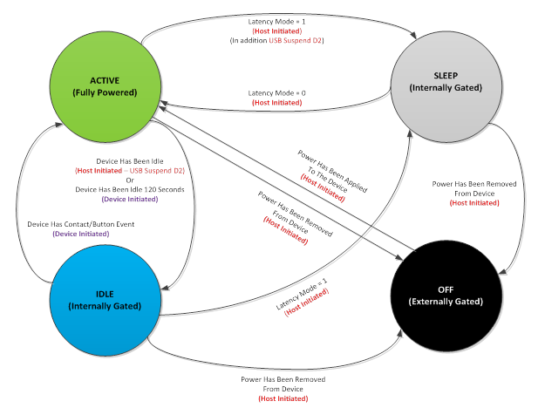
State machine thought experiment
How will you map your States to Tango States?
Do you really need more States or can they be implemented as attributes of enum type?
QUESTIONS?
32
Tango Controls Concepts – 5 October Tango Workshop @ ICALEPCS 2019

Slide 33
Device class concept #7
33
Tango Controls Concepts – 5 October Tango Workshop @ ICALEPCS 2019

Slide 34
Device class concept #7
All Tango Devices are implement by a Device Class. The Device Class implements a generic Device behaviour. Properties are used to configure the specific Device
Examples : PowerSupply, SerialLine, Polly
Device Server developers are in fact developing Device Classes
C++ developers have an extra class to develop – the so-called DeviceClassClass e.g. MyPowerSupplyClass. This is uses one of the Gang of Four patterns. Python and Java have only the DeviceClass.
34
Tango Controls Concepts – 5 October Tango Workshop @ ICALEPCS 2019

Slide 35
Device class thought experiments
How many Tango Device Classes do you need?
Share your classes on GitHub / GitLab!
To POGO or not to POGO that is the question?
Find classes in the Device classes catalogue
There is not too much sharing of classes – too easy to write your own?
How to package Device classes – Debian, Docker, Conda, …
QUESTIONS?
35
Tango Controls Concepts – 5 October Tango Workshop @ ICALEPCS 2019

Slide 36
Events concept #8
36
Tango Controls Concepts – 5 October Tango Workshop @ ICALEPCS 2019

Slide 37
Events concept #8
Tango Events are a Pub-Sub communication between clients and servers. Events are only supported for Attributes and Pipes. Multiple Event types are supported – Change, Periodic, Archive, User, ...
Examples : Send Event if Attribute changes by x%
Events use ZeroMQ + are the most efficient way to communicate. Events rely on Polling to be triggered.
Events are configured in the database or code
Tango implements a Polling algorithm to trigger events.
DO NOT only read Attributes, use Events
37
Tango Controls Concepts – 5 October Tango Workshop @ ICALEPCS 2019

Slide 38
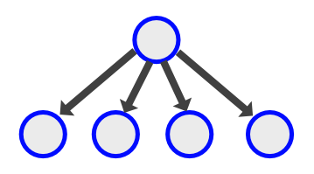
Events thought experiments
Have you understood how Polling triggers Events?
Multiple polling threading models – per Device, Poll single or multiple attributes
Understand standard Events vs. User Events.
Documentation describes multicast Events. No-one is using multicast!
Events performance scale per device server and inversely per client (see paper by Michal + Piotr)
QUESTIONS ?
38
Tango Controls Concepts – 5 October Tango Workshop @ ICALEPCS 2019

Slide 39
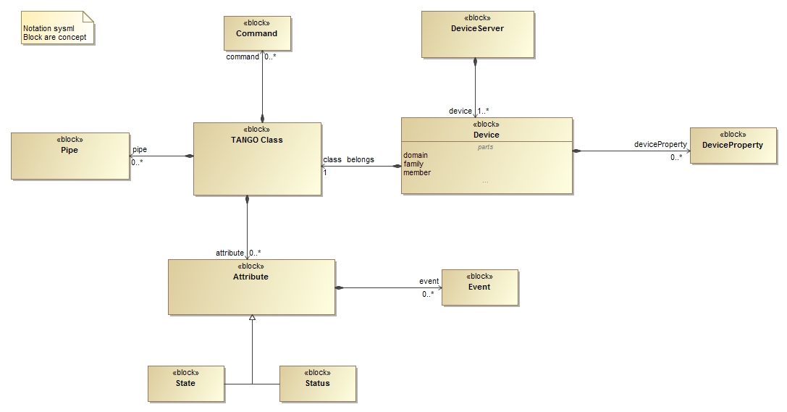
Tango simple Device Model (concepts #1 to #8)
39
Tango Controls Concepts – 5 October Tango Workshop @ ICALEPCS 2019

Slide 40
Database concept #9
40
Tango Controls Concepts – 5 October Tango Workshop @ ICALEPCS 2019

Slide 41
Database concept #9
Tango Database implements the Configuration and Naming Service for Tango. It can also persists settings values.
Examples : configuration properties, export/import
Tango Database is implemented as a Device Server. Clients use the Tango Client API and Data Types to access the Database. Only MySQL is supported. A (non-official) version exists for SQLite + yaml.
Database is only fixed address TANGO_HOST=host:port or /etc/tango.rc environment variable.
Multiple Databases supported.
41
Tango Controls Concepts – 5 October Tango Workshop @ ICALEPCS 2019

Slide 42
Database thought experiment
Have you understood how multiple Database support systems of systems?
Is the Database a Single Point of Failure? Multiple schemes to reduce the single point of failure (see Tango RTD)
Who needs in a non-MySQL version of the Database?
QUESTIONS?
42
Tango Controls Concepts – 5 October Tango Workshop @ ICALEPCS 2019

Slide 43
Device server concept #10
43
Tango Controls Concepts – 5 October Tango Workshop @ ICALEPCS 2019

Slide 44
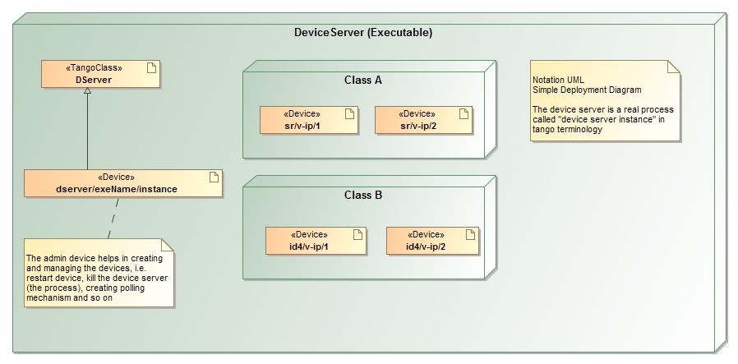
Tango runtime Device Model
44
Tango Controls Concepts – 5 October Tango Workshop @ ICALEPCS 2019

Slide 45
Device Server thought experiment
Important to understand difference between Device vs. Device Server vs. Device Server Instance Name vs. Device Server process?
Probably the most difficult concept but which gives Tango its flexibility to adapt to large numbers of Devices
Is this similar to an IOC ?
QUESTIONS?
45
Tango Controls Concepts – 5 October Tango Workshop @ ICALEPCS 2019

Slide 46
Device server model concept #11
46
Tango Controls Concepts – 5 October Tango Workshop @ ICALEPCS 2019

Slide 47
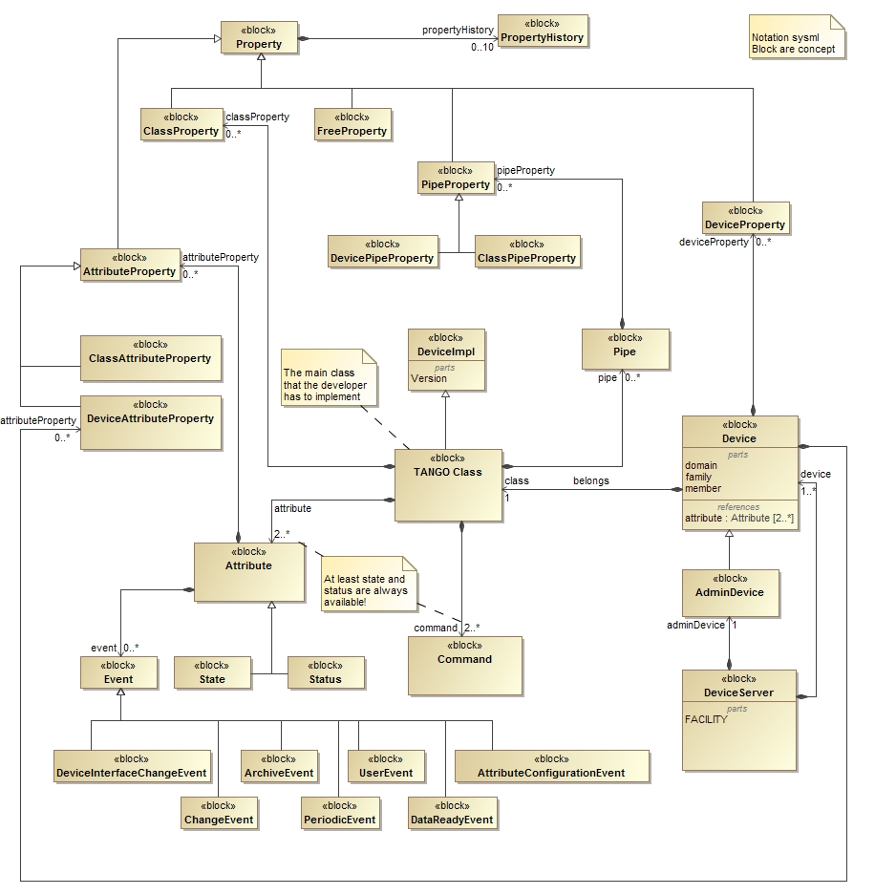
Tango full Device Model
47
Tango Controls Concepts – 5 October Tango Workshop @ ICALEPCS 2019

Slide 48
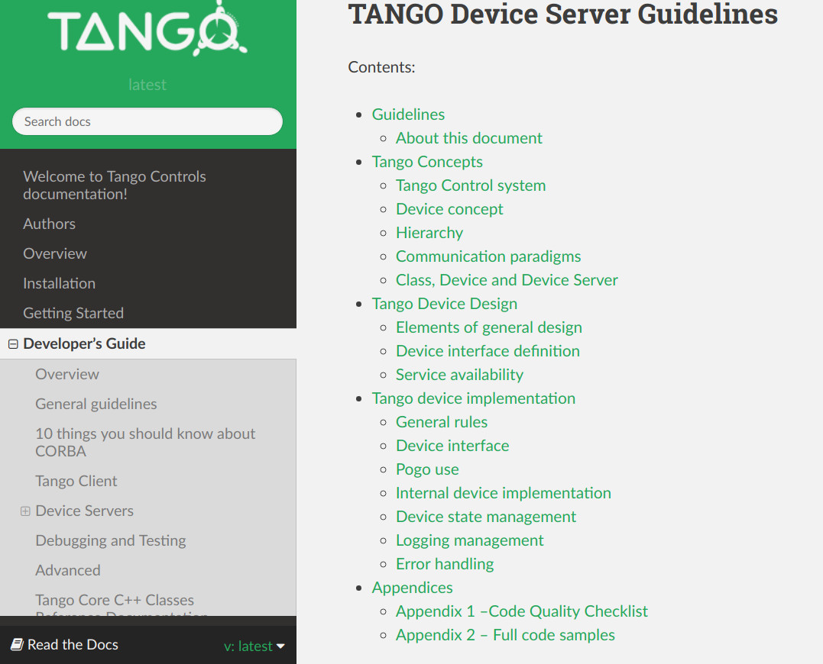
Tango Device Server developers guidelines
48
Tango Controls Concepts – 7 October Tango Workshop @ ICALEPCS 2017

Slide 49
Server + Client api concept #12
49
Tango Controls Concepts – 5 October Tango Workshop @ ICALEPCS 2019

Slide 50
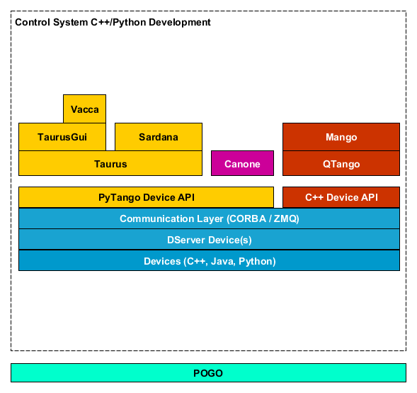
Tango Developers map
50
Tango Controls Concepts – 5 October Tango Workshop @ ICALEPCS 2019

Slide 51
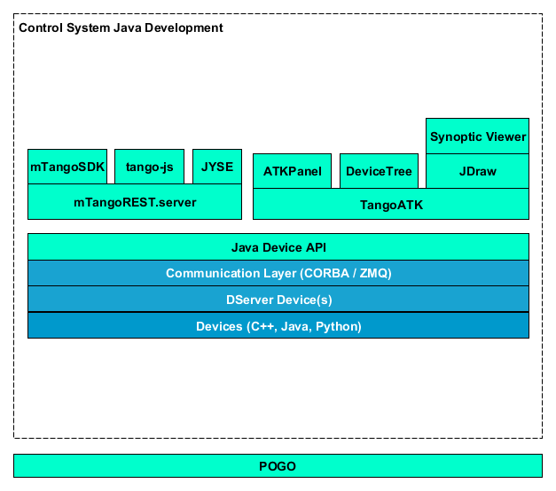
Tango Developers map
51
Tango Controls Concepts – 5 October Tango Workshop @ ICALEPCS 2019

Slide 52
Tools concept #13
52
Tango Controls Concepts – 5 October Tango Workshop @ ICALEPCS 2019

Slide 53
Tools concept #13
Many tools exist for Tango to configure + test Devices
Configuration tool = Jive (alternatives are dsconfig, Waltz, WebJive)
Start/stop control system = Astor (alternatives system 5, Supervisord)
Test + monitor Device tool = ATKPanel (alternatives are PyTango, Taurus, Waltz, WebJive, Jyse, …)
Archiver - HDB++ (alternatives are HDB)
View logs – Logviewer (alternatives Elasticsearch)
53
Tango Controls Concepts – 5 October Tango Workshop @ ICALEPCS 2019

Slide 54
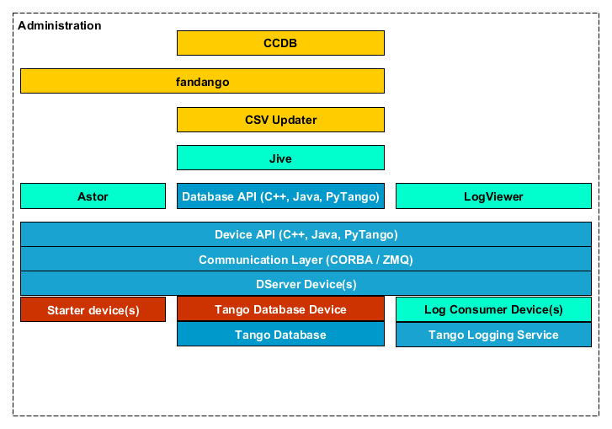
Tango Tools map
54
Tango Controls Concepts – 5 October Tango Workshop @ ICALEPCS 2019

Slide 55
Bindings concept #14
55
Tango Controls Concepts – 5 October Tango Workshop @ ICALEPCS 2019

Slide 56
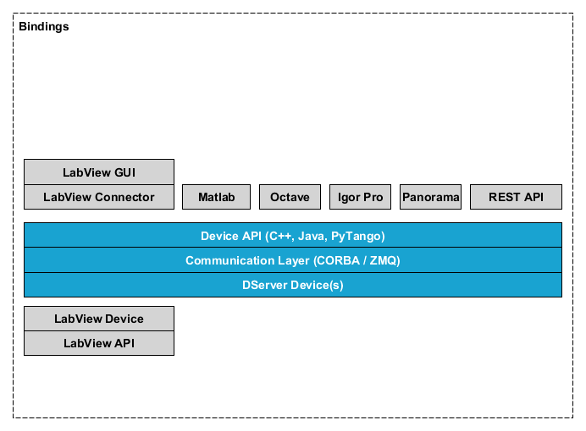
Tango Bindings map
56
Tango Controls Concepts – 5 October Tango Workshop @ ICALEPCS 2019

Slide 57
Bindings concept #14
Many language bindings exist – main ones are C++, Python and Java
C++ is core implementation language, support C++11 (with some arcane CORBA memory management specifics)
Python binding builds on C++ using Boost Python (new implementation with PyBind11 in progress). “Low-level” and “High-level” versions exist. HL-API is more Pythonic
Java implementation based on Jacorb. Currently supports Java 8 but will work with Java 11 (13?) with extra CORBA libraries.
Bindings for Labview, Matlab, Octave, Igorpro available.
57
Tango Controls Concepts – 5 October Tango Workshop @ ICALEPCS 2019

Slide 58
Bindings thought experiment
PyTango is the most used language binding by newcomers to Tango. The High Level API has made it extremely simple to use. Python can be used from Jupyter notebooks + web easily.
Which language do you plan to use?
QUESTIONS?
I should TRY PyTango !
58
Tango Controls Concepts – 5 October Tango Workshop @ ICALEPCS 2019

Slide 59
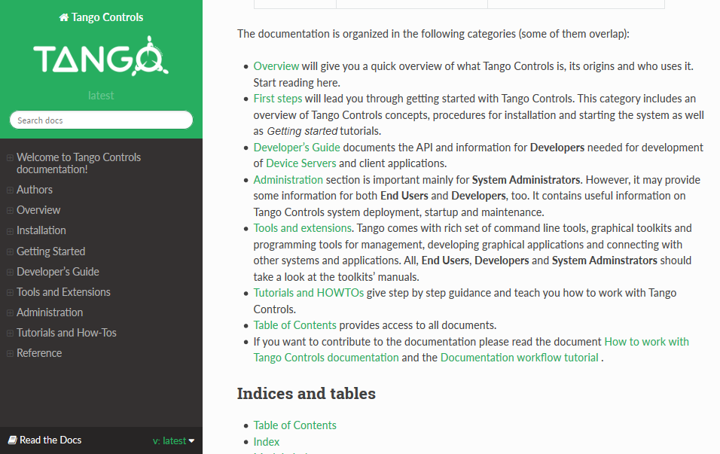
Read the Documentation !
https://tango-controls.readthedocs.io/
59
Tango Controls Concepts – 5 October Tango Workshop @ ICALEPCS 2019

Slide 60
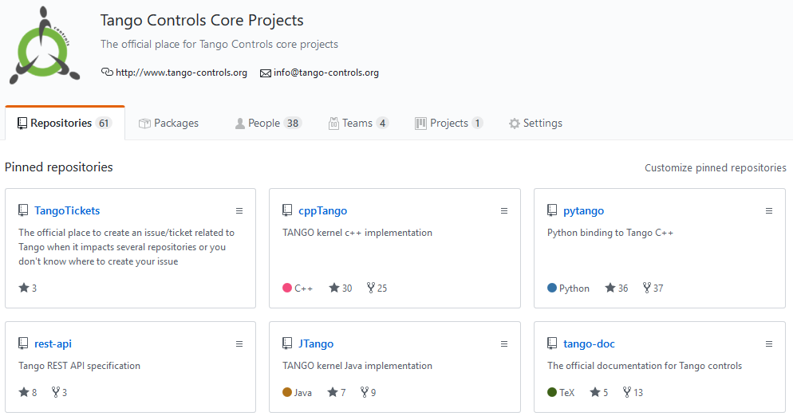
GitHub – Tango Controls organisation
https://github.com/tango-controls
60
Tango Controls Concepts – 5 October Tango Workshop @ ICALEPCS 2019

Slide 61
Discussion
QUESTIONS
REACTIONS
REQUESTS
61
Tango Controls Concepts – 5 October Tango Workshop @ ICALEPCS 2019

Slide 62
Thank you for your interest !
I think I will try Tango Controls
62
Tango Controls Concepts – 5 October Tango Workshop @ ICALEPCS 2019

