Slide 1
SKA developments on TANGO containers
TANGO meeting
M. Di Carlo, P. Harding, S. Williams, M. Bartolini

Slide 2
ska-docker
Motivation: SKA needed a standardised Tango environment for development, testing, and continuous integration
Result: a set of reference Docker images for Tango v9.3.3
‘Core’ images for C++, Java, and Python development with Tango
Illustrated on next slide..
Based on Debian stable, includes dependencies as specified in 9.3.3 README
Container images are built following best practice
Optimised using intermediate images, aim for single process per container, etc.
More details in a moment...
Project URL: https://github.com/ska-telescope/ska-docker

Slide 3
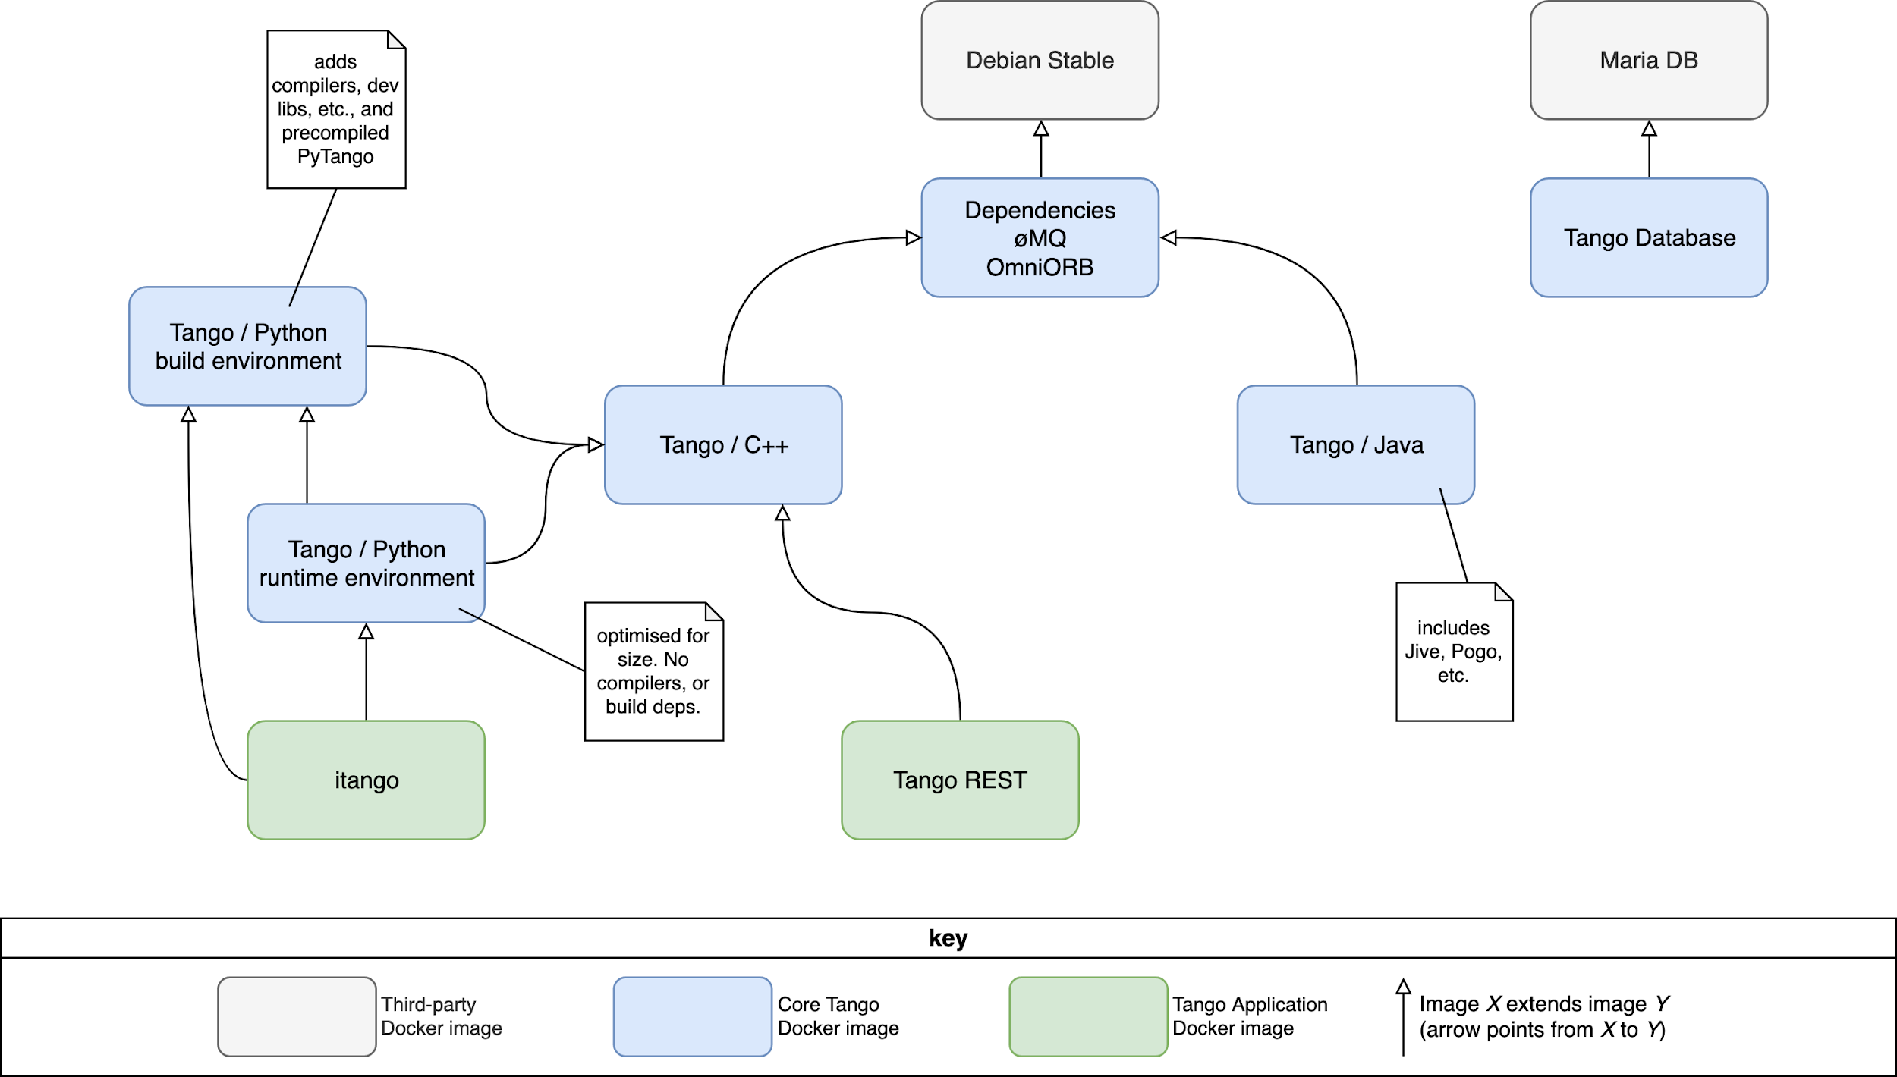

Slide 4
Container standards
Link:
http://developer.skatelescope.org/en/latest/development/containerisation-standards.html
best practices guide for developing containerised applications based on industry standards encompasses:
Structuring applications
Building images
Naming conventions
Running containerised applications
Summarised in a cheatsheet

Slide 5
Creating the images
Preliminaries: OS is updated and dependencies are installed into base image
Preferred øMQ and OmniORB versions not available in Debian stable
øMQ and OmniORB are patched, compiled, and installed into a parent image inherited by all core Tango images
Is this strictly necessary? Is anyone using the default Debian stable libs in production?
Tango is downloaded, compiled, and installed into an intermediate image
Intermediate image can contain compilers, development libs, intermediate output, logs, etc.
Tango binaries are copied into the final runtime image
Optimised for size: runtime image contains only the libs necessary to execute

Slide 6
Docker-compose Orchestration
Every tango project comes with a Docker-composed based orchestration (docker-compose.yml file) that includes
MariaDB service container
DatabaseDs service container
For each device server in the project, one container defined by the developer
Develop and debug TANGO code
Device created with POGO
Two selected IDE: PyCharm and Visual Studio Code
Debug can be done
Remotely (if docker compose creates a separate network)
Locally (if docker compose work in the same network as the host):
Device server does not work in a separate container
No difference with the old way of debugging

Slide 7
Development workflow
Example docker-compose

Slide 8
Kubernetes (K8s) Orchestration
Kubernetes is a portable, extensible, open-source platform for managing containerized workloads and services, that facilitates both declarative configuration and automation.
K8s key concepts:
Namespaces provide a scope for names. Names of resources need to be unique within a namespace, but not across namespaces (for use in environments with many users spread across multiple teams, or projects)
A Pod is the basic execution unit of a Kubernetes application–the smallest and simplest unit in the Kubernetes object model that you create or deploy. A Pod represents processes running on your Cluster.
Service is an abstract way to expose an application running on a set of Pods.
No service discovery mechanism. Kubernetes gives Pods their own IP addresses and a single DNS name for a set of Pods, and can load-balance across them.
Ingress: An API object that manages external access to the services in a cluster, typically HTTP.

Slide 9
K8s Orchestration guidelines
Link: http://developer.skatelescope.org/en/latest/development/orchestration-guidelines.html
Set of standards, conventions and guidelines for deploying application suites on Kubernetes
Encompasses:
What is cloud native
Defining and building cloud native application suites with Helm
Kubernetes primitives and how to use them
Structuring application suites for orchestration
Scheduling on Kubernetes
Based on examples

Slide 10
Integration Environment
Based on Kubernetes (k8s) orchestration and Helm
Helm is a tool for managing Kubernetes charts
Charts are packages of pre-configured Kubernetes resources (bundle of information necessary to create an instance of a Kubernetes application)
They are combined with configuration information to create a releasable object.
Helm charts:
Self contained examples with ska-docker, and tango-example
Workflow captured in Makefile targets
Default deployment aimed at Minikube for ease of local development
Example of configuration information:
the version of the docker image
Pull policy for the orchestration
…
# example of values
tmcprototype:
enabled: true
image:
registry: nexus.engageska-portugal.pt/tango-example
image: tmcprototype
tag: latest
pullPolicy: Always

Slide 11
Helm Charts for the Integration Environment
6 charts for the entire project
Every chart is composed by at least one pod
Containers within a pod are configured with the Dsconfig tool
No need for the starter components
We use also Waltz as second point of ingress of the environment
TANGO-base
(databaseds, mariadb and other optional resources like jive)
WebJive
(tangogql, traefik, inmemory db,… )
TMC
CSP
OET
SDP

Slide 12
Development workflow
Example minikube

Slide 13
Thank you
All questions can be addressed at:
matteo.dicarlo@inaf.it
m.bartolini@skatelescope.org

