Slide 1
Webjive @SKA
Tango Workshop @ ICALEPCS 2019
Saturday, 5 October 2019 - Marriott Hotel, Brooklyn (NYC)
Matteo Canzari
INAF – Osservatorio Astronomico d’Abruzzo

Slide 2
Introduction
The SKA needs a Tango user interface toolset that is available early in construction (2020) that can be issued to development teams to build engineering screens.
Value to the SKA:
Uniformity of user experience
Ease of linking systems developed by multiple consortia
Reduction of up-front development costs
Buttons Team (OSO-UI team) has been formed in order to investigate if there are some suitable solutions for SKA, or for the building a new User Interface Generator

Slide 3
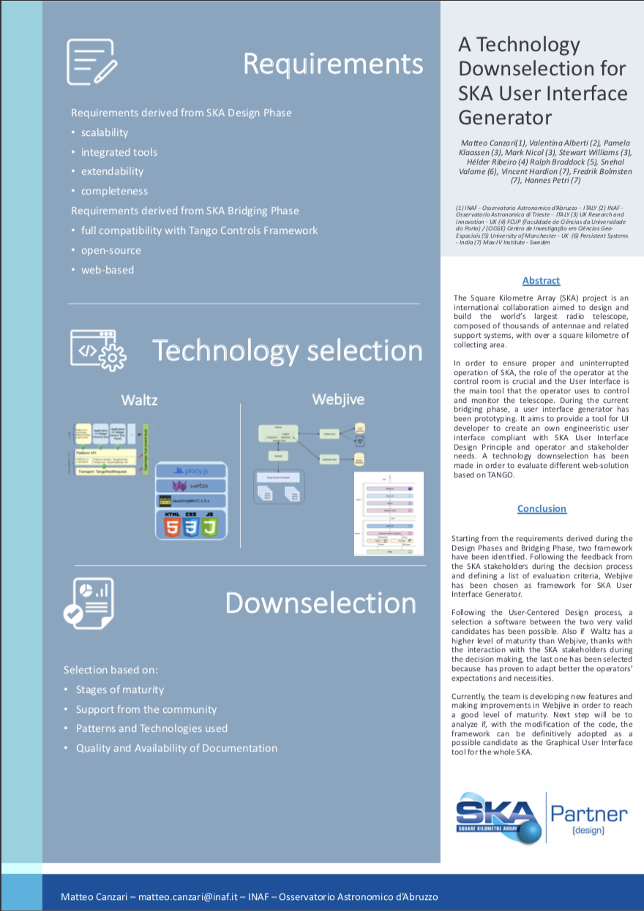
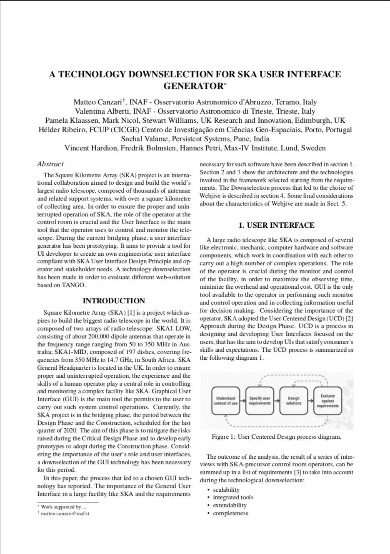
Technologies downselection
During the first period, a selection between Waltz and Webjive has been made
Webjive has been selected as a GUI framework for SKA User Interface Generator
Evaluation based on:
Stages of maturity
Support from community
Patterns and Technologies usedPatterns and Technologies used
Technologies downselection will be presented during mini-oral presentation in the Wednesday afternoon session (WEMPL)

Slide 4
SKA - MaxIV Collaboration
What is this collaboration about?
This is a collaboration between software teams in MaxIV and the Square Kilometer Array (SKA) to jointly work on developing the webjive suite. This is a number of closely related products that can be used to provide a web-based interface to a Tango Control System.

Slide 5
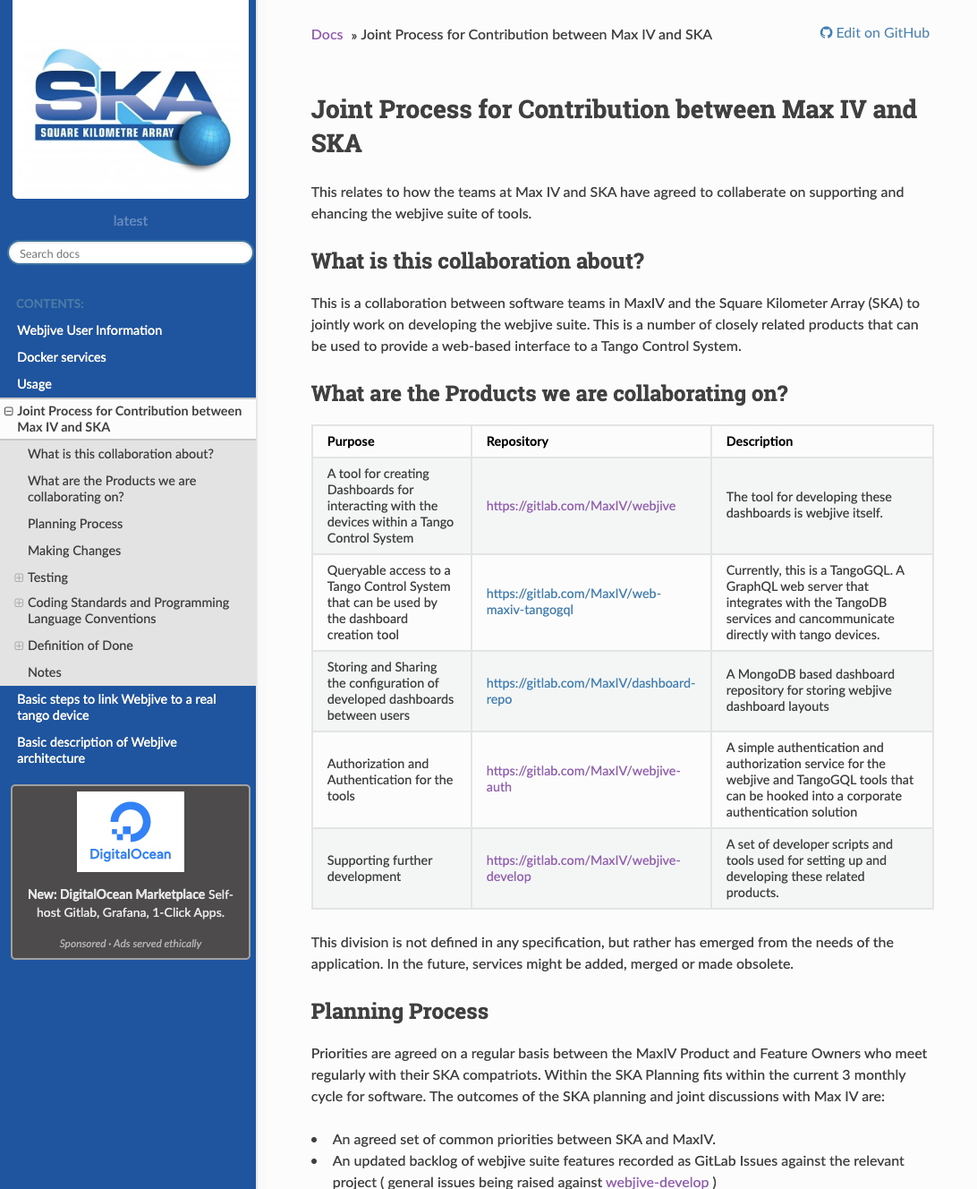
SKA - MaxIV Collaboration
In the collaboration has been defined
Products we are collaborating
Planning Process
Making Changes
Testing (legacy code and new code)
Coding Standards and Programming Language Conventions
Documentation
All information regarding the collaboration are available in the SKA Developer Portal
https://developer.skatelescope.org/projects/ska-engineering-ui-compose-utils/en/latest/contribution.html

Slide 6
Pipeline and tests
Linting
eslint
@typescript-eslint/parser
@typescript-eslint/eslint-plugin
Testing
jest, ts-jest, enzyme
Formatting
Prettier
code coverage
Jest
dependency management
npm
CI/CD
GitLab pipeline (gitlab-ci.yml file)

Slide 7
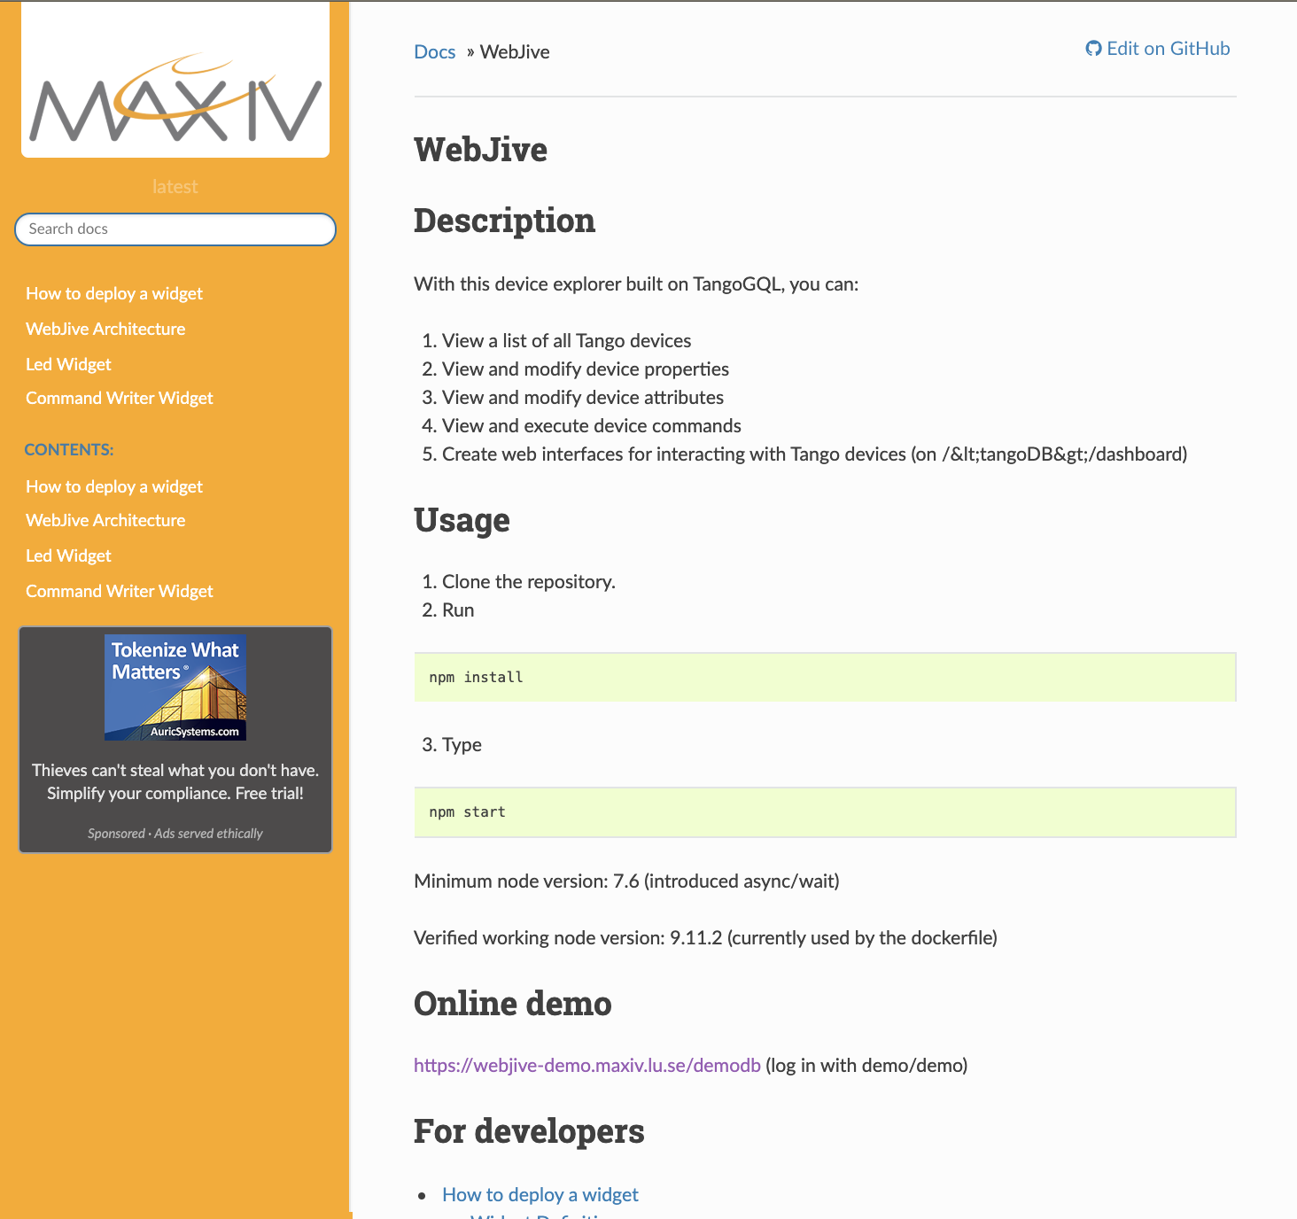
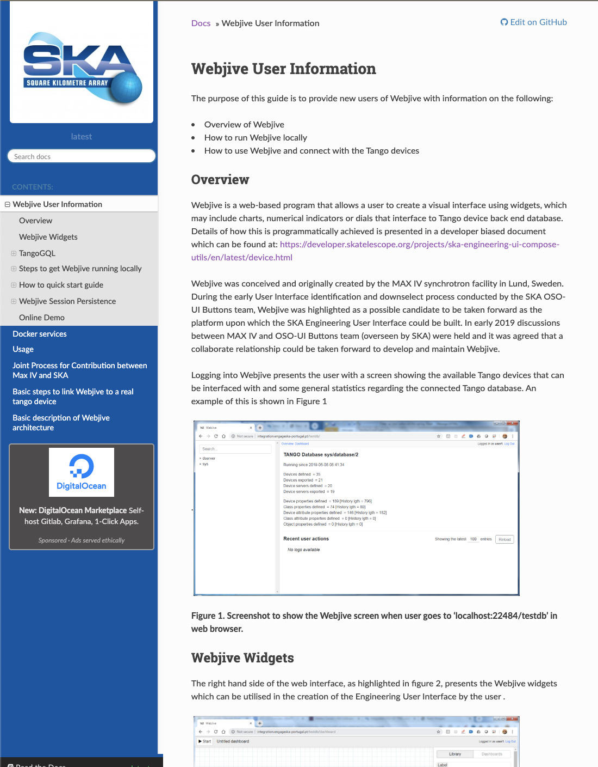
Documentation
Webjive Official Documentation
https://webjive.readthedocs.io/en/latest/
We are collaborating in writing documentation
Official Webjive Documentation
All new features are documented and reported into readthedocs portal
SKA related documentation
All features related to SKA and Webjive are reported into SKA Developer Portal
Webjive Documentation @SKA DEVELOPER PORTAL
https://developer.skatelescope.org/projects/ska-engineering-ui-compose-utils/en/latest/overview.html

Slide 8
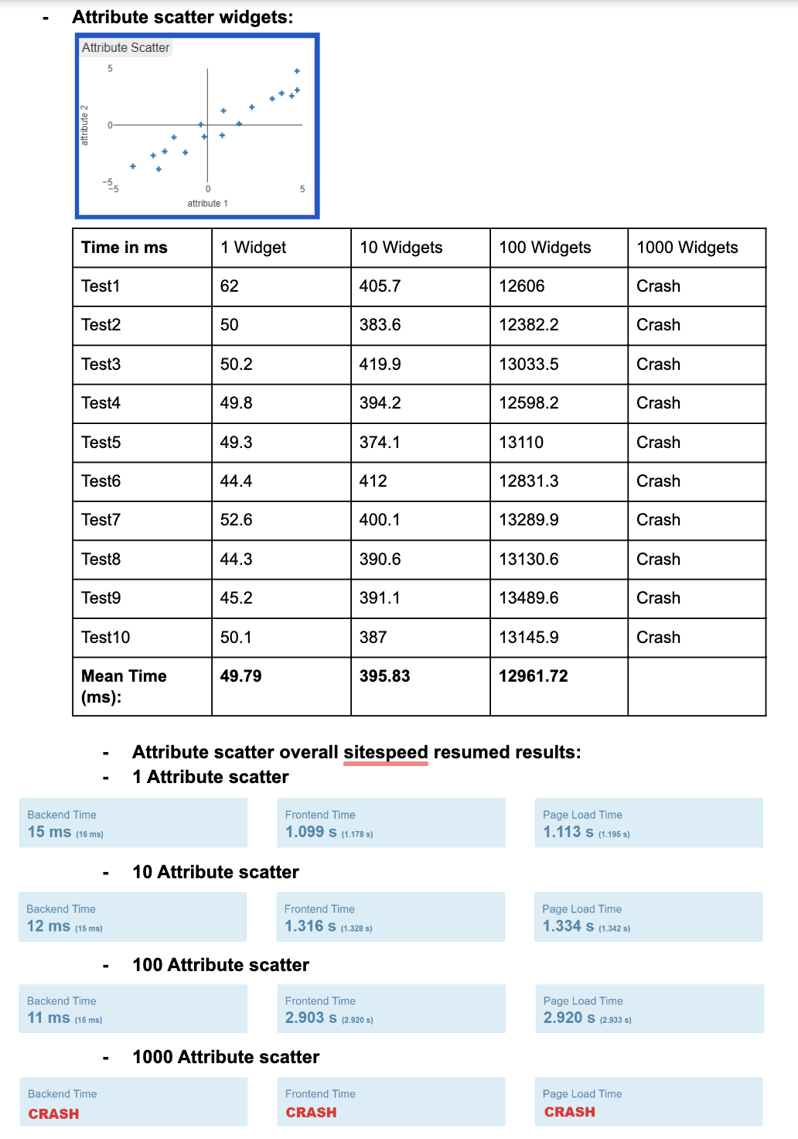
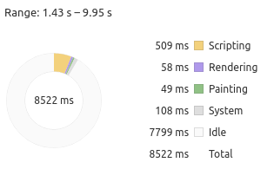
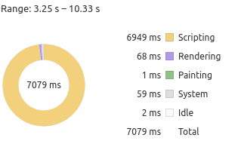
Benchmarking

Slide 9
Demo

Slide 10
Thank you for your attention!
Matteo Canzari
matteo.canzari@inaf.it

