Slide 1
SKA archiving
HDB++ Meeting 2019
Mangesh Patil
18 September 2019

Slide 2
Agenda
Current Status
Engineering Data Archive Requirements
Proposed Architecture
Prototyping
Findings
Concerns
Next Steps

Slide 3
Current Status
SKA1-Mid and SKA1-Low - two telescopes, common architecture
CDR completed for most sub-systems
System CDR closure ~ mid 2020
Bridging Activities in Progress - primarily aimed at:
Risk reduction
Building evolutionary prototype
Addressing CDR comments
Construction
Start ~ late 2020 / early 2021
Overall 5 years, with early production arrays along the way

Slide 4
Engineering Data Archive Requirements
Persist the engineering data collected and derived during the Telescope operations.
Data extraction for performing diagnostics, troubleshooting, system monitoring for health, performance, availability, reliability and management
Engineering Data comprises of –
Monitoring data
Alarms/Faults
External Data (Weather information, RFI, etc)
Data retention period - 50 years
Overall system availability 99.6%
Common archiver architecture and solution for both telescopes

Slide 5
Data Estimates
Considerations - Varying sampling frequency for monitoring points
5 % monitoring points @ 250 ms (subsecond rate)
25% monitoring points @ 1 to 5 second
70% monitoring points @ 10 second
Data size per sample ~ 100 bytes (includes attribute identifier, value, 2 timestamps, etc).
SKA1 MID Telescope
64 Meerkat Dishes + 133 Dishes + 10 other Elements (CSP, SDP, etc) = 207 Elements
1000 monitoring points per element
Total monitoring points in SKA1 - Mid = 207*1000 = 207000
Data Growth: 240 TB/year
SKA1 LOW Telescope
512 LFAA stations, each with 256 antennas
10 monitoring points per antenna
Total number of monitoring points = 10*256*512 = 1320720
Data Growth: 1540 TB/year

Slide 6
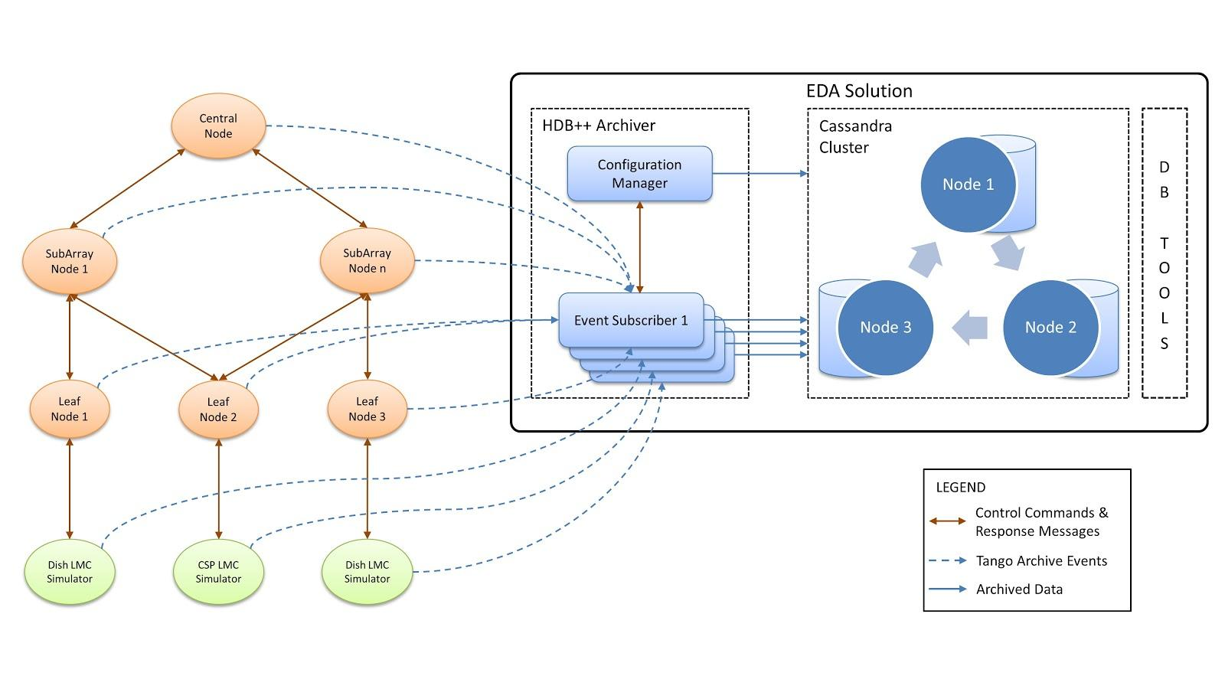
Architecture

Slide 7
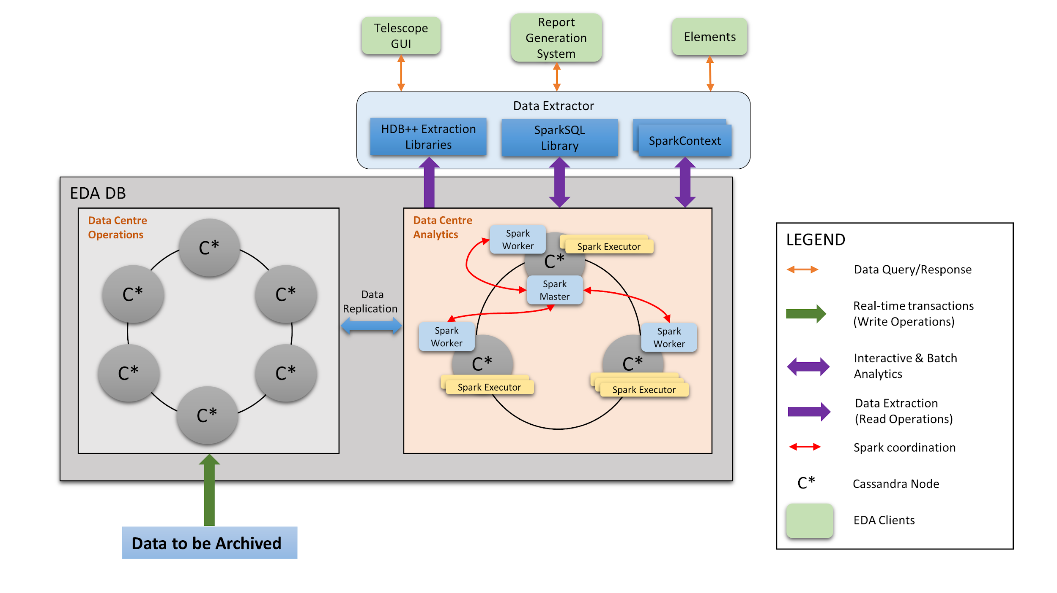
Data Extraction Architecture

Slide 8
Prototyping
Performance and Scalability of Archiver and Database
Throughput handled by a single archiver instance (500 attributes at varying frequencies)
1850 writes per second (year 2017)
2200 writes per second (year 2018)
Event Subscribers are able to scale-up linearly to handle 127,000 events/min per Event subscriber (tested with 5 instances of Event Subscribers).

Slide 9
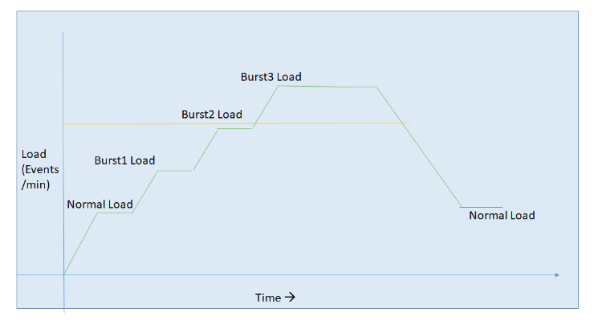
Prototyping….. contd.
Resilence of archiver - Ability to handle Burst load
Gradually step up the load to 60% of ‘threshold’ load
Increase load to 2x and maintain for 3-5 minutes
Archiver is stable until ‘pending number’ increases
No significant difference in write performance using ‘light’ schema

Slide 10
CDR Comments
Power and space constraints limit the number of instance deployed on site
Data size estimates are approximate. Can be worked through system CDR.
Risk of over design due to high availability requirements and overestimation of data size/growth
Stock replication of Cassandra is two way, all data
Degraded performance of analytics copy of database may affect operational db
Mitigation:
Start with both clusters (Operations and Analytics) co-located at the CPF. Operations cluster will maintain only few days of data. Analytics cluster maintains all data.
Consider moderate availability requirement (replication factor =1). This will limit the data storage needs. This should be sufficient for the initial array releases
Monitor data growth and performance - consider moving Analytics cluster to SOC. Additional computing infrastructure may be added at this stage.
Adopt custom replication using 3rd party tool for selective, one way replication
Asynchronous writes possible in replication. This will ensure that Operational db will not be affected by growth of analytics database.

Slide 11
Next Steps
Expecting optimizations to the archiver, which will increase the throughput for ‘write’ operations
Looking at other technologies options to evolve and mature in the SKA construction timeframes (e.g. TimescaleDb)

