Slide 1
Tango Server-side role-based access control system
39th Tango Community Meeting at INAF, Giulianova, May 22nd, 2025
Evgeny Gorbachev (JINR), Georgy Sedykh (JINR), Dmitry Egorov (MAX IV, JINR)

Slide 2
Acknowledgement
All the design and code were done by Evgeny Gorbachev and Georgy Sedykh from Joint Institute for Nuclear Research (JINR), Dubna, Russia

Slide 3
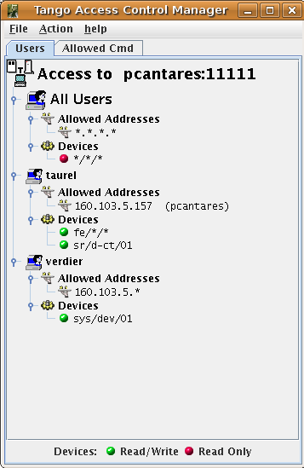
Original Tango Access Control
Limitations and problems:
Only system users can be used;
Groups do nothing (?);
No access control for attributes;
Allowed commands are defined per class, not per device;
No logging of user actions;
Easy to bypass by client (!) computer with the special environment variable.

Slide 4
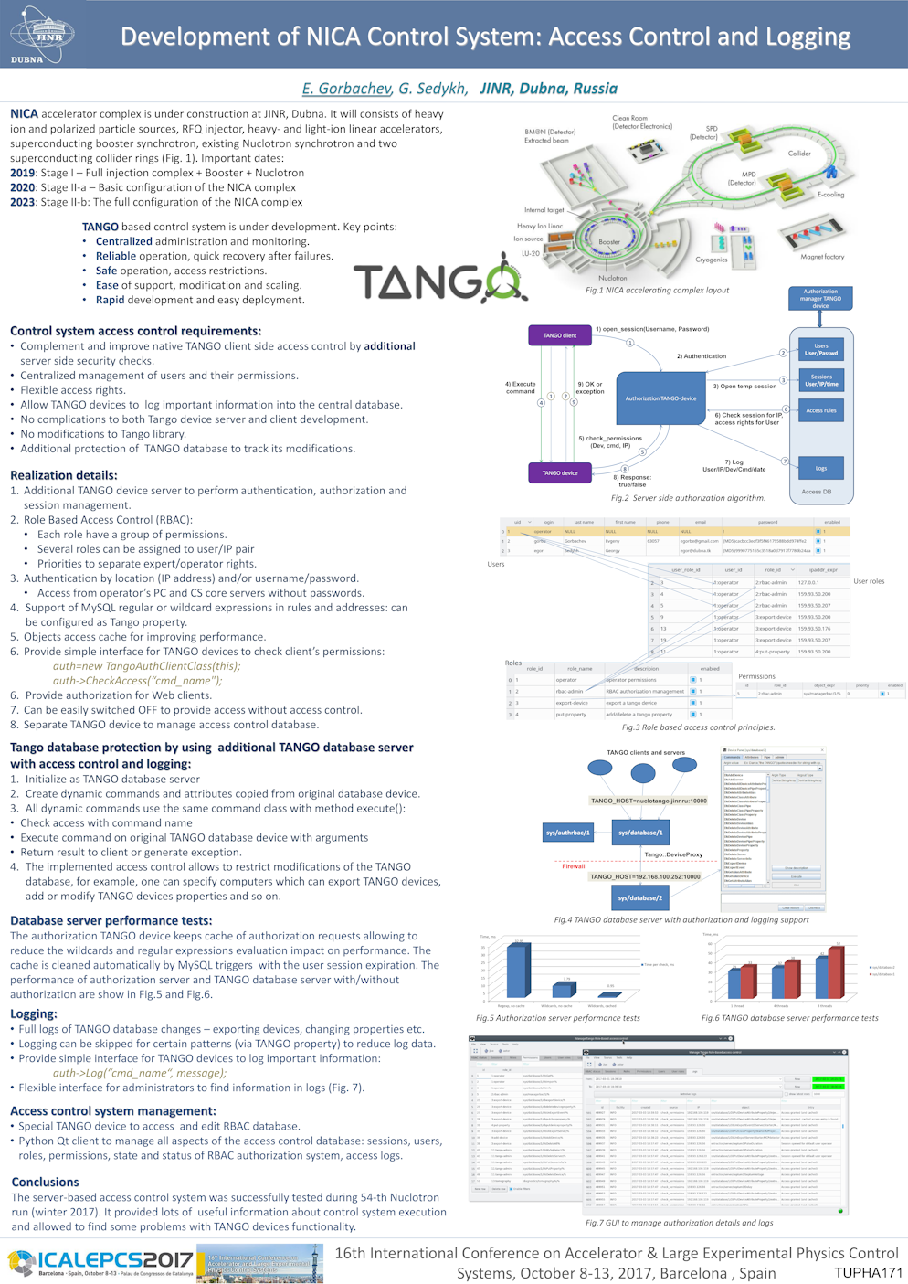
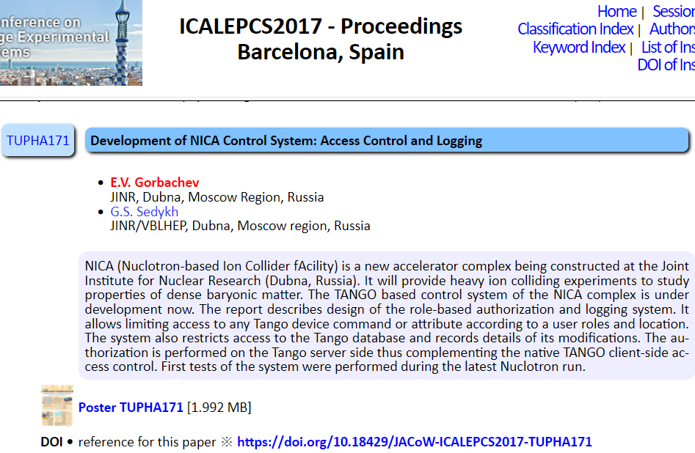
Role-based Access Control
https://accelconf.web.cern.ch/icalepcs2017/doi/JACoW-ICALEPCS2017-TUPHA171.html

Slide 5
NICA (Nuclotron-based Ion Collider fAcility)

Slide 6
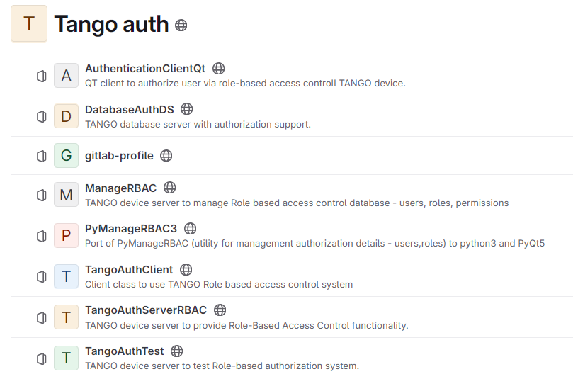
Role-based Access Control
https://git.jinr.ru/tango-auth

Slide 7
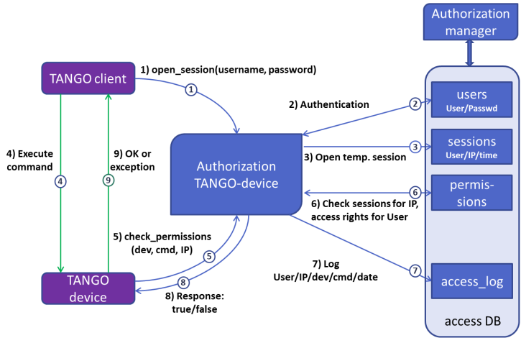
Role-based Access Control
Authorization algorithm

Slide 8
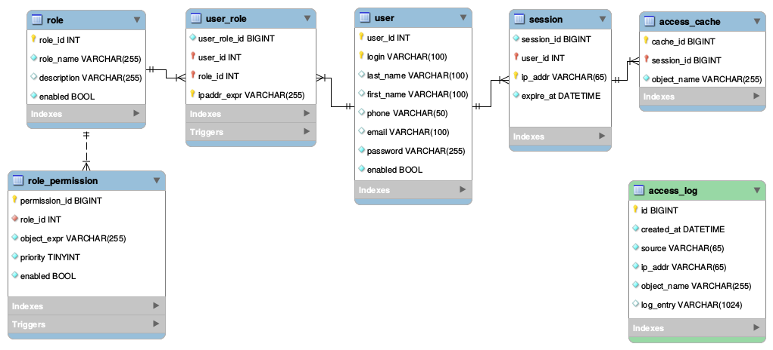
RBAC DB Schema
Database structure

Slide 9
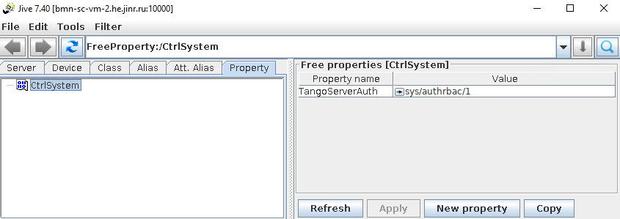
Tango Property
Set the FreeProperty in Jive

Slide 10
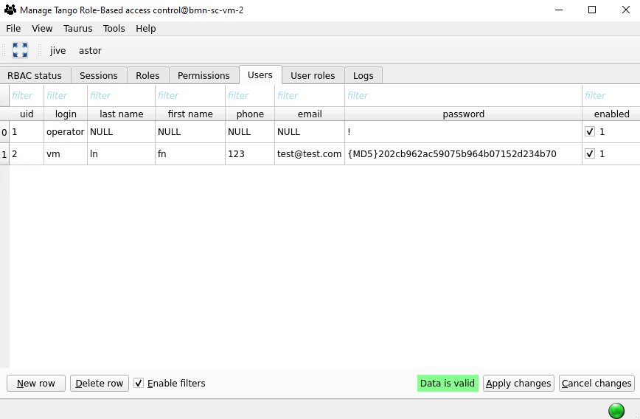
Users
Define user profiles with user-password pairs

Slide 11
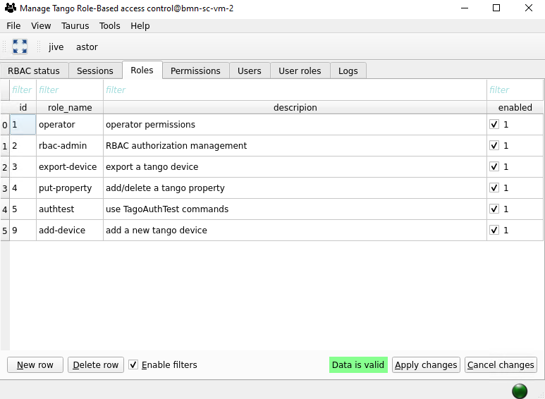
Roles
Create roles with description

Slide 12
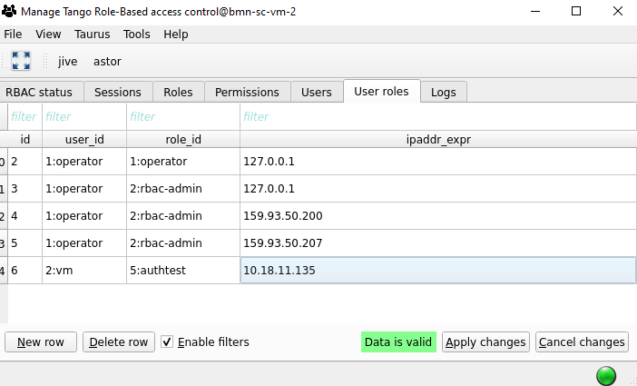
User roles
Connect users with roles and allowed IP addresses

Slide 13
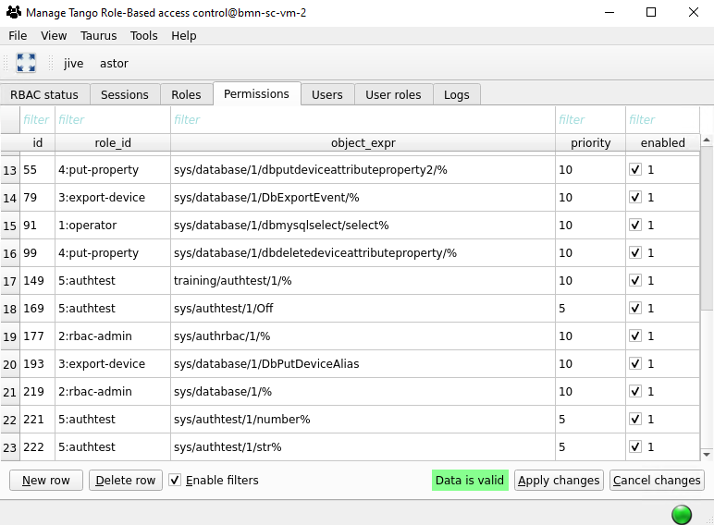
Permissions
Define permissions for roles:
Use Device Name and attribute/command name.
Wildcards (“%”) are supported – rules can be defined for the whole device domain or subset of attributes/commands.
Priority – permission with lower number will be used in case of multiple options.

Slide 14
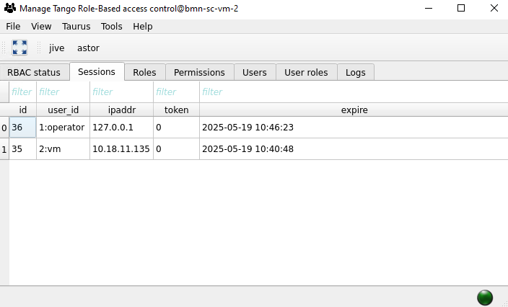
Sessions
User must open session by sending the command
open_session(user, password)
to the RBAC server.
Otherwise, session for default user ‘operator’ will be opened.
It’s possible to replace with SSO authorization, JINR SSO version is in production now.

Slide 15
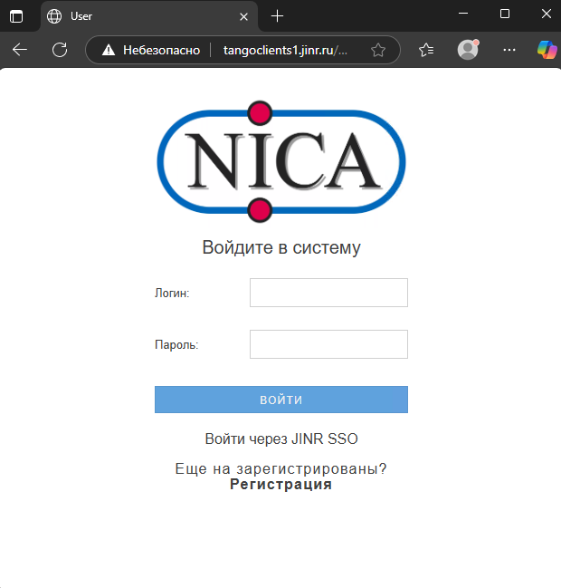
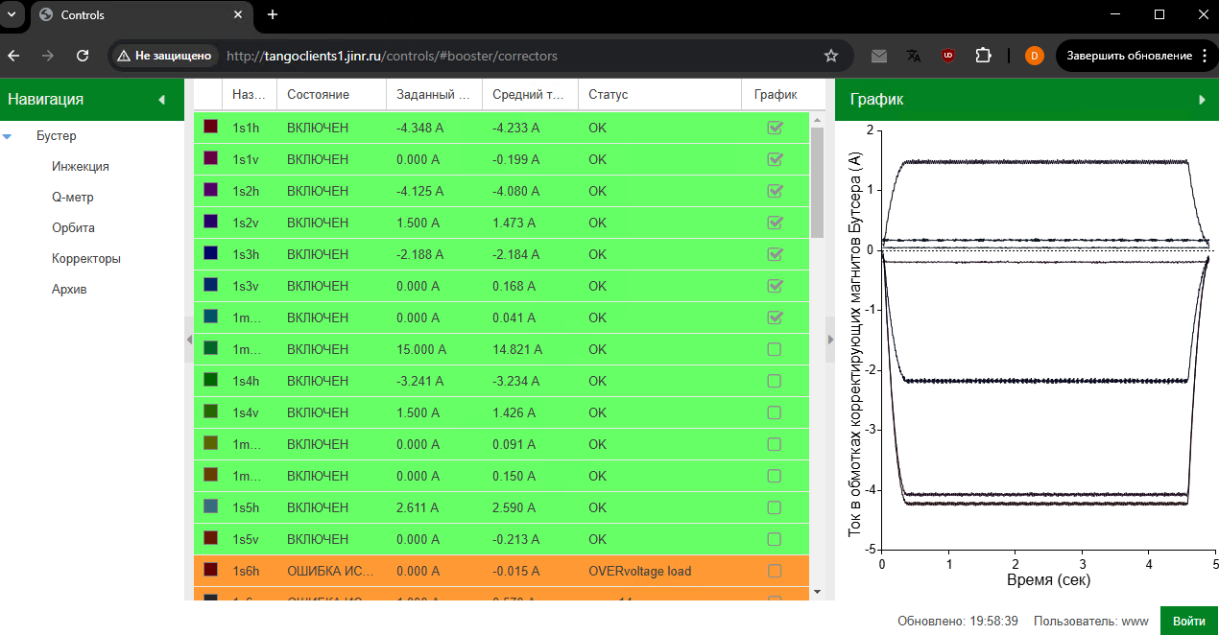
Sessions (web!)
Sessions and permissions are checked for end-user computers, not web-server.
Checked with check_permissions_www, session key is stored in IndexedDB storage in browser
Web login page, JINR SSO-based authorization is in production now.

Slide 16
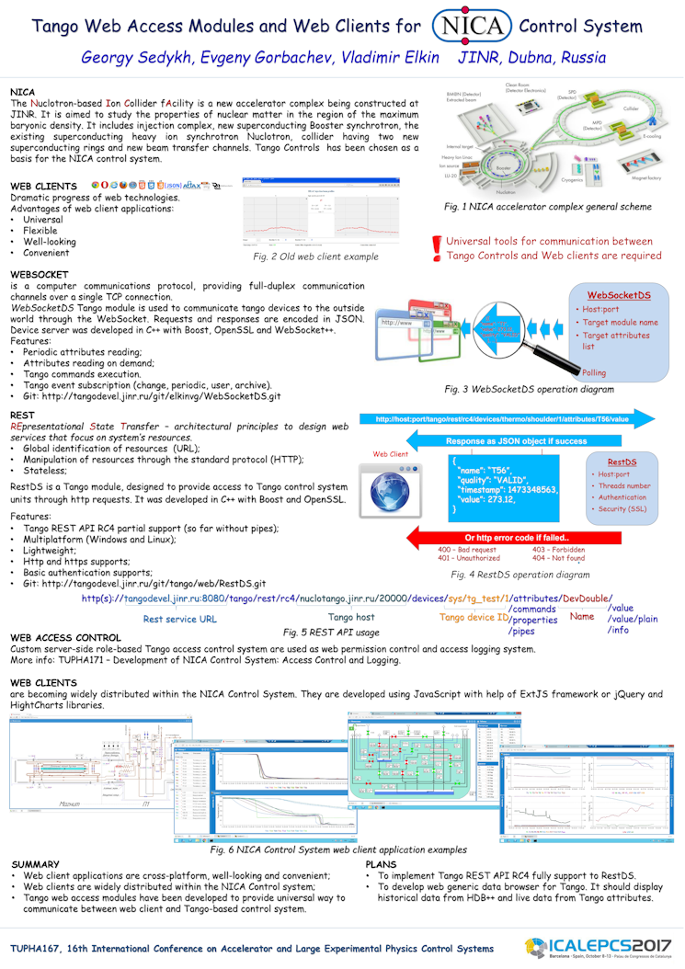
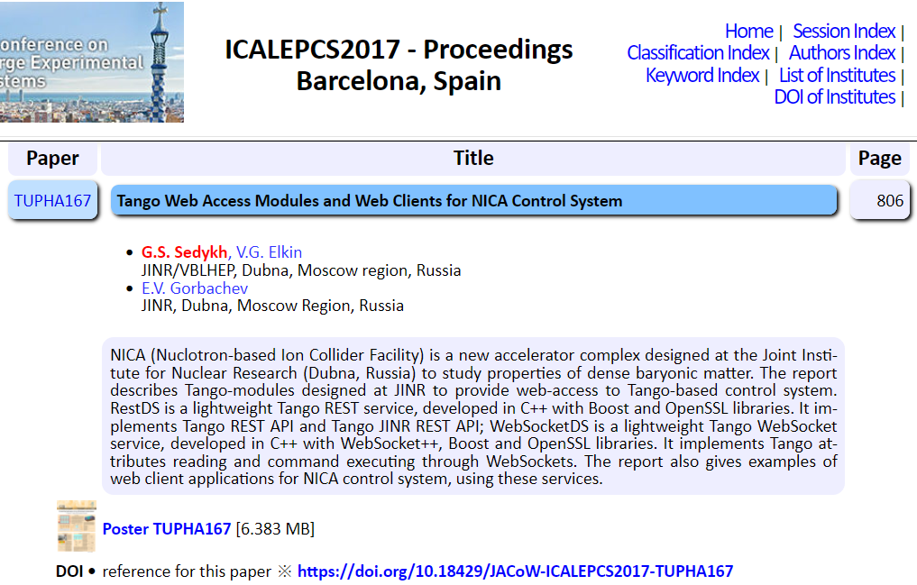
Sessions (web!)
https://accelconf.web.cern.ch/icalepcs2017/doi/JACoW-ICALEPCS2017-TUPHA167.html

Slide 17
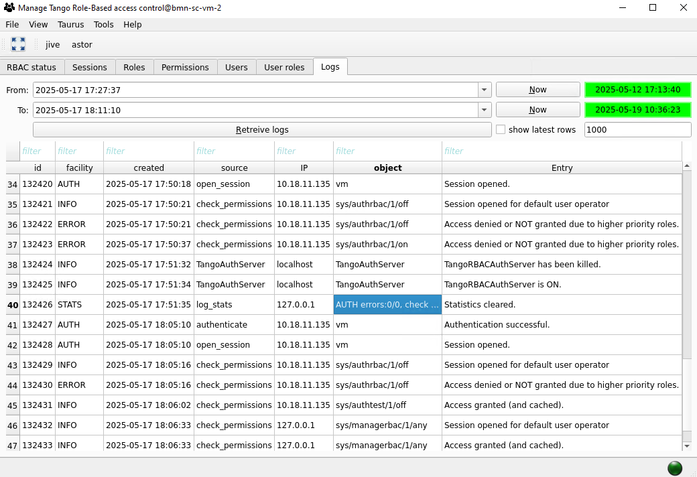
Logs

Slide 18
Code (on Device Server)
void TangoAuthTest::off() { auth->CheckAccess("off"); set_state(Tango::OFF); }
bool CheckAccess(string const &object_name, bool throw_ex=true) { string cl_ip=get_ip(); auth_rec.resize(3); auth_rec[0]=tangodev->get_name_lower(); auth_rec[1]=object_name; auth_rec[2]=cl_ip; try { Tango::DeviceProxy authdev(tangoauthserver); argin << auth_rec; argout = authdev.command_inout("check_permissions",argin); argout >> auth_success; } catch(Tango::DevFailed &e) { Tango::Except::print_exception(e); } if (throw_ex && !auth_success) Tango::Except::throw_exception("Permissions denied","Permissions denied, contact TANGO administrator","TangoAuthClientClass::CheckAccess()"); return auth_success; }
CheckAccess() takes ~2.5 ms
(DB and C++ servers on the same host)

Slide 19
Code (on Device Server)
string get_ip(void) { Tango::client_addr *cl=tangodev->get_client_ident(); string ip=cl->client_ip;
JAVA client class jive3.MainPanel - PID=1236 from host giop:tcp:[::ffff:10.18.86.34]:60266
CPP or Python client with PID 1687470 from host giop:unix:/tmp/omni-tango/002077882-1747491397
CPP or Python client with PID 33880 from host giop:tcp:[::ffff:10.18.86.34]:58630

Slide 20
Code (on Device Server)
PyTango 10.1.0.dev2 (10, 1, 0, 'dev', 2)
PyTango compiled with:
Python : 3.13.3
Numpy : 2.2.5
Tango : 10.1.0
pybind11 : 2.13.6
PyTango commit from last week
(Thanks to Yury!)
print(self.get_client_ident())
JAVA client class jive3.MainPanel - PID=7080 from host giop:tcp:[::ffff:10.255.255.254]:34708
CPP or Python client with PID 7737 from host giop:unix:/tmp/omni-user/000007898-1747844645

Slide 21
Authorization on RBAC server
check_permission(
devname,
keyword,
ipaddr)
If access session is cached
Check access_cache
If there are no opened sessions
Check user session
Open session for user “operator”
Get user role from opened session
Cache access
Check role permissions
Grant access
Deny access
Log

Slide 22
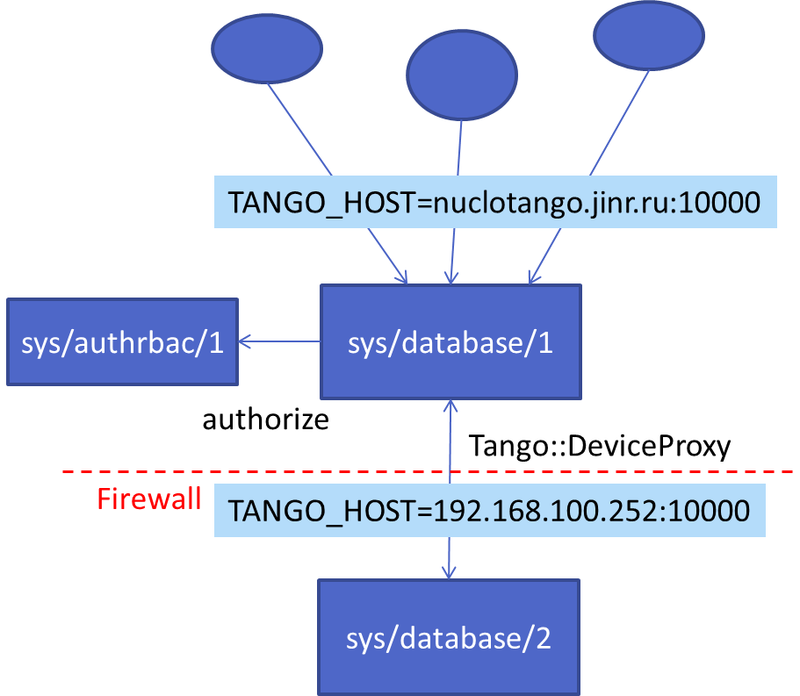
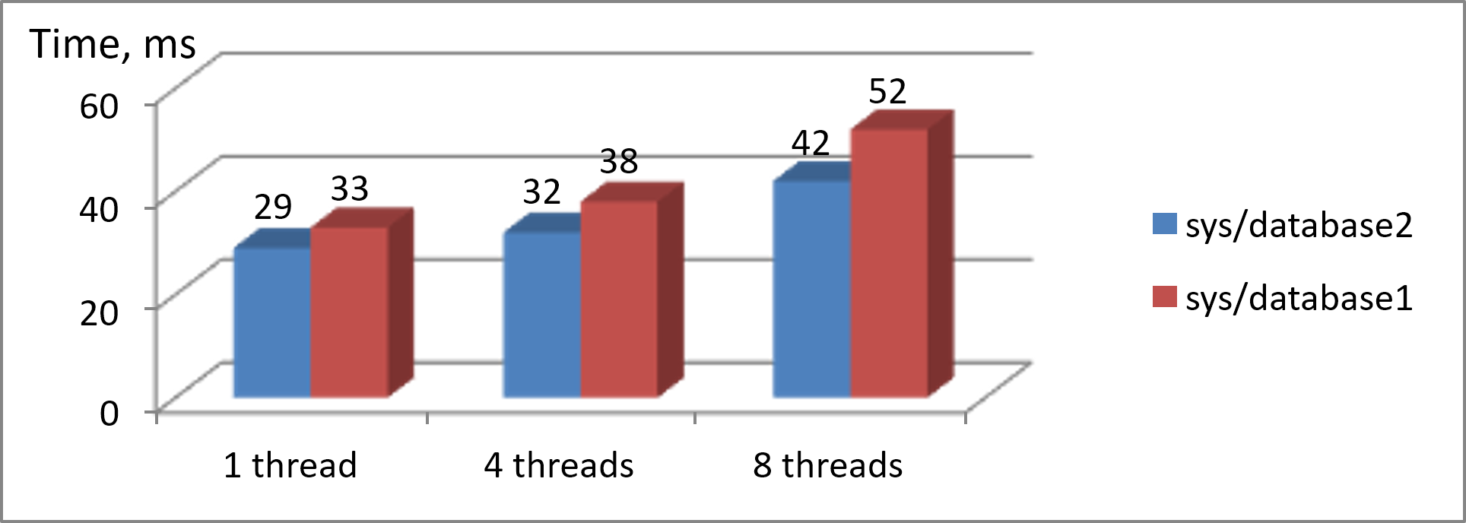
Access Control for TangoDB
CheckAccess()
Dynamically added TangoDB commands
Can it be “dockerized” on the same host?

Slide 23
DEMO
(if I have time)

