Slide 1
High throughput data streaming system for diagnostic signal analysis
39th Tango Community Meeting
INAF 2025
Maciej Mleczko
National Synchrotron Radiation Centre SOLARIS

Slide 2
Agenda
Why we need streaming system? Basic functionalities

Slide 3
Agenda
Why we need streaming system? Basic functionalities
Architecture

Slide 4
Agenda
Why we need streaming system? Basic functionalities
Architecture
Control system layer

Slide 5
Agenda
Why we need streaming system? Basic functionalities
Architecture
Control system layer
Current usage

Slide 6
Agenda
Why we need streaming system? Basic functionalities
Architecture and technology
Control system layer
Current usage
Further steps/plans
Hmm…

Slide 7
Introduction
Reasons
Many requests to provide raw fast signal for analysis purposes
Need to build online applications,
Fast archiving solutions,
„Feed” for Machine Learning solutions
Basic functionalities/features
Ability to connect to any source
Custom data filters
Speed: 10k samples/second (at least)
Scallable
Why?

Slide 8
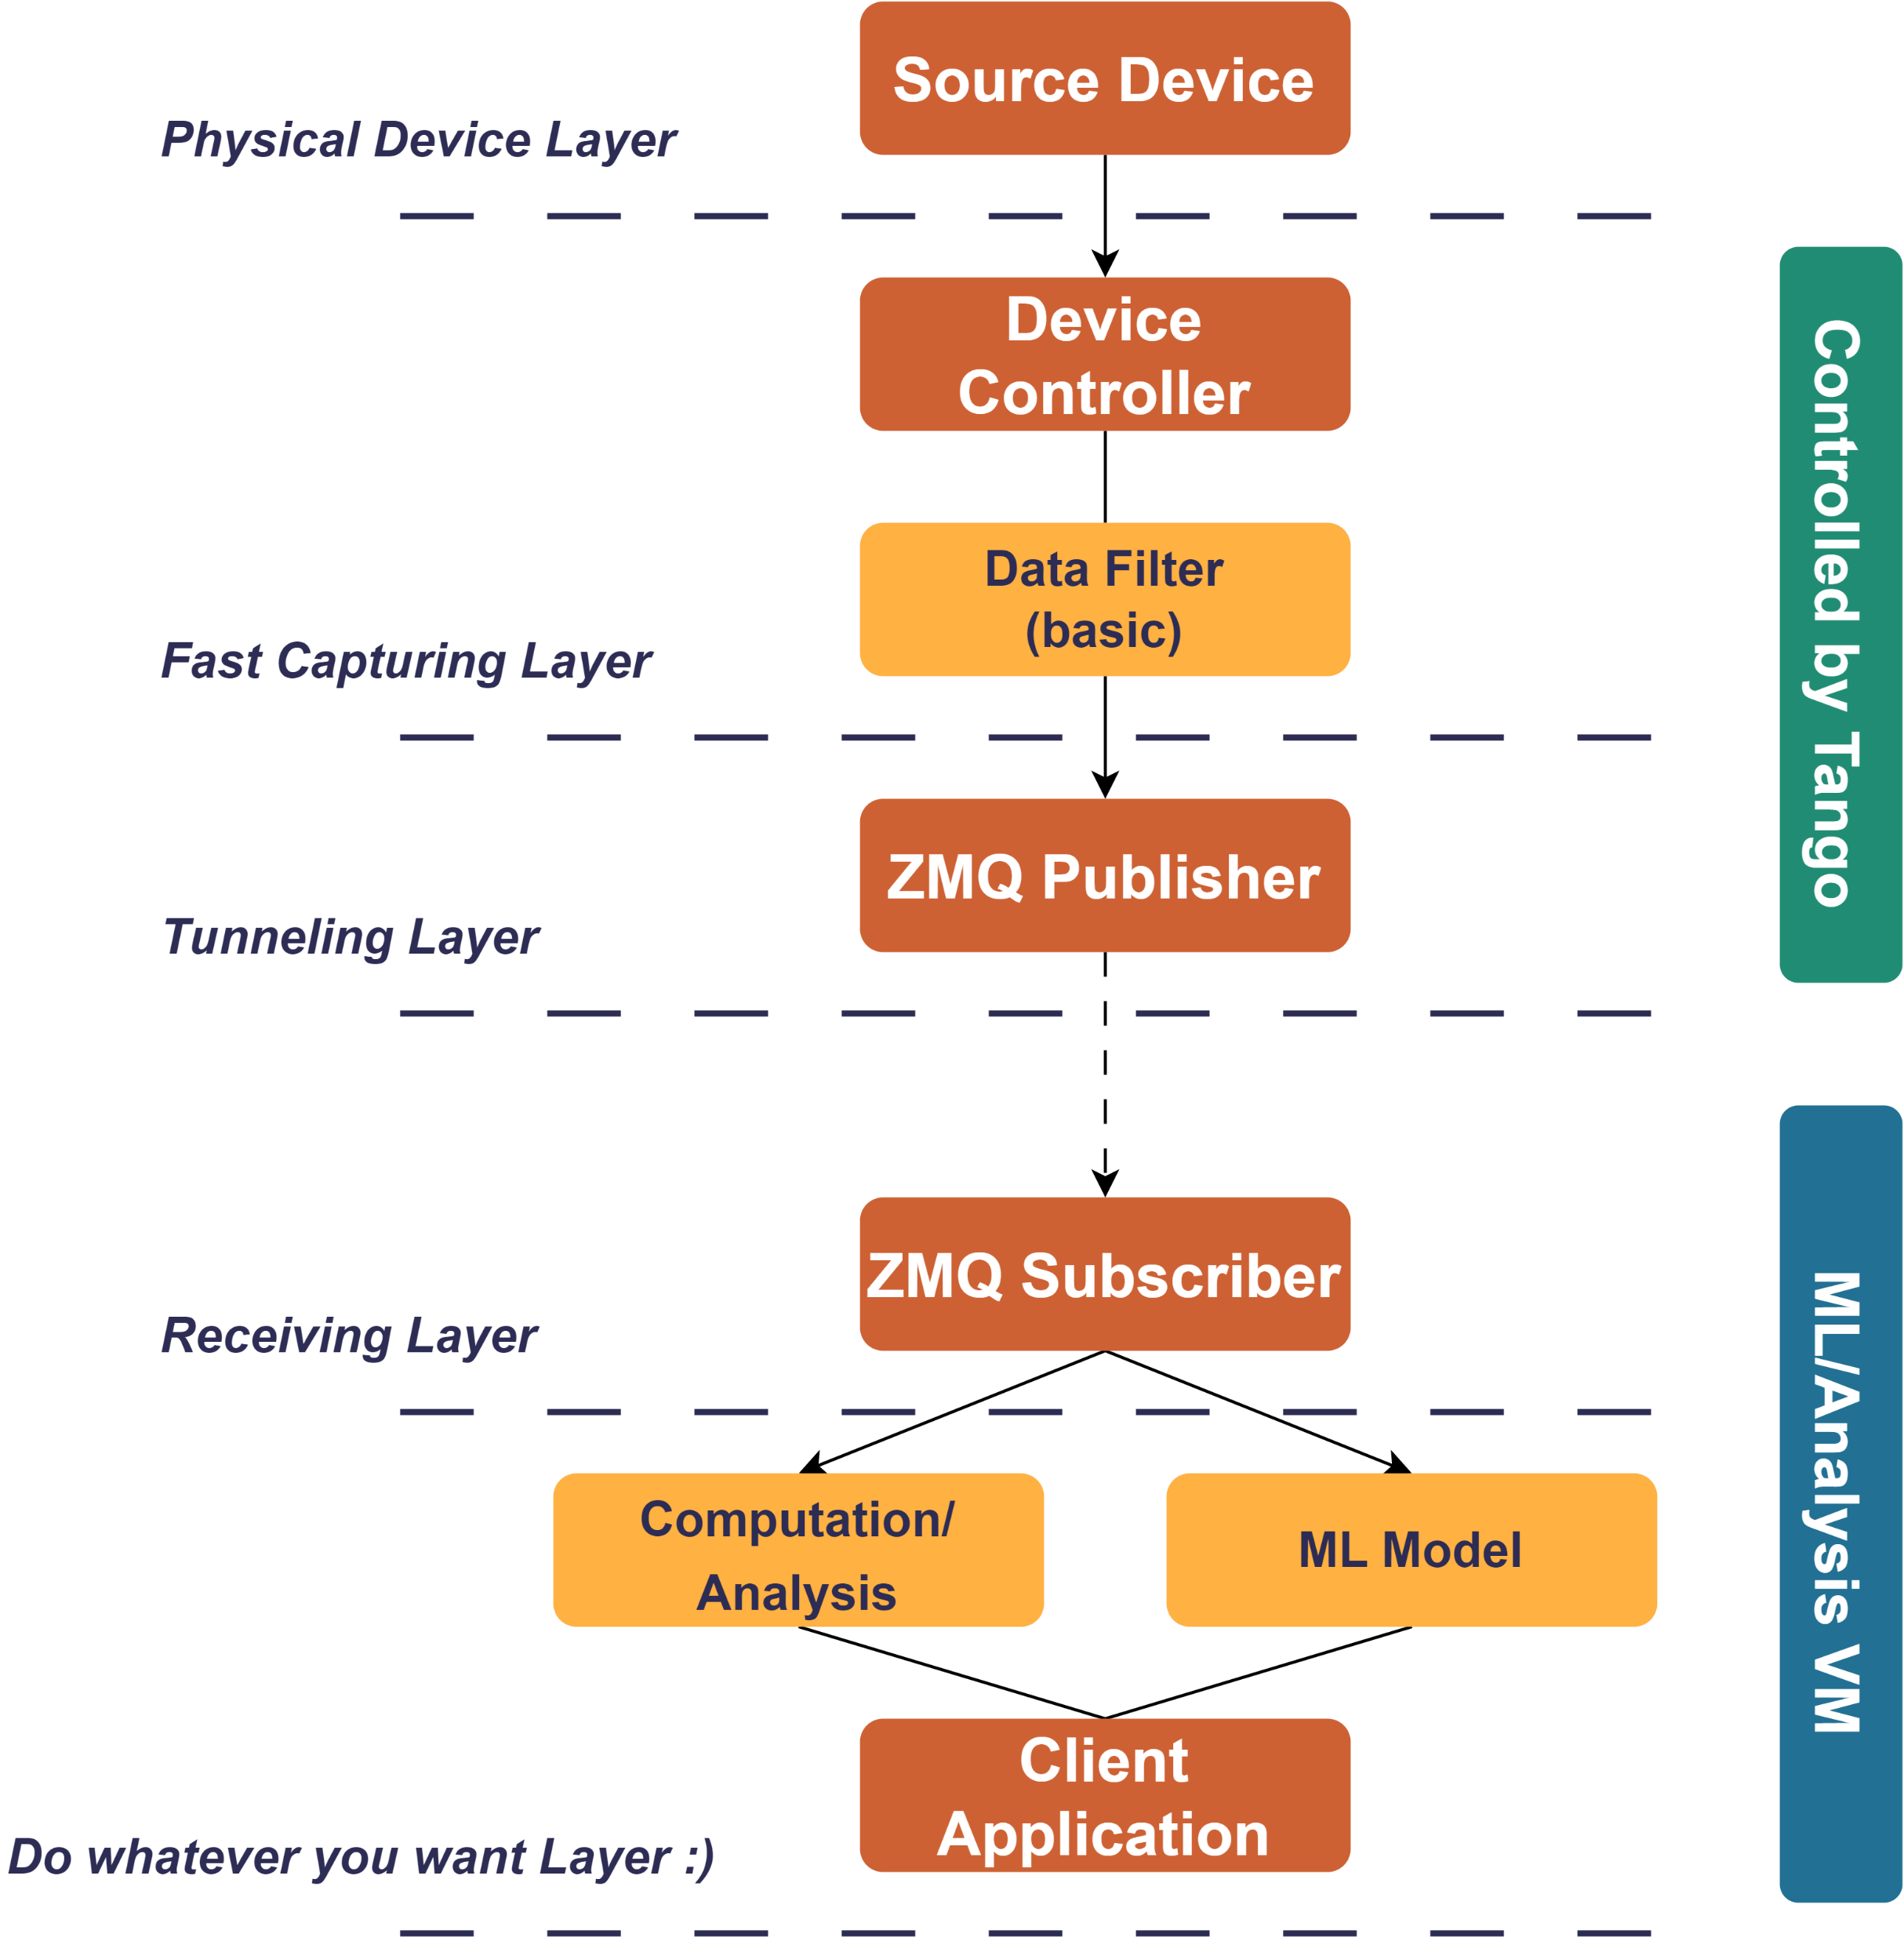
Architecture
Streaming system architecture
Server side compound with 3 layers
Source device
Capturing/filtering
Pushing into ether
Client side compound with 2 layers
Gathering
Analysis
Ok, but how does it work?

Slide 9
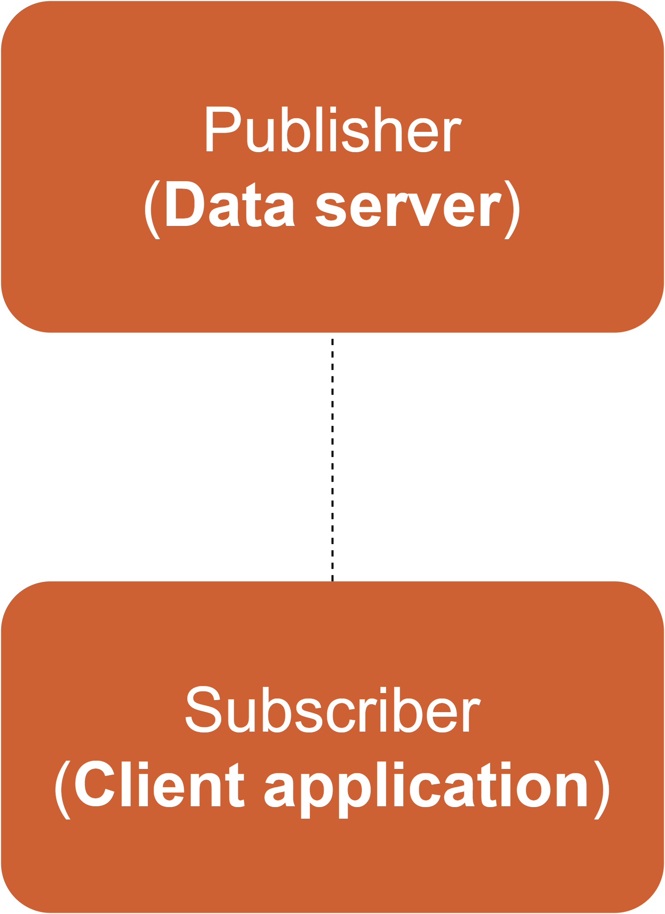
Architecture (ZMQ patterns)
Streaming system architecture
Basic PUB-SUB pattern
Provide sufficient performance
Easy to handle

Slide 10
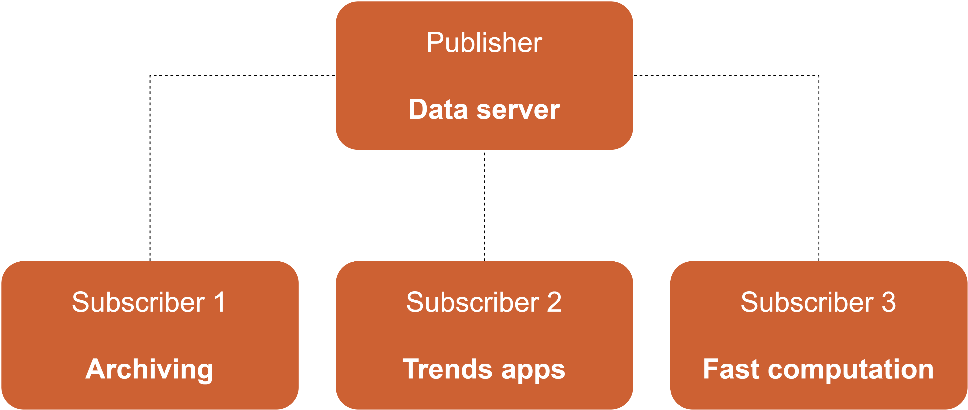
Architecture (ZMQ patterns)
Streaming system architecture
Basic PUB-SUB pattern
Provide sufficient performance
Easy to handle

Slide 11
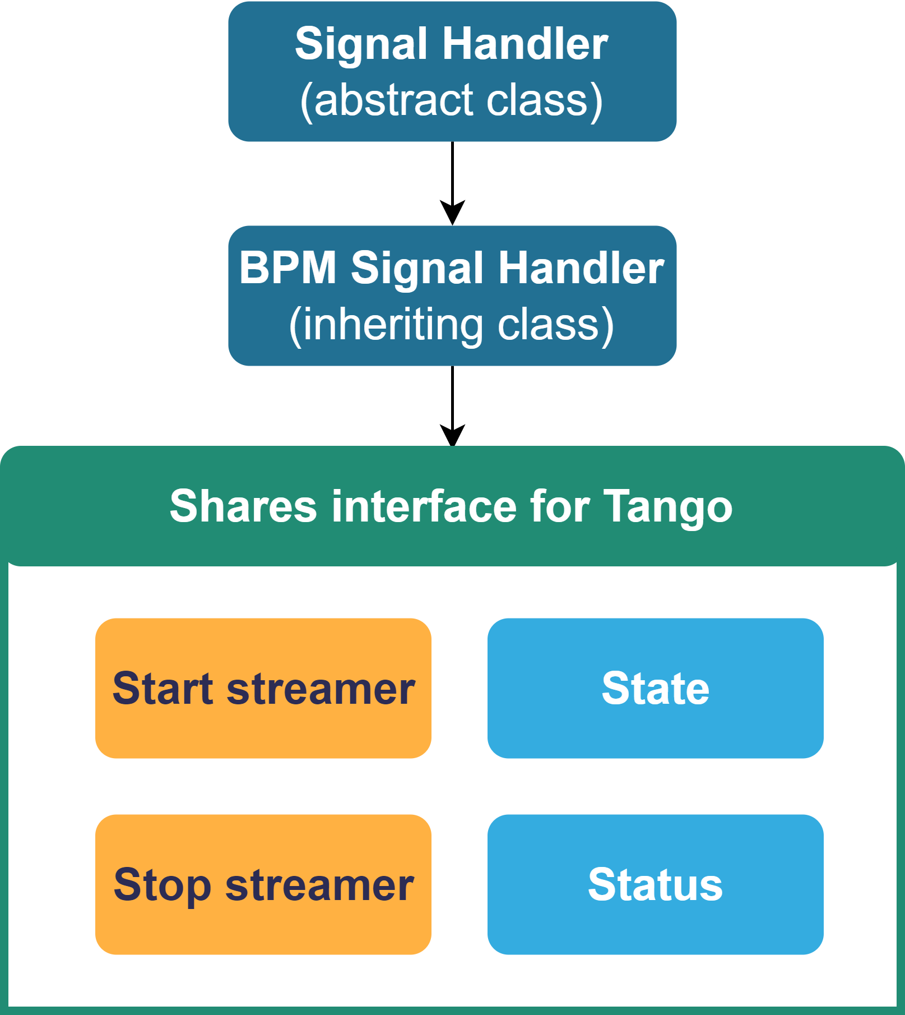
Architecture and technologies
Code structure
BPM Signal Handler class implements
connect method,
acquire_signal method,
handler_state property.
Technologies
Python 3.9
ZMQ Framework
NumPy (BLAS)
PyTango (of course ☺)

Slide 12
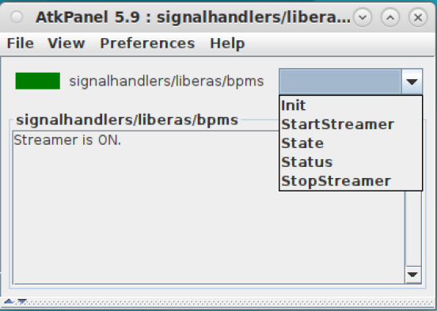
Control System Layer
Simple ATK panel view

Slide 13
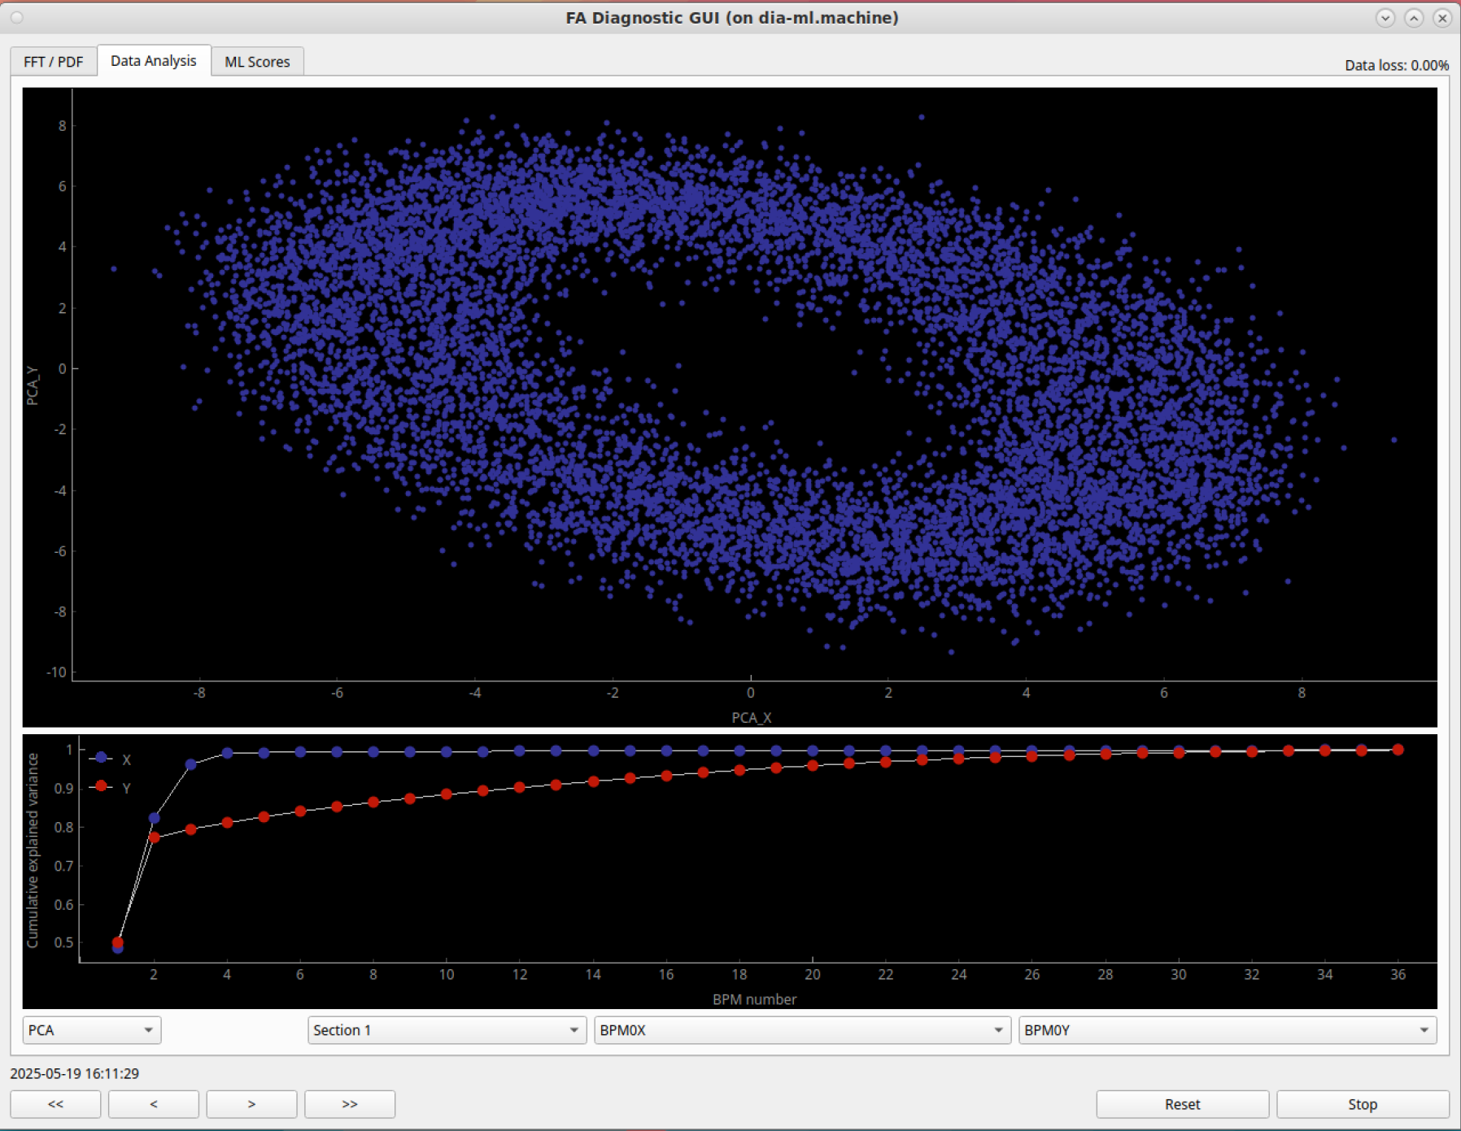
Current usage (examples)
Data analysis and ML application
PCA analysis
Mmm… what a tasty donut!
J. Biernat, M. Wróbel

Slide 14
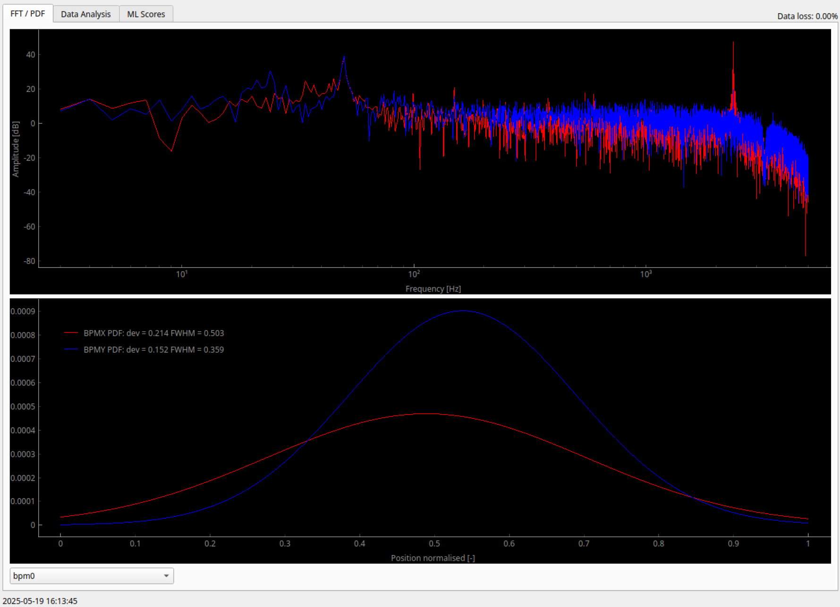
Current usage (examples)
Data analysis and ML application
PCA analysis
FFT/PDF analysis
Meh…
J. Biernat, M. Wróbel

Slide 15
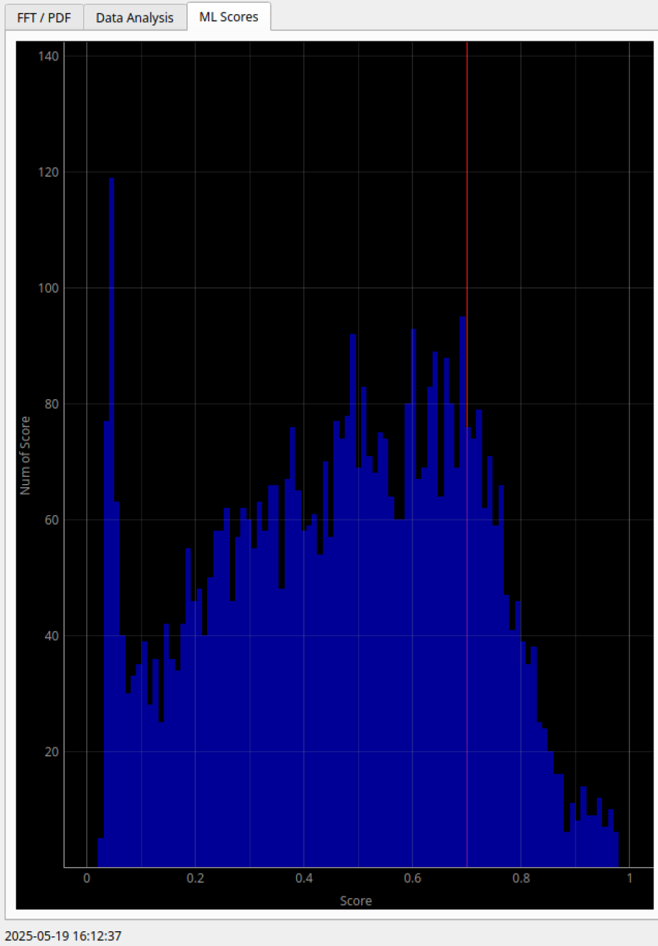
Current usage (examples)
Data analysis and ML application
PCA analysis
FFT/PDF analysis
Beam Anomaly Detection (ML classifier)
J. Biernat, M. Wróbel
?

Slide 16
Streaming System
Future plans
Implementation of Parallel Pipeline ZMQ pattern (task distribution),
Implementation of core features in C++ to increase performance (pybind11),
Config management.

Slide 17
This project is executed under the provision of the Polish Ministry and Higher Education project “Support for research and development with the use of research infrastructure of the National Synchrotron Radiation Centre SOLARIS” under contract nr 1/SOL/2021/2.
Grazie!

