Slide 1
Pytango Database Device Server
39th Tango Community Meeting, 2025.05.21-23 B. Bertrand

Slide 2
Outline
History
pytango-db
Demo

Slide 3
Acknowledgement
Most of this work has been done by Tiago Coutinho and Johan Forsberg
Huge thank you to them!

Slide 4
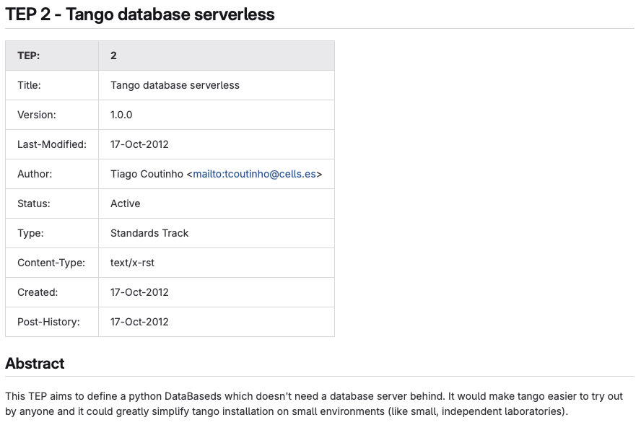
History
Part of PyTango, but no tests… and not maintained…
Notes:
In Pytango 9.3.6 or even 9.5, it’s broken

Slide 5
pytango-db

Slide 6
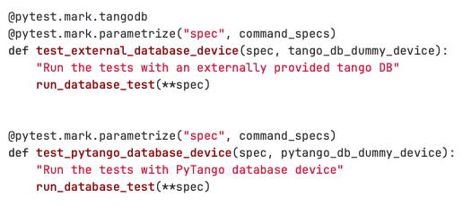
Testing
How many Db commands on Databaseds?
85!
2 tests:

Slide 7
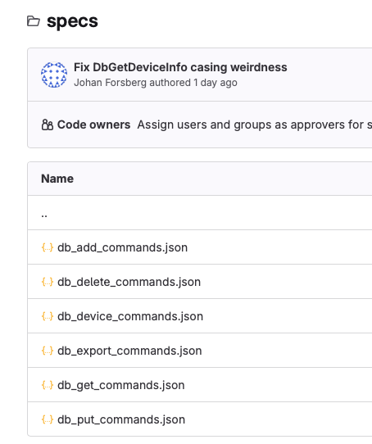
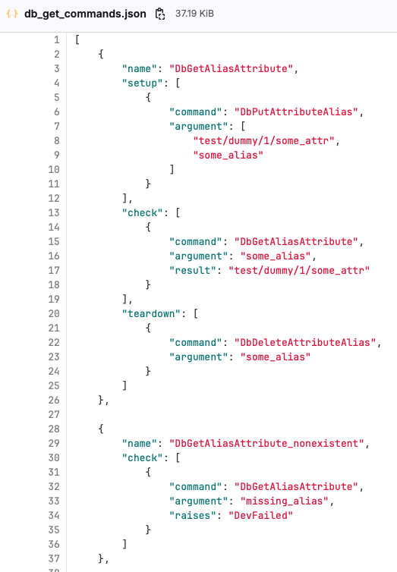
Testing: specs

Slide 8
How to run 1/3
pip/conda install pytango-db PyDatabaseds 2
Will start with giop:tcp:0.0.0.0:10000 by default
PyDatabaseds --port 11000 2
PyDatabaseds --port 11000 --host 127.0.0.1 2
TANGO_HOST=127.0.0.1:11000 PyDatabaseds 2
Notes:
Default ORBEndPoint

Slide 9
How to run 2/3
PyDatabaseds 2 -> create tango_database.db
Customize with PYTANGO_DATABASE_NAME variable
In-Memory Database using PYTANGO_DATABASE_NAME=":memory:"
Notes:
:memory: is a functionality from SQLite. Useful in CI.

Slide 10
How to run 3/3
uv
pixi
uvx --from pytango-db PyDatabaseds 2
pixi exec -s pytango-db PyDatabaseds 2
uv tool install pytango-db PyDatabaseds 2
pixi global install pytango-db PyDatabaseds 2
With pytango 10.x
python –m tango.databaseds.database 2
Notes:
Can be run without any installation (only creating a temporay env) with uv or pixi. Or installing locally with uv or pixi. Could also use pipx.

Slide 11
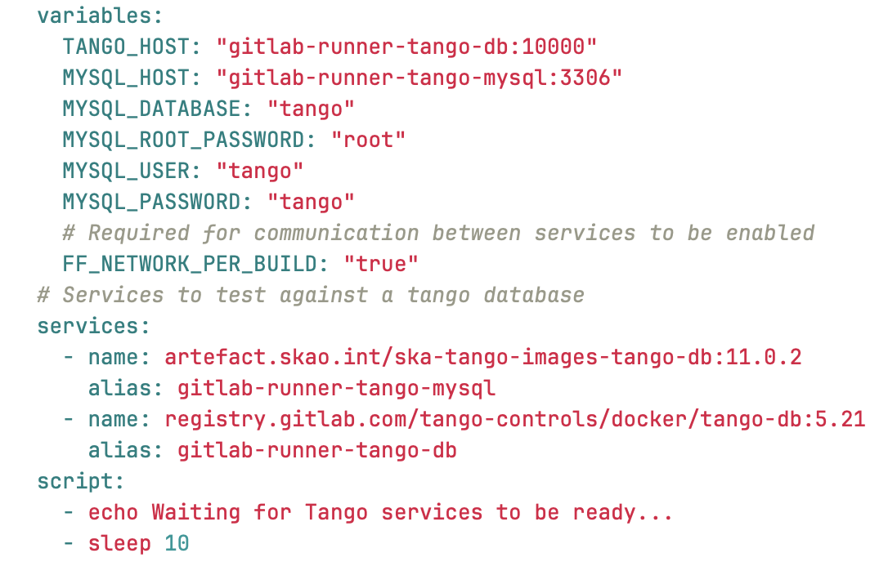
Usage: docker image in CI
Notes:
Nice but we can do better

Slide 12
Usage: pytest fixtures
pytango_db, a function-scoped fixture: database is started and stopped after each test
session_pytango_db, a session-scoped fixture: database is started only once and stopped at the end of the test session
Start the database on a random port (0) and set TANGO_HOST
Notes:
Just run pytest – database will be started automatically
Easy to run tests locally Will show you an example with itango

Slide 13
Demo
Notes:
Sardana and itango demo

Slide 14
Conclusion
Don’t run as your control system database in production
Still some bugs: not working with Starter / full sardana test suite
Try it:
local development
CI
Report issues!
Merge back in PyTango
End goal: deprecate pytango-db?

Slide 15
Links
https://gitlab.com/tango-controls/pytango/-/blob/develop/doc/tep/tep-0002.md
https://gitlab.com/tango-controls/pytango/-/issues/626
https://gitlab.com/tango-controls/incubator/pytango-db
https://gitlab.com/tango-controls/itango

