Slide 1
SKA TANGO Exporter
Matteo Di Carlo
39th Tango Community Meeting at INAF
Giulianova, Province of Teramo, Italy
https://gitlab.com/ska-telescope/ska-tango-exporter

Slide 2
Context
Kubernetes (k8s) for container orchestration (kubernetes.io)
Helm for packaging and deploying SKA Software (helm.sh)
Heavy use of Makefile (i.e., building, testing, deployment, …)
Gitlab for CI/CD

Slide 3
A Diagnostic tool
Extract every possible data from a TANGO system in order to assist the analysis of interconnected problems difficult to debug
Use existing data sources
TANGO DB
Kubernetes etcd
Container metrics
Elasticsearch
Create and populate 2 data sources
Prometheus to collect attributes - Polling
InfluxDB - Events
Grafana to display data
With one specific plugin to display TANGO attributes (ska-tango-attributes)

Slide 4
Runtime view
Legend
Kubernetes resource (pod)
Thanos
Request-reply call
Collector-#
Prometheus
Collector-#
Collector-#
Collector-#
TANGO collector #i
Elasticsearch
Grafana
TANGO-Db
Collector-#
Collector-#
InfluxBD
Dependency Graph
Collector-#
Collector-#
Event receiver #i
Kubernetes

Slide 5
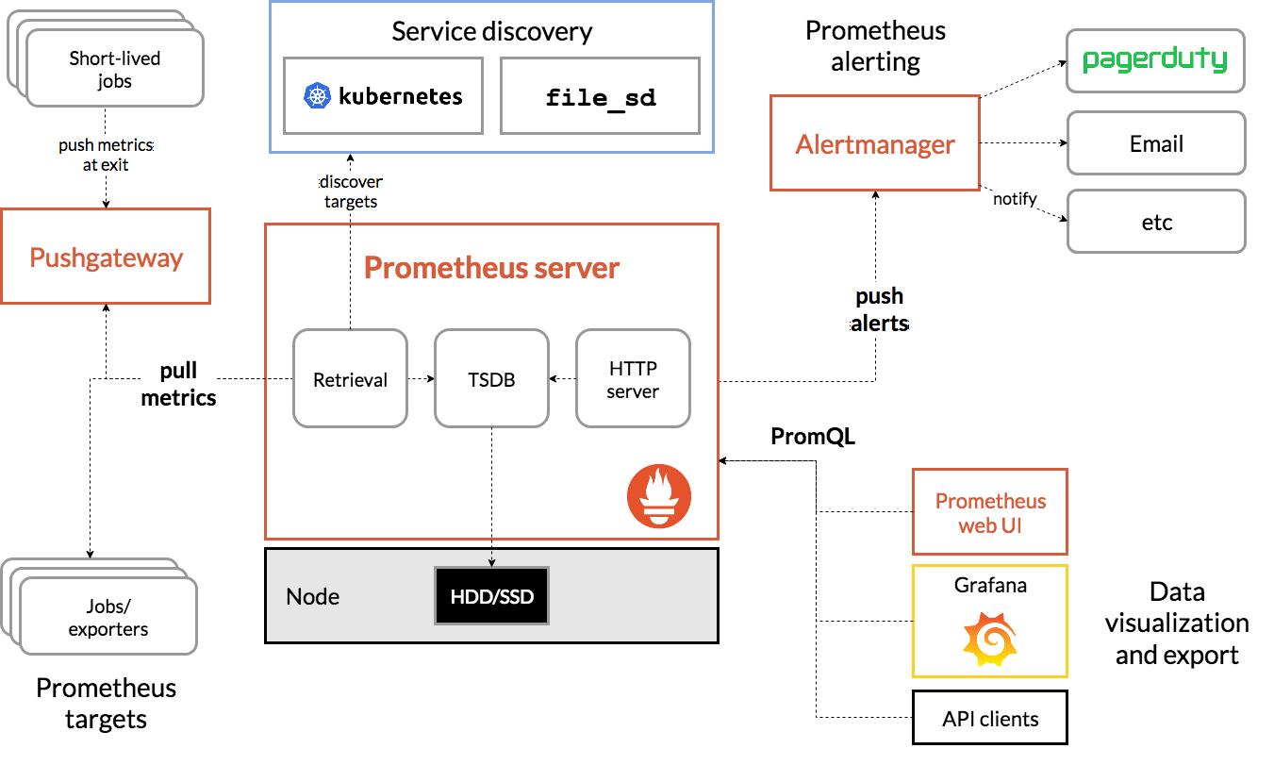
Prometheus (prometheus.io)
Client (Prometheus) - server (targets/exporters) application
All data are time series
Modifiability === easily add new exporters and alerts

Slide 6
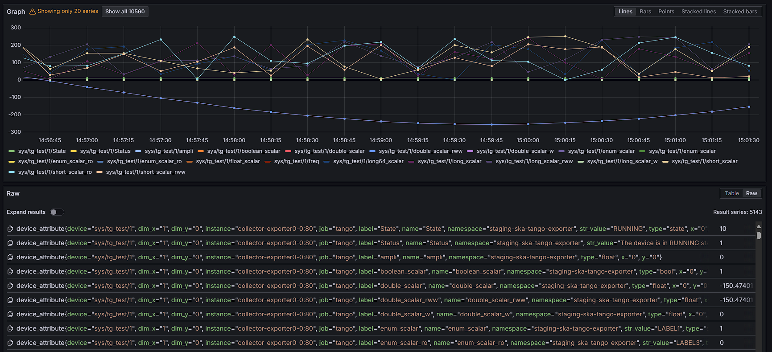
TANGO Attributes exporter
Using TANGO api to get all devices attributes and expose them in the notation
<metric name>{<label name>=<label value>, ...}
States (in general strings) exposed as text in a label

Slide 7
Event Receiver
Generate a number of pods that subscribe to all events of all devices
When an event occurs it generates an InfluxDB (www.influxdata.com) measurement
Why InfluxDB?
Easy
Integrated with Grafana

Slide 8
Architectural qualities
Scalability
Prometheus scale very well vertically and after some tests I decided to drop the horizontal scalability of it (for now)
InfluxDB scale very well
Both the TANGO exporter and the event collector takes as input the number of desired replicas
Performance
Every TANGO calls has a (very short) timeout so the read is very fast
Easy to use
Just include it as dependency chart

Slide 9
Dependency information
If using the SKA kubernetes tools, dependencies are provided in it
Easy to create a dependency graph

Slide 10
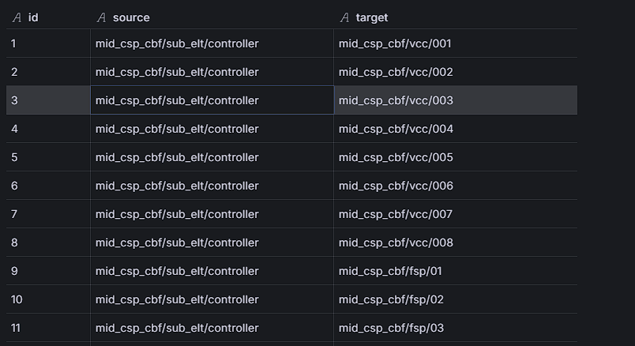
The node-graph grafana plugin
Allows to display graph by providing a new data source (simple http server) with mainly 2 tables (nodes and edges)
Python module for retrieving the information from k8s etcd and TANGO
With ability to filter device name
Deployed in the charts with the necessary authorizations

Slide 11
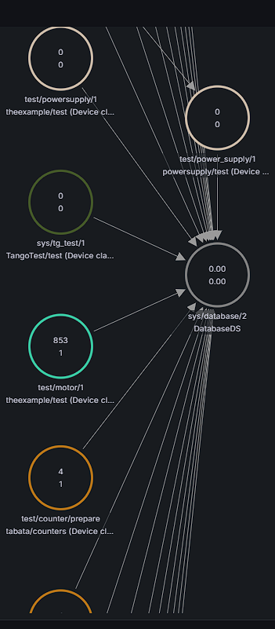
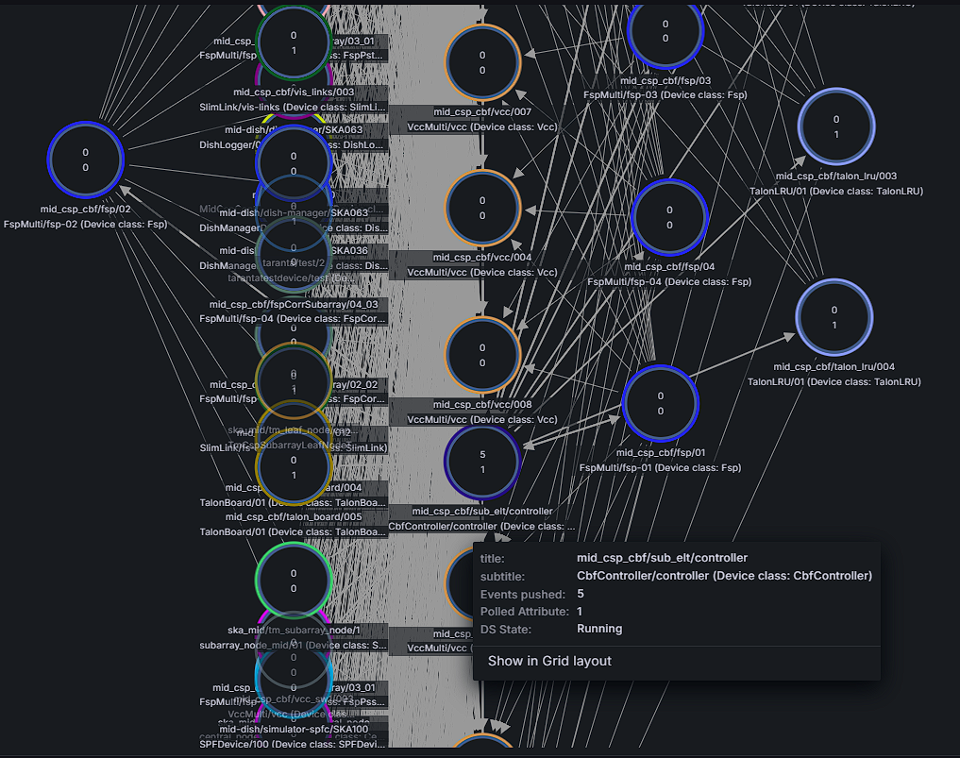
Dashboards: TANGO Node Graph

Slide 12
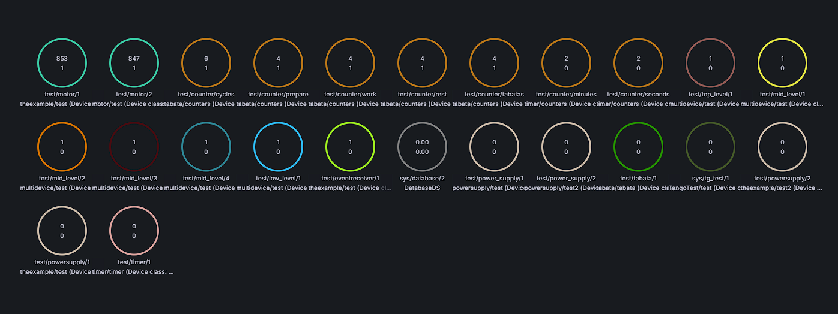
Dashboards: TANGO Node Graph

Slide 13
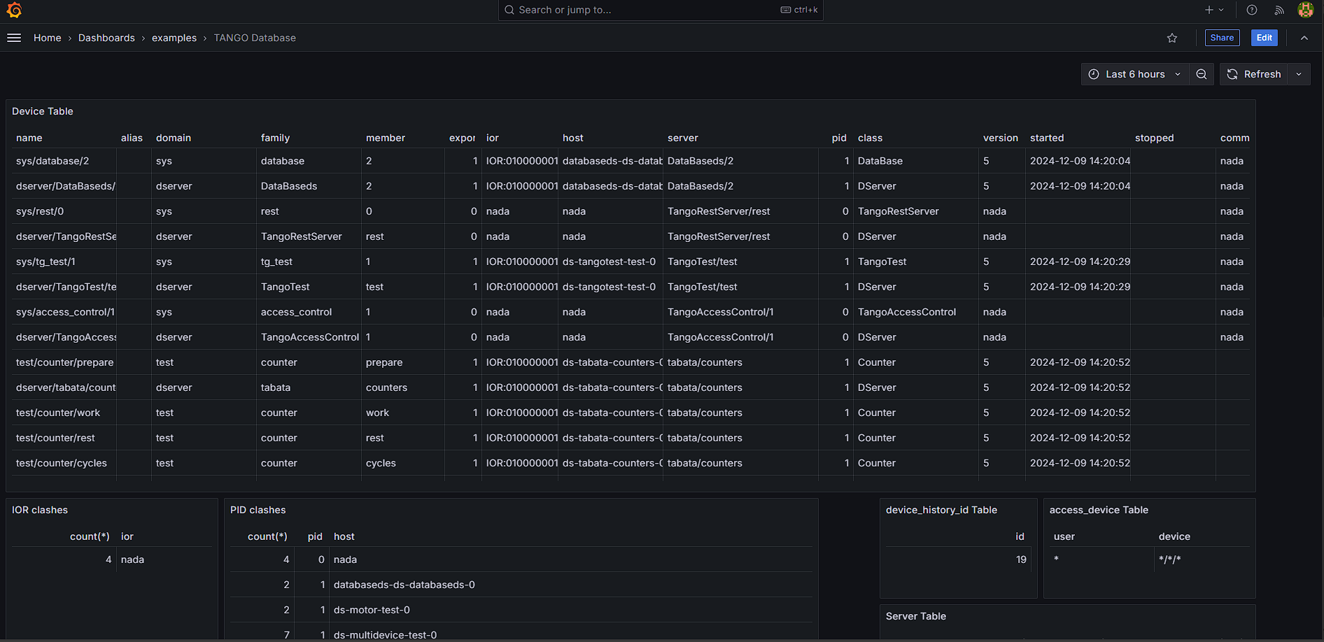
Dashboards: Tango Database

Slide 14
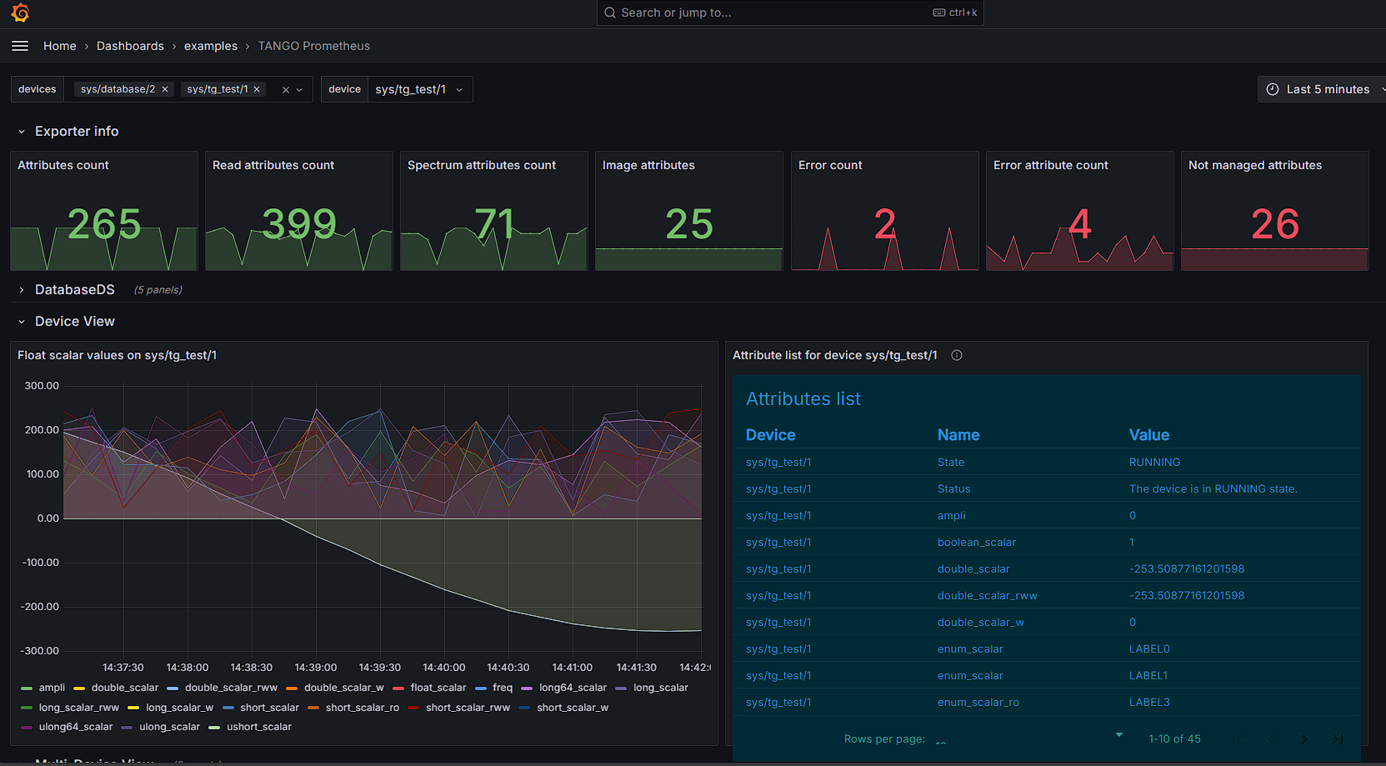
Dashboards: Tango Prometheus

Slide 15
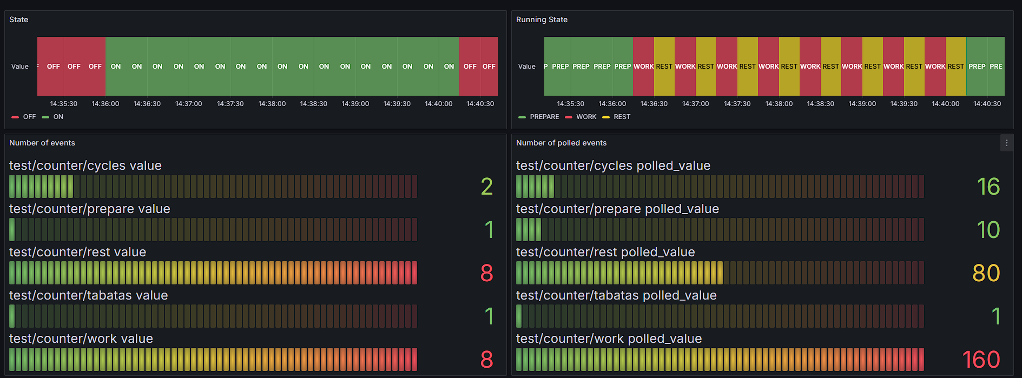
Dashboards: TABATA View

Slide 16
Dashboards: TABATA View

Slide 17
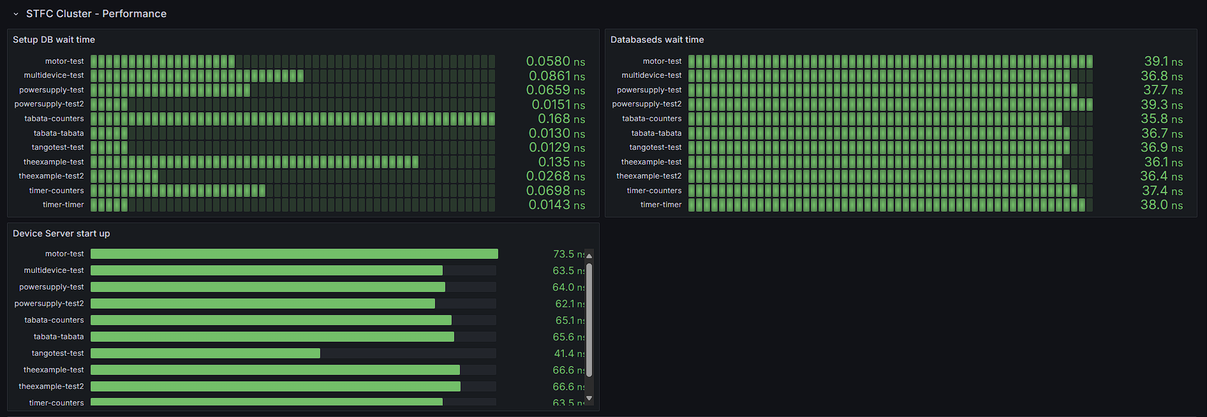
Dashboards: TABATA View

Slide 18
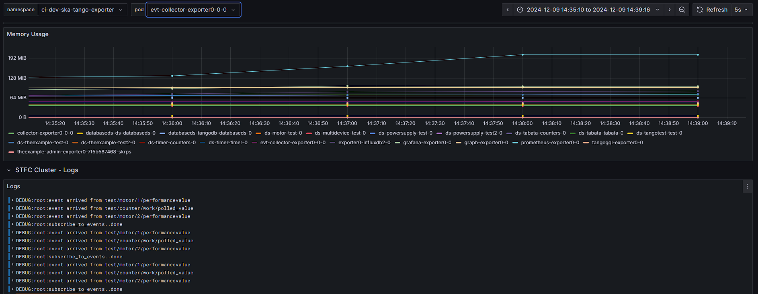
Dashboards: TABATA View

Slide 19
Conclusion
Very easy to include in a pipeline/project in kubernetes
available at https://<k8s-cluster-ip>/<namespace>/grafana/
Possible to include any sources in the grafana by configuration (values file)
Thanks
matteo.dicarlo@inaf.it

