Slide 1
SOLEIL Status
Raphaël GIRARDOT, TangoMeeting 2025

Slide 2
Outline
SOLEIL II status (upgrade plans)
Current usage of our Web applications
Archiving status at SOLEIL
Taurus usage at SOLEIL
Highlights
Ongoing developments and solutions

Slide 3
SOLEIL II status (upgrade plans)

Slide 4
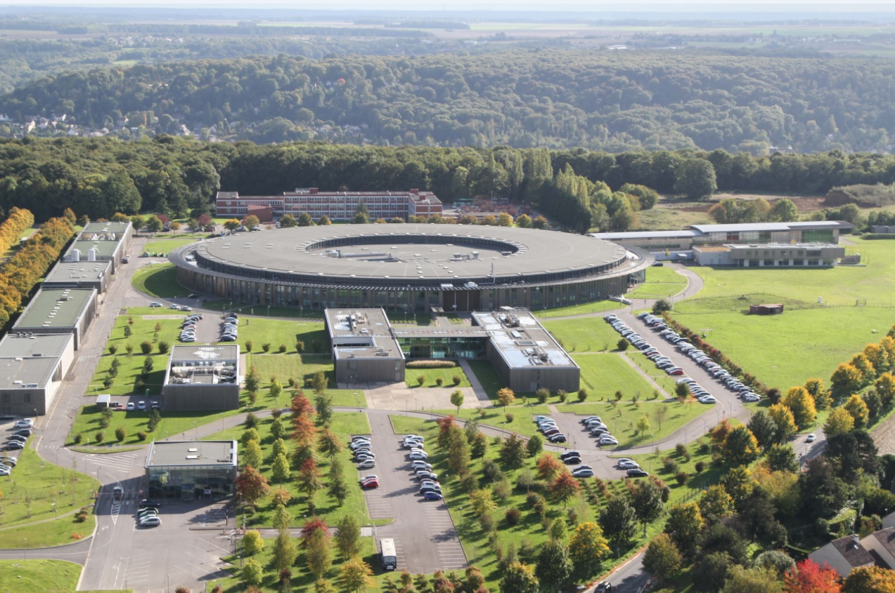
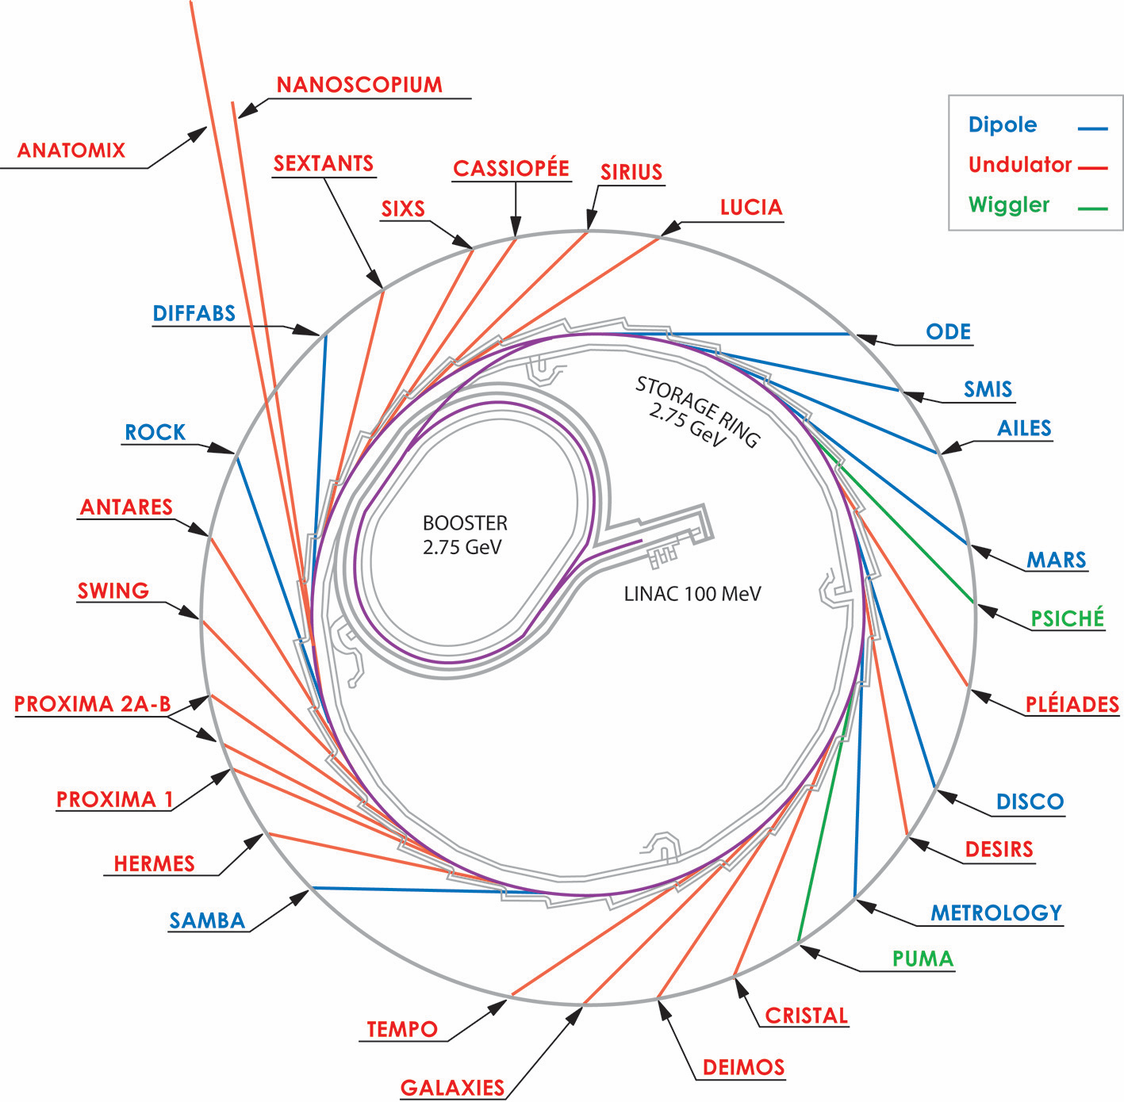
SOLEIL II status (upgrade plans)
SOLEIL Sychrotron
French installation, near Paris
29 beamlines
Opened to external users since 2008
Energy from far IR to hard X-rays
Storage ring 354m, 2.75GeV
~ 450 staff members / ~ 30 computing & electronics

Slide 5
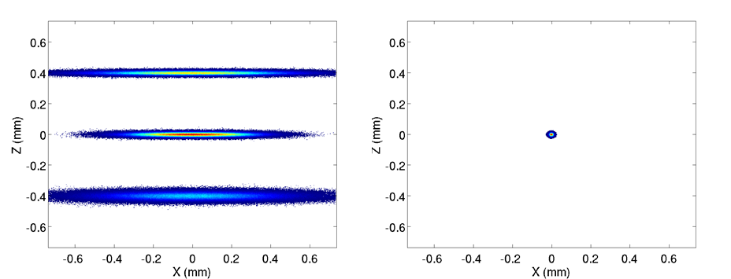
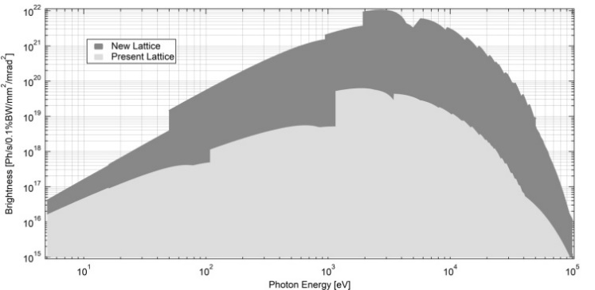
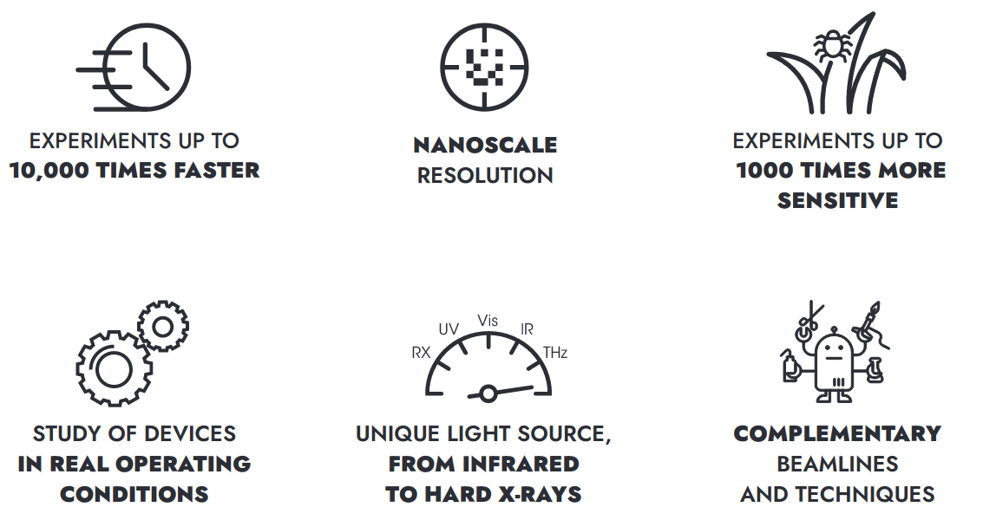
SOLEIL II status (upgrade plans)
Beam sizes
Towards SOLEIL II
New booster
New storage ring
Brightness
SOLEIL
SOLEIL II
SOLEIL II
400 µm
10 µm
Emittance < 100 pm.rad.
SOLEIL
https://www.synchrotron-soleil.fr/en/future-soleil-soleil-ii-project
Dark period
Phase 1: Construction
Phase 2: Towards full performance
Budget
Machine parameters
Infrastructure & buildings
Beamlines implementation
Project organization
New machine assembly
Shutdown and installation
Restart of 7/10 upgraded + 19/22 adapted beamlines
New machine commissioning
Instrumentation R&D
Beamlines optimisation and upgrade
Laboratories modernization
Instrumentation R&D

Slide 6
Current usage of our Web applications

Slide 7
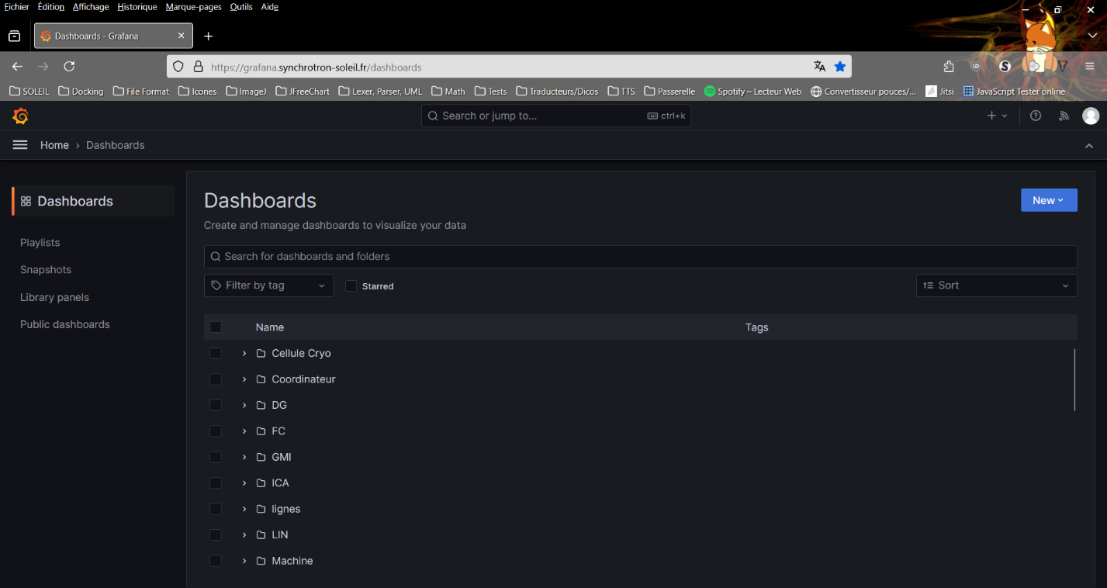
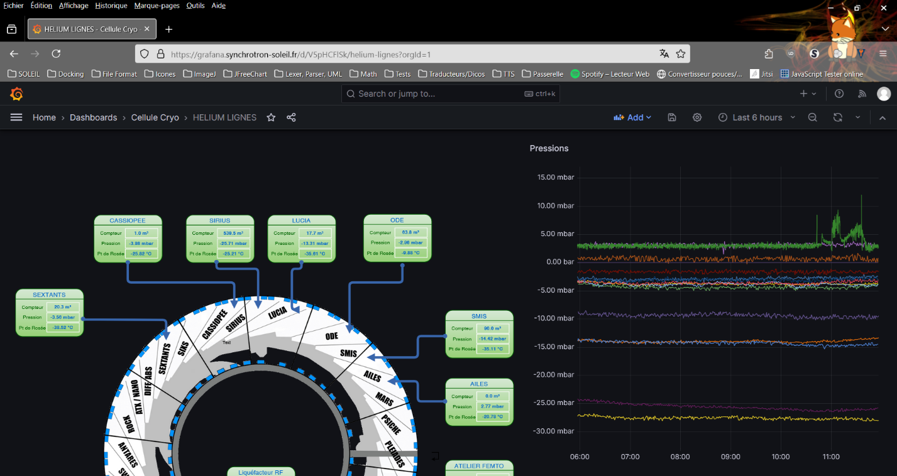
Current usage of our Web applications
Grafana for accelerators in production and highly used
74 users (accelerator operation groups), 144 dashboards
Based on archiving system for accelerators (GraphQL API)
Deployed with docker swarm and Portainer
Still working on monitoring and server scaling

Slide 8
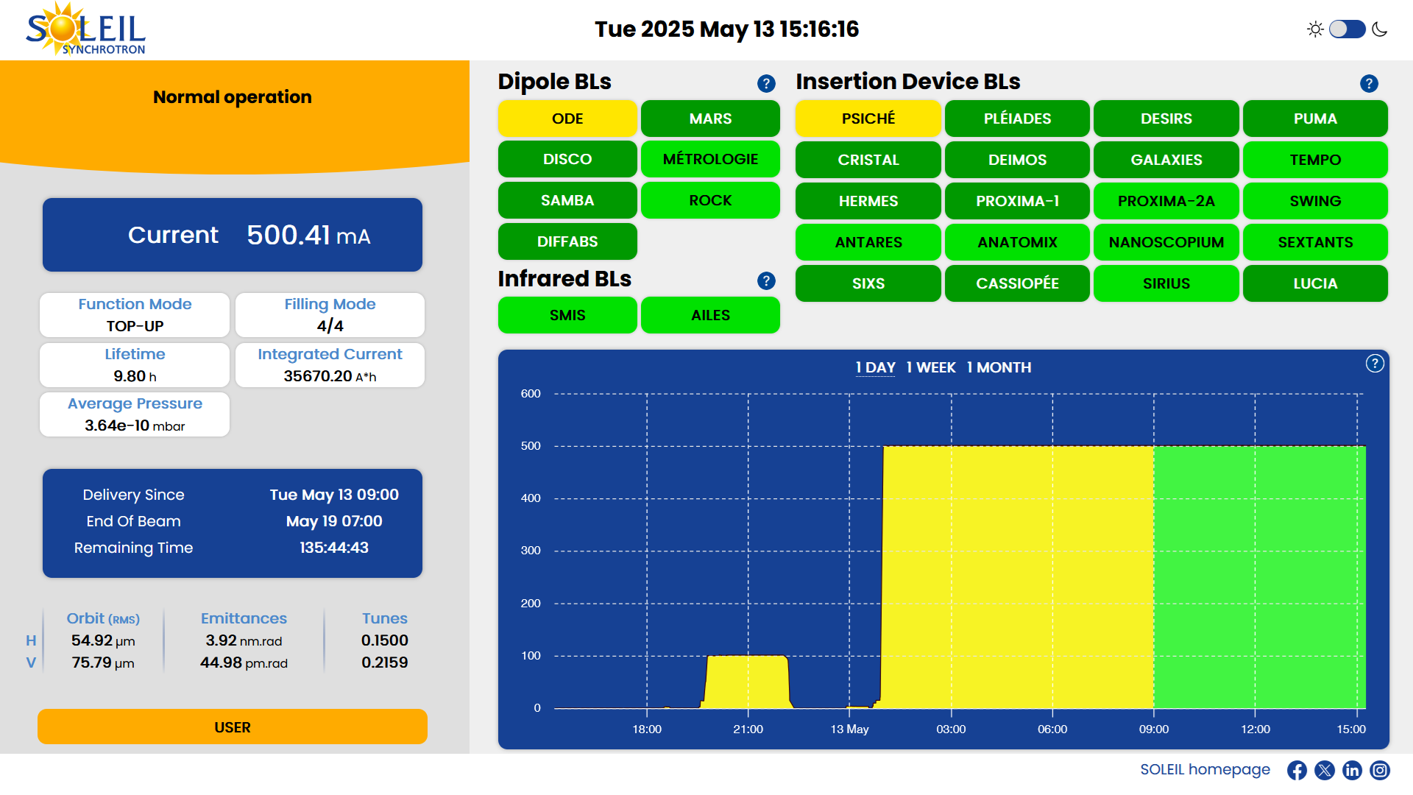
Current usage of our Web applications
MachineStatusWeb deployed
Available in restricted networks (private usage)
Based on archiving system for accelerators (GraphQL API)
Highly used by operators
Pending validations from comittees for public usage

Slide 9
Archiving status at SOLEIL

Slide 10
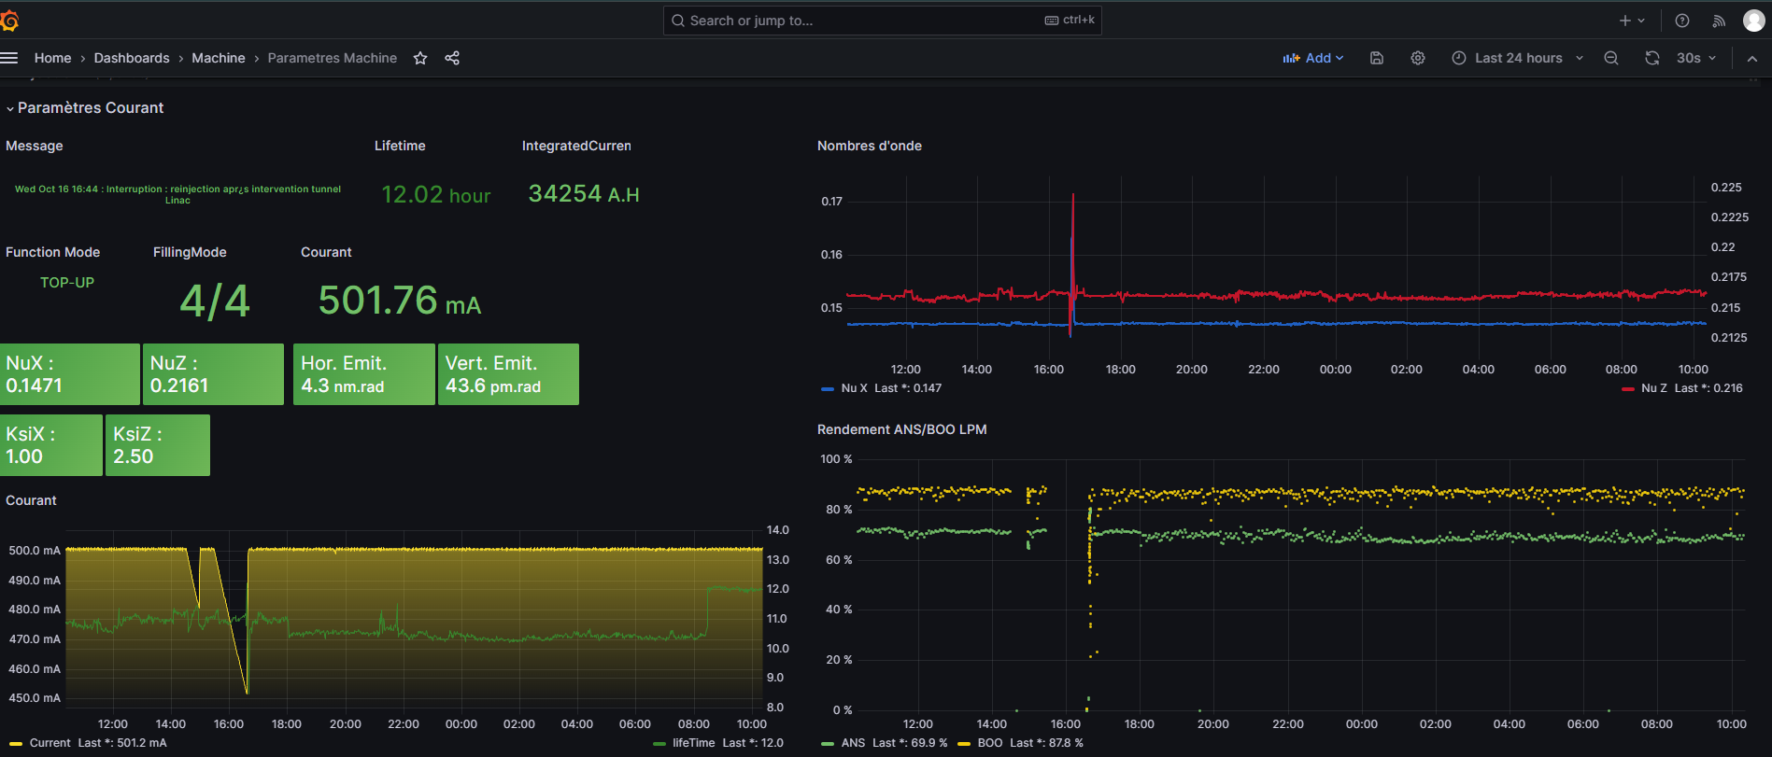
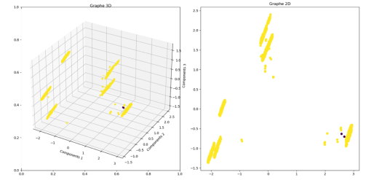
Archiving status at SOLEIL
Improving user experience, by moving from only-desktop GUI to web architecture
Since 2006
Intensively used on Accelerators, Beamlines & Labs
For monitoring and incident analysis
Complete user autonomy to add new data storage and retrieve data
~25 TB since 2006
x5 for SOLEIL II
Before 2024
From 2024
Progressive rollout before SOLEIL II’s dark period
Oracle/MySQL Databases
Timescale databases
Basic use cases study for automatic anomaly (AI) detection based on TANGO archiving data
Maintaining SOLEIL software stack → Allow smooth migration for users without any downtimes
Java Tango devices & Java Swing GUIs & Data fetching GraphQL API
Multiples insertions modes: polling (periodic, change…) & events
2 anomalies detected w/
Local Outlier Factor algorithm for RF systems
https://gitlab.synchrotron-soleil.fr/software-control-system/tango-controls-archiving

Slide 11
Taurus usage at SOLEIL

Slide 12
Taurus usage at SOLEIL
Taurus is still being tested on 1 beamline.
Simple, but highly used, applications developped.
Various use cases tested.
Taurus looks promising for them, though not perfect yet.
Notes:
- Control Helium injection, with automatic stop, as they used to do it with scripting, forgetting to close valve because of the logs invading the script console.
- Diffractometer config switch

Slide 13
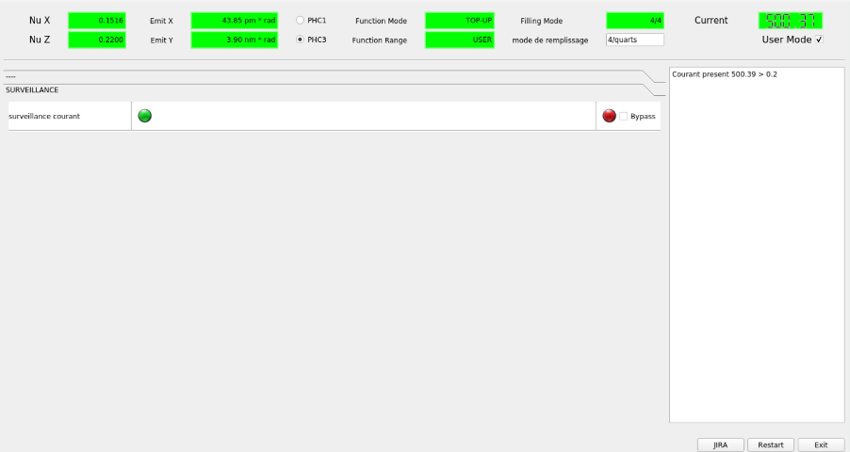
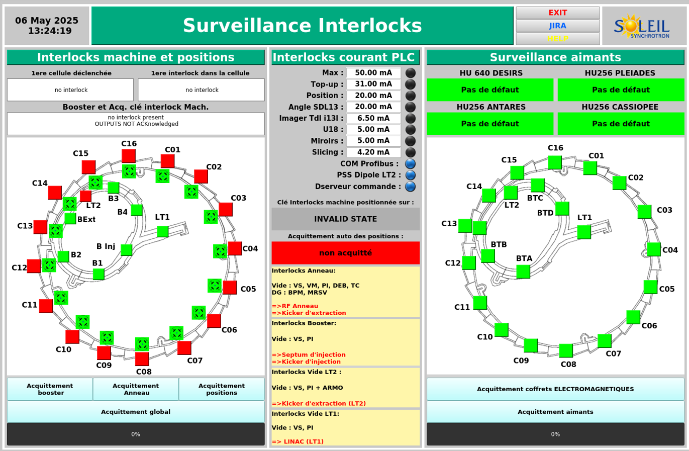
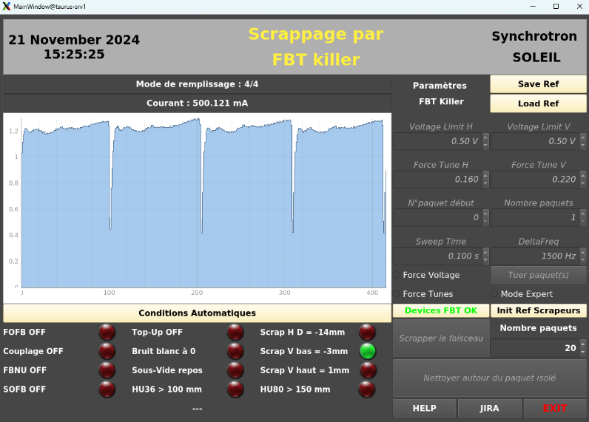
Taurus usage at SOLEIL
Still being tested in control room.
Applications regularly used, some migrated from LabView.
Taurus is highly appreciated
Notes:
Perte faisceau (checklist), FBT killer (tuer propre faisceau), interlocks

Slide 14
Taurus usage at SOLEIL
Taurus releases are regularly checked by our software team.
Keep Taurus team informed of encountered issues and potential solutions.
POC application for a new need on a beamline.

Slide 15
Highlights

Slide 16
Highlights
JTango 10 RC 1 is now available!
jtango-10 branch https://gitlab.com/tango-controls/JTango/-/tree/jtango-10
Soon available in maven
C++ software factory migrated to Conan/Cmake
All of our C++ devices (400) are built with Conan (delivered in production)
Ready for seamless upgrades

Slide 17
Ongoing developments and solutions

Slide 18
Ongoing developments and solutions
Working on alternatives to Java for UI
More web
More python
Upgrade from Tango 9.2.5 to latest LTS
Is Tango 10 LTS, or soon LTS?
Migration from Java 8 to latest LTS
Migrating Database device:
from 5.4 to 5.22
from MySQL 5.6 to MariaDB 10.5

