Slide 1


Slide 2

SOLARIS Status Update
Giulianova, 39th Tango Community Meeting 21-23.05.2025
Michał Piekarski, Michał Fałowski, SOLARIS CSIT Team
SOLARIS National Synchrotron Radiation Centre

Slide 3

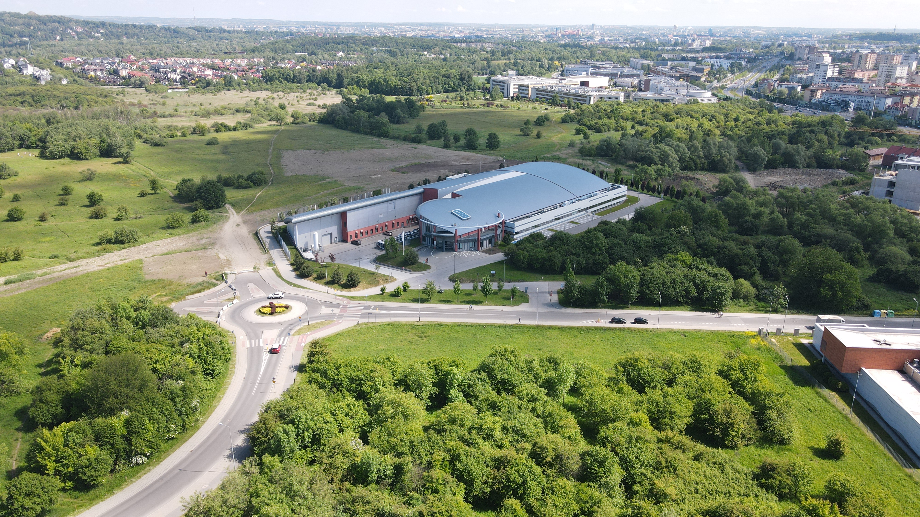
NSRC SOLARIS
Jagiellonian University New Campus
Kraków City Center
SOLARIS
Fot. Aleksander Koczur

Slide 4
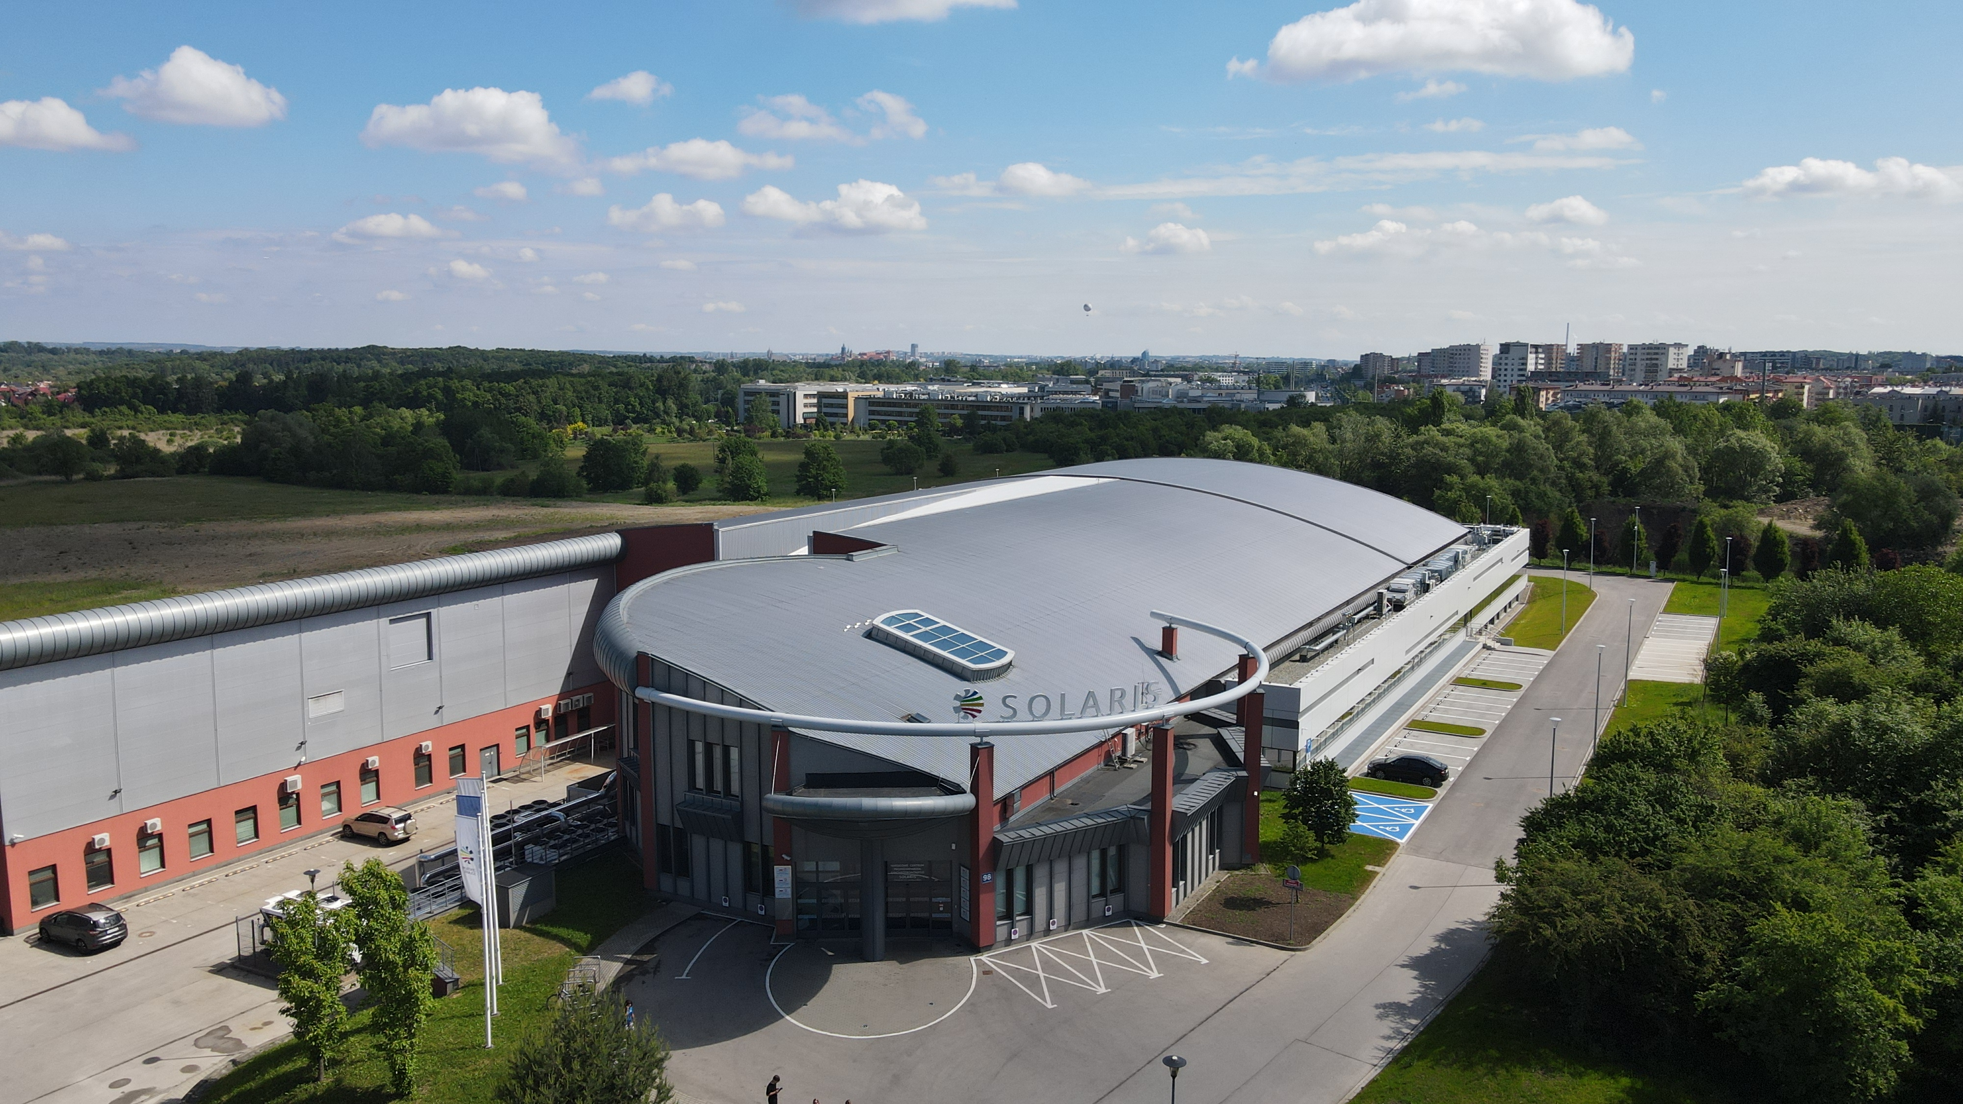
NSRC SOLARIS
Third generation light source.
Designed by MAX-lab team (Mikael Eriksson).
Constructed 2010 - 2015 in Krakow, Poland.
Between 2015 and 2018 the synchrotron as well as two beamlines (PIRX and URANOS) were commissioned.
Since October 2018 Solaris has been in the user operation mode.

Slide 5
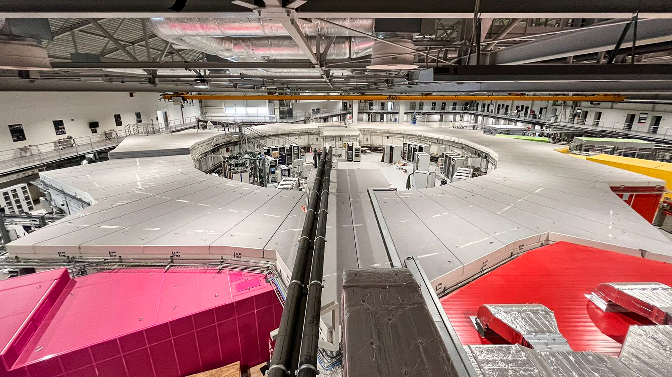
1.5GeV Storage ring
600MeV Linac
RF Thermionic Gun.
6 S-band 2998.5 MHz accelerating structures.
Accelerating gradient 20 MeV/m.
3 RF Units & SLED cavities.
Dog-leg vertical transfer line.
In operation since Dec. 2014.
Linac upgrade design is being contucted to match the ring energy (top up injection scheme).
12 DBA Cells – 96 m circumference.
Space for ID’s (10 sections) ~ 3.5 m.
100 MHz RF system.
300 MHz Landau Cavities.
Injection dipole kicker.
Ramping mode.
In operation since May 2015.

Slide 6

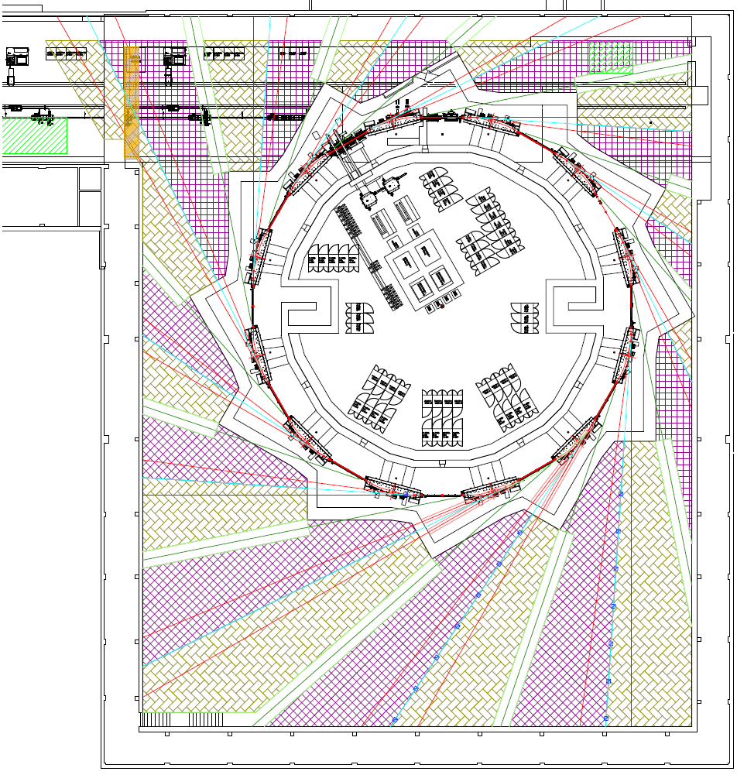


SOLARIS research infrastructure
Available and in user operation
POLYX
ASTRA
LUMOS
PINHOLE
Starting up
Project accepted, in construction, available in the future
Project application to be submitted
Available space for 4-5 beamlines
CIRI
in-vac initiative
+
CryoEm centre
Neutron-lab
(in construction)
SMAUG (SAXS)
Krios
HEROES
DEMETER
Glacios
ARYA
PHELIX
URANOS
NAP-XPS
end-station
PIRX
STXM
PEEM
Łukasiewicz Network
jakub.szlachetko@uj.edu.pl

Slide 7
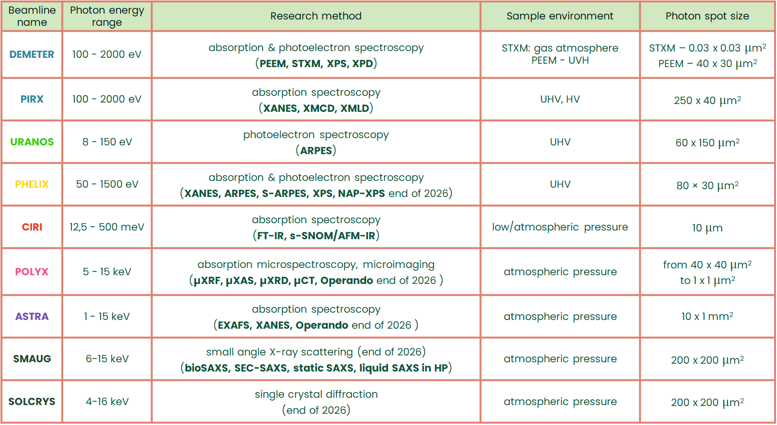

Slide 8
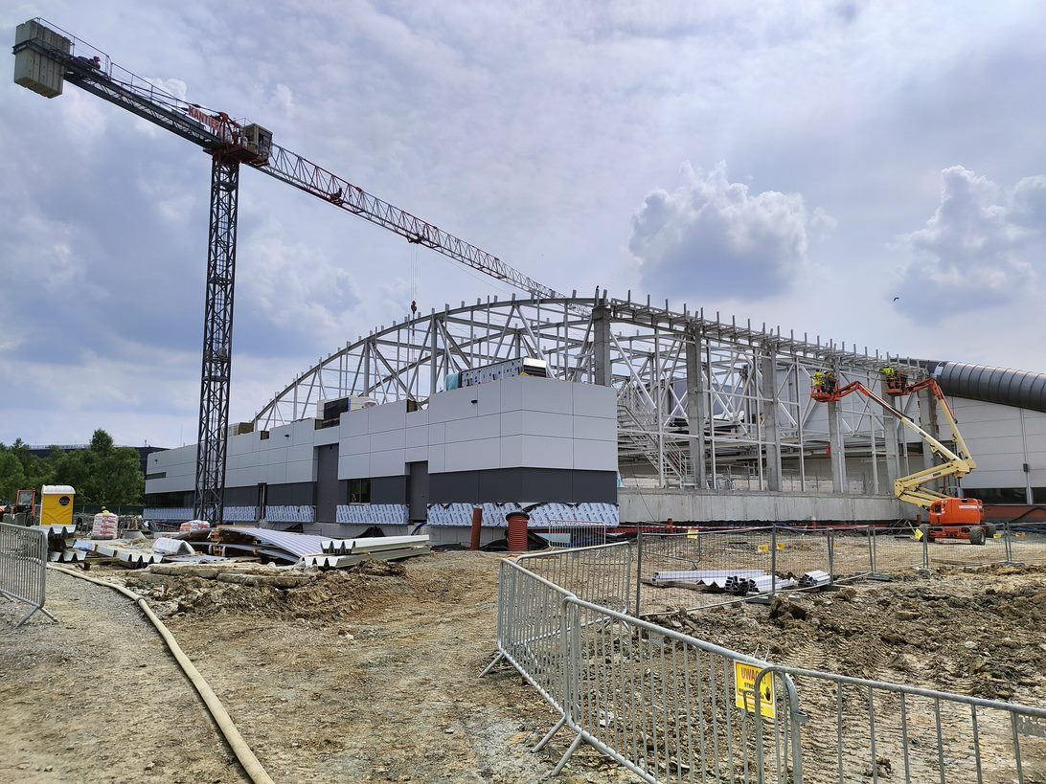
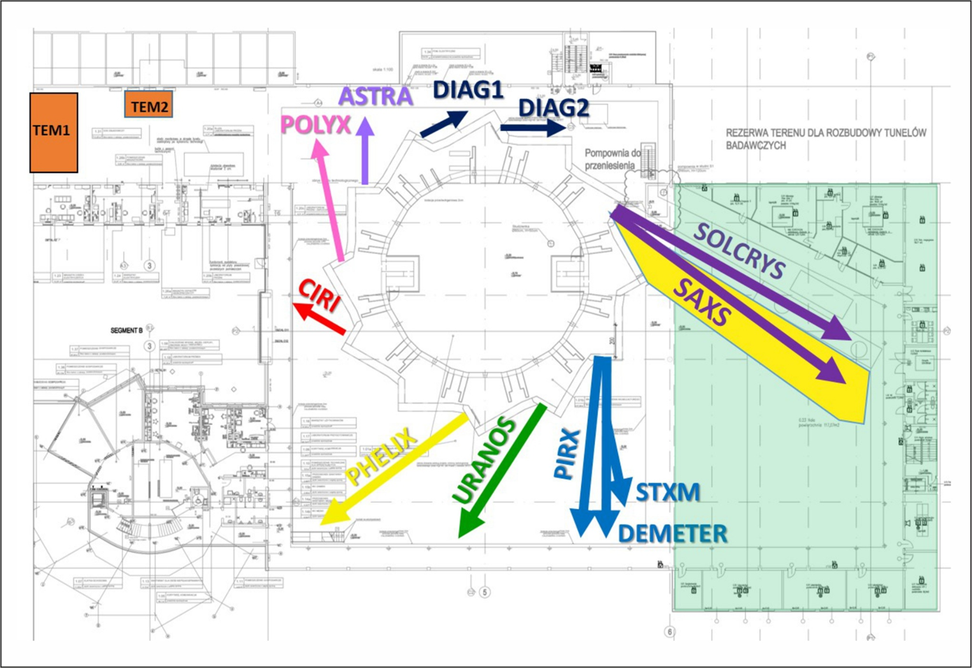
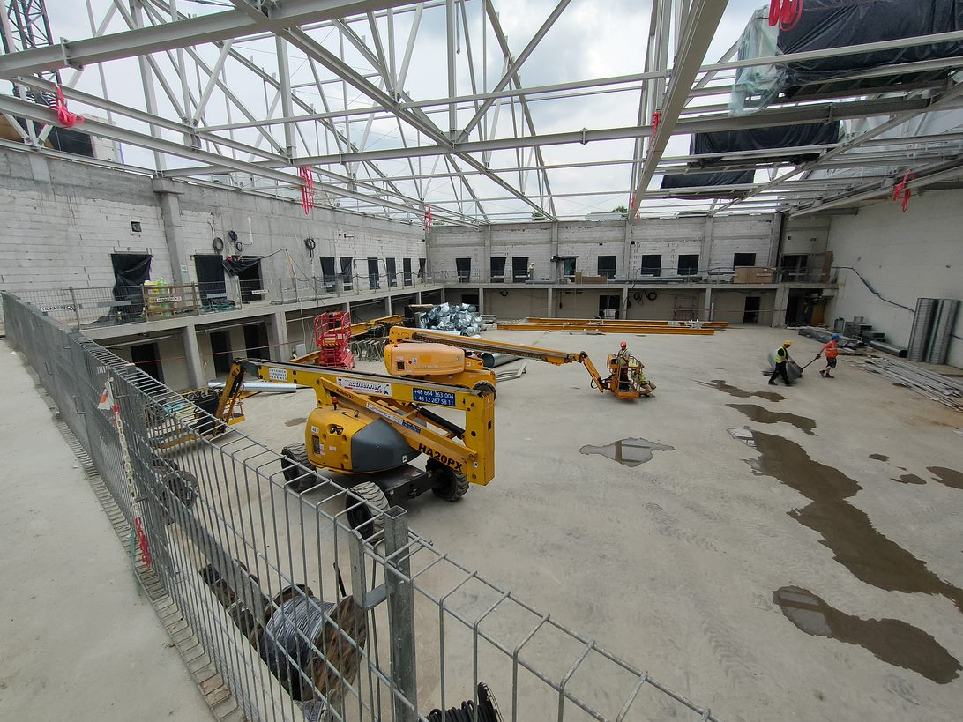
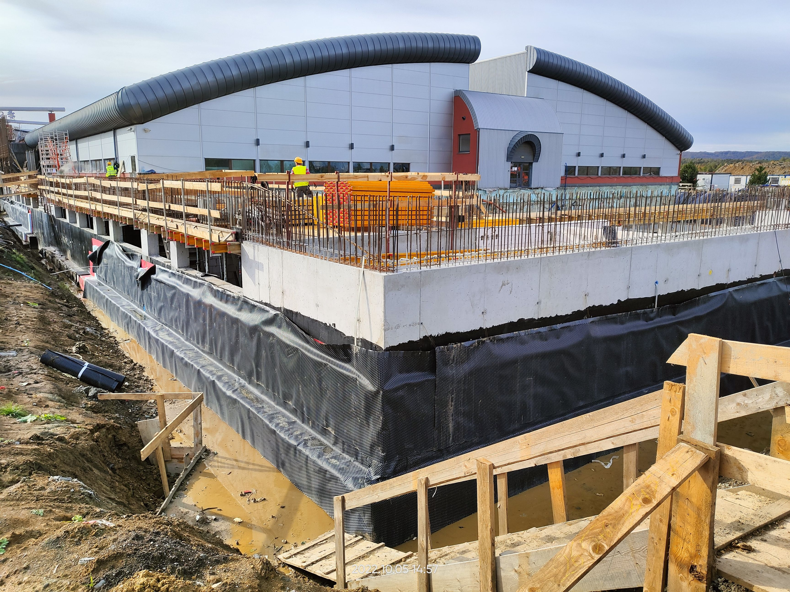
SOLARIS experimental hall extension
Cryo-Em Village
Done in Q3 2022-Q1 2024
8

Slide 9
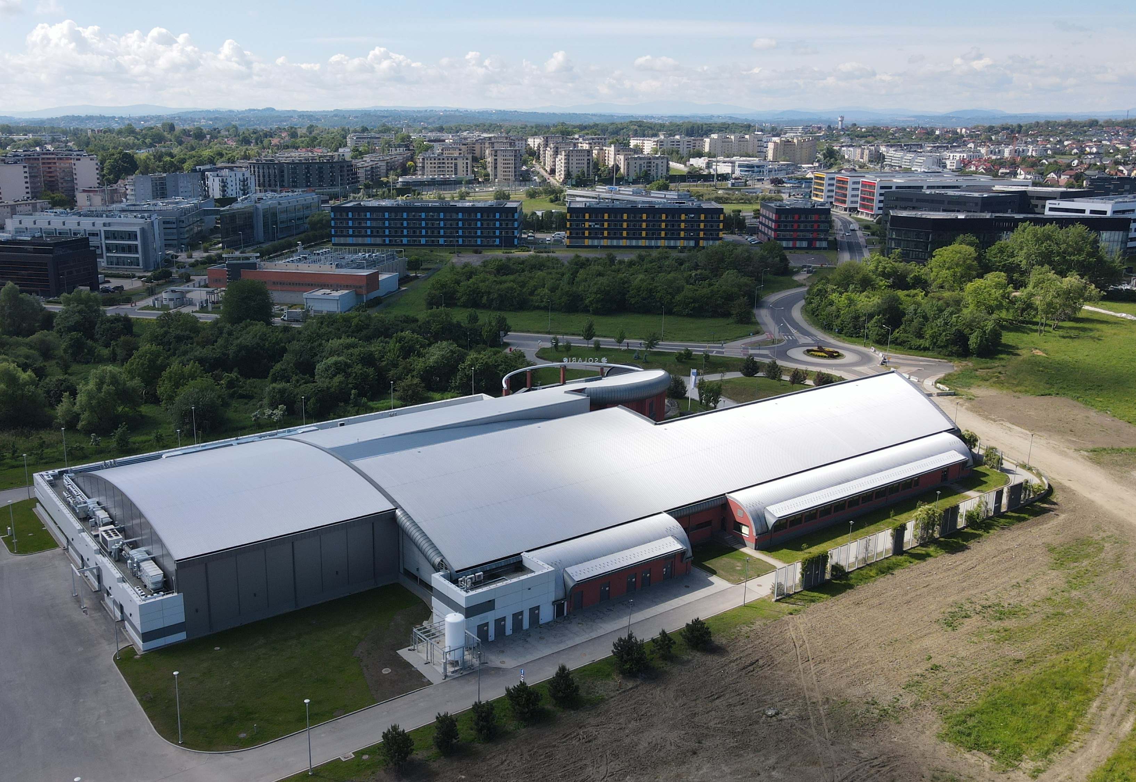
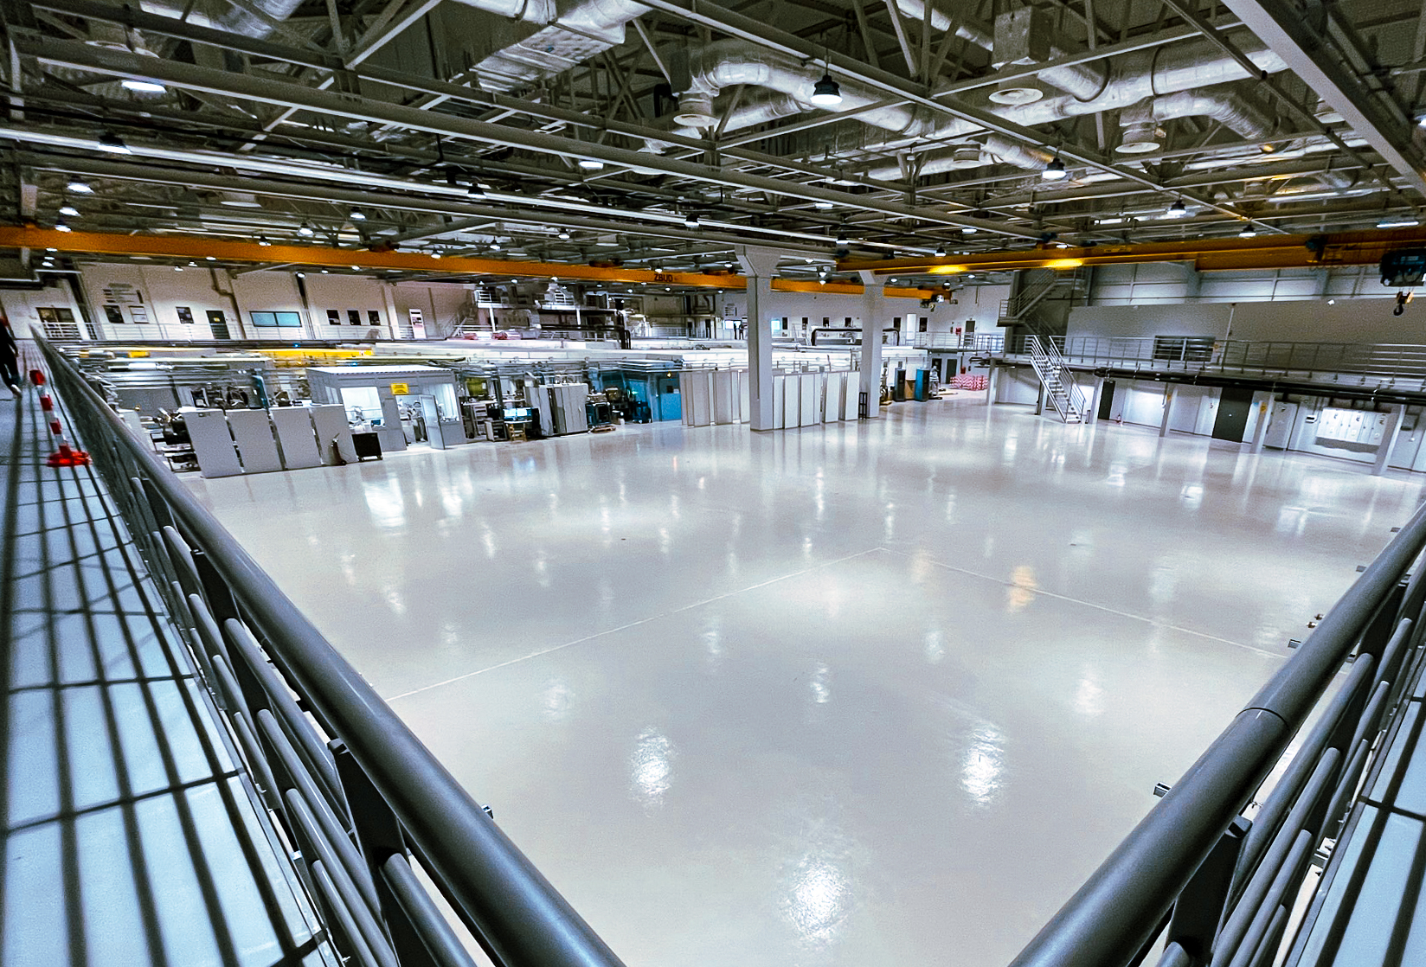

Slide 10
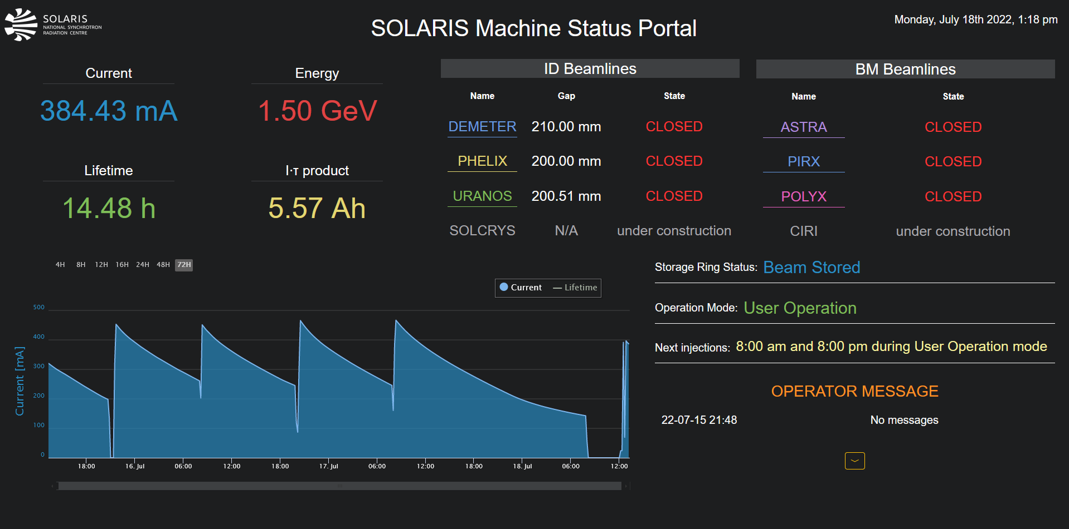
SOLARIS Operation
2 Shifts from Monday to Sunday (8:00-16:00; 14:00-22:00).
On call support to 2:00 am from Tuesday-Saturday.
2 operators per shift.
Monday – machine days, maintenance.
User operation 6 days/week (Tue-Sun).
Injection twice/day: 8:00 am and 8 pm.
One operation mode (uniform filling pattern).
Singe bunch operation mode under development.
Operation in the decay mode.
Banch by banch feedback (only for diagnostics).

Slide 11
SOLARIS CSIT Department
23 people in CSIT.
8 CS, 5 IT, 5 Web-SUN, 4 Web-CS.
Accelerators CS, Beamlines CS, Beamlines data auqisition and experiment control, Cybersecurity, IT Support, IT Infrastructure, Web development (digital user office, control system applications, general services), DevOps, AI and ML projects.
We plan to upgrade servers and disk arrays.
We plan to upgrade Control System and OS.

Slide 12
SOLARIS Cooperation – ML and AI
Creating working groups inside SOLARIS between accelerator, scientific and technical departments
Preparing subjects and project around ML and AI
We are in contact with CLARIN-PL group – Polish LLM PLLuM
We started colaboration with CDSI (Center of Excellence in Artificial Intelligence) from AGH University
We plan to create science club on AGH University under CDSI

Slide 13

2025 – the year of CS upgrade in NSRC SOLARIS

Slide 14
2025 – the year of CS upgrade in NSRC SOLARIS – reasons for quick upgrade
AWX/Ansible – older version contains a bug that prevents the installation of desktop environments in the latest operating systems.
AWX/Ansilbe – many Galaxy repositories are available only for the newer Ansible versions
K8s cluster was outdated and there were no more people responsible for deploying it for the first time
The repositories for CentOS 7 have been disabled, although the archive remains accessible.
ELRepo – locating archived repositories has become challenging, and there are no updated drivers available for the latest hardware.
Operators require a variety of Python tools.
It is becoming increasingly difficult to find dependencies for older Python packages.
Notes:
Older version

Slide 15
Control System upgrade – goal for 2025
New k8s cluster based on RKE2
AWX/Ansible update.
Repo and CI/CD refactor – to support two OS.
Build device class and GUI packages and dependencies in python 3.9.
Migrate all workstations to Alma 9.
Migrate data from HDB to HDBpp.
Migrate all non-Tango VMs to Alma 9.
Migrate most of the Tango VMs to Alma 9.
Windows machines to Windows 11 – mainly IT.

Slide 16
Control System upgrade – achievements in 2025
AWX/Ansible updated to the newest version (Execution Enviroments) and moved to the Kubernetes cluster
Prepared CI/CD to support two OSes.
Main Tango packages and dependencies has been built
Fixed package naming differences between OSes
Almost all workstations in CR are migrated to Alma 9
Most of the GUIs in CR migrated to Python 3.9 and Taurus 5.1 (or compiled to the newest version) – even these in Python 2.7 and Taurus 3.7 version
Most of the VMs are now Alma 9

Slide 17
Control System upgrade –issues arosed during the migration process
Impossible to have old OS on new hardware (even with many workarounds and LTS for drivers) – instead of migrating workstations last, we had to migrate them first
Numerous applications that appeared to be rarely used for years turned out to be quite vital, (still using Taurus 3 and Python 2).
MATLAB 2014 is incompatible with the latest version of Tango on the newest operating system.
The names of packages differ between the old and new operating systems, even when using similar distributions.
Many „if”s and hardcoded dependencies in Ansible playbooks.

Slide 18
Control System in NSRC SOLARIS now
Accelerators and beamlines for control system use PLC (BMS, MPS, PSS) and TANGO (high level, mostly python, sometimes C++).
OS: Alma 9 (mainly), CentOS 6, 7, 8, Windows 10, 11 + some embedded custom Linux and 1 Fedora (old one)
Python versions: 2.7 (GUIs), 3.7 (some web), 3.6 and 3.9 (mainly).
Tango versions: 9.4.2, 9.3.5 and 9.3.6 (mainly), 9.2.5 (few systems left), 9.1 (embedded) and some 8 (e.g. old archiving).
Taurus versions: 5.1 (mainly), some systems left 3.7 (virtual env), 4.1, 4.4 (virtual env), 4.5, 4.7
Additionally, some projects use Vue.js, Tango GQL and Taranta (for authentication).
Archiving: hdb++ + MySQL InnoDB <- moving data from old HDB archiving
Migrated to Sardana 3.5
No big difference between machine and beamlines - same software stack
running on VMs
Ansible, AWX EE
Cryomicroscopes are fully independent and are based on manufacturer software

Slide 19
Thank you!
Questions?

