Slide 1
TANGO-Controls @ POLARIS
current status and upcoming activities
Alexander Kessler, Dominik Hollatz
GSI - Helmholtz-Institut-Jena
39th-Tango-Community-Meeting-2025

Slide 2
Outline
Current Situation and Motivation for Tango
Roadmap for switch to Tango
POLARIS LabVIEW-Tango Bridge
Mapping Laser and Experiment Data to Shot ID
Upcoming activities in cooperation with S2Innovation
  Rethinking cppTango Thread Locks
  Transition NI-Vision => Free Open Source Solution
  Extension of SARDANA

Slide 3
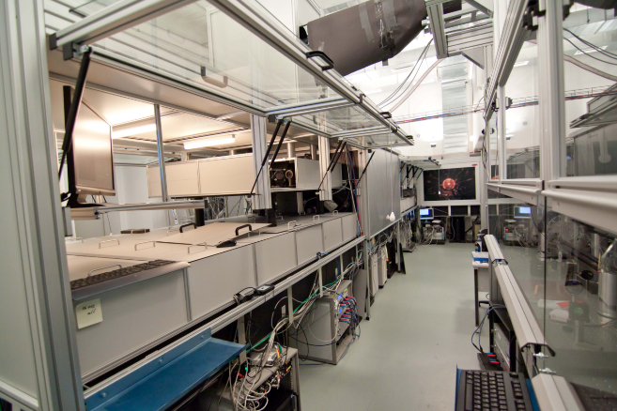
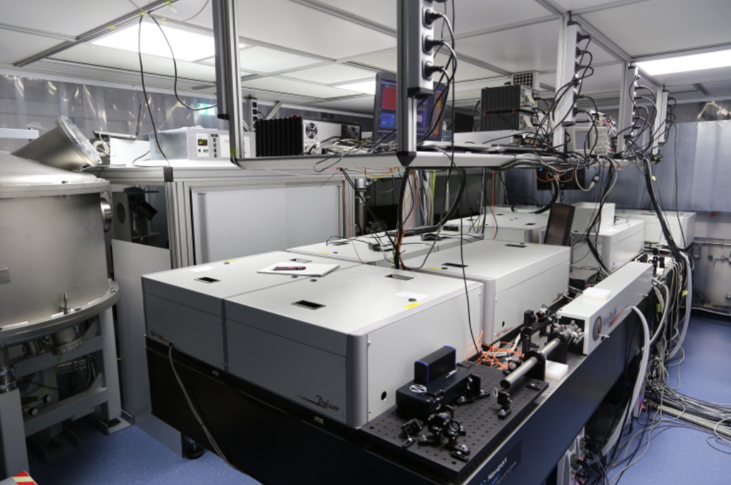
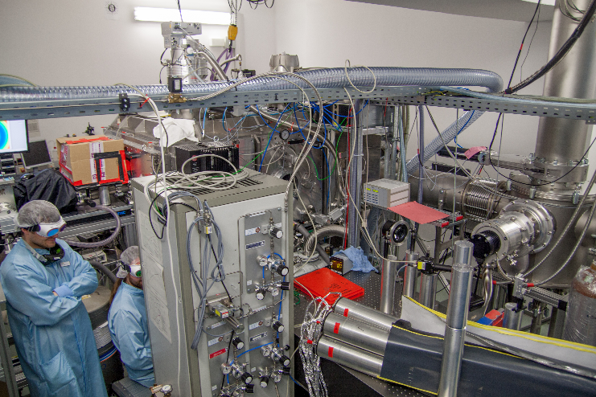
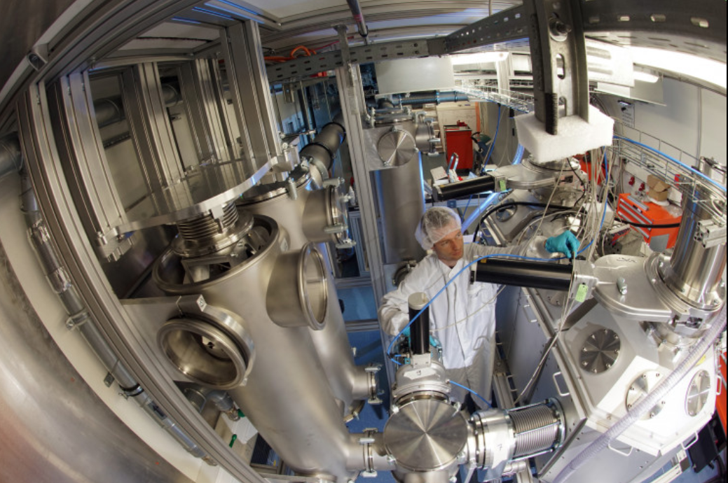
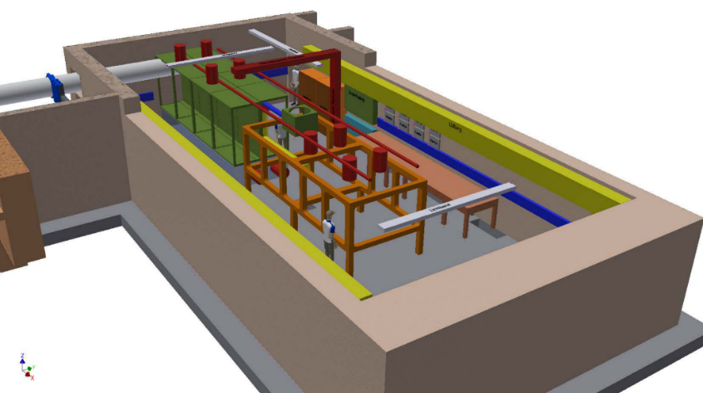
POLARIS and JETi200
Current situation:
standalone LabVIEW apps @ Windows XP – 10
Remote control via UltraVNC & Remote Desk.
Motivation:
POLARIS and JETi200 should to be used synchronized for high-intensity laser plasma experiments
Due to the increasing complexity, we need a SCADA system
Lab1: Strecher and A1-A4
Target
https://de.wikipedia.org/wiki/Polaris_(Laser)
https://www.physik.uni-jena.de/436/jeti-200

Slide 4
TANGO @ POLARIS: Roadmap
Make the change as transparent as possible!
Create a bridge LabVIEW <-> Tango
Benefit from Tango-Ecosystem
  HDB++, Sardana, Taurus/Taranta,
  (DON’T) PANIC
Get colleagues onboard
Rewrite Apps in pyTango:
Goodbye LabVIEW ☹, NI ☺
Switch to Linux:
Goodbye Microsoft ☺
Problems to solve: adapt Tango and Sardana to High-Intensity Lasers
Data Mapping via Shot ID
Human-Driven experiments
How to make data F.A.I.R.?
(Findable, Accessible, Interoperable, Reusable)

Slide 5
POLARIS LabVIEW-Tango Bridge
LV-Binding in Tango DS mode did not succeed due to permanent crashes of LabVIEW2020 (in year 2022)
LV-Binding in client mode: some problems are there, but it works!
  Requires a restart of the LV if the interface of the DS is changed
  The input of timestamps is available, but the LV bindings do not seem to pass them on to Tango...
  LabVIEW client receive ghost events when DS is stopped
  https://www.tango-controls.org/community/forum/c/development/labview/labview-client-receive-ghost-events-when-ds-is-stoped
A pyTango proxy DS provides interface to Tango
Extend LV-Apps to write attributes of the proxy DS
the Proxy DS fires data change and archive event

Slide 6
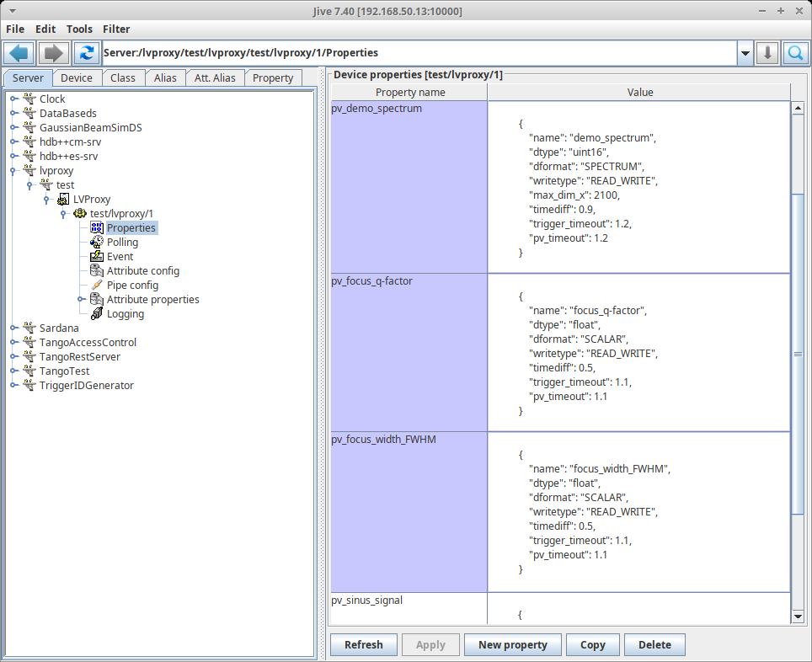
POLARIS LabVIEW-Tango Bridge: pyTango
First approach: general pyTango LVProxyDS proxy for Life, the Universe and Everything…
@command add_pv_attr()
in: attr descr as JSON
Stores Attributes in properties
Creates Attributes dynamic on start
This was a good exercise to get started with pyTango, but too complicated

Slide 7
Tango-Bridge: pyTango and LabVIEW
pyTango:
second approach: very simple pyTango DS with static attributes set
in total: more code, but much simpler
Use Tango DB to store calibration data and other settings in attributes
May use attributes as “pseudo command” e.g. acquisition_is_active
LabVIEW side:
Subscribe for attributes change containing settings and attributes for control
Event will be triggered at start, even without real changes of attributes
can be used to restore settings
use a separate non-blocking thread for writing of attributes! If DS not running, hang up

Slide 8
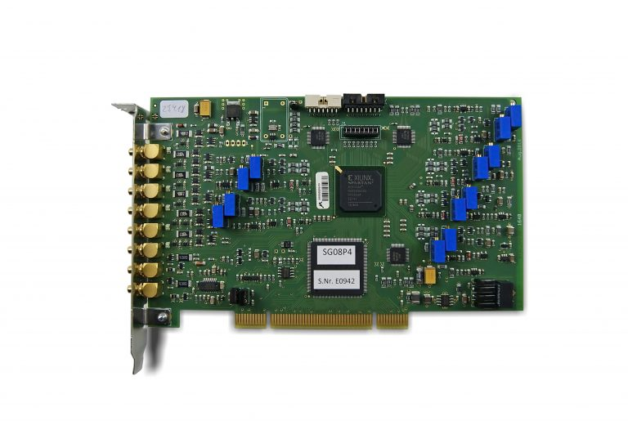
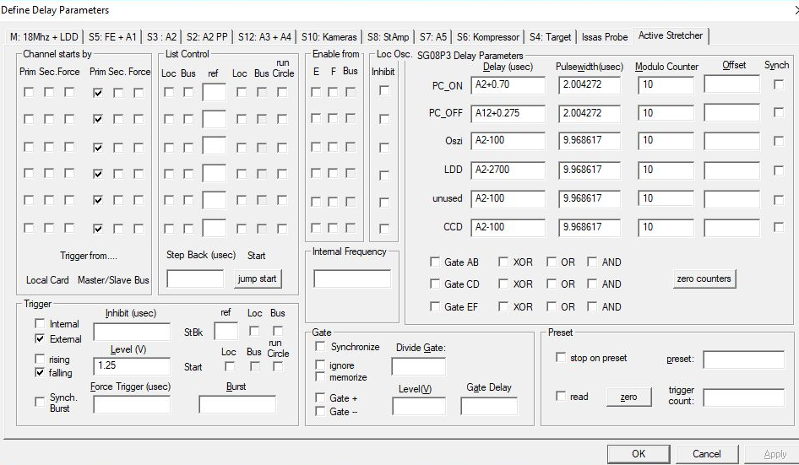
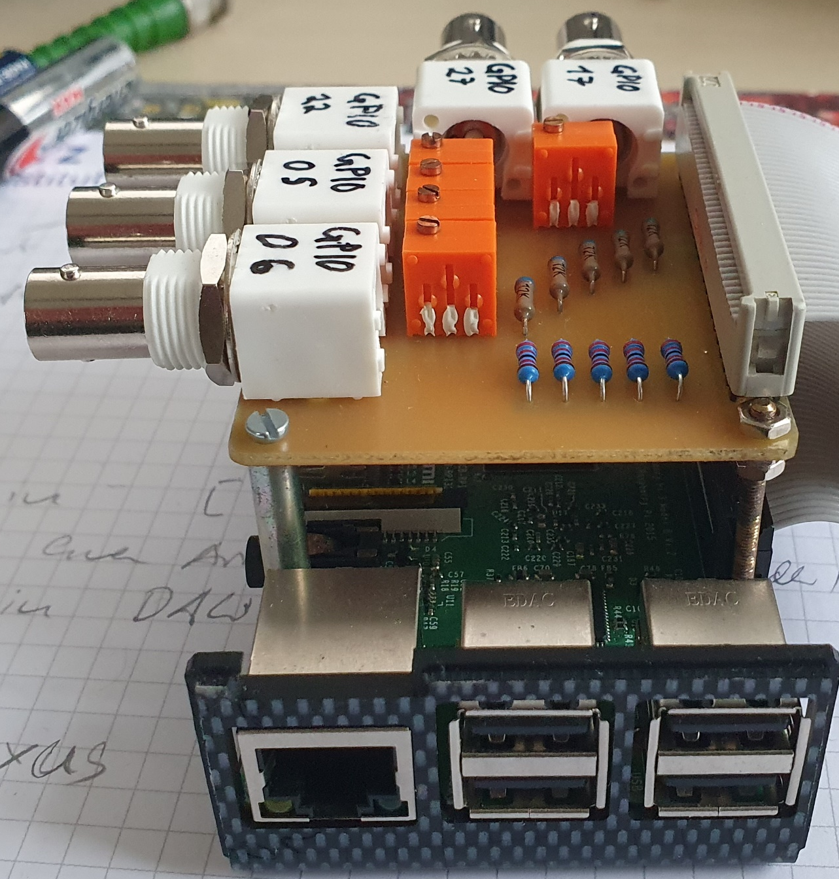
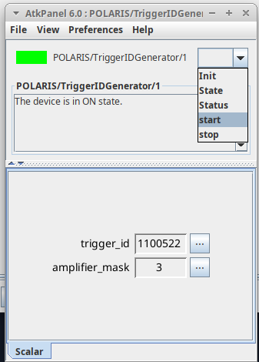
Assignment of Measurements to a Shot ID
Triggersystem 12x 6ch BME_SG08p
from co. Bergmann Messgeräte Entwicklung KG
Don’t touch a running system… ->
Raspberry PI GPIOs as trigger signal watchdog
Tango DS: TriggerIDGenerator
  connects to GPIO daemon via Ethernet
  generates TriggerID and Ampifiermask
  deploys via push_change_event and push_archive_event with timestamp to TANGO

Slide 9
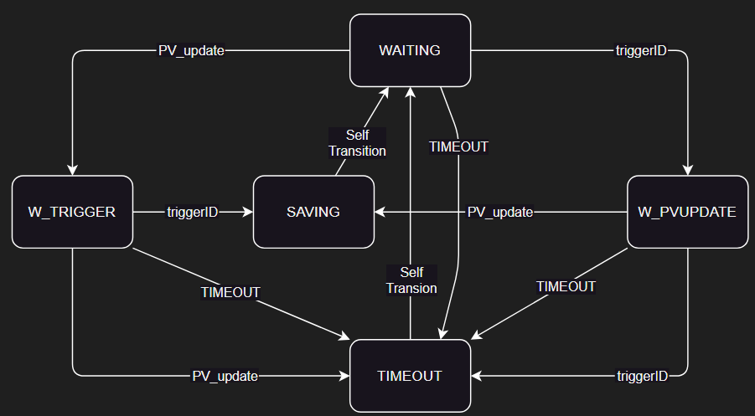
Assignment of measurements to the shot ID
How can attributes stored in HDB++ be correlated with each other?
First idea from HDB++ Slack: save all with the same timestamp
  Starts a watchdog for each attribute
  Correlates changes with trigger Id
  Push archive_event with exact same timestamp like trigger Id
Realized as an asynchronous state machine
Motivation:
  to learn how to program actors in Python
  should help to port my LV Actor Framework based applications
  to get familiar with Tango greenmode
Results:
  works not reliable if async for attribute.read|write is used
  works if async stuff is hidden behind a synchronous interface

Slide 10
Heisenbugs in AsyncIO greenmode…
Communication between Asyncio DS and client DeviceProxy times out, when DS is observed by Jive ATK panel
  pyTango issue #629
  cppTango issue #1380
  Discussion in Tango LV Forum
  https://www.tango-controls.org/community/forum/c/development/labview/is-a-reliable-interaction-between-labview-client-and-greenmodeasyncio-ds-possible
It seems to be a bigger annoying problem related to cppTango thread locks
https://gitlab.com/tango-controls/cppTango/-/issues/?sort=created_date&state=opened&label_name%5B%5D=Locking
We have ordered S2Innovations to investigate and try to solve
We kindly ask the Tango community to support us in this endeavor ☺

Slide 11
Assignment of measurements to the shot ID
Second idea from HDB++ Slack: just save all with own timestamps, build some query logic into the readout application
Should be sufficient for max. 10 Hz operation
The synchronization of PC clocks via NTP is precise enough
To do: readout application

Slide 12
Summary in between
Multiple options for LabVIEW integration
Multiple options for assigning measurements to shot ID
Benefit from Tango-Controls:
  longtime storage for facility data in HDB++
  use SARDANA for scans and structured storage in NeXus format
  quick GUI development with TAURUS
  may be Taranta for web dashboards
Todo:
  solve some Issues if proxy DS not running
  implement a Watch Dog for HDB++
  develop convenient GUIs and worflows
  get users onboard!
Would be nice to have:
  Single-Writer Mode for an attribute
  Watchdog for HDB++

Slide 13

Upcoming activities
We received a grant from the Thüringer Aufbaubank for the development of control systems for JETi200 and POLARIS
We want to
  support the redesign of cppTango thread locks (see slide #10)
  develop a FOSS alternative for HIJ-Vision
  extend SARDANA to support custom commands
  adapt SARDANA scans to laser experiments
  implement web dashboards for experiments with comment function
  define a data flow collecting data in F.A.I.R. way
  develop a pyTango DS for a Bronkhorst gas mixing devices
Yesterday we had a kick-off meeting with S2Innovation

Slide 14
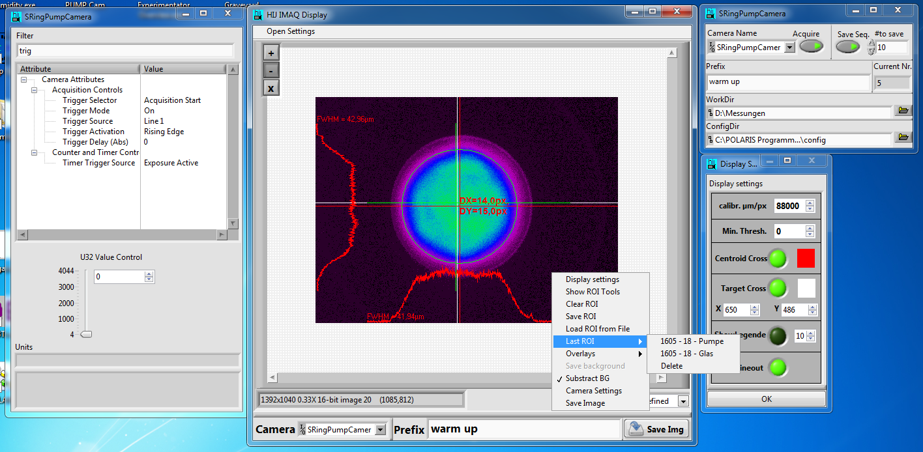
FOSS alternative for HIJ-Vision
app tailored for laserlab operation and experiments
offers ROI management
shows result as image overlay or in indicators of GUI
supports all GigE-Vision cameras
saves metadata for provenience of results
very important for getting colleagues on board
https://github.com/orgs/Vision-For-Laserlab/repositories
https://www.tango-controls.org/community/forum/c/general/other/looking-for-vision-applications/

Slide 15
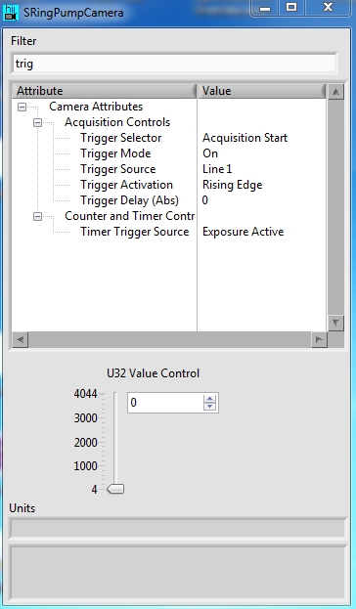
FOSS alternative for HIJ-Vision
common Tango DS for GigE-Vision cams
  Provision of an interface for changing as many camera parameters as posible
  stable handling of physically removing and reconnecting the camera
  triggers alarm if cam is overloaded
  may be: support of 12bit packed mode
the new application should support
  camera mode: store data and metadata
  file viewer mode: reload data, reproduce results

Slide 16
Extensions and Adaptation for SARDANA
Adding user-defined commands
a device can be integrated into SARDANA by creating subclass of the controller class.
can use TAURUS SARDANA widgets.
Now is not possible to define new commands (e.g. zero_counter) in pyTango way
user defined commands should also be available in TAURUS Widget
Adaptation to the POLARIS workflow
Synchrotron applications are standardized and one scan can be performed at a time
POLARIS experiments are often manually controlled
Adjustments of the target or laser system between scan points are common
SARDANA scans should be adapted for this situation

Slide 17
Acknowledgments
The entire TANGO community, especially everyone who supports us in Forum, GitLab, Slack|Mattermost, remote sessions
Dominik Hollatz (HI-Jena)
S2Innovations
Byte Physics
Thüringer Aufbaubank
Thank You for Your Attention!

Slide 18
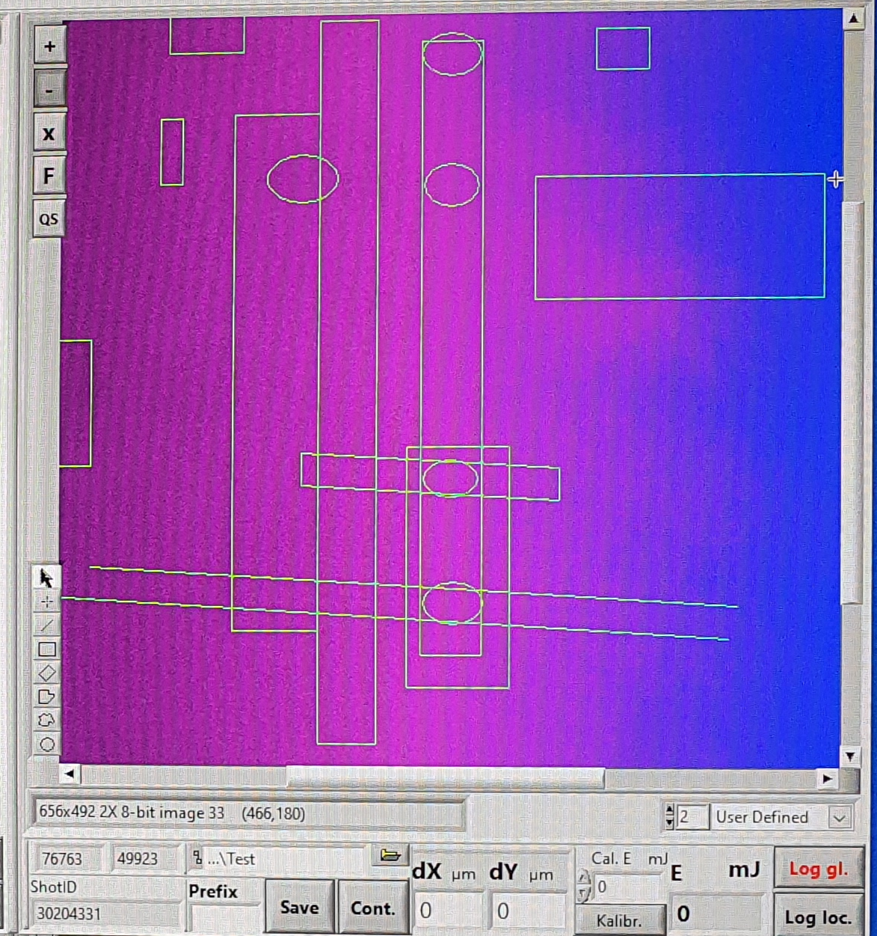
Example for a complex ROI ;-)

Slide 19
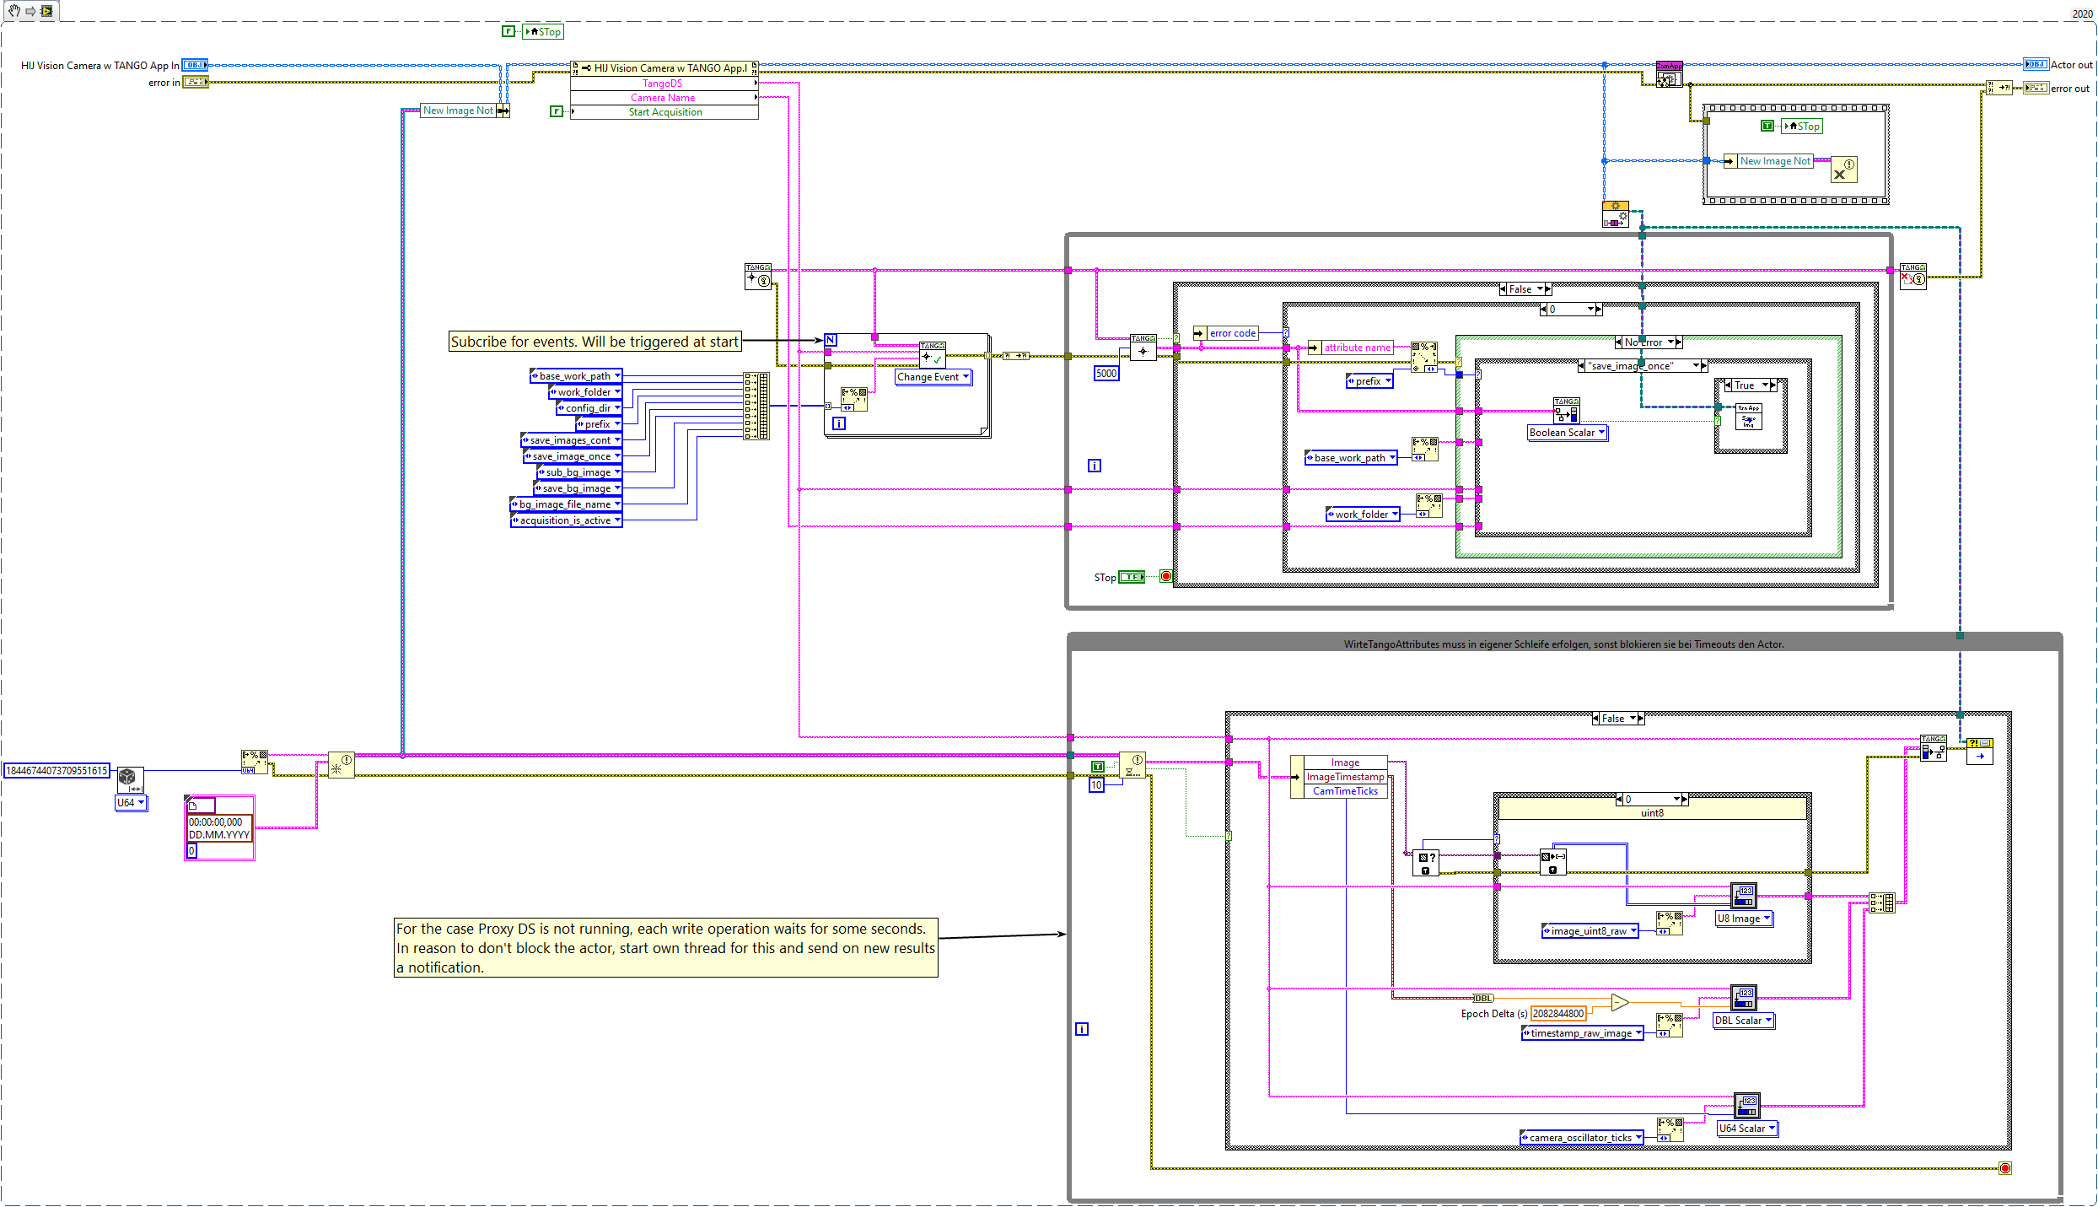
POLARIS LabVIEW-Tango Bridge: LabVIEW

