Slide 1

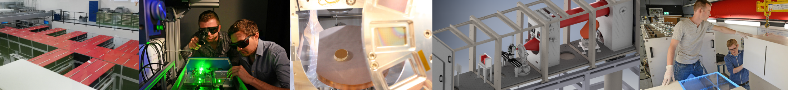
Overview on the
Tango infrastructure at the
Centre for Advanced Laser Applications (CALA)
Florian Schweiger(*), Michael Bachhammer, Leonard Doyle, Andreas Döpp, Christoph Eberle, Sonja Gerlach, Florian Haberstroh, Timo Pohle, Nils Weisse, Johannes Zirkelbach
Prof. Dr. Jörg Schreiber, Prof. Dr. Stefan Karsch
(*) flo.schweiger@campus.lmu.de

Slide 2
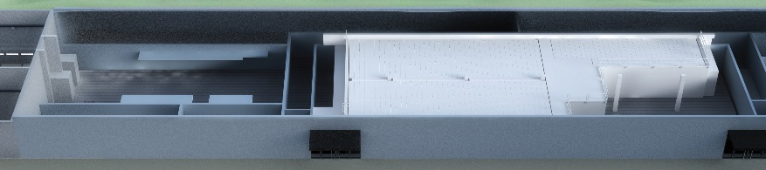
ATLAS-3000 laser and experiments
ATLAS
experiment
areas
Centre for Advanced Laser Applications in Garching near Munich, Germany
  University lab, no user facility
ATLAS-3000
  Ti:Sapphire laser
  60J in ~30fs at 1Hz rate (~2.5PW peak power)
  operational since 2017, currently ~500TW

Slide 3
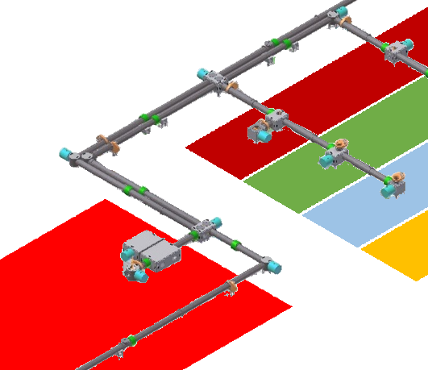
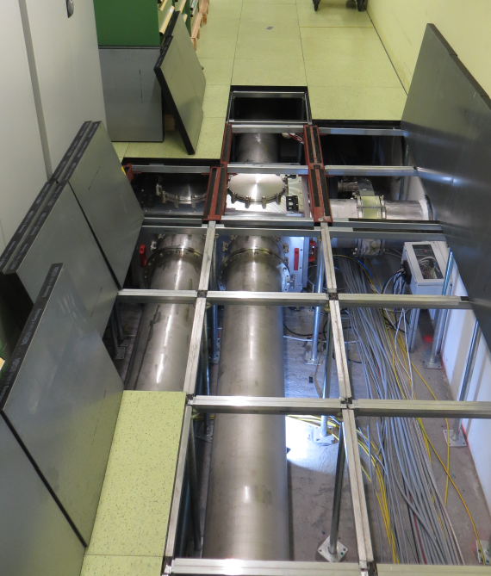
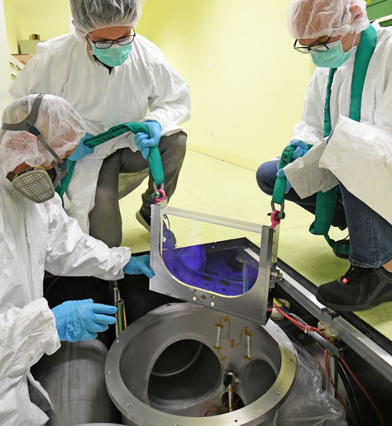
ATLAS-3000 laser and experiments
ATLAS
experiment
areas
Centre for Advanced Laser Applications (CALA)
Laser beam delivery
ATLAS

Slide 4
ATLAS-3000 laser and experiments
ATLAS
experiment
areas
Centre for Advanced Laser Applications (CALA)
Ion acceleration | Electron acceleration | Other activities
protons, carbons targetry, detectors, biomedical applications gold, heavy ions → nuclear astrophysics | Laser wakefield acceleration X-rays via betatron or Thomson backscattering accelerator research, biomedical imaging | Strong field QED laser pulse characterization

Slide 5


Tango infrastructure overview
Python + PyTango only
>800 devices on 5 TANGO_HOSTs
9 VMs (AlmaLinux)
~40 Windows hosts
9 Raspberry Pis
Limited work force
Laser is „student-run“
Tango maintenance + development by PhD students and student assistants
good support from university IT admins
Archiving:
  on-shot (up to <1Hz)
  Text files, PNGs
  <300GB per day

Slide 6
Tango infrastructure overview
Control system
Admin tools
Archiving
Monitoring
User / scripted
control

Slide 7
Admin tools

Slide 8
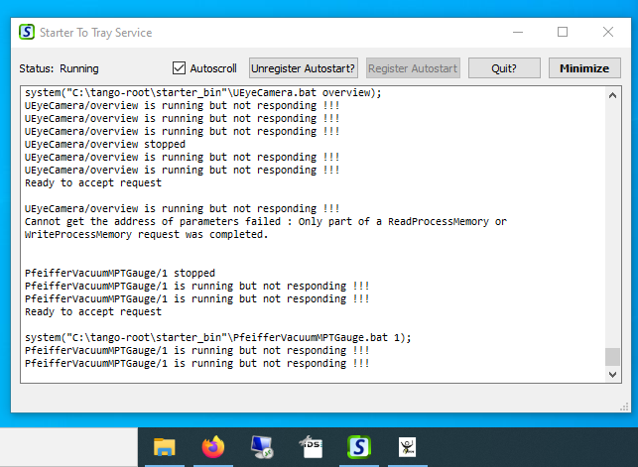
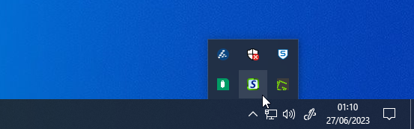
Admin tools: StarterToTray
„nssm“ for Starter.exe
  Console not accessible
  No network drive mapping
  Permissions different
„StarterToTray“
  Keep code running in „user space“
  But: hide in tray
  Downside: start after logon only

Slide 9
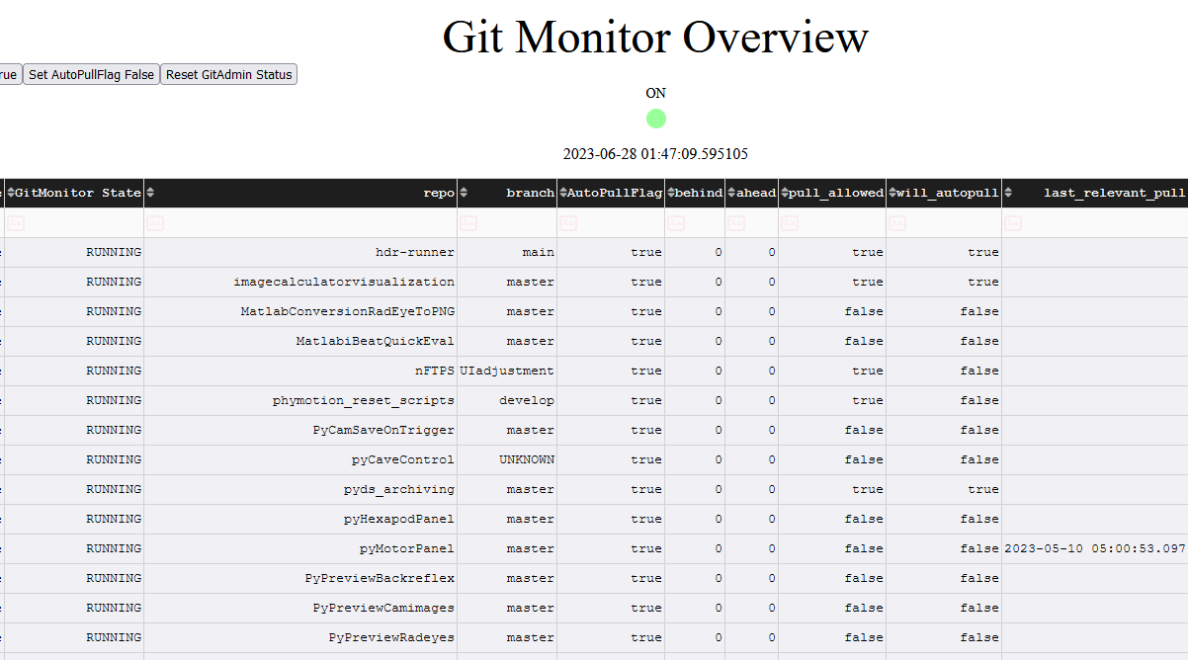
Admin tools: deployment helper „GitMonitor“
Python+PyTango:
  Deployment == „git pull“
  Tip: Use „pip install –e“ to avoid copy to „Lib\site-packages“
GitMonitor
  Scan all repositories in
  „C:\tango-root\tangolib“
  Every day 5AM do
  „git pull“ if clean state
  Compile central table of all hosts in helper device (web view Python-dash)
(+ manual device restart)

Slide 10
Archiving

Slide 11
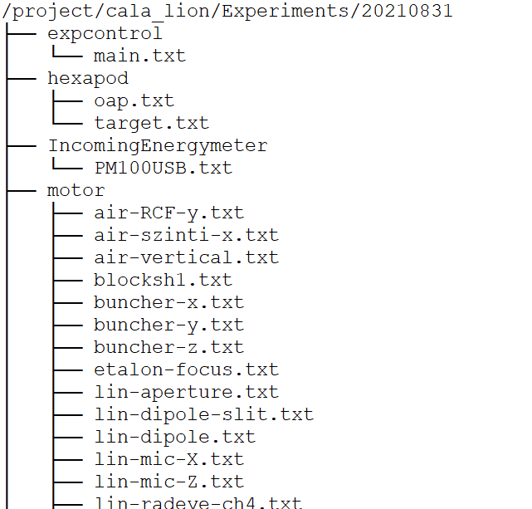
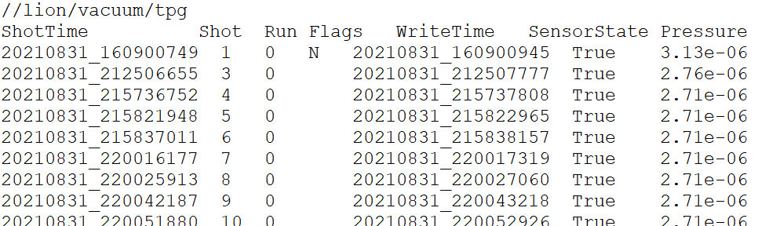
Data Archiving: File structure
Global folder (network share)
  /project/cala_lion/Experiments
  similar for other caves, laser
Subfolder/filename for each device
  `ExperimentPath/ArchDevicePath/ArchDeviceName`
  `ExperimentPath` = 20210831
  ArchDevicePath = property
    `automatic` → `hexapod` for `lion/hexapod/target`
  ArchDeviceName = property
    `automatic` → `target.txt` for `lion/hexapod/target`
20210831/vacuum/tpg.txt

Slide 12
Monitoring

Slide 13
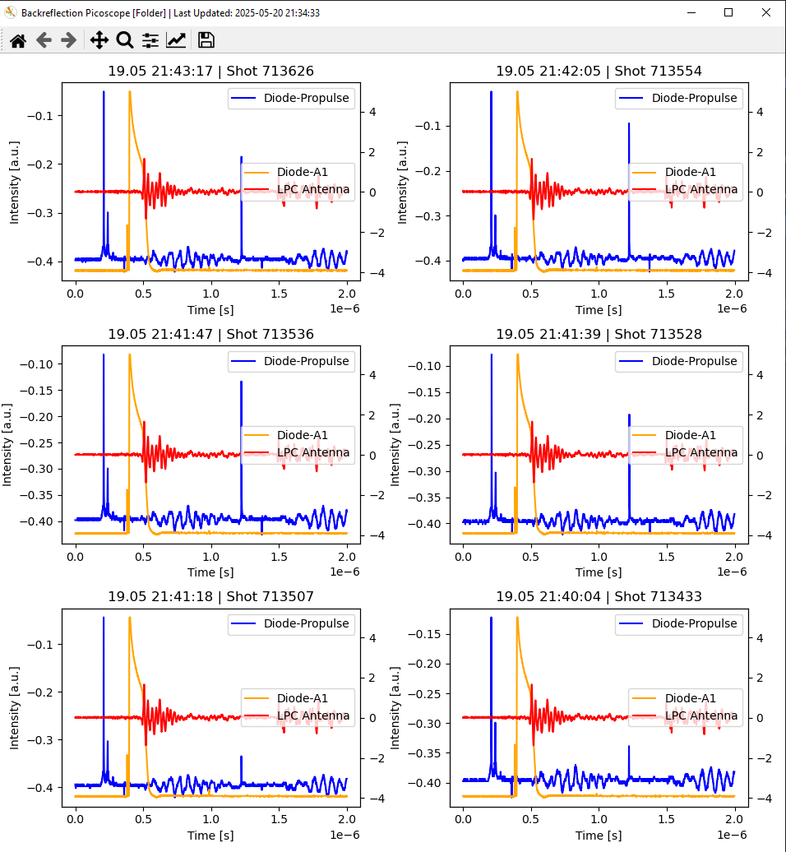
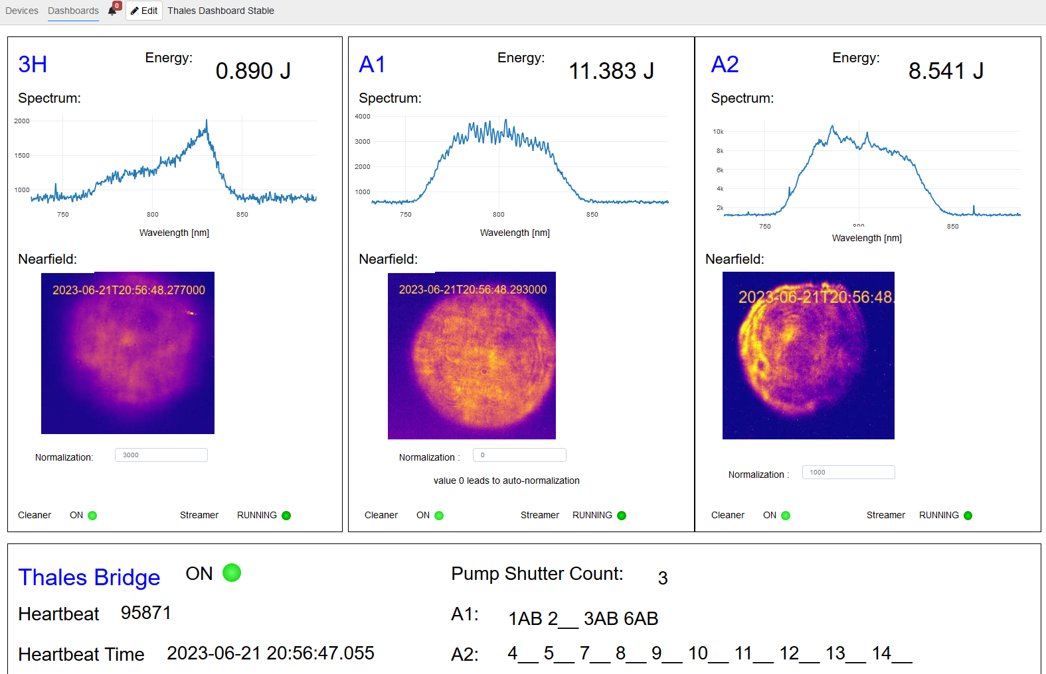
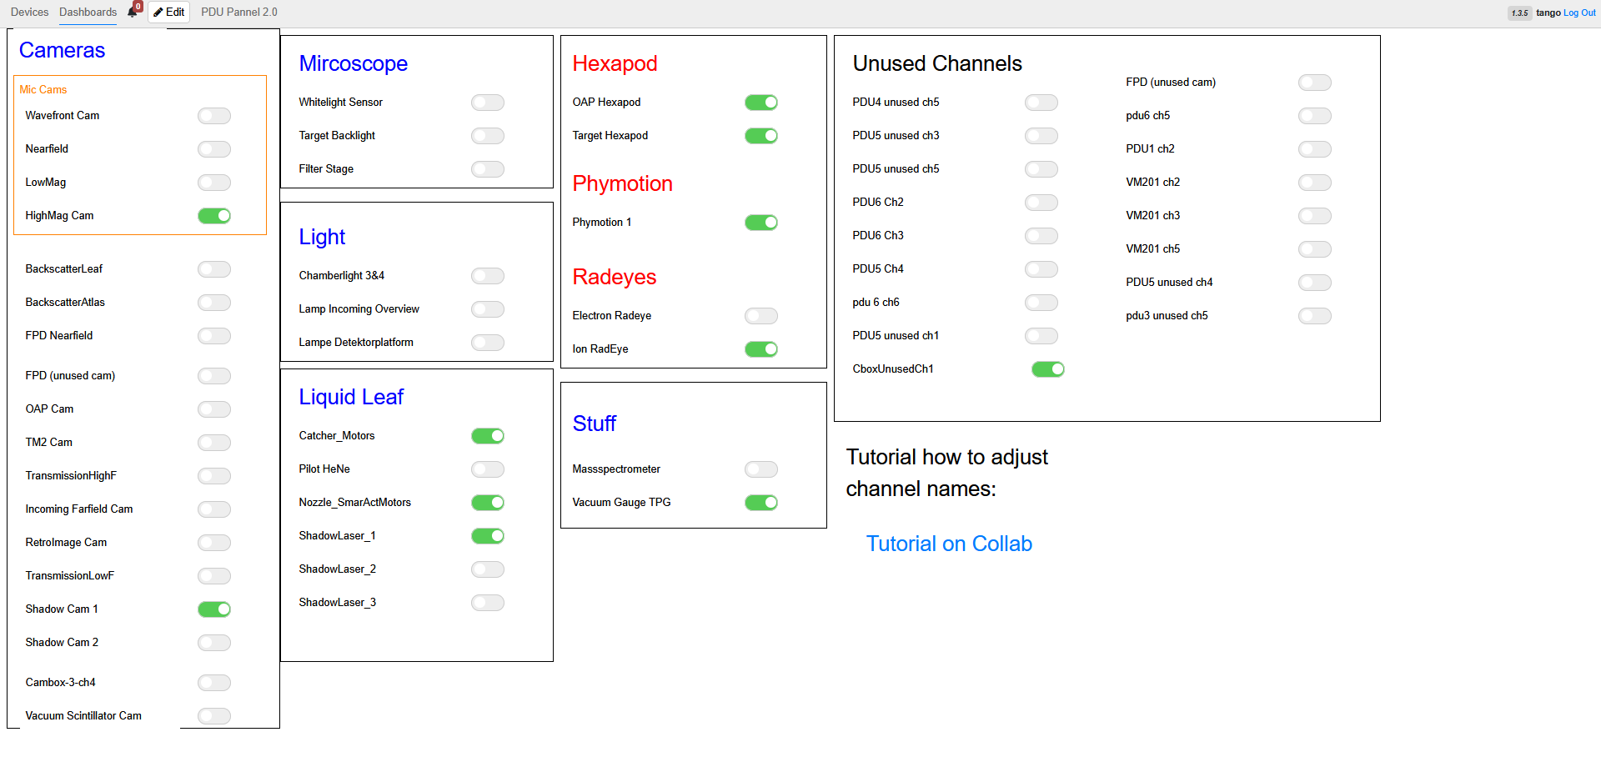
Monitoring: Taranta dashboards
System status & Non-critical control
Taranta
Plotly Dash
Experimental data visualization
Pyqtgraph
Matplotlib
Future
Long Term data visualization (Graphana,…)

Slide 14
System control

Slide 15
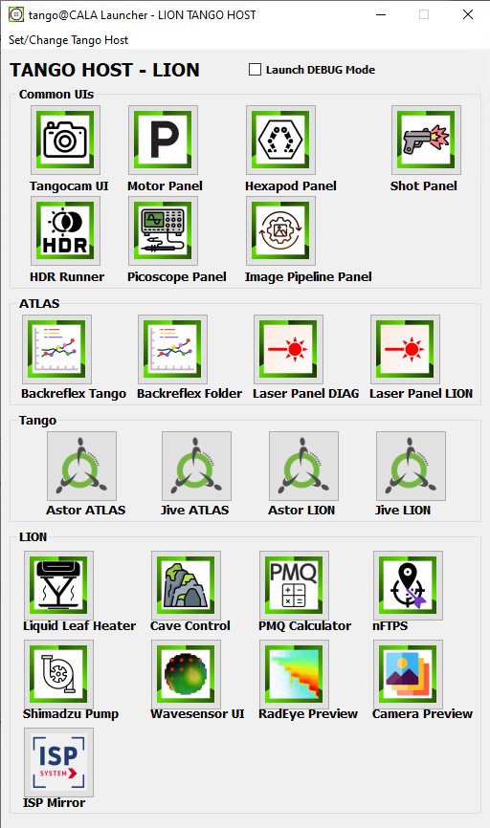
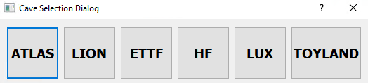
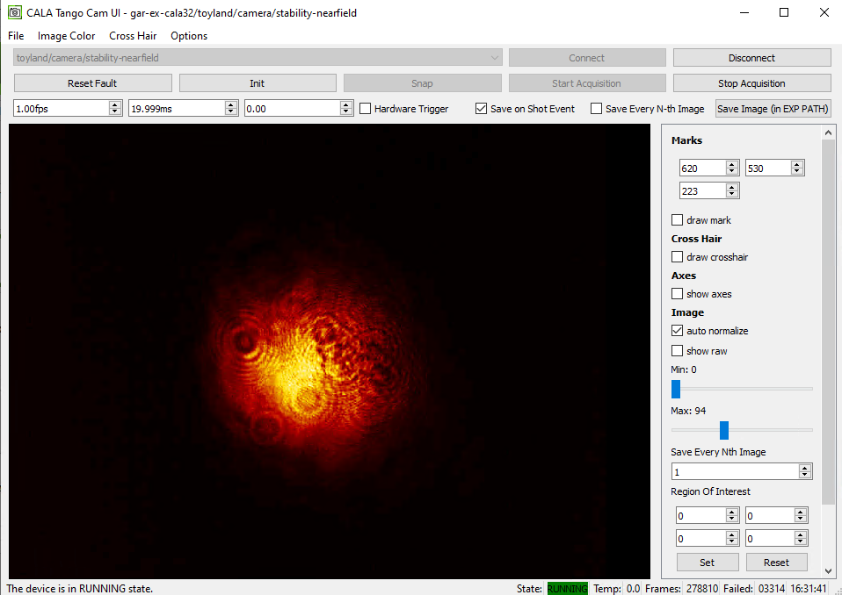
User control: PyQt5/Taurus GUIs
Previous
Simple windows short-cuts
Programs in network shares
→ Harder to maintain
Tango Launcher
Launches different GUI panels form network drive
User can change between different TANGO_HOST
Easier maintenance of program short cuts and logos

Slide 16
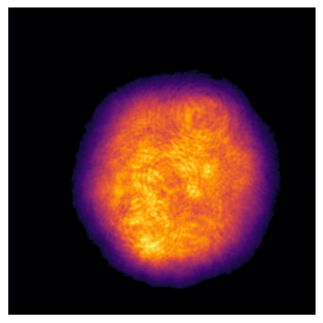
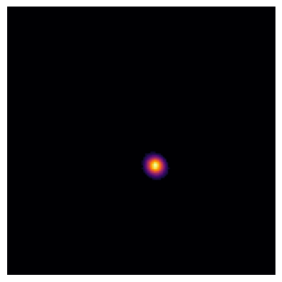
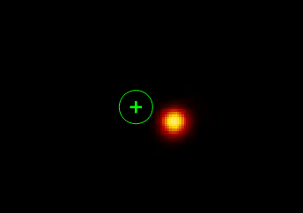
Scripted control: Active laser drift stabilization
Motorized mirrors
Motor Controller
Far field camera
Near field camera
Leakage
mirror
Normal
beam path
Correction distance
Lens
Target position
Current
center of mass
(CoM)
Near field
camera
Beam splitter
Far field
camera

Slide 17
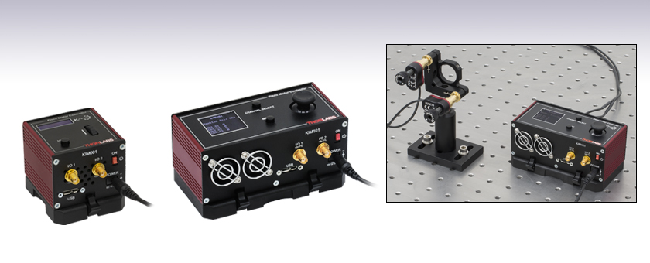
Scripted control: Active laser drift stabilization
Motor Controller
Communication with motor
Correction movement
CoM = (32,50)
Camera
Image Cleaner
Image Calculator
Drift Stabilization
Image
Image
CoM, Integral,
…
Trigger
Communication with camera
Background subtraction
Region of interest
Thresholding
….
Matching near- and far-field
Safety
Averaging
…
Timestamp is preserved

Slide 18
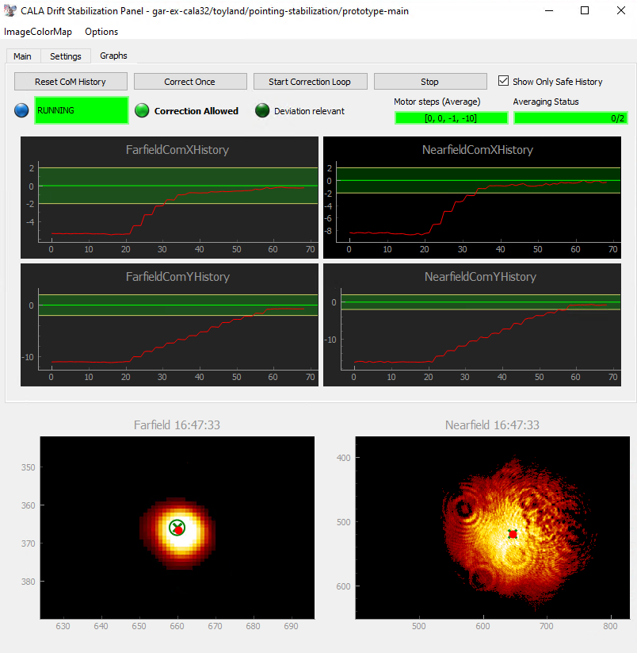

Scripted Control: Active laser drift stabilization
Taurus-GUI

Slide 19
Outlook: upcoming projects
Rebuild Archiving
At the moment: “Each device is individually responsible for archiving”
  → Strong coupling between archiving and control
  → Hard to maintain or update
Future: “Data is collected locally on each computer”
  1 Hz compatibility (hopefully)
  Conditional archiving
  Correlate data in facility and experiment to a specific shot ID
    → potentially important for future machine learning optimization
  Control devices should not know about archiving
    →better sharing between facilities
    →more standardized saving
  Easy switch of saving format (Txt-files, HDF5, Database, …)
Introduce framework for scripted control (Scanning and optimization tasks)
  Homebuilt vs Community (Sardana, Bluesky, Python-Middle-Layer, Xopt, …)

Slide 20

Summary
What is CALA?
  ATLAS-3000
  Experimental areas (ion-/electron-acceleration and related fields)
Tango infrastructure at CALA
  Stats
  Showcases
    Admin Tools (Starter to Tray, GitMonitor, Tango Launcher)
    Monitoring (Taranta, Matplotlib previews)
    System Control (PyQt5/Taurus GUIs, Scripted Control e.g. Active laser stabilization)
Many projects and devices are publicly available in our Gitlab:
  https://gitlab.lrz.de/cala-public

Slide 21
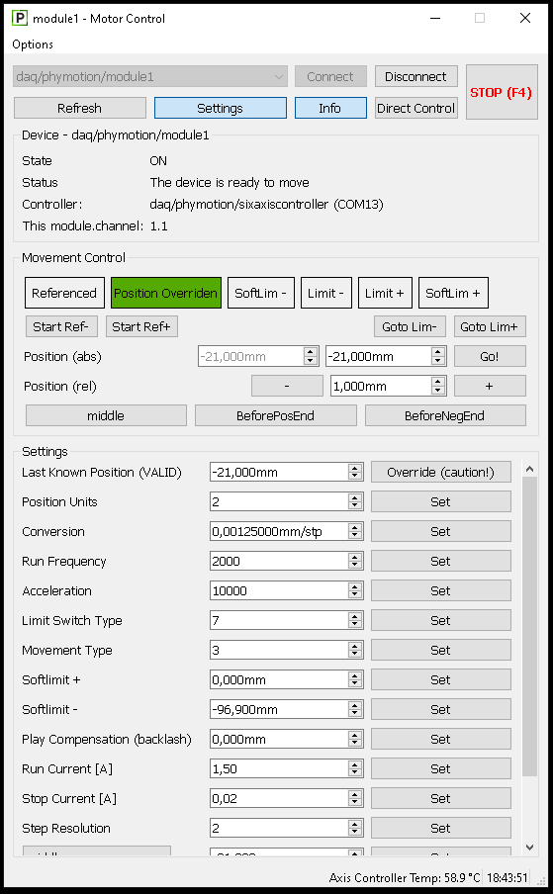
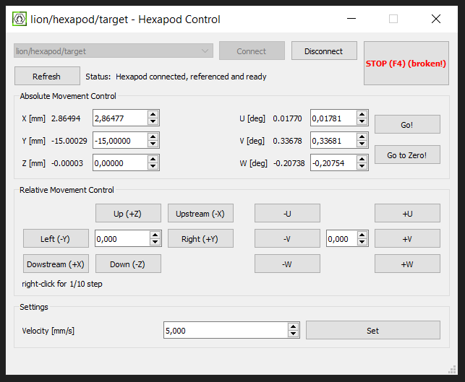
System Control: PyQt5/Taurus GUIs

Slide 22
Data Archiving: Problems and outlook
At the moment
Each device is individually responsible for archiving
Problems
Strong coupling between archiving and control can cause a block system control when archiving is disturbed by network problems
  → no 1Hz compatibility
Hard to maintain or update (e.g. to new saving format) since archiving code is spread out over the complete system
Future: “Archiving Collector”
One collector per computer
Reads data on condition from device server
Decide on a saving format (Txt-files, HDF5, Database, …)
1 Hz compatible (hopefully)
Requirements
Separate control and archiving
Saving format needs to be accessible
1 Hz compatible
Data correlation to centralized (Shot) ID
Notes:
Control devices should not know about archiving (better sharing between facilities, standardized saving)

Slide 23
Tango infrastructure overview
Experiment Control
User based control
(mostly) Homebuilt Tango device servers control for hardware control
PyQt5/Taurus based GUIs
Taranta
Automated/scripted control
Several homebuilt frameworks for scanning routines and machine learning optimization
Active laser drift stabilization
Monitoring
Online data visualization
Taranta
Matplotlib
Pyqtgraph
Online data evaluation pipelines
Images
Ion detector
…
System maintenance
Git repository status (Plotly-Dash)
Data Archiving
File based
Saving text files in network share
Trigger-based (Software or Hardware)

