Slide 1
HDB++: The Memory of Tango-Controls
Reynald Bourtembourg - ESRF

Slide 2
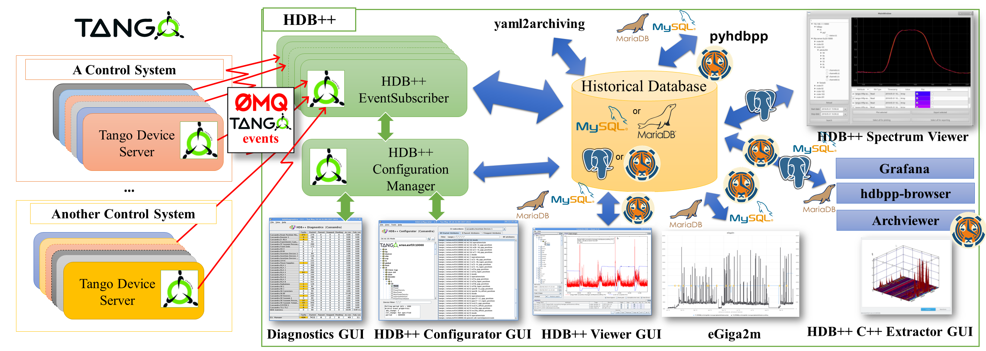
HDB++ Overview

Slide 3
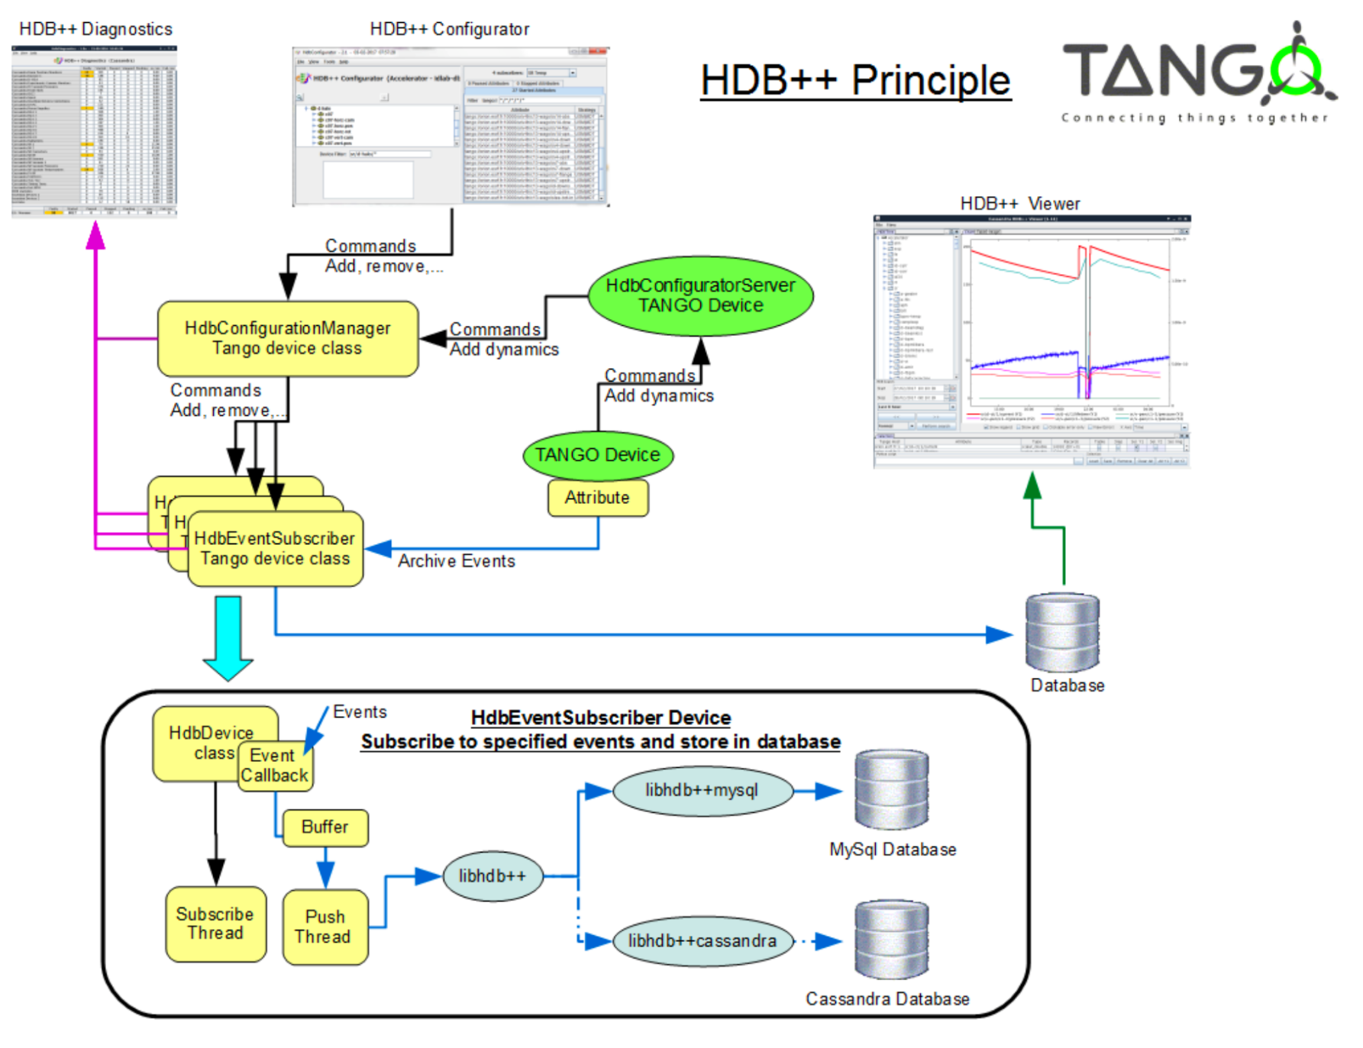
HDB++ Overview

Slide 4
Archive Events
TANGO provides specific event for archiving purposes
The archive event can be sent:
  on value change → specify absolute or relative threshold
  periodically → specify period
  by code (push_archive_event() methods)
Choosing the right thresholds is mandatory:
  if the threshold is too large no events are sent → no archiving
  if the threshold is too small too many events are sent → “noisy” archiving
The right threshold is strictly related to the variable/signal to be archived (type, bandwidth, sampling rate...)

Slide 5
What is archived?
Attribute value
Attribute set value (for RW or WO attributes)
Timestamp with microsecond resolution
Attribute quality factor (VALID, INVALID, CHANGING, ALARM, WARNING)
Error description in case of Exception (in case of consecutive errors, only the first error is stored in HDB)
Attribute Configuration (Archive event configuration, enum labels, units related configuration, label, format, description, …)

Slide 6
What is archived?
Events History
  attribute archiving add event
  attribute archiving start event
  attribute archiving stop event
  attribute archiving pause event
  attribute archiving removal event
  attribute archiving crash event

Slide 7
Special Features - TTL
TTL (Time to Live) => Data can be automatically deleted after a configured period.
  Setting per attribute
  Deleting expired data delegated to the SQL backend

Slide 8
Special Features – Archiving Strategies & Contexts
You can define your own archiving contexts
Example:
  ALWAYS
  RUN
  SHUTDOWN
  SERVICE
Trick: NEVER context could be used to stop archiving temporarily some attributes linked to hardware in maintenance

Slide 9
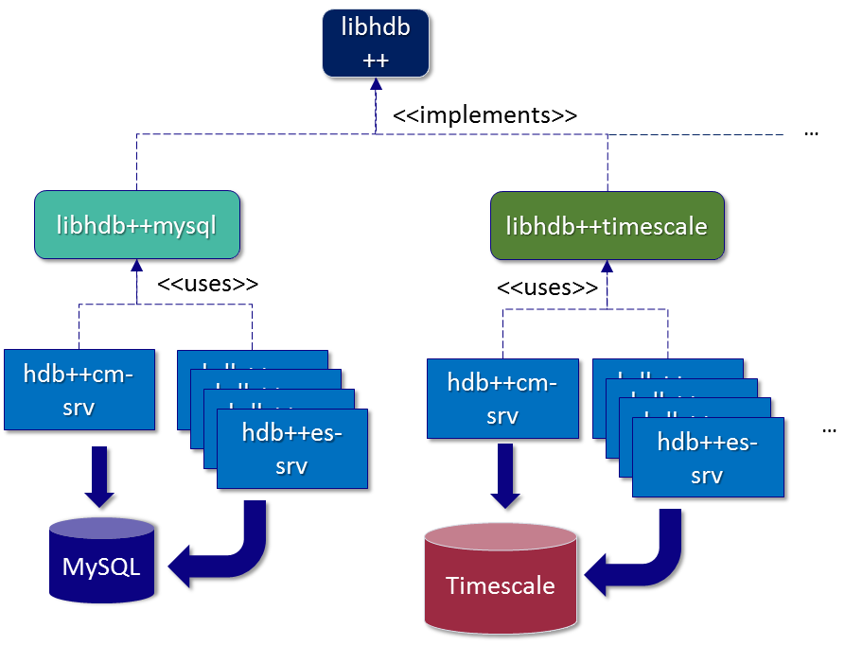
HDB++ Archivers & Configurators

Slide 10
HDB++ Archivers & Configurators
hdbpp-es and hdbpp-cm = Device servers independent from DB backend
DB backend library dynamically loaded

Slide 11
HDB++ Archivers & Configurators
Conda packages available:
> conda install hdbpp-es hdbpp-cm
> conda install libhdbpp-timescale

Slide 12
HDB++ Extraction Libraries
pyhdbpp (libhdbpp-python)
Java Extraction Library (can be used from Matlab)
C++ Extraction Library (only MySQL?)

Slide 13
pyhdbpp
Python3 package for data extraction
> pip3 install pyhdbpp
● Common API for MariaDB, MySQL and TimeScaleDB
● AbstractReader object provides generic extraction interface
● Dedicated DB back-end implementation is loaded at runtime
● Connection setup is stored in .yaml or Tango properties
● Taurus Widget available! (pyqtgraph)
import pyhdbpp
rd = pyhdbpp.get_default_reader()
rd.get_attribute_values('sr/vc/01/pressure','2023-06-03','2023-06-04')
Out: ((1685782812.169, 1.4e-08, 0),
(1685782842.011, 1.5e-08, 0), …

Slide 14
HDB++ Viewers – Taurus widgets

Slide 15
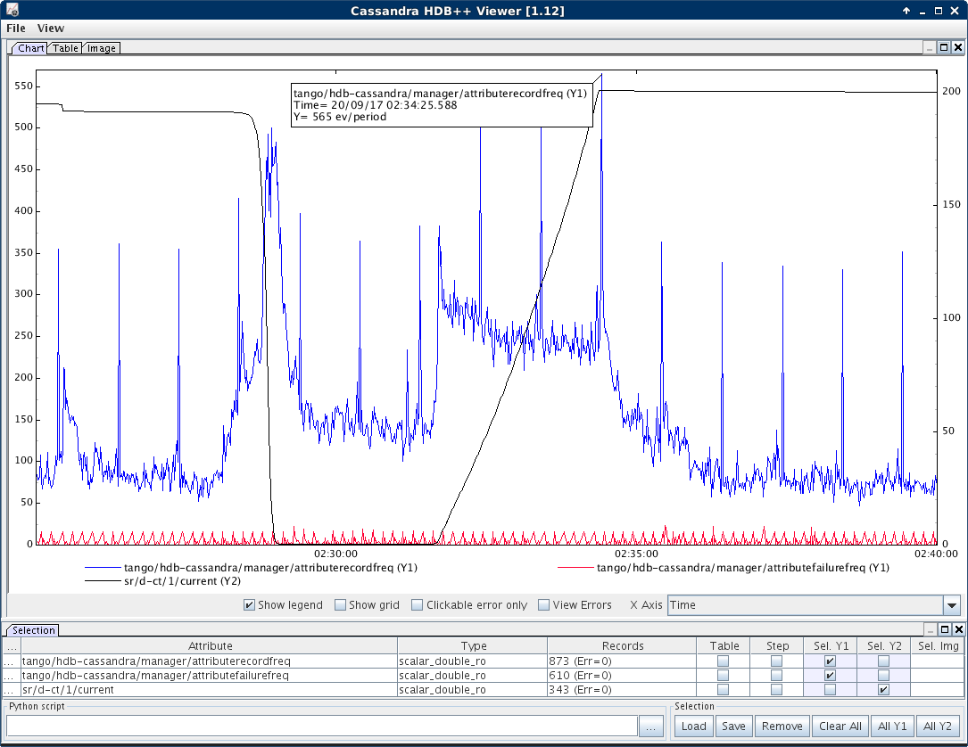
HDB++ Viewers - jhdbviewer
Notes:
Java based GUI for plotting
Exploits the Java extraction library
Table and multiline plots

Slide 16
HDB++ Viewers - jhdbviewer
Notes:
Java based GUI for plotting
Exploits the Java extraction library
Table and multiline plots

Slide 17
HDB++ Viewers – eGiga2m
1) Time period selection
2) Time series selection.
Strikethrough means time series are not current. A tooltip shows the last date the archiving was active, if available.
3) Chart tooltip shows time series numerical value or error explanation
4) Legend. Click to hide/show the corresponding curve.
A tooltip shows the number of samples and extraction time
5) Adjustable
Notes:
Web interface
MySQL and TimescaleDB backend

Slide 18
HDBExtractor++ GUI
Notes:
Qt based GUI using the MathGL framework for plotting
Exploits the C++ extraction library
Supports multiline and surface plots

Slide 19
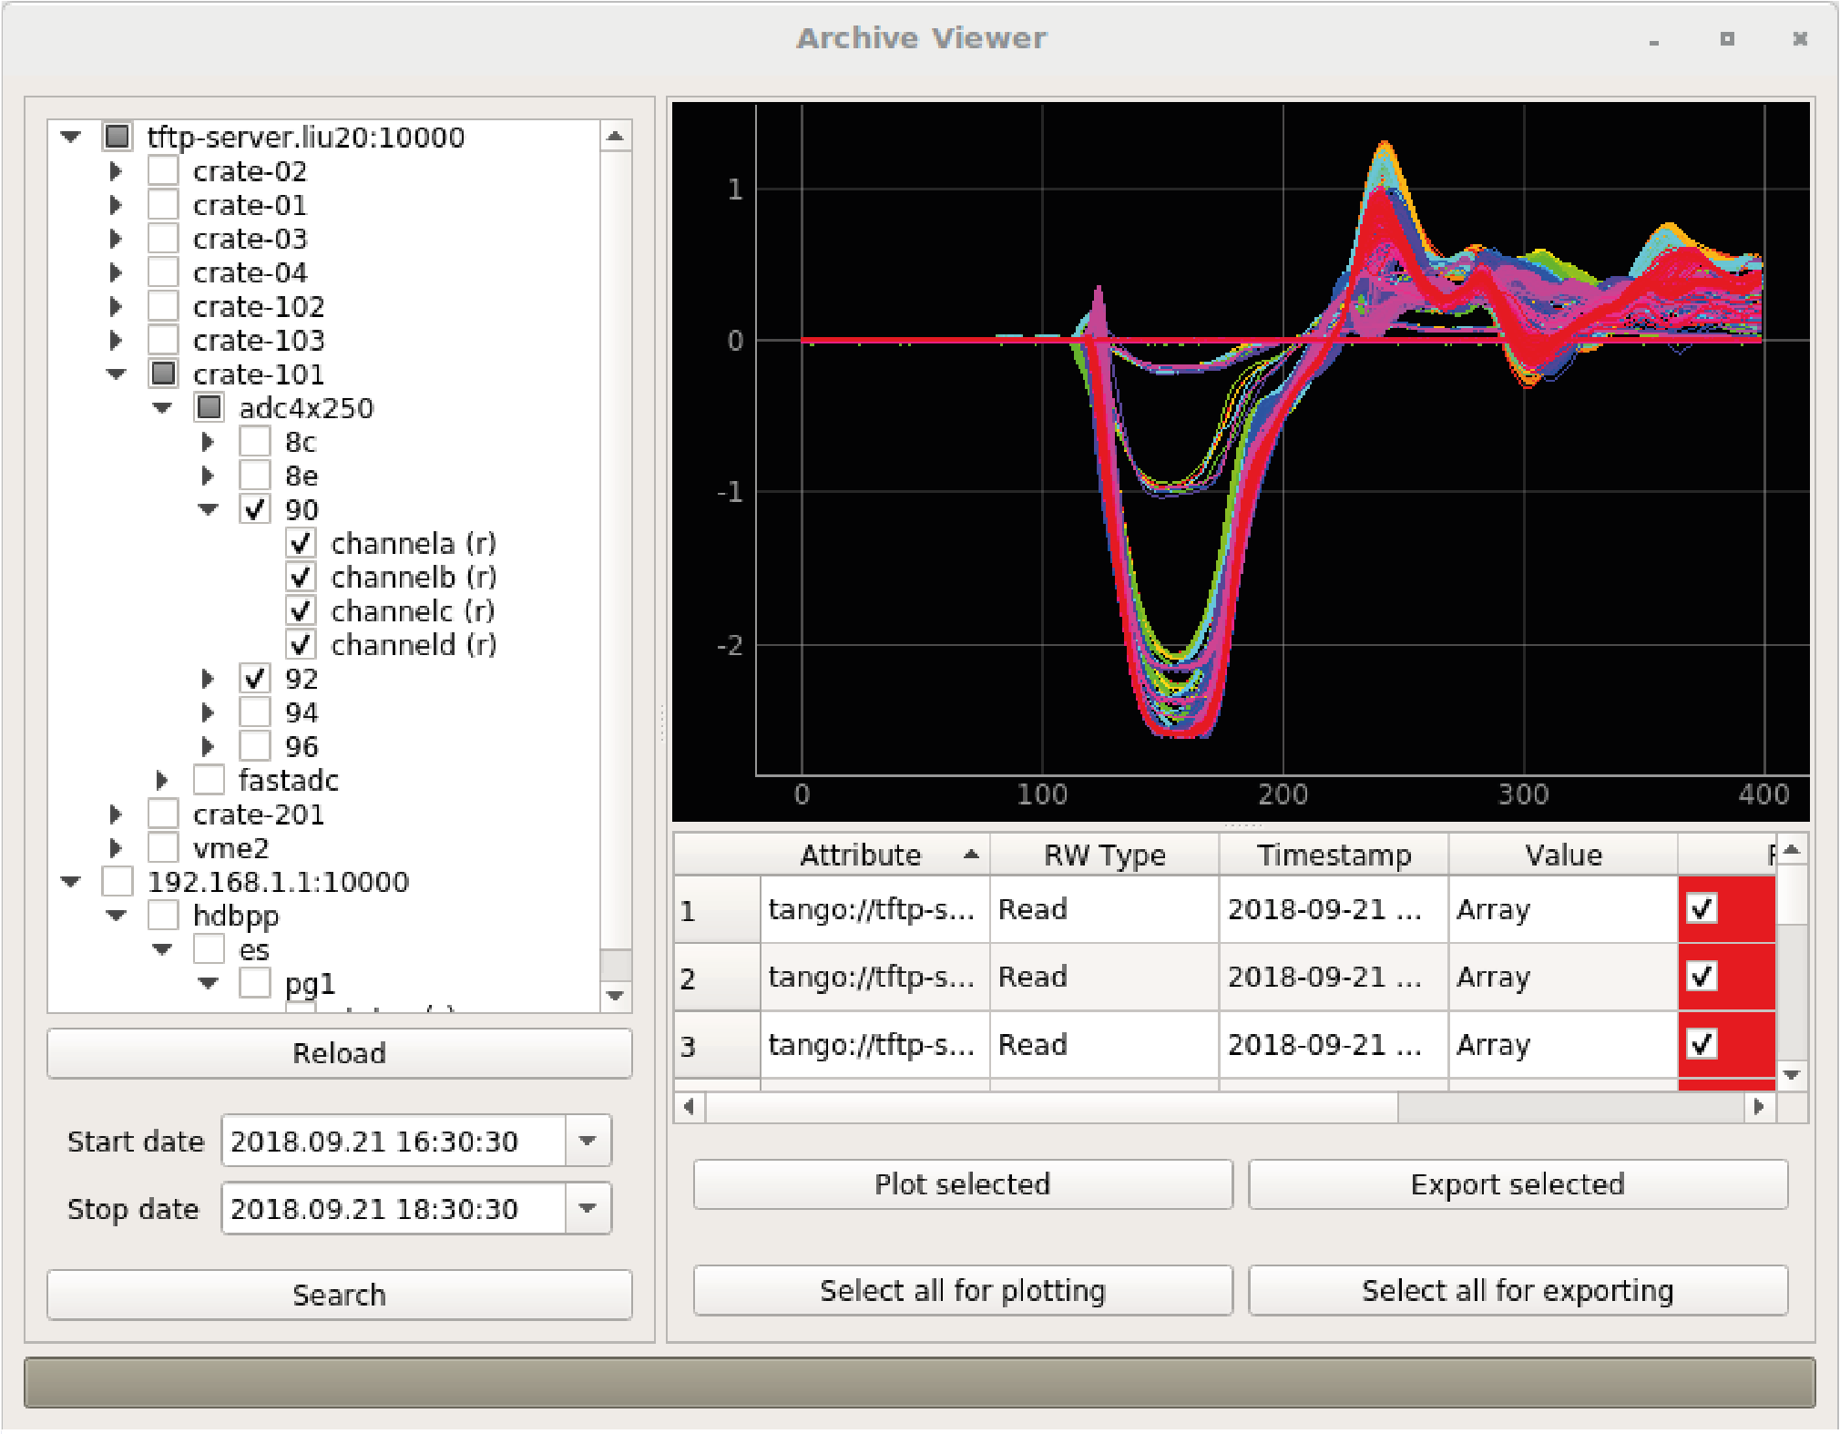
HDB++ Viewers – Archive Viewer (PostgreSQL)

Slide 20
HDB++ Viewers – archviewer (web)
Notes:
Webapp for plotting HDB++ from TimescaleDB
back-end in Python >= 3.8?
front-end javascript+preact+d3?

Slide 21
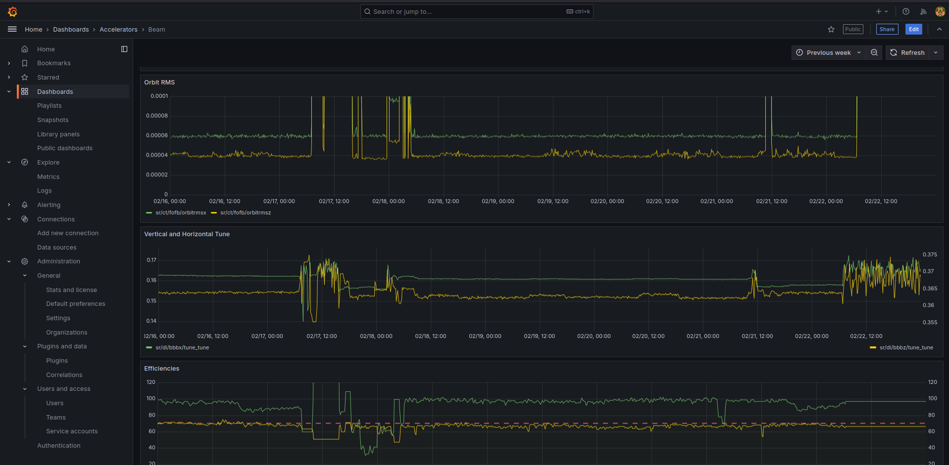
HDB++ Viewers – Grafana

Slide 22
HDB++ Viewers – Grafana
https://gitlab.com/tango-controls/hdbpp/libhdbpp-grafana-connector

Slide 23
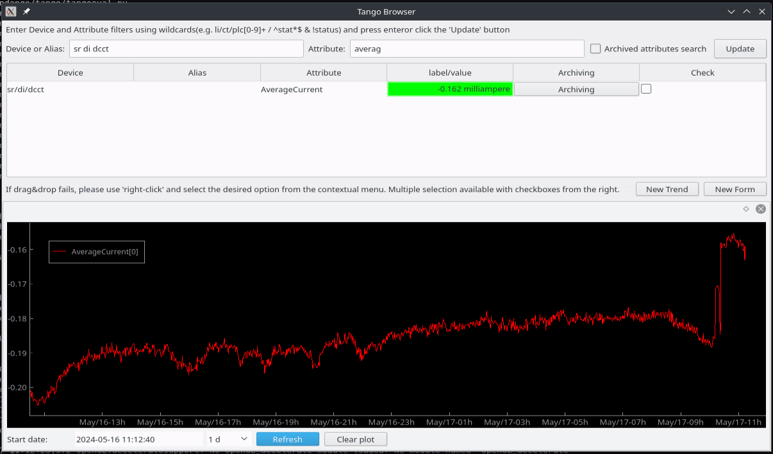
HDB++ Viewers – Tango Browser
https://gitlab.com/tango-controls/hdbpp/libhdbpp-tangobrowser

Slide 24
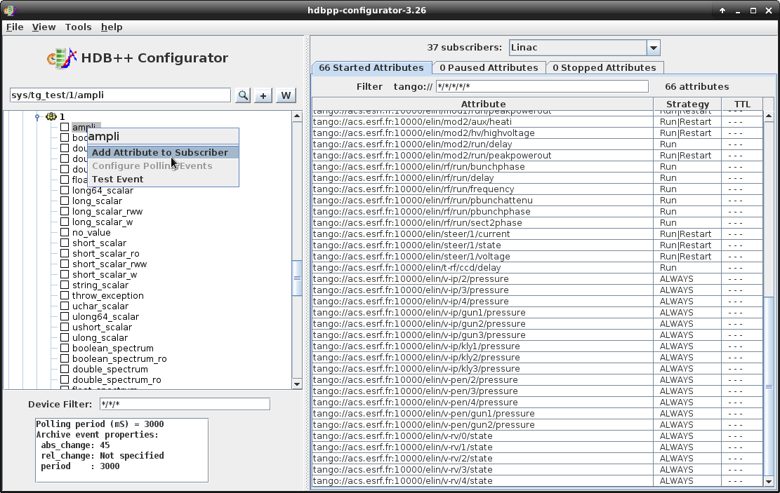
HDB++ Configurator GUI

Slide 25
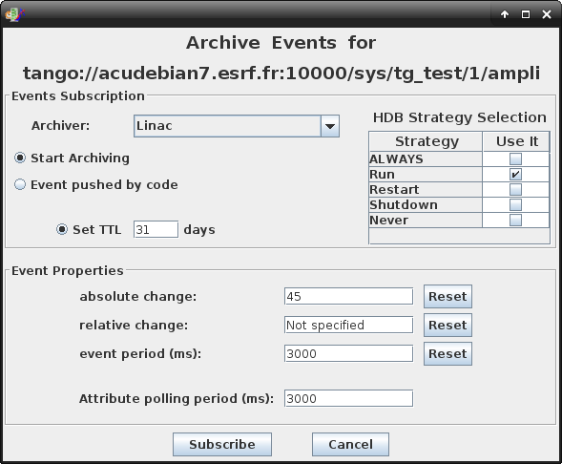
HDB++ Configurator GUI

Slide 26
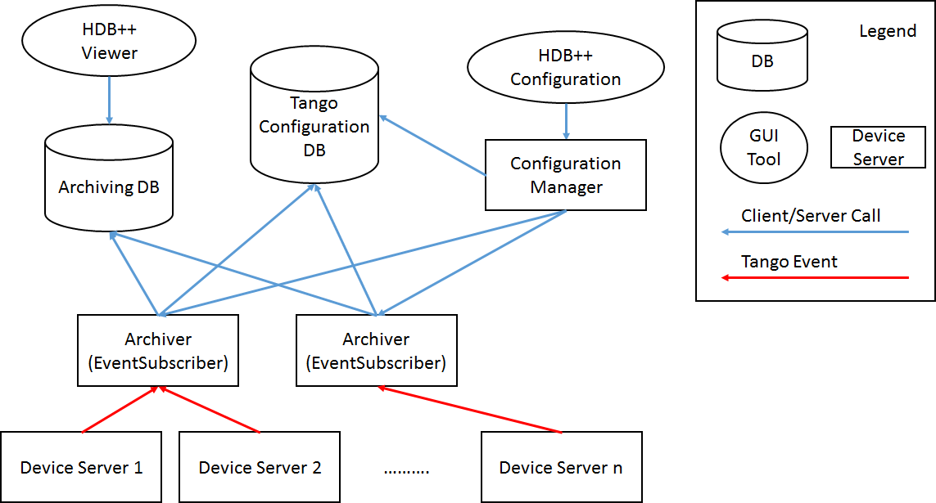
HDB++ Configurator GUI

Slide 27
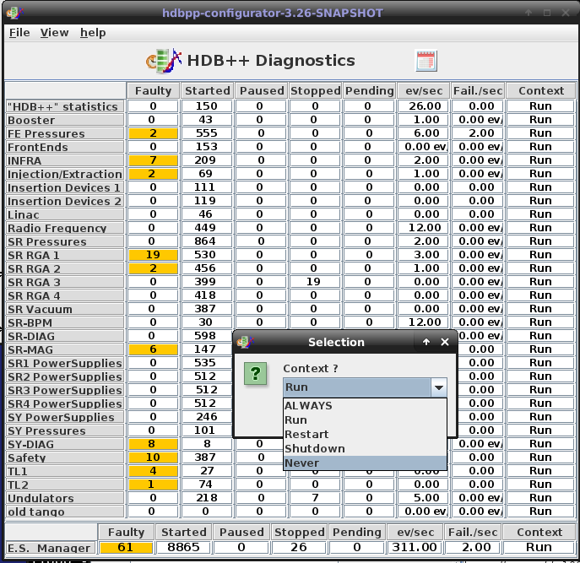
HDB++ Diagnostics GUI

Slide 28
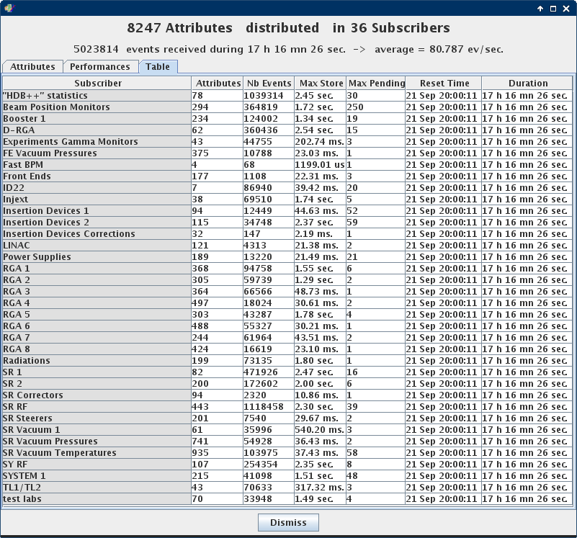
HDB++ Diagnostics GUI

Slide 29
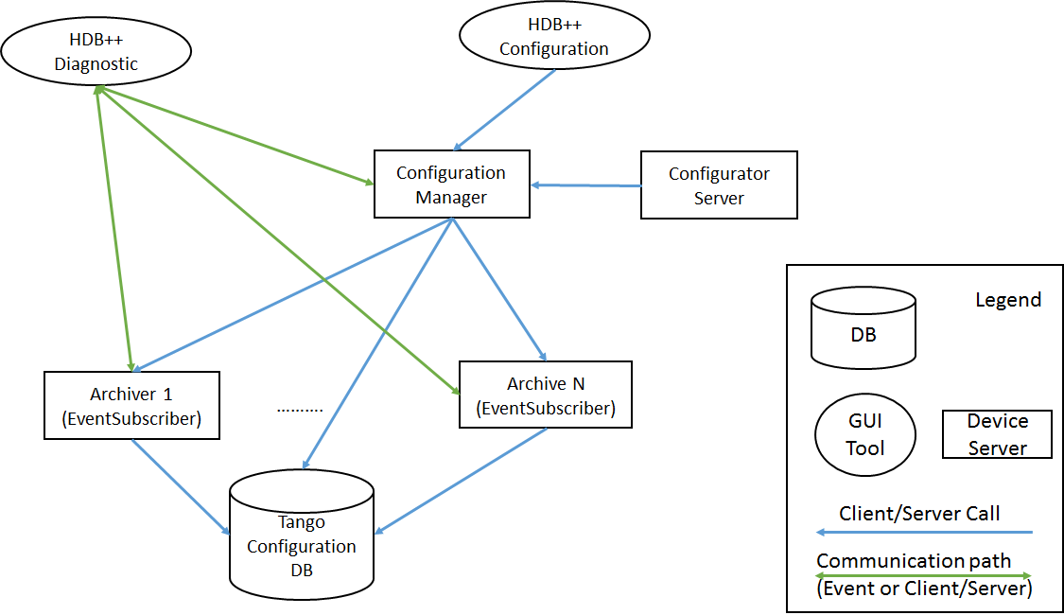
HDB++ Diagnostics GUI

Slide 30
yaml2archiving
Script to ease the configuration of the HDB++ Archiving by using YAML format files in order to add/remove/update archived attributes.
Each YAML file corresponds to one HdbEventSubscriber device and can include the state of the archived attributes with their settings.
https://gitlab.com/tango-controls/hdbpp/yaml2archiving

Slide 31
yaml2archiving
db: "g-v-csdb-0.maxiv.lu.se:10000“
manager: hdb/config/1
archiver: AUX/KITS/ARCHIVER-01
configuration:
TangoTest:
attributes:
short_scalar_ro:
archive_period: 6000
polling_period: 3000
archive_strategy: SERVICE
short_scalar:
archive_period: 7000
polling_period: 3000
archive_rel_change: 5

Slide 32
yaml2archiving
$ yaml2archiving path/to/config.yaml
...
CHANGE tango://g-v-csdb-0.maxiv.lu.se:10000/sys/tg_test/3/short_scalar_ro
archive_strategy: ALWAYS -> SERVICE
polling_period: 2000 -> 3000
CHANGE tango://g-v-csdb-0.maxiv.lu.se:10000/sys/tg_test/4/short_scalar_ro
archive_strategy: ALWAYS -> SERVICE
polling_period: 2000 -> 3000
ADD tango://g-v-csdb-0.maxiv.lu.se:10000/sys/tg_test/1/short_scalar_ro
archive_strategy: SERVICE
archive_abs_change: Not specified
archive_rel_change: Not specified
archive_period: 6000
polling_period: 3000
archive_rel_change: 5
REMOVE tango://g-v-csdb-0.maxiv.lu.se:10000/sys/tg_test1/1/short_scalar_ro ** Does not exist in the TangoDB (Cleanup Action)
REMOVE tango://g-v-csdb-0.maxiv.lu.se:10000/sys/tg_test1/1/short_scalar ** Does not exist in the TangoDB (Cleanup Action)
...
=== No changes were made, try the '--write' option to apply. ===
Notes:
will generate the configuration for the polling and the archiving settings of the short_scalar_ro & short_scalar attribute of all devices of the TangoTest Class.
his is a list of all the "actions" that the script would need to take in order for the archiver to be configured as described in the YAML file.
Like the last line of the output says, by default the actions are not actually applied, only listed. For that to happen, the user needs to add the --write option. Make sure that the actions printed are precisely the ones you expect, and then rerun the command with the -w/--write flag:

Slide 33
archwizard
simple web interface to the HDB++ archiving system for monitoring and troubleshooting, not maintenance such as adding and removing attributes.
built using Python, FastAPI, Jinja2 and PyTango
Features
  Display archiving statistics and errors
  Searching on attributes
  Filtering on archivers, attribute name and status (NOK, stopped, etc)
  Temporarily starting and stopping archiving of individual attributes
https://gitlab.com/tango-controls/hdbpp/archwizard

Slide 34
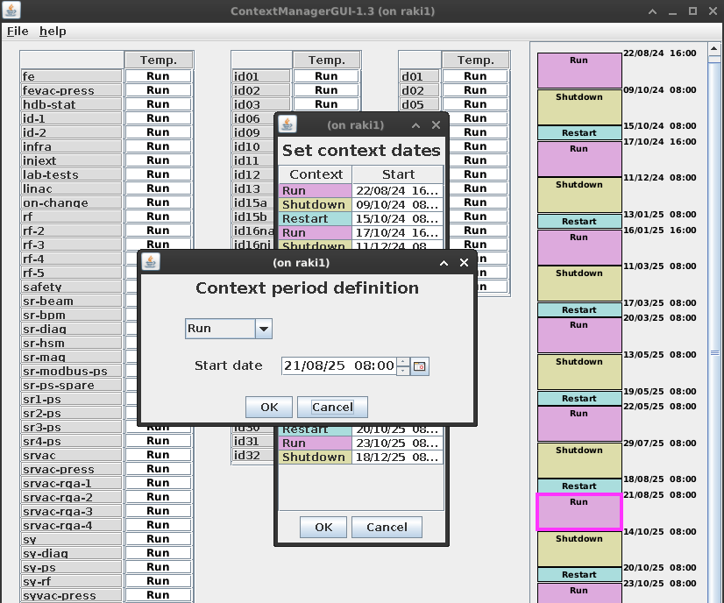
HDBContextManager (GUI & Device Server)

Slide 35
HDBContextManager (GUI & Device Server)
https://gitlab.com/tango-controls/hdbpp/ContextManager
https://gitlab.com/tango-controls/hdbpp/ContextManagerGUI

Slide 36
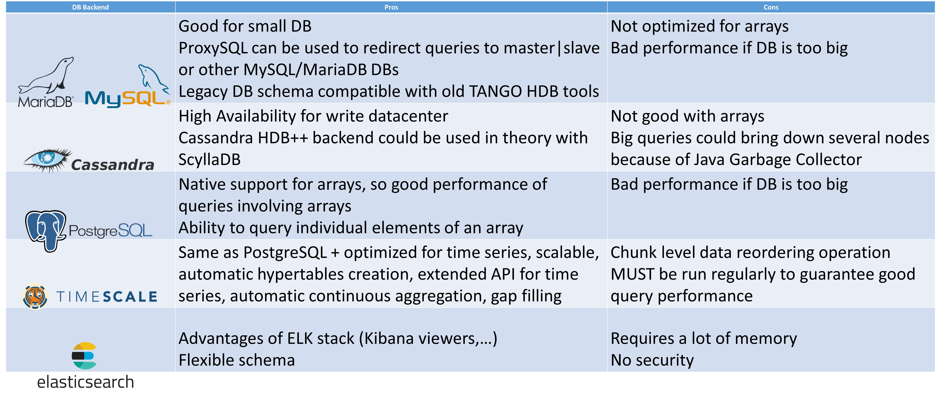
HDB++ Backends comparison
* Cassandra and elasticsearch HDB++ backends are no longer actively maintained

Slide 37
TimescaleDB
TimescaleDB is a Postgres extension for time series and demanding workloads
that ingest and query high volumes of data.
Timescale installation:
https://docs.tigerdata.com/self-hosted/latest/install

Slide 38
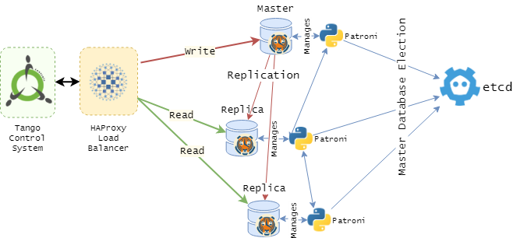
HDB++ Timescale Deployment @ ESRF
Using barman for the backups
Notes:
TimescaleDB is a Postgres extension for time series and demanding workloads
that ingest and query high volumes of data.

Slide 39
Useful links
https://gitlab.com/tango-controls/hdbpp
https://tango-controls.readthedocs.io/en/latest/tools-and-extensions/archiving/HDB++.html
https://gitlab.com/tango-controls/hdbpp/hdbpp-tickets
https://forum.tango-controls.org
hdbpp channel on Mattermost tango-controls

Slide 40
Thank you
Many thanks to all the HDB++ contributors!
Feel free to join us at our regular HDB++ Meetings (1 Zoom meeting every 1 to 2 months)
You can also subscribe to the hdbpp mailing list
➔ https://lists.tango-controls.org/wws/info/hdbpp

