Slide 1
ICA Activities Status – Tango Meeting 2020 November
Sandra PIERRE-JOSEPH ZEPHIR

Slide 2
Plan
SOLEIL and Tango
ICA Team
Its members
Its activities
Pepper by SOLEIL Upgrade subjects
Toward further collaborations …
U

Slide 3
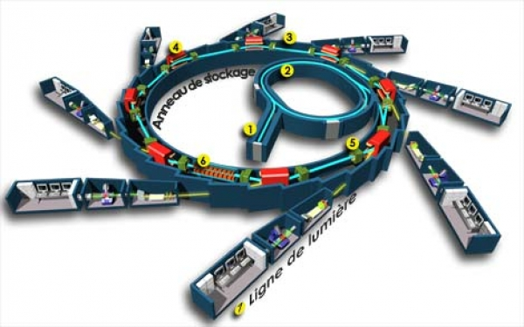
Synchrotron SOLEIL
Third Generation Synchrotron Radiation Facility (https://www.synchrotron-soleil.fr)
SOLEIL’s nominal energy is 2.75 GeV - storage ring with a circumference of 354 m (Accelerators called Machine)
Electrons trajectory is bent by magnetic fields => emission of light in an extremely thin beam.
29 Beamlines to explore the matter
Upgrade is in progress (to 4G), Conceptual Design Report is being written
Some goals to achieve before the beginning of the shutdown (in 2 or 3 years)
U

Slide 4
SOLEIL and TANGO
In the collaboration since the beginning
Full Tango installation (Machine and Beamlines) – V9.2.5
Jive, Astor, AtkPanel, Devices : essential tools well known by 2/3 of SOLEIL’s employees !
➔ Next SOLEIL generation based on next Tango generation ☺
U

Slide 5
ICA team … and TANGO
ICA Team in charge of providing control command system software for SOLEIL’s Machine, Beamlines and Laboratories.
Leaving from ICA Team
Katy Saintin – near 3 years ago – CEA (Public French Research Center)
Gregory Viguier - one and half year ago – Canada
Jean Coquet – near 4 years ago – IA on SOLEIL beamline
Majid Ounsy - one year ago – SOLEIL Data analysis group (GRADES)
Nicolas Leclercq - one and half year ago - SOLEIL Information System Strategy
Alain Buteau - one year ago – head of SOLEIL IT group
Now 10 Permanents (of 350), 1 Apprentice, 1 Machine operator at 20%, Contractors

Slide 6
ICA team … and TANGO
Same TANGO distribution in all control systems
Some applications are developed by Machine/Beamlines persons
Implication in the collaboration
Java Archiving system HDB/TDB/SNAP
JTangoServer
Tango V10 Specification redaction
LabView, Matlab, Igor Binding => Still Nicolas – on collaborative way by the help of pull-requests on github

Slide 7
Tango Devices
Tango Devices In number
Near 450 distincts Dservers type to pilote equipments, to process data
 | TANGO STATS – 09/2020
 | DEVICES_NUMBER | DSERVER_DEFINED | TANGO_HOSTS_NUMBER
MACHINE | 15805 | 5073 | 233
BEAMLINES | 20330 | 5703 | 366
LABORATORIES | 6634 | 1384 | 87
C++
JAVA
1 contractor

Slide 8
Lima Detector
Collaboration with ESRF, also used by Alba, MaxIV, Desy
Windows- Linux 32-bit and 64-bit
One kind of DServer and lot of specifics devices :
AndorCCD BaslerCCD Dhyana Eiger Hamamatsu ImXpad Lambda MarCCD Maxipix Merlin Pco PerkinElmer PilatusPixelDetector PrincetonCCD ProsilicaCCD SimulatorCCD SlsEiger SlsJungfrau SpectrumOneCCD (WIP) SpectralInstrument (WIP) UFX Uview XpadPixelDetector Xspress3
1 contractor

Slide 9
Acquisition Service and Data storage
2 Acquisition services
Step by Step and FlyScan
With electronic team
Experimental Data Files Management
See next presentation
IHM
IHM

Slide 10
User Interfaces
Command Line Spyc in Python, IPython
Used by 8 Beamlines
Generics commands (move, scan …) + Beamlines specifics commands developed by themselves
Graphical provided in JAVA-Swing
Sequencer tool Passerelle (SupportSquare)
Scada tool named Coox (Ordinal Software)
Various IHM

Slide 11
User Interface
Toward Web Applications
Old Rest API available upper Archiving Service:
Client MamboWeb
Some applications for accelerators people developped
First implementation of Archiving API in GraphQL
First implementation of Grafana plugin upper Rest API
WebJive installation on development plateform

Slide 12
Archiving Service
HDB/TDB/SNAP on Oracle DB
Polling, beginning of archiving events usage (configuration and monitoring must be improved)
Machine, Beamlines, Laboratories
Upgrade projection: study other kind of DB, other way to store data, analyse others Tango collaboration solutions
PANIC – alarms tool
Tested by Machine people / In a near future to be deployed in production
Beamlines people are also interested
U
Jérémy
Oracle DBA
IHM

Slide 13
Tools
CI/CD
CI and automatic Delivery
Jenkins / Maven for C++ and Java
Windows 32/Linux
Aging installation
Toward Conan/Cmake
SVN, CVS => Git
Be able to be evolutive and strong Software factory for Upgrade
Jira (Bug Traker) /Confluence (Collaborative tool)
Confluence management is moving toward another group
Toward an OnCloud installation
U

Slide 14
Tools
Testing
Lot of Unitary Tests in Java devices automatically executed in CI plateform
UT on unitary graphicals components not included in the CI plateform
No automatics tests at device C++ level – some python tools has been created to mock systems has a socket server, to trigger tests => improve
One testing plateform in simulated env before delivery but lot of devices are tested on production during testing slot
Upgrade : having automatic tests, creation of a plateform with somes real equipements, developpement of simulators …
Tango Workshop to discuss about our various practices?
U

Slide 15
Operation
On-Call duty period => Need tools to be more confortable
Log files exploitation
ElasticSearch is being studied
One Tango DB per Beamline => In need of a tool to collect data to be able to explore them (find where a class of device is used, the various configuration …)

Slide 16
Infrastructure
For the Control Systems
Machine – Beamlines - Laboratories
Physical and Virtuals Machines – Proxmox – CentOs6
Windows Images (CompactPCi are managed by Electronic group)
5 Automatic deployments per year
Tango DB Management
…
 | INFRA STATS – 09/2020
 | HN_NUMBER | CT_NUMBER
MACHINE | 22 | 258
BEAMLINES | 63 | 290
LABORATORIES | 12 | 94
HN_NUMBER = Number of physical servers in production
CT_NUMBER = Number of virtuals conteneurs

Slide 17
Our Names
Sandra PIERRE-JOSEPH - Gwenaëlle ABEILLE - Stéphane POIRIER
Jade PHAM – Raphaël GIRARDOT – Arafat NOUREDDINE
Stéphane LE – Patrick MADELA – Xavier ELATTAOUI – Florent LANGLOIS
Thomas MARION – Antonin HOTTOIS
Email : firstname.famillyname@synchrotron-soleil.fr

Slide 18
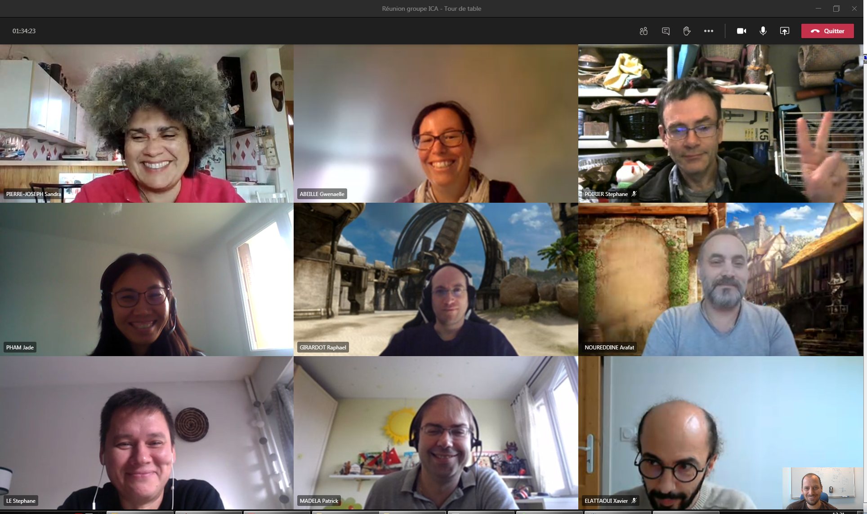
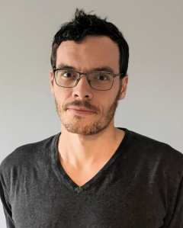
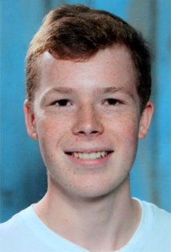
In Image
One permanent contract here : https://www.synchrotron-soleil.fr/fr/emplois/ingenieure-developpement-c
2 missions: C++ developer / Project management assistant

