Slide 1


Preliminary notes on the USSR Control System

Slide 2
USSR: new Russian MEGA-science project
New Russian 4th generation Synchrotron Radiation Source called USSR ( Ultimate Source for Synchrotron Radiation, former SSRS-4) has been chosen as a Russian national flagship project that will be open also for international, especially European utilization. The estimated core of USSR is a ~1.1 km diffraction limited storage ring with an electron energy of 6 GeV.
Today we are at the stage of CDR development, design and preliminary numerical simulations of main components of the USSR: lattice, beamlines, vacuum system, diagnostics and control, etc.
We want to take into account the international experience of new X-ray sources: ESRF, European XFEL,MAX-IV, Sirius and other projects Russian Federation participates in.
The USSR should be complement to the existing European sources and raised interest of the European scientific community. We are not going to be limited to only national scientific projects.
New machine shouldn’t be a replica of one of the existing sources. USSR must enhance capabilities of new sources and effectively fit into the existing European Mega-science infrastructure.

Slide 3
USSR Description
Estimated USSR’s main parameters
Parameter | ESRF-EBS | USSR4
Circumference, m | 844 | ~1 100
Number of Cells | 32 | 40
Energy, GeV | 6 | 6+FEL
Horizontal emittance, pm | 133 | 68
Bunch length, mm | 2.9 mm | 2.32 mm
Beam energy spread, % | 0.095 | < 0.1
Lifetime, hour | 1 18 | > 1 for high current per bunch > 10 for low current per bunch
RF Voltage, MV | 6.5 | 5
RF Frequency, MHz | 352 | 476
Suggestions for USSR parameters
Consideration of a 8-bend Achromat lattice
Using a short Bend, 10cm, 2mrad, in the center of the cell
Using a long straight (10…15 m) for high beta-function value at injection 40 m
Using permendur in quadrupole magnets for getting on 30% larger chambers
ID dominate impedance budget (90%), +/- 4 mm vertical aperture

Slide 4

CREMLIN+
CREMLIN Project – Connecting Russian and European Measures for Large-scale Research Infrastructures. Improving and strengthening European-Russian collaboration in Research Infrastructures. Funded by EU Horizon 2020. 19 Collaborators, 8 Work Packages over 3 years (2015-2018), including WP5 SSRS-4 – X-ray RI, NCR KI+ESRF.
CREMLIN+ is the successor to CREMLIN. Funding scheme: Research and Innovation Action (RIA). 35 Collaborators in 10 Work Packages over 4 years, including WP4 – USSR (former SSRS-4) – fourth-generation high energy synchrotron radiation source, in the frame of preparation of synchrotron/neutron research program according to Executive Order on National Goals.
Main task of CREMLIN+ related to WP4: joint conceptual and technical design of Russian Infrastructures
WP4 Collaboration: NRC KI, ESRF, DESY, E-XFEL, INFN.

Slide 5
CREMLIN+ WP4.2 Control & Diagnostic Task
WP4 include several tasks: lattice and main ring systems, vacuum chambers, photogun and top-up linac, beamlines, and our: Task 4.2. Diagnostics and control for the main ring. Task 4.2 collaborators: NRC KI and ESRF.
Our main works are CDR reports:
  Diagnostics: define diagnostics requirements; preliminary design of several measurement systems: emittance, BPM and BLM
  Control System: define hardware requirement; design of software part of control system based on the TANGO framework; GUI review; timing and synchronization system evaluation

Slide 6
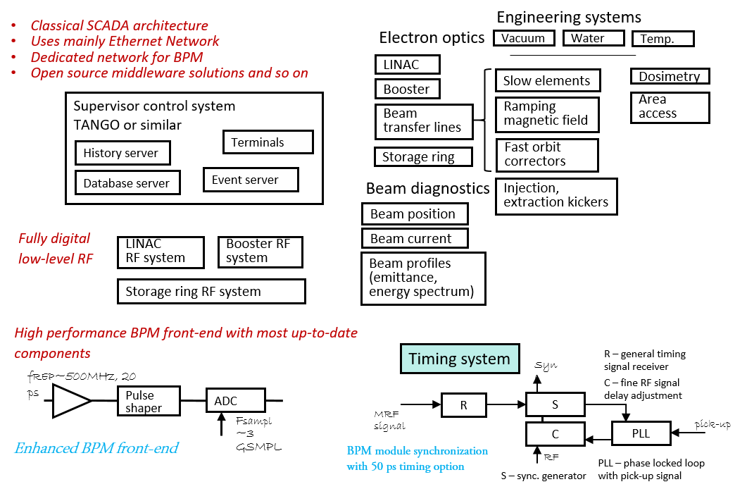
Diagnostic, Control & Timing

Slide 7
Control Systems Prototypes and Simulators
USSR Control System simulator development can include:
  Device servers simulators developments
  Network and traffic management tools
  Basic services developments: archiving, alarming, logging
  User interfaces developments, including web interface
  Beam optic simulator to CS prototype integration
Development and tests of Control System on several accelerator’s subsystem prototypes: …, magnet control, …, LLRF, … , as a base for main Control System.

Slide 8
Prototypes
Net Topology Prototyping
The family of switches must be able to implement the chosen topology by determining the route of data packets depending on the destination addresses contained in the headers of the Internet protocols. It should be possible to connect controllers of different systems to the closest switch, with the ability to separate data streams belonging to different systems from each other.
To control the routing of data packets, we can use the following mechanisms: virtual, or logical, local computer networks, or VLANs, and control of the routing of broadcast messages supported by the IGMP control protocol group, or multicast, data transmission.
Unidirectional Link Detection (ULDL) allows you to test for a physical connection to a remote host, and delay data packets until the connection is restored. Similar capabilities are used in standard traffic control mechanisms - flow control and blocking prevention - Head-Of-Line blocking.

Slide 9
Prototypes
HIPR (Heavy-Ion Prototype) CS developments
As part of the creation of a double-charge helium injector on the basis of the existing HIPR installation, its control system is being modernized
This made it possible to use the prototype CS HIPR for testing the integration of CS into the TANGO framework
As the first test work, the gate from the HIPR control system to the user interface is implementing

