Slide 1
cppTango UPDATES

Slide 2
cppTango: Fixed release cycles
NEW: 6 month release cycle
→ 9.4.0 release on 2022-10-02
Focus on 9.4.x
Major overhaul → see next slides
Quick bug fix releases
9.3.x in maintenance mode
Critical bug fixes only
No backporting of new features
No new features
© Gary Larson

Slide 3
Development Branches
main | 9.3-backports
Future cppTango 9.4.x | (9.3.x LTS branch)
Requires C++14 at least | Does not require C++11 (Can be compiled on old compilers but might need a more recent CMake version)
Not binary compatible with cppTango 9.3.x | Binary compatible with cppTango 9.3.x
Gitlab CI: Debian 9, 10 and 11, 11-cross-32bit Alpine Ubuntu 20.04 Latest LLVM (14.0.5) Latest GCC (12.1.0) Clang-tidy, clang-analyzer Sanitizers (ASAN, TSAN, UBSAN) | Gitlab CI: Debian 7, 8, 9 and 10 (c++98!) (frozen) Alpine Ubuntu 20.04 (planned) LLVM unsupported (frozen)! GCC (8.3.0, frozen)
Appveyor: win32 and x64 msvc 15 | Appveyor: win32 and x64 for msvc9, msvc10, msvc12, msvc14 and msvc 15

Slide 4
cppTango 9.4 - Changes
•!927 Addition of Database::get_class_property_list wildcard method for cppTango#847
•!829 Fix a bug in FileDatabase::DbGetClassProperty (#816) [Forwardport]
•!949 .gitlab-ci.yml: Remove CI for debian 9
•!888 Fix crash with DevString forwarded attributes (#512)
•!854 Don't treat state attribute special (To be able to extract State attribute twice from a DeviceAttribute)
•!881 Use new docker images from gitlab
•!864 Add support for sanitizers
•!773 cppapi/server/pollthread.cpp: Catch more exceptions

Slide 5
cppTango 9.4 - Changes
!946 ci/gcc-latest/Dockerfile: Update to 12.1
!942 Resolve "Breaking changes coming with Gitlab 15.0“
!940 appveyor.yml: Remove Visual Studio 2015 support
!939 CODEOWNERS: Adapt it (Added Thomas Juerges and removed Nicolas Leclercq)
!875 Add conda recipe to build dev packages
!906 Remove PyLock and PyData
!725 Remove deprecated functions usage
!891 Remove sonar and coveralls related code
!936 Support not exported devices in group wildcards (To be reviewed)

Slide 6
cppTango 9.4 - Changes potentially impacting users
•!934 Rename coutXXX macros to TANGO_LOG_XX. !! Device Servers code need to be regenerated with a new version of Pogo
•!735 Public/private header separation and stable ABI proposal
•!885 Resolve "Remove code duplications when switching over data types“ => ~ 5000 loc less
•TANGO_USE_USING_NAMESPACE=OFF (default = ON)
using namespace std;
no longer added in tango headers

Slide 7
cppTango 9.4 - Changes potentially impacting users
•New optional dependency to libjpeg or libjpeg-turbo
•Possibility to compile in RelWithDebInfo or MinRelSize
•!895 add prefix "TANGO_" to cmake options
•!792 Make compilation on 32bit linux warnings free and remove TANGO_LONGXX defines
•!886 Fix 622/Change input reference arguments to const references
•!845 Change logging default layout (More human readable timestamp, thread number has been removed)

Slide 8
cppTango 9.4 - Changes potentially impacting users (!742)
!742 Function name and line number in logs and exceptions:
2021-05-04T23:04:41,544490+0200 DEBUG (utils.cpp:412) dserver/Mytestclass/test Connected to database
2021-05-04T23:04:41,544872+0200 DEBUG (utils.cpp:1627) dserver/Mytestclass/test Entering init_device() method

Slide 9
cppTango 9.4 - Changes potentially impacting users (!742)
void TangoTest::read_throw_exception(Tango::Attribute &attr)
{
DEBUG_STREAM << "TangoTest::read_throw_exception(Tango::Attribute &attr) entering... "
<< std::endl;
/*----- PROTECTED REGION ID(TangoTest::read_throw_exception) ENABLED START -----*/
TANGO_THROW_EXCEPTION((const char *) "exception test",
(const char *) "here is the exception you requested");
// Tango::Except::throw_exception((const char *) "exception test",
// (const char *) "here is the exception you requested",
// (const char *) "TangoTest::read_throw_exception");
/*----- PROTECTED REGION END -----*/ // TangoTest::read_throw_exception
}

Slide 10
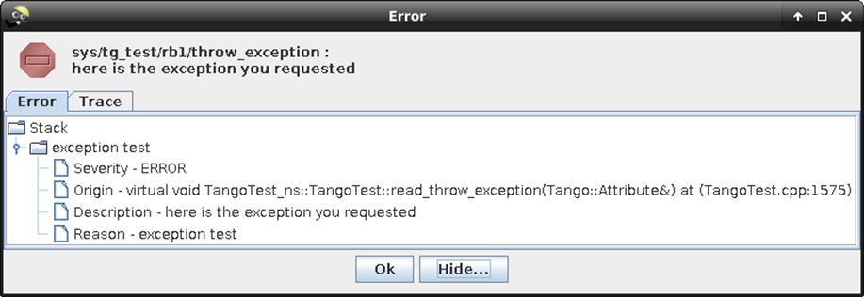
cppTango 9.4 - Changes potentially impacting users (!742)

Slide 11
cppTango 9.4 - Changes potentially impacting users
•Add server_init_hook() method (!551)
–Called when admin and all other devices are exported
–void MyDev::server_init_hook() override;
•Support for grouping remote devices (!608)
–group.add("tango://remote:20000/dev/*");
Planned:
•Notifd event no longer supported (only ZMQ events)
•Multicast events no longer supported

Slide 12
cppTango 9.3.5
Latest cppTango stable release: cppTango 9.3.5
released in February 2022.

Slide 13
cppTango 9.3.5 - Main Changes
ZMQ ports used for the Tango events can now be configured using TANGO_ZMQ_EVENT_PORT and TANGO_ZMQ_HEARTBEAT_PORT environment variables ((#880, !893).
cppTango can now also be compiled in Release mode with debugging information using CMAKE_BUILD_TYPE=RelWithDebInfo
cppTango can also be compiled in Release mode with the smallest possible binary size using CMAKE_BUILD_TYPE=MinSizeRel (#839, !905).
The way to build on Windows has been modified to be able to build independently the static and dynamic versions of the library (#550, !896).
The logging timestamp precision has been increased to microseconds (#858, !866).
An artificial limit of 6 device classes per device server when using the File Database has been removed (#816, !818).
It is now possible to compile the Tango C++ library on Alpine Linux using musl libc (#767, !841).
Some additional classes are now also documented in the Doxygen documentation which is now available on Gitlab.com: https://tango-controls.gitlab.io/cppTango/ (!780).

Slide 14
cppTango 9.3.5 - Bug fixes
Many bugs have been fixed, the most important ones are:
Events should now work better in nodb mode (!852)
Fix the problem where archive periodic events were no longer received after a polling restart (#675, !778)
Allow compiling JPEG support with MMX extensions with old compilers again (!828)
Fix wrong usage of omniORB object leading to crash (#842, !842)
Fix deadlock when updating attribute configuration (#409, !863)
Catch more exceptions in the PollThread to avoid crashes (#691, !873)
Fix segfault on unsubscribing (#843, !852)
Fix crash when reading a forwarded State attribute (#550, !896)

Slide 15
TangoSourceDistribution 9.3.5
Finalize move to Gitlab (CI, releases)
Remove references to bintray Comes with:
TangoTest 3.4
TangoDatabase 5.17
cppTango 9.3.5
tango-idl 5.1.0
TangoAccessControl 2.17
Starter 7.7
tango_admin 1.16
tango-doc 9.3.5

Slide 16
Tango Windows Installer
Beta version of the Tango Windows installer available:
https://gitlab.com/tango-controls/TangoTickets/-/issues/61#note_974367265
Please try it out and give some feedback in https://gitlab.com/tango-controls/TangoTickets/-/issues/61

Slide 17
Tango Kernel Webinars
Goals
•Share the knowledge on the Kernel Code
•Help/Guide first contributors to the Kernel Code
https://tenor.com/view/nod-beard-pai-mei-gif-5470798
Notes:
Goals
•Share the knowledge on the Kernel Code
•Help/Guide first contributors to the Kernel Code

Slide 18
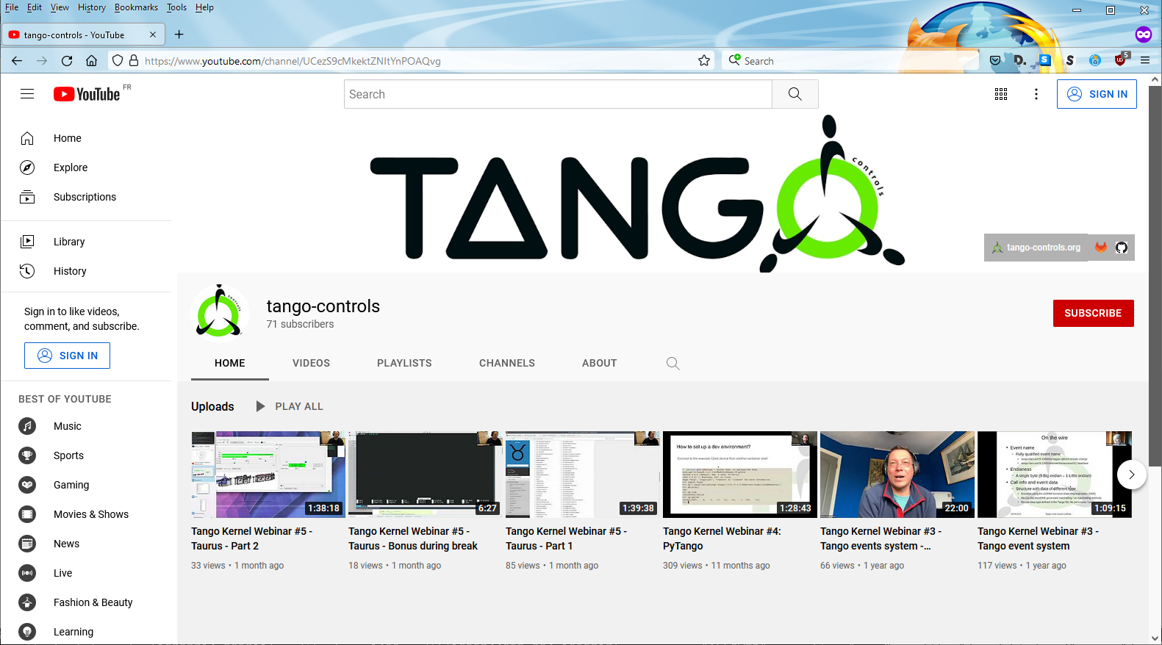
Tango Kernel Webinars
Video records available on tango-controls YouTube channel:
https://www.youtube.com/channel/UCezS9cMkektZNItYnPOAQvg
Notes:
Goals
•Share the knowledge on the Kernel Code
•Help/Guide first contributors to the Kernel Code

Slide 19
Tango Kernel Teleconf Meetings
•On 2nd and 4th Thursday of the month at 15:00 (Paris time)
•Agenda and minutes available on Github:
•https://github.com/tango-controls/tango-kernel-followup
•Status of recent development (cppTango, JTango, pyTango, POGO, RFCs, …)
•Technical discussions
•Define priorities
Notes:
Goals
•Share the knowledge on the Kernel Code
•Help/Guide first contributors to the Kernel Code

Slide 20
cppTango weekly Meetings
•Usually on Thursday at 14:00 (Paris time)
• Reminder usually sent on cpptango-dev tango-controls slack channel
•Technical discussions
•Define priorities
Notes:
Goals
•Share the knowledge on the Kernel Code
•Help/Guide first contributors to the Kernel Code

Slide 21
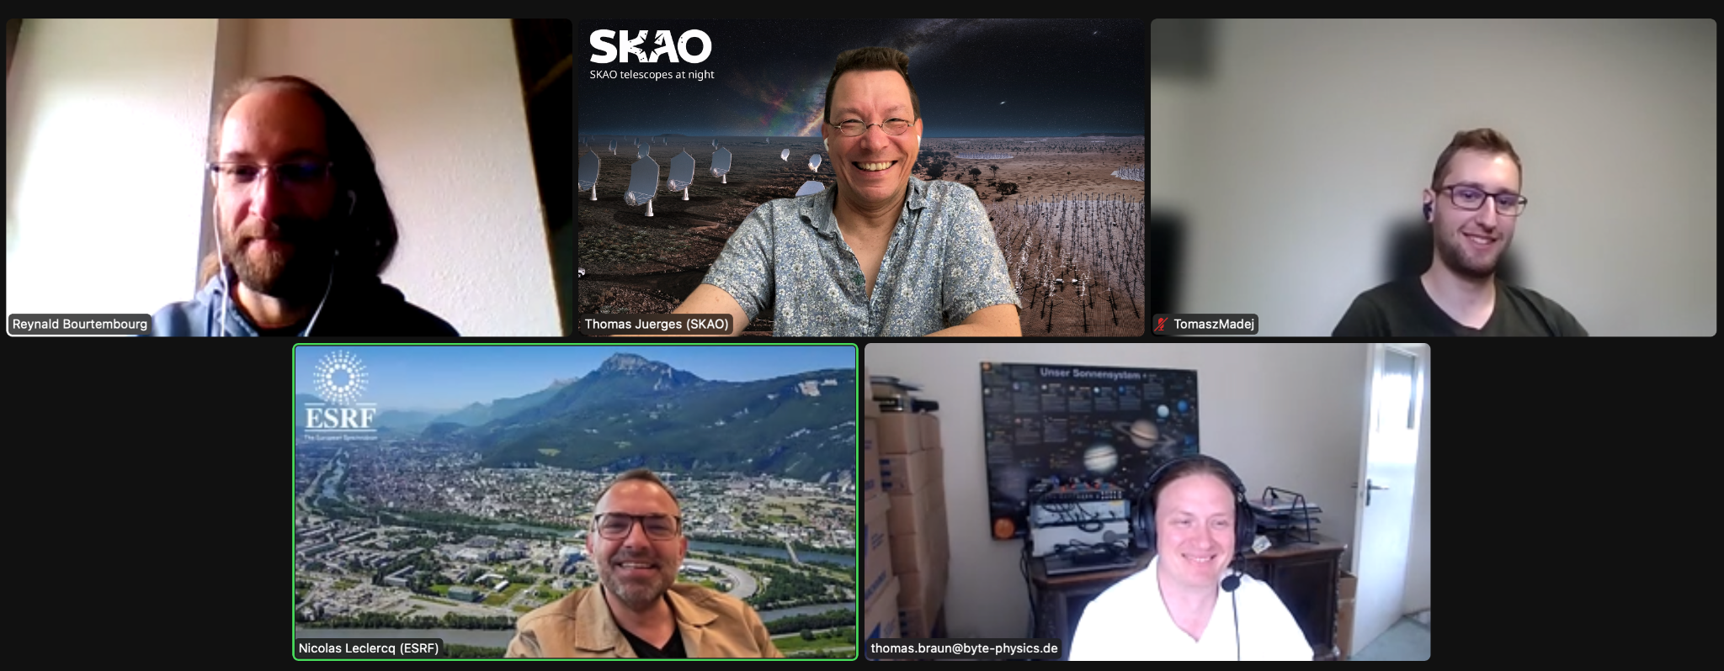
Meet the team
Top row from left to right: Reynald Bourtembourg (ESRF), Thomas Juerges (SKAO), Tomasz Madej (S2Innovations)
Bottom row from left to right: Nicolas Leclercq (ESRF), Thomas Braun (byte-physics)
Weekly meetings can be fun! Please join us.

Slide 22
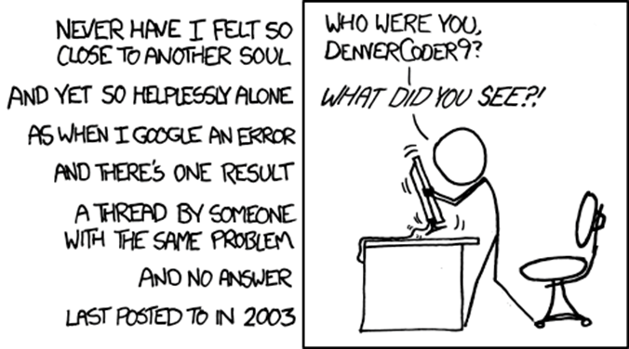
Tango-Controls Forum

Slide 23
This is the last slide (Yes, really!)
Thank you!
Any questions?
Acknowledgement:
Michal Liszcz, Aya Yoshimura, Benjamin Bertrand, Damien Lacoste, Grzegorz Kowalski, Jack Yates, Nicolas Leclercq, Reynald Bourtembourg, Thomas Braun, Thomas Juerges, Tomasz Madej, Alexander Senchenko, Andy Goetz, Anton Joubert, Carlos Pascual, Dmitry Egorov, Emmanuel Taurel, Frédéric Picca, Geoff Mant, Giacomo Strangolino, Graziano Scalamera, Guifré Cuni, Hélder Ribeiro, Igor Khokhriakov, Jairo Moldes, Jean-Luc Pons, Johan Venter, Katarzyna Rzęsikowska, Lorenzo Pivetta, Marius Elvert, Michał Gandor, Nicolas Tappret, Pascal Verdier, Piotr Goryl, Sergi Rubio, Sébastien Gara, Tiago Coutinho, Zbigniew Reszela and so many others for their contributions (PR, bug reports, code reviews, comments, …)
https://gitlab.com/tango-controls/cppTango/-/milestones
https://www.gitlab.com/tango-controls/cppTango/issues
https://www.gitlab.com/tango-controls/TangoSourceDistribution/issues

