Slide 1
General SISO PID Tango Device for Temperature Control for MaxPEEM

Slide 2
General SISO PID Tango Device for Temperature Control for MaxPEEM

Slide 3
General SISO PID Tango Device for Temperature Control for MaxPEEM
Carla Takahashi, Áureo Freitas, Benjamin Bertrand, Mirjam Lindberg, Vincent Hardion, Darren Spruce
KITS – Software

Slide 4
Single-Input Single-Output PID Controllers
IntroDUCTION
Overview of SISO PID controllers
KITS – Software

Slide 5
PID controllers
SISO systems are systems that regulates only one process variable (PV), having only one input and only one actuating signal.
PID controllers are classical devices that regulates process variables according to the error between the process variable (PV) and the Setpoint (SP).
The PID calculates a actuating signal to correct the process variable according to the error, its integral and its derivative.
KITS - Software

Slide 6
Closed Loop Control
$$u\left(t\right)=K_{P}e\left(t\right)+K_{i}\int_{0}^{t}{e\left(τ\right)dτ}+K_{d}\frac{de\left(t\right)}{dt}$$
$$U\left(s\right)=\left(K_{P}+\frac{K_{i}}{s}+K_{d}s \right)E\left(s\right) \\ G_{C}= \frac{U\left(s\right)}{E\left(s\right)}=\left(K_{P}+\frac{K_{i}}{s}+K_{d}s \right) \\ G_{C}=\frac{K_{d}s^{2}+K_{p}s+K_{i} }{s}$$
The Closed Loop system is defined by the following equation:
$\frac{PV}{SP}= G=\frac{G_{c}G_{P}}{1+G_{C}G_{P}}$
The proportional term is related to the current error magnitude. It increases the speed to reach the set point, i.e. reduces the rise time, but it also increases overshoot and degrades stability.
The integral part takes into account both the magnitude and duration of the error. Thus, it reduces steady-state error and rise time, however it increases overshoot and settling time.
The derivative term, considers the slope or speed of the error over time, which decreases overshoot and settling time and may improve stability.
$$G_{P}= \frac{1}{s^{2}+1.33s+1}$$
$$G= \frac{K_{d}s^{2}+K_{p}s+K_{i}}{s^{3}+\left(1.33+K_{d}\right)s^{2}+\left(1+K_{p}\right)s+K_{i}}$$
KITS – Software

Slide 7
Discrete PID Controllers
Standard Realization
$$u\left[k\right]=K_{p}e\left[k\right]+K_{i}T_{S}\sum_{j=0}^{k}{e\left[j\right]} +\frac{K_{d}}{T_{S}}\left(e\left[k\right]−e\left[k−1\right]\right) \\ u\left[k\right]=K_{p}e\left[k\right]+\left(u_{i}\left[k−1\right]+K_{i}T_{S}e\left[k\right]\right)+\frac{K_{d}}{T_{S}}\left(e\left[k\right]−e\left[k−1\right]\right)$$
In discrete systems, we have a dependency on the sampling time.
Both system transfer functions and the controller functions became dependant on the sampling frequency.
The implementation of the discrete PID device can be done using different approaches.
Modelling from Frequency Domain
$$U\left[z\right]=K_{p}E\left[z\right]+{K_{i}T}_{S}\frac{z}{z−1}E\left[z\right]+\frac{K_{d}}{T_{S}}\frac{z−1}{z}E\left[z\right] \\ U\left[z\right]=z^{−1}U\left[z\right]+\left(K_{p}+K_{i}T_{S}−\frac{K_{d}}{T_{S}}\right)E\left[z\right] −z^{−1}\left(K_{P}+\frac{2K_{d}}{T_{s}}\right)E\left[z\right]+z^{−2}\frac{K_{d}}{T_{S}}E\left[z\right] \\ u\left[k\right]=u\left[k−1\right]+\left(K_{p}+K_{i}T_{S}−\frac{K_{d}}{T_{S}}\right)e\left[k\right]−\left(K_{P}+\frac{2K_{d}}{T_{s}}\right)e\left[k−1\right]+\frac{K_{d}}{T_{S}}e\left[k−2\right]$$
KITS - Software
Notes:
General representation of the output u function in discrete time.
$$u\left[k\right]=u_{p}\left[k\right]+u_{i}\left[k\right]+u_{d}\left[k\right]$$
Z transform for each term of the output u
$$U_{p}\left[z\right]=E\left[z\right] \\ U_{i}\left[z\right]=\left(z^{−1}U_{i}\left[z\right]+E\left[z\right]T_{s}\right)=\frac{1}{\left(1−z^{−1}\right)}T_{S}E\left[z\right]=T_{S}\frac{z}{z−1}E\left[z\right] \\ U_{d}\left[z\right]=\frac{1}{T_{s}}\left(E\left[z\right]−z^{−1}E\left[z\right]\right)=\frac{1−z^{−1}}{T_{s}}E\left[z\right]=\frac{z−1}{zT_{s}}E\left[z\right]$$
The derivative and integral term uses the Backward Euler realization for in the discrete domain
$$\frac{U\left[z\right]}{E\left[z\right]}=K_{p}+K_{i}T_{S}\frac{z}{z−1}+\frac{K_{d}}{T_{S}}\frac{z−1}{z} \\ \frac{U\left[z\right]}{E\left[z\right]}=\frac{\left(K_{p}+K_{i}T_{S}−\frac{K_{d}}{T_{S}}\right) −z^{−1}\left(K_{P}+\frac{2K_{d}}{T_{s}}\right)+z^{−2}\frac{K_{d}}{T_{S}}}{1−z^{−1}}$$

Slide 8
Timed Façade Devices
IntroDUCTION
Brief Explanation about TimedFacade Tango Devices
KITS – Software

Slide 9
FacadeDevices
Façade Device
Tango FacadeDevices provide descriptive interfaces for reactive high level devices.
They are available on the git-hub repo: MaxIV-KitsControls/tango-facadedevice
Façade devices link attributes and commands from remote underlying devices.
They can also observe attribute events from remote underlying devices and forward them to user.
For this, they use specific objects create an interface between the Façade device and the remote device:
local_attribute
logical_attribute
proxy_attribute
combined_attribute
state_attribute
proxy_command
The rules for values and state trasitions of Façade devices are structured in a Graph.

Slide 10
FacadeDevices
Timed Façade Device
TimedFacade Devices are based on the Facade device, but they include time handling. In this case, they can be updated periodically and execute a callback function at each update time.
The main differences are:
Name | Type | Description
UpdateTime | Polled command | This command is polled peridically, as defined in the UpdateTime polling value. It updates the Time local attriibute
Time | Local attribute | Local variable that is updated with a new timestamp at every time tick.
on_time | method | Callback function that is executed whenever the Time variable is updated

Slide 11
SISO PID Tango Device
Implementation
Overview of the SISOPID Tango Device
KITS- Software

Slide 12
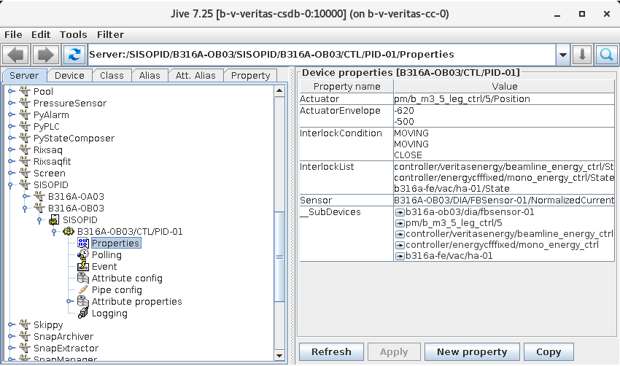
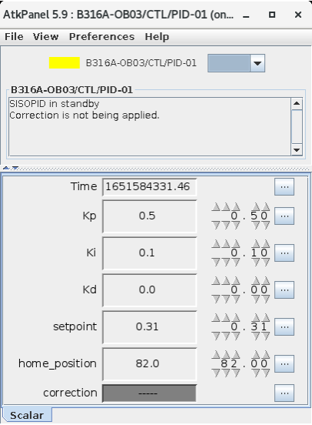
SISO PID Device
The aim of this class is to have a software implementation of a SISO PID controller.
This device can be used for regulating non critical PV.
The control loop action is defined in the on_time method.
The UpdateTime defines the control loop frequency and the sampling rate.
KITS – Software

Slide 13
Properties
Properties
Name | Description
Actuator | Tango attribute that will be used as the feedback actuator
ActuatorEnvelope | Actuator limits (minimum and maximum)
InterlockCondition | Tango attribute value for trigger interlock condition.
InterlockList | Tango attribute list for interlocks.
Sensor | Tango attribute that is used as feedback loop sensor.

Slide 14
Attributes
Attributes
Name | Default value | Description
Kp | 1 | PID Proportional gain
Ki | 0 | PID Integral gain
Kd | 0 | PID Derivative gain
correcton | READ_ONLY | PID correction value (not the actuator signal)
setpoint | 0 | PV setpointvalue
home_position | 0 | Home value of the actuator to avoid saturation of the actuator.
Time | READ_ONLY | Timestamp of the last control loop action

Slide 15
Commands
Commands
Name | Description
Start | Start control loop
Stop | Stop control loop
UpdateTime | Inherited from the TimedFacade device. Triggers the on_time callback

Slide 16
MaxPEEM Temperature Control
Use Case
Leem2000 temperature control using the SISOPID device at MaxPEEM
KITS- Software

Slide 17
The System
The Leem2000 is the control software of the aberration-corrected SPELEEM microscope(Elmitec GmbH) used in MaxPEEM.
In MaxPEEM, it also controls the current over a filament, which is used to change the temperature of the sample.
The measurement of the sample temperature is also available on the Leem2000.
KITS - Software

Slide 18
Tuning Process
The sampling rate was set to 1s, which is sufficient to this temperature control system.
The method used to tune the PID was the Ziegler-Nichols approach, since we did not have a transfer function of the system.
We found the ultimate gain with $K_{u}≈4.8$
With this gain, the fundamental oscillation period was $T_{u}≈85s$
$K_{i}$ was removed as it easily introduced instabilities.
In order to meet the system restrictions on overshoot, the $K_{p}$ was reduced.
KITS - Software

Slide 19
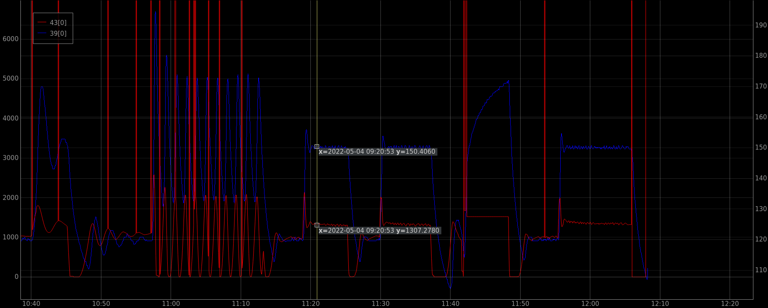
PID parameters
$$K_{p}$$ | 3.6
$$K_{i}$$ | 0
$$K_{d}$$ | 40
UpdateTime | 1000 ms
Controlled System
Overshoot | 3.3% (120 to 150℃)
Steady State Error | ±0.6℃
KITS - Software

Slide 21
General SISO PID Tango Devices and Applications
Conclusion
Our Findings and Future Work
KITS -Software

Slide 22
Conclusions
Conclusions
A straightforward Tango based PID controller has numerous feasible applications.
The simple implementation is advantageous for tuning on the user stand point.
The current SISO PID has some room for improvement, we let our users give us some feedback about it.
A straightforward MIMO PID device would be another valuable implementation.

