Slide 1

DEVICE SERVER FOR THE USE OF PROSILICA CAMERAS
Maguette SOW | C2S UNIT

Slide 2
Overview
Introduction
Presentation of Apollon
Prosilica cameras and Vimba API
DevVimba Device Server
Conclusion

Slide 3
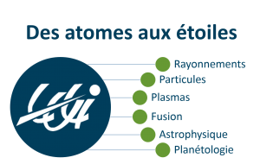


Introduction
Apprenticeship: student at Polytech Sorbonne while working at LULI (C2S unit)
Speciality: Electronics and Industrial Computing
Beginner in Tango
First project: DevVimba

Slide 4
Few words about Apollon
Located close to Soleil synchrotron (Fr)
One of the two LULI facilities
PW class laser
2 target areas :
  Short Focal Area
  Long Focal Area
High intensity plasma physics
Experimental campaigns since end of 2020
Controlled with Tango system
Virtual Visit of Apollon: IR-Apollon (matterport.com)
https://luli.ip-paris.fr/en
https://apollonlaserfacility.cnrs.fr/en/home/

Slide 5
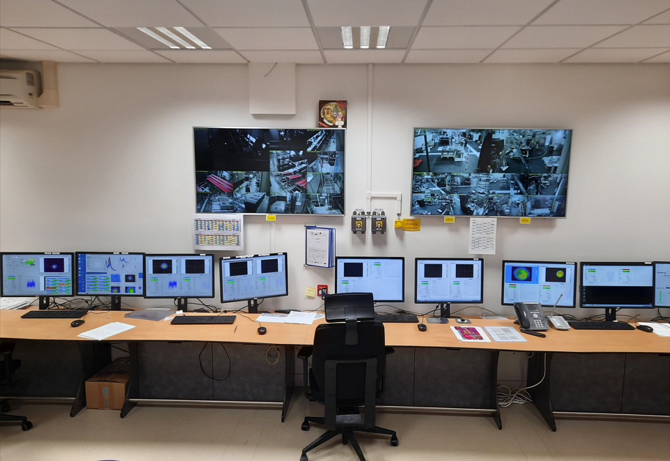
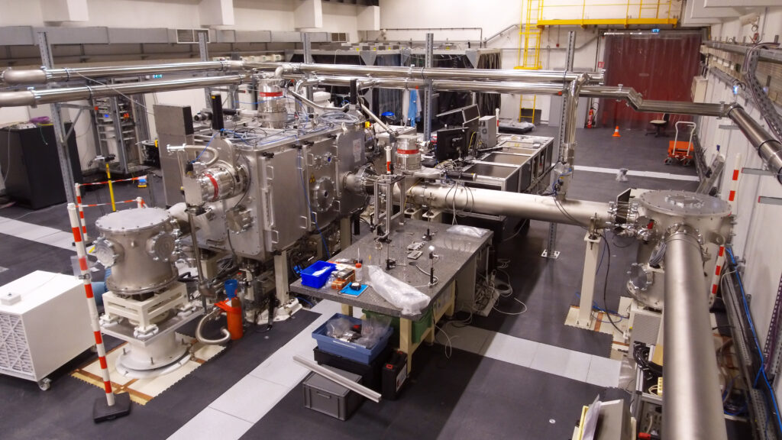
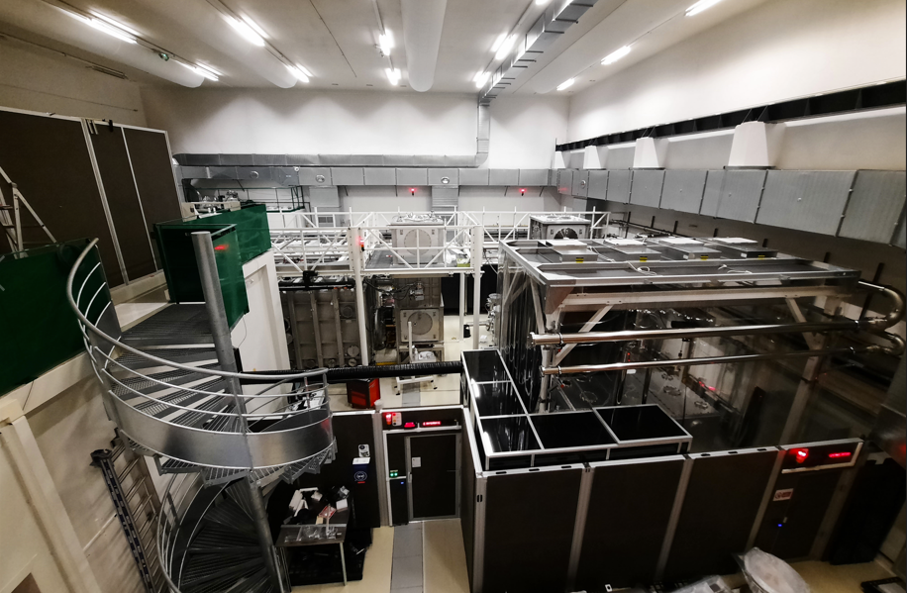
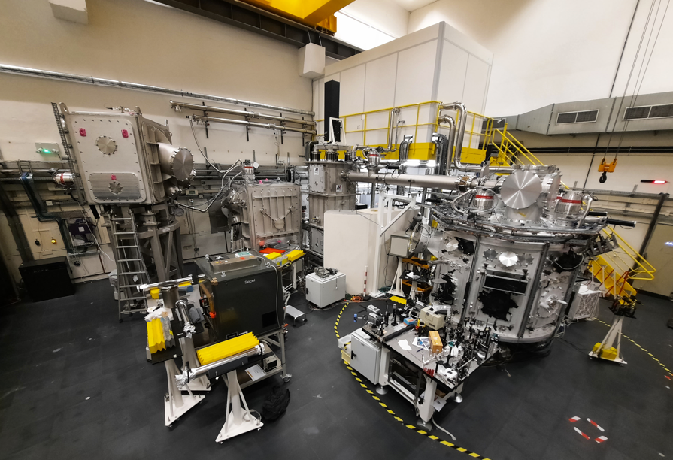
Few words about Apollon
Laser control room
Experimental space of the 1PW beam in the Long Focal Area
Compression and beam switchyard area
Short focal target area

Slide 6

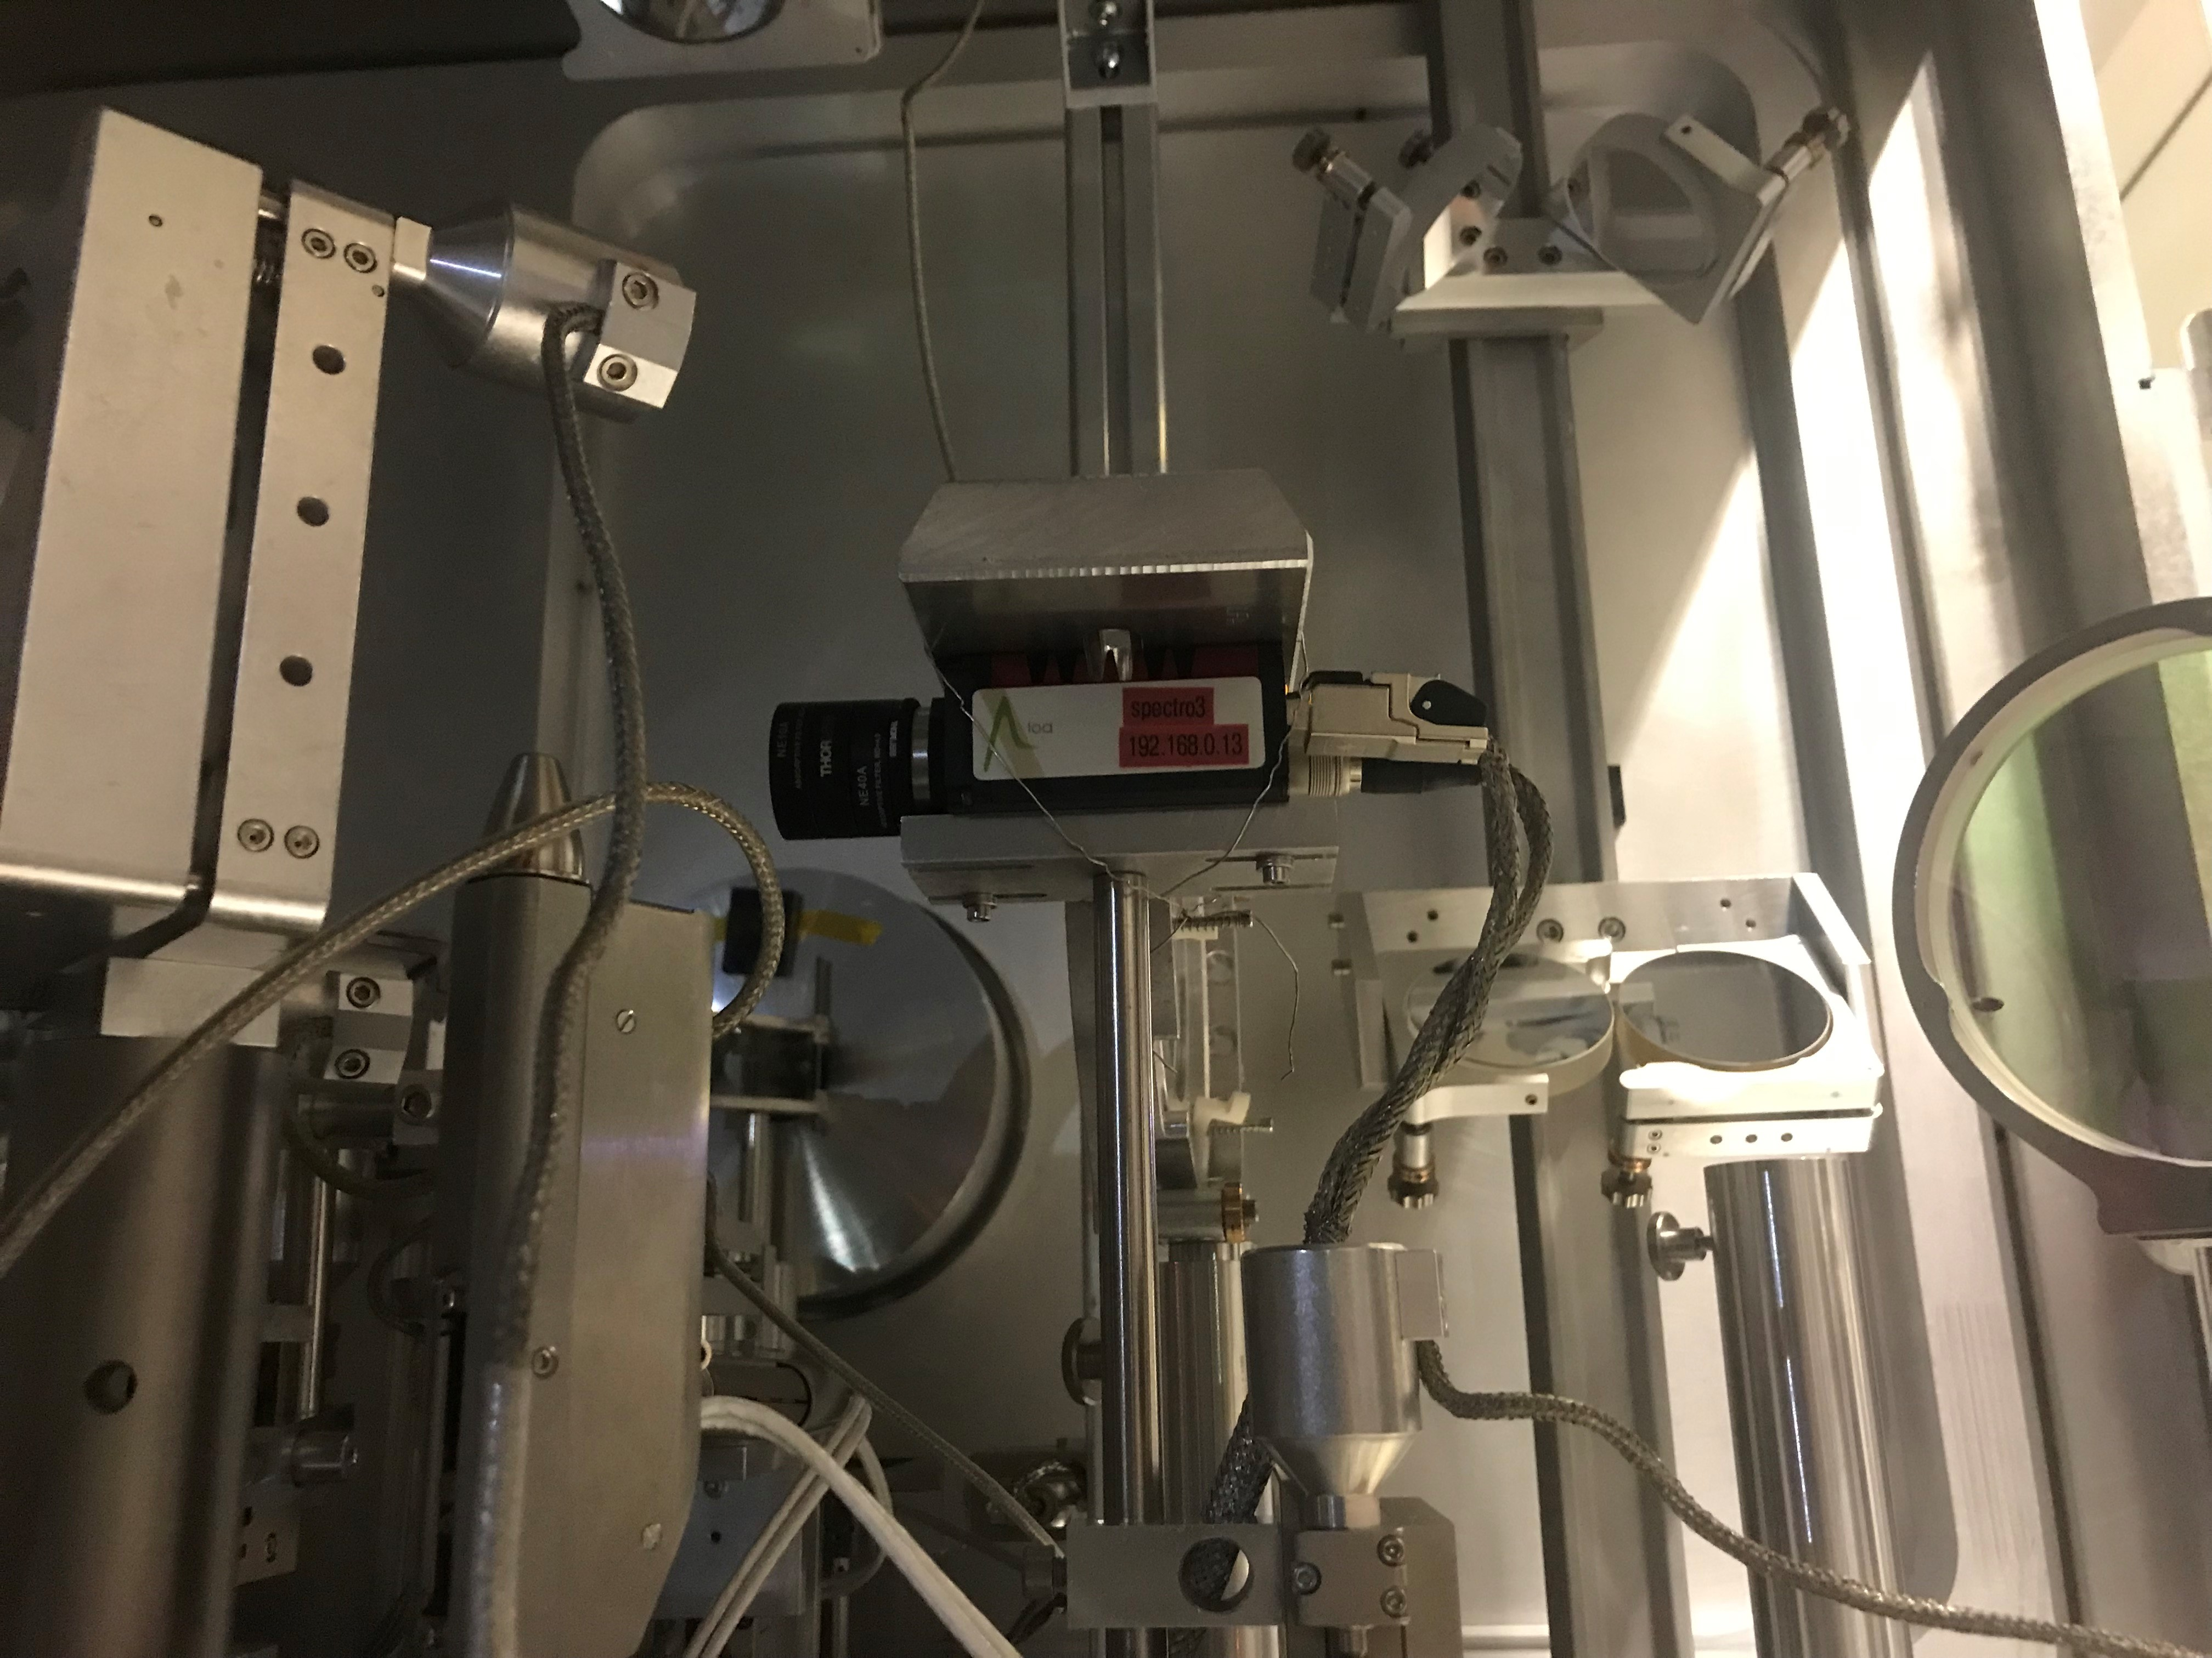
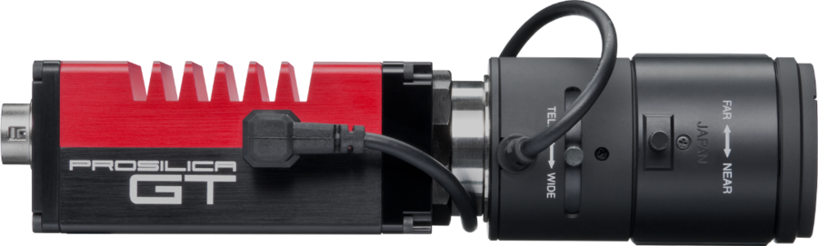
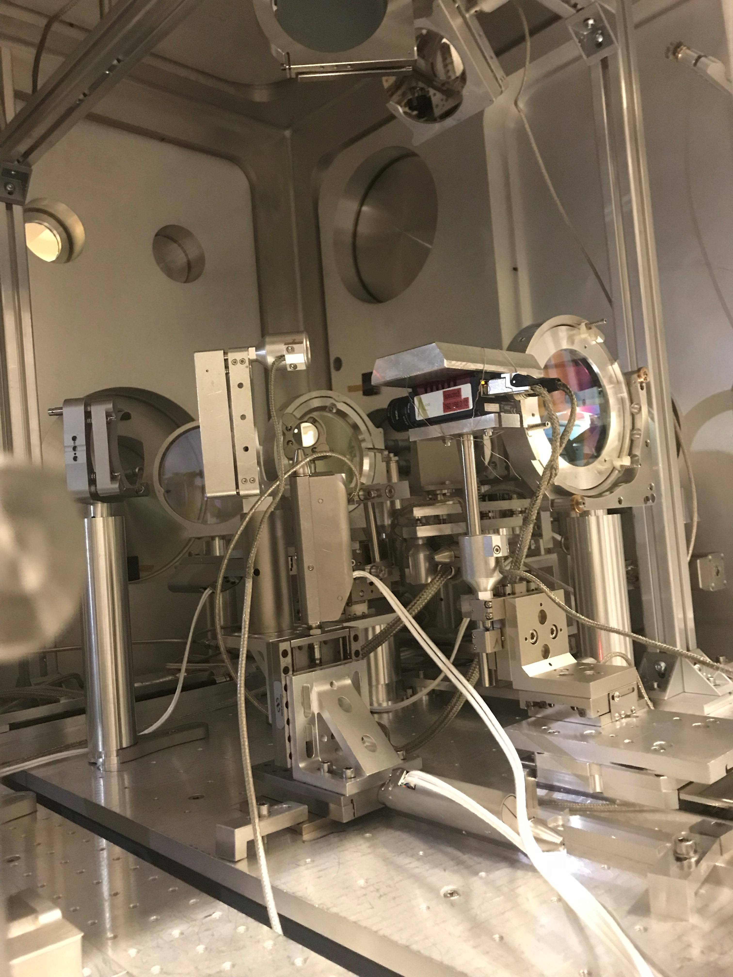



Prosilica cameras & Vimba API
CHARACTERISTICS OF THE PROSILICA
High performance camera
Validated in vacuum vessel in LULI
Harsh industrial environments
Extreme temperatures from -20°C to +65°C
THE VIMBA API
alliedvision/VimbaPython: Allied Vision Vimba Python API (github.com)
The prosilica GT1290
Cameras prosilica already installed in a vacuum chamber
Distribution
OS used
Python v3.8

Slide 7
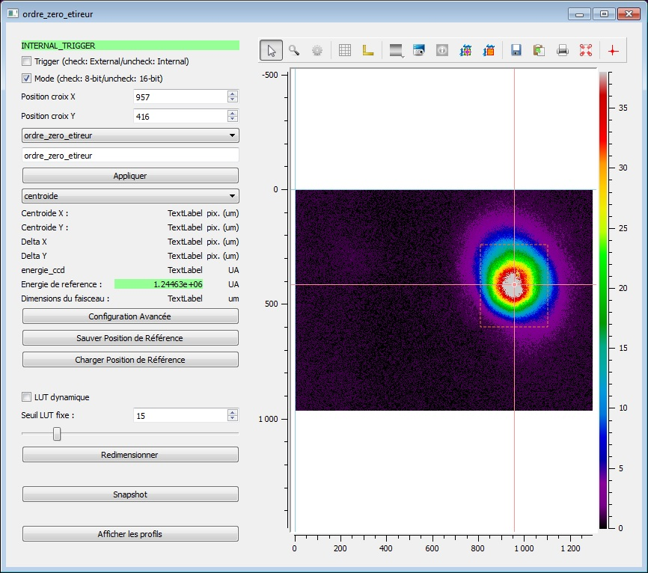
DevVimba Device Server
PURPOSE
Create a new tool using Prosilica cameras similar to this existant DS for Basler cameras
PROCESS DEVELOPMENT
Write a source file about the features of the camera
Create an interface that allows the user to adjust the parameters
Get introduced to Tango by creating a device server named DevVimba
Library of features param.py
GUI QTW
DevVimba

Slide 8
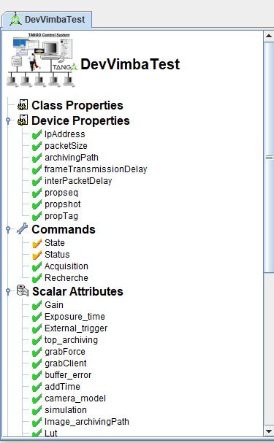
DevVimba Device Server
Activities
Tango training on December 2021 | C2S and Sonia Minolli (Nexeya)
Getting Started with Pogo, Jive, ATKPanel, threading…
Progressive addition of the attributes
Setting up several states of the Device
Few difficulties
Image type matching (numpy array / pointer, conversion, …)
Pogo Generated File Corruption
Slowness of the device and the display of images
Image size / type of the camera
size / type expected by the attributes

Slide 9
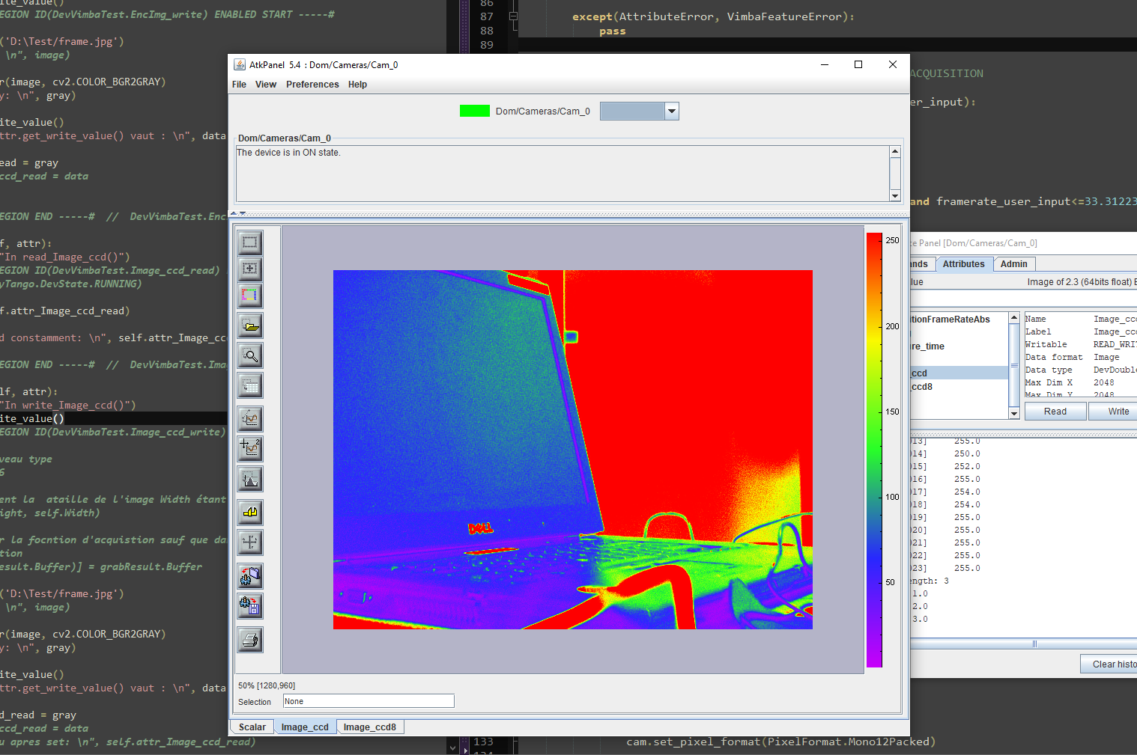
RESULTS
Perfect acquisition and fast display of the images
Resolution management (Mono8 and Mono12)
Better understanding of the Tango API

Slide 10
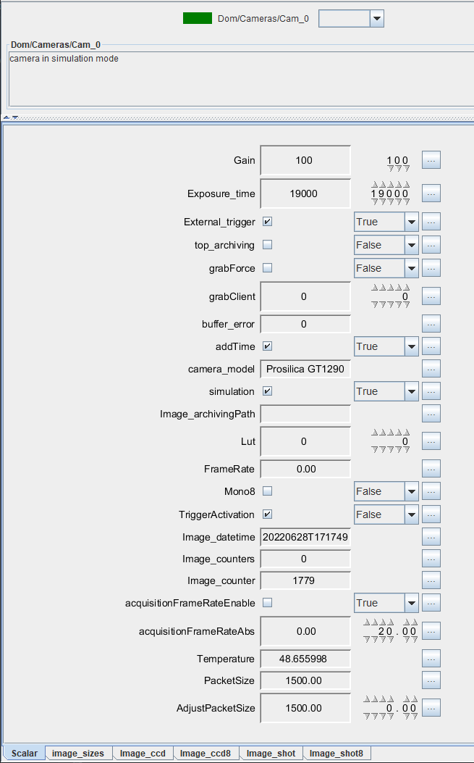
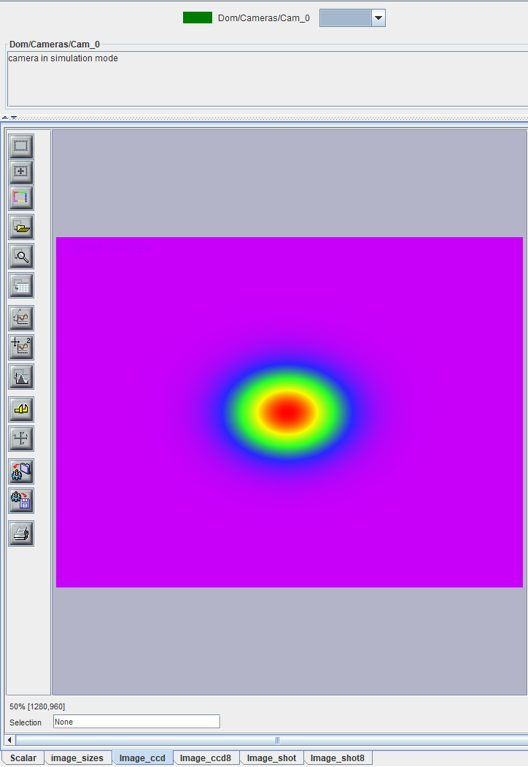
RESULTS

Slide 11
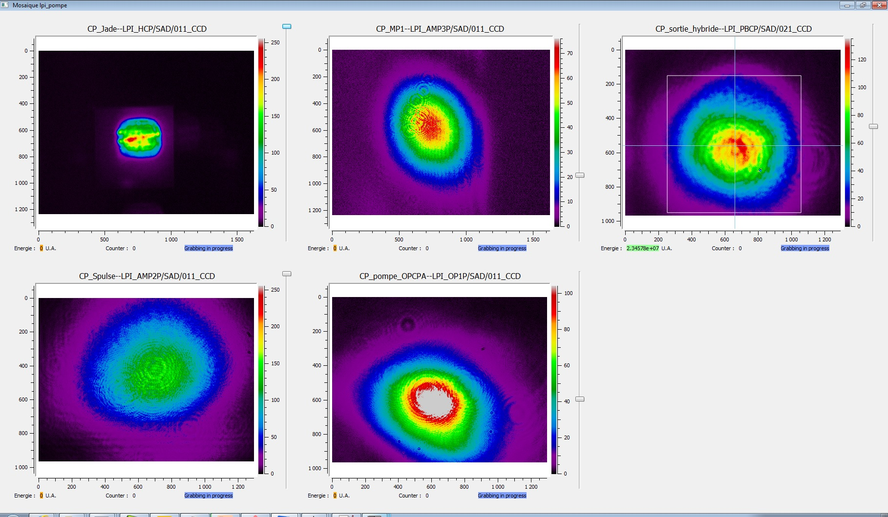
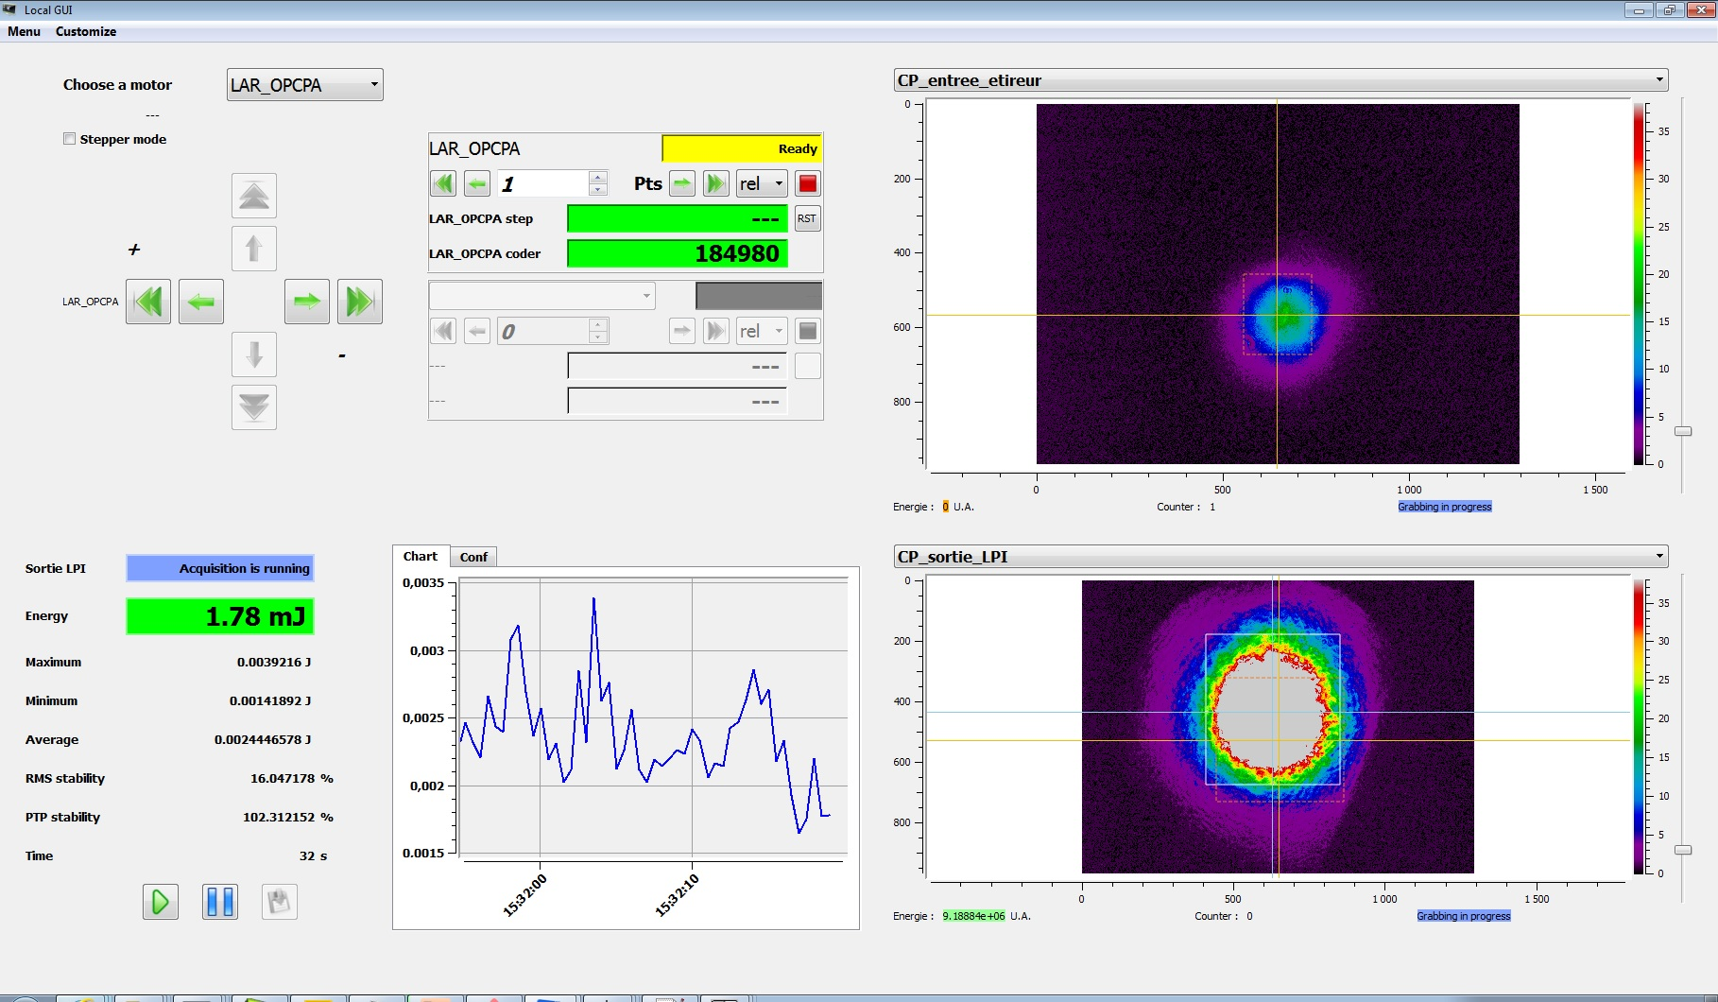
EXISTING GUI EXAMPLES
Thanks for your attention !

