Slide 1




Taranta project
Tango Controls Workshop @ ICALEPCS 2023 South Africa
7 October 2023 Century City Convention Centre
Matteo Canzari – INAF – Osservatorio Astronomico d’Abruzzo

Slide 2

Taranta @ICALEPCS 2023
Some Taranta presentation during the conference
Taranta Project @Tango workhop (this one) - Taranta features and demo
Taranta Project - Update and Current Status Oral Presentation (FR2BCO03) Friday, 11:00-11:15 – New features added in Taranta and Roadmap
Front-End Monitor and Control Web Application for Large Telescope Infrastructures: a Comparative Analysis – Mini-oral & Poster (TUMBCMO09) Tuesday, 14:09-14:12
Improving Performance of Taranta: Analysis of Memory Requests and Implementation of the Solution – Poster (TUPDP044) Tuesday, 16:15-17:45

Slide 3
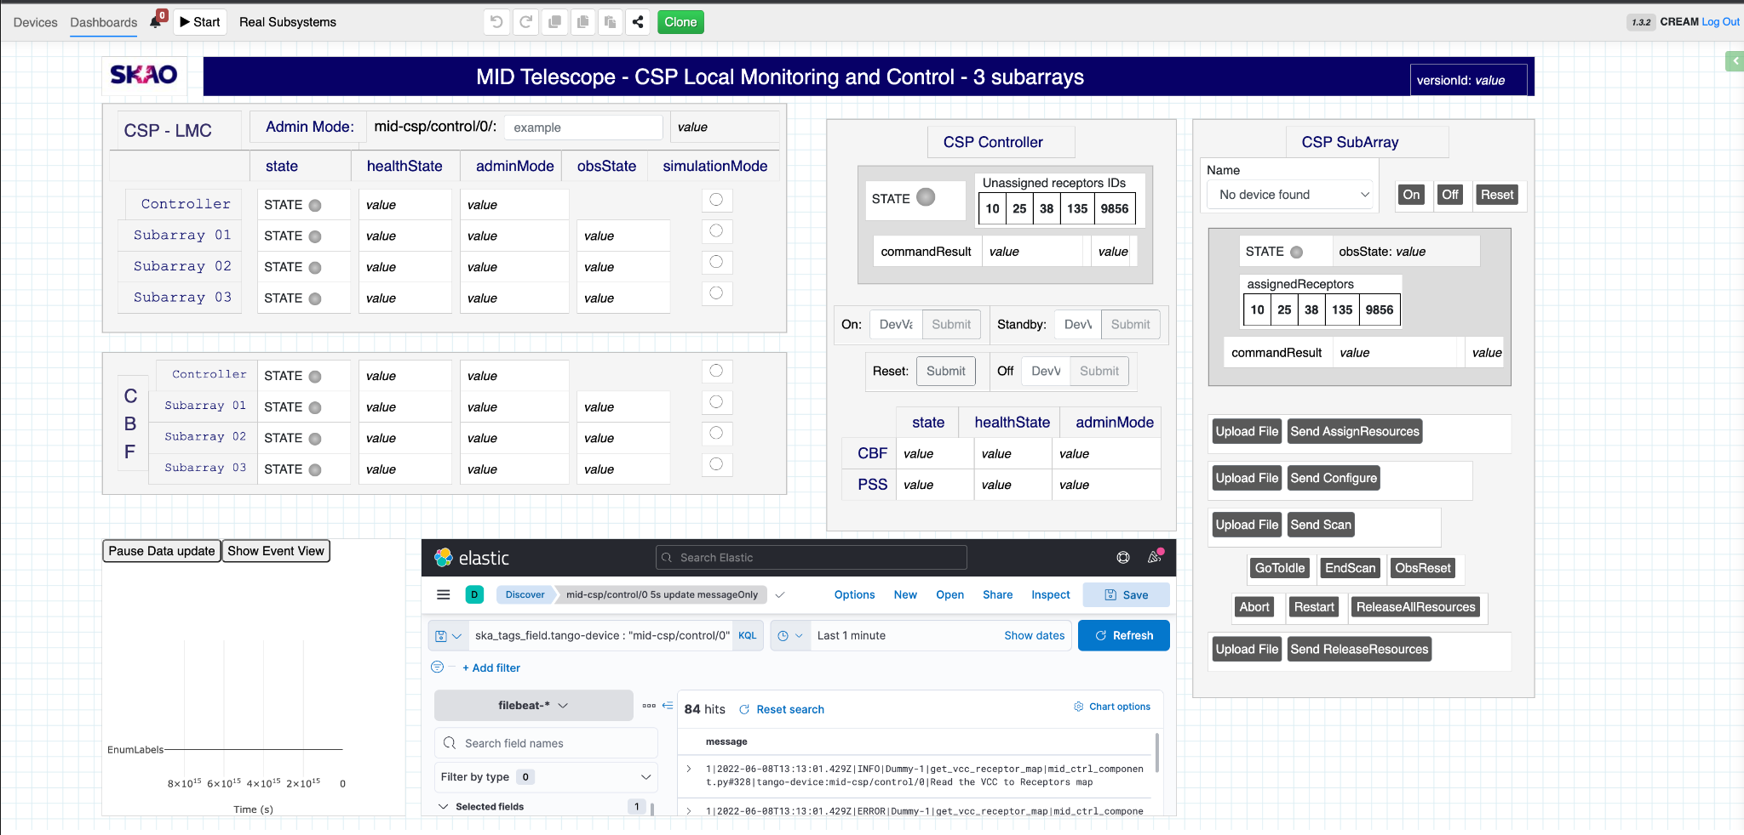
What is Taranta
Taranta is a web application that allows a user to:
easily browse devices of a Tango server, inspect them and interact with them, all using web browser of choice.
quickly develop and change interactive dashboards with widgets that allow you to monitor and interact with Tango devices. Once created, dashboards can be run, saved, and exported.
a dashboard can be defined in a few minutes, with minimal knowledge of web technologies; you only need to know which devices you want to interact with and what attributes and commands they expose.

Slide 4
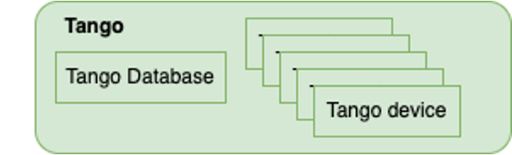
Control system
Tango Database – naming services
Tango device - single indipendent component

Slide 5


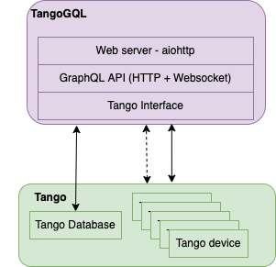
Backend
GraphQL is a data query and manipulation language for APIs
HTTP to query TangoDB synchrounous data
Websocket for subscribing to asynchronous attribute value events
Aiohttp: Asynchronous HTTP Client/Server

Slide 6



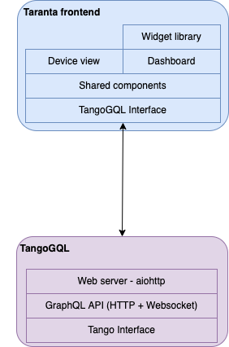
Frontend
Shared components provide APIs to access TangoGQL and util libraries
Device view provides a fast view of devices without customization
Dashboard permits users to create a custom user interface
Widget is a React component that implements functionalities to interact with a Tango Device or a dashboard
Improving Performance of Taranta: Analysis of Memory Requests and Implementation of the Solution – Poster (TUPDP044) Tuesday, 16:15-17:45

Slide 7

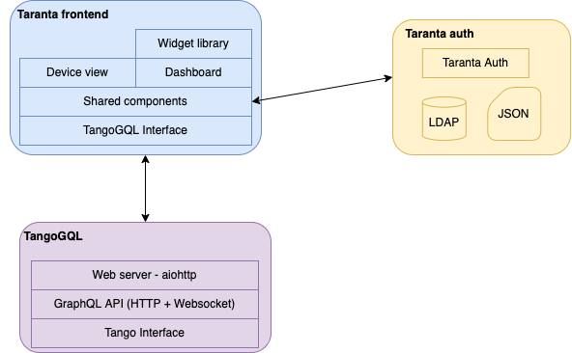
Authentication system
Provides authentication system
JSON Web Token (JWT) is an open standard that defines a compact and self-contained way for securely transmitting verifiable information between parties as a JSON object
Permits to retrive user data from LDAP server or a JSON file
Manage also TangoGQL authentication

Slide 8


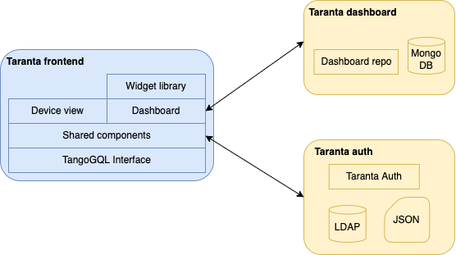
Dashboard storage
API for fetching and storing the dashboards
Thanks to MongoDB, it is possible to change the dashboard schema
A dashboard is stored as a JSON file. It is also possible to import/export/share dashboard
It exposes some specific endpoints to anonymous users

Slide 9
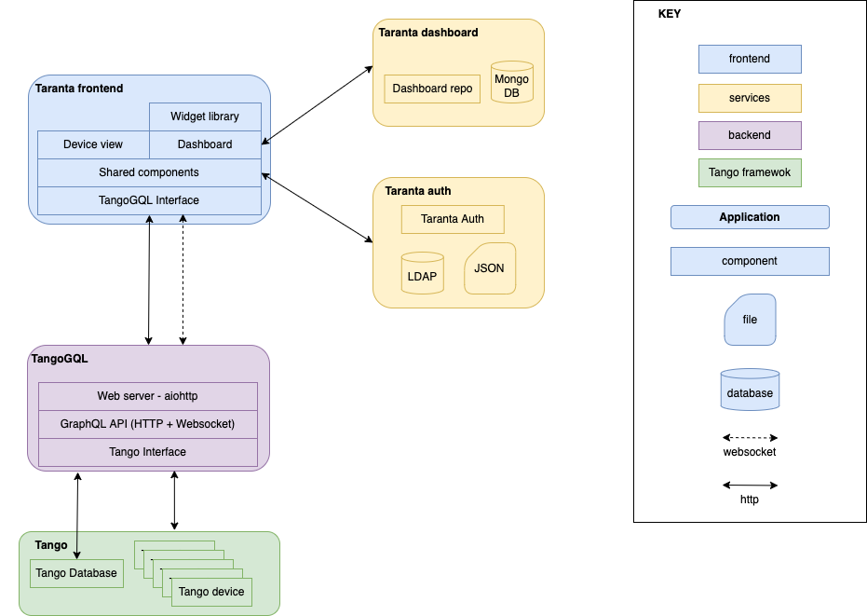
Taranta Architecture

Slide 10
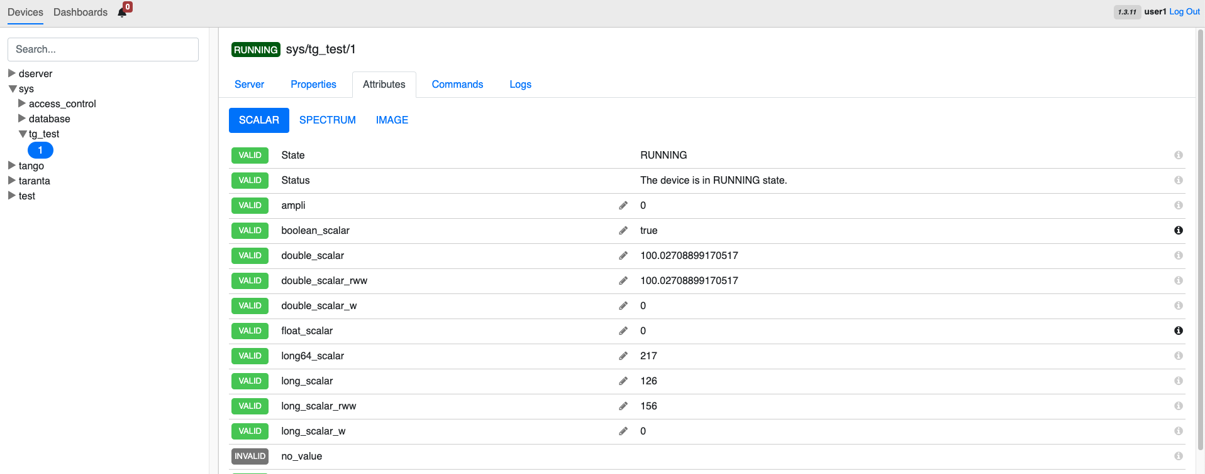
Jive
Devices (or jive) view permits to explore Tango Devices running, read/write attributes, run commands, set properties and so on

Slide 11
Taranta Dashboard
A dashboard is custom view composed of a collection of widgets organized to achieve certain objective.
A person needs to be logged in to create a dashboard.
There are two modes in dashboard:
Edit Mode: User creates dashboard with help of widgets by organizing them in an order. User can position or resize widgets but cannot view/change tango device state in this mode.
Run Mode: Once user has created the dashboard he can click on run button to interact with the dashboard either by viewing attributes or by executing commands on tango device.

Slide 12
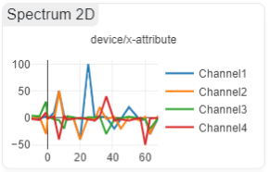
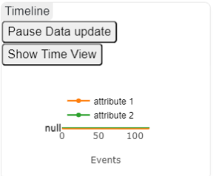
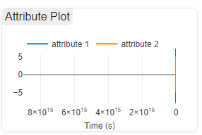
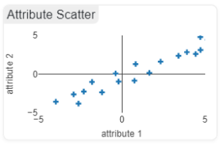
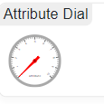
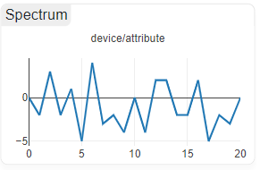
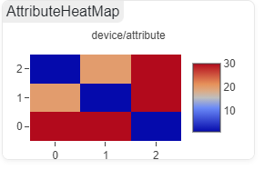
What is a Widget?
Widget is a graph/chart or combination of HTML elements that lets you to view or interact with Tango device.
A widget can let you see how an attribute changes over time, or its current value; a widget can let you send a command to a device or change an attribute or its state.
These widgets are used to while creating dashboards

Slide 13
Widget Types (1)
Depending upon the usage of widgets they are classified as below
    Dealing with labels: This is used to add some text or label in the dashboard
    Dealing with attributes: These widgets are used to view or change the attribute of a device. There are 15 widgets that deals with attribute:
      Device Status, Attribute Display Widget, Boolean Display Widget, Led Widget, Attribute Writer Widget, Attribute Writer Dropdown Widget, Attribute Plot Widget, Attribute Scatter Widget, Timeline Widget, Spectrum-2D Widget, Attribute Logger, Attribute Heat Map, Spectrum Table, Attribute Dial Widget
    Dealing with commands: These widgets are used to execute command on Tango device. There are at present 2 widgets dealing with commands:
      Command (former Command Array Widget) & Command File Widget
    Dealing with spectrum:
      Spectrum 2D

Slide 14
Widget Types (2)
    Dealing with grouping of widgets: This is used to group other widgets into a container. This is helpful in creating logical grouping of widgets while creating dashboards
    Dealing with dashboard: These operate on dashboard level, these are of 2 types
      Variable Selector: User can create dashboard variables which contain tango device name, these variables can be used with help of variable selector widget. Practical Demo
      Embed Page Widget: This widget allows the user to embed web pages within the dashboard. This widget is completely independent of tange devices and is a stand-alone widget for porting externally developed web-tools to bring controls and monitoring on one platform

Slide 15
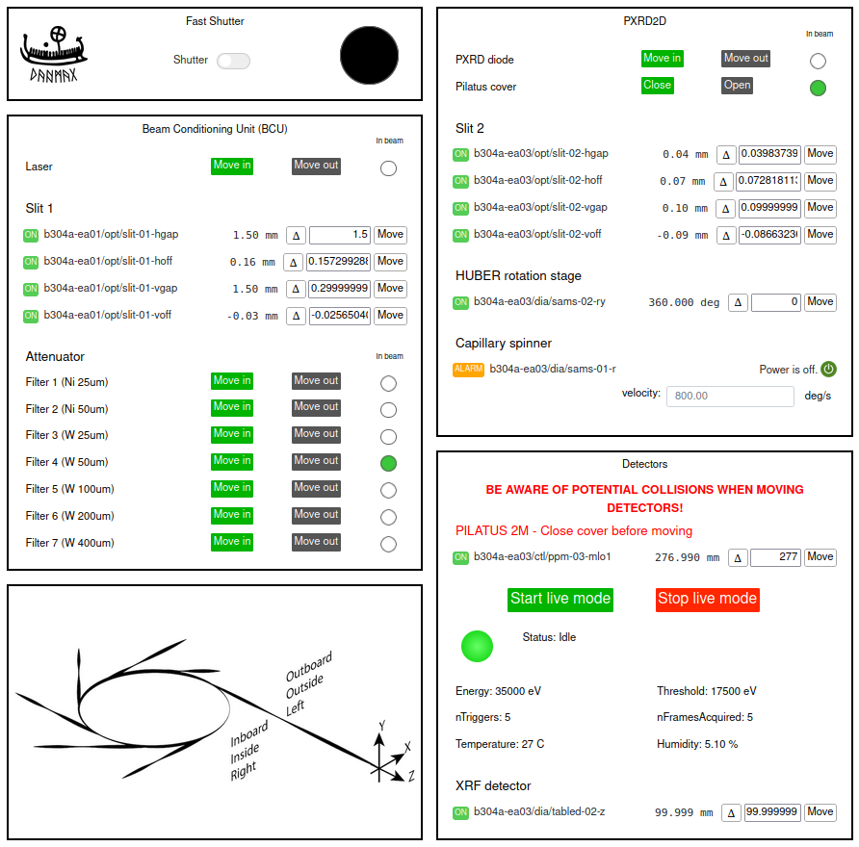
Example of dashboards

Slide 16

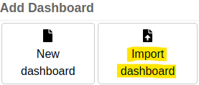
Import/export dashboards
Export Dashboard:
  After creating a dashboard, the user can share it with colleagues by exporting it.
  Pressing the export button downloads current dashboard as a JSON file named: <dashboard-name.wj>
Import Dashboard:
  User can import a dashboard from an .wj file extension.
  During import some validation checks are made and on success a new dashboard is created from the imported file.
  Validation checks include syntactic validation and formal validation(mandatory field checks).
  In case of failed validation, an error message is shown and the dashboard is not imported

Slide 17
Community
Join the #taranta-webjive slack channel in the Tango Slack Domain (http://tango-controls.slack.com/)
Attend the Taranta Weekly meeting, every Friday from 9:00 AM to 10:00 AM UTC on Zoom (in the slack channel you will receive the details)
https://us02web.zoom.us/j/84105114910?pwd=c2RHVGxBSytQc3dqcDIraDNSWW9lUT09
Add feedbacks, new desiderata or report bugs in our GitLab Repository, in the Issue Section
Contribute to code and raise your merge request
https://taranta.readthedocs.io/en/latest/howto_contribute.html

Slide 18


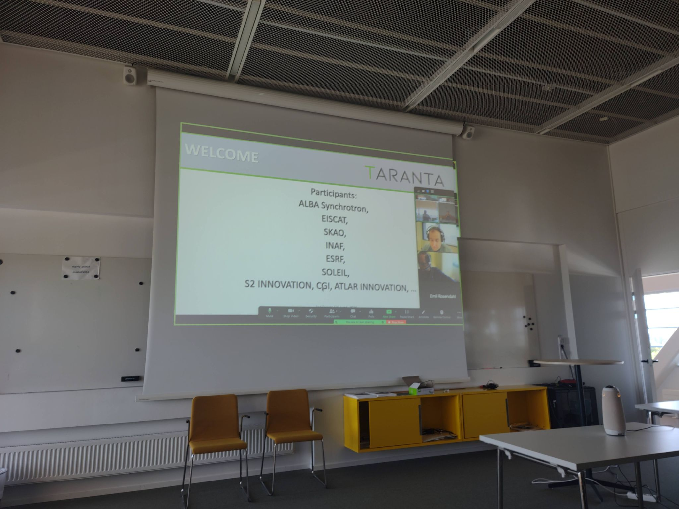
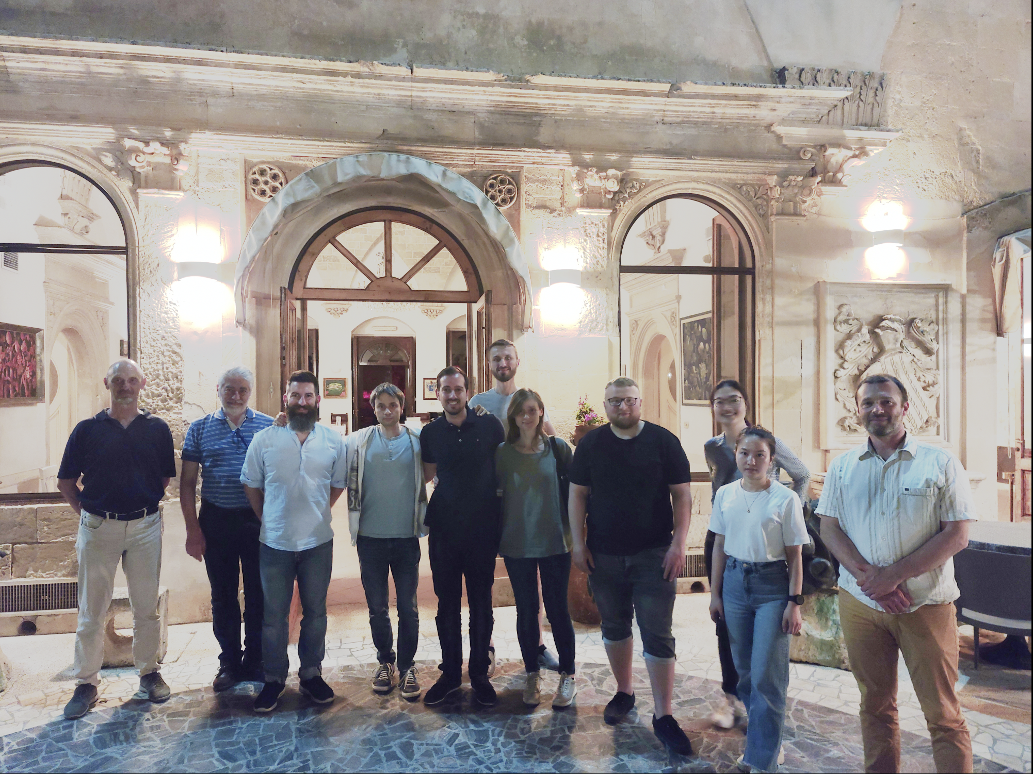
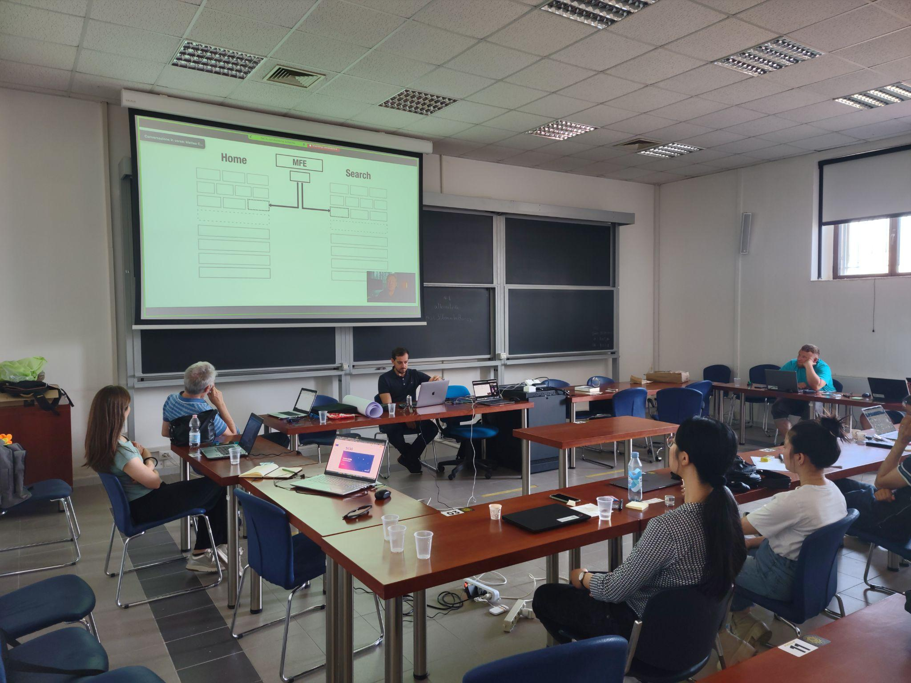
Community: Taranta F2F meeting
2nd F2F Taranta Meeting
Hosted by MaxIV
29–30 May 2023
20 participants, coming from 9 institutions or private companies
11 contributions and a half-day dedicated to open discussion and brainstorming
17 partecipants (11 in person)
11 Institutes/companies
8 Countries

Slide 19

Repository
Current Taranta Version: 2.4.1
Tango web: https://gitlab.com/tango-controls/web
Taranta Project - Update and Current Status Oral Presentation (FR2BCO03) Friday, 11:00-11:15 – New features added in Taranta and Roadmap
Taranta suite: https://gitlab.com/tango-controls/web/taranta-suite
  Taranta https://gitlab.com/tango-controls/web/taranta
  Taranta-Auth https://gitlab.com/tango-controls/web/taranta-auth
  Taranta-Dashboard https://gitlab.com/tango-controls/web/taranta-dashboard
  TangoGQL https://gitlab.com/tango-controls/web/tangogql

Slide 20
Useful links
Documentation: Detailed documentation about taranta, its widgets, workflows can be found at https://taranta.readthedocs.io/en/latest/index.html
Deployment: Taranta can be deployed on minikube as well as on docker
Configuration: It is possible to customize Taranta installation using a json file the src/config.json file It contains the list of variables that are used to customize taranta application.
MIN_WIDGET_SIZE: This is used to define the minimum size (height & width) of widgets in the Dashboard section. Its default value is 20
WIDGETS_TO_HIDE: It contains an array of widgets to hide in the Dashboard section. Eg. `[“SARDANA_MOTOR”, “MACROBUTTON”]`
SHOW_COMMAND_FILE_ON_DEVICES: This is a boolean variable if set to true, it allows users to upload a file to send as an argument in the commands that accept DevString, in Devices section. Its default value is false

Slide 21
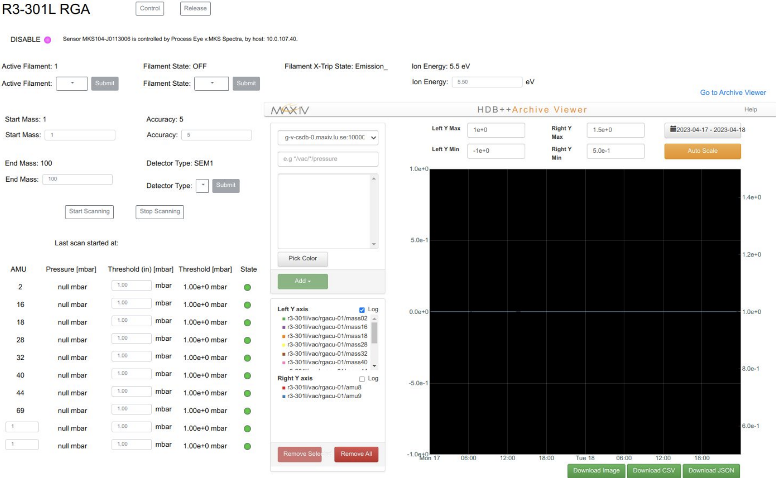
Taranta MaxIV use cases
Taranta is widely used in MAX IV from accelerator operators to the beamlines. Dozens of dashboards are created for monitoring usage, device configure/control and motor movement.
Machine/Accelerators
monitoring various systems
motor movements
Beamlines
Overview of equipments
Configure parts of the experiments
Users
engineers
beamline staffs
experiment users

Slide 22
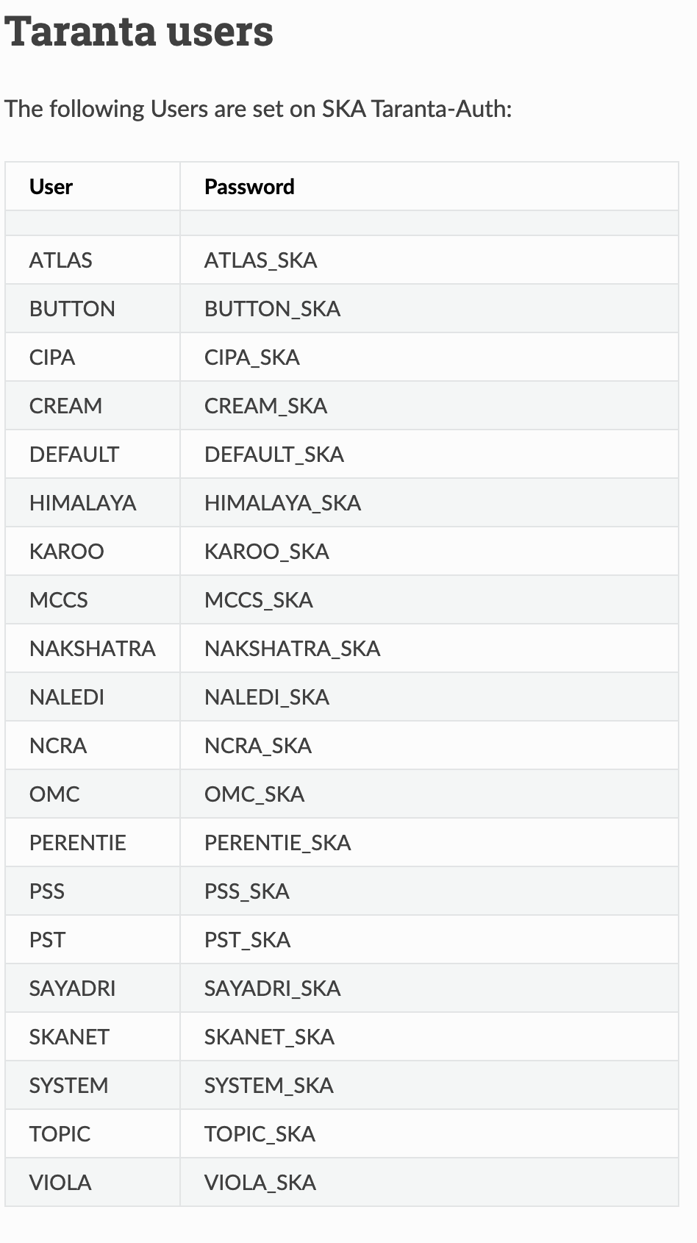
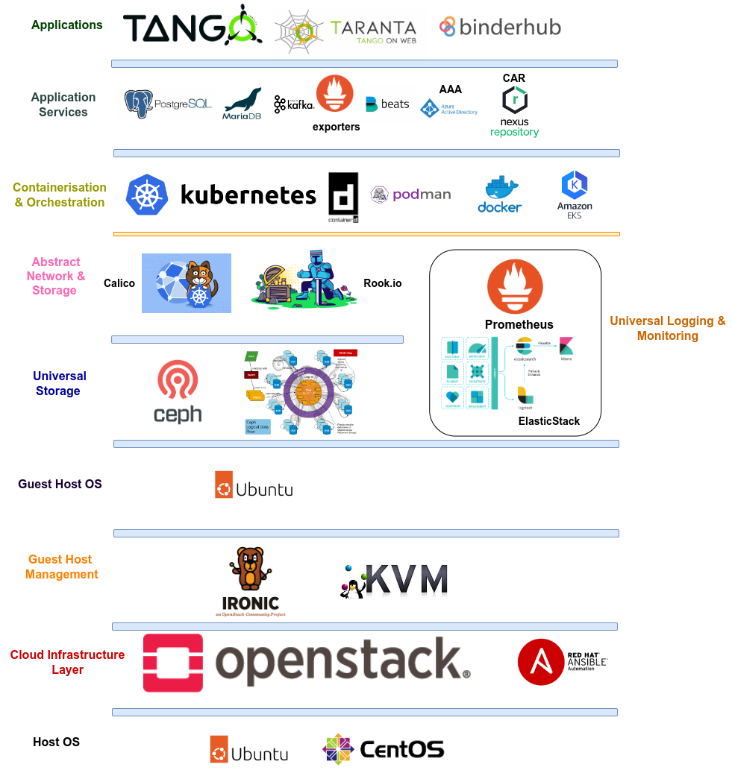
Taranta SKAO use cases
Taranta is a tool used by engineers, integrators and commissioners for monitoring, controlling and debugging Tango devices for the telescope.
Key selling points:
quick development of UIs
easy to modify existing UIs
no need for UI-related skills
no need to use other tools
Front-End Monitor and Control Web Application for Large Telescope Infrastructures: a Comparative Analysis – Mini-oral & Poster (TUMBCMO09) Tuesday, 14:09-14:12
Slides from Giorgio Brajnik

Slide 23
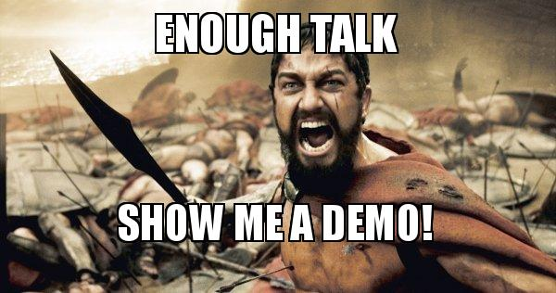
Demo

