Slide 1
Developing a TANGO device in a k8s context
Matteo Di Carlo, INAF – Osservatorio Astronomico d’Abruzzo
On behalf to SKA system and bang team
Tango Controls Workshop @ ICALEPCS 2023 South Africa

Slide 2
SKA Deployment Practices
Kubernetes (k8s) for container orchestration (kubernetes.io)
Helm for packaging and deploying SKA Software (helm.sh)
A chart is a recipe to deploy the several k8s resources (i.e., containers, storage, networking components, etc) required for an application to run
Works on templates, allows to adapt generic configurations to different environments (i.e., the different SKA datacentres)
Heavy use of Makefile (i.e., building, testing, deployment, …)
Gitlab for CI/CD

Slide 3
Development environments for Kubernetes
There are a number of competing Kubernetes development environments - eg:
Minikube - https://kubernetes.io/docs/tasks/tools/install-minikube/
Kind - https://kind.sigs.k8s.io/docs/user/quick-start/
Microk8s - https://microk8s.io/
Minikube still remains the most comprehensive option for a personal Kubernetes development environment
It is based on kubeadm, the core Kubernetes cluster deployment tool, and tracks around 1-3 months behind k8s cluster point releases

Slide 4
Install Minikube
Install docker-engine
https://docs.docker.com/engine/install/ubuntu/
Deploy a Minikube development environment using make
https://gitlab.com/ska-telescope/sdi/ska-cicd-deploy-minikube
This repo is intended for ubuntu 22 but works OK also in a WSL2 system

Slide 5
Detailed steps – install docker-ce ubuntu
$ sudo apt-get update
$ sudo apt-get install -y ca-certificates curl gnupg make
$ sudo install -m 0755 -d /etc/apt/keyrings
$ curl -fsSL https://download.docker.com/linux/ubuntu/gpg | sudo gpg --dearmor -o /etc/apt/keyrings/docker.gpg
$ sudo chmod a+r /etc/apt/keyrings/docker.gpg
$ echo \
"deb [arch="$(dpkg --print-architecture)" signed-by=/etc/apt/keyrings/docker.gpg] https://download.docker.com/linux/ubuntu \
"$(. /etc/os-release && echo "$VERSION_CODENAME")" stable" | \
sudo tee /etc/apt/sources.list.d/docker.list > /dev/null
$ sudo apt-get update
$ sudo apt-get install -y docker-ce docker-ce-cli containerd.io docker-buildx-plugin docker-compose-plugin
$ sudo groupadd docker
$ sudo usermod -aG docker $USER
$ newgrp docker
$ sudo service docker start
$ docker run hello-world

Slide 6
Detailed steps – install minikube
$ git clone https://gitlab.com/ska-telescope/sdi/ska-cicd-deploy-minikube/
$ cd ska-cicd-deploy-minikube/
$ git submodule update --init --recursive
$ echo "MEM=6144" >> PrivateRules.mak
$ echo "DRIVER=docker" >> PrivateRules.mak
$ make all
Minikube Installed: Yes!
Helm Installed: Yes!
DRIVER: docker
RUNTIME: docker
ADDONS: --addons=logviewer --addons=metrics-server --addons=ingress
CPUS: 4
MEM: 6144
OS_NAME: linux
OS_ARCH: x86_64
OS_BIN: amd64
EXE_DIR: /usr/local/bin
SUDO_FOR_EXE_DIR: sudo --preserve-env=http_proxy --preserve-env=https_proxy
IPADDR: 172.19.24.208
MINIKUBE_IP: 192.168.49.2
HOSTNAME: MattZenBook1.
FQDN: MattZenBook1..local.net
MOUNT_FROM: /srv
MOUNT_TO: /srv
PROXY_VERSION: 2.8
PROXY_CONFIG: /home/ubuntu/.minikube/minikube-nginx-haproxy.cfg
MINIKUBE_VERSION: v1.30.1
KUBERNETES_VERSION: v1.27.3
KUBERNETES_SERVER_VERSION: v1.27.3
HELM_VERSION: v3.12.1
HELMFILE_VERSION: 0.155.0
YQ_VERSION: 4.34.1
INGRESS: http://192.168.49.2
USE_CACHE:
CACHE_DATA: /home/ubuntu/.minikube/registry_cache
Minikube status:
minikube
type: Control Plane
host: Running
kubelet: Running
apiserver: Running
kubeconfig: Configured

Slide 7
Detailed steps – WSL2
# Make sure system is configured and resolv.conf not automatically generated
$ cat /etc/wsl.conf
[boot]
systemd=true
[network]
generateResolvConf = false
# setup name server
sudo -s
apt update -y
systemctl disable --now systemd-resolved
rm -rf /etc/resolv.conf
echo "nameserver 8.8.8.8" > /etc/resolv.conf
apt install dnsmasq dnsutils ldnsutils -y
echo "server=8.8.8.8" >> /etc/dnsmasq.conf
echo "server=1.1.1.1" >> /etc/dnsmasq.conf
echo "server=1.0.0.1" >> /etc/dnsmasq.conf
echo "server=/svc.cluster.local/$(kubectl get svc --namespace extdns extdns-coredns -o jsonpath='{.status.loadBalancer.ingress[0].ip}') # minikube" >> /etc/dnsmasq.conf
rm -rf /etc/resolv.conf
ln -s /run/resolvconf/resolv.conf /etc/resolv.conf
systemctl restart dnsmasq

Slide 8
What exactly did we install?
Minikube https://github.com/kubernetes/minikube/releases
logviewer - simple logview available on port 32000 - browse with `sensible-browser http://$(minikube ip):32000`
metrics-server - simple metrics server
ingress - NGINX based Ingress Controller for exposing HTTP/HTTPS services
metallb - enable creation of `LoadBlancer` type `Service` resources to expose application ports out of Kubernetes. This is deployed in conjunction with a DNS responder (`extdns`) that can be integrated with the local users DNS settings to have automatic name resolution for these services.
Helm https://github.com/helm/helm/releases
Haproxy https://registry.hub.docker.com/_/haproxy
K8s tools https://kubernetes.io/releases/

Slide 9
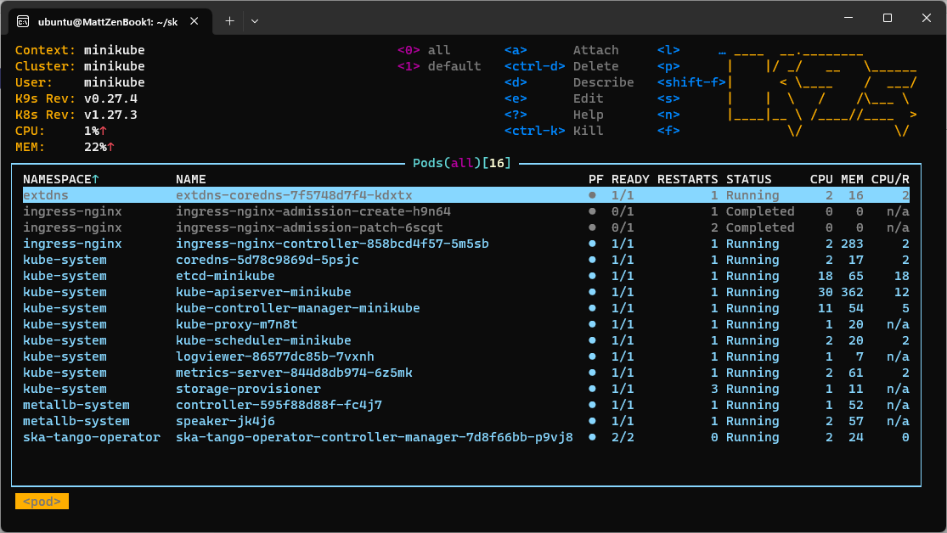
k9s
Talk
TH2AO06 SKA Tango Operator
Thursday - 12 October 2023

Slide 10
ska-tango-examples repository
Demonstrates how to structure a project that provides some simple Tango devices coded in PyTango in k8s.
Use k8s for development and testing so that the build environment, test environment and test results are all completely reproducible and are independent of host environment.
List of TANGO examples that demonstrate some features of the framework as starting point for SKA developers in learning it
We also use it for testing new versions of the framework

Slide 11
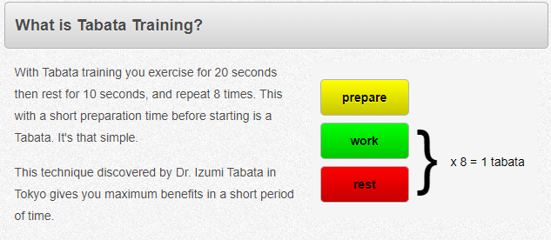
The Tabata device
It is a realization of a gym workout
more information at https://en.wikipedia.org/wiki/High-intensity_interval_training.
https://www.tabatatimer.com/

Slide 12
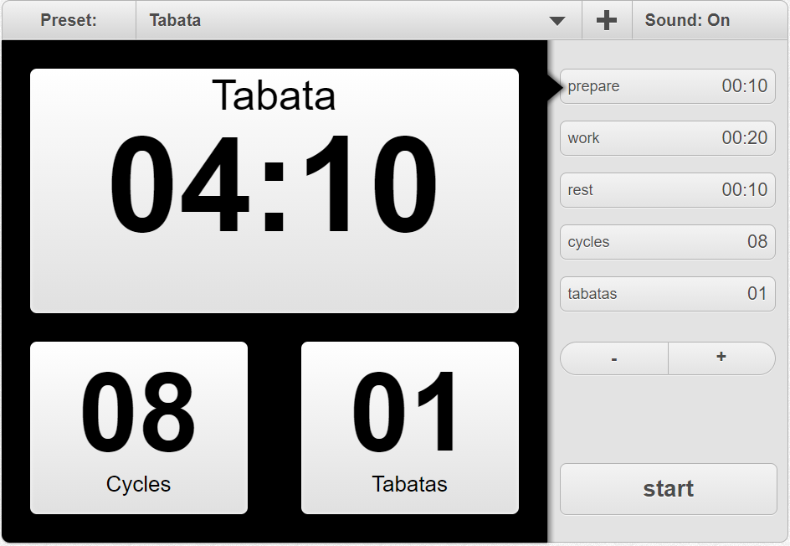
The Tabata device

Slide 13
The Tabata device
prepareCounter
workCounter
Tabata
restCounter
KEY
cyclesCounter
Device
TANGO commands
attributes read/write
tabataCounter
ZeroMQ events

Slide 14
The counter device
This Device demonstrate the use of the TANGO event mechanism to send change events to clients.
There's also a device attribute in polling so that events for that attribute are sent automatically.
Commands:
Increment
Decrement
CounterReset
Attributes:
value (only read)
polled_value (only read)
fire_event_at (read/write)

Slide 15
The Tabata device: attributes
Running_state (PREPARE, WORK, REST)
State (ON, OFF)
tabatas: for counter initialization
cycles: for counter initialization
rest: for counter initialization
work: for counter initialization
prepare: for counter initialization

Slide 16
The Tabata device: properties
prepCounter: device name for the prepare counter
workCounter: device name for the work counter
restCounter: device name for the rest counter
cyclesCounter: device name for the cycles counter
tabatasCounter: device name for the tabatas counter
sleep_time: to speed the execution during tests

Slide 17
The Tabata Device: commands
Start: start a python thread for interacting with the counters
Stop: stop the python thread for interacting with the counters
ResetCounters: reset the counters to the related attributes

Slide 18
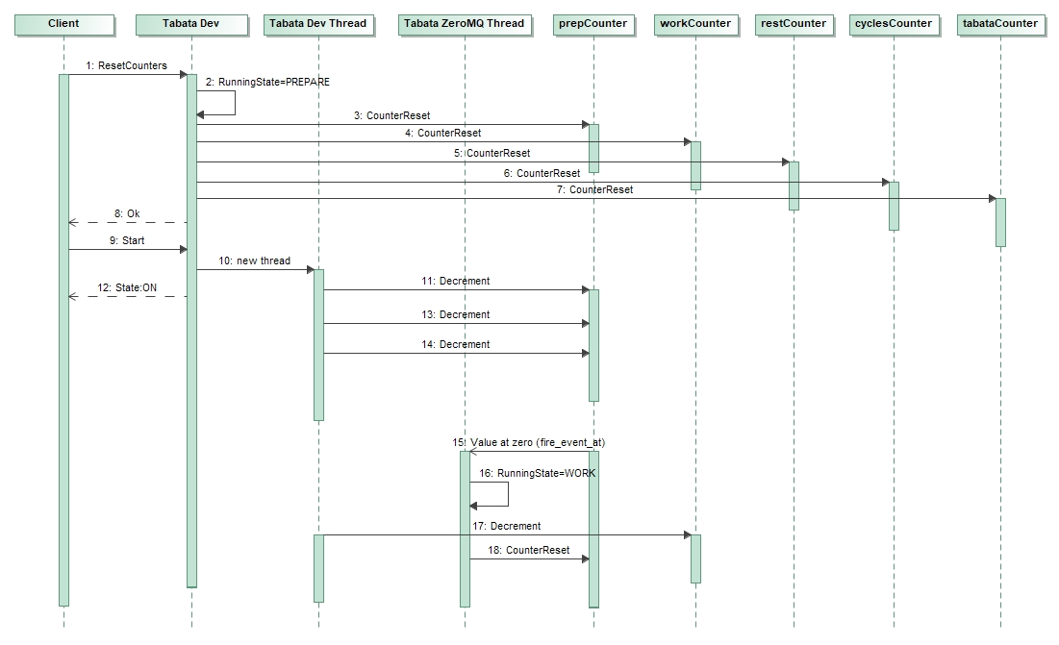

Slide 19
The AsyncTabata Device
Same as Tabata but the realization is asynchonous.
The tabata device has 2 commands: Run and Stop.
The run executes the entire job so it's not possible to use it without an async command.

Slide 20
Notes on serialization model
It is not common to change the default behaviour, usually commands are always very quick and, in case a long job, a thread can be used for the execution with the necessary lock mechanism.
Anyway, while the Tabata device uses the default serialization model, the AsyncTabata changes the default to no synchronization.
https://pytango.readthedocs.io/en/stable/green_modes/green_modes_server.html
https://tango-controls.readthedocs.io/en/latest/development/advanced/threading.html#serialization-model-within-a-device-server

Slide 21
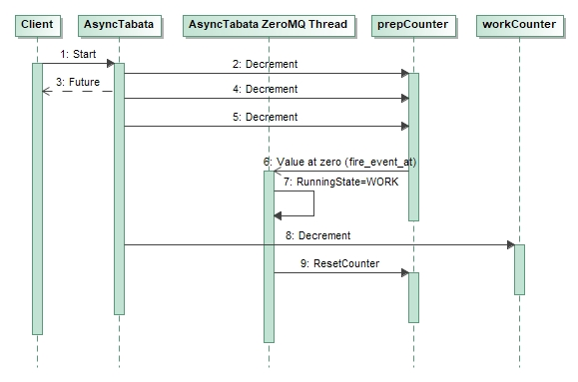
The AsyncTabata Device sequence diagram

Slide 22
ska-tango-examples structure
Folders:
src: source code, i.e. src/ska_tango_examples/tabata/Tabata.py
tests: test code, i.e. tests/integration/test_tabata.py
charts: helm charts for installing into k8s
docs: documentation
.make: ska makefile submodule for automation
In the root folder:
Dockerfile
pyproject.toml

Slide 23
Poetry - pyproject.toml
Poetry is a tool for dependency management and packaging in Python. It allows you to declare the libraries your project depends on and it will manage (install/update) them for you. Poetry offers a lockfile to ensure repeatable installs, and can build your project for distribution.

Slide 24
Poetry - pyproject.toml
[tool.poetry]
name = "ska-tango-examples"
version = "0.4.28"
description = "SKA Tango Examples“
[…]
[tool.poetry.dependencies]
python = "^3.9"
pytango = "^9.4.2"
ska-tango-base = "^0.12.0"
ska-ser-log-transactions = "*"
numpy = "1.23.0"
debugpy = "^1.5.1"
Poetry is a tool for dependency management and packaging in Python. It allows you to declare the libraries your project depends on and it will manage (install/update) them for you. Poetry offers a lockfile to ensure repeatable installs, and can build your project for distribution.

Slide 25
OCI image - Dockerfile
ARG BUILD_IMAGE="artefact.skao.int/ska-tango-images-pytango-builder:9.4.3"
ARG BASE_IMAGE="artefact.skao.int/ska-tango-images-pytango-runtime:9.4.3"
FROM $BUILD_IMAGE AS buildenv
FROM $BASE_IMAGE
USER root
WORKDIR /app
COPY --chown=tango:tango pyproject.toml poetry.lock ./
RUN poetry export --format requirements.txt --output poetry-requirements.txt --without-hashes && \
sed -i '/pytango/d' poetry-requirements.txt && \
sed -i '/numpy/d' poetry-requirements.txt && \
pip install -r poetry-requirements.txt && \
rm poetry-requirements.txt
COPY --chown=tango:tango src ./
USER tango

Slide 26
Testing
Encapsulated in the Makefile
It uses pytest with no bdd
It uses pytest fixture and a factory pattern for creating the right device context
Unit (no install required) testing with
$ make python-test
Integration (install required) testing with
$ make k8s-test

Slide 27
DevFactory class
It is a factory class which provide the ability to create an object of type DeviceProxy.
When testing the static variable _test_context is an instance of the TANGO class MultiDeviceTestContext (done with pytest fixture).
More information on tango testing can be found at the following link: https://pytango.readthedocs.io/en/stable/testing.html

Slide 28
conftest.py
Dictionary fixture present in the test files
@pytest.fixture
def tango_context(devices_to_load, request):
true_context = request.config.getoption("--true-context")
logging.info("true context: %s", true_context)
if not true_context:
with MultiDeviceTestContext(devices_to_load, process=False) as context:
DevFactory._test_context = context
yield context
else:
yield None

Slide 29
Install the ska-tango-examples
Kubernetes (k8s) for container orchestration (kubernetes.io)
Kubernetes Service == TANGO Device Server
Helm for packaging SKA k8s applications (helm.sh)
Each SKA element provides an helm chart for running it in k8s
Helm has the concept of dependency: a chart can have one or more sub-charts

Slide 30
ska-tango-examples dependencies
dependencies:
- name: ska-tango-util
version: 0.4.7
repository: https://artefact.skao.int/repository/helm-internal
- name: ska-tango-base
version: 0.4.7
repository: https://artefact.skao.int/repository/helm-internal
condition: ska-tango-base.enabled,global.sub-system.ska-tango-base.enabled
The ska-tango-util helm chart is a library chart which helps other application chart defines TANGO device servers.
Application chart which defines the basic TANGO ecosystem in Kubernetes:
tangodb: mysql database used to store configuration data used at startup of a device server
databaseds: device server providing configuration information to all other components of the system as well as a runtime catalog of the components/devices
itango: it is an interactive Tango client
tangotest: it is the tango test device server

Slide 31
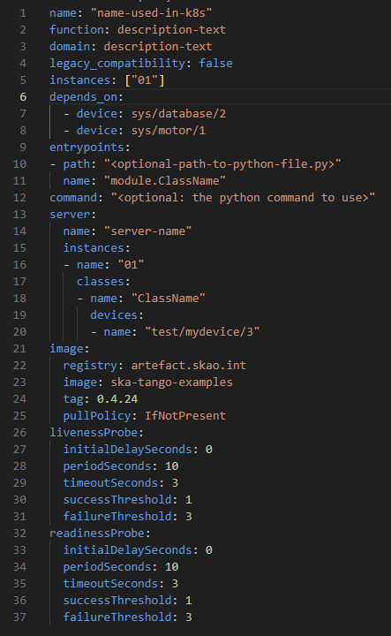
Declare the Device Servers
Name is the k8s name of the resources
The list of dependencies: devices or simple host and port
Command or entry points of the device servers (if more than one entry point is specified, we are referring to a multi-devices DS)
Partial set of parameters to set!
The server definition, it can indicates the list of instances, devices, classes, etc.
The container image to use
How to check when the DS is ready or in failure

Slide 32
ska-tango-examples dev workflow
$ git clone https://gitlab.com/ska-telescope/ska-tango-examples.git
$ cd ska-tango-examples
$ git submodule update --init --recursive
$ eval $(minikube docker-env)
$ curl -sSL https://install.python-poetry.org | python3 -
$ poetry install; poetry shell
$ make python-test
$ make oci-build
$ make k8s-install-chart
$ make k8s-watch; make k8s-wait
$ make k8s-test
$ make k8s-uninstall-chart

Slide 33
Common tools available
Jive
Logviewer
AtkPanel
DevicePanel
Pogo
docker run --network host --user 1000:1000 --volume="/home/ubuntu/ska-tango-examples:/home/tango/ska-tango-examples" --volume="/tmp/.X11-unix:/tmp/.X11-unix" --env="DISPLAY=:0" artefact.skao.int/ska-tango-images-tango-pogo:9.6.35

Slide 34
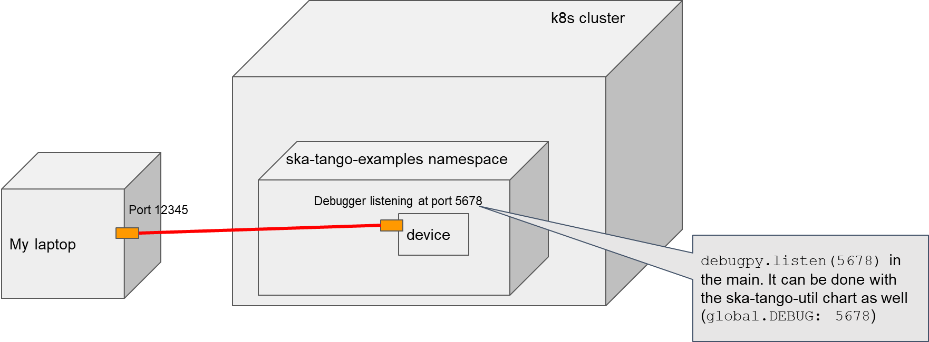
Debugging - debugpy library
It is an adapter of the pydevd used in PyCharm: https://github.com/microsoft/debugpy
How it works:
CLI: python3 -m debugpy --listen localhost:5678 mydevice.py
From code:
import debugpy
debugpy.listen(5678)
$ kubectl port-forward pod/ds-tabata-tabata-0 5678:5678 -n ska-tango-examples

Slide 35
debug_this_thread
A TANGO Device server does not use the python threads so they are not debuggable unless we make them aware of the debugger.
https://github.com/microsoft/debugpy/wiki/API-Reference#debug_this_thread
Makes the debugger aware of the current thread, and start tracing it. Must be called on any background thread that is started by means other than the usual Python APIs (i.e. the threading module), in order for breakpoints to work on that thread.

