Slide 1
SVG Synoptic
Graphical User Interface
GUI workshop, ICALEPCS 2023
Vincent Hardion, 7/10/2023

Slide 2
SVG
Synoptic connected with Tango
Pan
Zoom
Layers
- Advance Zoom feature
- Functional Layers
Misc
- Tooltip
- Open Specific panel
- CSS, …
Agenda

Slide 3
SVG
Web standard
Markup language for describing two-dimensional graphics applications and images
Inkscape, one the greatest drawing software is also fully open-source
https://en.m.wikipedia.org/wiki/File:Ghostscript_Tiger.svg
CC-BY

Slide 4
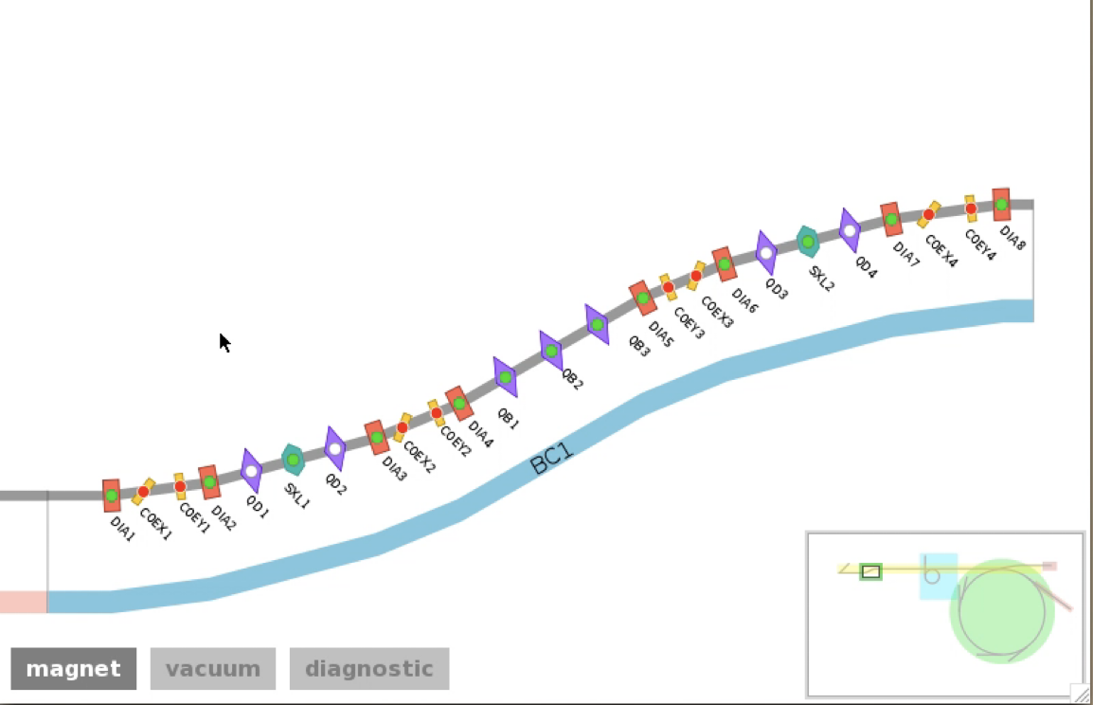
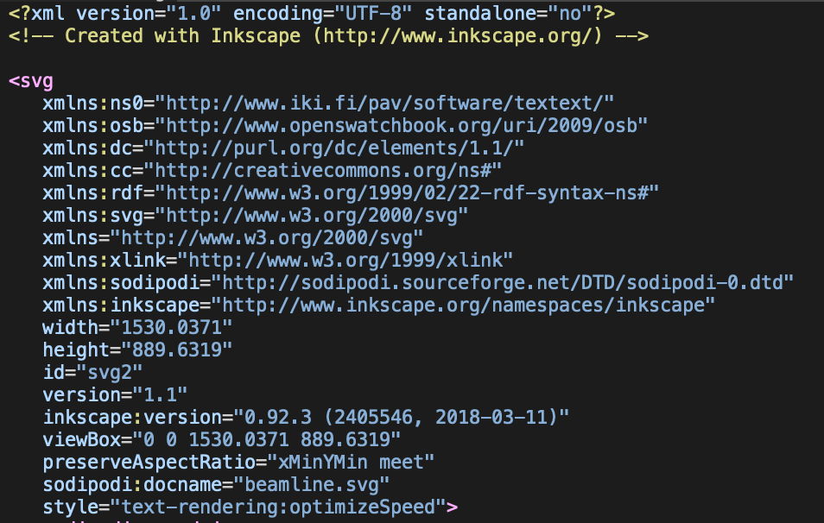
SVG Synoptic
Render with WebKit
Desktop PyQT
Control System communication with Taurus
Webkit
Qt
Taurus
Tango Control System

Slide 5
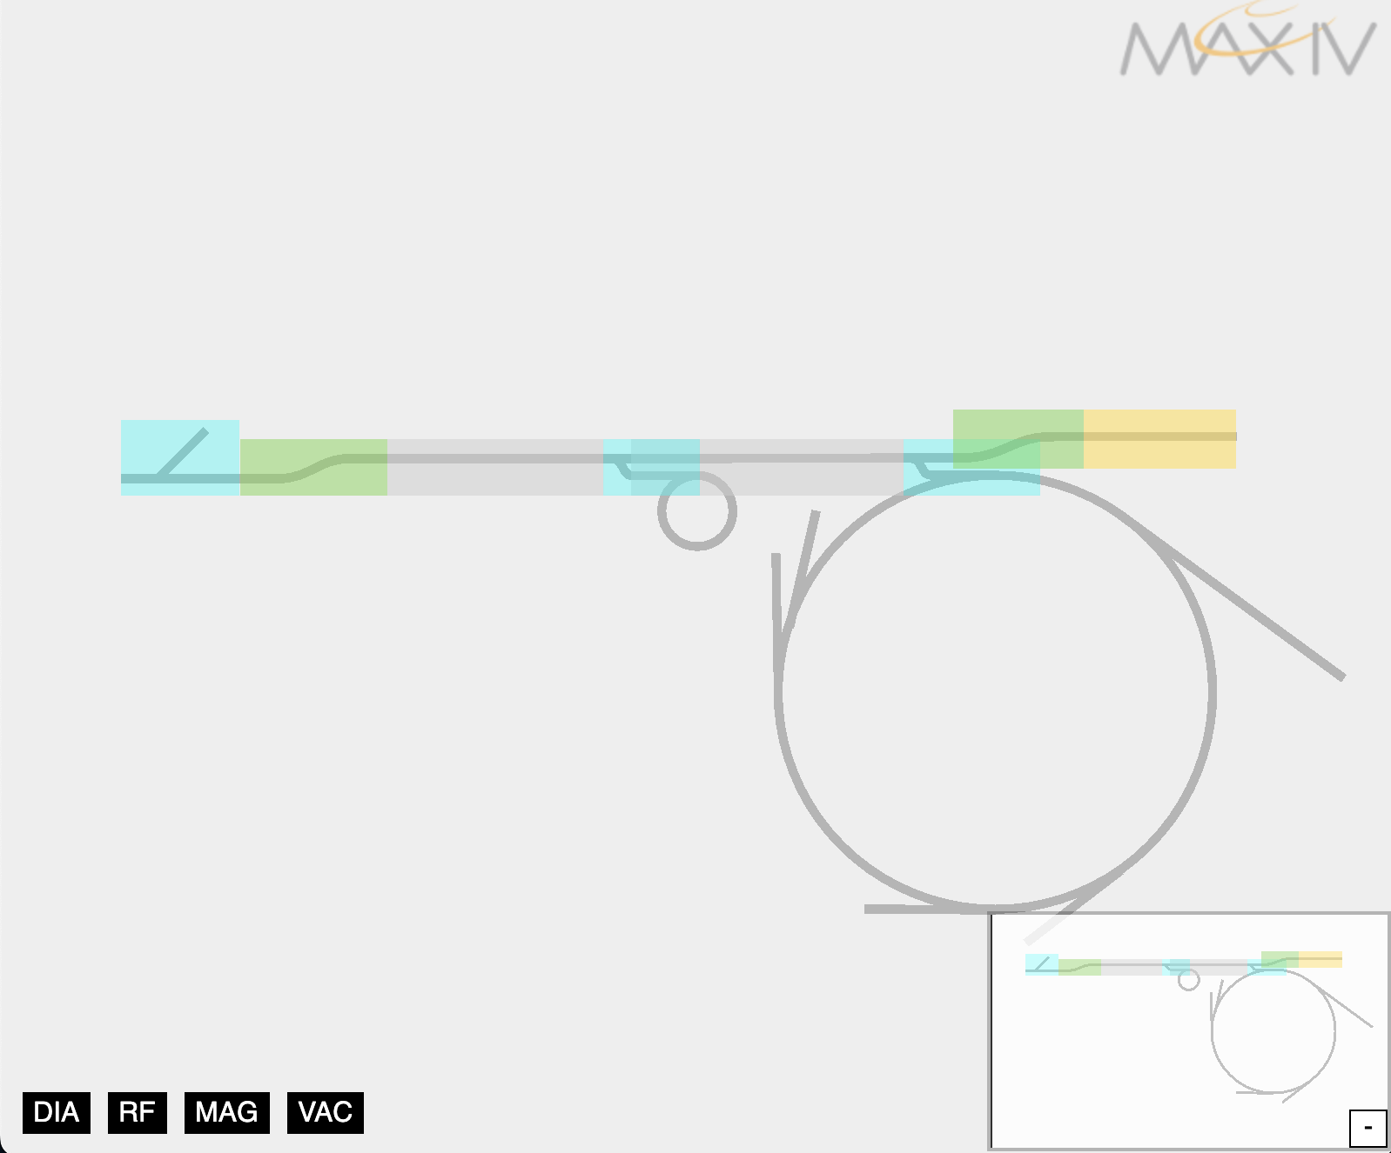
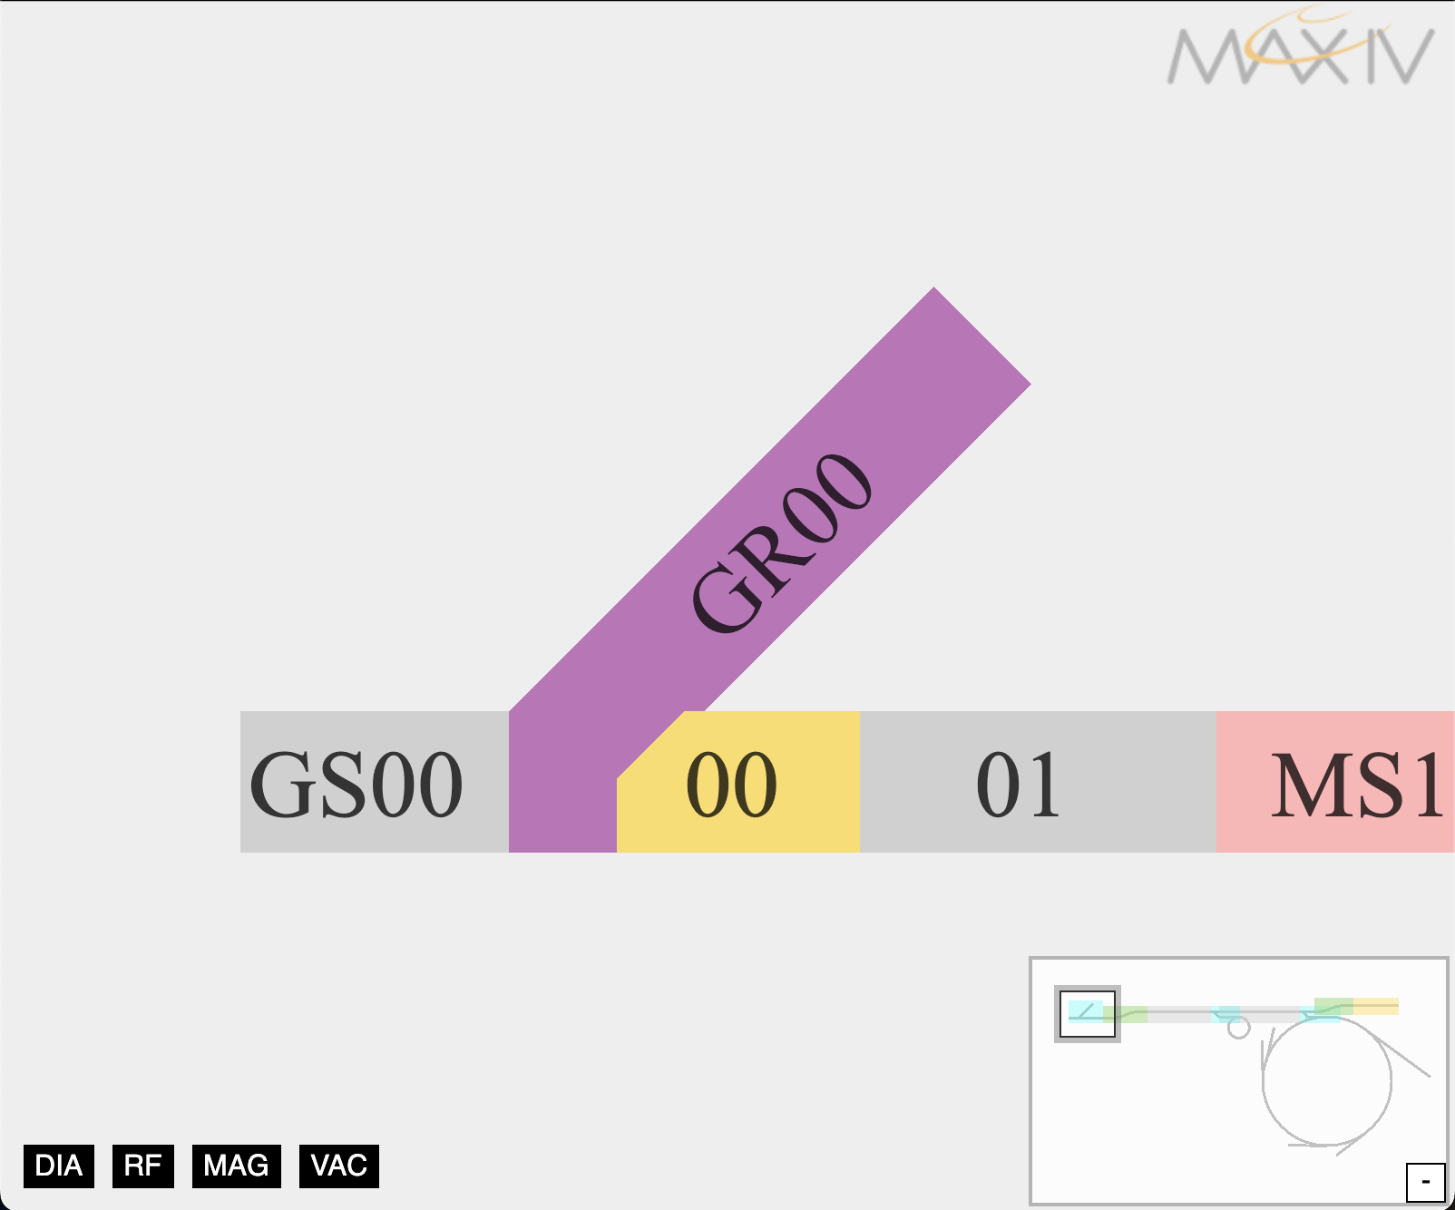
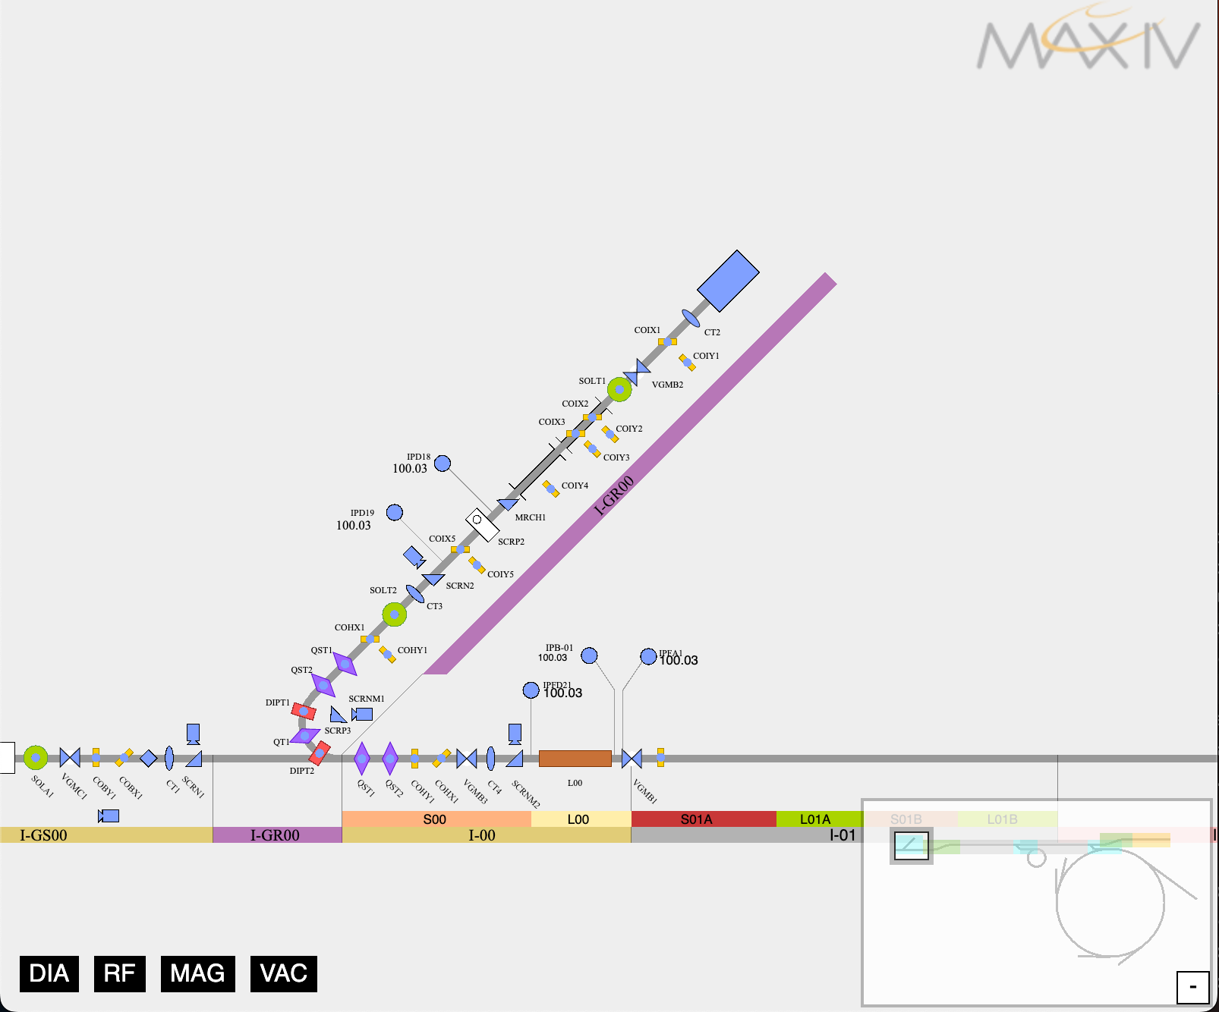
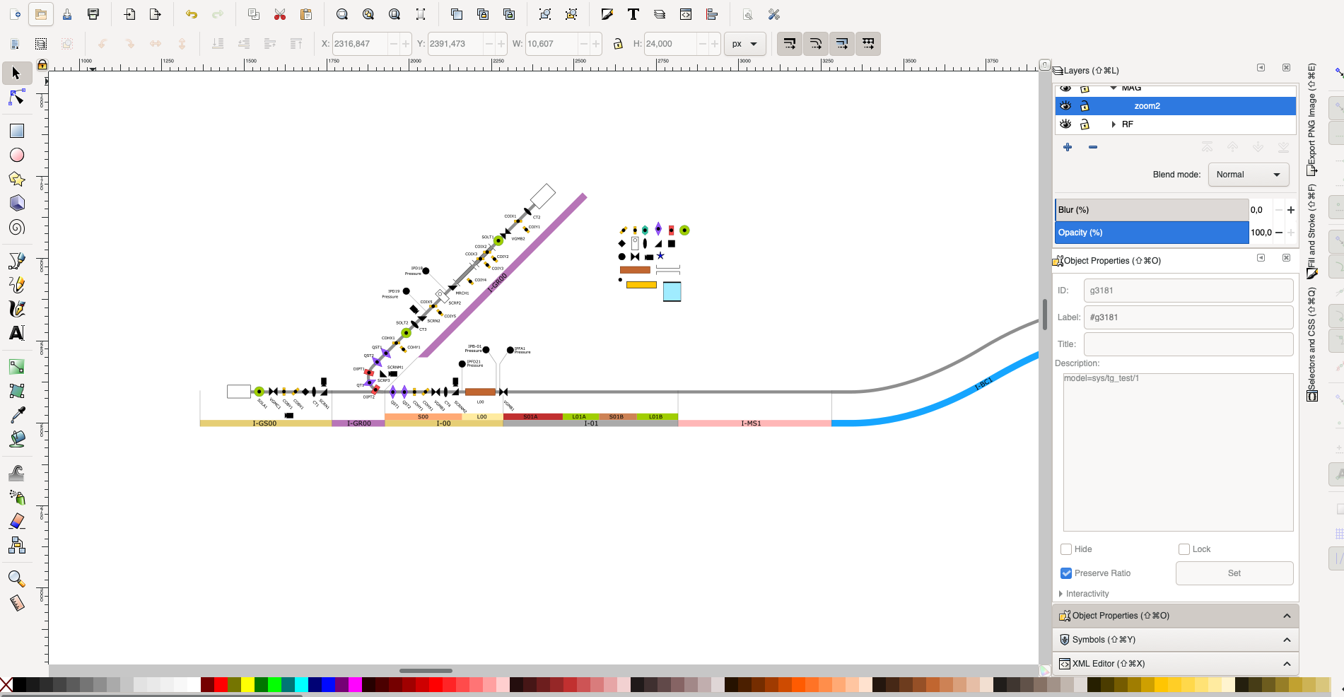
Exercise I: run the synoptic
Demo: https://gitlab.com/MaxIV/synopticdemo
Check the README
Create the conda environment
Run ctsynopticdemo
Navigate to the linac gun
Open Inkscape
Open the svg file located in synopticdemo/resources/images/linac.svg
5

Slide 6
BUILT IN FEATURE
PAN
SVG is a complete set for rendering image
PAN/ZOOM
View port
Viewbox

Slide 7
SVG is rendered as vectorial drawing
No loss of quality when Zoom
Thumbnail
ZOOM
Z factor
Thumbnail

Slide 8
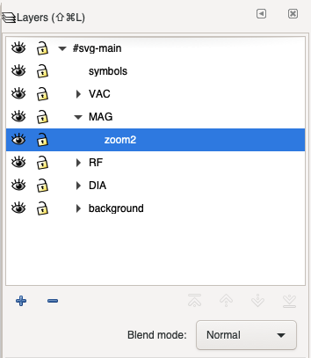
SVG Layer
Layer
Main
<svg>
<g id=“Main”>
<g id=“Background”>
…
</g>
<g id=“misc”>… </g>
</g>
</svg>
Group components together
Can be define in sequence and
nested
Background
TANGO
Misc

Slide 9
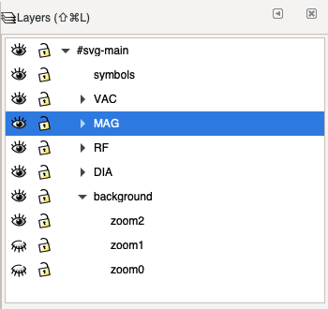
Zoom Layer
Layers
0
Table Mountain View
Hide and Show following the level of zoom
Zoom can be continuous (mouse wheel) or discrete (click)
Z
1
Intermediate View
<g
style="display:inline;opacity:1"
inkscape:label="zoom2"
id="layer1"
inkscape:groupmode="layer"
2
Detailed view

Slide 10
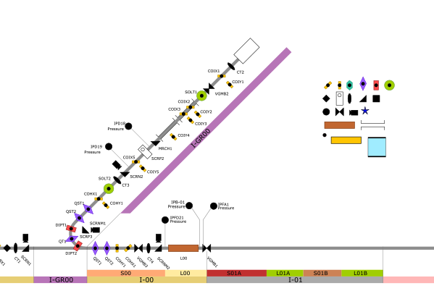
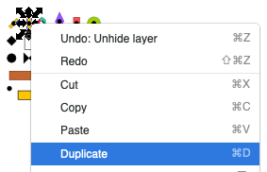
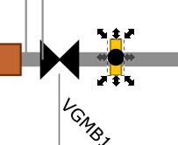
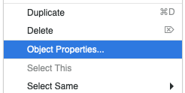
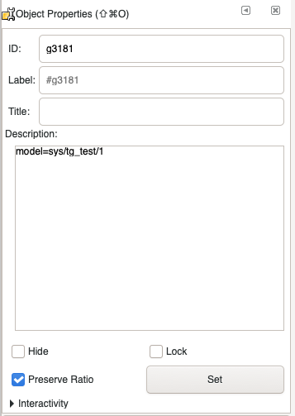
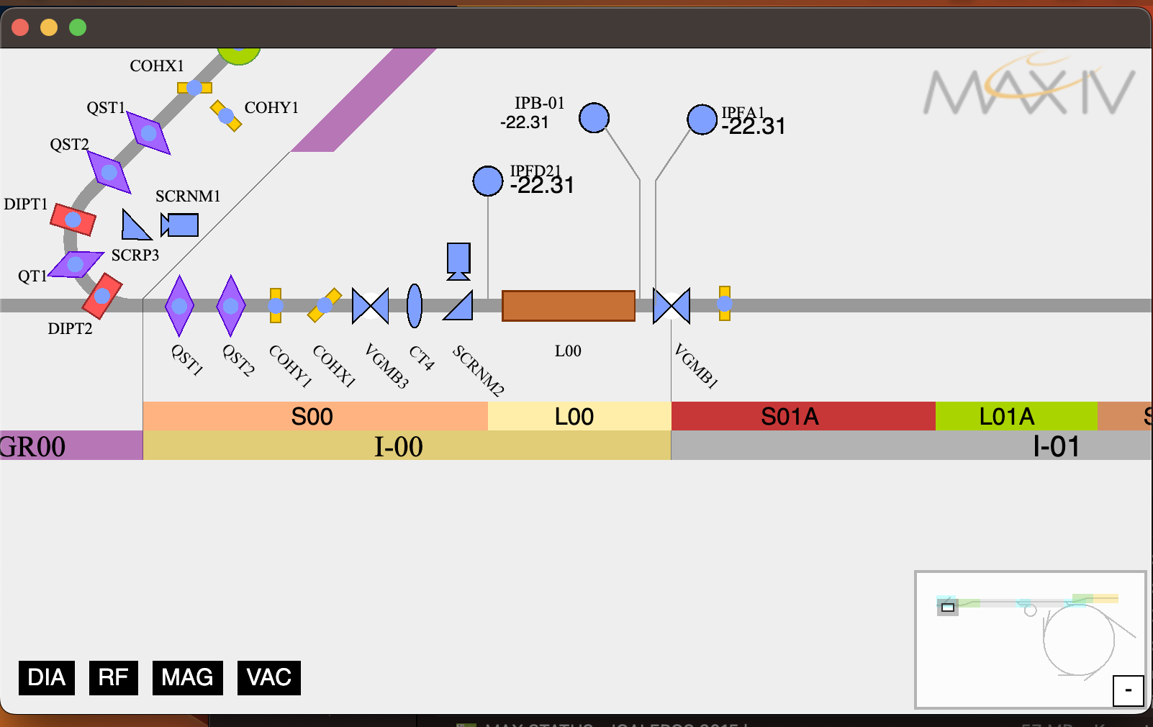
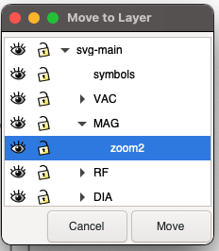
Add a new device
Symbols
1
2
3
Duplicate one of the symbols
Move it along the linac
Open the Object Properties
In the Description, write: model=sys/tg_test/1
Validate by clicking on the “Set” button
Move to layer MAG->zoom2
Run the synoptic
4
7
6
5

Slide 11
Functional Layer
Layers
Main
T=20 C
<svg>
<g id=“Main”>
</g>
<g
id=“Flow”
hidden=True>
…
</g>
<g
id=“Temp”
hidden=False>
</g>
</svg>
Hide and Show on demand
Same zoom level
Flow
Temp
T=20 C
Flow
Cooling

Slide 12
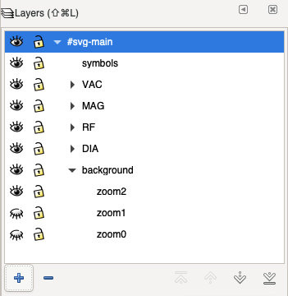
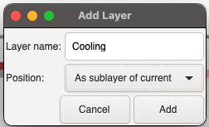
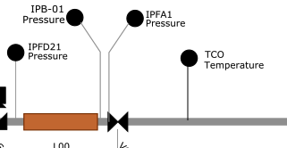
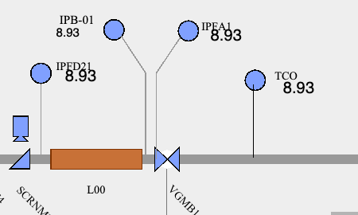
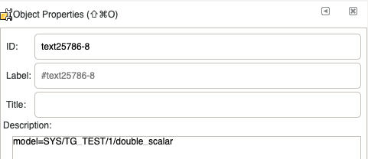
Exercise III: add a functional layer
1
2
3
Open the Layers panel
Add a new layer “cooling” under the “svg-main”
Position “As sublayer of current”
Create an element “TCO”
Create a text element called “temperature”
Change the description to “model=sys/tg_test/1/double_scalar
Change the layer to “Cooling”
Run the synoptic
4
5

Slide 13
SVG is HTML
Part of the DOM
Tooltips
Click
CSS
Device: I-MS1/DIA/BPL-02
T=20 C

Slide 14
SVG is HTML
Drawing
css:
.state[data-value="ON"] {fill: green !important}
CSS powered
Drawing
css:
.state[data-value=“ON"] {fill: purple !important}
T=20 C

Slide 15
Take away Challenge for you
Change the color of the FAULT state

Slide 16
Question?
Question Everything (Nullius in verba), Dunk 🐝
CC-BY

