Slide 1
SKA TANGO Operator
Matteo Di Carlo on behalf of the System Team and P. Harding
37th Tango Community meeting at SKAO, June 2023

Slide 2
SKA Deployment Practices
Kubernetes (k8s) for container orchestration (kubernetes.io)
Helm for packaging and deploying SKA Software (helm.sh)
A chart is a recipe to deploy the several k8s resources (i.e., containers, storage, networking components, etc) required for an application to run
Works on templates, allows to adapt generic configurations to different environments (i.e., the different SKA datacentres)
Heavy use of Makefile (i.e., building, testing, deployment, …)
Gitlab for CI/CD

Slide 3
Kubernetes
Open-source system for automating the deployment, scaling, and management of containerized applications
Very extensible with multiple plugin points
Collection of primitives: an abstraction of compute, network, and storage
Supports common scheduling models: stateful, replicas (stateless), daemons and jobs
Declarative “model” of operation, with various controller components managing the lifecycle of the declared resources

Slide 4
Imperative vs Declarative
"Imperative" is a command
Add this device to the DB
Execute this python command
…
"Declarative" is a statement of the desired state
Deploy these devices, with this configurations, in this specific order, with those dependencies…

Slide 5
Setting up a TANGO Device server (in general)
For every device server:
Deploy the code (i.e. to a VM, container, …)
Configuration (i.e., environment variables)
Resources(i.e., persistent storage, networking)
Include all of the devices in the TANGO database:
Properties (i.e., properties, attributes, commands)
Polling definition
…
Start devices in order (if there are dependencies, wait for each of them)

Slide 6
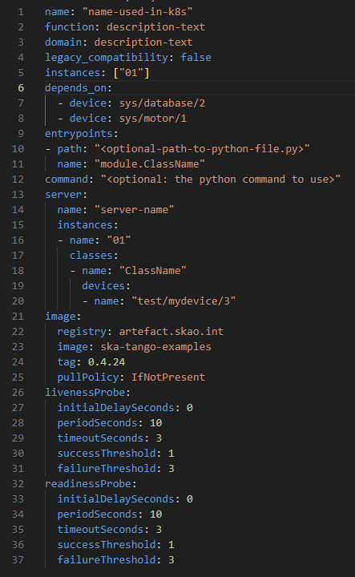
Declaring a DS in k8s
Name is the k8s name of the resources
The list of dependencies: devices or simple host:port
Command or entry points of the device servers (if more than one entry point is specified, we are referring to a multi-device DS)
Partial set of parameters to set!
The server definition, containing the list of instances, devices and classes to be ran
The container image to use
How/when to check if the device server is ready or in failure

Slide 7
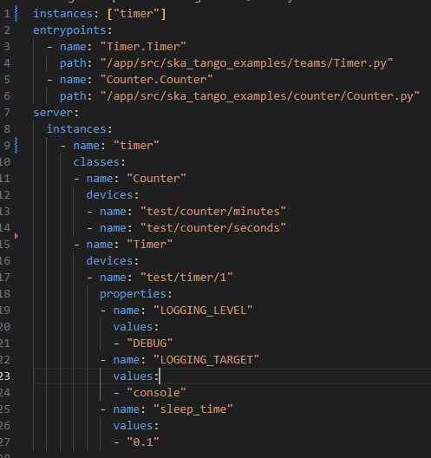
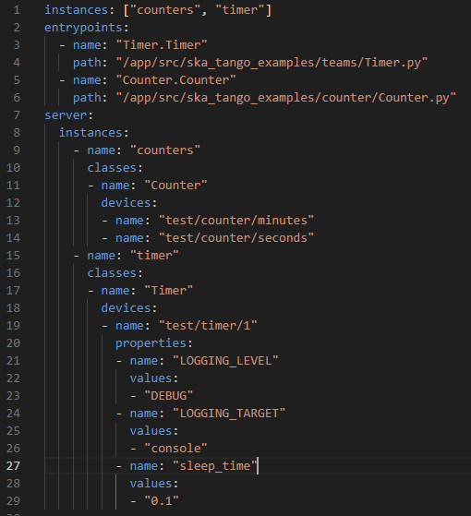
Timer example

Slide 8
Device server architecture in k8s
A device server will be composed by the following k8s resources:
Job for the initialization of the TANGO database
Service (exposes the application to the network)
Statefulset (in k8s this is an object used to manage stateful applications)
Pod (in k8s groups one or more containers into a unit)
InitContainers (specialized containers that run before app containers in a Pod) to resolve the DS dependencies
Waiting for the configuration job to complete
Waiting on devices to be up in TANGO

Slide 9
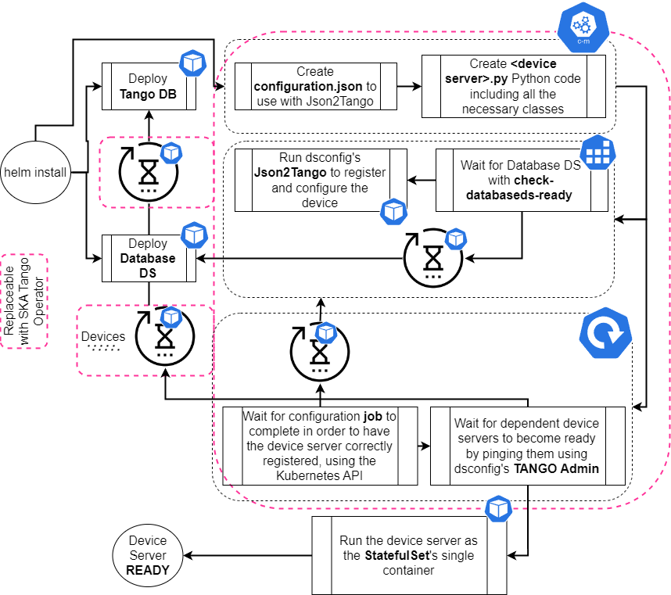
From YAML to k8s resources
2 Helm charts:
ska-tango-base: which installs the databaseds and tangodb
ska-tango-util library chart: Translates the yaml definition into k8s resources
https://gitlab.com/ska-telescope/ska-tango-images/-/tree/master/charts

Slide 10
Challenges with ska-tango-util helm library chart
Creates extra resources in the Kubernetes cluster (i.e., extra init-containers to solve dependencies)
Leaves behind spent resources (i.e., job pods that have completed)
The Crash Loop Backoff behaviour that exists in the Kubernetes cluster can slow the Device Server startup in case of multiple dependencies
An environment might end up with different versions of the k8s resource declarations, at the choosing of the developers (i.e. developers can select the version they like)

Slide 11
Extending k8s - The Operator pattern
“The operator pattern aims to capture the key aim of a human operator who is managing a service or set of services. Human operators who look after specific applications and services have deep knowledge of how the system ought to behave, how to deploy it, and how to react if there are problems“
Extends the Control Plane to give custom behaviours
Uses Custom Resource Definitions (extending the API) to create new manageable resources
Uses the control loop pattern (a non-terminating loop that regulates the state of a system) to reconcile the resources to their desired state

Slide 12
The SKA TANGO Operator
Kubernetes Operator capable of managing TANGO resources (DeviceServer and DatabaseDS), controlling their lifecycle within the Kubernetes' native control/event loop
Allows for a lighter deployment, due to avoiding init-containers for dependency resolution
Optimised startup time for Device Servers, as the operator can directly tap into the TANGO environment and retrieve information on dependent devices and the TANGO host itself

Slide 13
Why introduce an Operator ?
Developers know Device Servers, not StatefulSets and Pods (or any k8s resource for that matter), as those are components relevant to the platform and not the application
Making TANGO components first-class citizens of Kubernetes
Automating much of the tasks a human would do to operate a TANGO resource, quicker and more reliably
Allows to collect custom metrics on the CRDs, giving information on the system in a TANGO domain instead of a k8s domain (i.e., Device servers instead of StatefulSets)

Slide 14
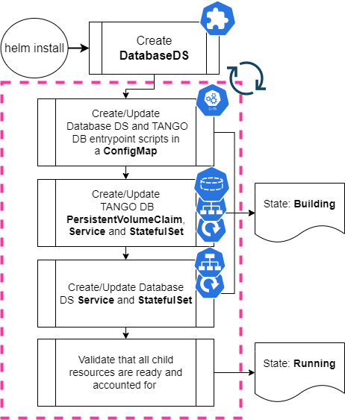
Custom Resource Definition (CRD) databaseds.tango.tango-controls.org
States
Building
TANGO DB StatefulSet, Service and PersistentVolume
Database DS StatefulSet and Service
Running

Slide 15
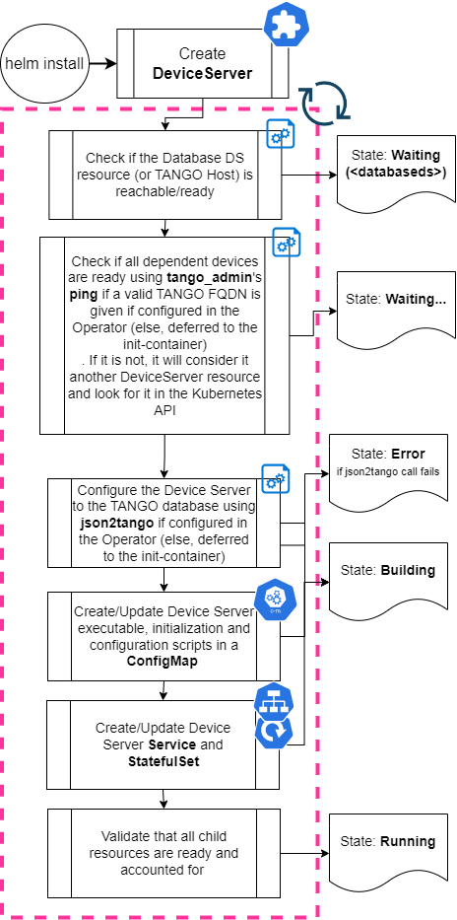
Custom Resource Definition (CRD): deviceservers.tango.tango-controls.org
Device Server StatefulSet and Service and Configurations (DS script used to run the device)
States
Error
Pending
Running
Building
Waiting

Slide 16
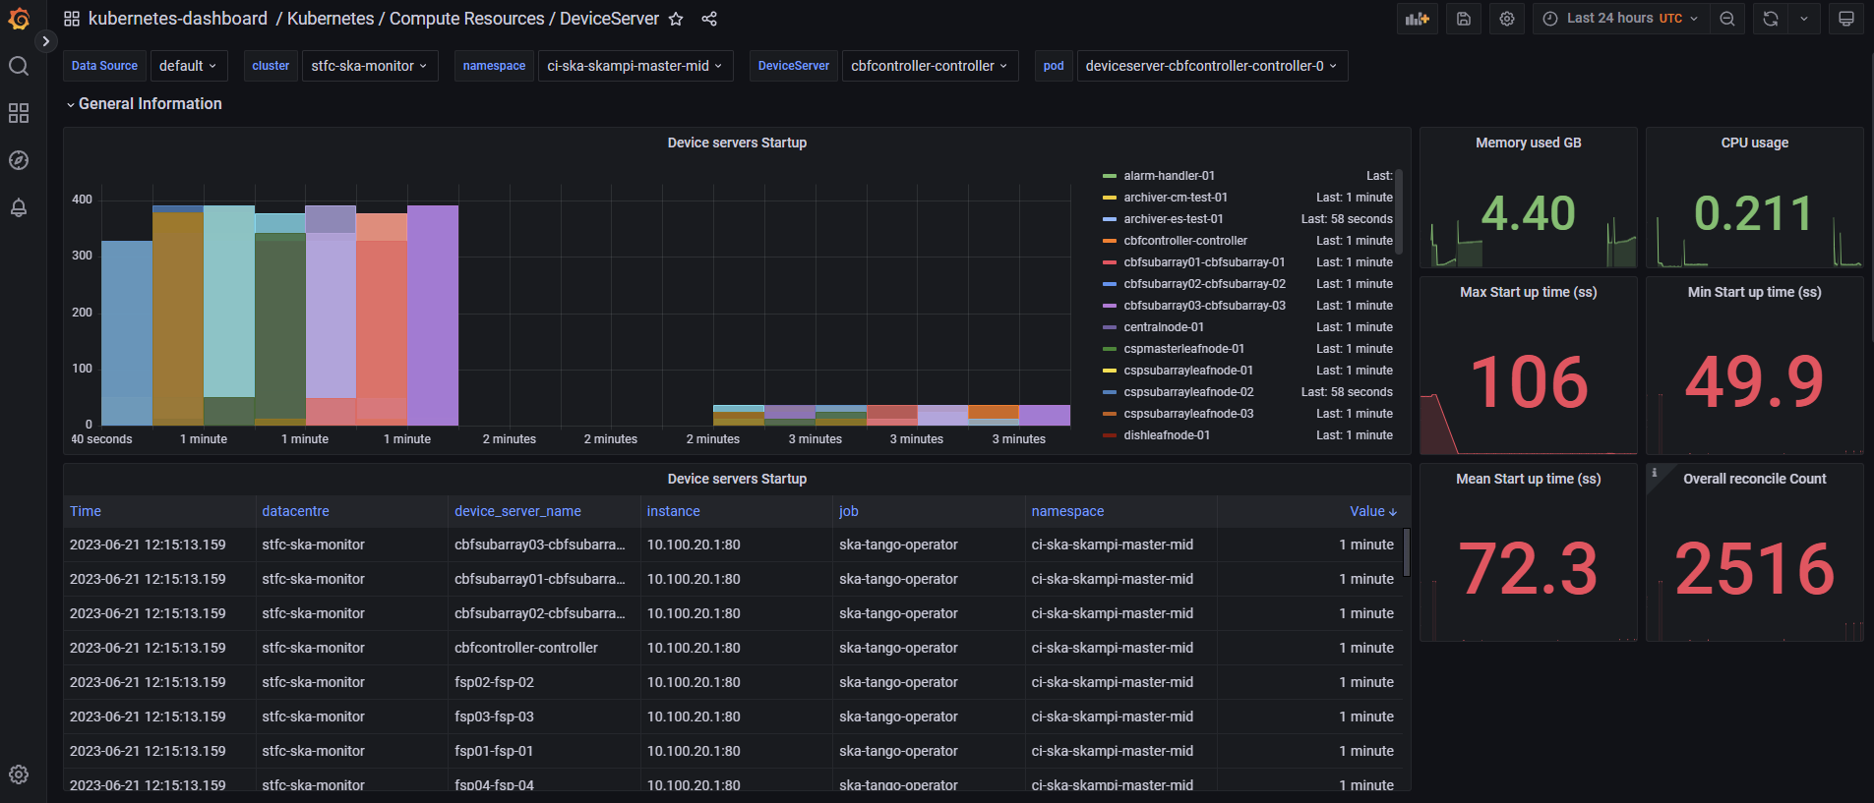
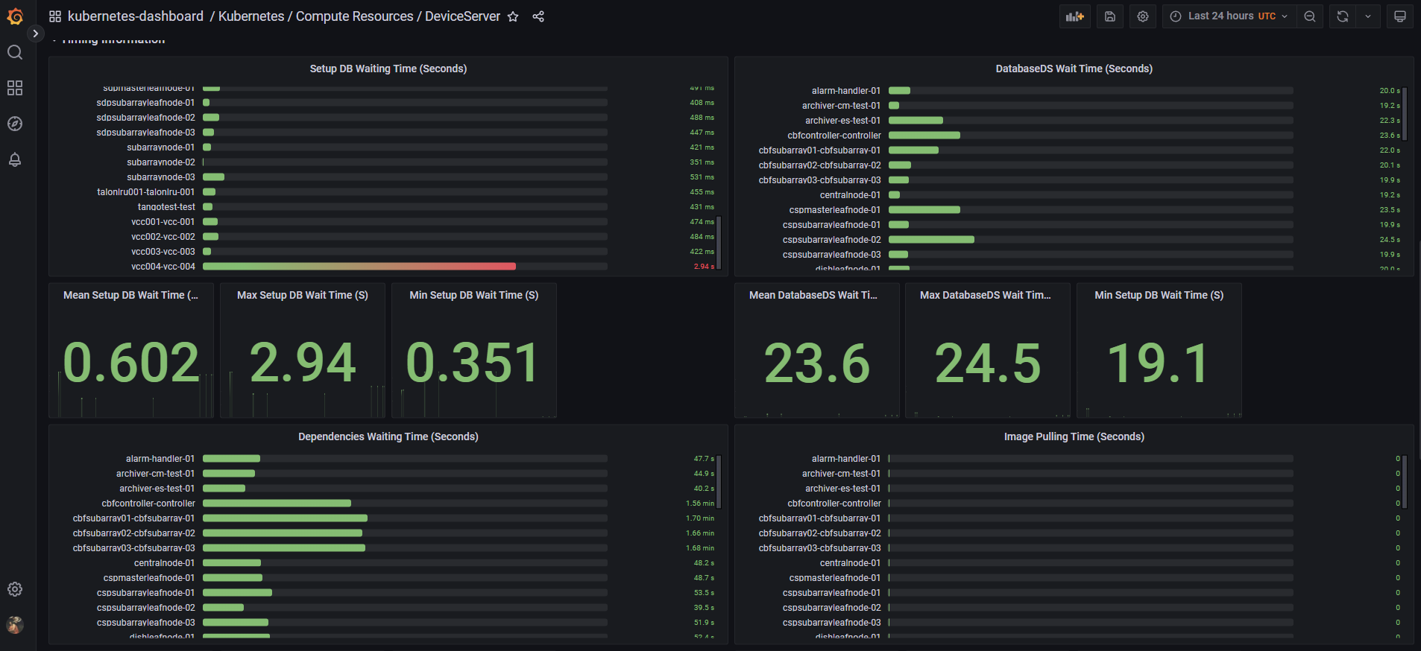
Grafana support for the Operator metrics

Slide 17
What do we got ?
Kubernetes managed device servers!
Optimized initialization times and startup reliability
Configuration delegated to a specialized service
Less resources usage (memory, cpu, storage and even network)
Better metrics (and dashboard) to evaluate our device servers
Abstraction of TANGO domain-specific components from the platform ones
And… Security (almost) for free!

Slide 18
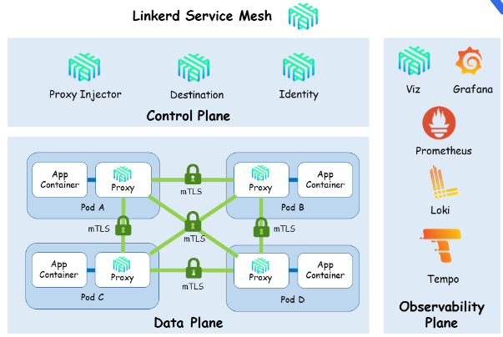
Securing Tango - With Linkerd
Linkerd is a service mesh:
It provides a lightweight proxy that is attached as a SideCar to Pods
It captures in and outbound traffic
The traffic is encrypted/decrypted
Policy controlled
Traffic is monitored and logged

Slide 19
Securing Tango - Linkerd, a Universal Mesh
Linkerd can be used in Cluster and between Clusters
This approach enables the end to end security of the Tango Controls hierarchy - all without modification to the underlying application
It can also be used for non-Tango traffic (any TCP), wherever it is challenging to retrofit mTLS

Slide 20
Thanks

