Slide 1
Conan for building C++ Tango devices
Tango community meeting – 2023 – P. Madela

Slide 2
Outline
Control systems software factories
Challenges for C++
Conan overview
Proof-of-concept projects
Deliverables
Conan 2
Pros and cons of Conan
Conan as the alternative for our build system
Conan recipe

Slide 3



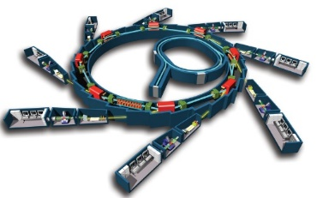







Control systems software factories
Continuous integration to build software artifacts
Deployment of packages at each technical shutdown
Developers
Source code
Binaries (app., lib., …)
Packages
Control system
code
build
release
deploy
Gitlab Soleil
Jenkins
Java
~80 projects
16 packages
C++
3 packages
~460 projects

Slide 4







Challenges for C++
Components of our C++ factory are severely outdated
  No support for building 64-bit binaries
  No support for C++11 and higher standards
  No support for building third-party code
Maven is not common for C++ development
No support for future platforms and new programming standards

Slide 5
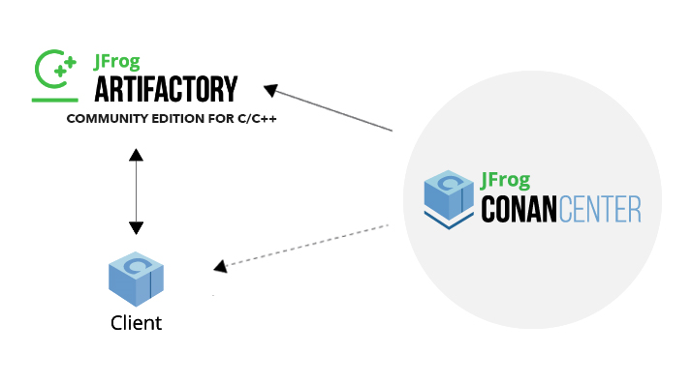
Conan overview
Conan = Package and dependency manager for C/C++
  A repository like other package managers: Maven, npm, PyPI...
  But not a deployment package manager
Plus
  An abstract build system for any other build system
  Packages can be used from any build system: CMake, Make, MSBuild...
  A repository system for multi-platforms and multi-binaries packages
  A public central repository for the most popular open-source C/C++ libraries
  A good solution for C/C++ continuous integration workflows

Slide 6
Conan recipe
conanfile.py
from conan import ConanFile from conan.tools.cmake import CMake, cmake_layout class mydeviceRecipe(ConanFile): name = "mydevice" version = "0.0.7" license = "MIT" url = "https://gitlab.synchrotron-soleil.fr/mydevice" description = "A fantastic device" settings = "os", "compiler", "build_type", "arch" generators = "CMakeToolchain", "CMakeDeps" exports_sources = "CMakeLists.txt", "src/*" requires = "cpptango/9.2.5@soleil/stable" def layout(self): cmake_layout(self) def build(self): cmake = CMake(self) cmake.configure() cmake.build() def package(self): cmake = CMake(self) cmake.install()
A recipe is a python script that describes how to build and package an application, a library, a tools …
It specifies the dependencies, build instructions, and other metadata
It provides information about a library to consumers.
Conan provides a collection of tools to help with building within recipes

Slide 7
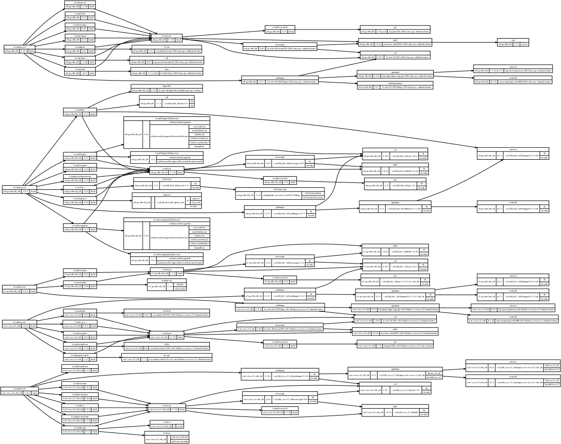
Proof-of-concept Lima
Unable to build Lima using legacy software factory
  5 target platforms
Partial scripted build
  None of platforms share the same dependency graph
With Conan
  Successful build of Lima devices across all platforms sharing the same dependency graph

Slide 8
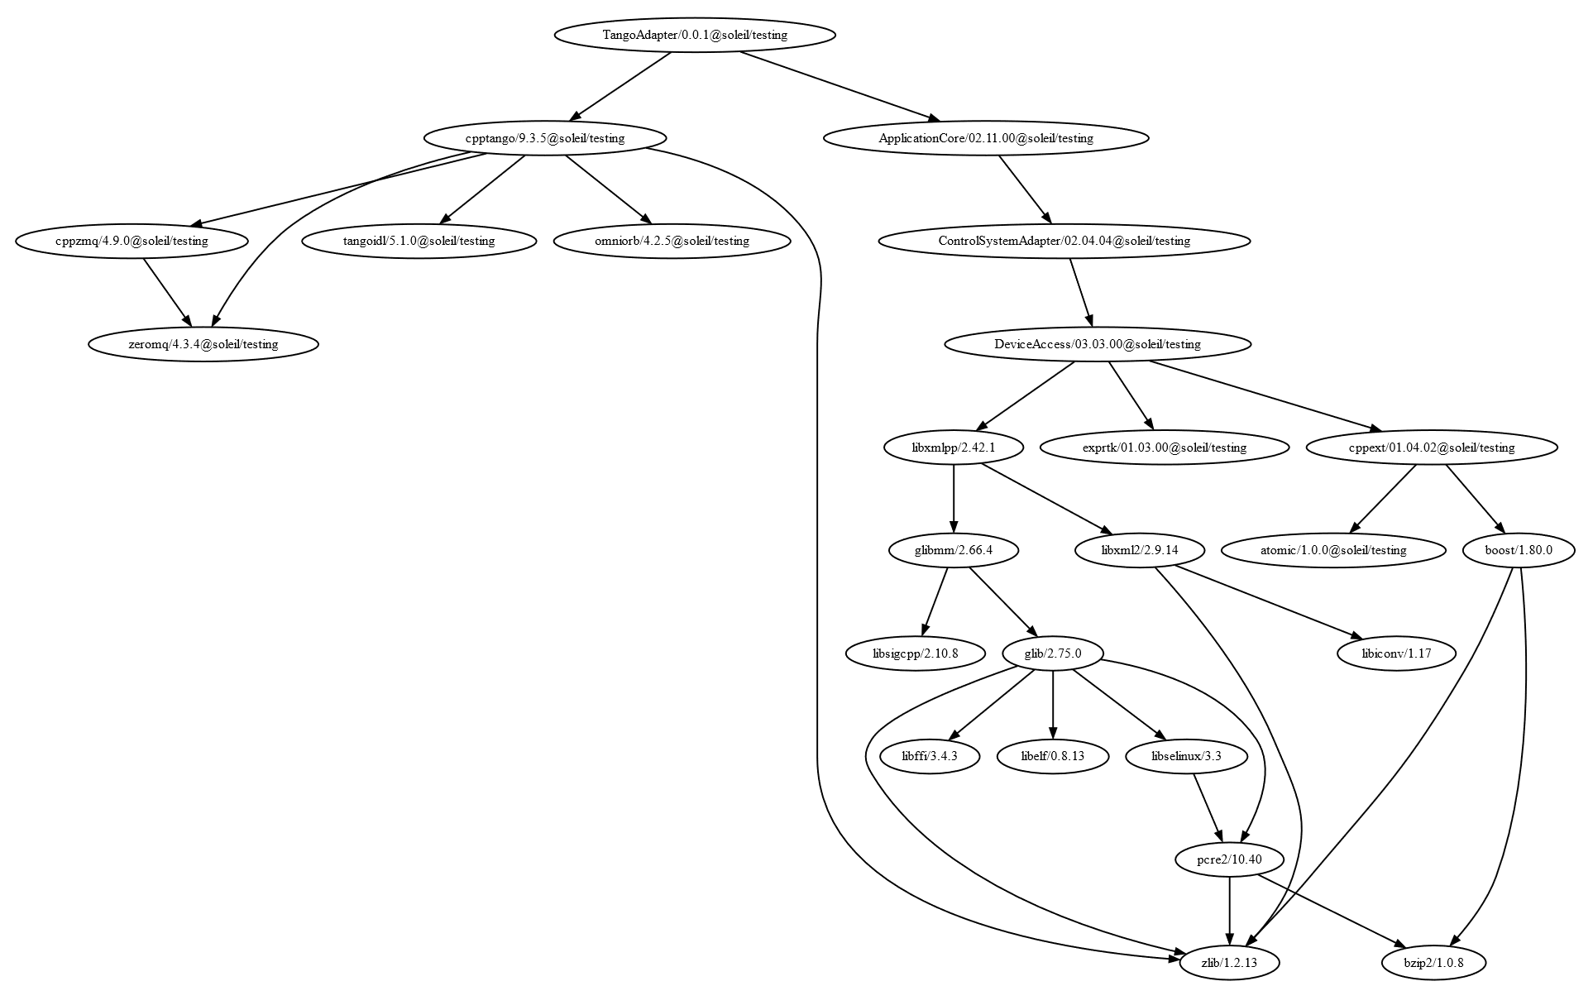
Proof-of-concept ChimeraTK
Manually
  Unable to build ChimeraTK on CentOS 6/7
With Conan
  Successful build of ChimeraTK Tango device on CentOS 6 and CentOS 7

Slide 9



Deliverables
Proof-of-concept
projects
Build
automation
Porting of
C++ projects
Realizations
Linux
Docker
Images
Linux
Tools
Windows
Tools
Tools
Artifactory
Jenkins
Infrastructure
Linux
Docker
Agents
Windows
Agents
Infrastructure

Slide 10
Conan 2
What’s new in Conan 2.0
(released 2.0.0 22-Feb-2023, latest 2.0.7 21-Jun-2023)
New graph model
  Conan 2 introduces new requirement traits and package types for relationships between C and C++ binaries
New modular Python API
  Conan 2 introduces a modular architecture for easier extension and customization.
New build system integrations
  Conan 2 uses modern build system integrations like CMakeDeps and CMakeToolchain that are fully transparent CMake integration
Revision Support
  Conan 2 adds support for package revisions, enabling management of multiple versions of a package within the same repository.
Documentation Improvements
  Documentation enhancements in Conan 2.0 for better understanding of features

Slide 11





Pros and cons of Conan
Packages and dependencies management
Multiplatform support
Flexibility with build systems
Version and revision control
Access to popular open-source libraries
Initial learning curve
Introduces additional complexity
Still requires knowledge of sub build systems
Requires recent version of tools
Compatibility limitation of Conan-Center recipes for our legacy platforms

Slide 12
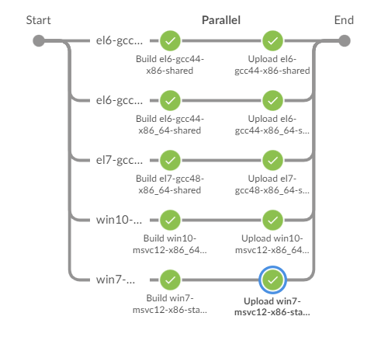
Conan as the alternative for our build system
Conan with Cmake build system is good alternative to replace our existing Maven-based build system
Simultaneously builds devices for legacy and future platforms
Facilitates collaborations while maintaining OS independence
Simplifies upgrading third-party libraries
Centralized Jenkins pipelines templates
Shared profiles/configurations between CI/CD and developer’s environments
Prepares to the next challenges
  The migration to 64-bit and newest compilers/standards
  The update of our deployment process
  The CI/CD for electronics

Slide 13


