Slide 1
CI/CD at MAX IV
37th Tango Community Meeting, 2023.06.27-29
Notes:
Share the workflow put in place at MAX IV for building and deploying Tango devices

Slide 2
Outline
Centralized GitLab CI templates
Linting and formatting
Building conda packages
Testing Python tango devices
Publishing and deploying
Continuous deployment
Notes:
We will focus on the use of GitLab CI templates

Slide 3
Python GitLab CI template
On branch (dev package: 1.0.1.dev3+g9c9a3d7)
On tag (prod package: 1.1.0)
Notes:
One project where we keep GitLab CI templates. Only one file to include in projects

Slide 4
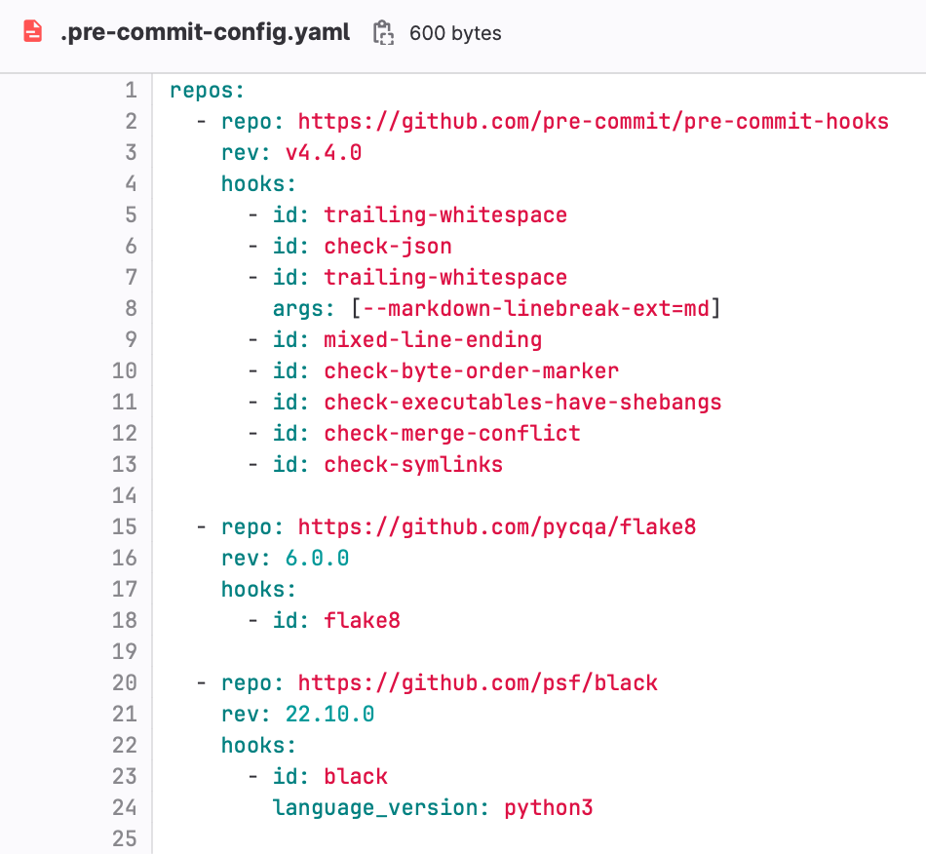
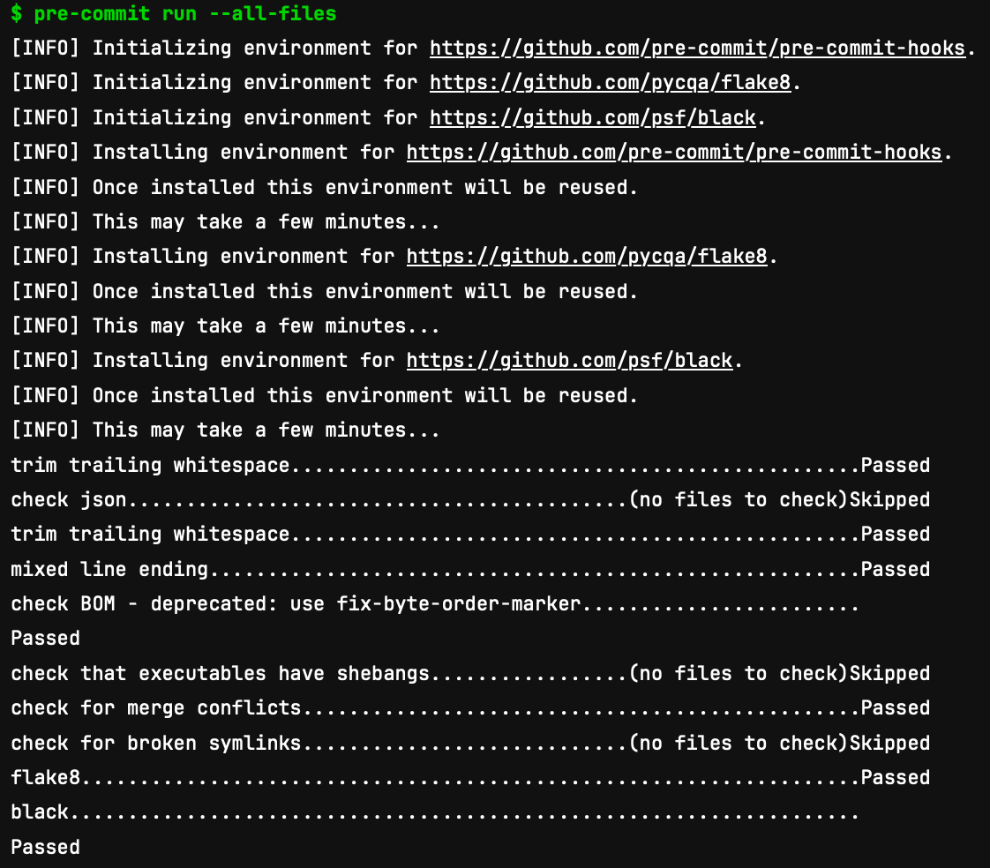
pre-commit
https://pre-commit.com A framework for managing and maintaining multi-languages pre-commit hooks

Slide 5
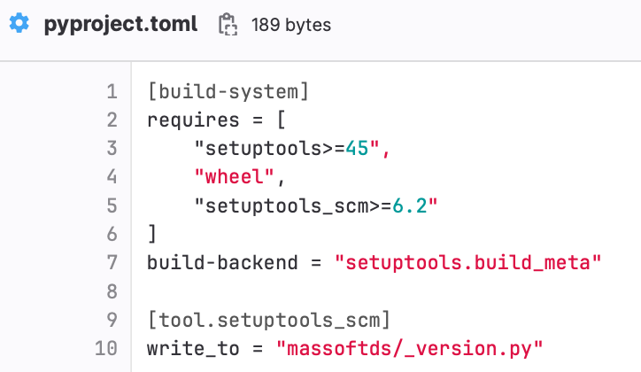
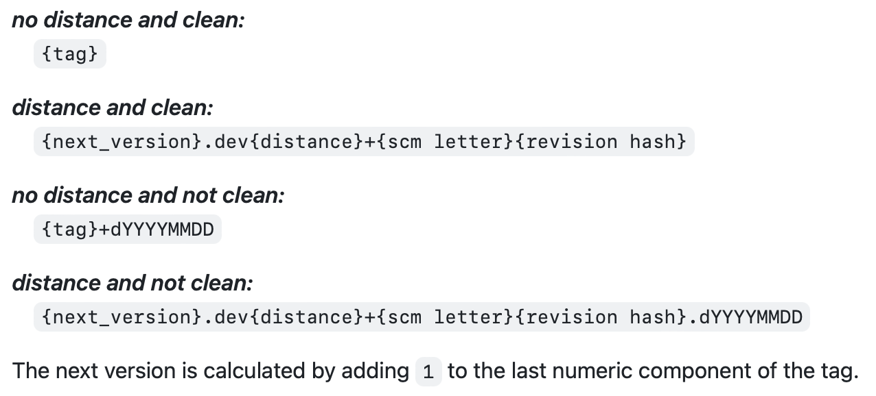
pypi build
python -m build
On branch: 1.0.1.dev3+g9c9a3d7
On tag: 1.1.0
setuptools-scm rules:
Notes:
Not fully migrated to pyproject.toml. But planning to.

Slide 6
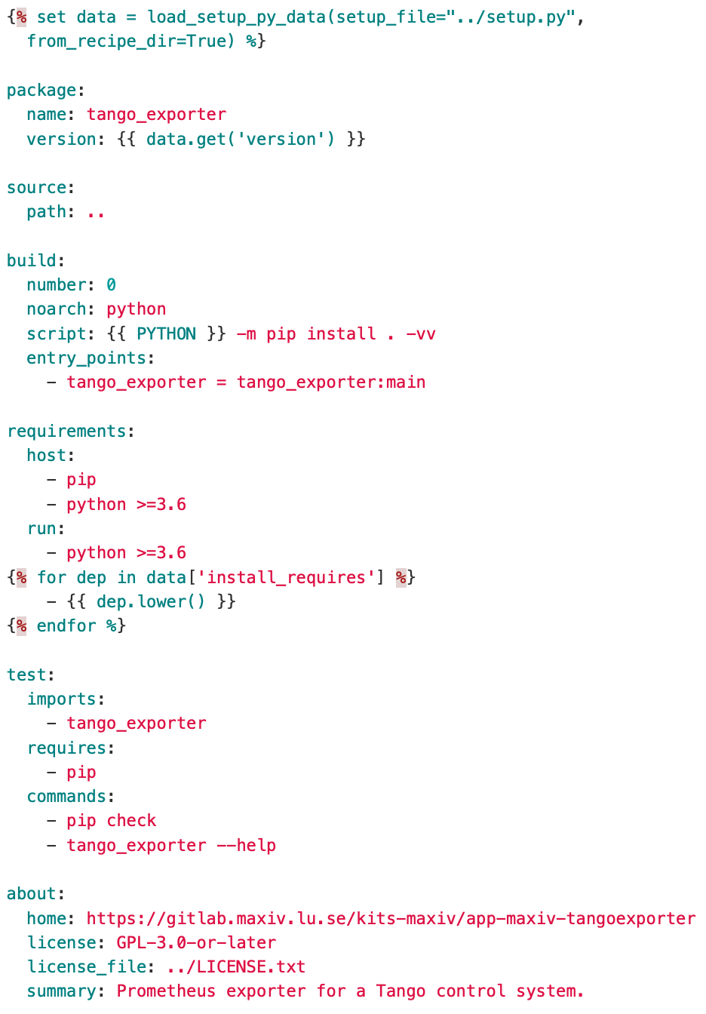
auto build conda package 1/2
Initially created a cookiecutter template to generate a conda recipe:
Required to add a recipe to every repository
One more file to maintain (switching to setuptools-scm had impact on the recipe)
Slow adoption
Solution? Grayskull 💀 Recipe generator for Conda
Notes:
Used to build RPM using fpm. Started to test conda but slow adoption. Many existing repositories.

Slide 7
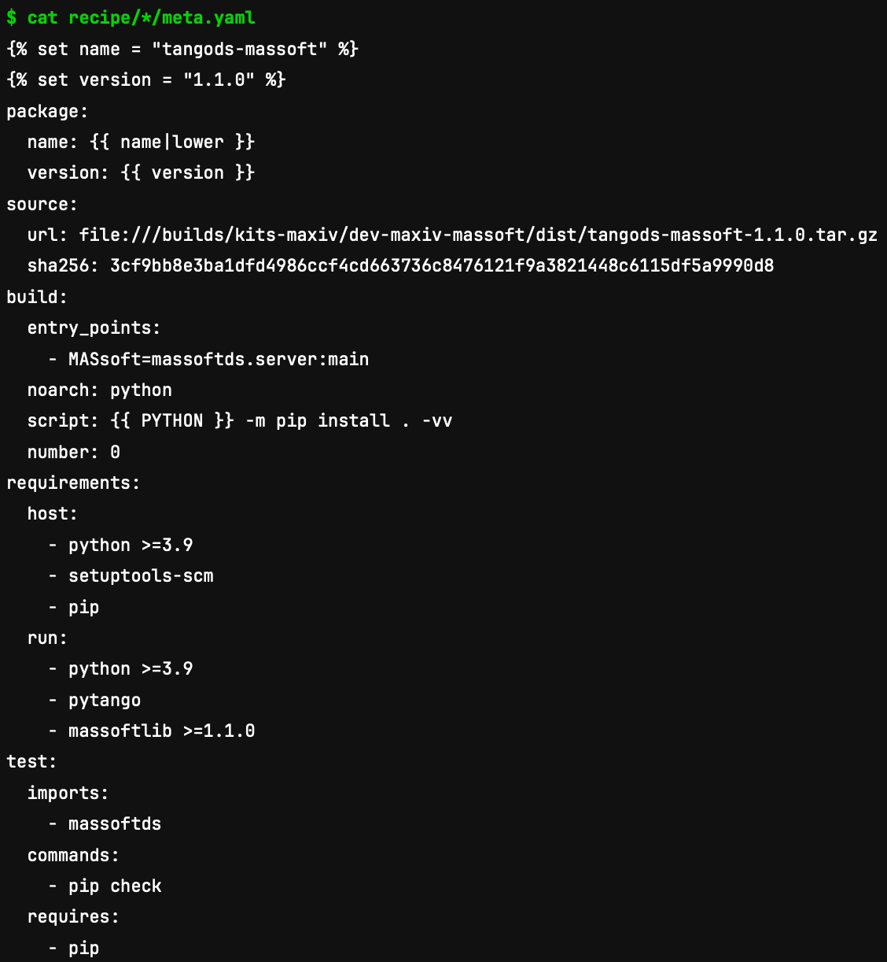
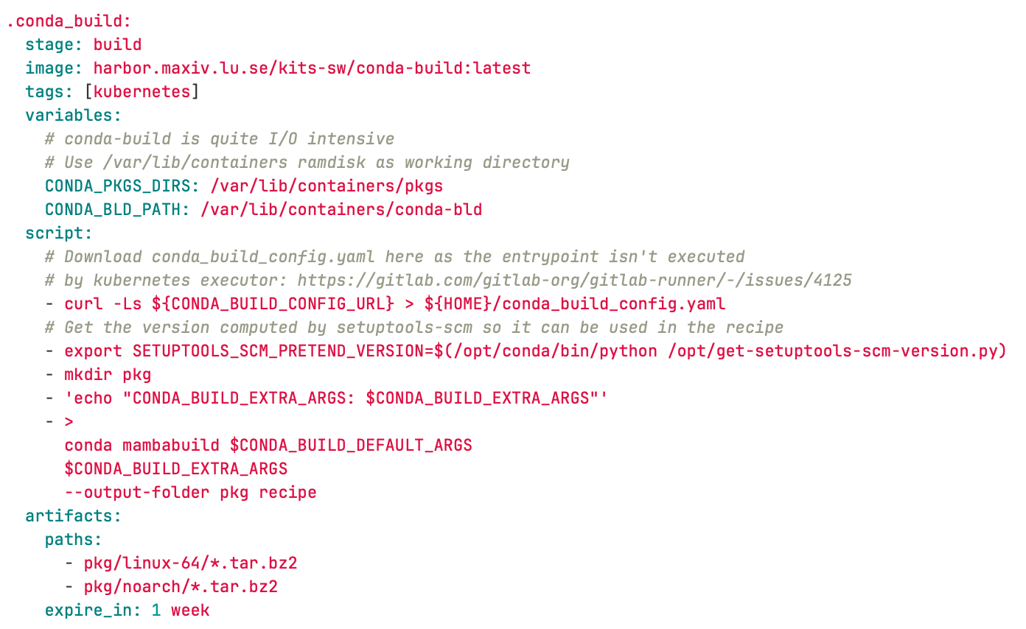
auto build conda package 2/2

Slide 8
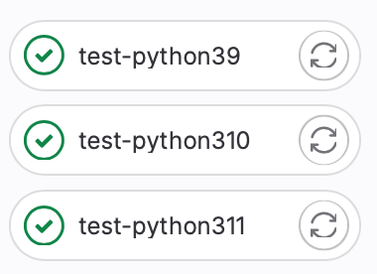
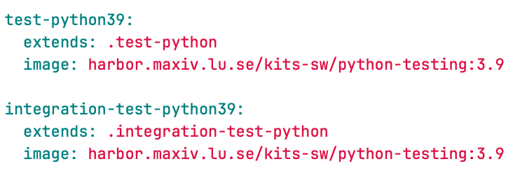
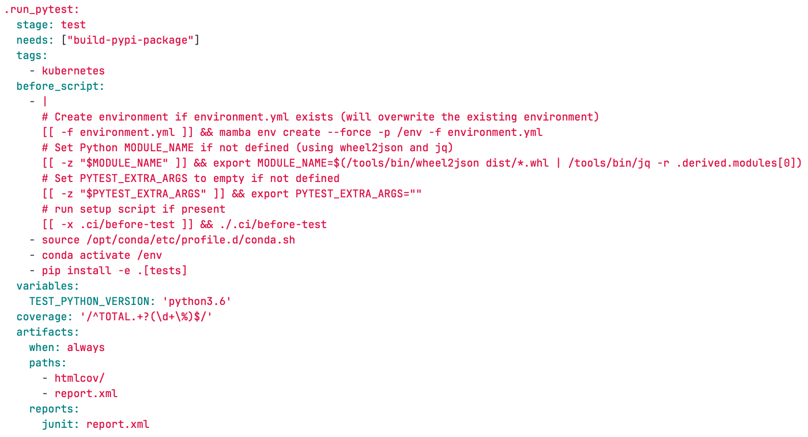
Test python
Docker image with pytango and sardana already installed (with conda)
Notes:
We pip install the package. PyTango wasn’t available as wheel. Also ensure that we test with the current version deployed (9.3.6) and not latest.

Slide 9
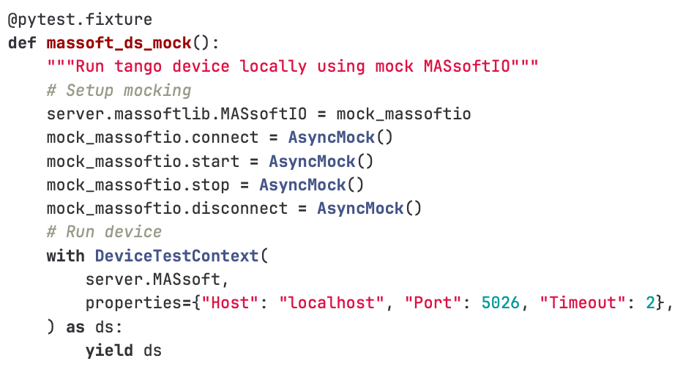
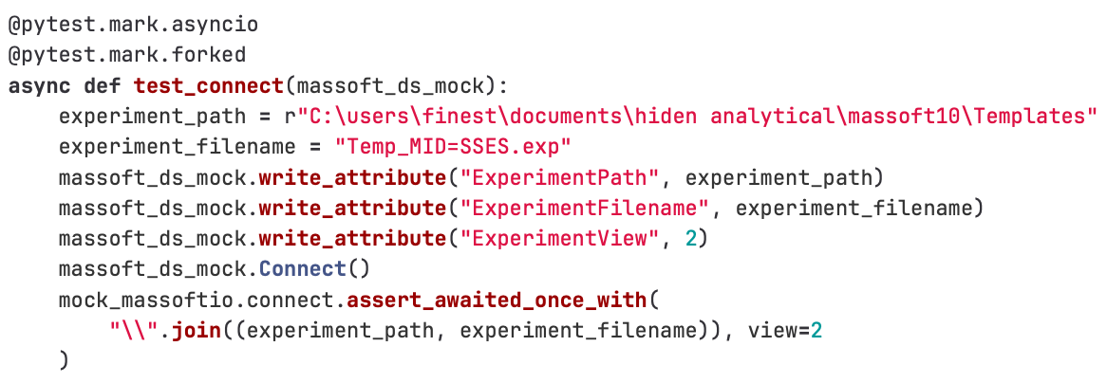
Test python
No Tango database needed Requires pytest-forked

Slide 10
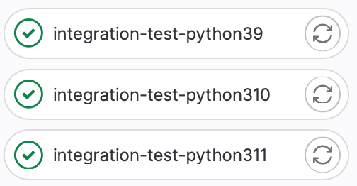
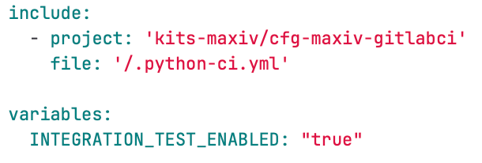
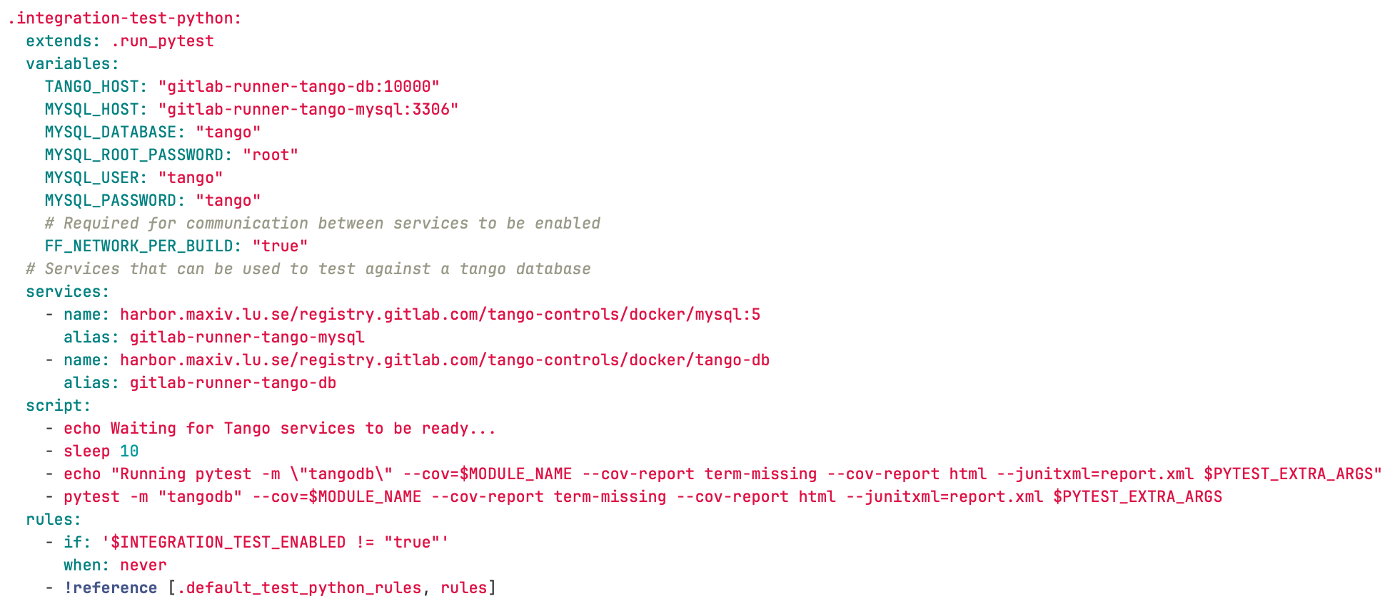
Integration test
Tango database required

Slide 11
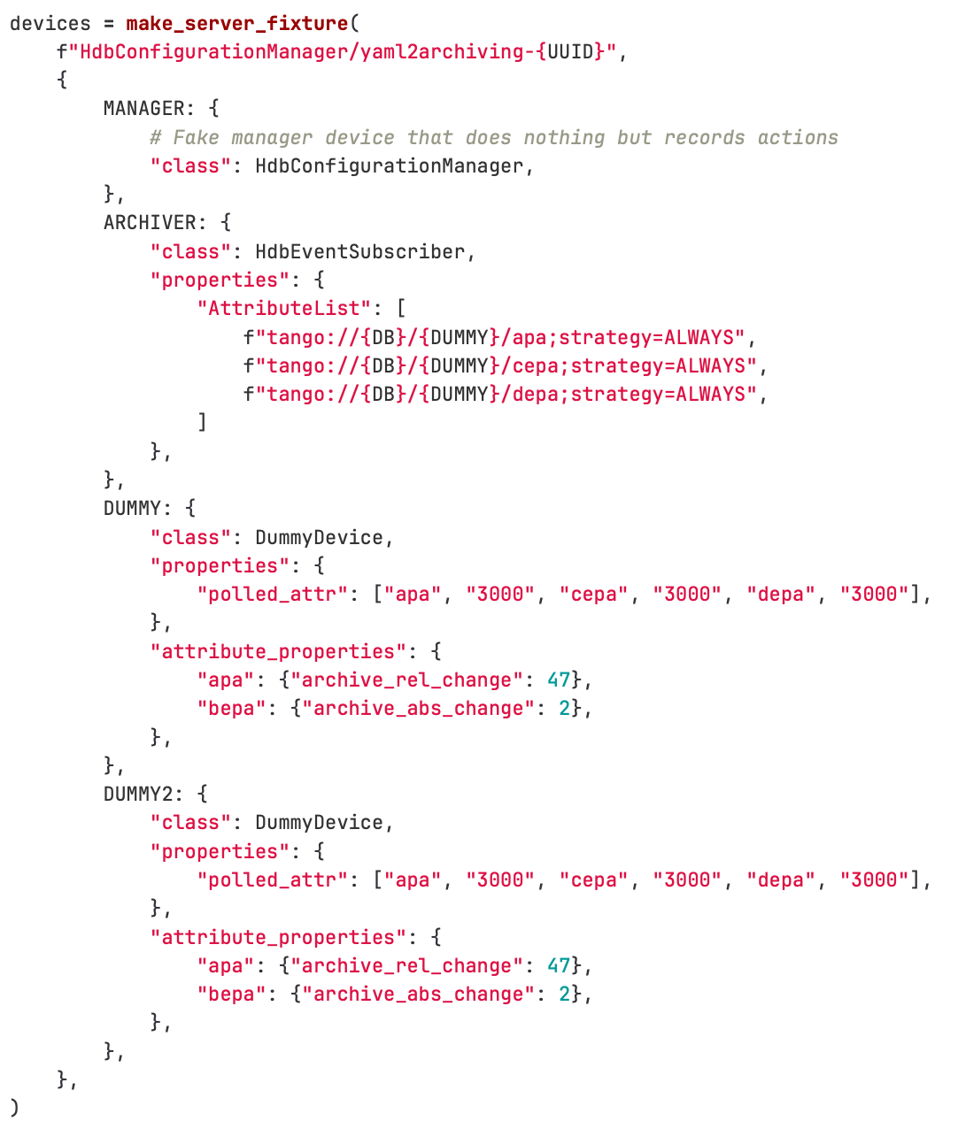
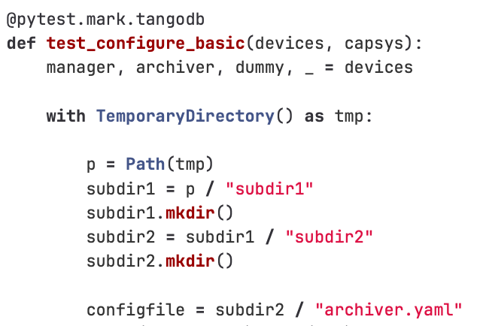
Integration test
Notes:
Not showing the full test. What is important is that the test is marked with “tangodb”.

Slide 12
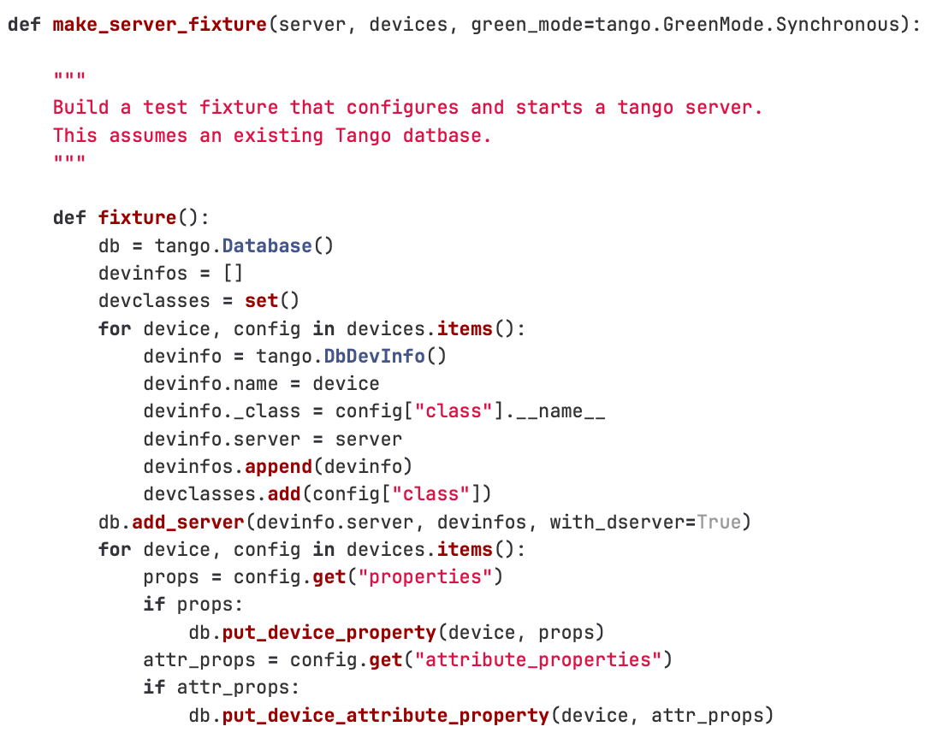
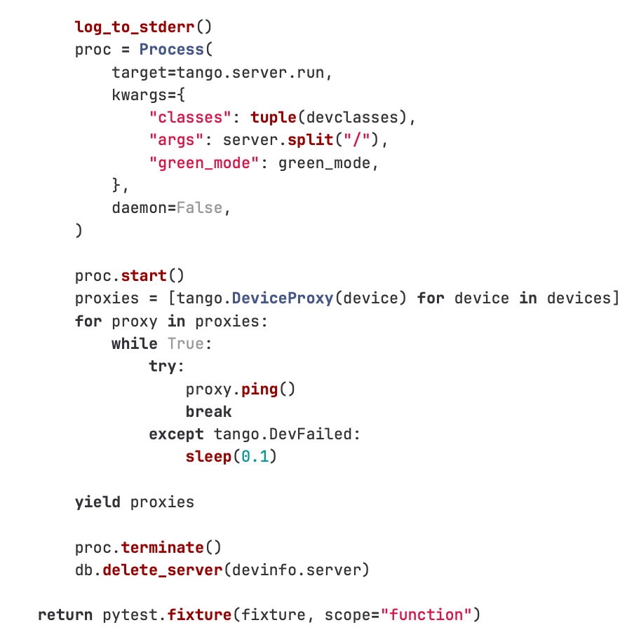
Integration test

Slide 13
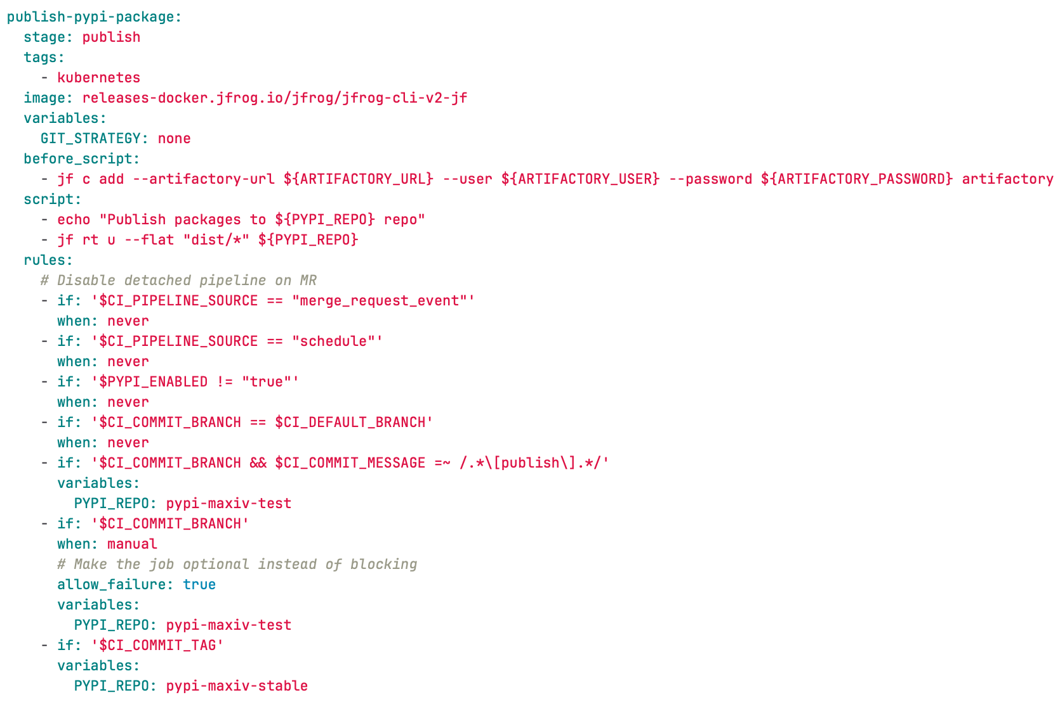
Publish

Slide 14
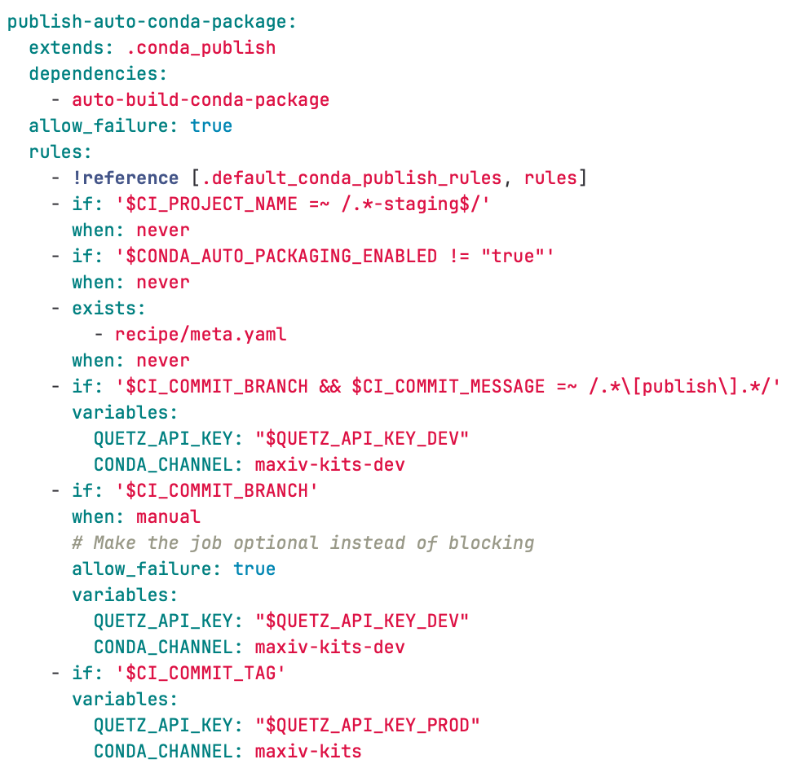
Publish

Slide 15
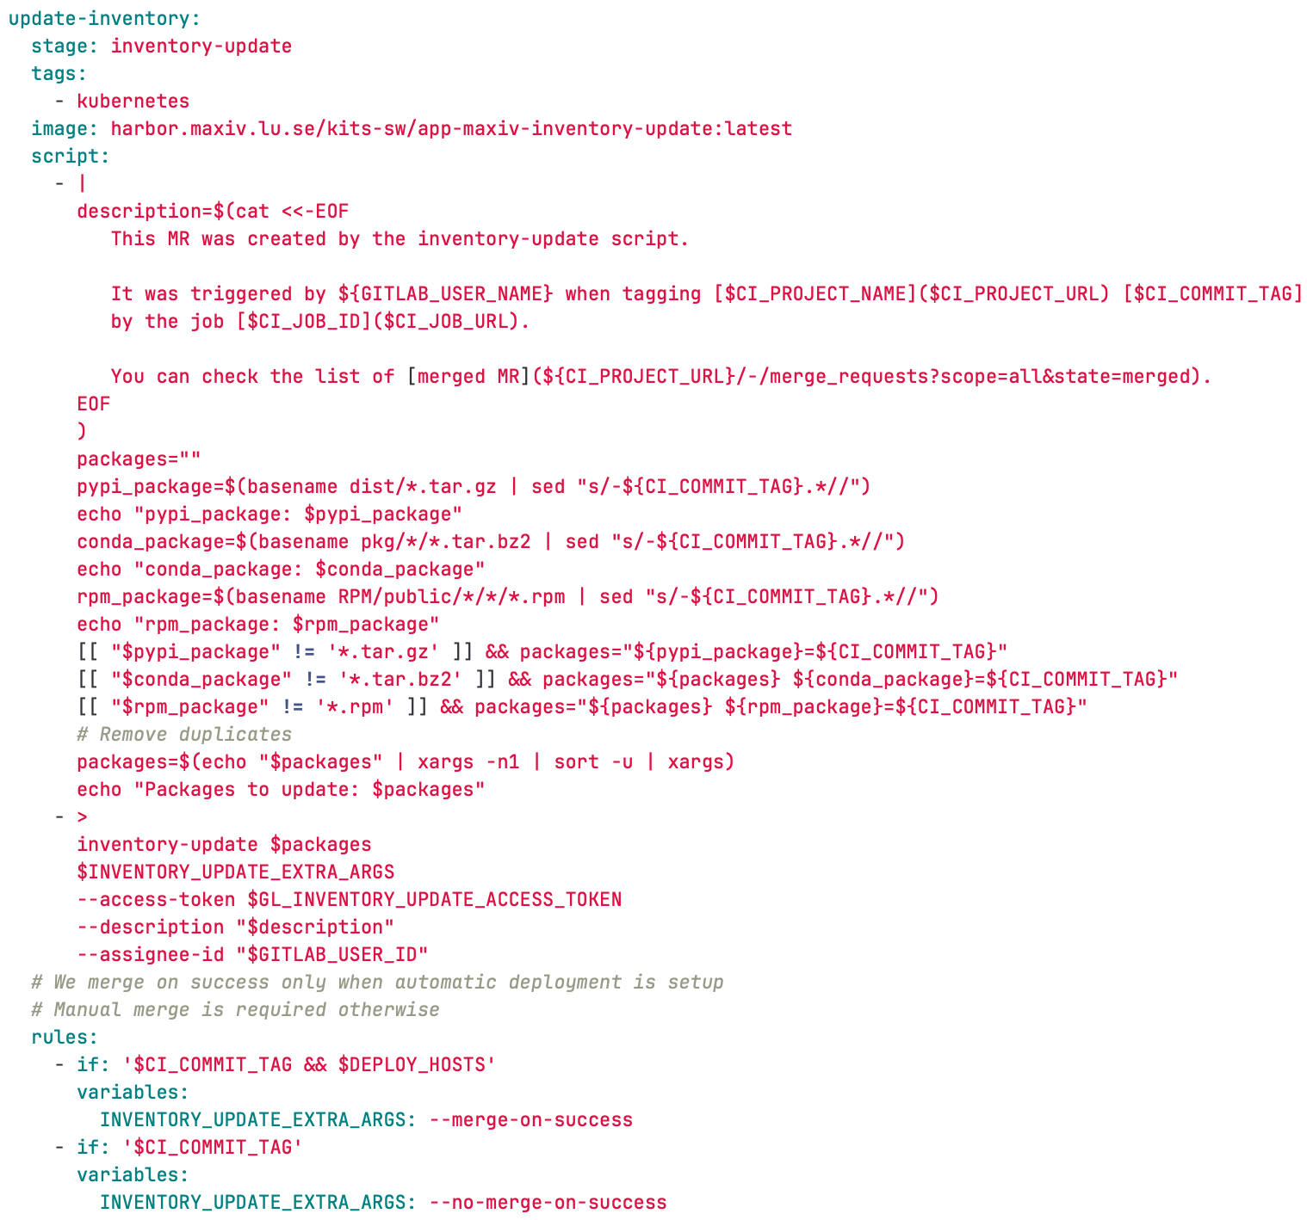
Update inventory

Slide 16
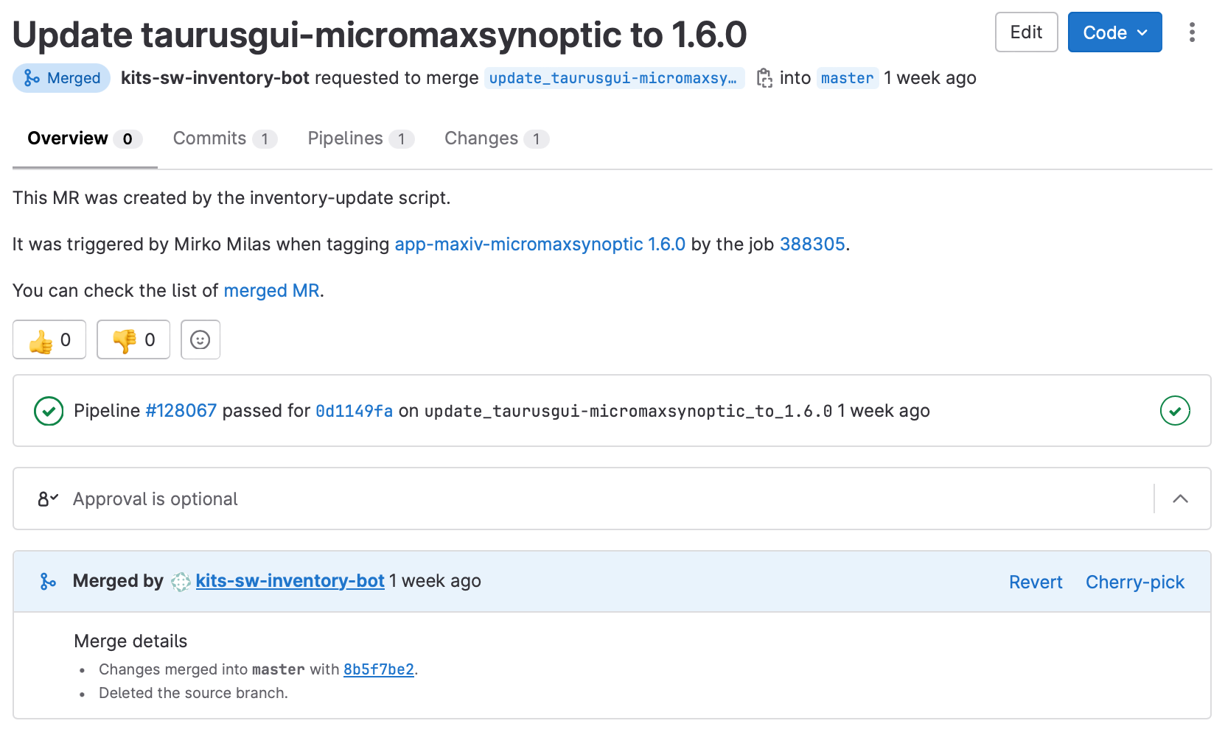
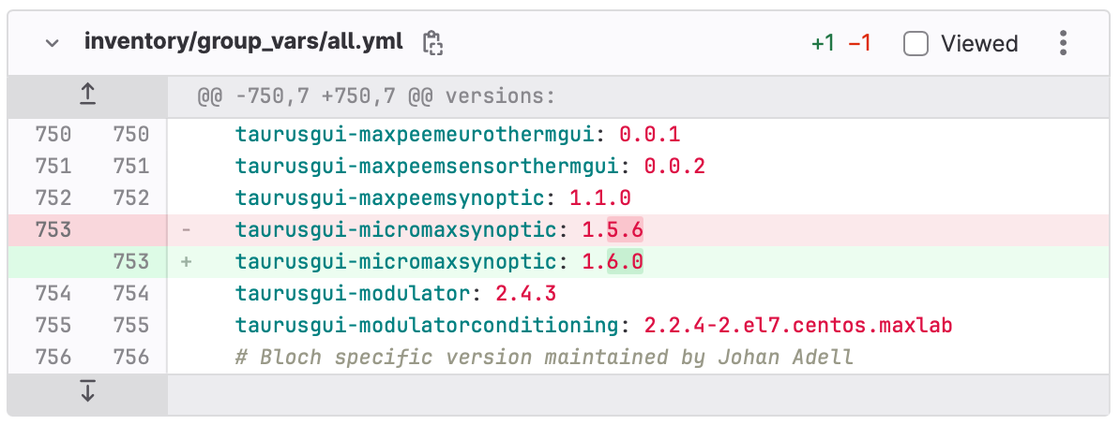
Update inventory

Slide 17
Continuous Integration
Dev package published only if needed – for testing

Slide 18
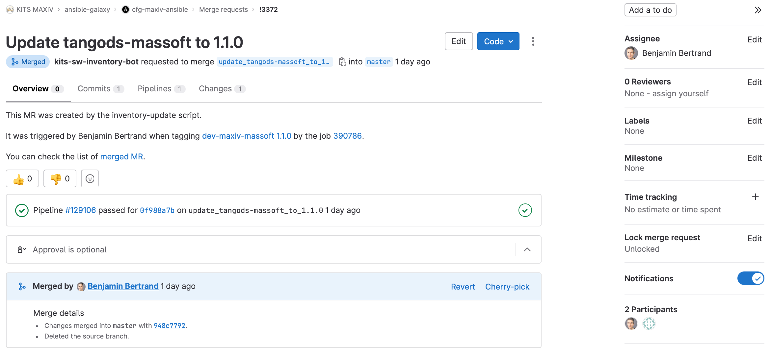
Continuous Integration

Slide 19
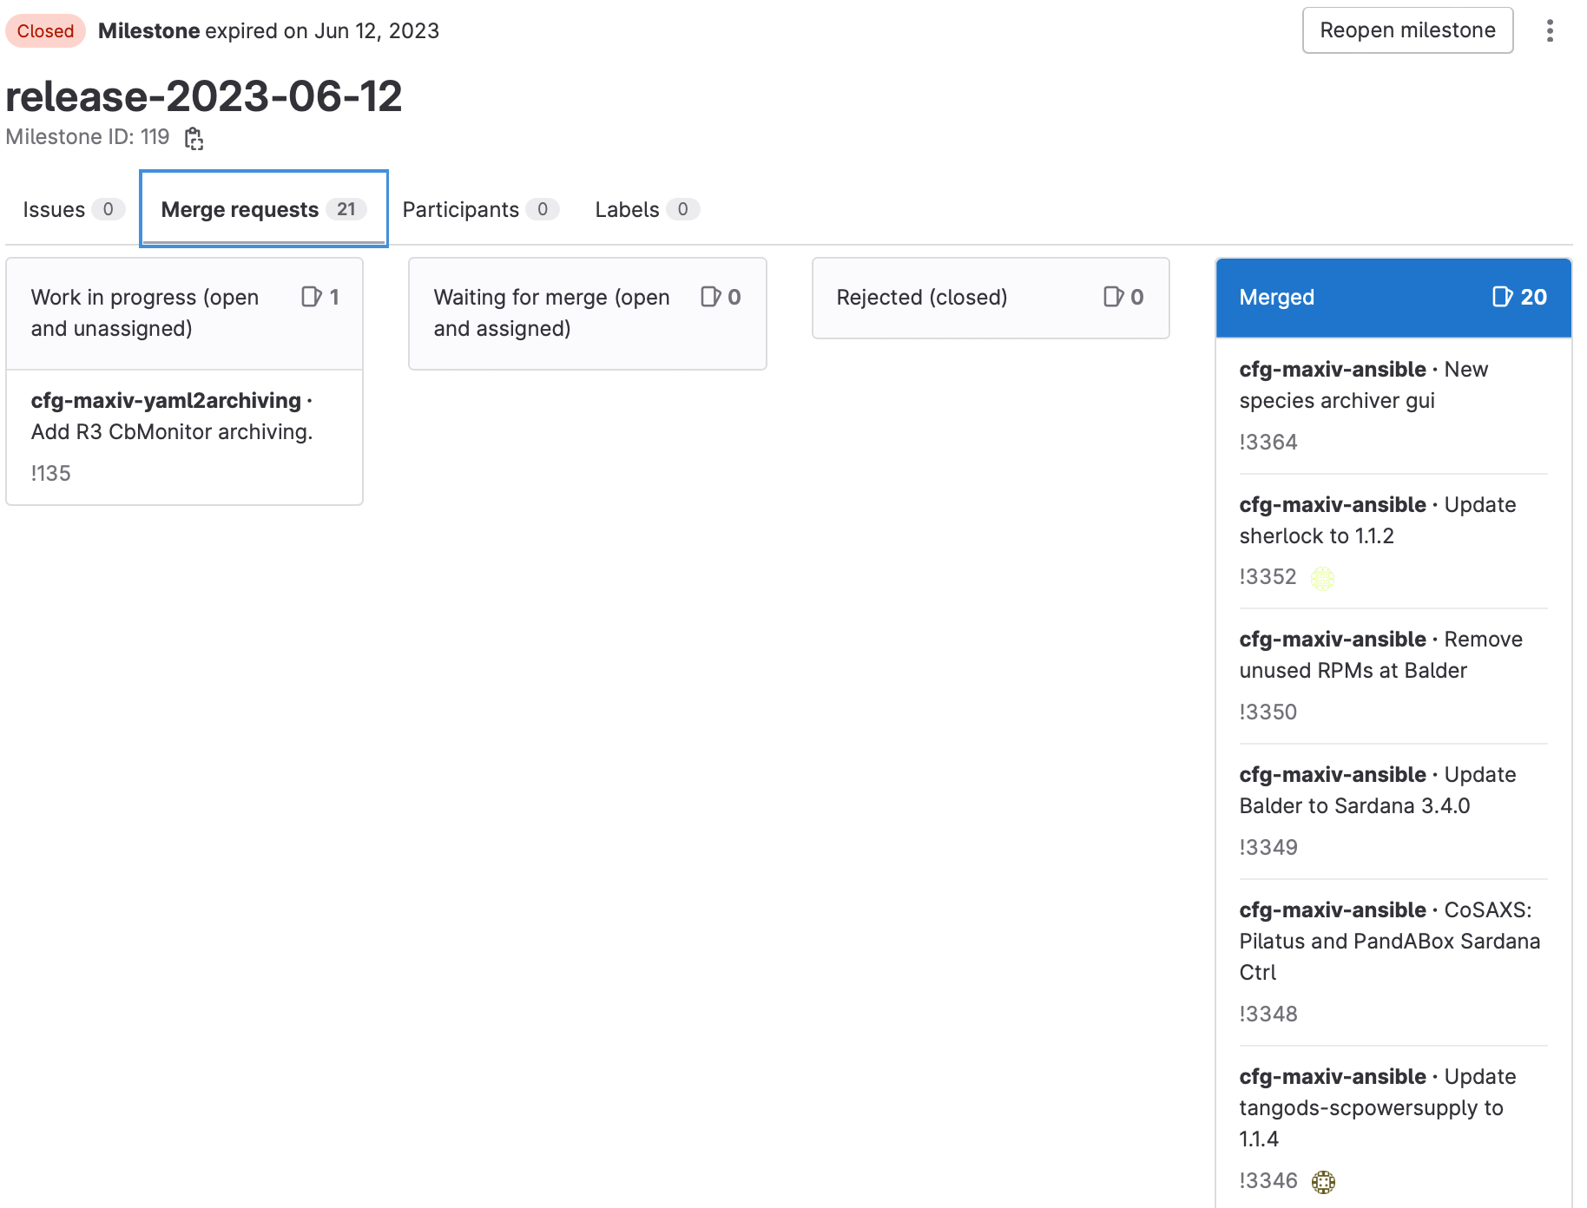
Monday deployment
All approved Ansible MRs belonging to the corresponding milestone are merged by the Monday Deployment Crew.
The Monday Deployment Crew deploys the updates by running the deploy playbook in AWX, limited to beamlines group.

Slide 20
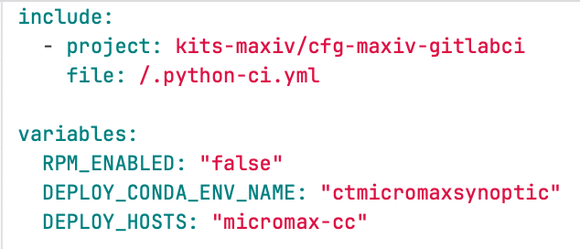
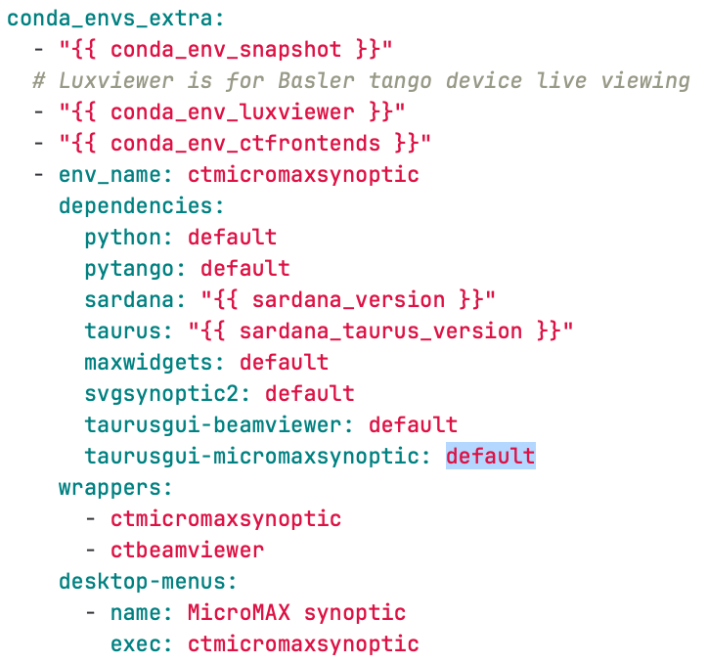
Continuous deployment

Slide 21
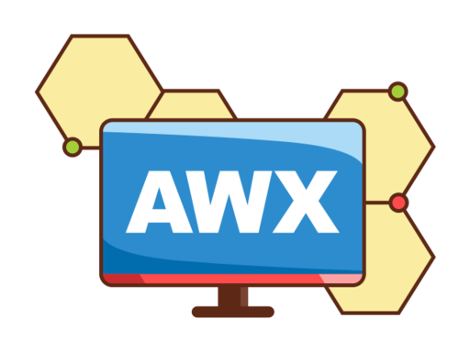
Continuous deployment
MR in the inventory is automatically merged
Only for specific use-case! Synoptic is a typical one. Beamline staff can update the app themselves.

Slide 22
Conclusion
Centralized GitLab CI templates
Keep the same pipeline for all projects
Can be used by anyone without specific knowledge
setuptools-scm to manage version
Automatic conda recipe creation thanks to grayskull
Testing with or without Tango database
Automatic inventory update
Deployment

