Slide 1
Taranta status report
Matteo Canzari (INAF - OAAb - SKAO)
37th Tango Community meeting at SKAO (Jodrell Bank - England)
27–9 Jun 2023

Slide 2
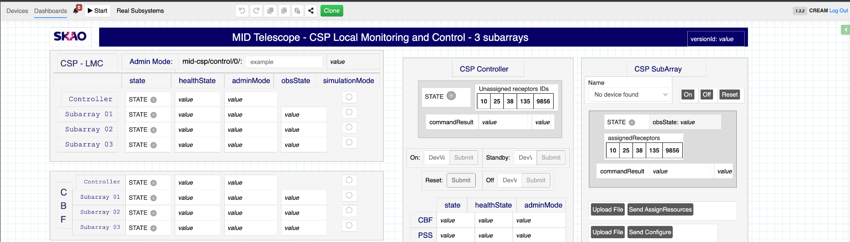
What is Taranta?
Taranta is a web application that allows a user to explore Tango devices and to create a graphical user interface to interact with them; the user interface may include a variety of charts, numerical indicator, dials, commands that can be used to monitor and to control devices

Slide 3
Taranta history

Slide 4
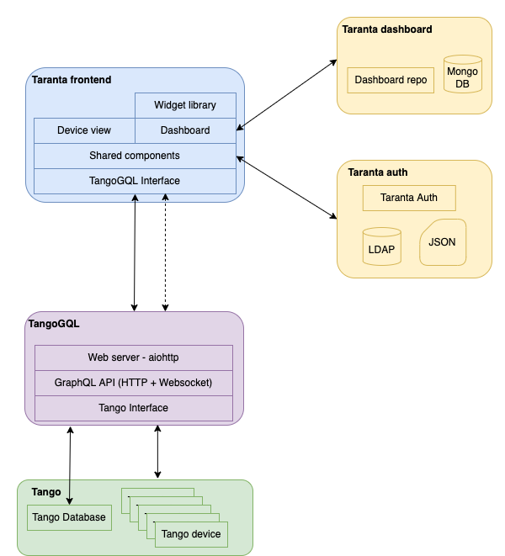
Taranta architecture

Slide 5
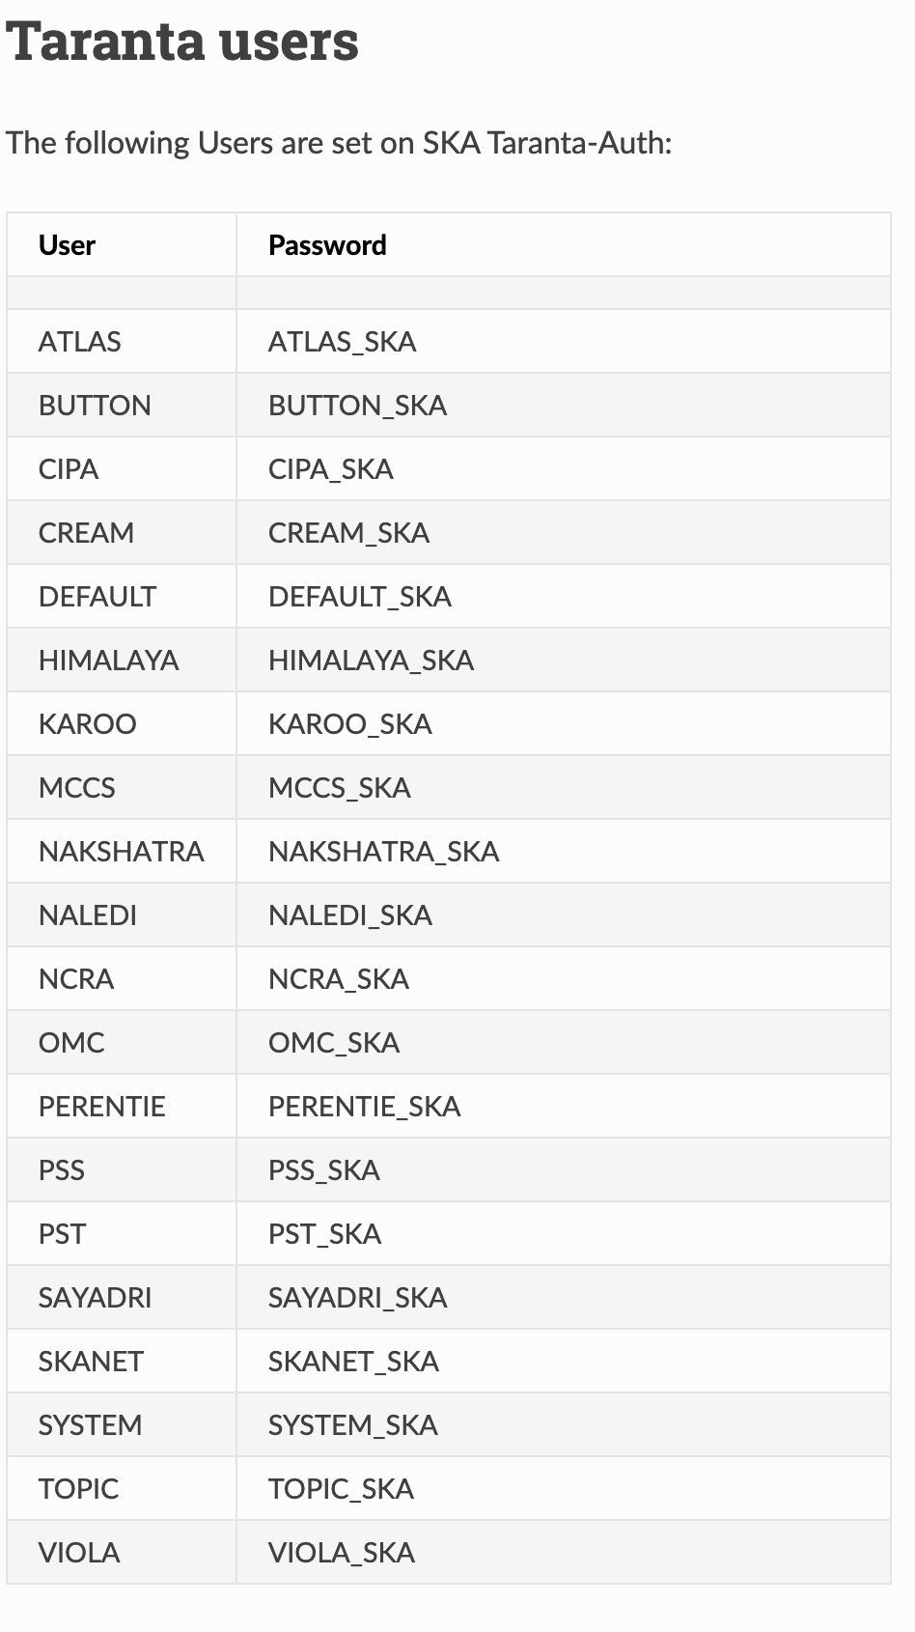
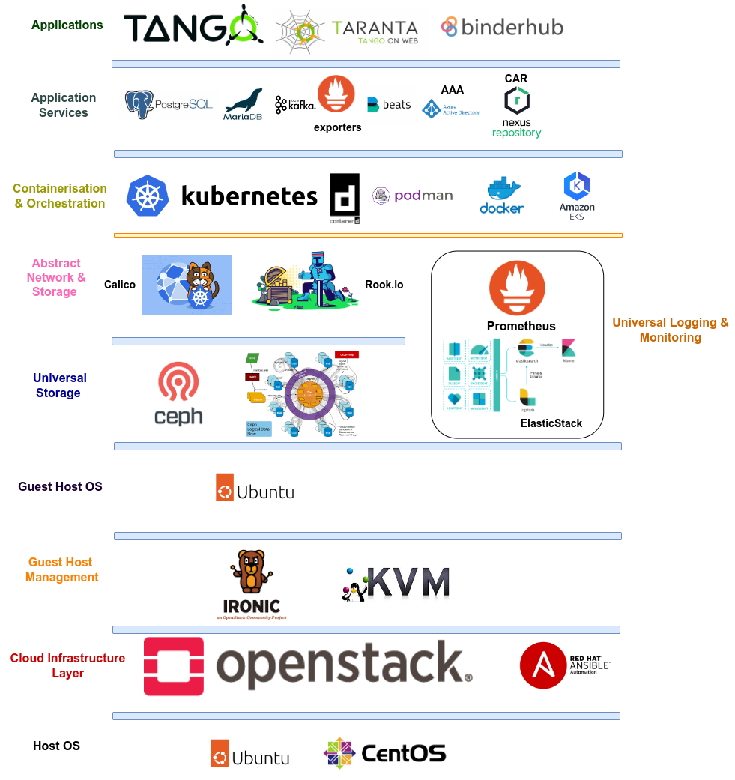
Taranta SKAO use cases
Taranta is a tool used by engineers, integrators and commissioners for monitoring, controlling and debugging Tango devices for the telescope.
Key selling points:
quick development of UIs
easy to modify existing UIs
no need for UI-related skills
no need to use other tools

Slide 6
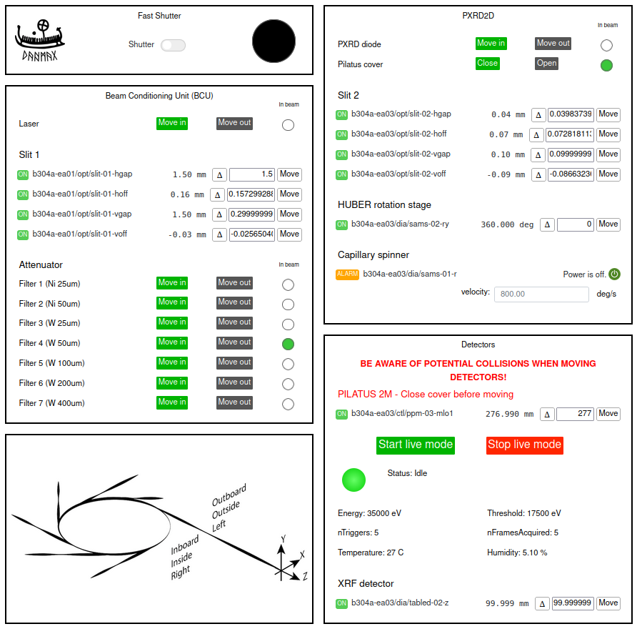
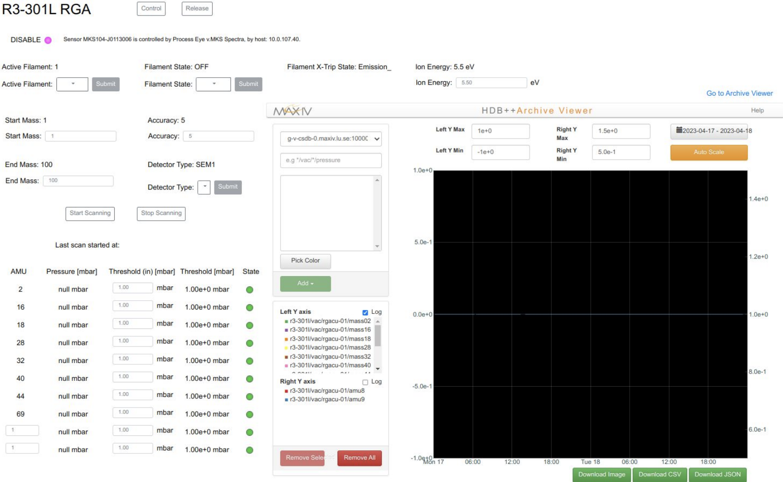
Taranta MAX IV use cases
Taranta is widely used in MAX IV from accelerator operators to the beamlines. User by engineers, beamline staffs, experiment users.
Monitoring usage: insertion devices, radio frequency, cooling system, vaccum system, different beamline status
Interaction with devices: overview of all equipements, configure/control motors, detectors, experiment control

Slide 7
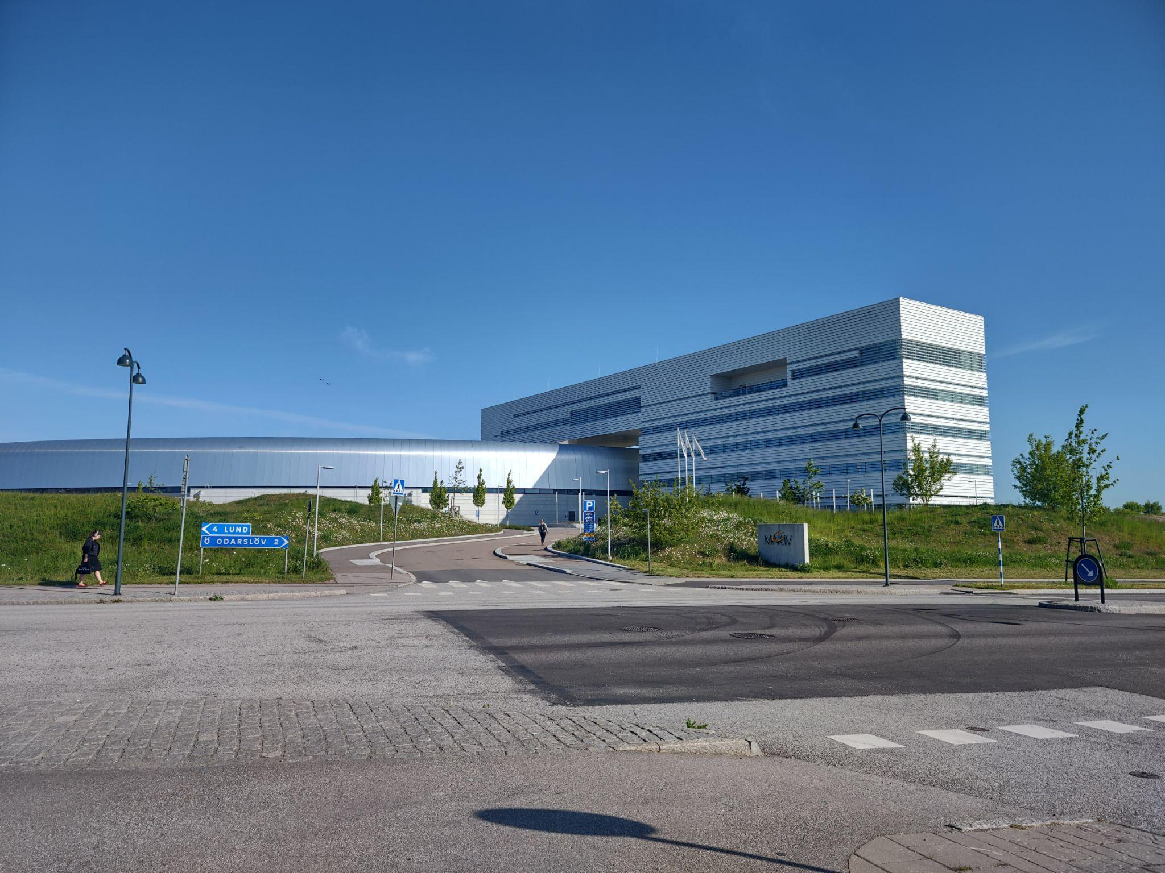
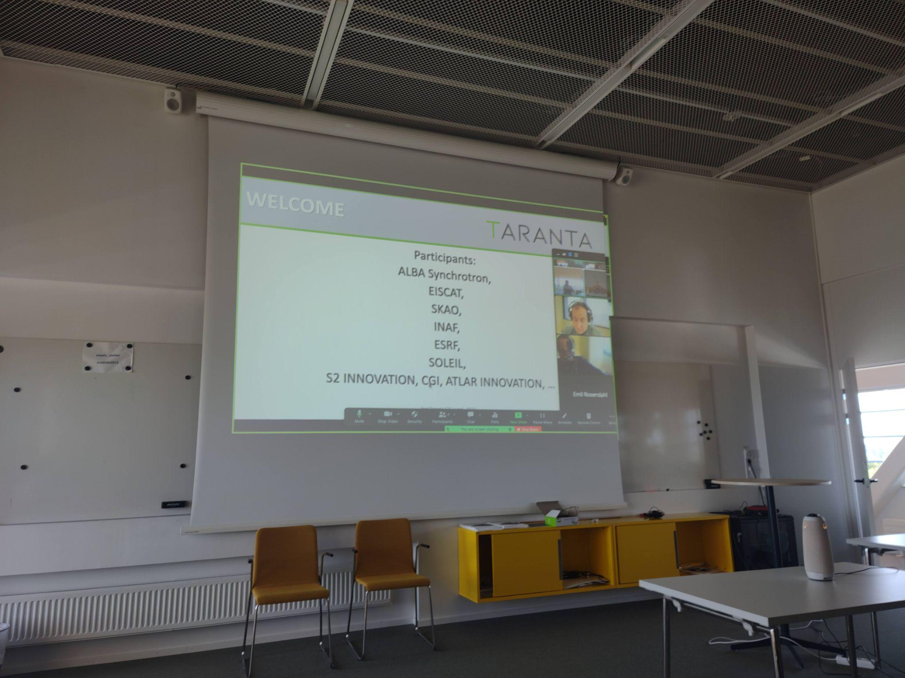
2nd Taranta F2F meeting
Hosted by MaxIV, 29–30 May 2023
20 participants, coming from 9 institutions or private companies
11 contributions and a half-day dedicated to open discussion and brainstorming

Slide 8
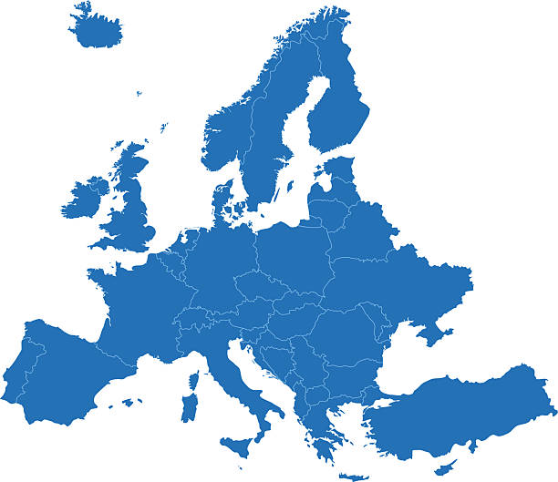
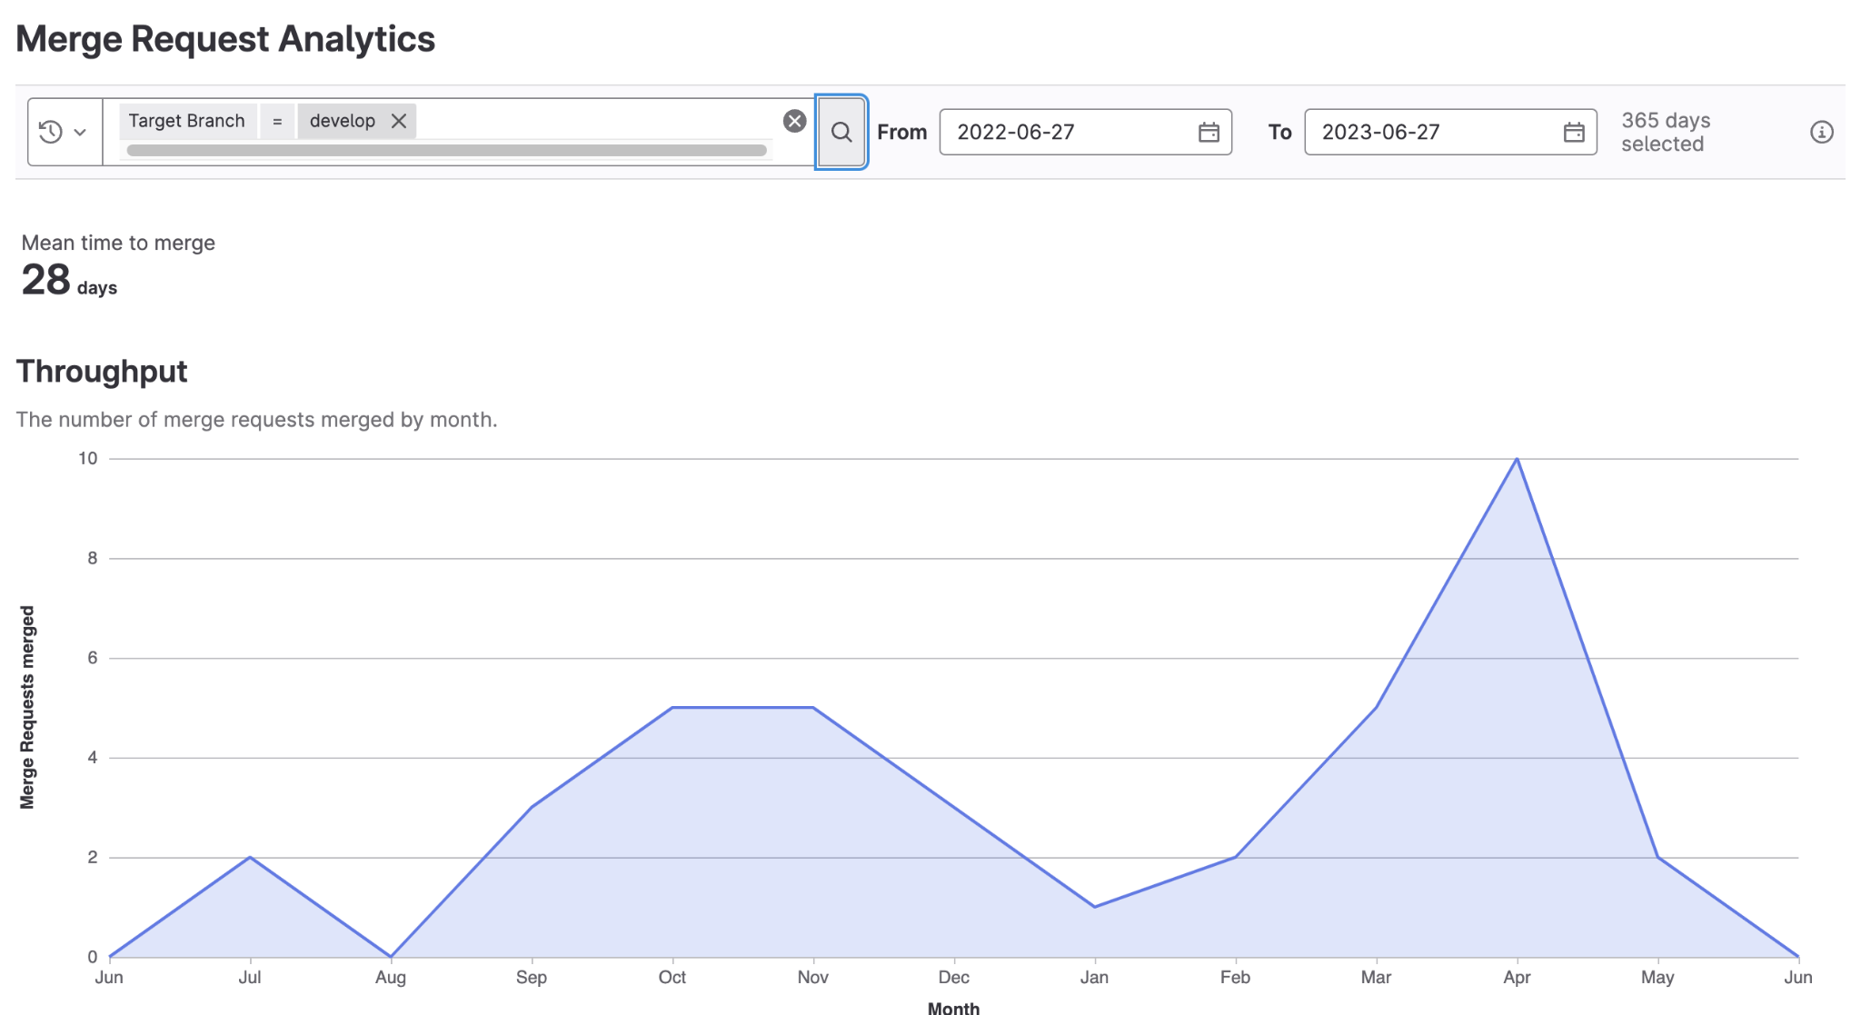
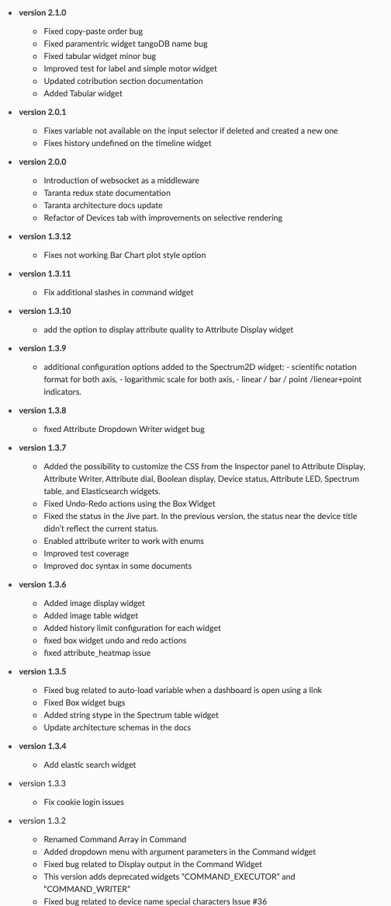
Rocky road to Jodrell Bank
1.3.2
2.3.0
https://taranta.readthedocs.io/en/latest/history.html

Slide 9
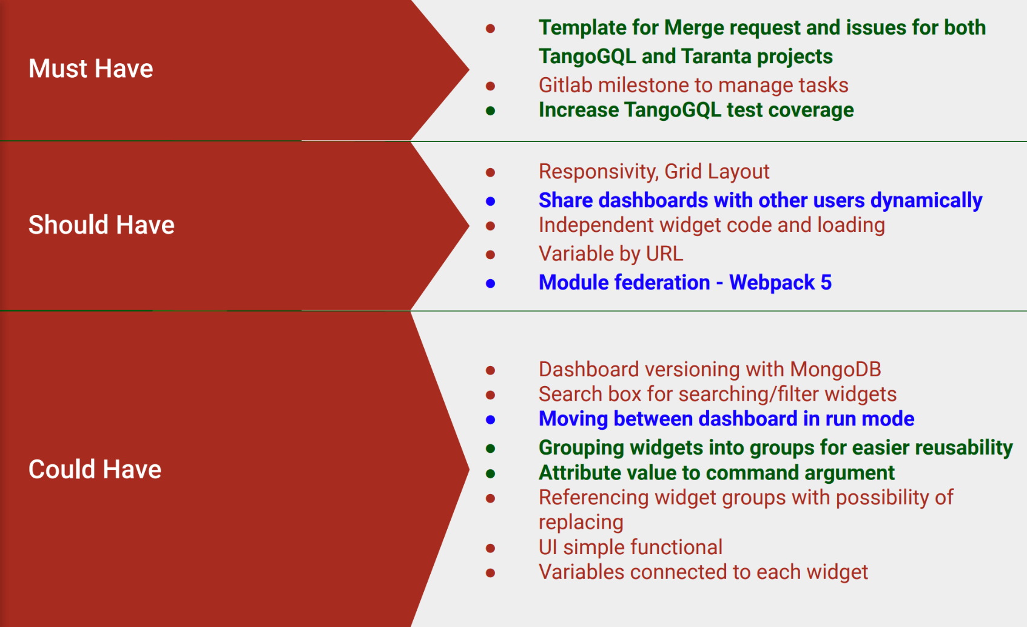
From 1st Taranta F2F meeting outcomes

Slide 10
Improvements
TangoGQL
Taranta

Slide 11
Tabular widget
A "Table Widget" that allows presentation of information on a bidirectional grid, N rows x M columns. Each row presents an instance of devices and each column represents a property of that device, Examples of tables are: list of receptors, list of subarrays, list of alarms. Example of columns are names, addresses, LEDs, states, attribute values.

Slide 12
Update vulnerable packages Step 1
Main libraries updated:
React: 16 -> 17
@types/node: 12.0.2 -> 18.14.0
node: 14-alpine -> 18-alpine
2.2.0
2.3.0

Slide 13
Performance issue
A big chunk of work resolved a problem that leads to memory leaks that can be experienced with dashboards containing a dozen of widgets that are updated frequently for a couple of minutes.

Slide 14
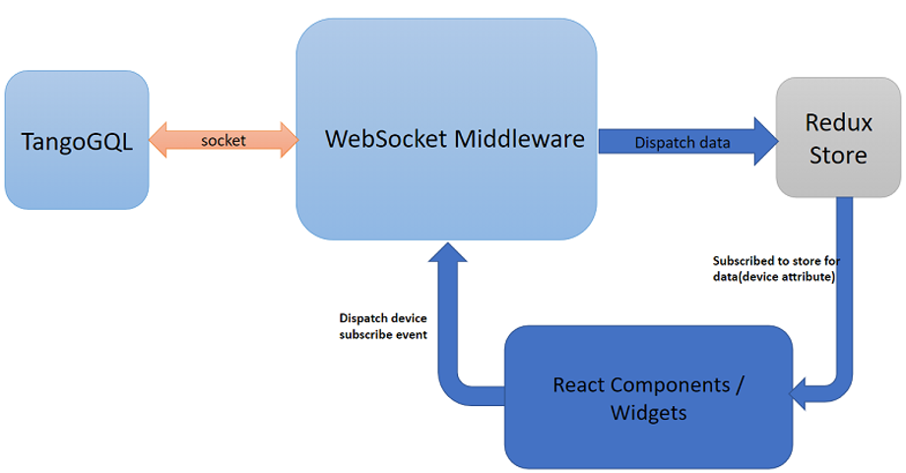
Refactor device and dashboard

Slide 15
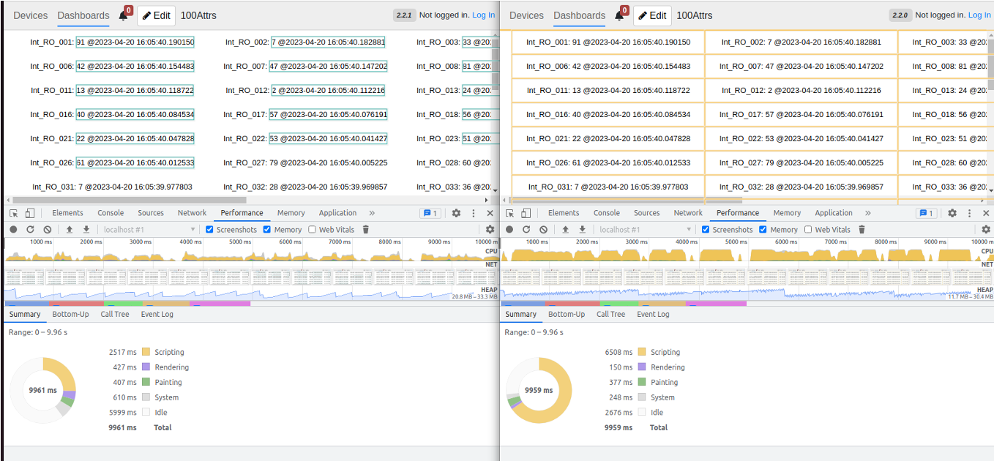
Refactor

Slide 16
Refactor key points
Performance improvement (Unnecessary dashboard renders are avoided)
Long-running dashboards freeze bug fixed
Standardization of data access on taranta (making it faster and easier to implement new components)
Improved WebSocket management and communication recovery
Backward compatibility
Tests improvement

Slide 17
Current version
Current stable version | to be released (by September)
2.3.0 | 2.4.x
vulnerability update device part refactored all widgets updated | dashboard part refactored

Slide 18
Rocky road to ?
?

Slide 19
In the near future
Usability improvements
We received feedbacks from SKA and MaxIV users (24 pages)
Most of them will be solved with the new release
Other improvements will be prioritized and developed from September
Multiple Tango Database
Access multiple Tango database from widgets
One default Tango database
Strongly requested both from MaxIV and SKAO

Slide 20
In the near future
Web Synoptic
SVG synoptic widget
Mouse interaction (Zoom/Pan, layers)
TangoGQL improvement using Ariadne (a prototype already exists)
Schema mostly complete (partially tested with Taranta)
Test suite adapted from TangoGQL
Missing some Taranta specific stuff, like auth
Uses data loaders
Taranta as framework
Use Taranta as framework to develop independent web user interface

Slide 21
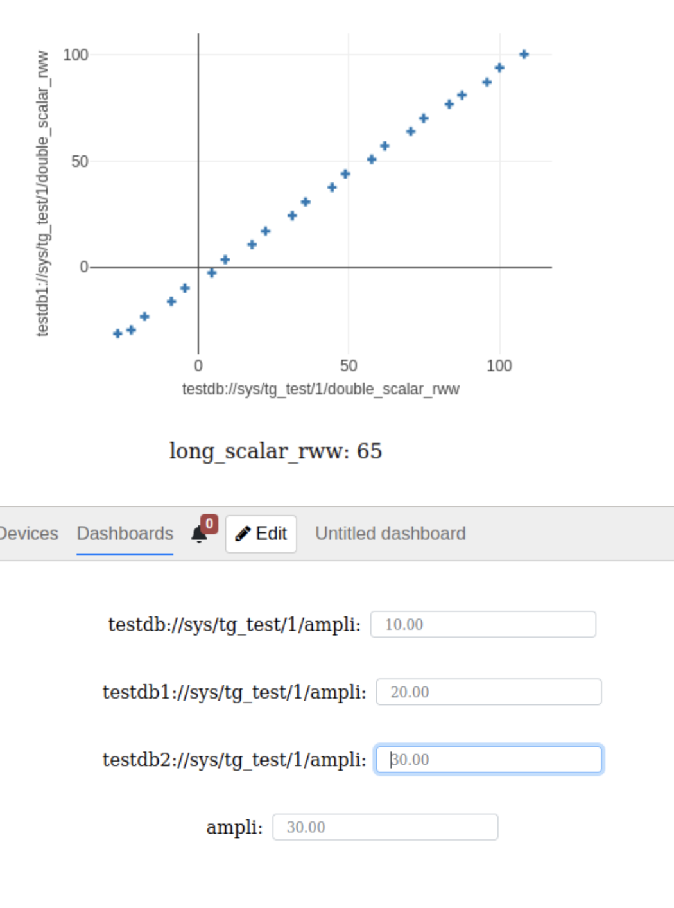
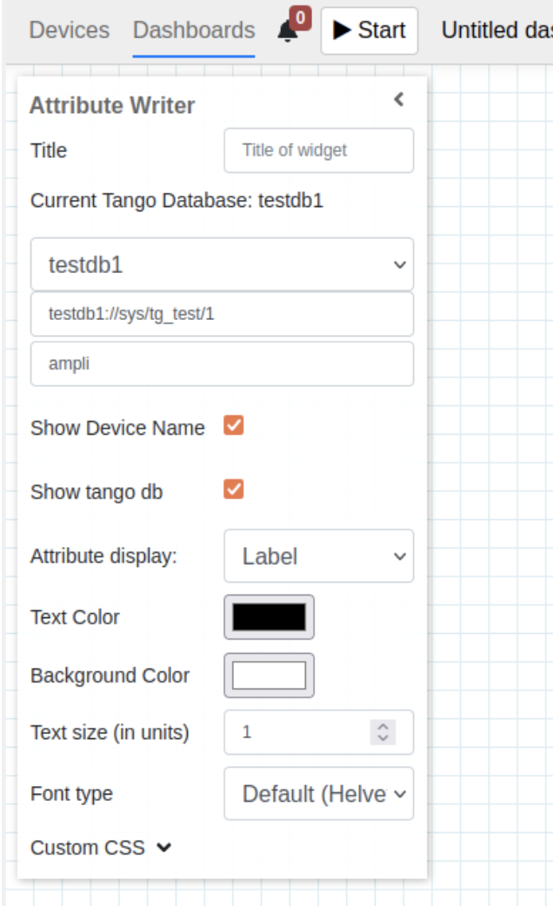
The future is not so far :)

Slide 22
Community: how to contribute
Join the #taranta-webjive slack channel in the Tango Slack Domain (http://tango-controls.slack.com/)
Attend the Taranta Weekly meeting, every Friday from 9:00 AM to 10:00 AM UTC on Google Meet (in the slack channel you will receive the details)
Add feedbacks, new desiderata or report bugs in our GitLab Repository, in the Issue Section
Contribute to code and raise your merge request
https://taranta.readthedocs.io/en/develop/install_howto_contribute.html

Slide 23
Thank you for your attention!
Matteo Canzari - matteo.canzari@inaf.it

