Slide 1
Polka web-based Astor
www.s2innovation.com
contact@s2innovation.com
Jakub Kowalczyk

Slide 2
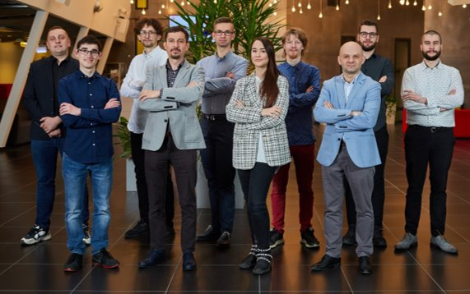
S2Innovation
Over 15 engineers with expertise on
Control systems engineering:​
Open-source SCADA frameworks
PLC
Software development
Python, C++, Java, .Net, Matlab
JavaScript, React, HTML, CSS
Tango Controls, EPICS
Documentation
DevOps

Slide 3
What is Polka?
Polka is a web-based application that supports most of the basic functionalities of the well-known Astor.
Functionalities:
- start/stop/restart server (TangoGQL)
- level management (TangoGQL)
- searching for server (TangoGQL)
- authentication and authorization (Taranta Auth)
- mobile view

Slide 4
Architecture of Polka
Technologies:
- Polka (JavaScript, React)
- TangoGQL (Python, AIOHTTP)
- Taranta Auth (JavaScript)

Slide 5
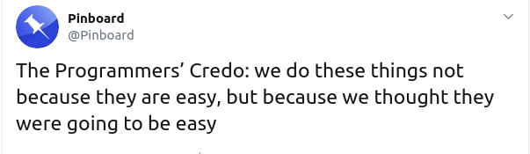
Why we chose Taranta services?
They cover all our needs
They are compatible with each other
They are actively developed and supported
We know the code base and used technologies
GraphQL is super flexible
They are production ready and already deployed
Don’t waste, re-use! #ZeroCodeWaste

Slide 6
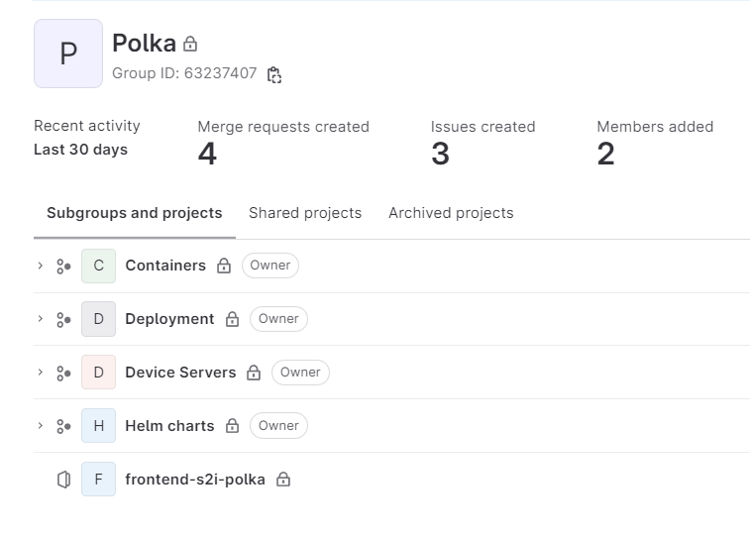
Ready for deployment
Containerization-Ready
Deployment Flexibility
Helm Charts Prepared
Continuous Delivery Pipeline
Polka available at polka.s2industry.com
Test deployment at MAX IV (17 beamlines)

Slide 7
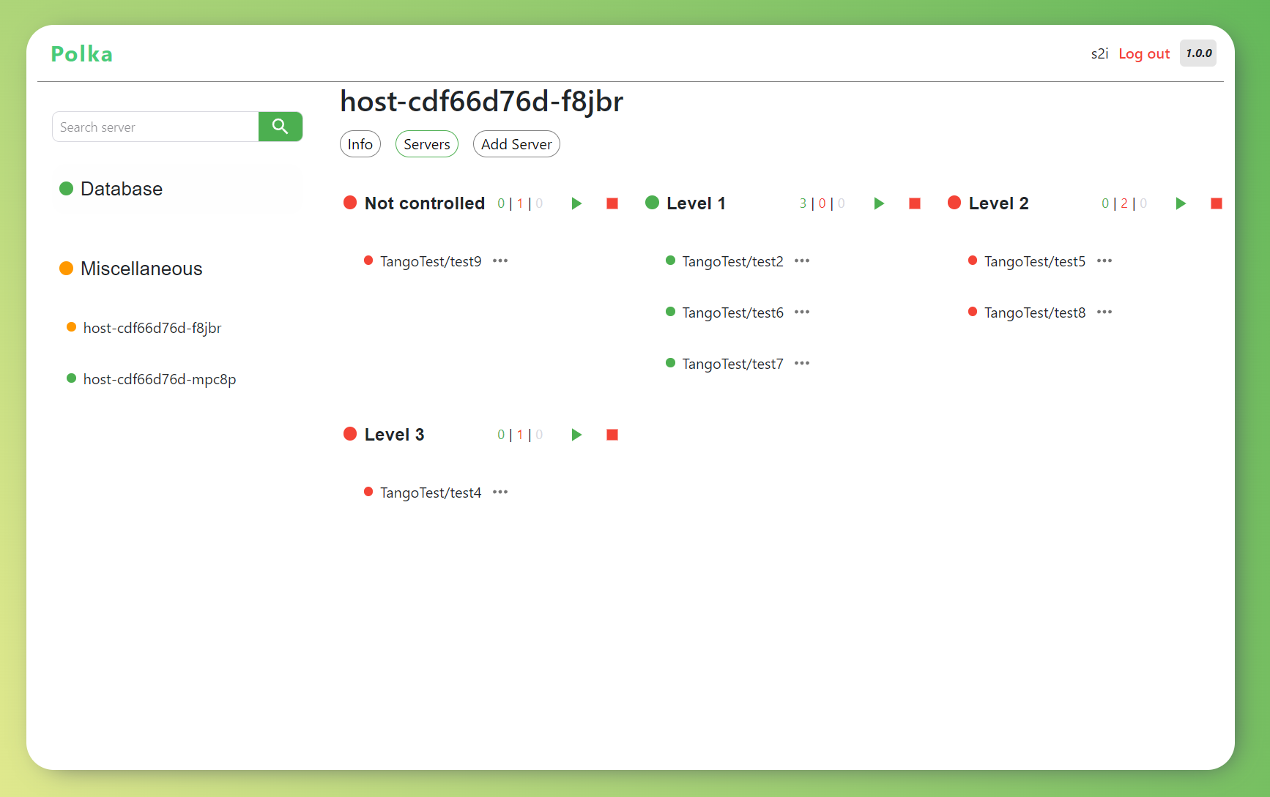
Desktop view

Slide 8
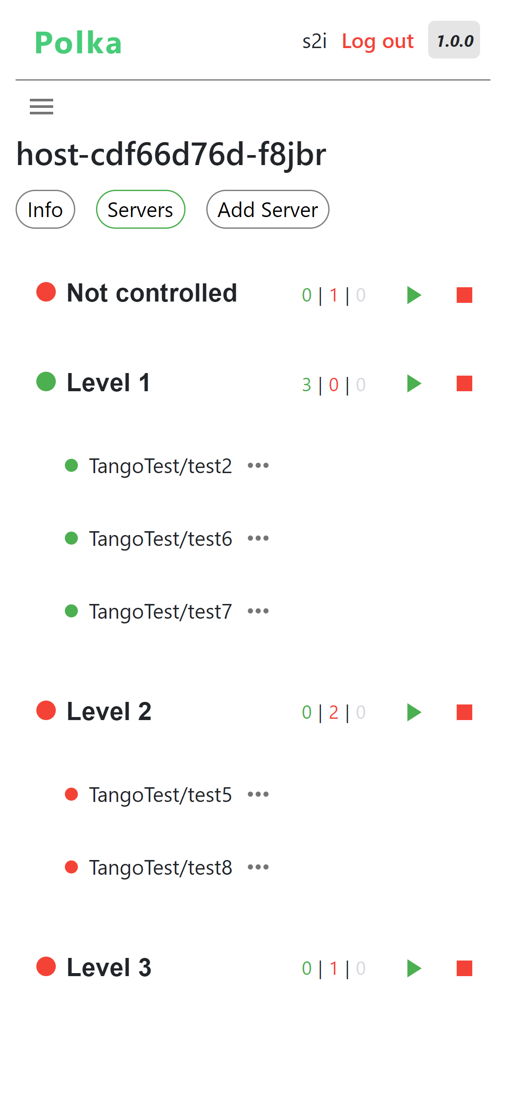
Mobile View

Slide 9
Demo time!

Slide 10
Future is bright
Make searching more user-friendly
Create shortcuts for frequently used stuff like Sardana
Add more of Astor functionalities
Integration with Taranta
User activity logs
Access to starter / devices logs

Slide 11
Thank you!

