Slide 1

Deployment of IC@MS
web-based alarm management software
www.s2innovation.com
contact@s2innovation.com
Jakub Kowalczyk

Slide 2
What is IC@MS?
IC@MS is a web-based application for the management of alarms:
Functionalities:
- add/edit/delete alarms
- reacting to alarm (Acknowledge, Reset, Disable)
- displaying the current state of the alarm system
- browsing historic data
- authentication and authorization (e.g. LDAP)
- admin panel
- alarm API
- supports different alarm providers (PyAlarm, AlarmHandler)

Slide 3
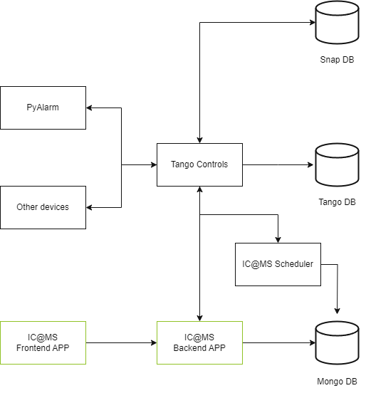
Architecture of IC@MS
Technologies:
- Frontend (JavaScript, React)
- Backend (Python, Flask)
- Scheduler(Python)

Slide 4
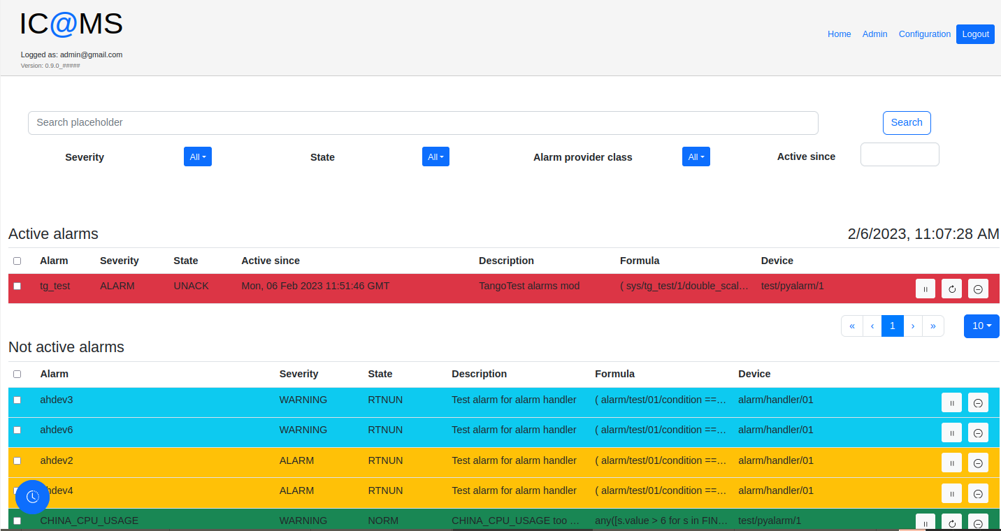
Home page

Slide 5
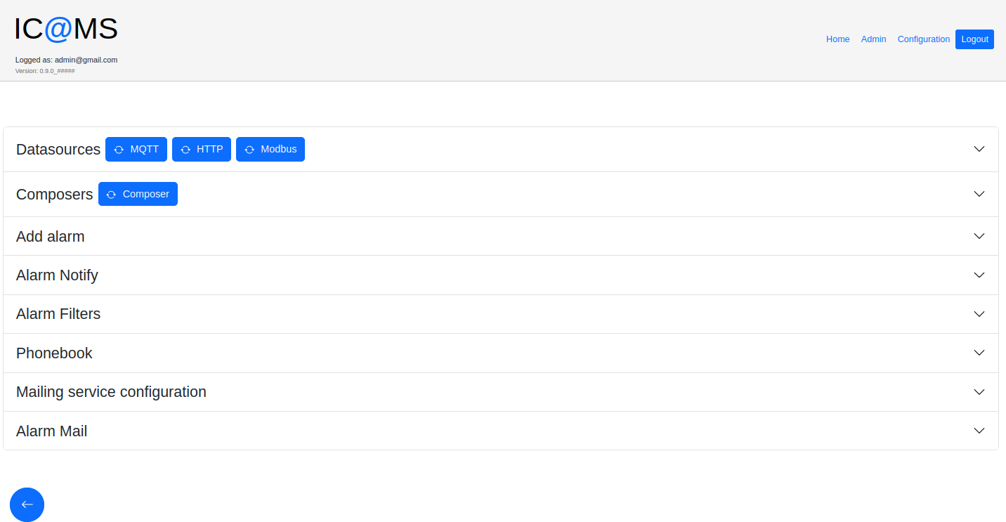
Configuration page

Slide 6
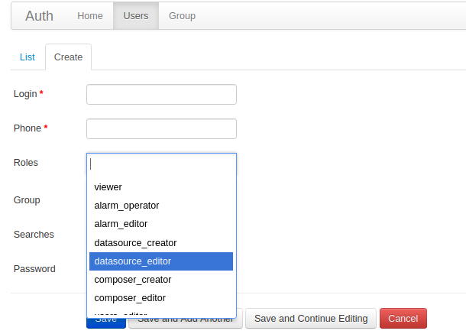
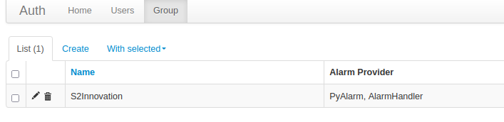
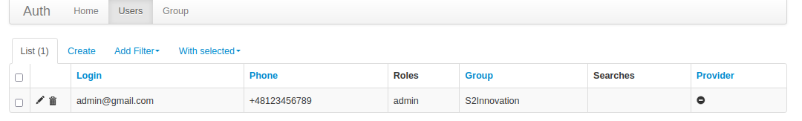
Admin panel

Slide 7

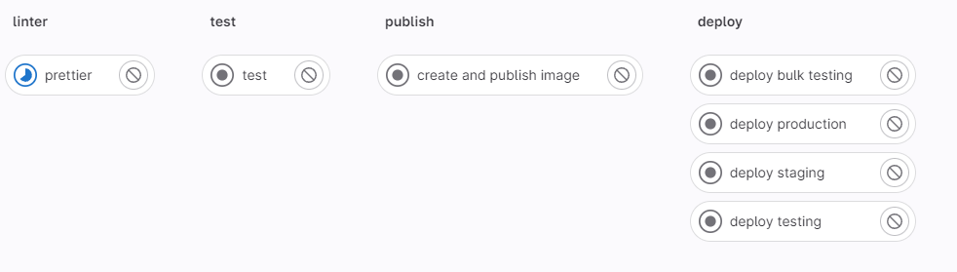
CI/CD pipeline
Increased Quality of Software
Improved Developer Productivity and Efficiency
Faster Feedback Loop
Reduced Risk

Slide 8
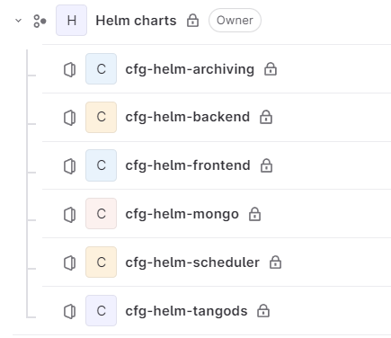
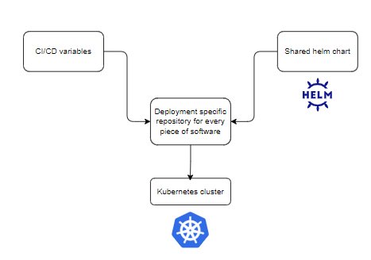
Helm charts
Simplifying Deployment
Parameterization
Consistency and Reusability
Community Support

Slide 9
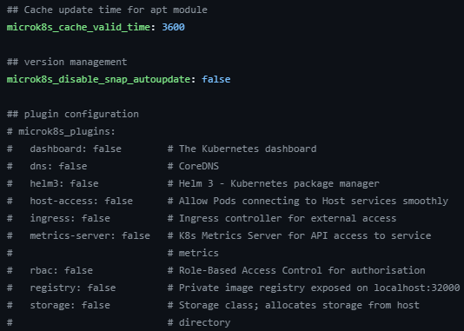
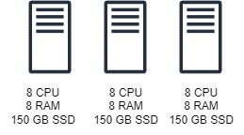
Our Kubernetes cluster
Created with Ansible Role galaxy.ansible.com/gepaplexx/microk8s
High availability

Slide 10
Thank you!

