Slide 1
TANGO Implementation of SKA Mid Dish Control Elements
37th Tango Community meeting
Samuel Twum
28 June 2023

Slide 2
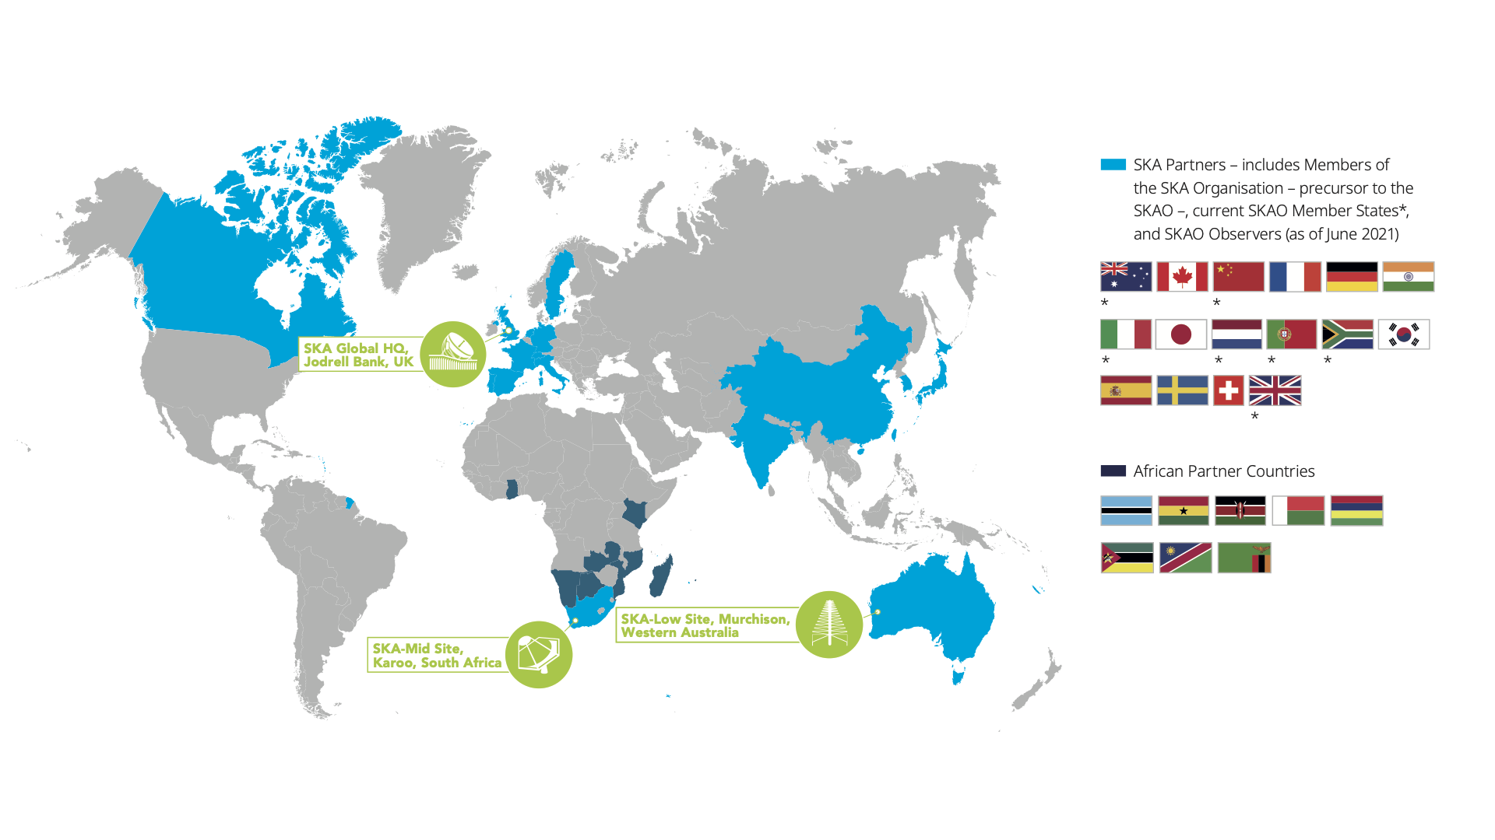
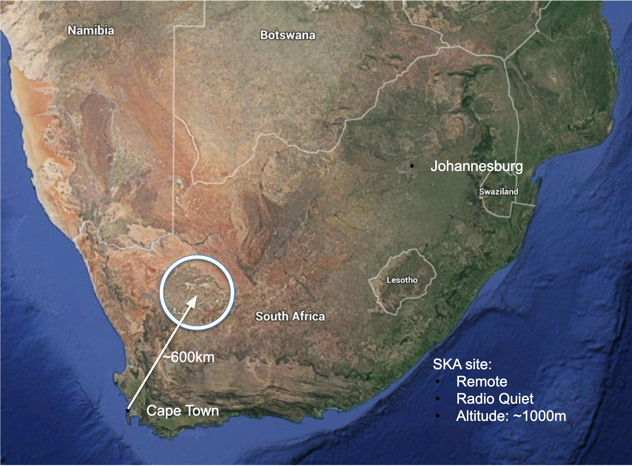
One Observatory, Two Telescopes, Three Continents
Image credit: SKAO website

Slide 3
SKA-Low Telescope
512 stations
50 MHz - 350 MHz
Maximum distance 74 km
Image credit: SKAO website

Slide 4
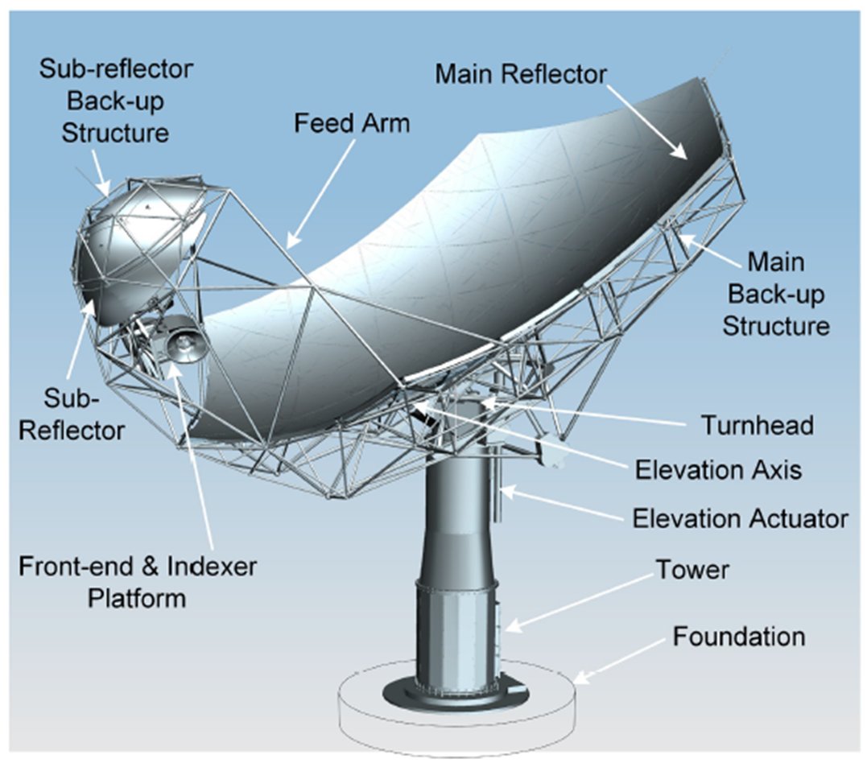
SKA-Mid Telescope
133 SKA 15m dishes
64 MeerKAT 13.5m dishes
Maximum baseline 150 km
Image credits: SKAO website

Slide 5
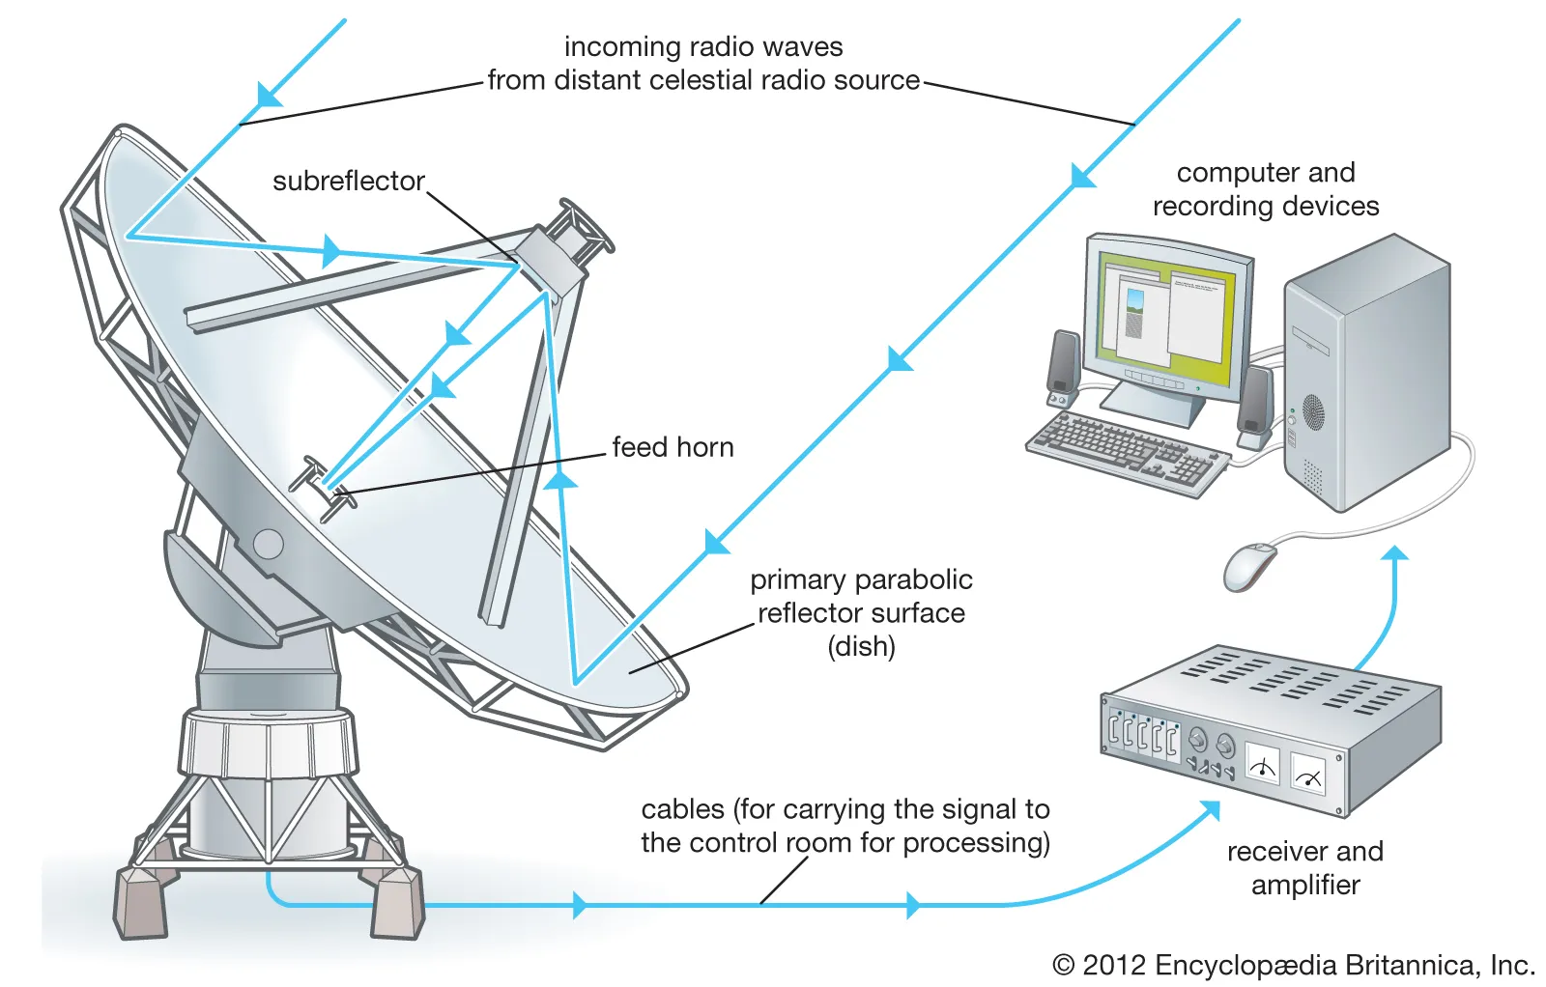
Dish: How does it work?

Slide 6
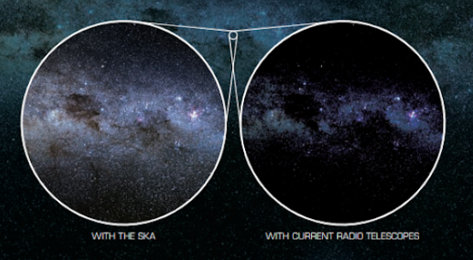
Two Element Array (Interferometer)
Better resolution
Image and video credits: SKAO website
Better sensitivity
https://www.skao.int/en/explore/

Slide 7
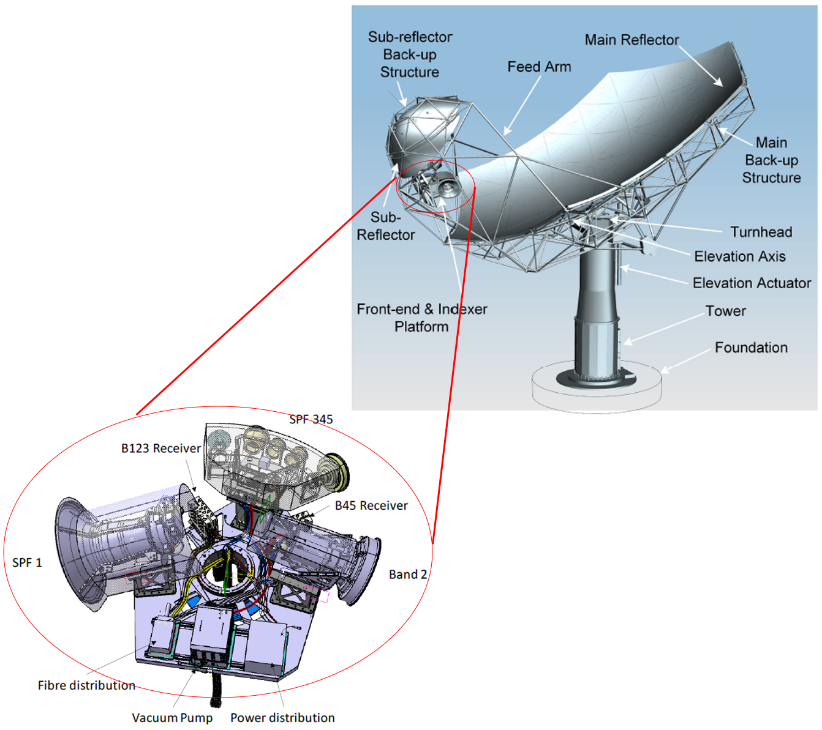
Dish Components
Dish Structure
Controller
Amplifiers, drives, encoders & limit switches for azimuth, elevation and feed indexer
Stow pin installation
Band 1 Single Pixel Feed (SPF B1)
Band 2 Single Pixel Feed (SPF B2)
Band 345 Single Pixel Feed (SPF B345(6))
SPF Controller
SPF Services (Helium & Vacuum Services)
Local Monitoring & Control (LMC)
Single Pixel Feed Receiver (SPFRx)
Indexer RF Sampler B123 (RXS123)
Indexer RF Sampler B45 (RXS45)
SPF
Image credit: Alice Pellegrini, SKAO

Slide 8
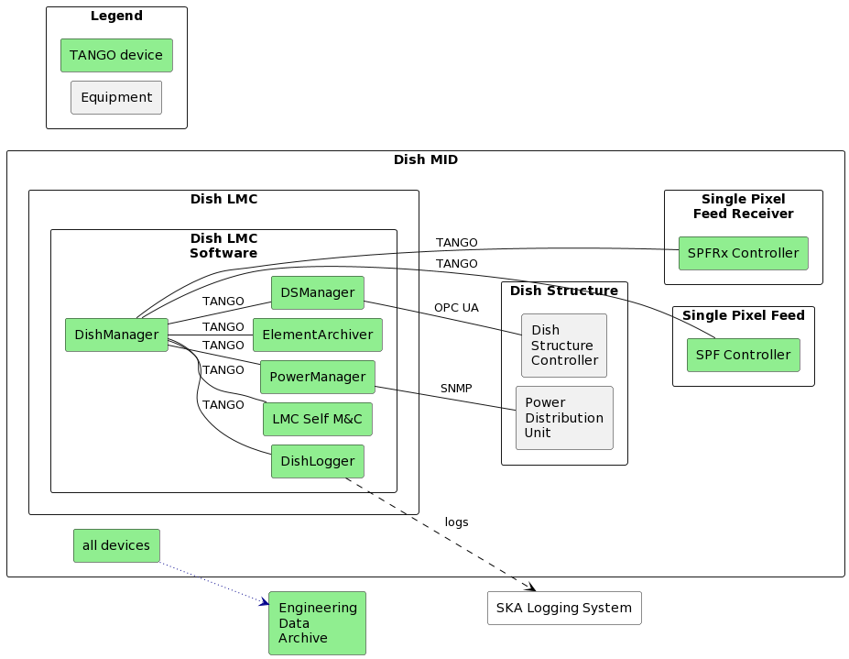
Mid Dish Software Architecture Overview

Slide 9
SKA Telescope Functional Overview
👨🏻‍🎤🧑🏽‍💻👨🏿‍🔬👩🏼‍🔧👷🏾 Telescope users
Observatory Science Operations
OSO Data Archive
PST_{oso}
PMT
ODT
OPT
OST
OET
SKA Regional Centres
Synchronisation and Timing
Telescope Monitor and Control
Engineering Management System
Engineering Data Archive
Central Signal Process
Science Data Processor
CBF
PST
PSS
VLBI
Visibilities, Pulsar Candidates, etc
Observing Data Archive
LOW
MID
Digitised, Packetised Data
Observational/processing requirements:
Observed data:
PST_{OSO} = Proposal Submission Tool, PMT = Proposal Management Tool, ODT = Observation Design Tool, OPT = Observation Planning Tool OST = Observation Scheduling Tool, OET = Observation Execution Tool, CBF = Correlator Beamformer,
PST = Pulsar Timing, PSS = Pulsar Search, VLBI = Very Long Baseline Interferometry
Image credit: SKA OMC Program Team

Slide 10
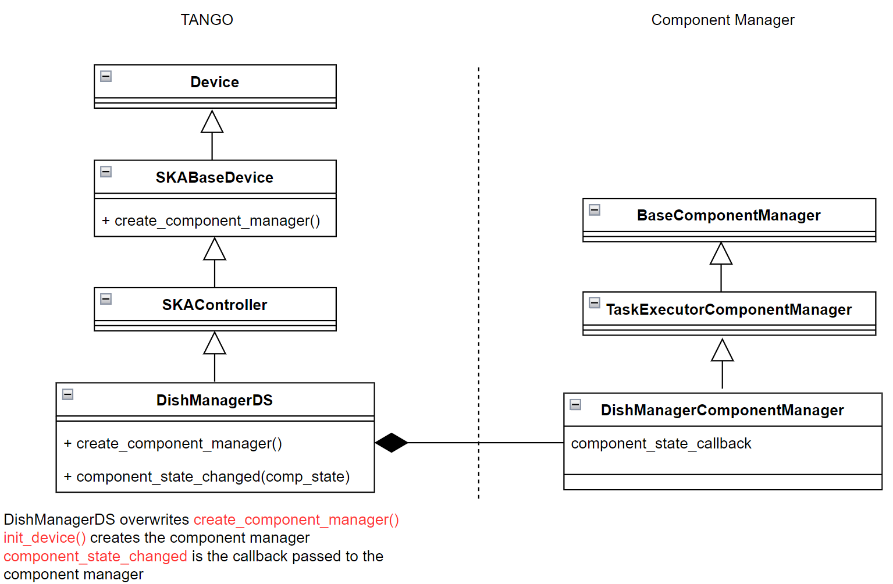
SKA Base Classes
SKABaseDevice
SKAController
SKAObsDevice
SKASubarray
SKAAlarmHandler
SKACapability
SKALogger
SKATelState
SKA-TANGO-BASE
SKA-TANGO-BASE
Visit SKA Tango Base repository for more details

Slide 11
SKA Base Classes
A shared repository which provides base classes to aid in the development of the Control System for the project
ensures consistently formatted logging across the system
enhances testing of business logic without spinning up TANGO infrastructure
implements a component manager which establishes and maintains communication, monitors and controls the component from within the tango device

