Slide 2
SOLARIS State Grid Web Migration
Council Chamber (SKAO), 28.06.2023
Joanna Wajda
SOLARIS National Synchrotron Radiation Centre

Slide 3
Agenda
Introduction of State Grid and United States applications
New version concept
Results of TangoGQL Interface tests
Initial Implementation of Frontend
Future Features

Slide 4
State Grid & United States

Slide 5
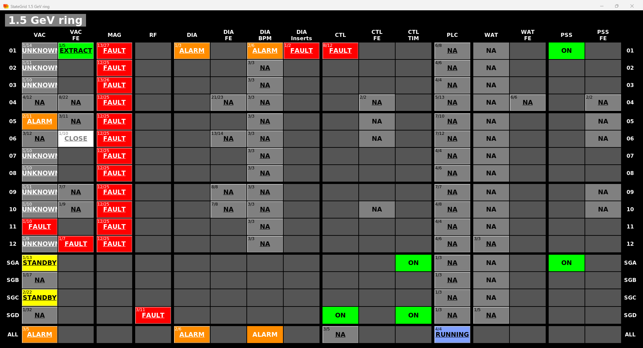
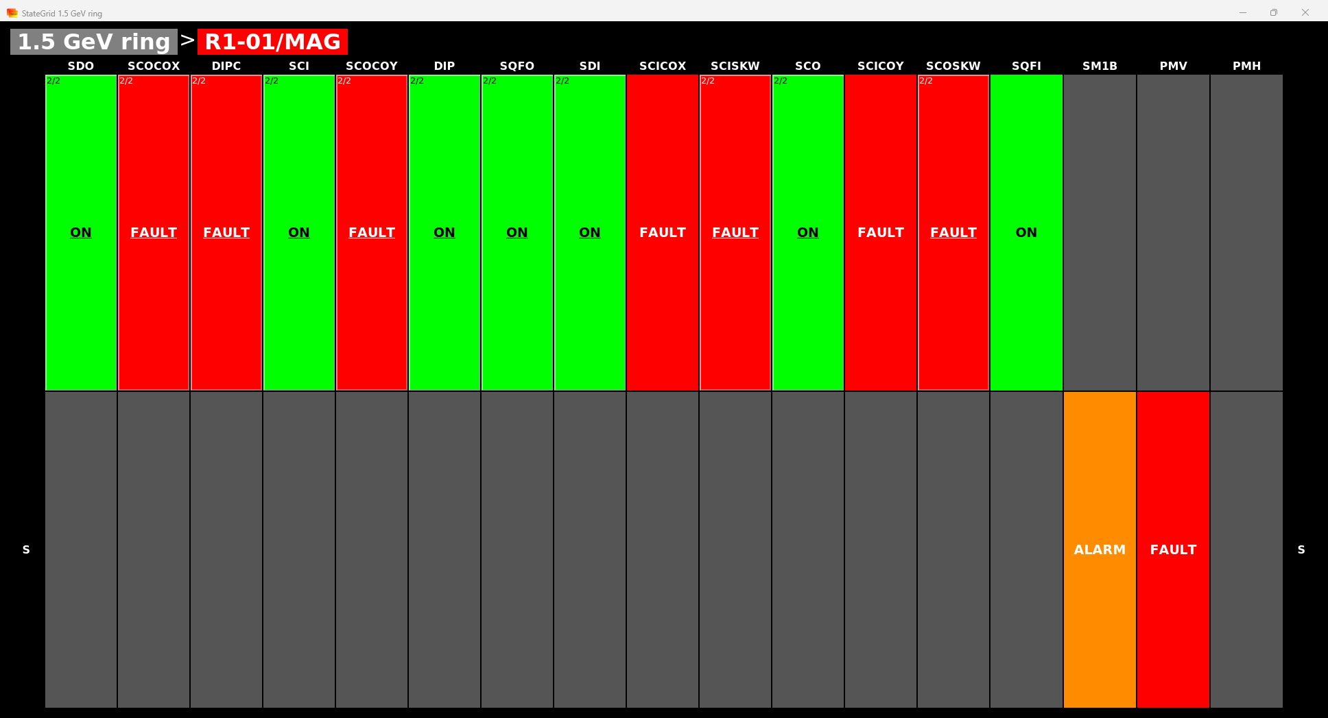
State Grid
Displays grouped states of the accelerator devices
Displayed state value is the most important state of the group
States are retrieved from the United States device

Slide 6
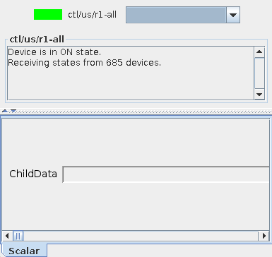
United States
Device which aggregates states of defined devices
Device has one string attribute – ChildData, which contains JSON encoded States of monitored devices
ChildData sends event at every device state change

Slide 7
New version concept

Slide 8
Concept of architecture
Web Client:
Request data about device states from Backend
Backend:
Constantly request states data from Tango GQL API
Generate configuration of grids and send them to Web Client
Read configuration from database (optional)
Database:
Store saved configs and another information for future features
Notes:
VUE: - reactive and easy state propagation via Vuex state management
Fast API:
- Avoide multiple sources of subcription -

Slide 9
Tests of TangoGQL

Slide 10
Performance tests single subscription
Testing setup:
Intel(R) Xeon(R) Gold 6126 CPU 2.60GHz
Memory DDR4 2933MHZ
Response time = elapsed time after request till reaching the first response
Vertical scaling makes no big difference,
all results in average differ from 2 to 3 ms

Slide 11
Performance tests bulk subscription
Still no benefits from vertical scaling in a given setup
Response time = elapsed time after request till reaching first response for all devices
Quite linear trend, which might suggest no parallel subscriptions within one bulk request – reasons?:
Tango?
TangoGQL implementation?

Slide 12
Performance tests chunk subscription
No performance gain while dividing subscription into parallel chunks.
It suggest, that there is no parallel processing between consecutive requests, at least until first result is obtained.

Slide 13
Performance tests chunk subscription
Horizontal scaling seems to has satisfactory results
We can get less than 3.5s or even less total response time for 1000 devices with reasonable number of instances

Slide 14
Initial Implementation of Frontend

Slide 15
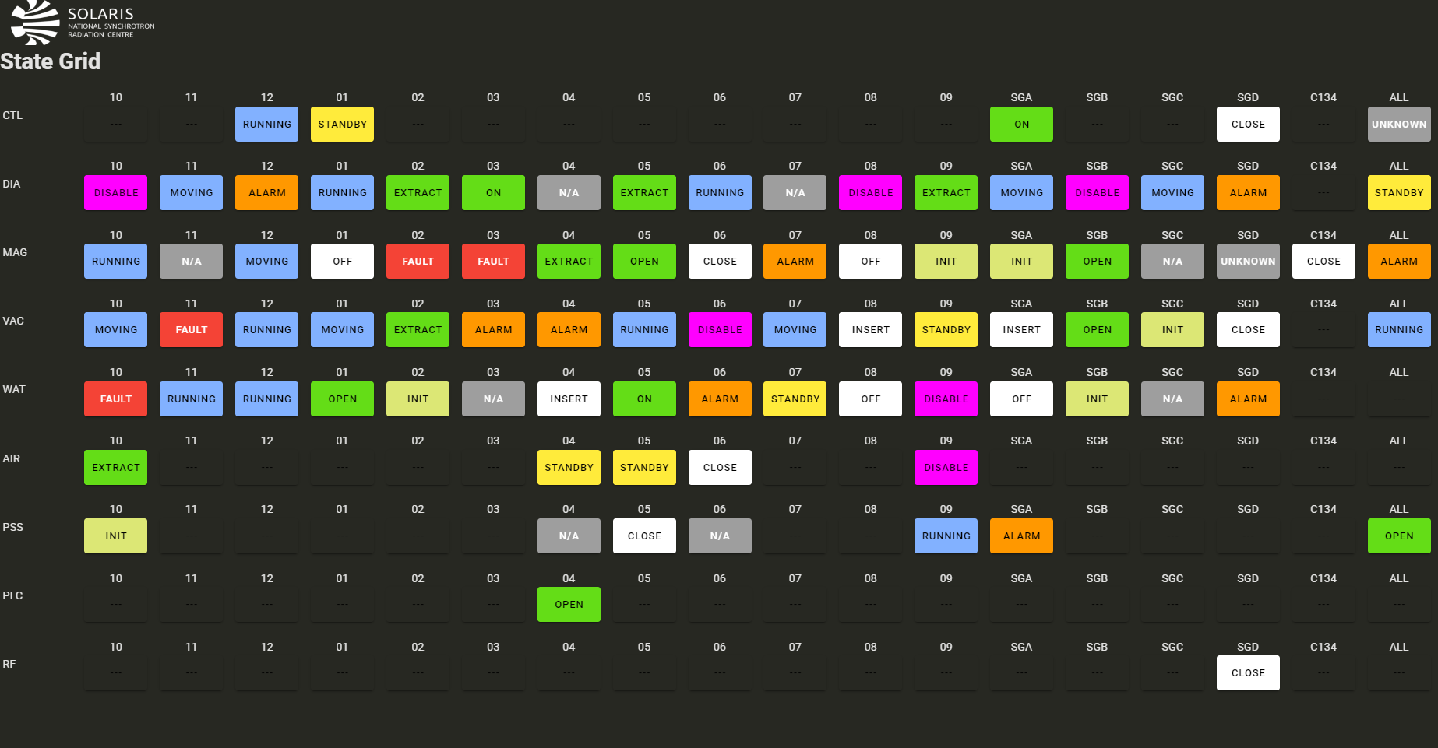
Initial Implementation of Frontend

Slide 16
Future Features
Configurable Dashboards
User Login
Device management from frontend app

Slide 17
Summary
Conclusions from tests – two option to load data faster:
Scale TangoGQL horizontally and divide subscription request into separate chunks
Additional backend service, which also offers additional functionalities
Web application provides the advantage of checking device status on any device, including mobile phones.

Slide 18
Thank you for attention
Joanna Wajda
SOLARIS National Synchrotron Radiation Centre
joanna1.wajda@uj.edu.pl

