Slide 1
PLC emulation for Tango Devices testing purposes
SKAO at Jodrell Bank, Cheshire United Kingdom, June 28th, 2023
Maciej Mleczko
SOLARIS National Synchrotron Radiation Centre

Slide 2
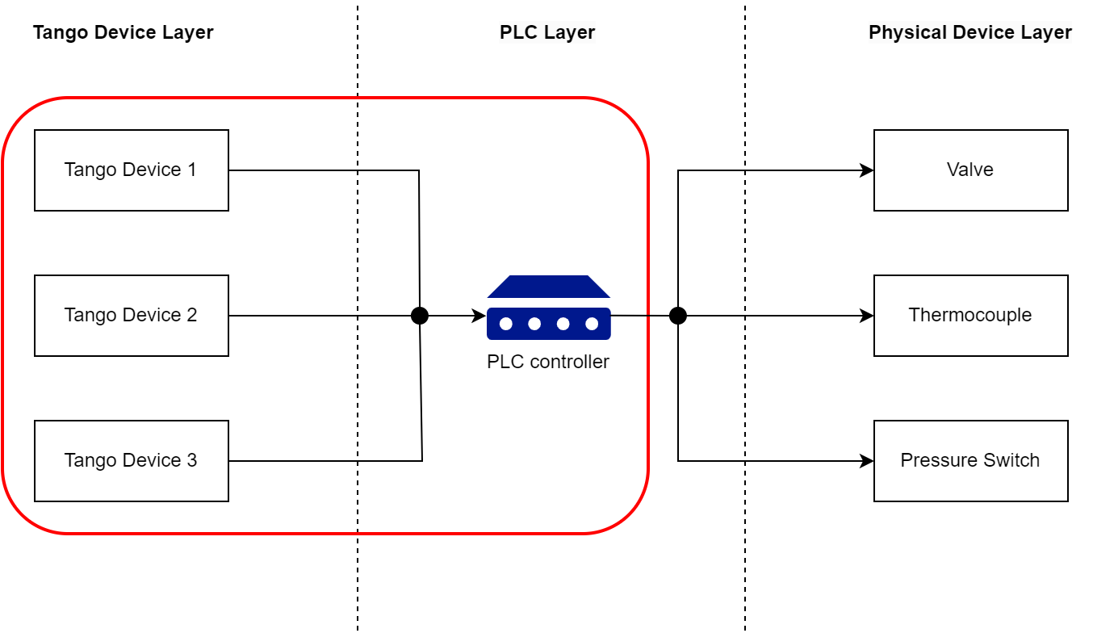
Introduction

Slide 3
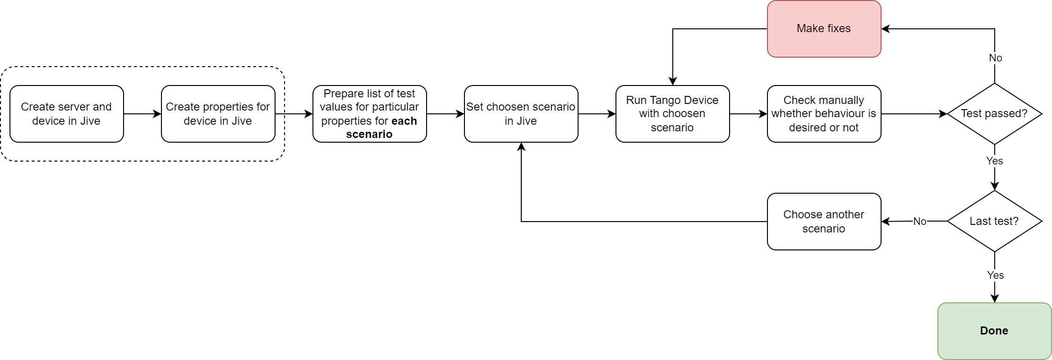
Current testing method

Slide 4
Current testing method
Few problems this method generates:

Slide 5
Current testing method
Few problems this method generates:
You can test only one scenario at a time

Slide 6
Current testing method
Few problems this method generates:
You can test only one scenario at a time
You have to manually change values of properties for each scenario

Slide 7
Current testing method
Few problems this method generates:
You can test only one scenario at a time
You have to manually change values of properties for each scenario
You have to remeber what went wrong and where

Slide 8
New testing method

Slide 9
New testing method

Slide 10
New testing method

Slide 11
New testing method

Slide 12
New testing method

Slide 13
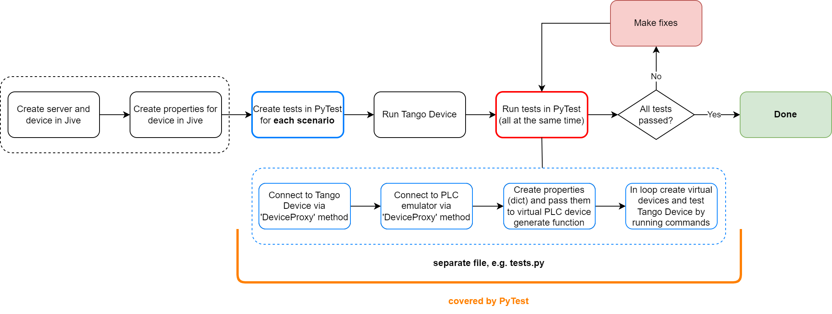
New testing method

Slide 14
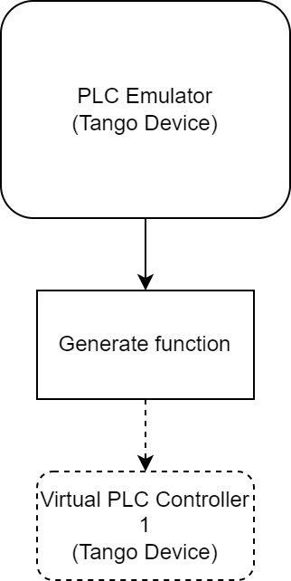
Emulation of PLC Controller – basic information
Theoretical assumptions:
PLC emulator is a separate Tango Device which shares an interface to generate virtual PLC devices

Slide 15
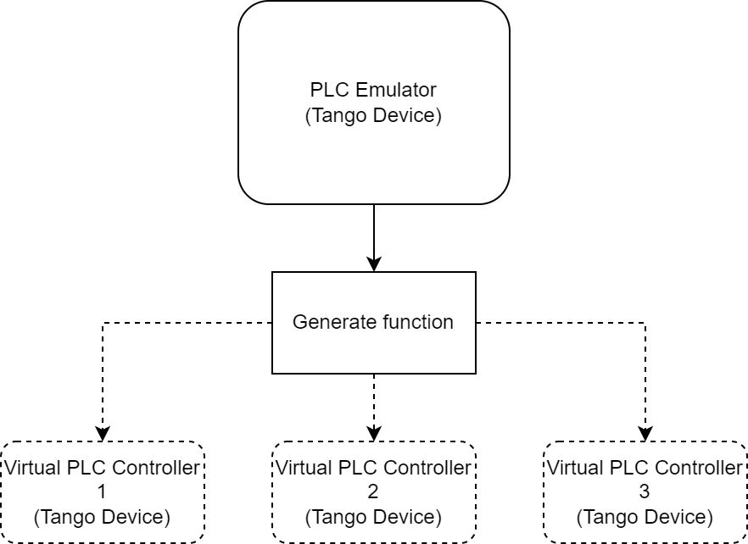
Emulation of PLC Controller – basic information
Theoretical assumptions:
PLC emulator is a separate Tango Device which shares an interface to generate virtual PLC devices (as many as developer needs)

Slide 16
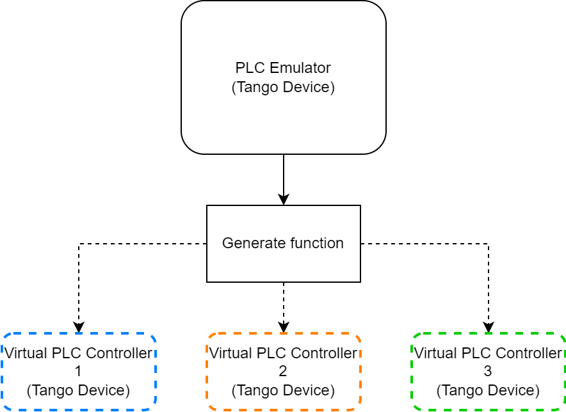
Emulation of PLC Controller – basic information
Theoretical assumptions:
PLC emulator is a separate Tango Device which shares an interface to generate virtual PLC devices (as many as developer needs)
Generated device emulate PLC controller (virtual device) which is connected to Tango Device tested by developer

Slide 17
Emulation of PLC Controller – basic information
Theoretical assumptions:
PLC emulator is a separate Tango Device which shares an interface to generate virtual PLC devices (as many as developer needs)
Generated device emulate PLC controller (virtual device) which is connected to Tango Device tested by developer
Developer can parametrize Virtual PLC device by passing dictionary with values for particular properties (different test scenarios) in generate function

Slide 18
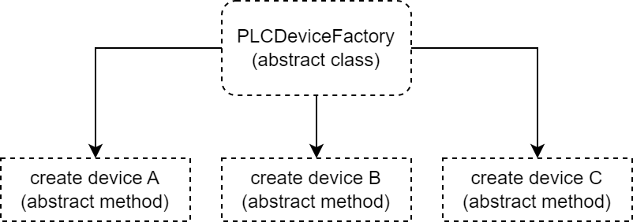
Emulation of PLC Controller – technical details
Theoretical assumptions:
PLC emulator architecture is based on Abstract Factory design pattern

Slide 19
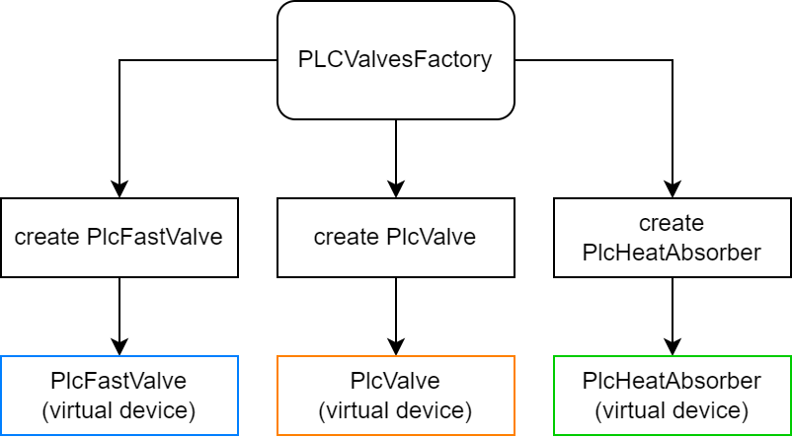
Emulation of PLC Controller – technical details
Theoretical assumptions:
PLC emulator architecture is based on Abstract Factory design pattern
Skeleton provides mechanism for producing concrete classes and producing concrete virtual devices

Slide 20
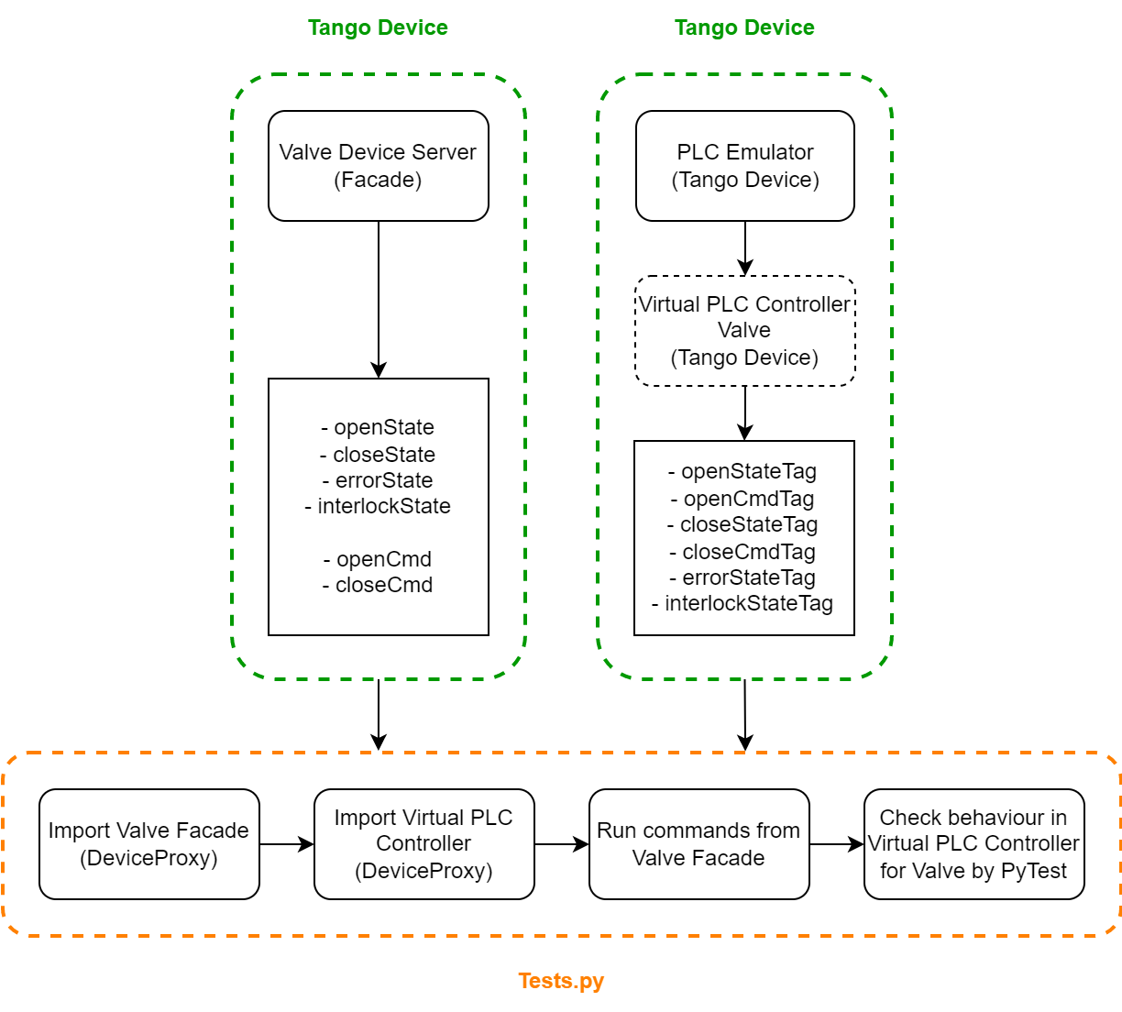
Example of testing Valve device

Slide 21
Summary
Current testing method
Performing tests immediately
Time consuming in next phases
Not scalable

Slide 22
Summary
Current testing method
Performing tests immediately
Time consuming in next phases
Not scalable
New testing method
At the beginning require more time to prepare tests
Scalable for higher amount of tests and larger projects
Performing all prepared tests at the same time

Slide 23
Thank you!

