Slide 1
cppTango: What's new?
9.4.2, 9.3.6 (LTS) and everything else (10.x)

Slide 2
cppTango: Fixed release cycles (refresher)
10.0:
10.0.0 to be released on 2023-10-02
9.4:
9.4.0 released on 2022-09-30
9.4.1 released on 2023-02-23
9.4.2 released on 2023-06-19
9.3.6 (LTS)
released on 2023-04-02
9.3.x in maintenance mode
Currently no further release planned
Critical bug fixes only
No backporting of new features
No new features
© Gary Larson

Slide 3
Development Branches (refresher)
main | 9.3-backports
Future: cppTango 10.x | (9.3.x LTS branch)
Requires C++14 (at least) Requires CMake 3.18 | Does not require C++11 (Can be compiled on old compilers but might need a more recent CMake version)
Not binary compatible: neither with cppTango 9.3.x nor with cppTango 9.4.x | Binary compatible with cppTango 9.3.x
Gitlab CI: Debian 11 and 12, 12-cross-32bit Alpine Ubuntu 20.04 LLVM (16)/GCC (13.1) Clang-tidy, clang-analyzer Sanitizers (ASAN, TSAN, UBSAN) | Gitlab CI: Debian 7 (c++=*), 8 (c++=*), 9 (c++=*) and 10 (c++=* and c++98) (frozen) *=distribution default Alpine GCC (8.3.0, frozen)
Appveyor: win32 and x64 msvc 15 | Appveyor: win32 and x64 for msvc9, msvc10, msvc12, msvc14 and msvc 15

Slide 4
cppTango 9.4 - Changes
Please refer to RELEASE_NOTES.md in the repository!
👉 Release notes
Major improvement when compared to 9.3:
Event subscription and publishing possible across isolated container networks
👉 cppTango 9.4 is cloud native 😉

Slide 5
cppTango 9.4.2 - Bug Fixes
A regression introduced in cppTango 9.4.1 was preventing to specify an omniORB endpoint with an empty hostname. (#1055)
MacOS support has been improved (!1072,!1094],!1079,!1056)
When using Group::write_attribute, a bug could prevent client/server connection if the server was started after the client (#906)

Slide 6
cppTango 9.3.6
Latest cppTango 9.3 LTS release:
9.3.6, released 2023-04-02
(Remember: 9.3 LTS supports ends 2027-10-02)

Slide 7
cppTango 9.3.6
It is now officially possible to extract the DEV_STATE attribute multiple times from a DeviceAttribute object (!943,#845)
The device server programmer can now use the DeviceImpl::get_client_ident() method to get information on the client (!1055,#801)

Slide 8
cppTango 9.3.6 - Main Bug fixes
Event data corruption could occur with big spectrum or image attributes when a device server was exporting several devices (!1069,#1007,#684)
Restore event subscriptions after device server rename and restart (!1052,#679)
A crash could occur when reading a DevString RW Scalar Forwarded Attribute (!914,#512)
A Segfault could occur in db API when using alternate casing for "DServer" class (!960,#893)
Fix group write_attribute connection problem when server starts after client (!961,#906)
The interface event stateless subscription can now succeed as expected with non reachable device (!860,#750)
Device Servers should now always exit as expected when receiving the SIGTERM signal (!1054,#927)
Case sensitivity bug for class attributes property (!1070,#1085)
Allow users to select C++ standard (!928). There was a regression preventing users to use c++98 standard
Use Expected omniidl When TANGO_OMNI_BASE Is Given (!994,#971)
"Suspected bug in devapi_pipe" (!954,#925)

Slide 9
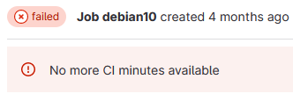
Gitlab Runners
gitlab.com changed the rules in the way to count the CI Minutes
We switched to our own Gitlab Runners
Many thanks to all the institutes who contributed some runners
Still some performance issues to be solved

Slide 10
Known issues elsewhere (a.k.a. dependencies)
We are aware of a couple of problems or defects in software that cppTango depends on:
omniORB <= 4.2.5, <= 4.3.0
Defect on macOS aarch64 (aka Apple M1/M2)
Will be fixed in the next 4.2 and 4.3 releases
libzmq == 4.3.3 and 4.3.4
Handshake timeout error with ZMTP_2_0
Fix in libzmq > 4.3.4 (to be released, no release date)
libjpeg-turbo (used since cppTango 9.4.0)
General quality regression with identical quality settings when compared to libjpeg
Not a bug! Result of the faster implementation of libjpeg-turbo.
Fix: Adjust your quality settings (and store them as a property or as an attribute 😉).

Slide 11
The future is brighter than ever: cppTango 10.0.0 and later
The next cppTango release will be
cppTango 10.0.0
To be released on 2023-10-02
Will require omniORB >= 4.3
Planned major features for 10.0.0 (details in IDLv6 talk):
New alarm event
Enhanced logging system with tracing of command calls
Warning and alarm hysteresis
New DevInfo_6 with version information
Outlook/planned for cppTango 10.x (details in IDLv6 talk):
New datatype DevDict
Multi-parameter commands
Multi-dimensional arrays

Slide 12
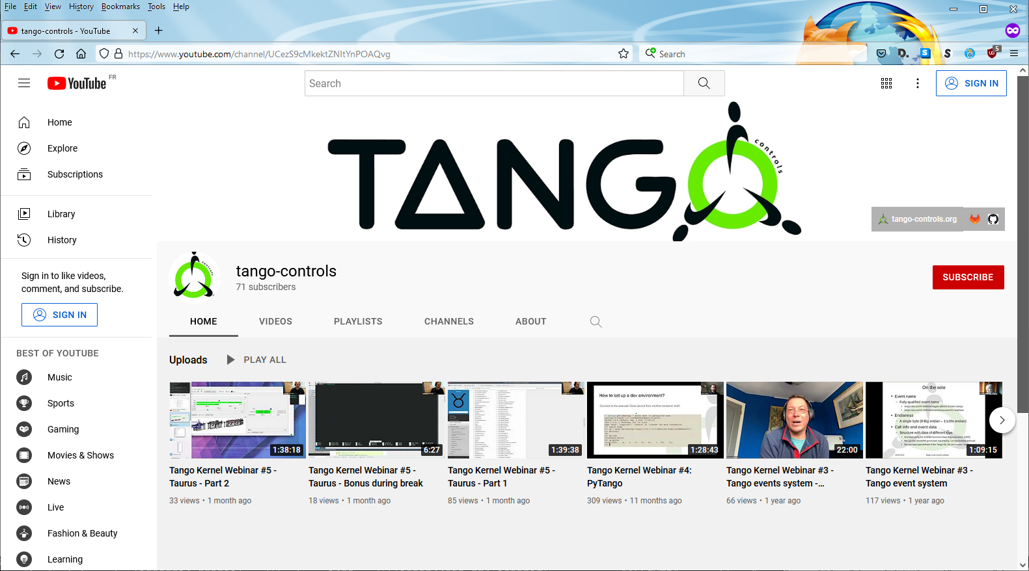
Tango Kernel Webinars
Video recordings available on tango-controls YouTube channel:
https://www.youtube.com/channel/UCezS9cMkektZNItYnPOAQvg
Notes:
Goals
•Share the knowledge on the Kernel Code
•Help/Guide first contributors to the Kernel Code

Slide 13
Tango Controls Telecon Meetings
Kernel
On 2nd and 4th Thursday of the month at 15:00h (CET/CEST)
Agenda and minutes available on Gitlab: tango-kernel-followup
Status of recent development (cppTango, JTango, pyTango, POGO, RFCs, …)
Technical discussions
Define priorities
cppTango
Every Thursday, 14:00h (CET/CEST)
Prioritising issues
MR discussion
Feature discussion and prioritisation
Notes:
Goals
•Share the knowledge on the Kernel Code
•Help/Guide first contributors to the Kernel Code

Slide 14
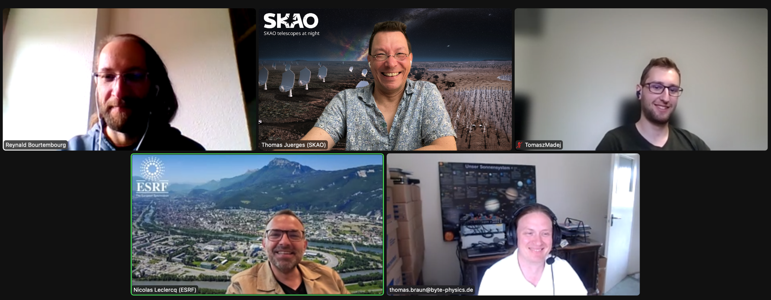
Meet the cppTango team
A random photo from our telecon. Top row from left to right: Reynald Bourtembourg (ESRF), Thomas Juerges (SKAO), Tomasz Madej (S2Innovations) Bottom row from left to right: Nicolas Leclercq (ESRF), Thomas Braun (byte physics e.K.) Weekly meetings can be fun! Please join us.

Slide 15
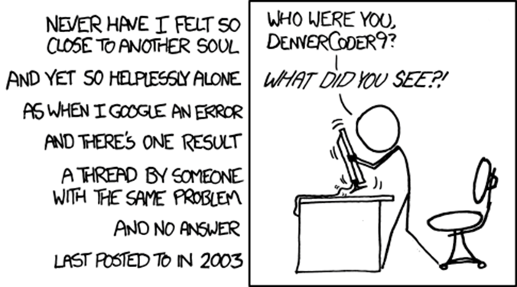
Tango-Controls Forum

Slide 16
Tango-Controls Slack cppTango Channel
You can also get some help from the experts on https://www.tango-controls.org/community/slack/

Slide 17
This is the last slide (Yes, really!)
Thank you!
Any questions?
Acknowledgement (in alphabetic order):
Benjamin Bertrand, Damien Lacoste, Grzegorz Kowalski, Jack Yates, Kieran Mulholland, Michal Liszcz , Nicolas Leclercq, Piers Harding, Reynald Bourtembourg, Thomas Braun, Thomas Ives, Thomas Juerges, Tomasz Madej
and so many others for their contributions (PR, bug reports, code reviews, comments, …)
https://gitlab.com/tango-controls/cppTango/-/milestones
https://gitlab.com/tango-controls/cppTango/-/issues
https://gitlab.com/tango-controls/TangoSourceDistribution/-/issues

