Slide 2
Device Server to SIP POWER Ion Pump Controller
37th Tango Community meeting SKAO Jodrell Bank, 27-29.06.2023
Mateusz Floras
SOLARIS National Synchrotron Radiation Centre

Slide 3
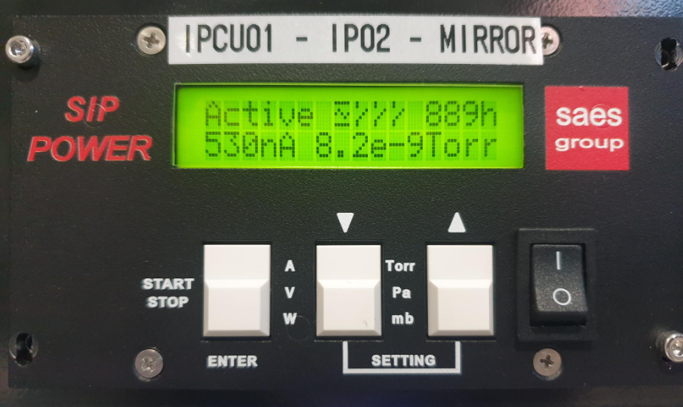
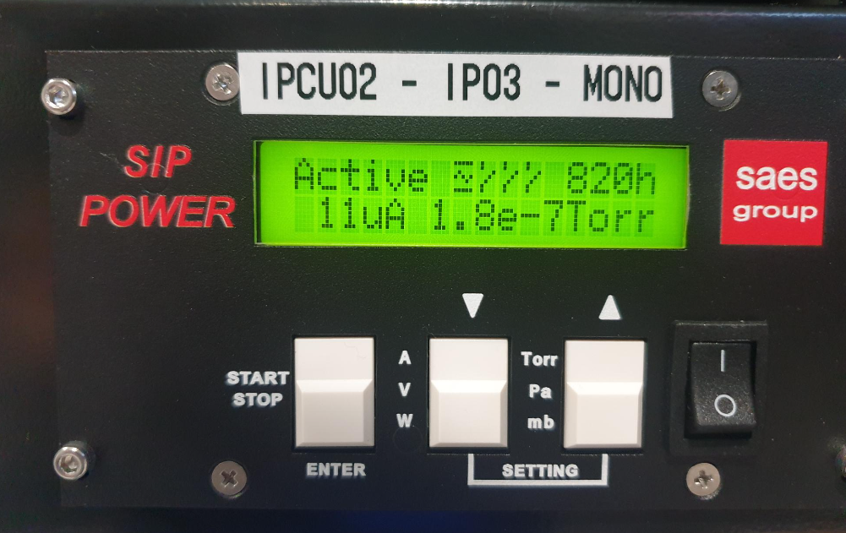
INTRODUCTION
SIP POWER is the power supply that controls the ion pump of NEXTorr family.
NEXTorr pumps combine in a very compact and unique design Non Evaporable Getter (NEG) and ion pump
technologies.

Slide 4
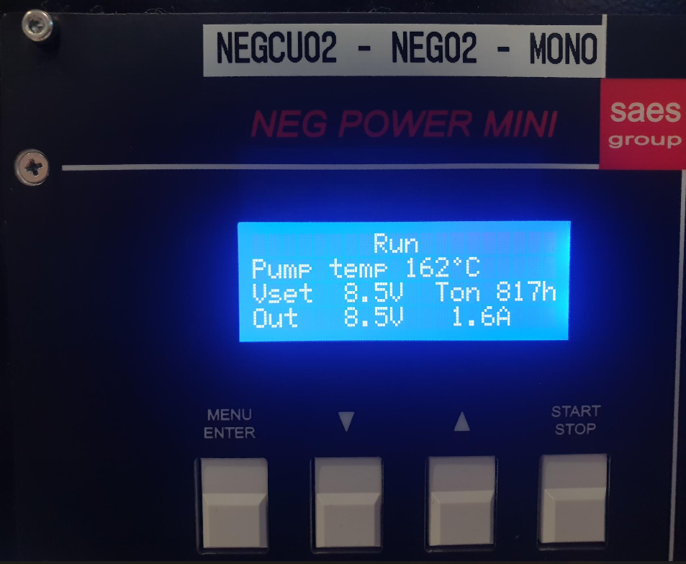
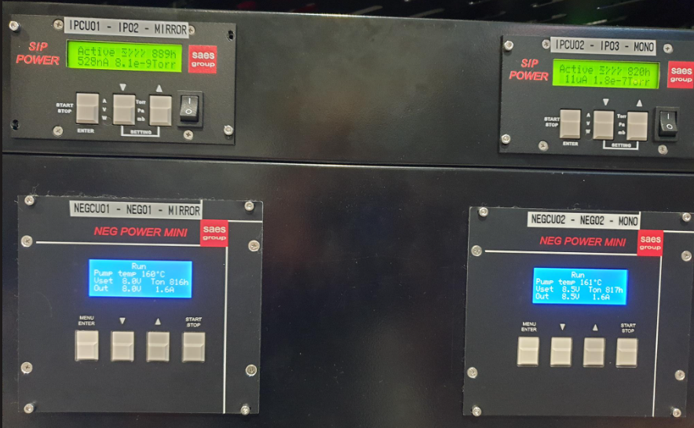
NON EVAPORABLE GETTER
The term "non-evaporable" refers to the fact that the getter material does not evaporate or sublimate at normal operating temperatures
It remains solid and stable, allowing it to maintain its gas absorption properties over long periods without depleting or losing effectiveness

Slide 5
WORKING MODES
1. Simple working mode:
1 treshold
If the current is smaller than preset threshold, the indicator on the display and the output switch of related comparator opens contact on output until current value does not go over threshold value
Otherwise output contact is closed
2. Window working mode
2 thresholds (min and max)
If the current is between preset min threshold and max threshold values the state of the indicator and output switch of related comparator on output connector causes the closing of the output connector’s contact
Otherwise output contact is opened

Slide 6
SWITCHES MODES
Working modes are selected in the controller using three available switch modes:
Switch 1 contains only the simple working mode
Switches 2 and 3 contain both the simple and window working modes

Slide 7
CONNECTION
Connection with device is released using Asynchronous Modbus TCP Client from PyModbus 2.5.3
Host IP address is mandatory
Port numer is optional

Slide 8
ASYNC IO IN PYTHON
corutine - a programming construct that allows code to be paused and resumed at specific points, enabling efficient execution of concurrent or asynchronous tasks (functions whose executions you can pause)
asyncio library
async/await syntax to write corutines
async def statement to define functions
await to run corutine
Asyncio green mode from PyTango

Slide 9
READING AND WRITING VALUES
values contained in particular registers have different number of bits
read_holding_registers method to read values using 3 parameters: address, count and unit
write_registers to set values in the registers using 3 parameters: address, value/s, unit

Slide 10
LOGICAL SHIFT
Values directly read from registers need to be transformed by a logical shift operation
Example:
SW2 min threshold = 100 000 nA
Values in two 16 bits registers: 1 and 34 464
We use logical shift operation:
1 << 16 + 34464 = 100 000
To write values to registers the inverse operation is required:
100 000 >> 16 = 1
Values needed to write registers: 1 and 34464

Slide 11
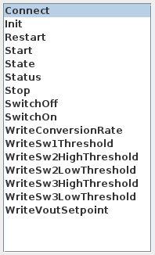
COMMANDS
Connect device
Start/Stop/Restart
Switch On/Off
Set modes tresholds
Set conversion rate
Set Vout set point

Slide 12
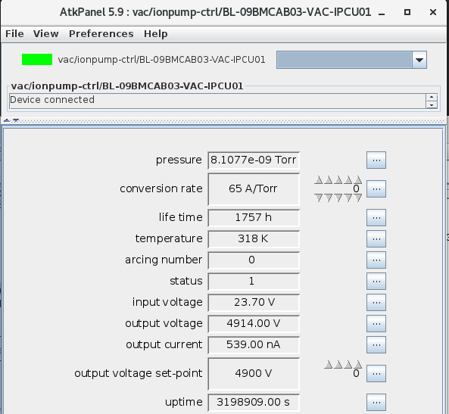
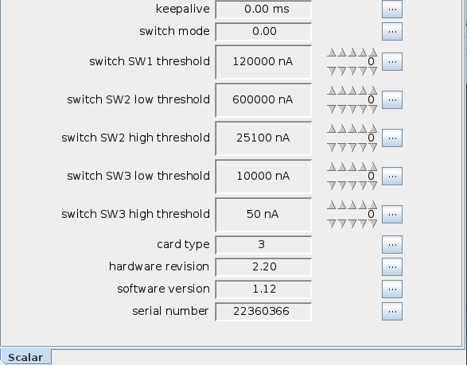
ATTRIBUTES READING

Slide 13
PRESSURE READING
Firstly it is needed to read output current and conversion rate defined by user.
Then pressure can be calculated by dividing the output current by conversion rate:
$p= \frac{Iout}{Conv}$;
where conversion rate value is in the range 1 to 200 A/Torr.
The smallest value of pressure is 8.6957e-12 Torr.

Slide 14
FIXES AND DEVELOPMENT
Simplified way of setting switch modes
Fixes for attributes reading
Alarms
Interlock alarm blocks the controller

Slide 15
Thank you for your attention!

