Slide 1
Apollon Control System Status
Tango meeting 2023-06-27
Stéphane Marchand
Laboratoire pour l’Utilisation des Lasers Intenses

Slide 2
Overview
Facility
Team
Key figures
Network improvements
Tango system, diagnostics
Archiving system
Summary

Slide 3
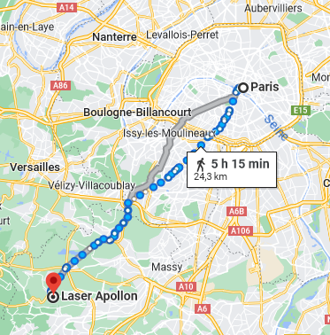
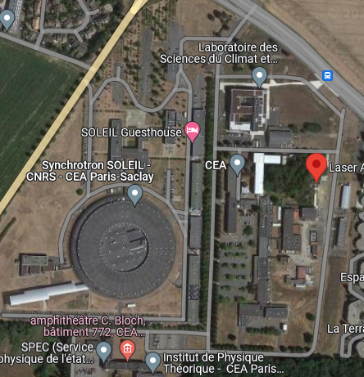

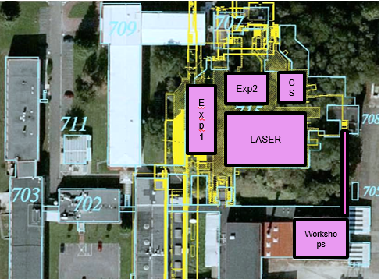


Localization, Apollon building
LULI (High intensity laser laboratory); site : “L’Orme des Merisiers” (25km from Paris, 5km from X) but also 2 facilities on X campus (LULI2000 & HERA, Tango too)
Underground
Heavy shielded installation
Laser : 700 m² (cleanroom)
Exp1 (long focal) : 420 m²
Exp2 (short focal) : 210 m²
Control rooms : 200 m²
Workshops : 480 m²
Offices : 300 m²

Slide 4
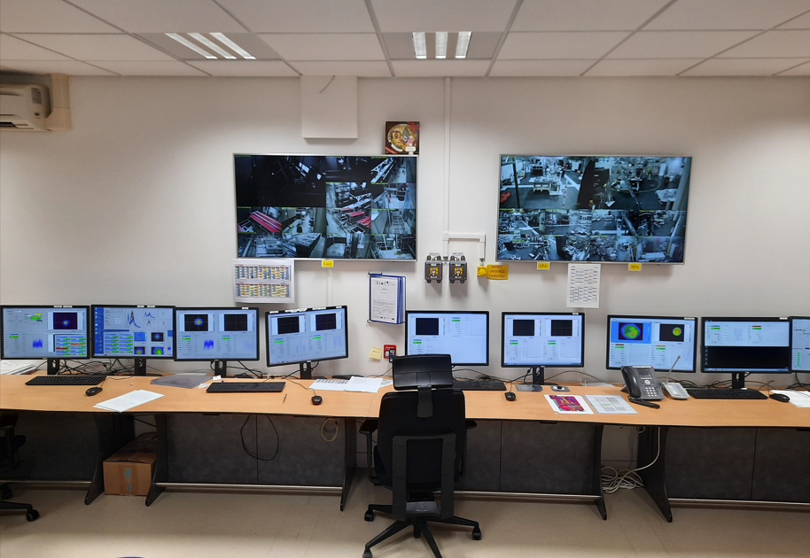
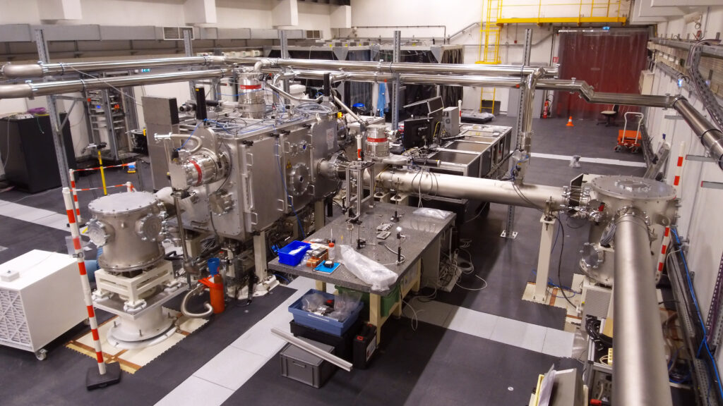
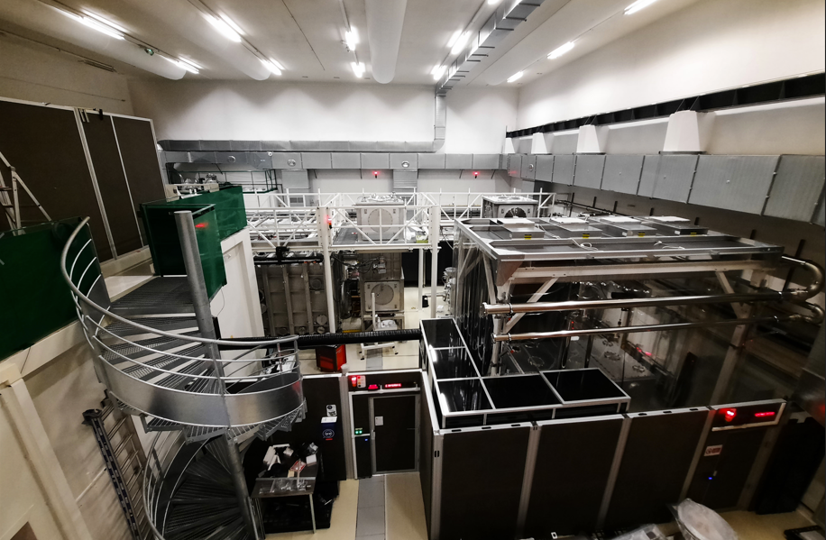
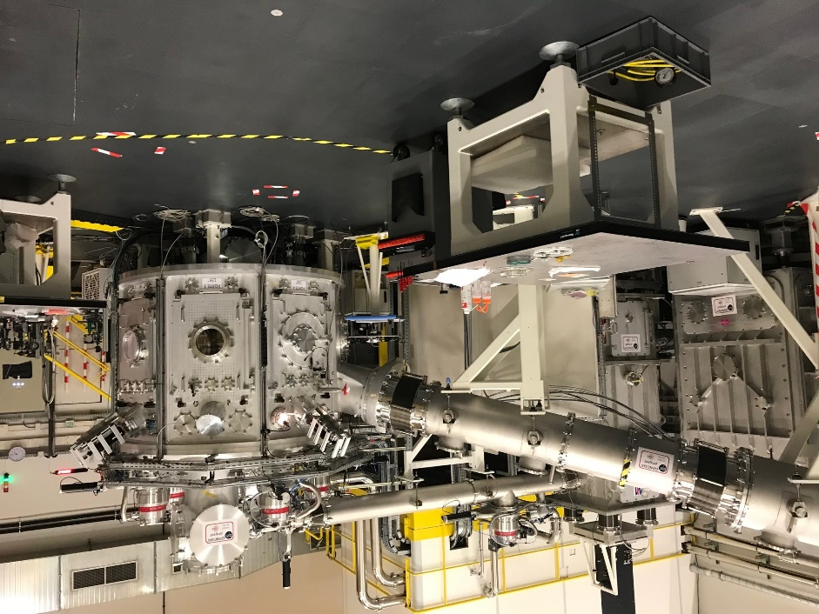
Inside Apollon
Control room
Long focal Area (420 m²)
Compression and switchyard laser subsystem
Short Focal Area (210 m²)
<link for a 3D Virtual tour>

Slide 5
Milestones
Reappointment of the French nuclear safety authority (ASN) authorization until the end of 2027
Third year in operation : > 10 experimental campaigns
2023: main laser beam (40cm diam.) commissioned
  Two beams in operation : 1PW and multiPW
  First qualification multiPW experiment in Short Focal Area w/ more than 2PW on target, on the multiPW roadmap (2024: 4PW; 2025: 8PW)

Slide 6
Command-Control Team (C2S)
(currently playing w/ Tango)
Jean-Luc Bruneau
Laurent Ennelin permanent positions
Stéphane Marchand
Maguette Sow, 2nd year Engineer apprentice (until mid-2024)
Sonia Minolli (since end of 2021 as service w/ Nexeya then fixed-term contract w/ LULI) who came with super-strong quality code skills

Slide 7
Key figures
Devices in operation | April 2019 | April 2021 | December 2022 | Updated Estimation
Hypervisors | 7 | 7 | 6 | <8
Virtual Machines | 33 | 49 | 54 | 60
Control stations | 18 | 41 | 43 | ~50
CCD: laser beam CCD: plasma diag CCD: live exp. setup | 42 | 59 12 8 | 62 12 8 | ~80 12(*) 8(*)
Calorimeters | 16 | 18 | 19 | >20
Motor channels: laser Motor interaction chamber Motor: diagnostics | 66 | 93 25 ~15 | 100 ~50(*) 20 | 120 ~60(*) 30
Delay generators | 10 | 12 | 12 | ~14
* : Depending on campaigns

Slide 8
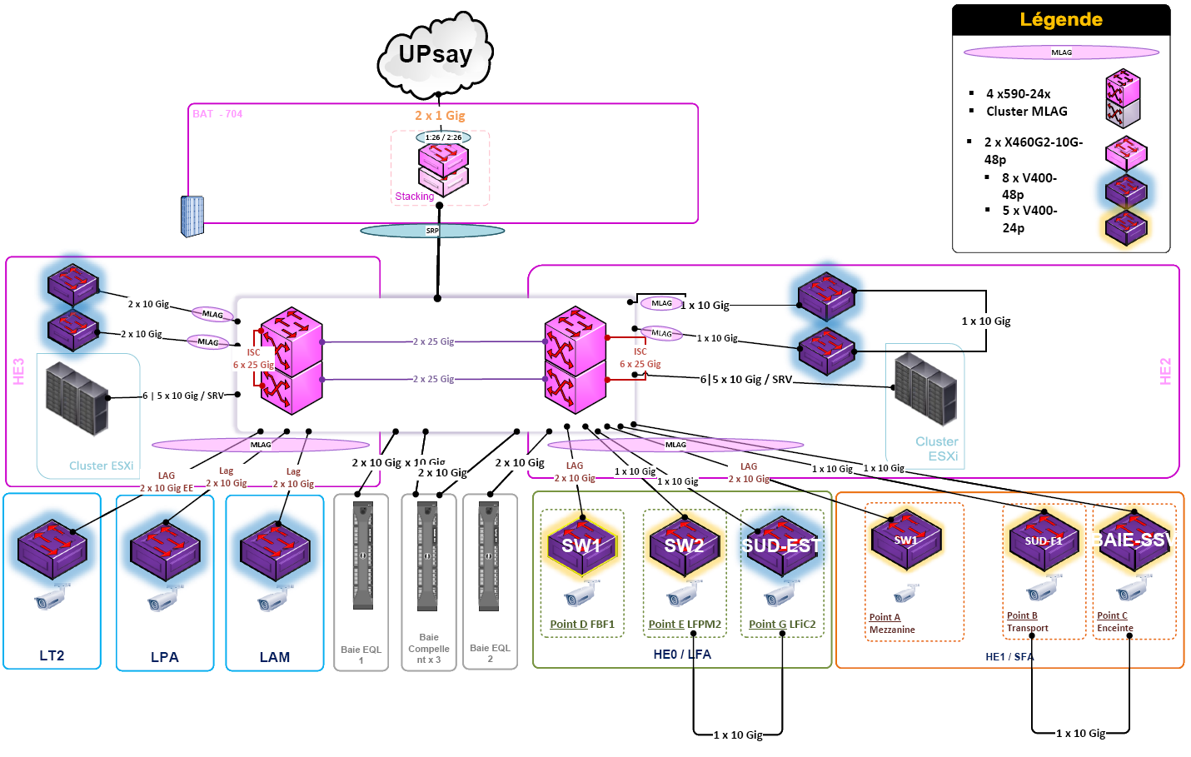
2021 Network and VM Upgrades
LULI @EP
2 cores <=> 4 x 25Mbps
10Gbps Redundancies

Slide 9
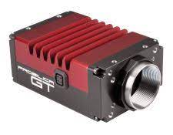
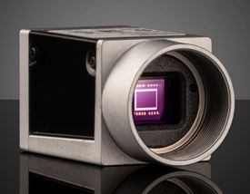
Network separation
In short: redundancy 10-Gbps everywhere w/ separation of cameras' flux
Updated from "office software" version w/o any redundancy from 2015 (see extra slide)
VM
server
C2S
VMware v6.0.0
~80 VM
…
…
2515
…
…

Slide 10
Versions
C2S Devices | Vacuum Devices (Soleil)
64-bit Windows 10 Python 3.8 Tango 9 PyTango 9 NI LabView 2022 Currently updating to 64-bit Windows Server 2022 Datacenter on vSphere web client | 64-bit Linux Ubuntu 14.04 LTS 6 Tango 9 NI LabView 2016
Archiving | GUI
Linux Ubuntu 20.04 LTS Tango 9.3.4 HDB++: Devices version 2.0.0, GUI Configurator version 3.1.1 BDD: MySQL | Windows 7 32 bits Python 2.7 Tango 8 PyTango 8 PyQt 4.8 Currently updating as C2S Devices servers

Slide 11
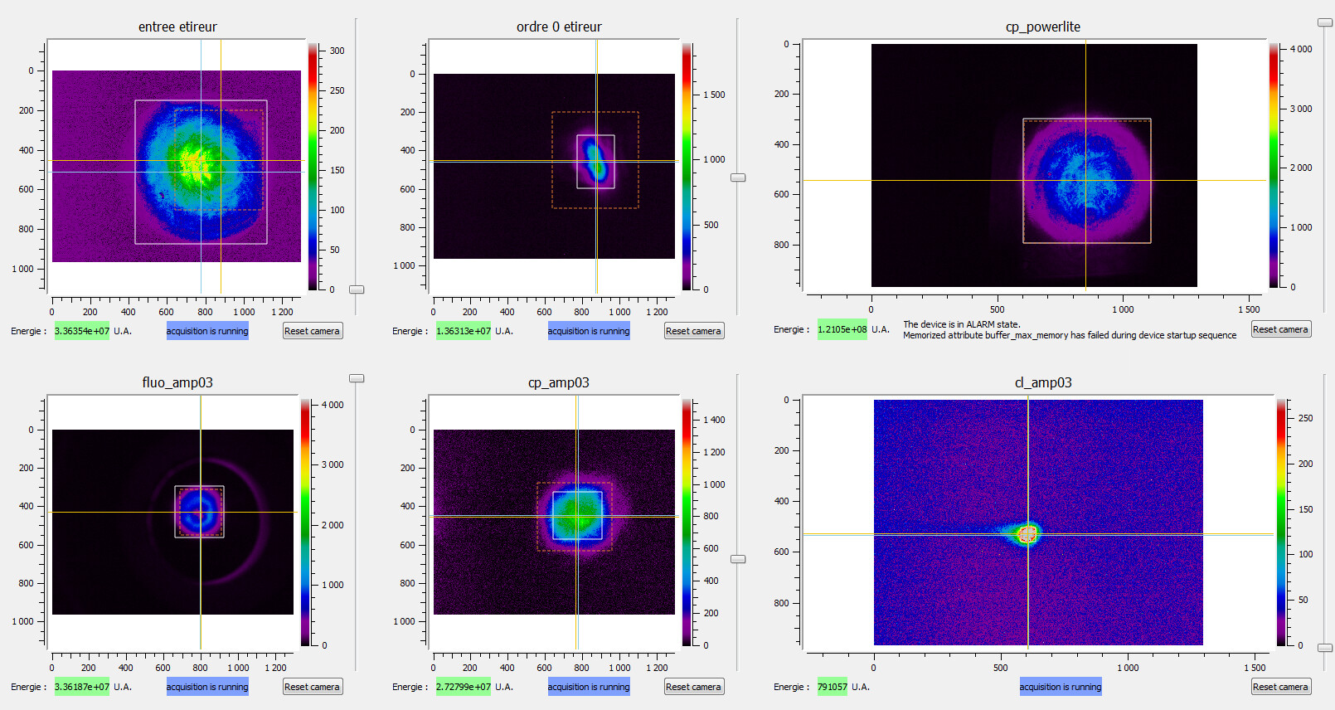
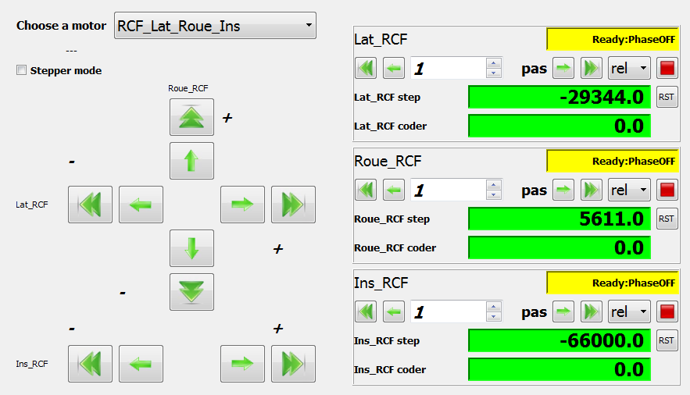
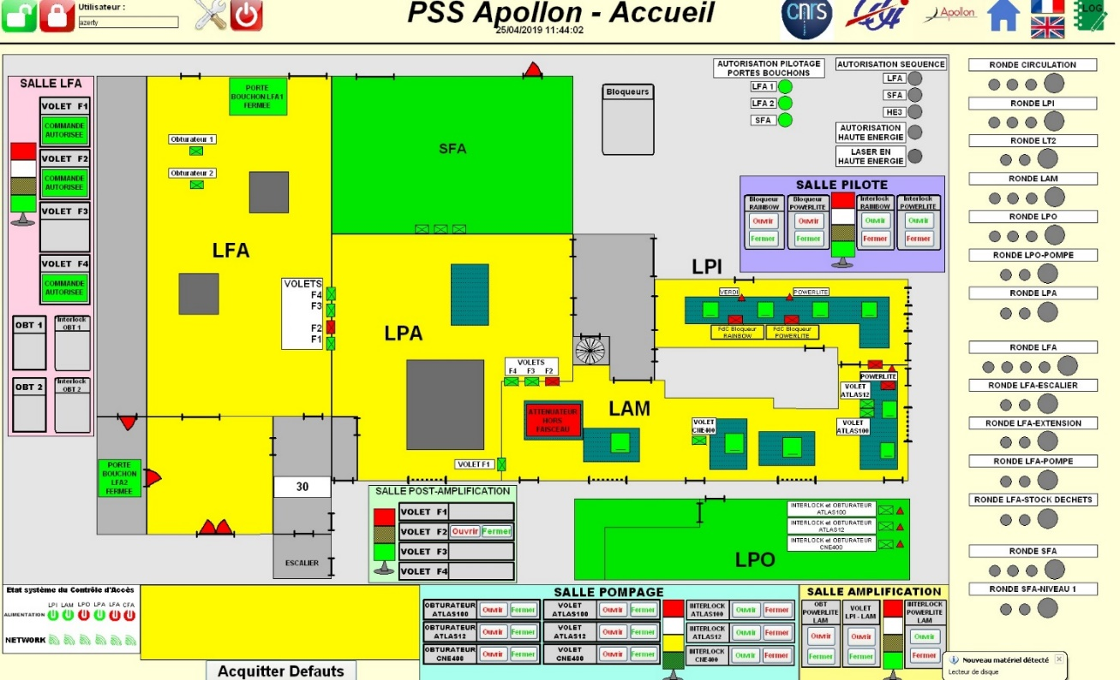
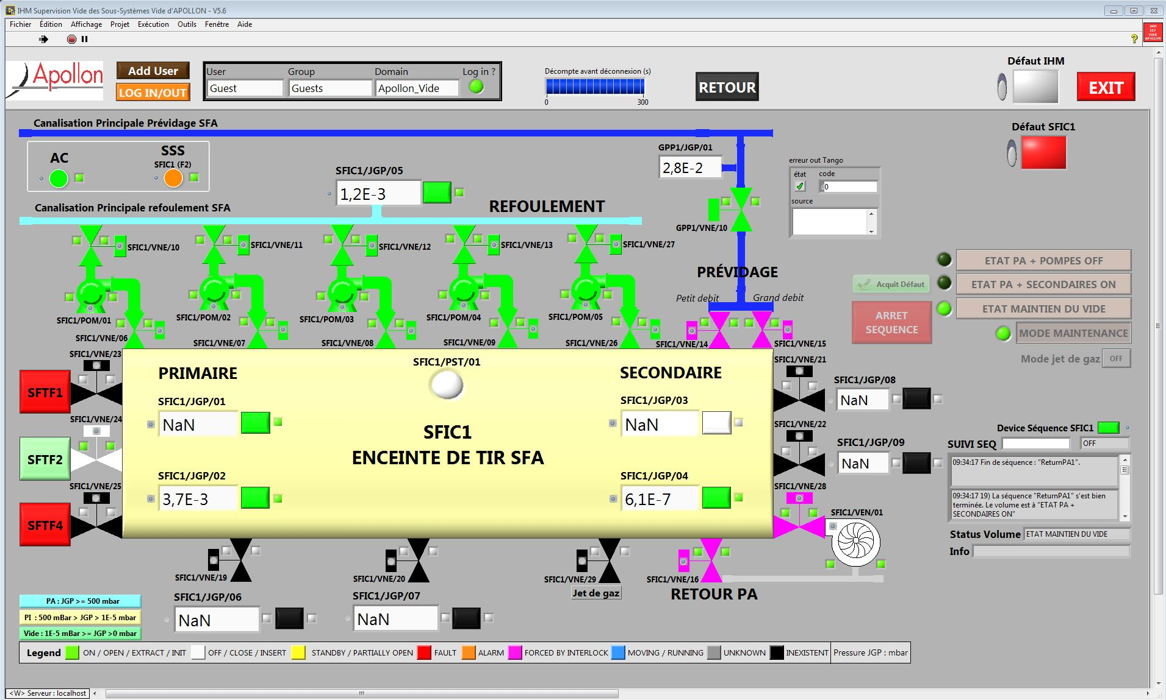
GUI for monitoring
Motors
Cameras
Vacuum
Personal Security System

Slide 12
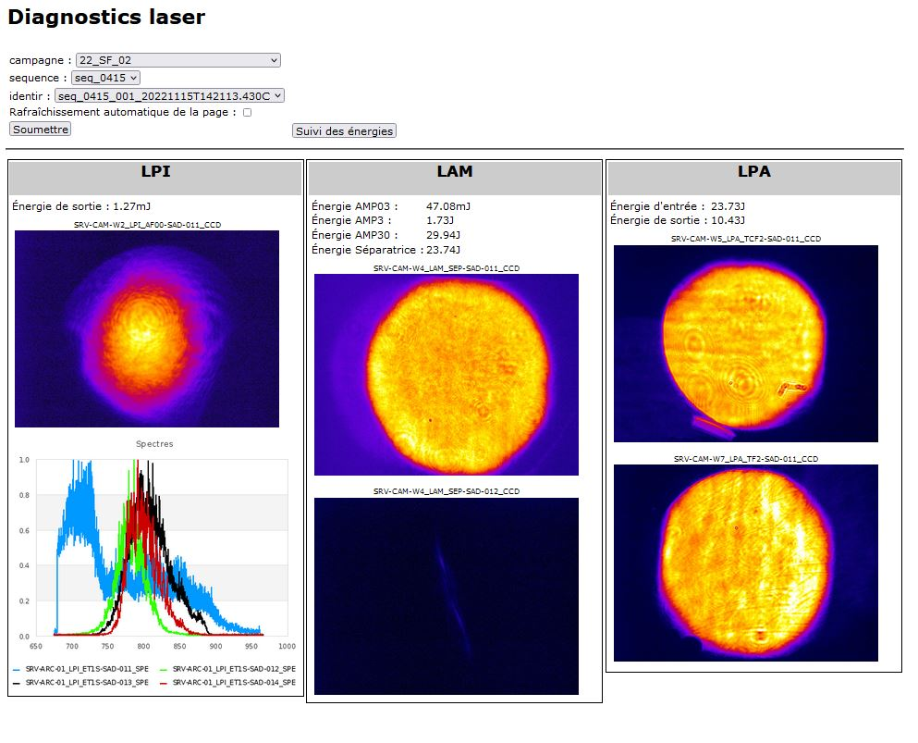
Laser diagnostics web interface
NOW: PHP to shared filesystem resource
upgrading to
NEXT: Django to Archiving Database

Slide 13
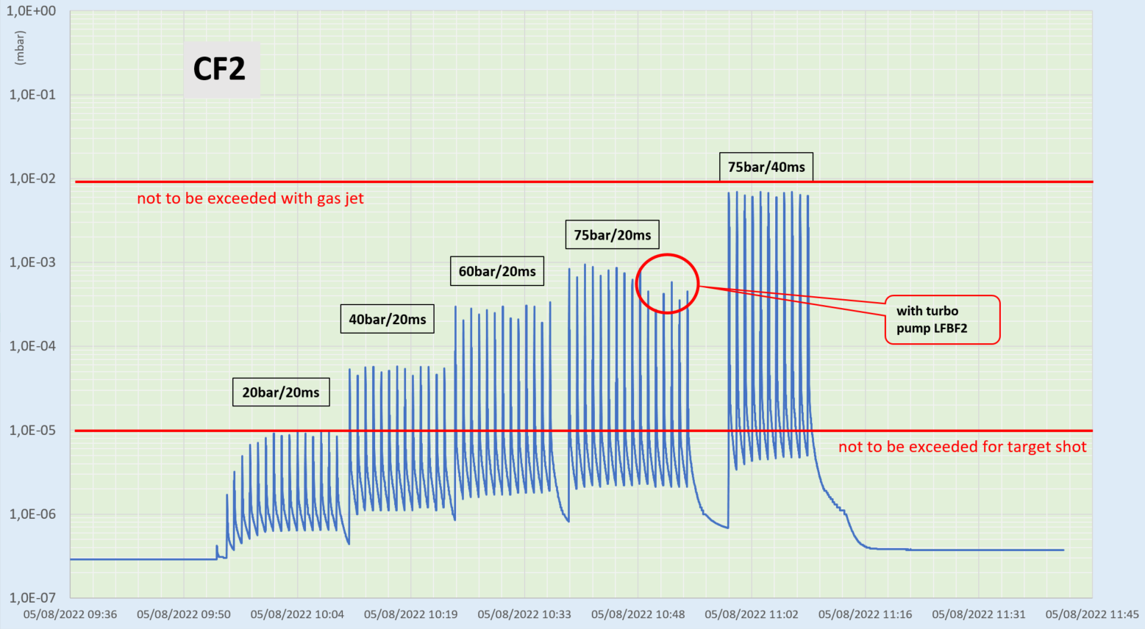
Vacuum analysis w/ current archiving mode
Vacuum chief leader: Jean-Philippe Delaneau

Slide 14
Infrastructure for Archiving
VM servers: Spectrum, Energy, Vacuum…
VM arc
Emit soft top_shot
Copy in
csv-like file
ArcSync
Communication w/ synchros
Tango Devices servers
Filesystem
Shared resource
Emit archive_event
VM hdbpp
hdb++[es|cm]
Archiving Devices
VM bdd?
MySQL Database
Web service
Python
Data extraction from Database
VM bdd
MySQL Database
OR BDD ON VM?

Slide 15
Status for HDB++ Archiving
Laserbeam (from pilot to experimental rooms) at different frequencies: F1 (10Hz), F2 (1Hz), F3 (10sec), F4 (1min); shots at F4 (1min) rate
Different modes of archiving
Continuous (long term monitoring F2—F4) Tango polling (ie. ~150 attributes for vacuum system at F2 rate) | Sequence (trigged on shots during campaigns, F4: laser and experimental diags)
Trigged (short duration period, F3—F4) is synchronized w/ F1 signal
Well, under construction, still some major issues (timeout, lost database connection, Faulty attributes) BUT we're back at it, at least.

Slide 16
Summary
Network and virtualized system upgraded last year
VM environment upgrades within summer
Tango system widely used (Apollon but also LULI2000 and Hera, 3 facilities of LULI)
Python3, PyQt5 upgrades (devices/GUI)
HDB++ Data archiving solutions in progress

Slide 17
Thank you for your attention!

Slide 18
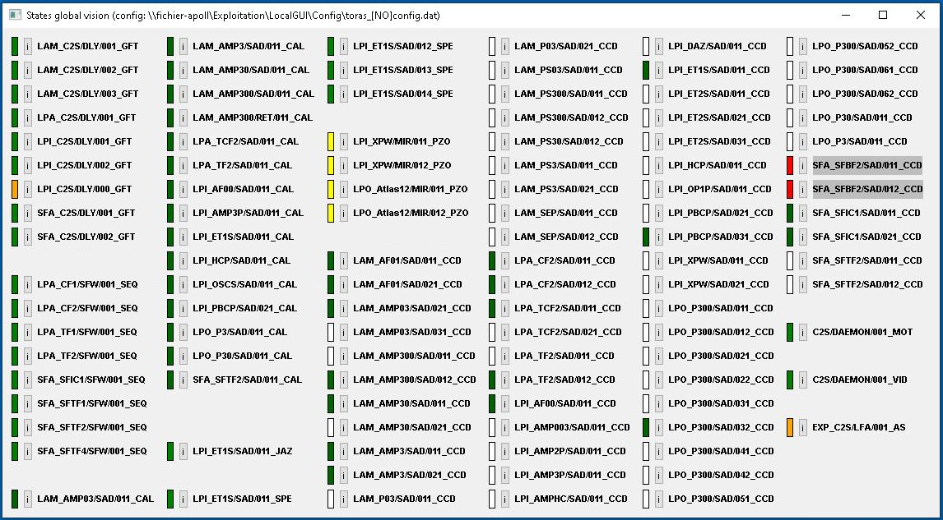
Global DS monitoring

Slide 19
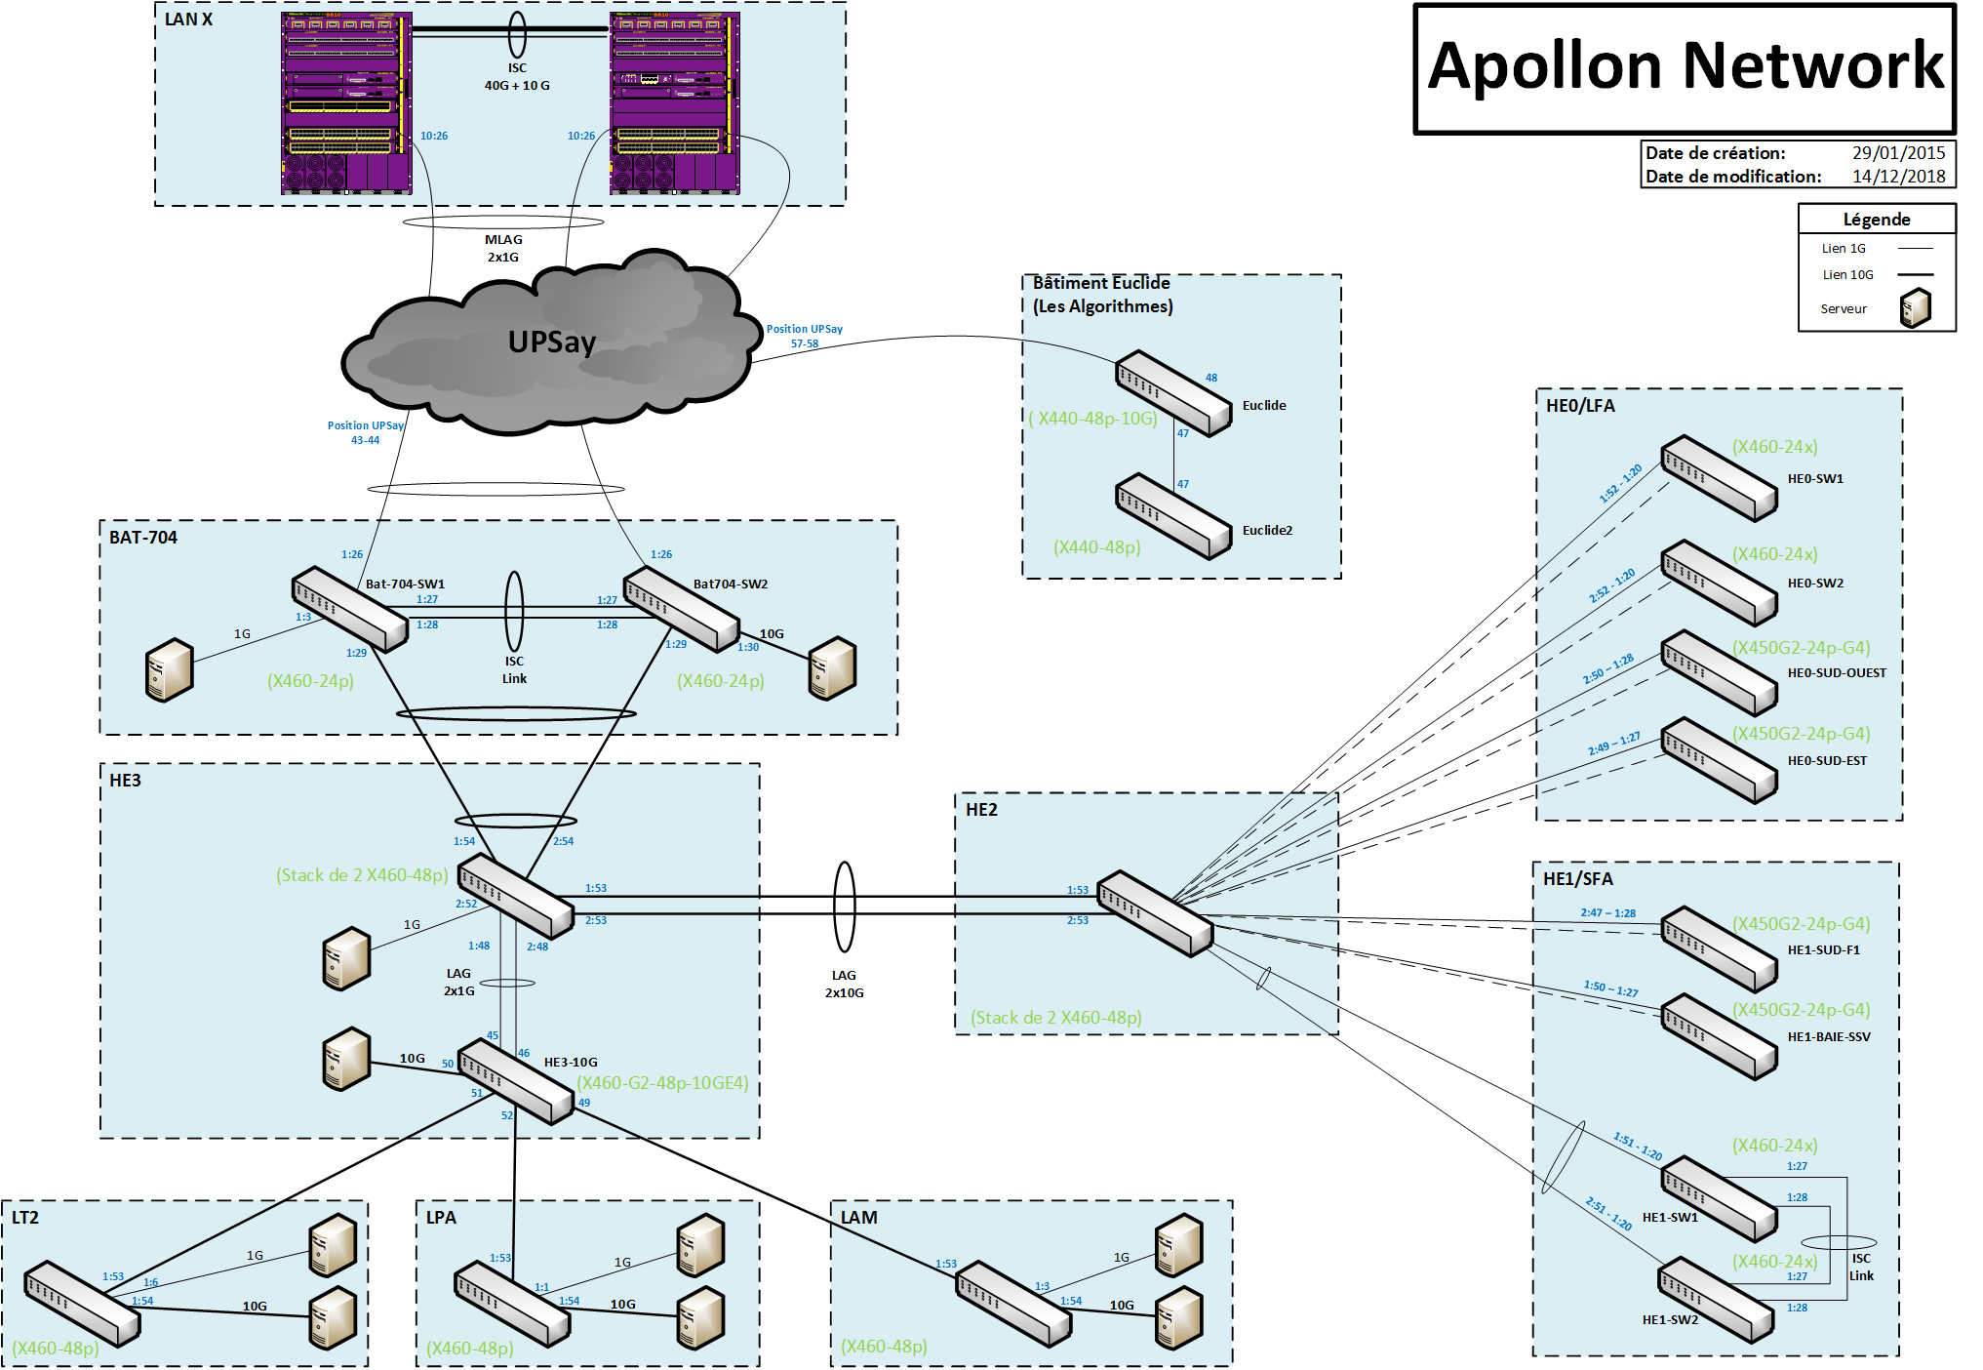
Apollon network: 2018

