Slide 1
OMC ART System Demo 18.6
SP-3183 - Refactor Taranta frontend to improve performance of running dashboards
Cream Team
Hélder Ribeiro - 25th May 2023

Slide 2
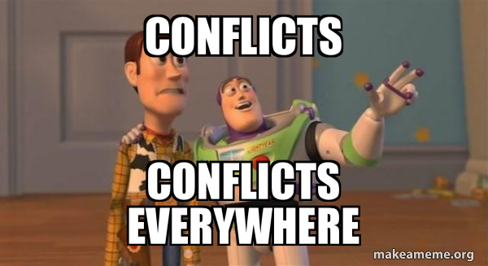
SP-3183 - Refactor Taranta frontend to improve performance of running dashboards
Widgets affected by the refactoring in PI18 are:
Label
Box
Attribute Display
Timeline
Tabular
Command
Command File
Spectrum Table
Attribute Writer Dropdown

Slide 3
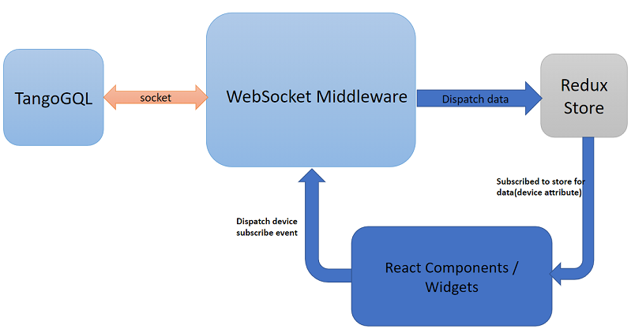
SP-3183 - Refactor Taranta frontend to improve performance of running dashboards
More info please visit: https://taranta.readthedocs.io/en/latest/architecture.html

Slide 4
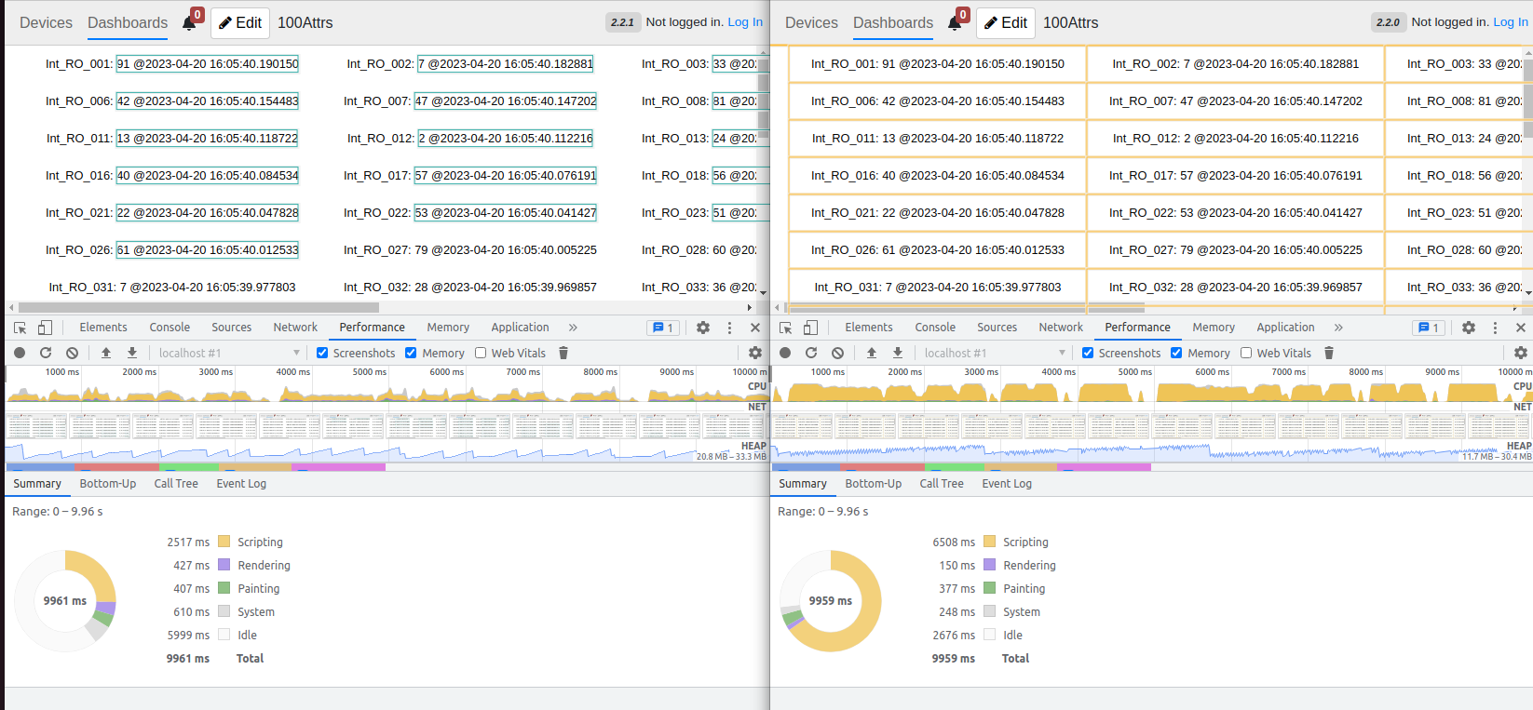
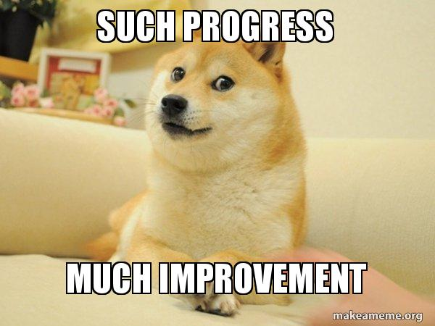
SP-3183 - Performance improvement

Slide 5
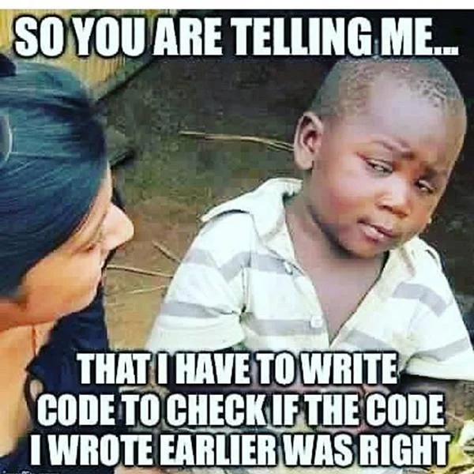
SP-3183 - Tests and docs improvement
Widgets affected by the refactoring in PI18 are:
Label
Box
Attribute Display
Timeline
Tabular
Command
Command File
Spectrum Table
Attribute Writer Dropdown
https://jira.skatelescope.org/browse/SPO-2039

Slide 6
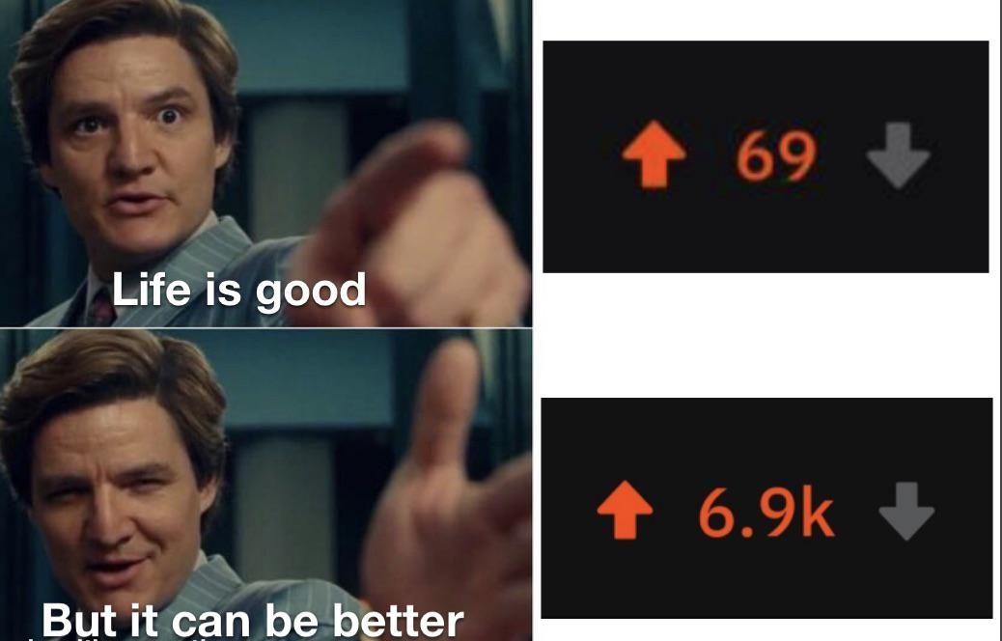
SP-3183 - Key points of this refactoring
Performance improvement (Unnecessary dashboard renders are avoided)
Long-running dashboards freeze bug fixed
Standardization of data access on taranta (making it faster and easier to implement new components)
Improved WebSocket management and communication recovery
Backward compatibility
Tests improvement

Slide 7
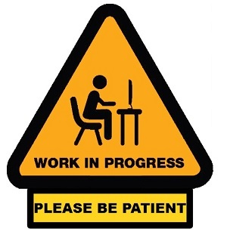
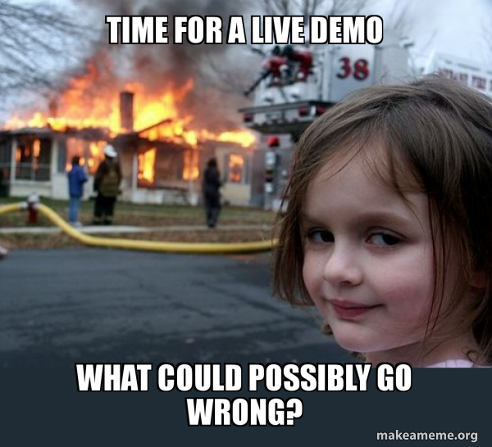
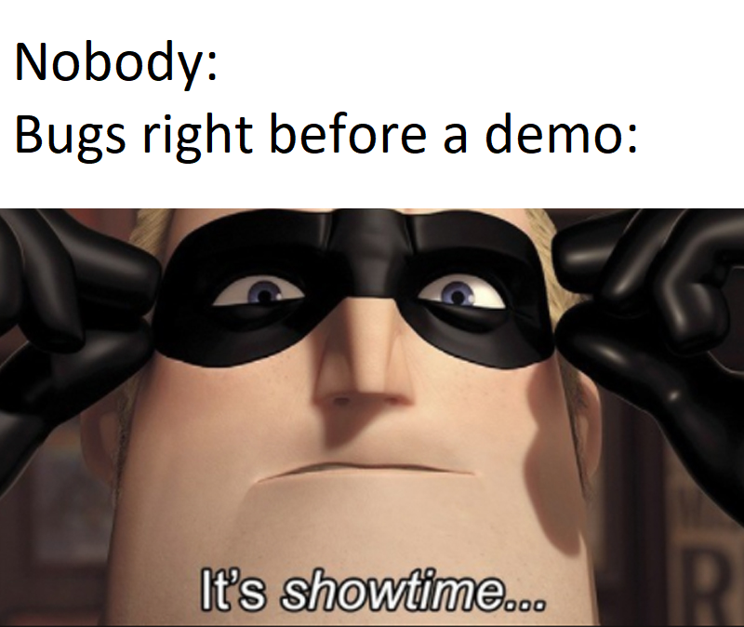
Thanks for your attention!

