Slide 1
TANGO Admin tools for SOLEIL – Castor and monitoring
A.Tison: engineer apprentice, developer​
G.Abeillé: developer, product owner

Slide 2
Context

Slide 3
TANGO Context at SOLEIL
There are currently 40,000 TANGO devices deployed when considering the different control systems at SOLEIL, and for SOLEIL II there will be even more devices than at present.
Moreover, with the construction of SOLEIL II, there will be a need to create test benches, along with their dedicated Tango databases and sets of devices to deploy to test their behavior.

Slide 4
Context
To operate the TANGO control system, several needs exist:
  Deploy / start / configure / stop / delete devices
  Assist with configuring devices that have dynamic attributes (PLCServer, Pandabox, ModbusDataViewer, etc.)
  Understand the root cause of incidents through monitoring
  Manage attribute archiving
Some of these needs — such as deployment, device configuration, and archiving — are currently handled at SOLEIL through bash/Python scripts and GUIs (Jive, Astor, etc.).
Other needs, such as ensuring monitoring are not being addressed entirely.

Slide 5
Example use case: deploying TANGO archiving
To start TANGO archiving on a new server, we need:
Manual declaration in Jive
Or scripted declaration
of multiple devices
with their properties:
ArchivingMonitor
ArchivingManager
TimeseriesArchivers (as many as needed)
Start devices in order (Scripts/Astor)
Exec commands StartArchiving(attributes…) using scripts (or painfully through Jive…)
=> 2-3 separate scripts are needed to perform this operation, even though the need for these use cases is extremely common.

Slide 6
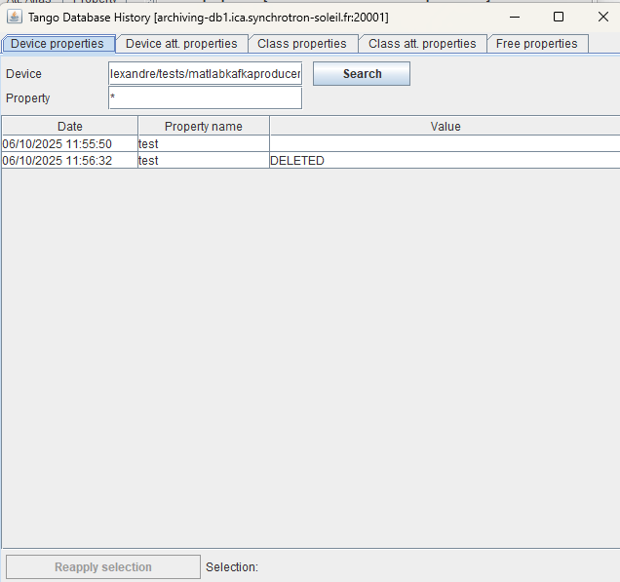
Example use case: Monitoring
Recurring issues in operations are:
Changes in device configuration
Untracked creation / deletion of devices
-> The current solution is to consult the history provided by Jive for most recent changes, but only for properties.

Slide 7

TANGO device deployment service
CAstor (means Beaver in French)

Slide 8
Deployment service: Castor
This service is available on SOLEIL GitLab: https://gitlab.synchrotron-soleil.fr/software-control-system/web/tangops/castor
Written in Python (FastAPI) with a PostGreSQL database. Tested using Docker & Conda
Can be used as an API or as a CLI tool
Allows the creation/deletion of devices as well as starting/stopping them
Creation/Deletion of devices can be done using CSV, JSON or YAML files
Can deploy devices on multiple tango hosts
A web front-end prototype (Vue.js) is also available (https://gitlab.synchrotron-soleil.fr/software-control-system/web/tangops/webstor-vue).

Slide 9
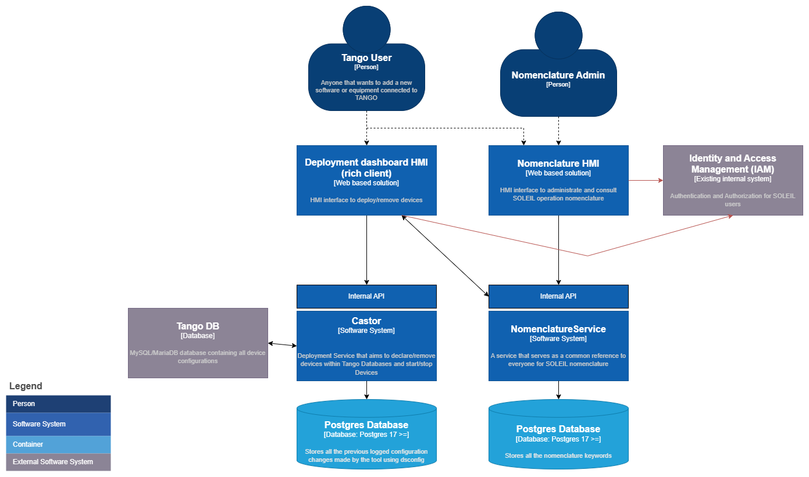
Castor architecture
Configure
TANGO
Check nomenclature
conformity

Slide 10
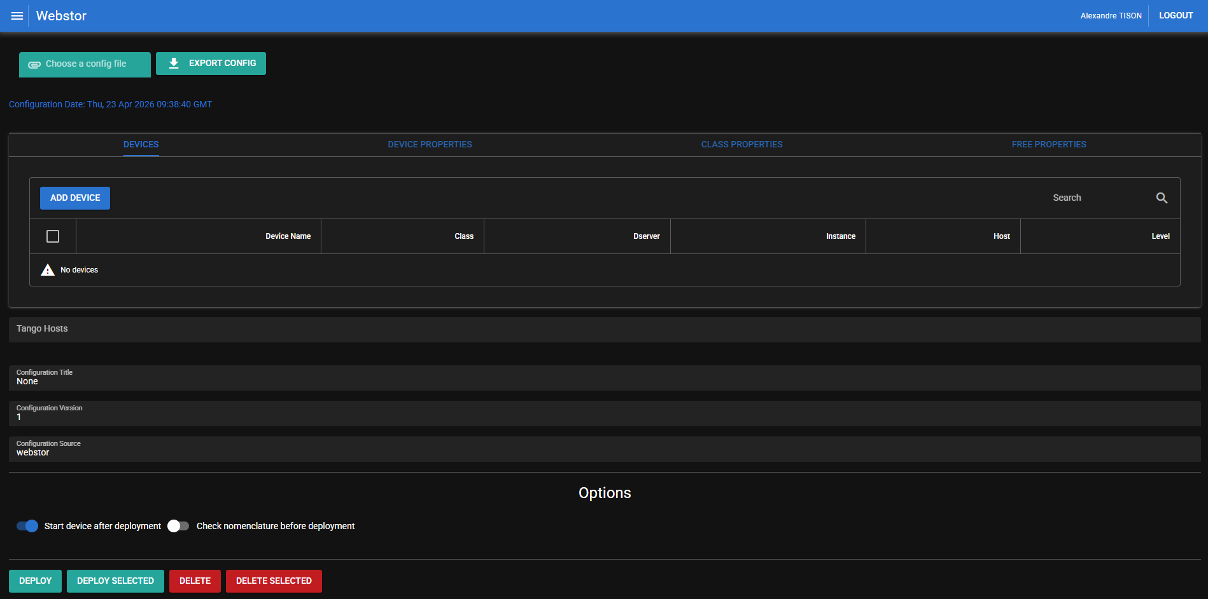
Web interface

Slide 11
Deployment service : next steps
Create an /UPDATE endpoint to enable post-start configuration of devices, covering settings such as polling and logging.
“dry-run” option: Check changes on TANGO DB before applying them
Templates for classes, especially for devices with dynamic attributes (PLCDataViewer, …)
Improve (Web/CLI) interfaces for users

Slide 12
TANGO Database Reporting

Slide 13
Context
No monitoring of the TANGO database (e.g., when a device was created or deleted).
The existing monitoring for properties requires some familiarity with Jive and TANGO and remains limited.
More subjectively, this same monitoring does not allow you to see the latest changes in a TANGO database at a glance.

Slide 14
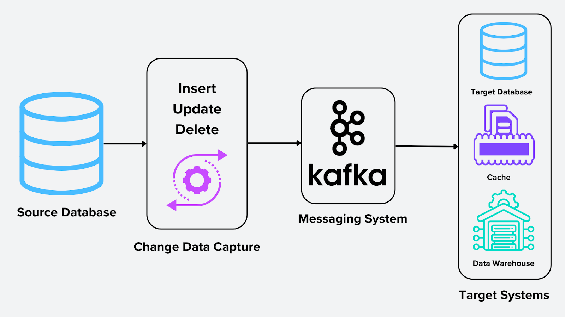
Solution: Change Data Capture
Change Data Capture (CDC) is a mechanism whose purpose is to keep a history of changes made to the data in one or more tables of a database.
This history makes it possible to reconstruct all the steps that led to the state of a table at a given point in time.
In practice:
This mechanism is supported by most modern databases (MariaDB, MySQL) through specific log files (binlogs) that contain SQL queries
And the changes they produced a message on each change (INSERT, UPDATE, ..).

Slide 15
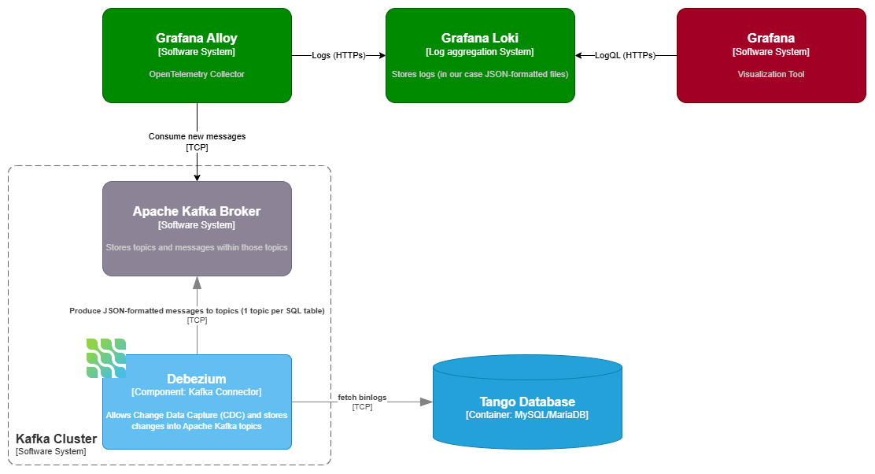
CDC Solution with Apache Kafka (Debezium)

Slide 16
Concrete example of JSON-formatted change event message
{
"before": {
"device": "sys/database/2",
"name": "tes",
"domain": "",
"family": "",
"member": "",
"count": 1,
"value": "",
"updated": "2025-07-18T08:17:59Z",
"accessed": "2025-07-18T08:17:59Z"
},
"after": {
"device": "sys/database/2",
"name": "tes",
"domain": "",
"family": "",
"member": "",
"count": 1,
"value": "qer",
"updated": "2025-07-18T08:18:05Z",
"accessed": "2025-07-18T08:18:05Z"
},
"op": "u",
"ts_ms": 1752826765376,
"source": {
"version": "2.4.2.Final",
"connector": "mysql",
"name": "mysql-01",
"ts_ms": 1752826685000,
"snapshot": "false",
"db": "tango",
"table": "property_device",
"server_id": 1,
"file": "mysql-bin.000003",
"pos": 39200,
"row": 0,
"thread": 123
}
}

Slide 17
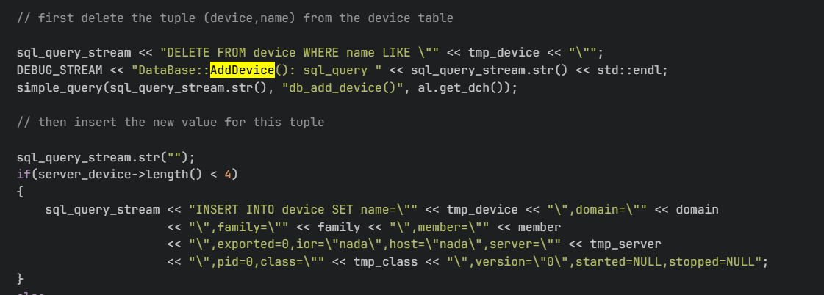
Issues met with the current Database Device
The Database device that feeds the MySQL/MariaDB database performs queries that programs like Debezium can correctly interpret, but which clutter the information received by the end user.
Example: creating a device triggers a pre-emptive deletion of the device:
-> Modification of the code to comply with Debezium : link

Slide 18
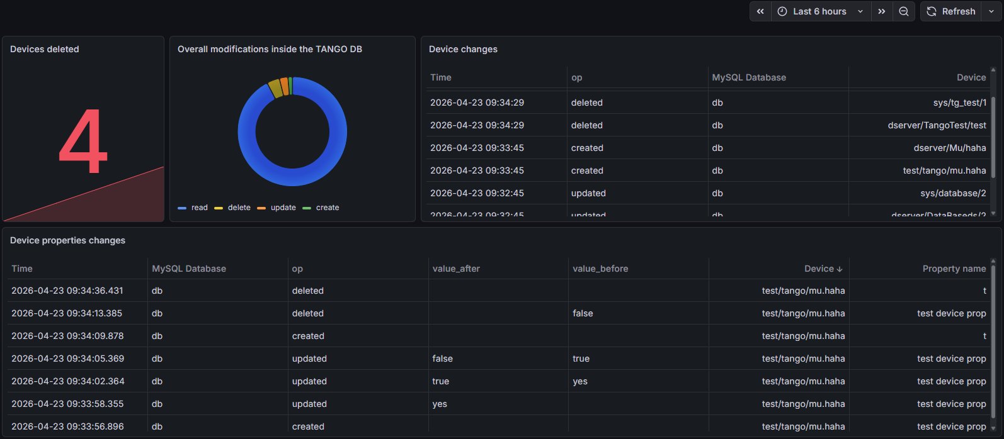
Demo with Loki/Grafana stack

Slide 19
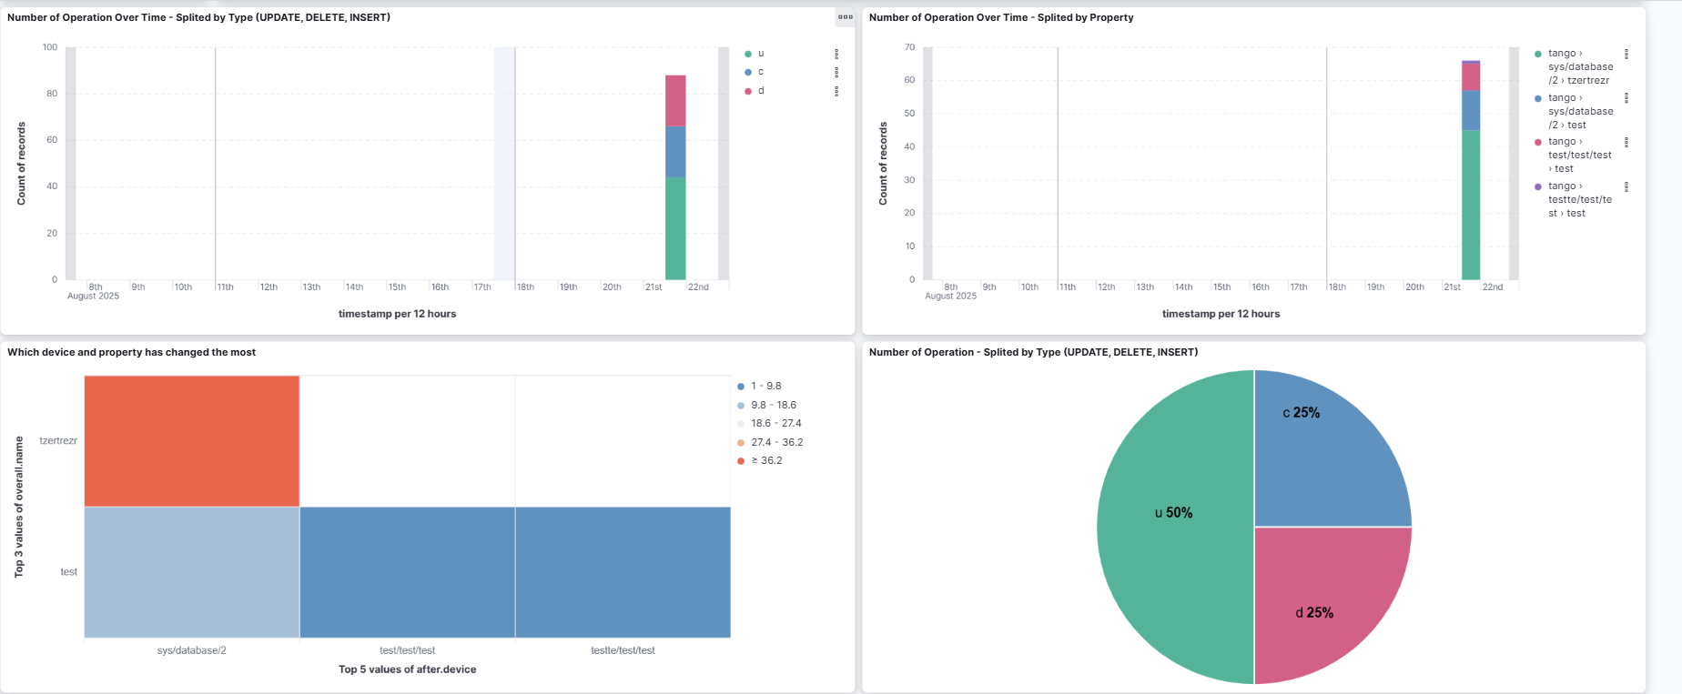
Demo with ELK stack

Slide 20
Next?
Validate and consolidate Castor and TANGO Database reporting on SOLEIL II tests benches.
TANGO Database device evolutions:
  May these changes made for CDC be useful for the TANGO community?
  We have noticed some other SQL queries optimizations that we can share

Slide 21
Resources
Debezium: https://debezium.io/documentation/faq/#what_is_debezium

Slide 22
Demo: Castor
Usage: main.py [options] FILE
Options:
-h, --help show this help message and exit
--th=TANGO_HOST, --tango-host=TANGO_HOST
Tango host (comma-separated list of host:port pairs)
--f=FILE, --file=FILE
Devices to deploy. Either use JSON or CSV format and
refer to the documentation for the expected format. If
you use CSV, you can add a second and third file with
your class and device properties, Example: --f devices
.csv,class_properties.csv,device_properties.csv,free_p
roperties.csv. For JSON files, use dsconfig format.
--d=DEVICES, --devices=DEVICES
Device to deploy. Use the following format:
domain/family/member;Class;Instance;host;level (comma-
separated list)
--op=OPERATION, --operation=OPERATION
Operation to perform (default: deploy)
--no-db Do not use the database logging for this operation
--diff Show the difference between the last configuration and
the second to last configuration in the database. This
is useful to see what has changed since the last
deployment.
--no-start Do not start the devices after deployment.

Slide 23
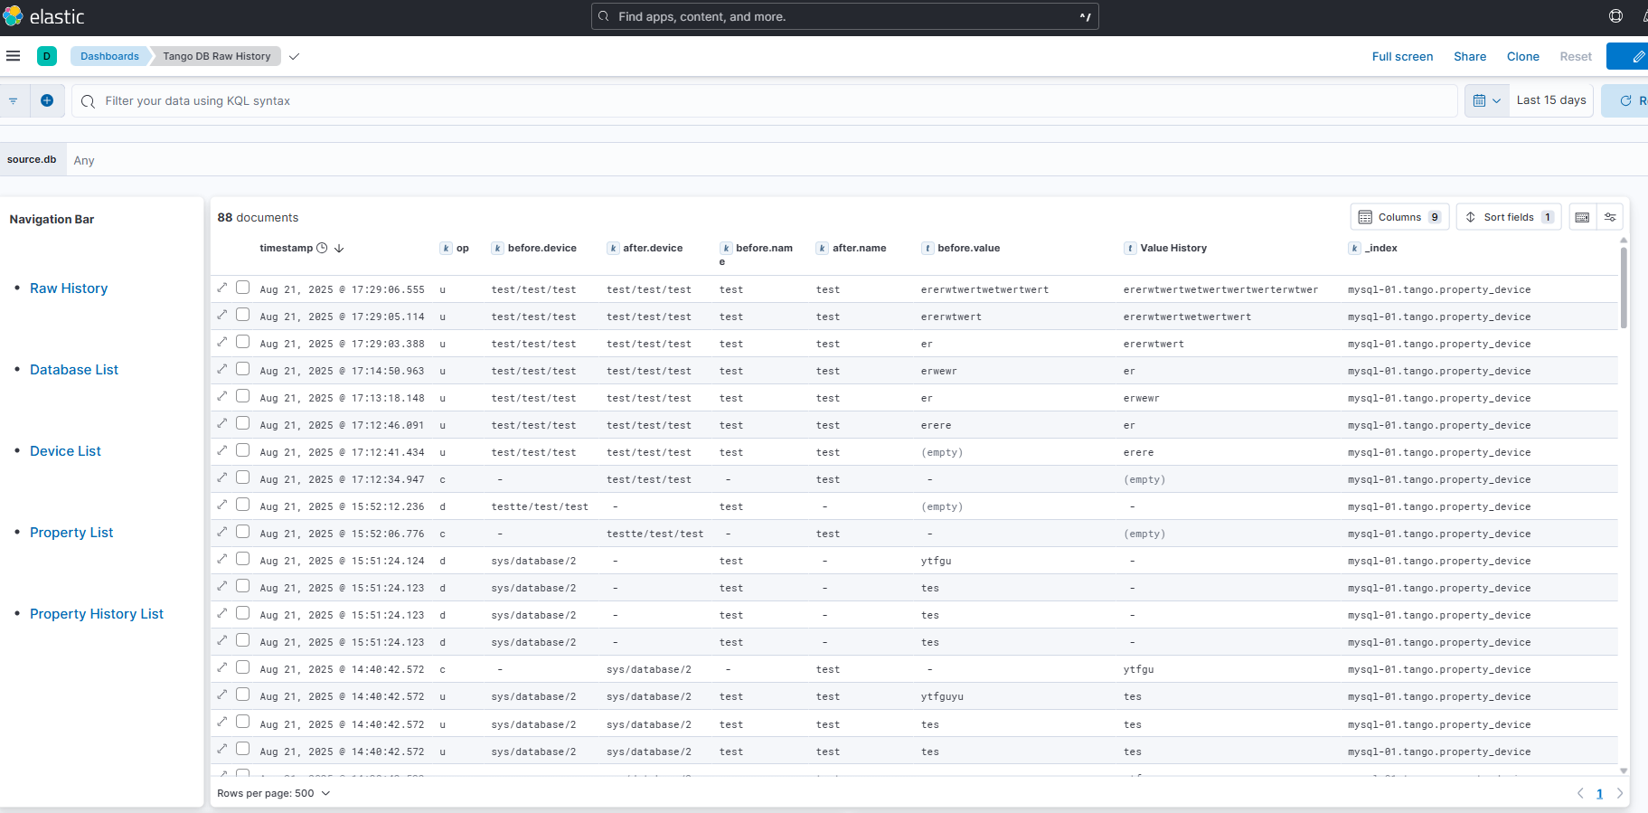
ELK demo

