Slide 1
HIJ-pyVision
…. and Claude Code supported refactoring
Alexander Kessler
GSI - Helmholtz-Institut-Jena
40th-Tango-Community-Meeting

Slide 2
Outline
hij-pyvision
from GenICam*-DS to universal 2D source
  usage of py-transitions
Metrics-DS
  plugin pattern for analysis
Taurus-Widget
Sardana-Ctrl for Cam-DS
orchestration
claude code
(my) experience with refactoring
problem of good context
  C4 model for development, cooperation and documentation
(!) update agents for docu readme etc.
* GenICam: industrial standard for 2D sensors defined by European Machine Vision Association (EMVA) https://www.emva.org/

Slide 3
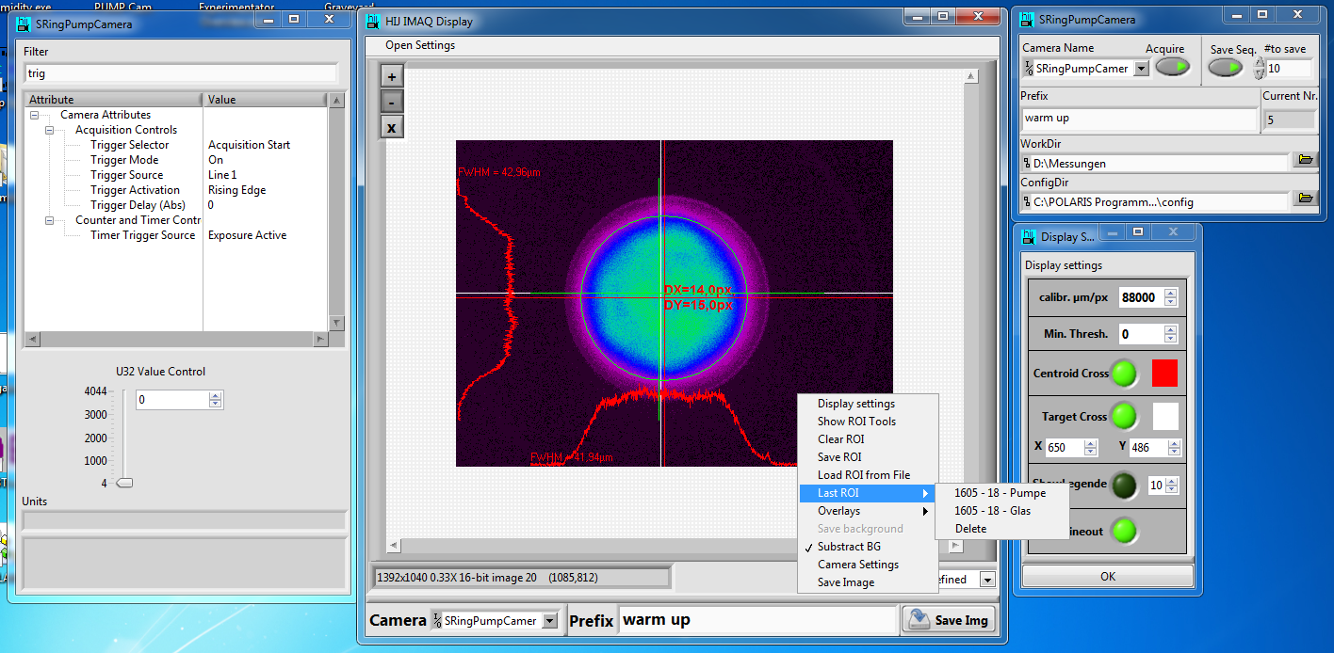
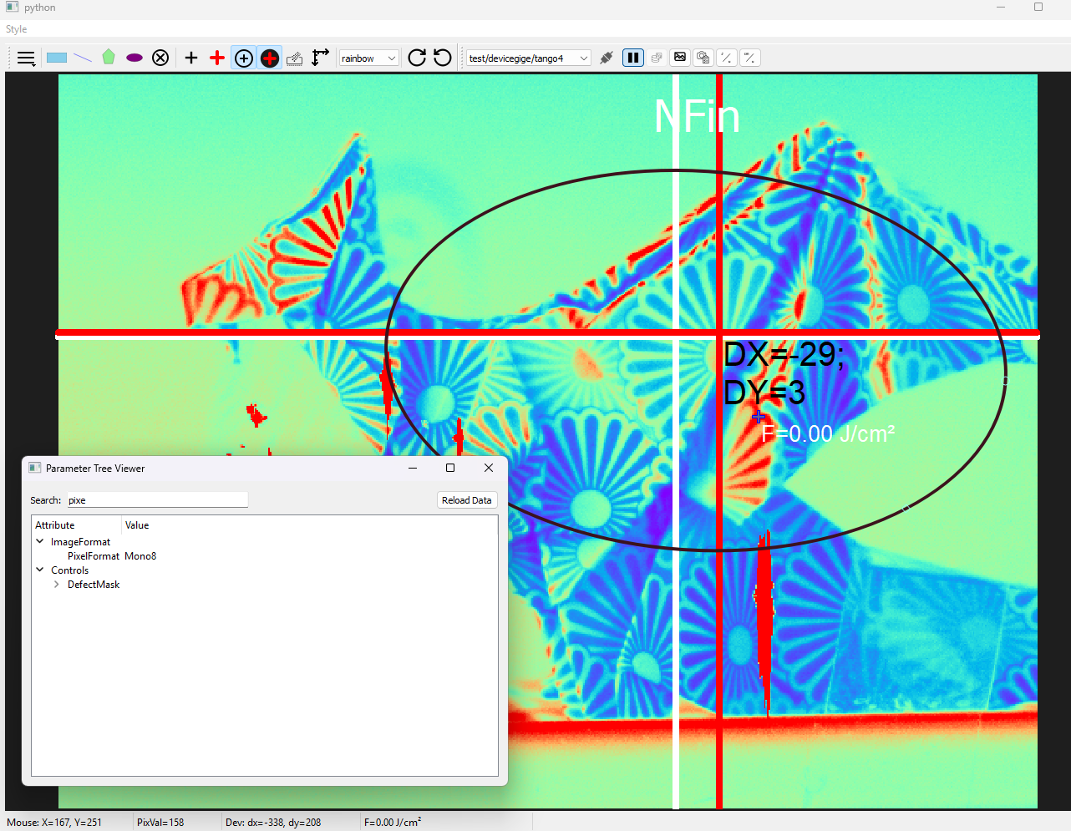
From LabVIEW-HIJ-Vision to HIJ-pyVision
Motivation:
  one universal DS for (almost) all Cams!
  Remove NI dependencies
  Images + analysis metadata stored together
  Python replaces LabVIEW
  Convenient Taurus Widget
  Integration in Sardana scans

Slide 4
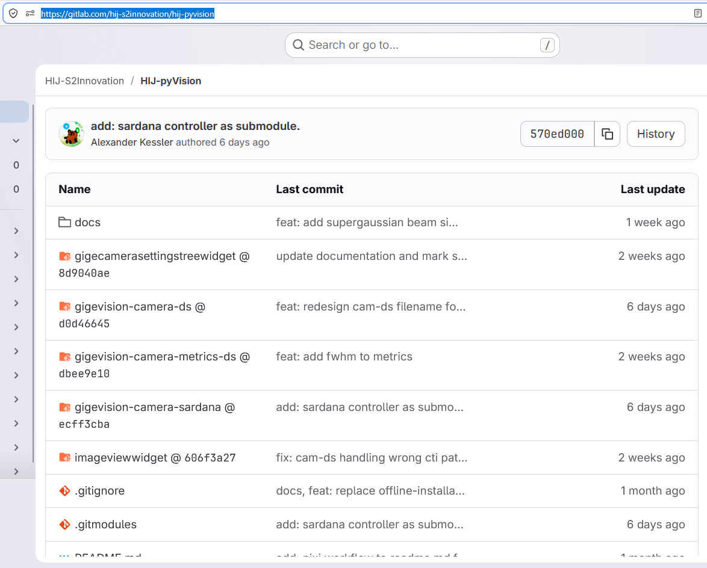
Component Overview
Component | Role
Camera DS | Frame acquisition, HDF5 storage, ROI, background subtraction
GigEVision Metrics DS | Event-driven image analysis, push archive events to HDB++
SettingsTreeWidget | GUI for all accessable GenICam settings
ImageViewWidget | Taurus/Qt5 live viewer + ROI editor + calibration settings + target point + real-time overlays
gigevision-camera-sardana | Sardana TwoDController + scan hooks

Slide 5
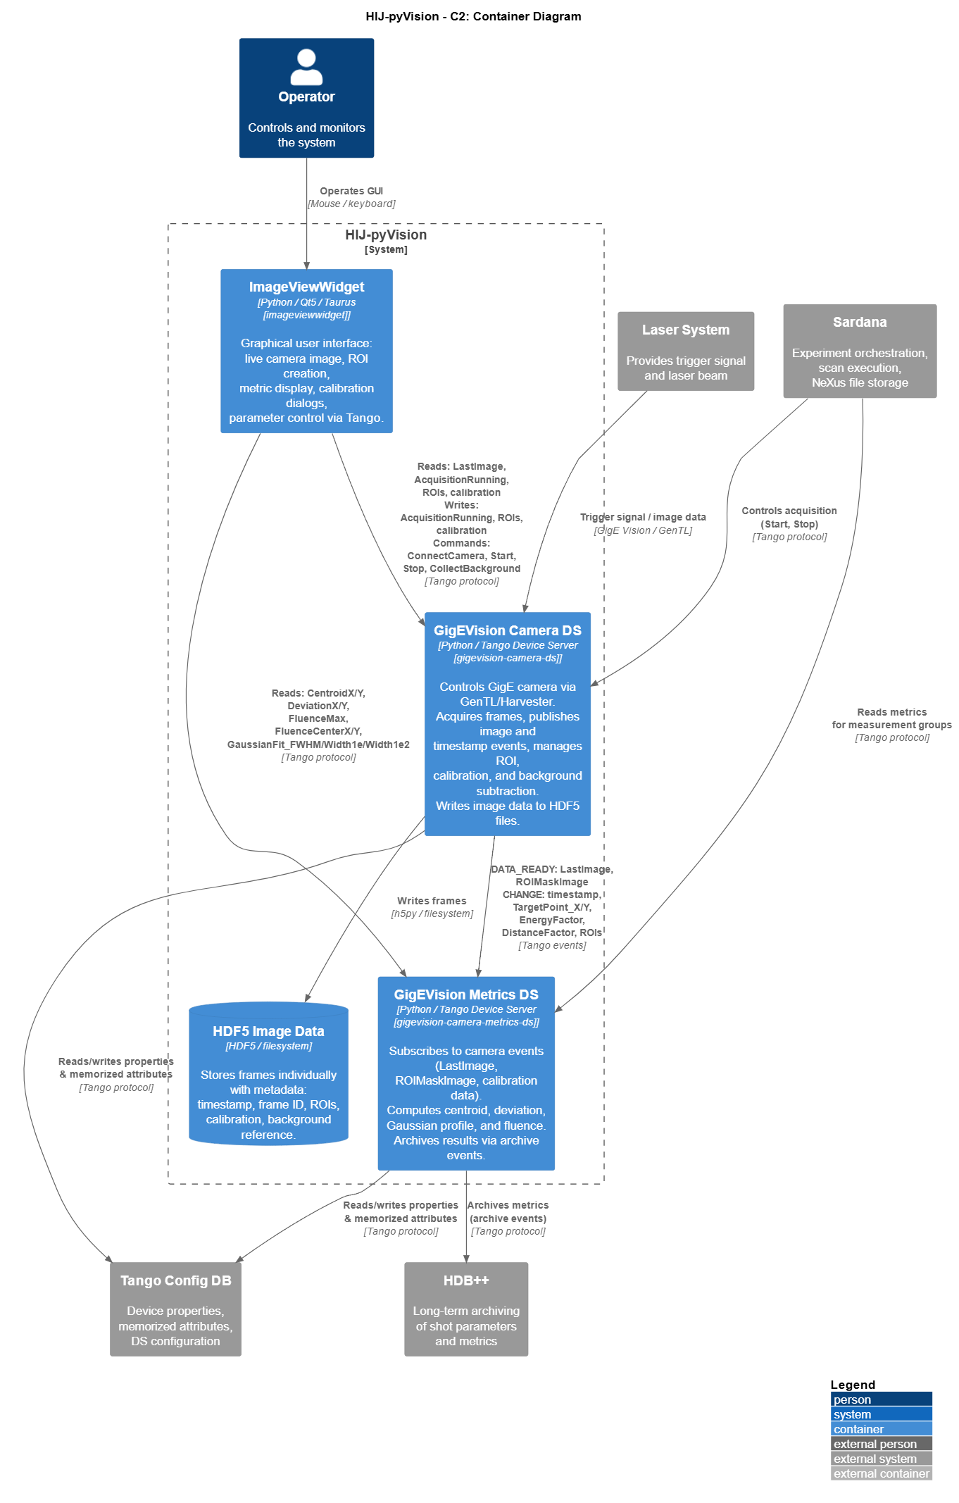
C(2)omponent Overview
Component | Role
Camera DS | Frame acquisition, HDF5 storage, ROI, background subtraction
GigEVision Metrics DS | Event-driven image analysis, push archive events to HDB++
SettingsTreeWidget | GUI for all accessable GenICam settings
ImageViewWidget | Taurus/Qt5 live viewer + ROI editor + calibration settings + target point + real-time overlays
gigevision-camera-sardana | Sardana TwoDController + scan hooks

Slide 6
Intersection: C4-Model
by Simon Brown · structurizr.com
Hierarchical description model for software architecture
4 levels of abstraction: Context → Container → Component → Code
Diagrams for different audiences (management to developers)
Simplifies onboarding and team communication
  my teammate: Claude Code
Zoom Analogy
🗺️ Continent
Who? What?
🏙️ City
Which parts?
🏢 Building
How structured?
📐 Floor plan
Code details

Slide 7
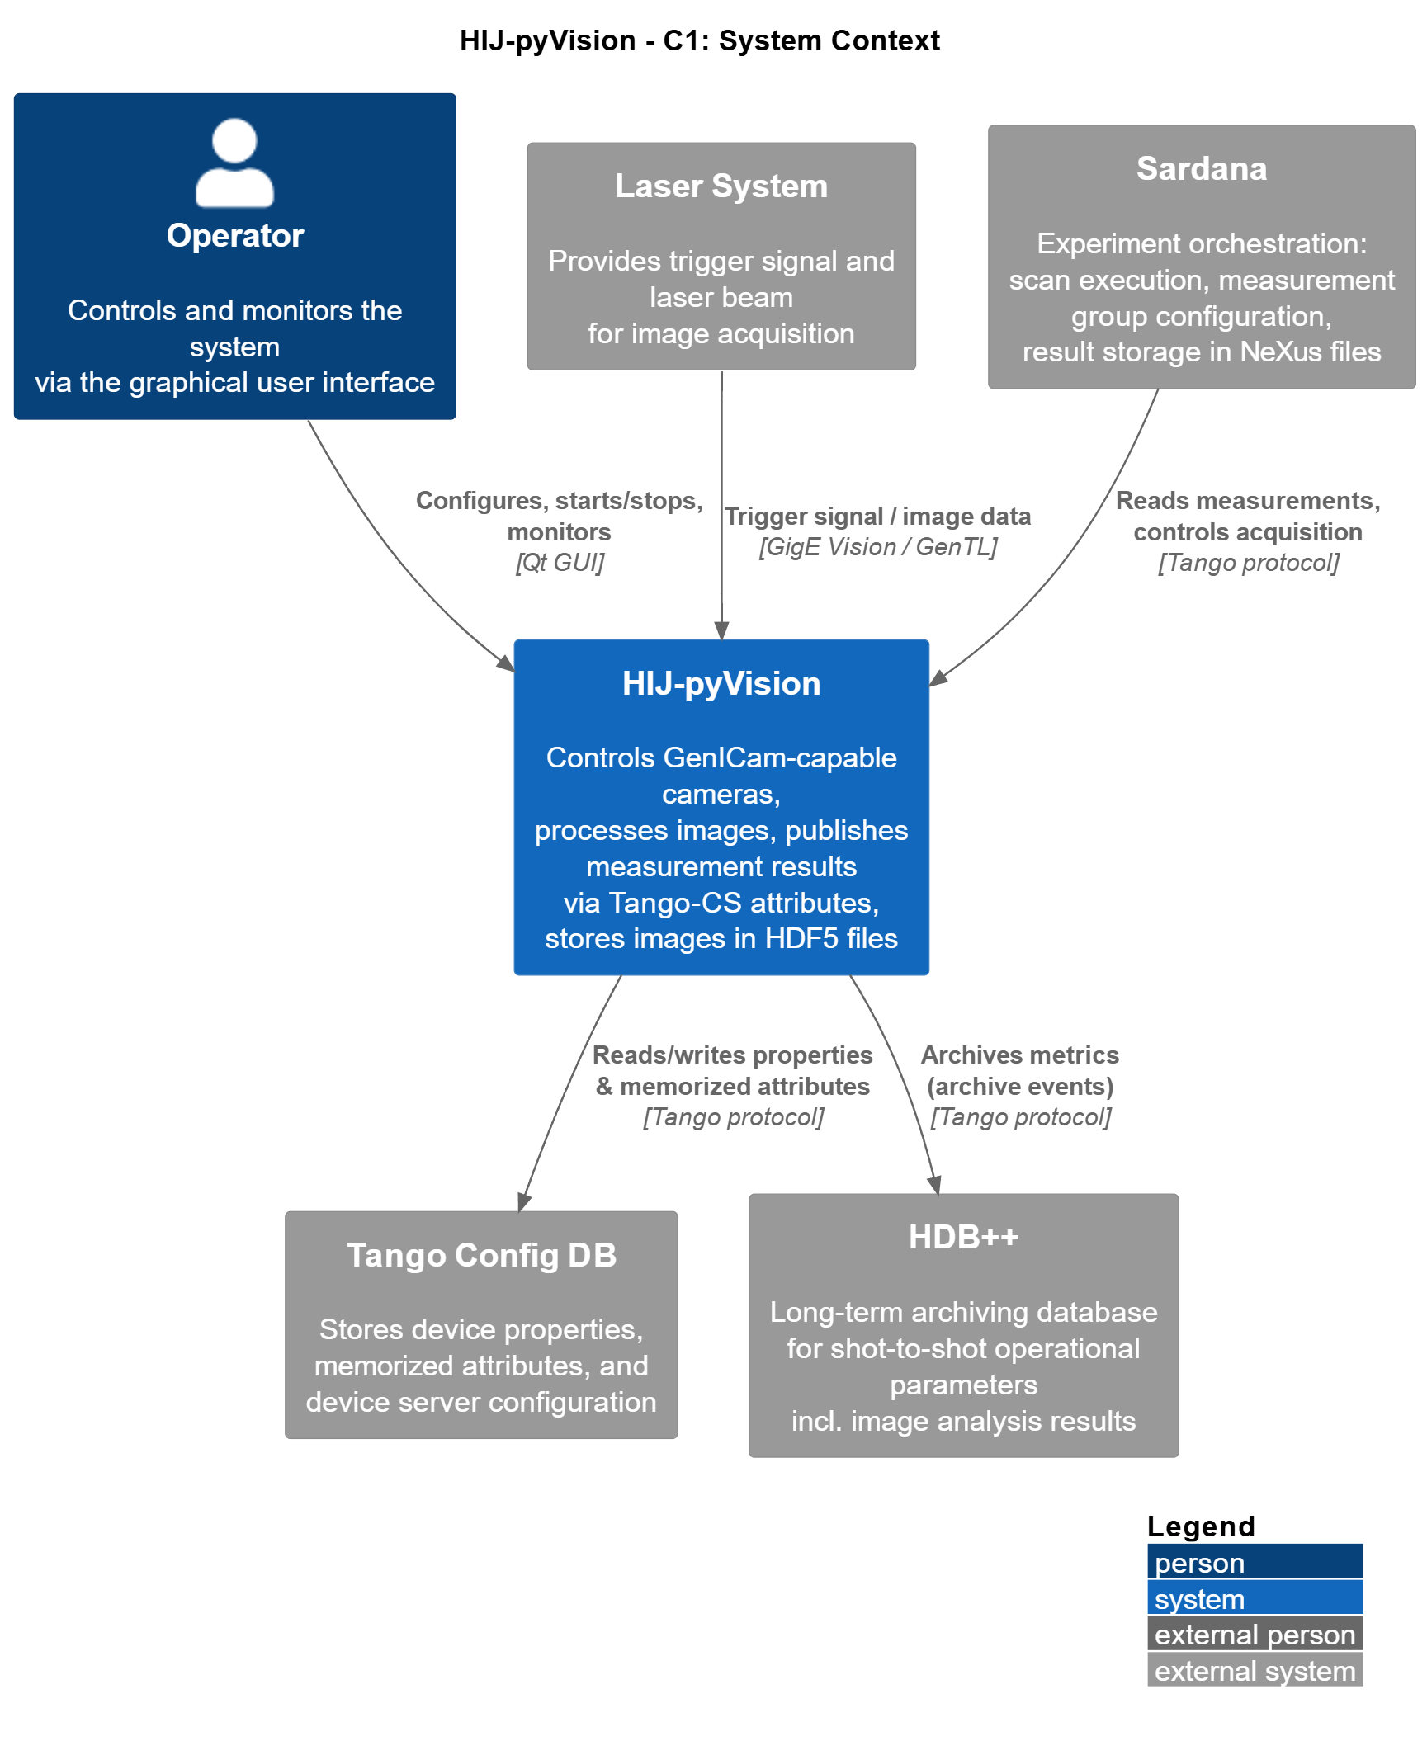
HIJ-pyVision: C1-context
@startuml C1_SystemContext_en
!include <C4/C4_Context>
LAYOUT_WITH_LEGEND()
title HIJ-pyVision – C1: System Context
Person(operator, "Operator", "Controls and monitors the system\nvia the graphical user interface")
System(hijpyvision, "HIJ-pyVision", "Controls GenICam-capable cameras,\nprocesses images, publishes measurement results\nvia Tango-CS attributes,\nstores images in HDF5 files")
System_Ext(laser, "Laser System", "Provides trigger signal and laser beam\nfor image acquisition")
System_Ext(tangoConfigDB, "Tango Config DB", "Stores device properties,\nmemorized attributes, and\ndevice server configuration")
System_Ext(hdbpp, "HDB++", "Long-term archiving database\nfor shot-to-shot operational parameters\nincl. image analysis results")
System_Ext(sardana, "Sardana", "Experiment orchestration:\nscan execution, measurement group configuration,\nresult storage in NeXus files")
Rel(laser, hijpyvision, "Trigger signal / image data", "GigE Vision / GenTL")
Rel(operator, hijpyvision, "Configures, starts/stops, monitors", "Qt GUI")
Rel(hijpyvision, tangoConfigDB, "Reads/writes properties\n& memorized attributes", "Tango protocol")
Rel(hijpyvision, hdbpp, "Archives metrics\n(archive events)", "Tango protocol")
Rel(sardana, hijpyvision, "Reads measurements,\ncontrols acquisition", "Tango protocol")
@enduml

Slide 8
C2 of HIJ-pyVision
Component | Role
Camera DS | Frame acquisition, HDF5 storage, ROI, background subtraction
GigEVision Metrics DS | Event-driven image analysis, push archive events to HDB++
SettingsTreeWidget | GUI for all accessable GenICam settings
ImageViewWidget | Taurus/Qt5 live viewer + ROI editor + calibration settings + target point + real-time overlays
gigevision-camera-sardana | Sardana TwoDController + scan hooks

Slide 9
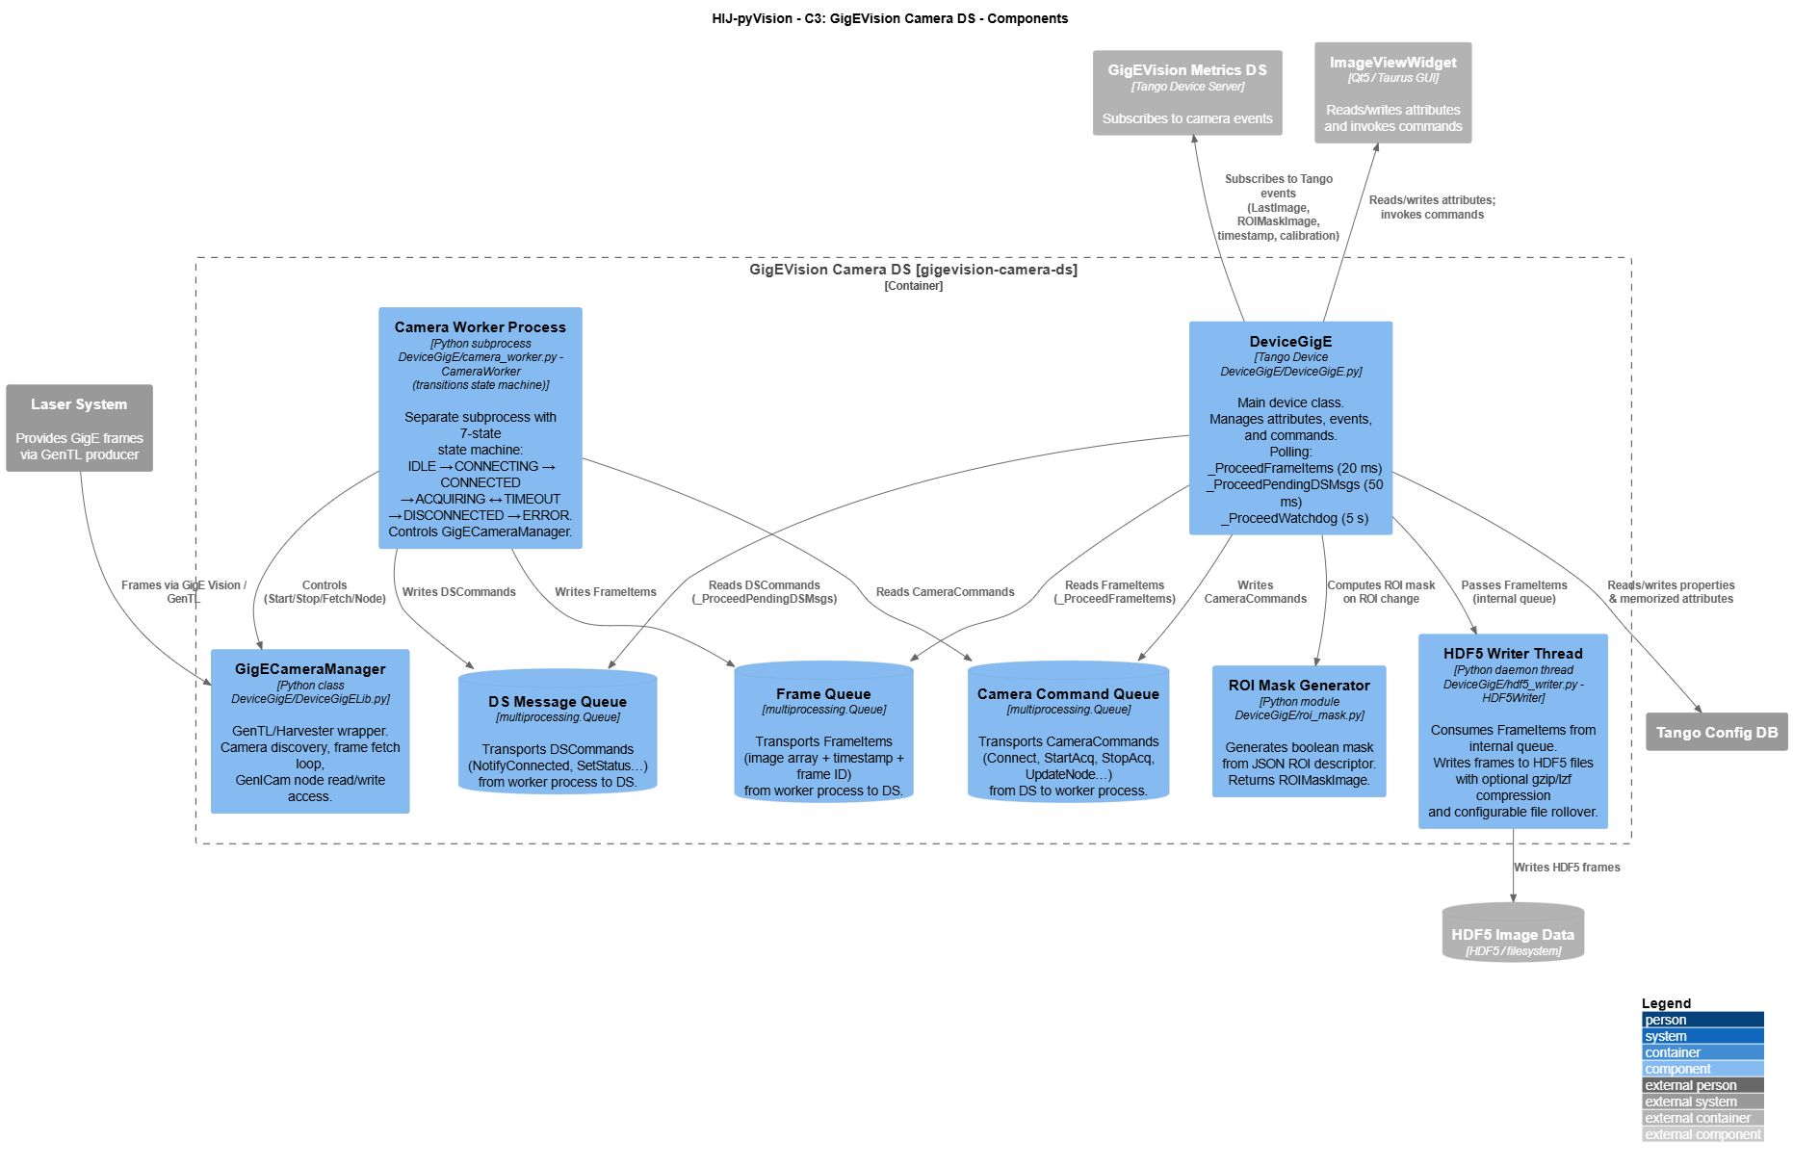
HIJ-pyVision: C3
@startuml C3_CameraDS_en
…
title HIJ-pyVision – C3: GigEVision Camera DS – Components
System_Ext(laser, "Laser System", "Provides GigE frames\nvia GenTL producer")
System_Ext(tangoConfigDB, "Tango Config DB")
Container_Ext(metricsDS, "GigEVision Metrics DS", "Tango Device Server", "Subscribes to camera events")
Container_Ext(imageViewWidget, "ImageViewWidget", "Qt5 / Taurus GUI", "Reads/writes attributes\nand invokes commands")
ContainerDb_Ext(hdf5Files, "HDF5 Image Data", "HDF5 / filesystem")
Container_Boundary(cameraDS, "GigEVision Camera DS [gigevision-camera-ds]") {
Component(deviceGigE, "DeviceGigE", "Tango Device\nDeviceGigE/DeviceGigE.py", "Main device class.\nManages attributes, events, and commands.\nPolling:\n _ProceedFrameItems (20 ms)\n _ProceedPendingDSMsgs (50 ms)\n _ProceedWatchdog (5 s)")
…..
…..
}
' Internal connections
Rel(deviceGigE, cmdQueue, "Writes CameraCommands")
Rel(cameraWorker, cmdQueue, "Reads CameraCommands")
Rel(cameraWorker, msgQueue, "Writes DSCommands")
…..
' External connections
Rel(laser, gigeCameraManager, "Frames via GigE Vision / GenTL")
Rel(hdf5Writer, hdf5Files, "Writes HDF5 frames")
Rel(deviceGigE, tangoConfigDB, "Reads/writes properties\n& memorized attributes")
Rel_Back(metricsDS, deviceGigE, "Subscribes to Tango events\n(LastImage, ROIMaskImage,\ntimestamp, calibration)")
Rel_Back(imageViewWidget, deviceGigE, "Reads/writes attributes;\ninvokes commands")
@enduml

Slide 10
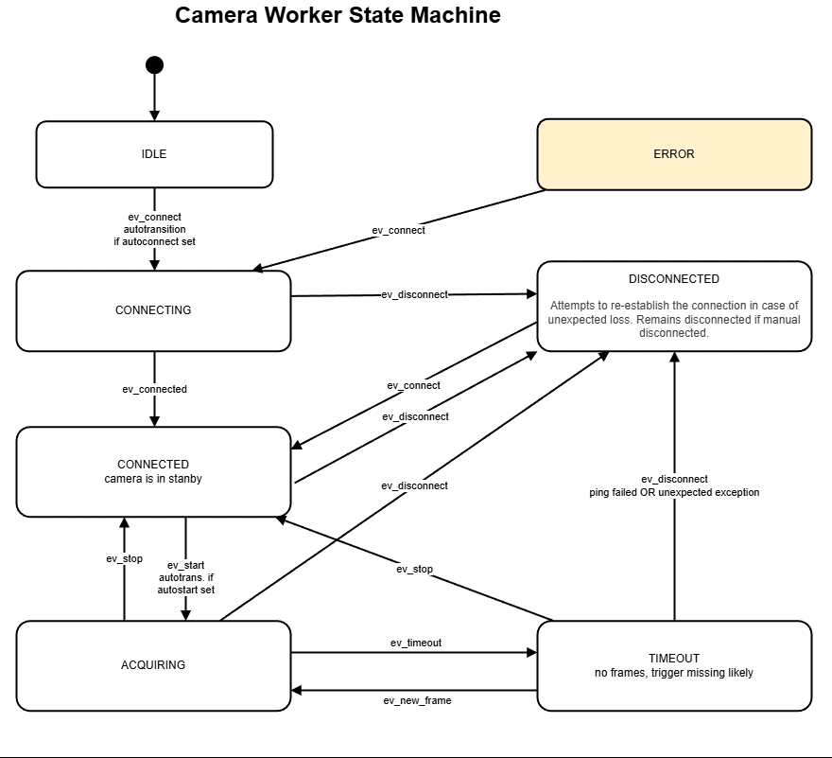
Camera – DS, architecture decision
image producer runs in a separate subprocess
  e.g. Allied Vision ignores GenTL harvester timeouts → the thread freezes
  watchdog can kill and restart the process without restarting the DS
communication image-producer <-> tango-ds via multiprocess queues
  zero coupling to specific lib e.g. harvesters!
  same idea like LabVIEW-ActorFramework
python transition state mashine
  realy powerfull, easy to use library
  clean transition, no ifelse ballet
  nice to have in pyTango !?

Slide 11
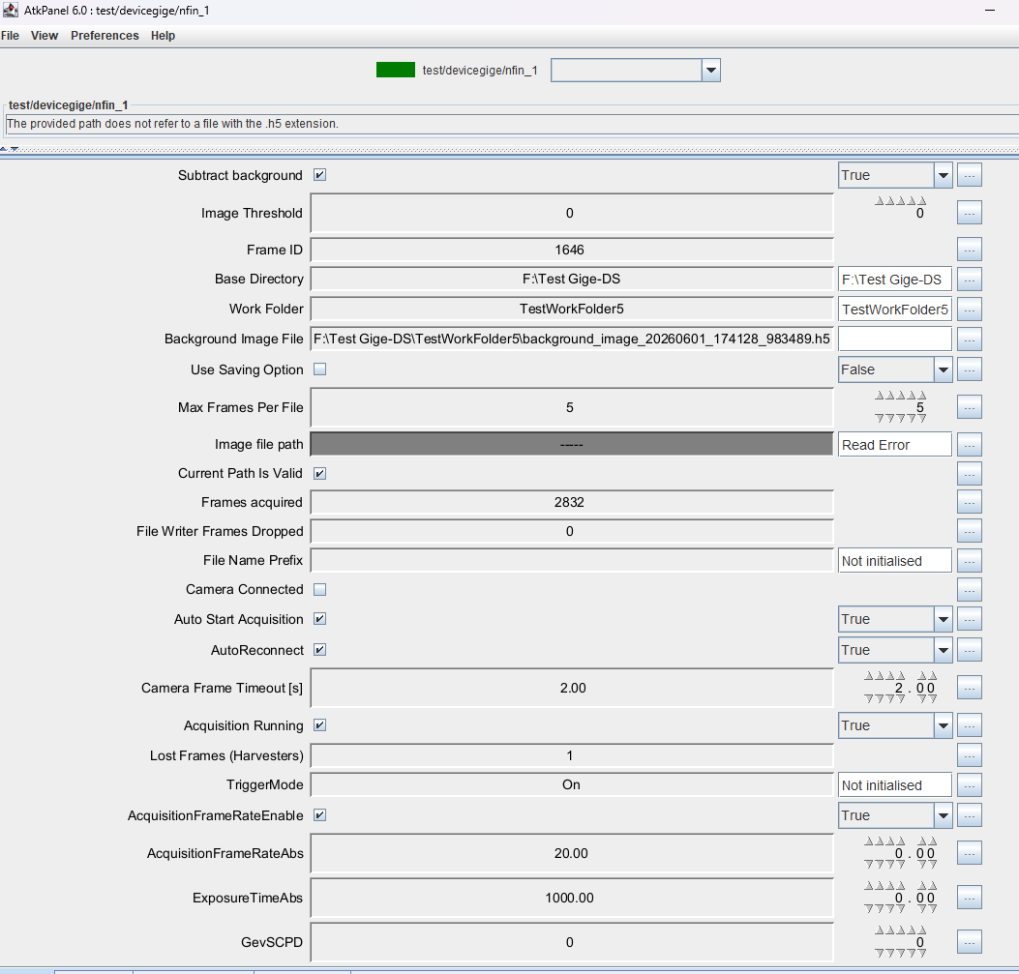
Tango-DSs for image sources
DeviceGigEBase: base DS class for all images sources (legacy name DeviceGigE….)
  DeviceGigE: child class for GenICam
  DeviceGigESimulator
  DeviceGigEFileReader
HDF5 writer mixin
  mixin for Camera- and Simulator-DS

Slide 12
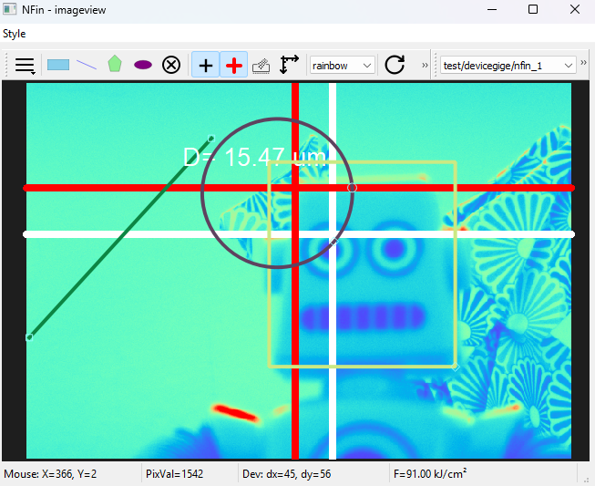
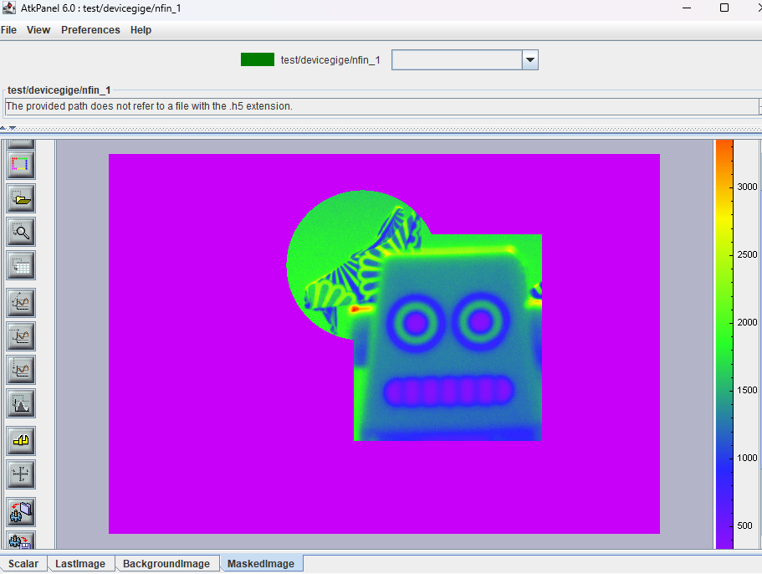
DeviceGigE features
GenTL / Harvesters — vendor-neutral; any GenICam-compliant camera with a .cti producer
Threshold filter, background subtraction applied to LastImage
ROI Maskgeneration
Publish data_change_event for scalars and data_ready_event for images
Storage — HDF5 with rollover:
- Writes per-frame: image array, timestamp, frame_id, ROI mask, calibration metadata
- File rollover at MaxFramesPerFile (0 = unlimited)
- Compression: gzip (level 0–9) or lzf
- h5clear -s recovery if DS killed ungracefully
GenICam node access via Tango:
- UpdateNode / RemoveNodeOverride — persists settings to camera_settings_json property
- Settings re-applied on every reconnect
- Dynamic Tango attributes created for each persisted node

Slide 13
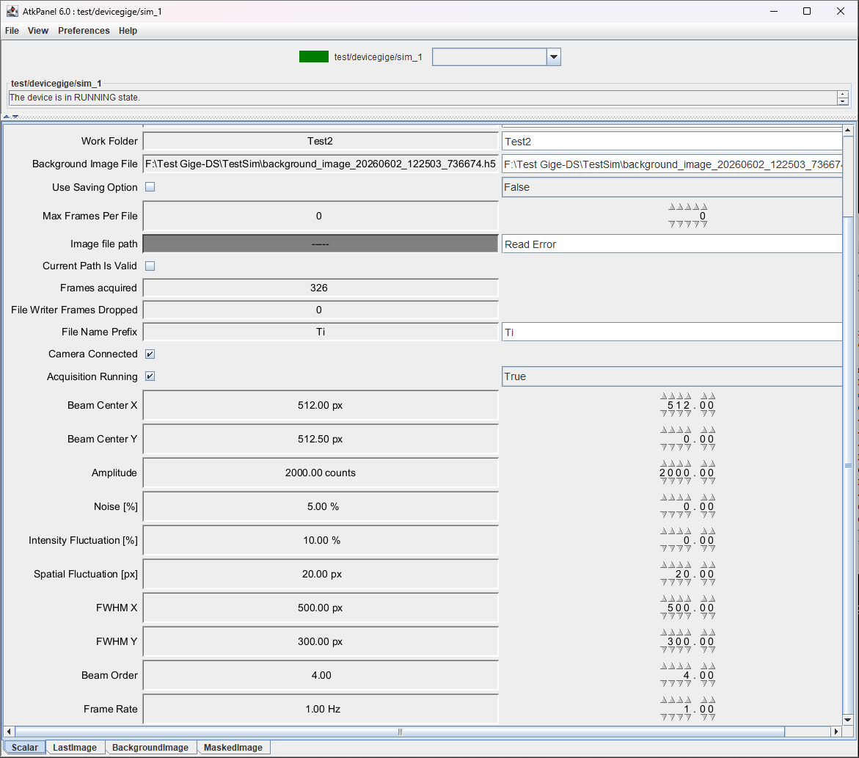
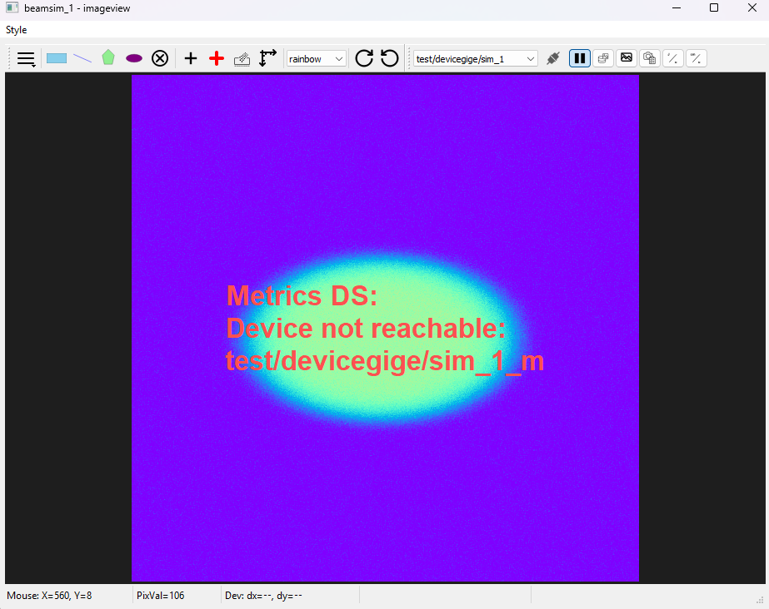
DeviceGigESimulator

Slide 14
DeviceGigEFileReader
Video Demo

Slide 15
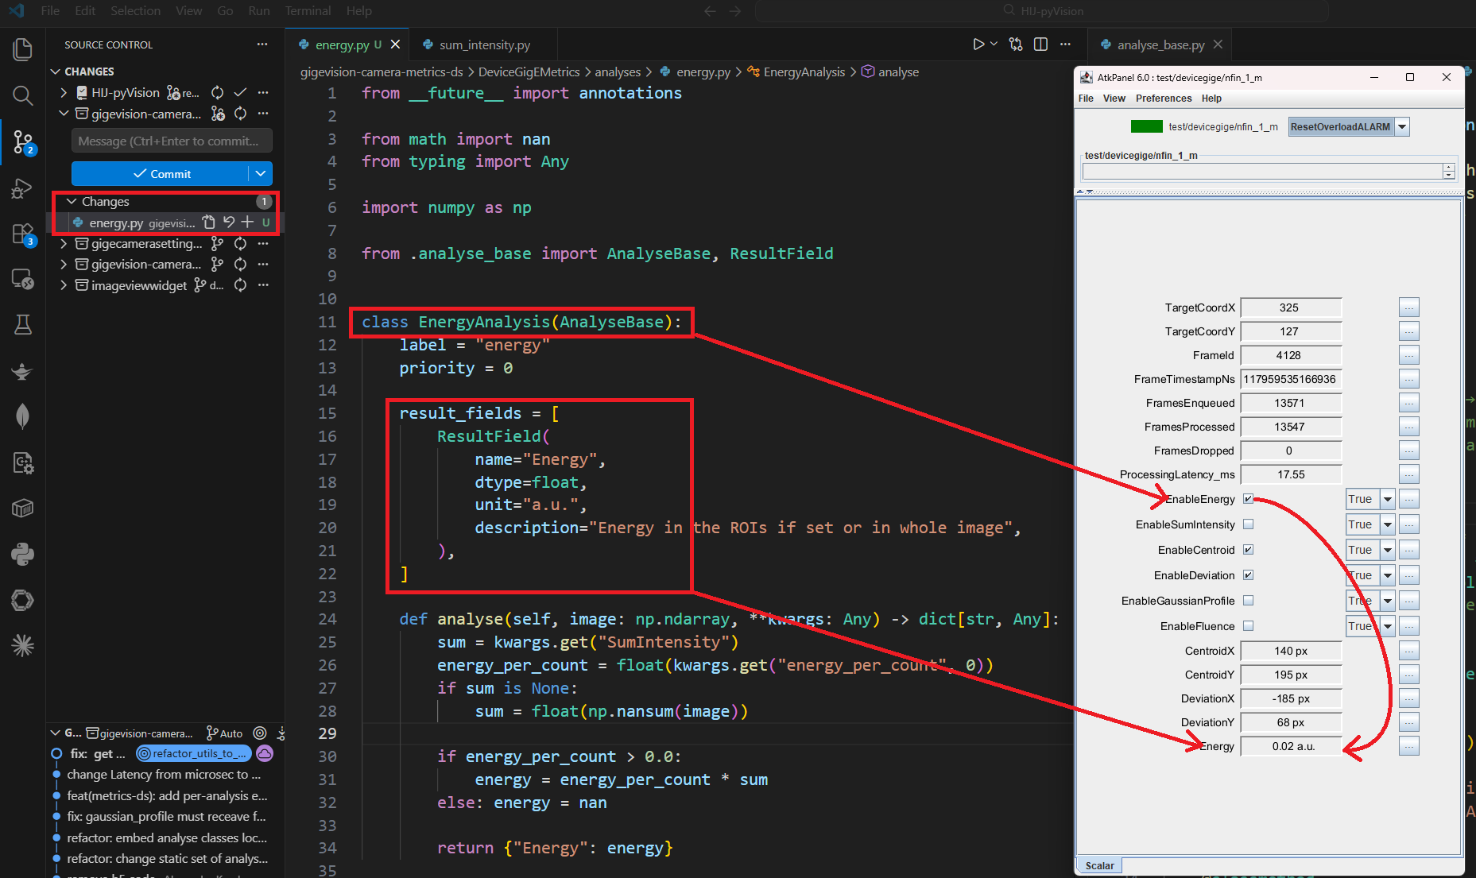
Metrics Device Server
Results pushed as change events with timestamp of the image
Overflow detection
plugin pattern for analysis classes
  Distance, Deviation, Fluence, FWHM, Gaussian Fit
  Adding new classes (e.g energy) by inheriting from the AnalyseBase
User selects active metrics

Slide 16
HIJ-pyVision: Taurus Widget
Image display with live overlays from Metrics DS attributes
  ROI (Region of Interest)
  Target Point and Centroid Cross
  Distance for Line ROIs
  Settings persisted via Cam-DS and synchronized between widget instances
  dynamic adjustment of context menus according to Metrics-DS settings is in progress

Slide 17
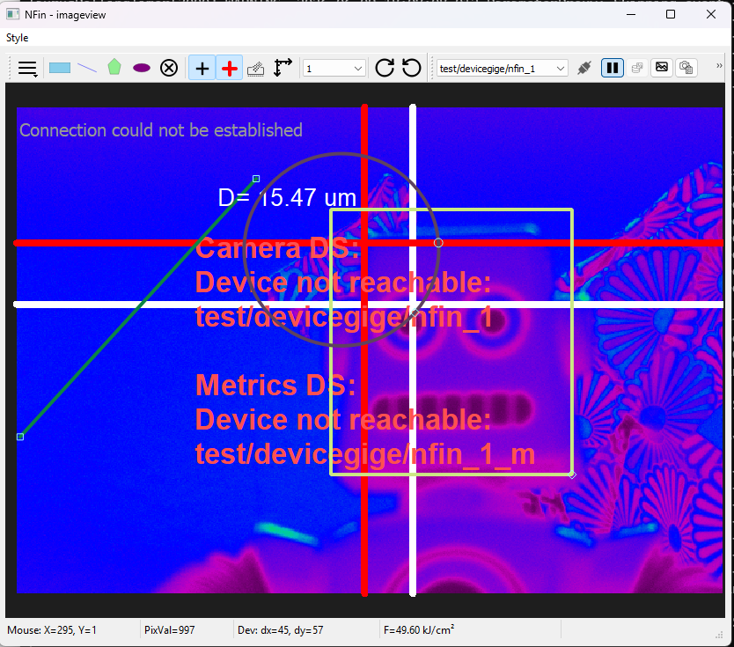
HIJ-pyVision: Taurus Widget
Image display with live overlays from Metrics DS attributes
  ROI (Region of Interest)
  Target Point and Centroid Cross
  Distance for Line ROIs
  Settings persisted via Cam-DS and synchronized between widget instances
  dynamic adjustment of context menus according to Metrics-DS settings is in progress

Slide 18
Summary and next step
tailored vision stack for laserlabs
adaptable for other needs
free and open source
100% python
extendable for special cams and image sources
FAIR data format
integrated in Sardana
tests!
https://gitlab.com/hij-s2innovation/hij-pyvision
add 12bit packed mode
Tango supports 16bit array -> add compression images and send via bytestreams

Slide 19
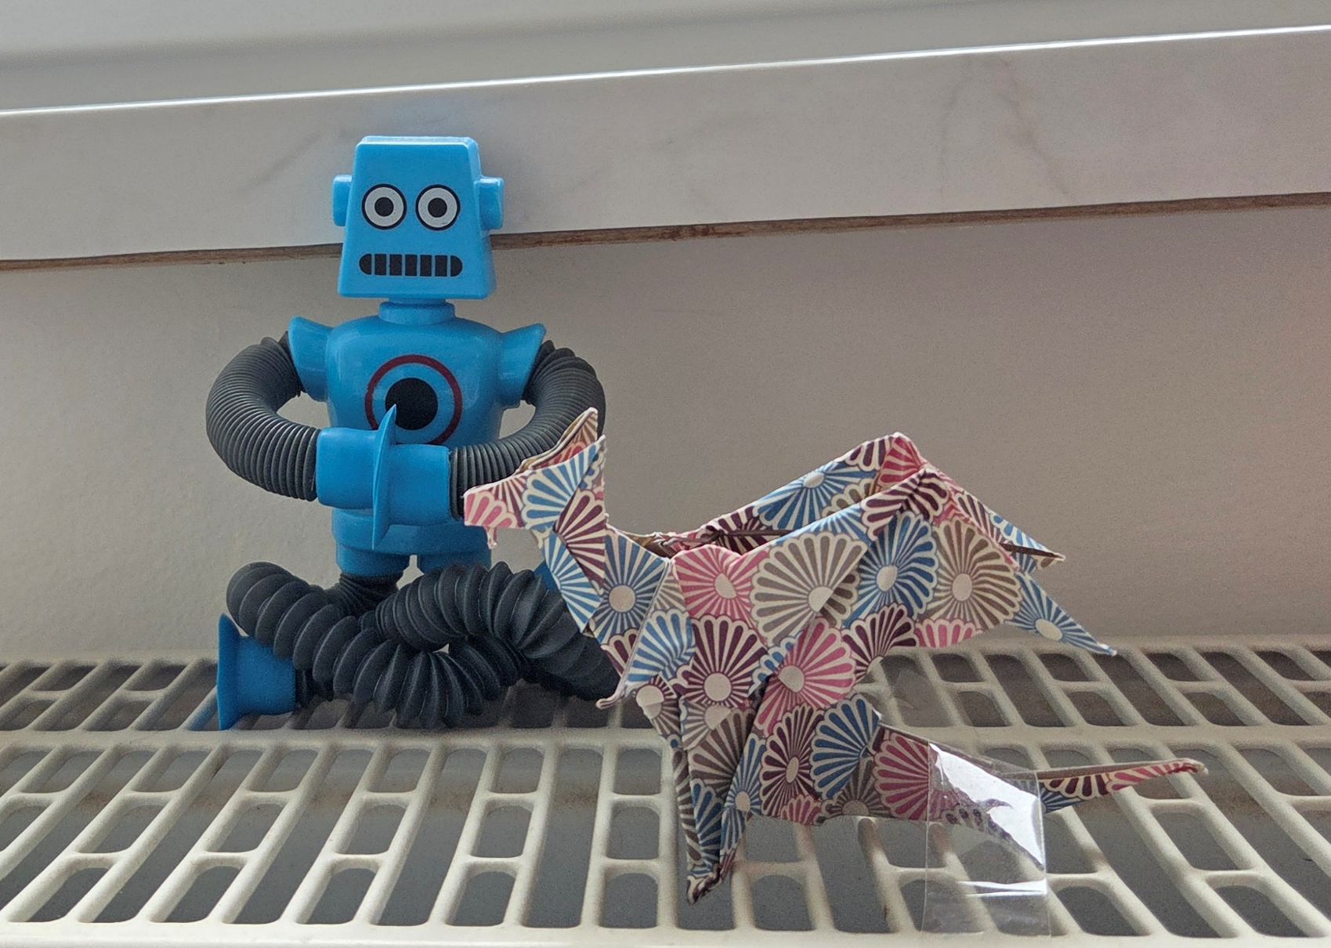
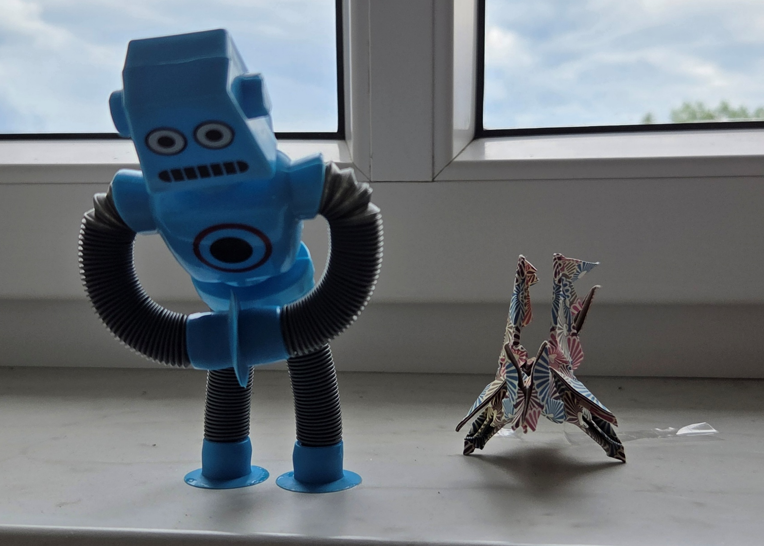
Acknowledgments
Thanks to
  Adrian Justyniarski
  Wojciech Kitka
  Michał Hemperek
  Tomasz Madej
  Lukasz Zytniak
  …and whole S2Innovation team
Thank You for Your Attention! 🙇

