Slide 1
Operation of a Liquid Leaf target system for laser-driven ion acceleration using Tango Controls
Mykhailo Salan F. Schweiger, X. Chen, M. Bachhammer, L. Doyle,
S. Gerlach, L. He, S. Henzelmann, J. Schreiber
June, 2026
Chair of Experimental Physics – Medical Physics
Laser-Ion Acceleration Group, Prof. Dr. Jörg Schreiber

Slide 2
Table of Contents
Introduction
Laser-driven ion acceleration
Experimental setup, Liquid Leaf
Whitelight sensor
Nozzle motors
Overview

Slide 3
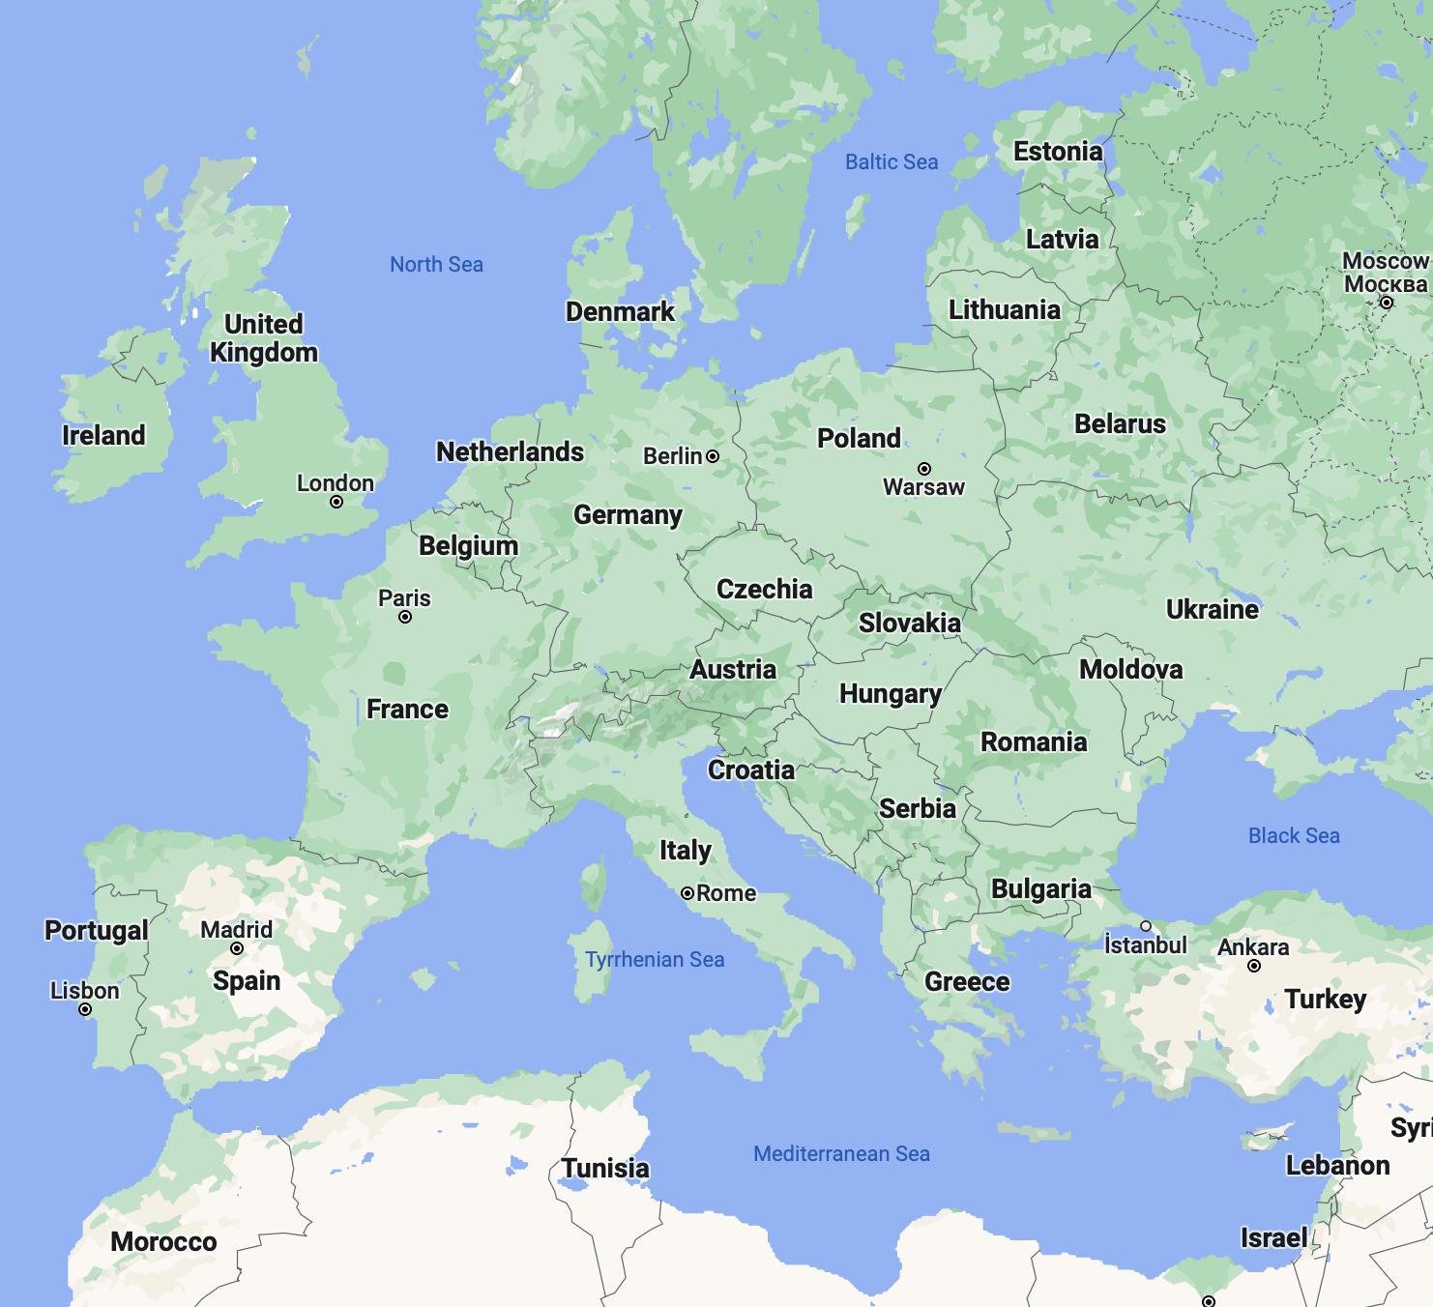
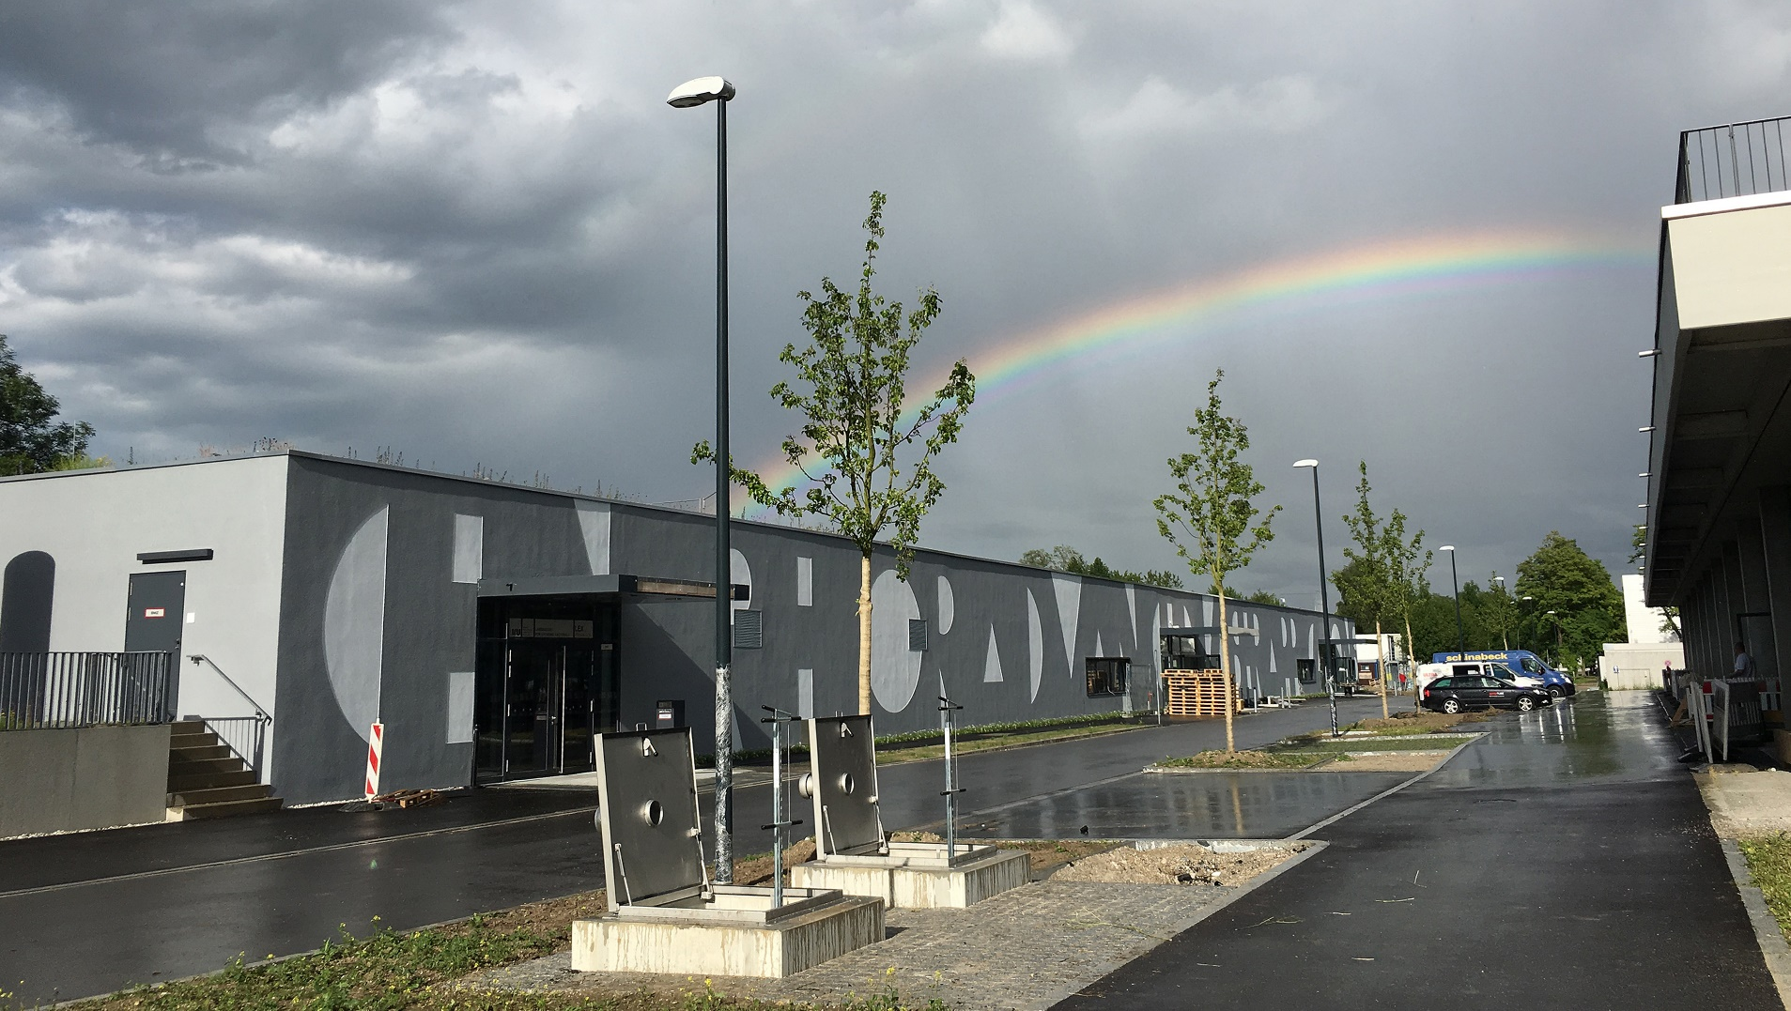
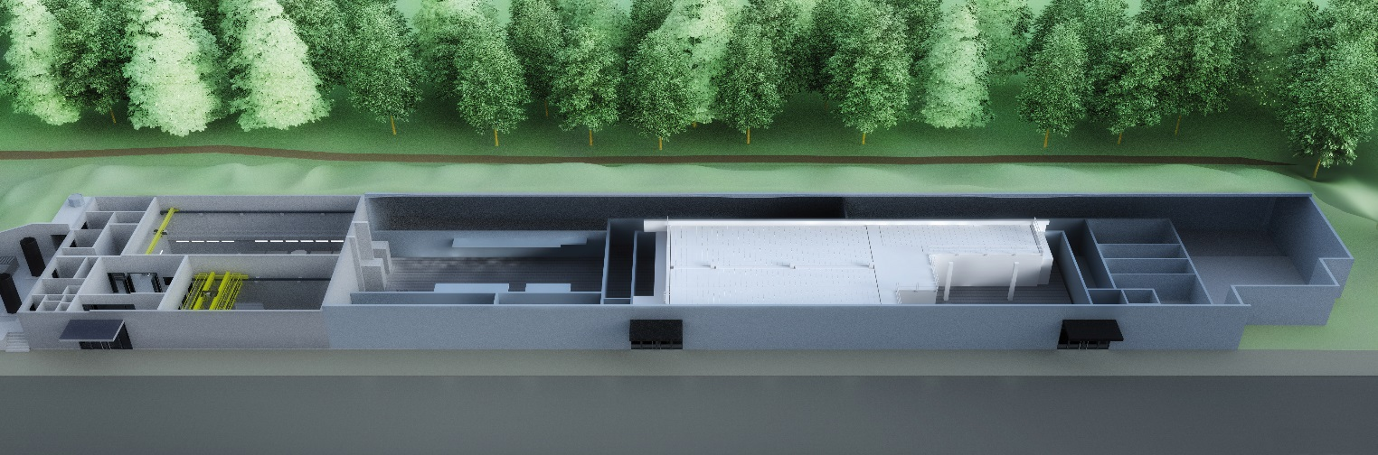
Centre for Advanced Laser Applications
Fig: Google maps
ATLAS (2.5PW)
LION
HF
ETTF
ATLAS 3000
2.5 PW, 1Hz, 27fs
Protons, Ions
Electrons, X-rays
High field, heavy ions

Slide 4
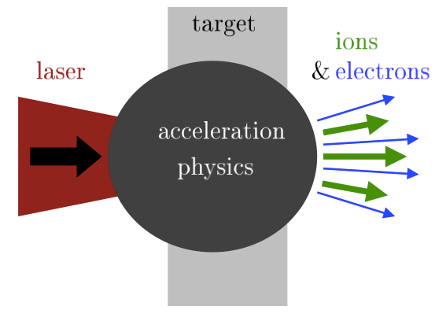
Laser-Ion Acceleration in a Nutshell
Many interesting properties:
Ultra-high peak currents
Broad energy distribution
Relativistic particles
…
?
Many useful applications:
Radiobiological experiments
(in context of radiotherapy)
Research in astrophysics
…
Fig: Macchi, 2017

Slide 5
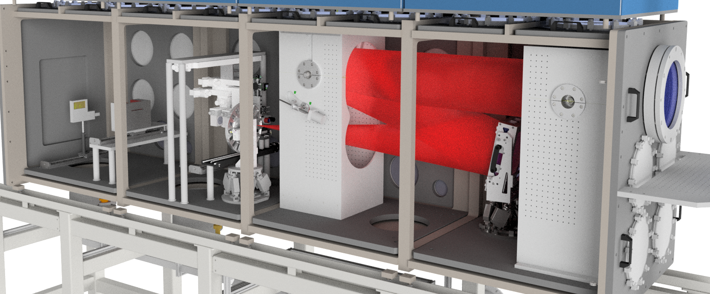

Big-Picture Setup
Target positioning system
Wide angle spectrometer
f/5 off-axis parabola
Permanent magnet quadrupoles

Slide 6
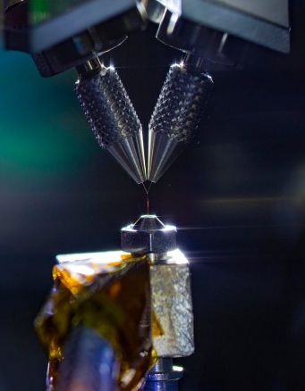
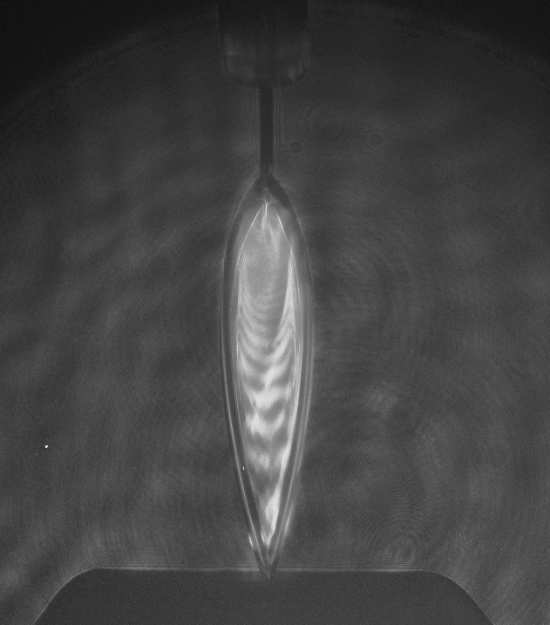
Liquid leaf target (Star of the show)
FRONT VIEW
4 µm
Two colliding water jets
Thickness
Liquid leaf enables unlimited
1 Hz ion acceleration!
0.8 µm
1 mm
6

Slide 7
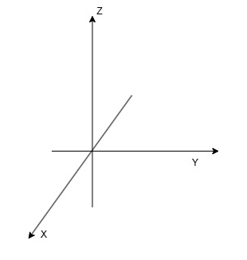
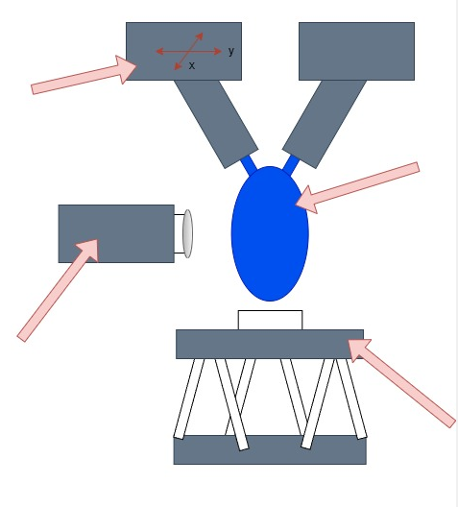
Target Hardware setup
Nozzle system
Is placed on
The hexapod
Nozzle motors
(xy movable)
Liquid leaf
Microscope with
Whitelight sensor
Several cameras
Hexapod
(xyz movable + 3 angles)
7

Slide 8



Motivation for Tango
Nozzle displacement after laser shot
→ needs automated nozzle alignment
Automate target thickness measurement routine
→ Implement target system in
Device | Tango implementation
Hexapod
Nozzle motor
Whitelight sensor
Cameras
8

Slide 9
Whitelight Sensor
9

Slide 10
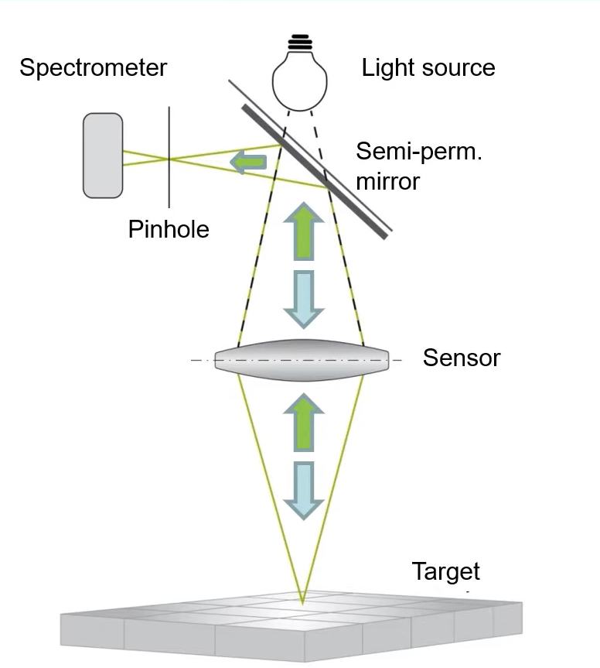
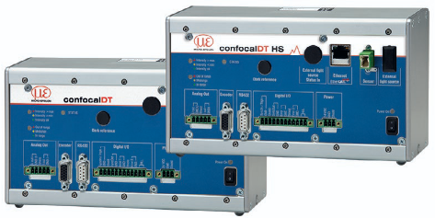
Whitelight sensor
(ConfocalDT2451, Micro-Epsilon)
Has a built-in spectrometer
Has an internal LED
10

Slide 11
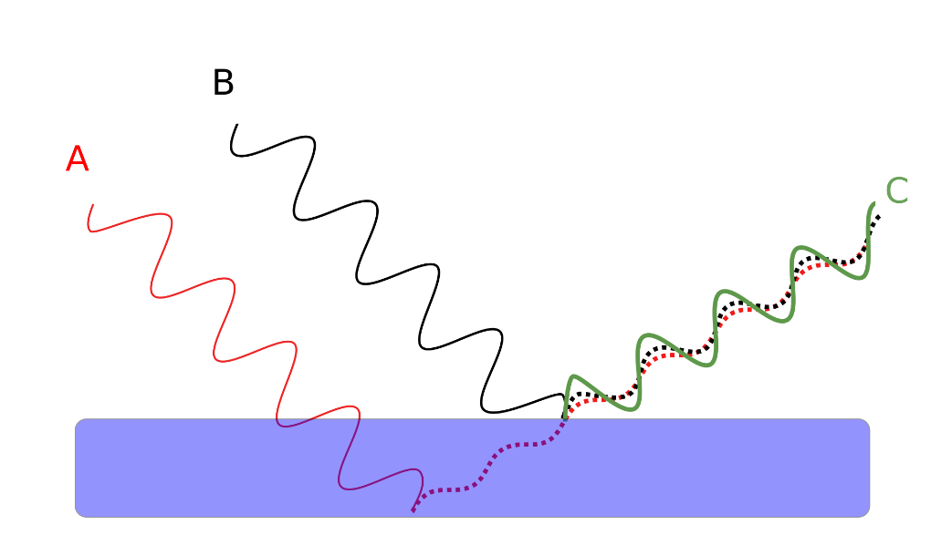

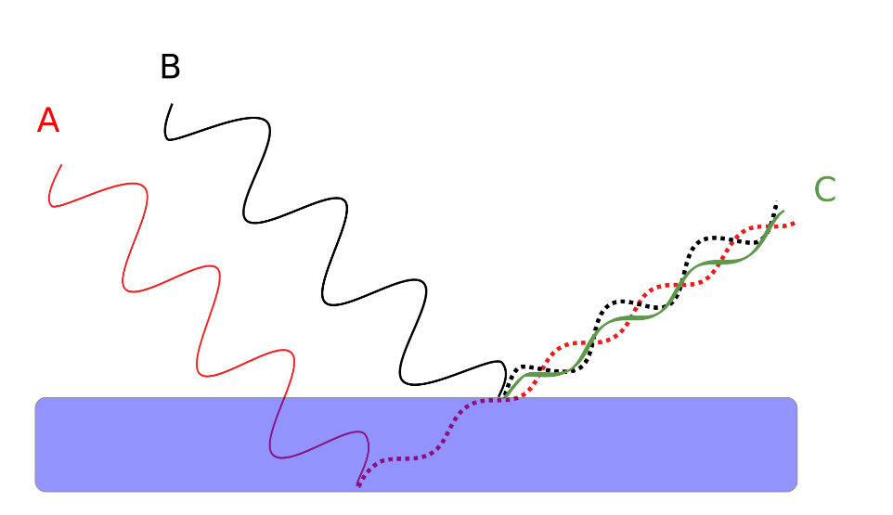
Thickness Measurement –
Thin-film interference
Water-mixed diesel thin film
By Jhbdel - using inkscapePreviously published: unpublished,
CC BY-SA 3.0, https://commons.wikimedia.org/w/index.php?curid=25234684
11

Slide 12
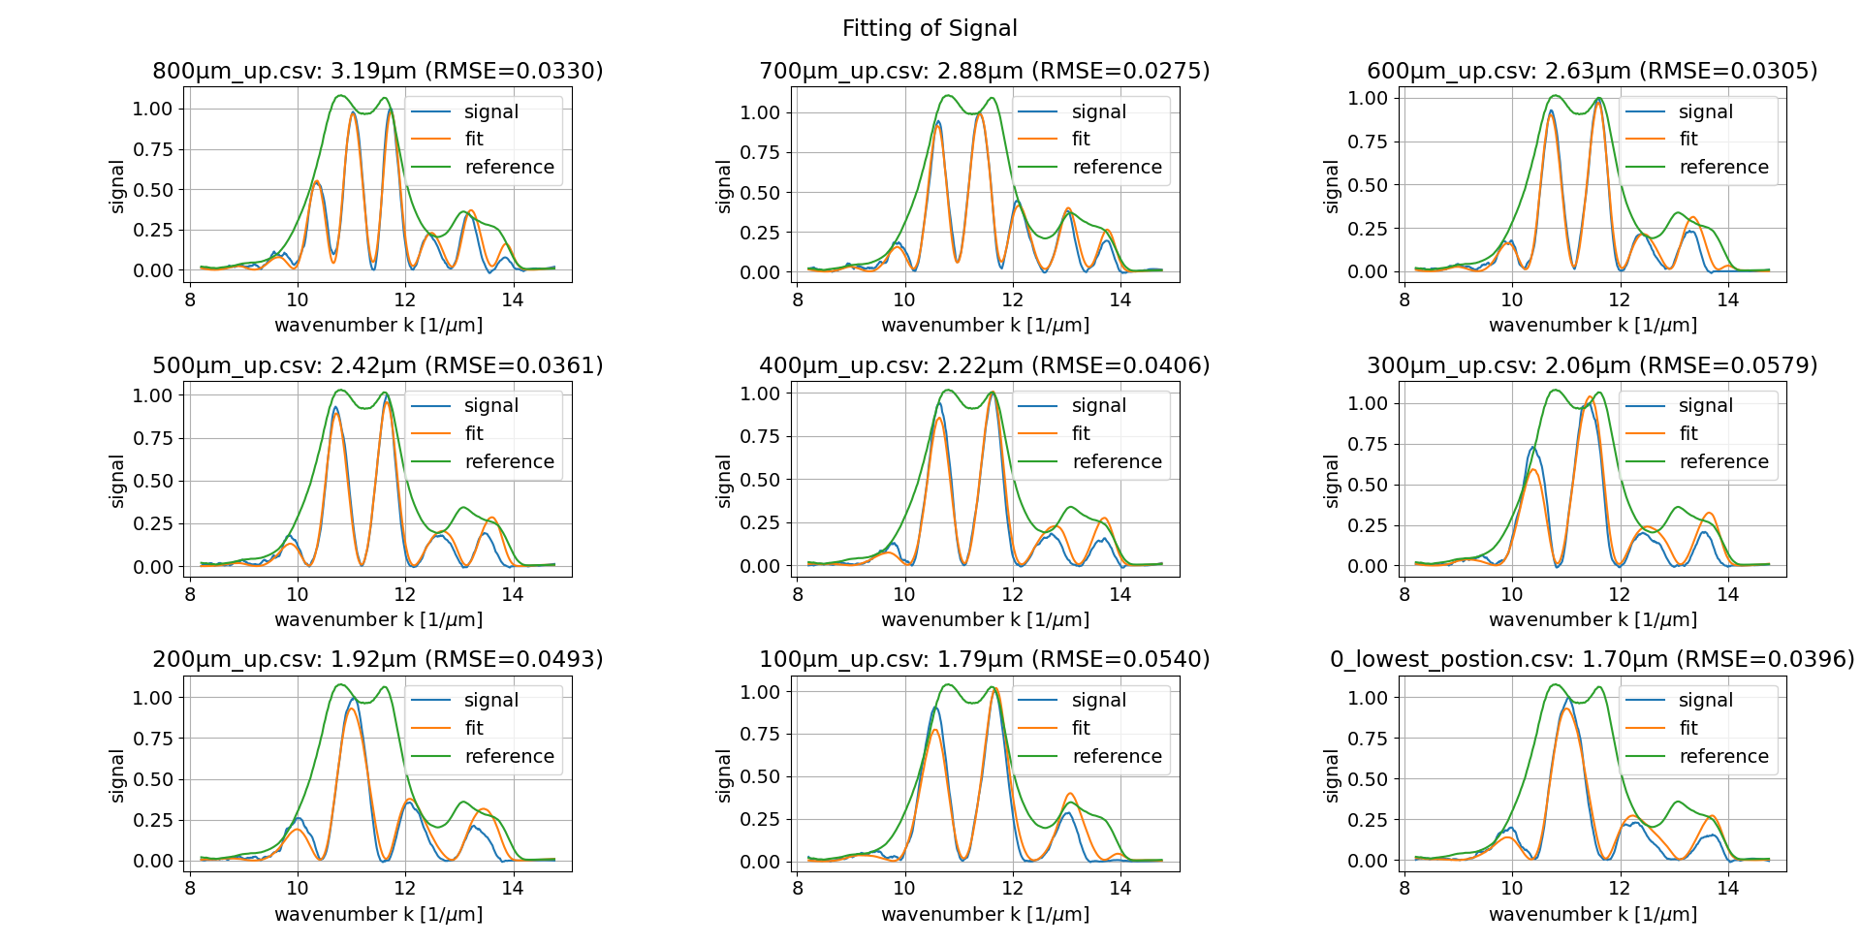
Numerical fit
Michael Bachhammer
12

Slide 13
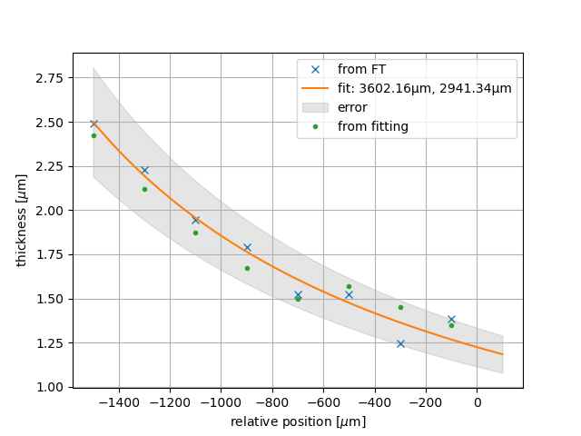
Thickness along target height
13

Slide 14
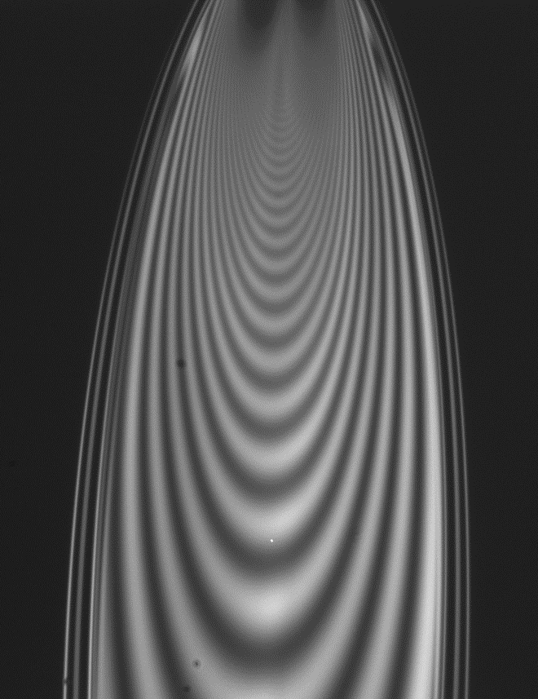
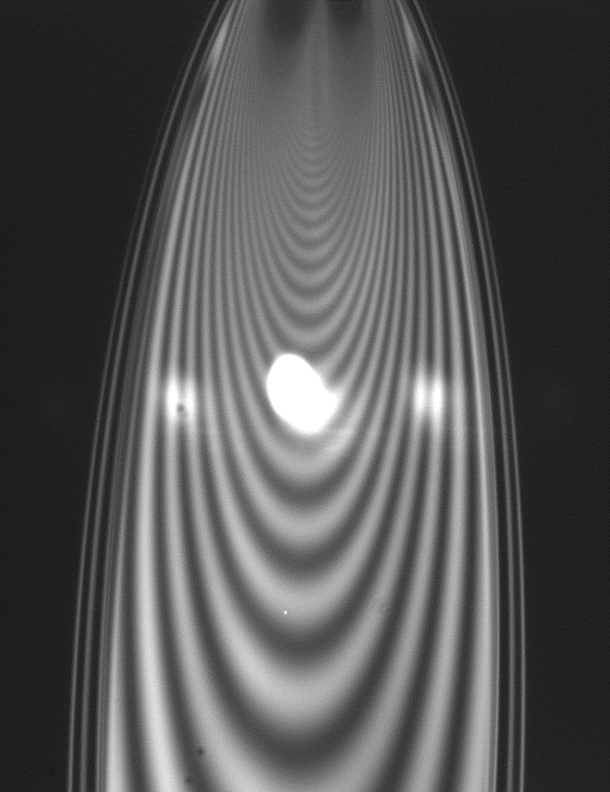
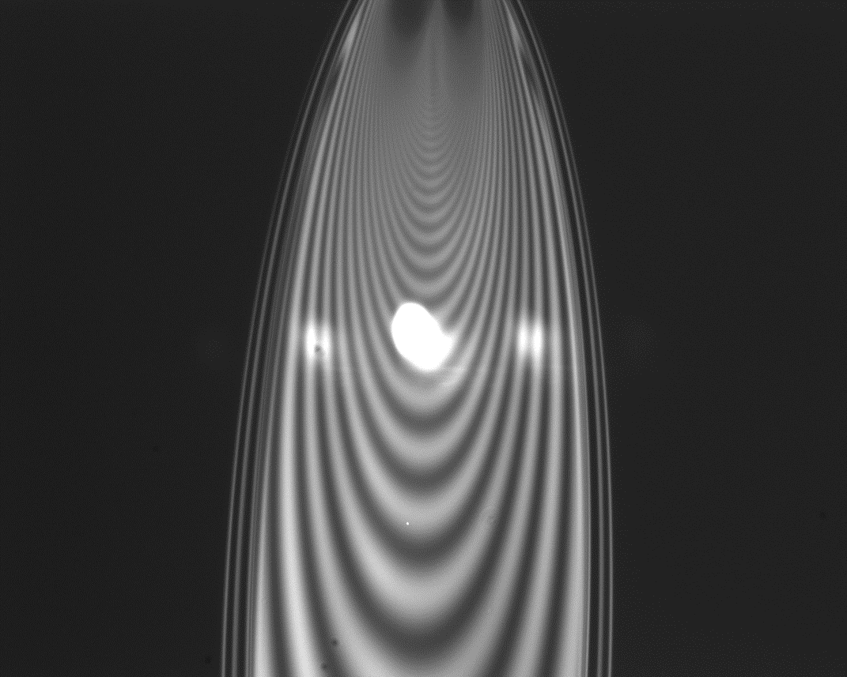
Thickness measurement process
thin-film interference pattern provides relative thickness map
FRONT VIEW
absolute thickness value via white light interferometry
1 mm
14

Slide 15
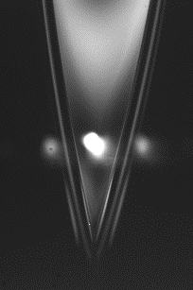
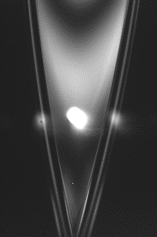
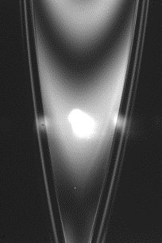

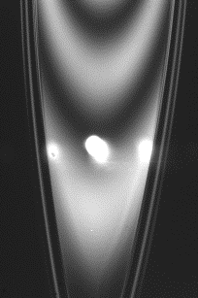
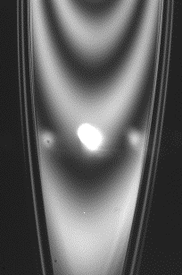
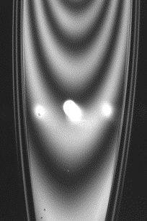
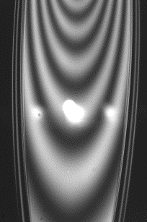
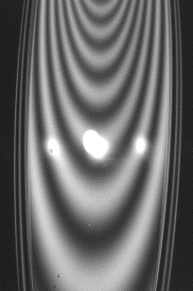
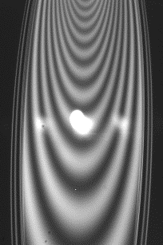
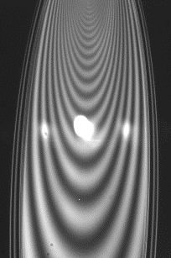
Thickness measurement process
Relative thickness map allows for
automatic selection of measurement points
Simplify operation
More reproducible comparable data
Position-thickness profile
15

Slide 16
Nozzle motors
16

Slide 17
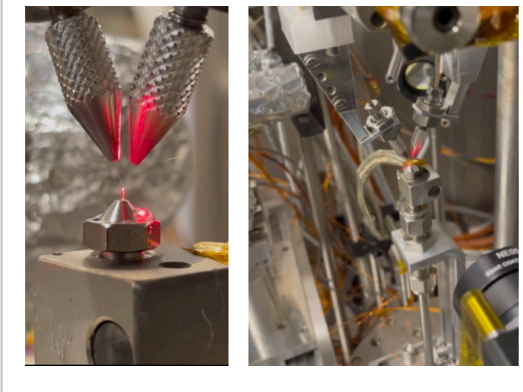
Nozzle motors
Smaract MCS2 Motor Controller
Smaract motors
Currently : manual alignment
Planned : automatic self-alignment
17

Slide 18
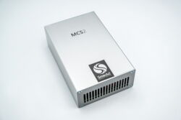
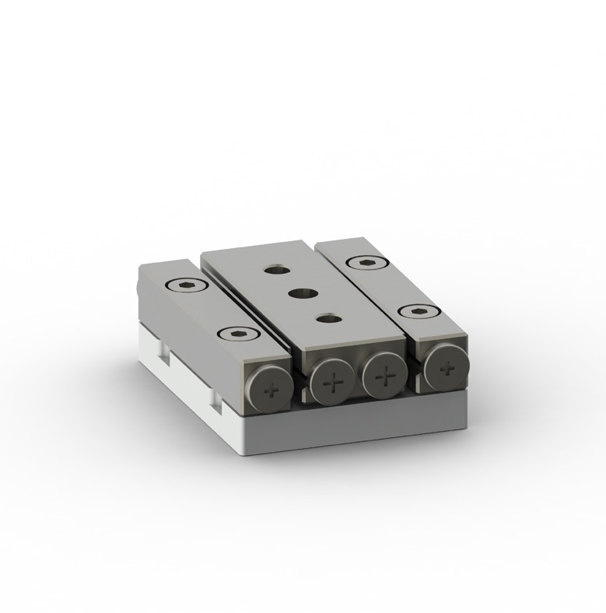
Nozzle Motors — Tango Structure
Handles communication with Hardware
→Clean Tango Classes
Wrapper Package
Tango Devices
Motor 1
Motor 1
Motor 2
Controller
Controller
Device Proxy
Motor 2
Temp
IP-adress
…
Motor 2
Tango Controller Class: MCS2Ctrl.py
Motor 2
Move
Position
…
Controller Class: Device.py
Tango Motor Class:
MCS2Motor.py
Motor Class: Channel.py
18

Slide 19
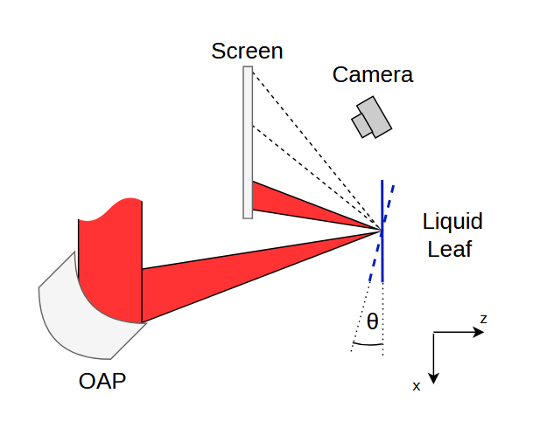
Liquid Leaf self-alignment
Currently : manual correction
  Time consuming
  Human error
Planned : automatic self-alignment
Closed loop stabilization of
Liquid Leaf rotation
19

Slide 20
Summary
Current status:
Tango implementation of hexapod and cameras, data archiving.
Manual target thickness measurement and alignment
Planned:
Automate thickness measurement
Closed-loop stabilization of Liquid Leaf rotation
→ 1Hz laser ion acceleration
20

Slide 21

Acknowledgments
Thanks to all the people at CALA
This work has been funded by the Centre for Advanced Laser Applications and the Deutsche Forschungsgemeinschaft (DFG) under Grant No. 558546291.
Many of our projects are publicly available at our GitLab :
https://gitlab.lrz.de/cala-public

Slide 22
Questions ?
(Mykhailo.Salan@campus.lmu.de)
22

Slide 23
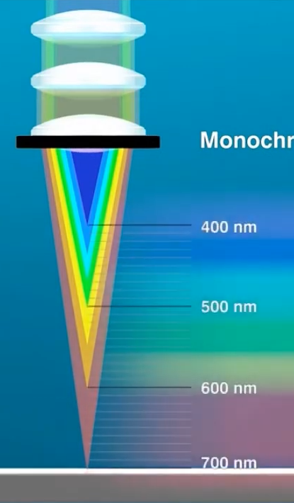

Thickness Measurement – confocal chromatic sensors
Only works up to
5µm, leaf is thinner
23

