Slide 1

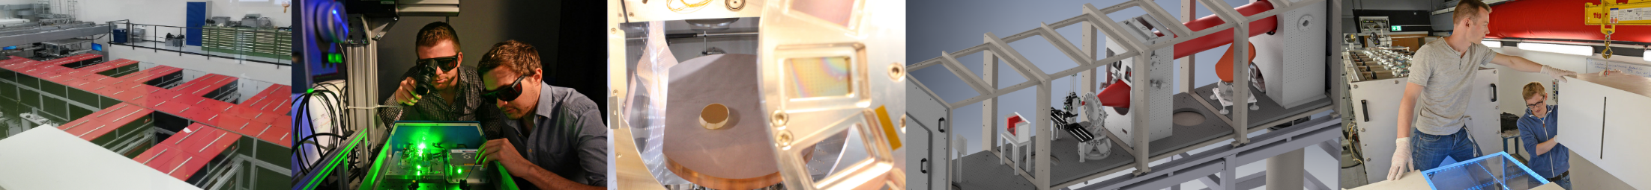
Tango Control infrastructure and automated laser alignment at CALA
S. Henzelmann(*), F. Schweiger, M. Bachhammer, L. Doyle, A. Döpp, S. Gerlach, T. Pohle, M. Salan, J. Zirkelbach
Prof. Dr. S. Karsch, Prof. Dr. J. Schreiber
(*) sebastian.henzelmann@campus.lmu.de
Notes:
Vorname als Initiale

Slide 2
Outline
Overview: Cala & Tango
Automated Alignment of the Laser
Monitoring & Control
Summary

Slide 3
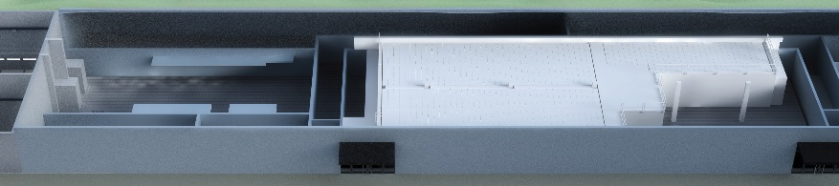
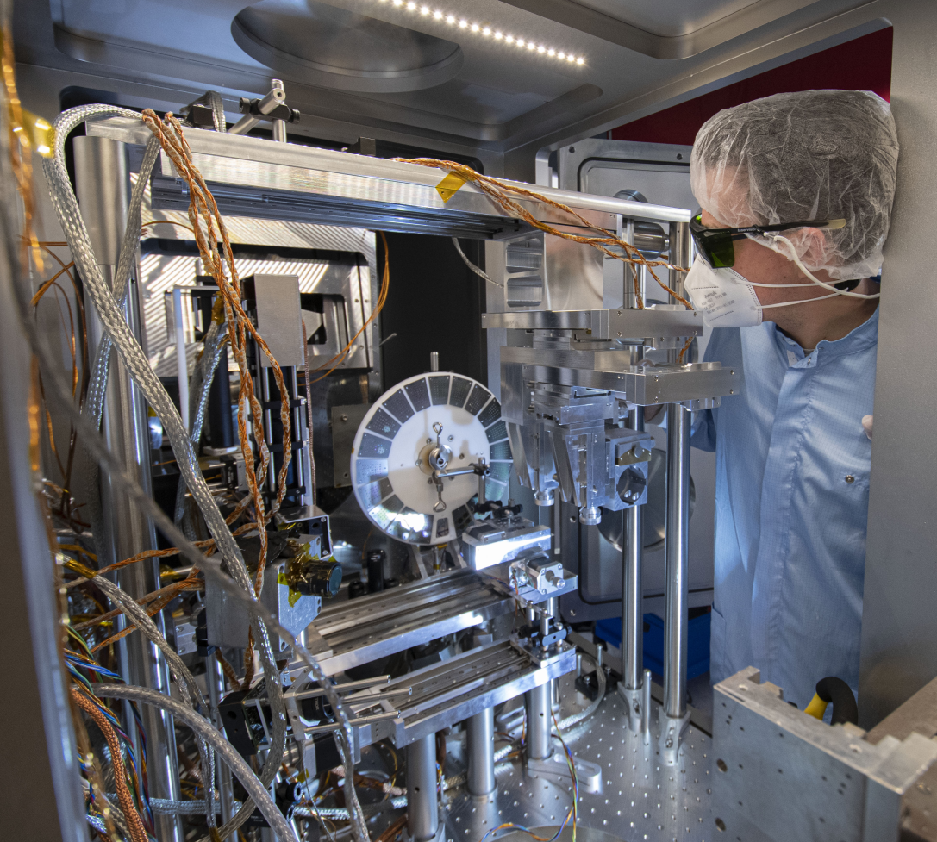
ATLAS-3000 laser and experiments
LION
ATLAS
LUX
ETTF
SPECTRE
Centre for Advanced Laser Applications in Garching near Munich, Germany
  University lab, Facility and Tango is student-run
ATLAS-3000
  Ti:Sapphire laser
  60J in ~27fs at 1Hz rate (~2.5PW peak power)
  multiple research groups
Notes:
In operation since 2017, currently ~500TW

Slide 4
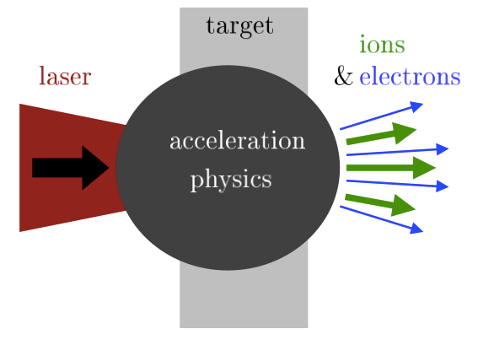
Laser Driven Ion Acceleration (LION)
New kind of accelerator:
Single shot operation
µm
Many interesting properties:
Ultra-high peak currents
Broad energy distribution
…
Many useful applications:
Radiobiological experiments
Probing of ultrafast processes
Research in astrophysics
…
Notes:
neue art von beschleuniger ,mit laser, im singel shot prinzip
Solid and gas but we do solid density with water leave
One example is LION (Laser driven ION acceleration)
Take on laser and shot a extremely short laser puls of 27fs with a peakpower of 2.5PW at a target which is only a few µm thick
→ High intesity accelerated protons and electrons
These particels have interesting propertiers and useful applications
But what here is labeled with one simple word ‘Laser’ is actually an understatement for a machine which is able to produce a of up to 2.5PW

Slide 5


Tango infrastructure overview
Python + PyTango only
>800 devices on 5 TANGO_HOSTs
9 VMs (AlmaLinux)
~40 Windows hosts
9 Raspberry Pis
Limited work force
Tango maintenance + development by PhD students and student assistants
Very good support from university IT
Archiving:
  on-shot (up to <1Hz)
  Text files, PNGs
  <300GB per day

Slide 6
Automated Alignment of the Laser

Slide 7
ATLAS-3000
ATLAS-3000 main amplifier: 90J, 1Hz
by THALES
Notes:
Laser start here on the left →
→ takes up a lot of space
Very long beam path
We need to align the of mirros very carefully ervery time to point the beam at the right point
To safe time and improve reproducibility: build multible automated aligement system
(later: GUI required to manage all the stages and have a overview over the energies, etc.

Slide 8
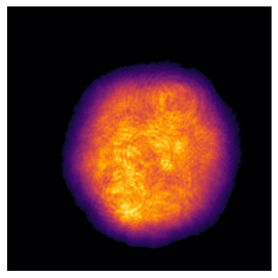
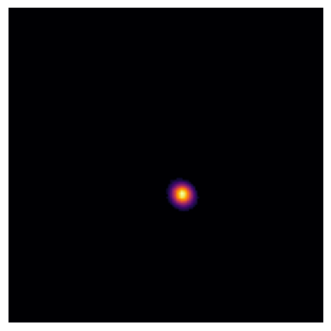
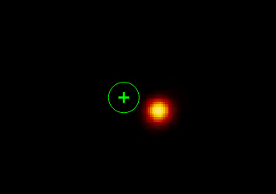
Automated aligment
Motorized mirrors
Motor Controller
Far field camera
Near field camera
Leakage
mirror
Normal
beam path
Correction distance
Lens
Target position +
Region
Beam Position
Near field
camera
Beam splitter
Far field
camera
Notes:
Motivation: Why we want to stabilize laser systems? causes

Slide 9
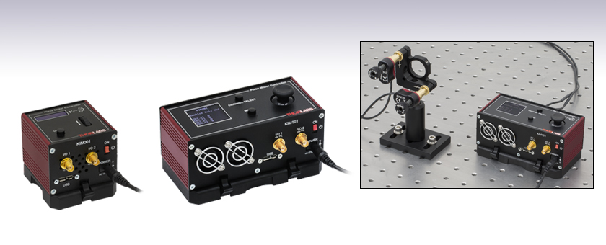
Scripted control: Active laser drift stabilization
Motor Controller
Communication with motor
Correction movement
Beam Position = (32,50)
Camera
Image Cleaner
Image Calculator
Drift Stabilization
Image
Image
Trigger
Communication with camera
Background subtraction
Region of interest
Thresholding
….
Center of mass
Circle Fit
…
Averaging
Calculate correction
Machine-Safety:
Figure of Merits: beam area, integral
…
Timestamp of the image is preserved
Notes:
Timestamp of original camera image is forwarded …
And each of these steps is performend on a single Tango Device:
Individual device can be used for multible differend purposes, multiusage
Each device can run on different computers
Cool thing about this is we can let it run autonumasly
Automated aligement but also drift stabi.. Throughout the day

Slide 10
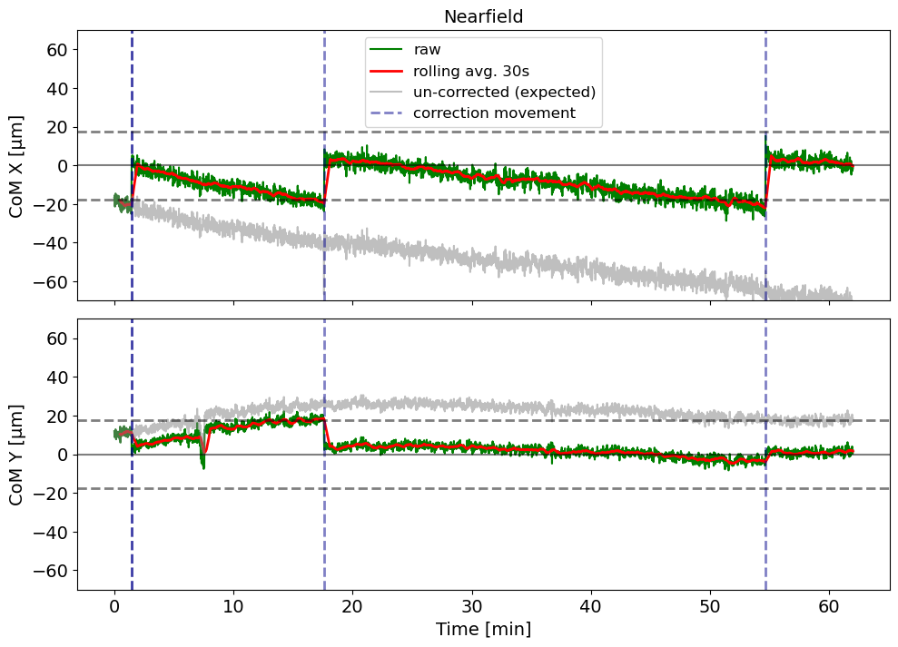
Example
70 µm
Autonomous Drift Stabilization
16.5 µm
Notes:
Target region in graph is significantly bigger than in the application -> normaly range of jitter
Grey: expected behavior

Slide 11
ATLAS-3000 system and experiments
8 stations planned / 4 built / 3 in daily use
Present: auto alignment & supervised stabilization
  Significantly reduced turn-on times of 2-3h by 1h
Next step:
  build more stations
5
4
7
8
6
2
3
1
Notes:
Laser start here on the left →
→ takes up a lot of space
Very long beam path
We need to align the of mirros very carefully ervery time to point the beam at the right point
To safe time and improve reproducibility: build multible automated aligement system
(later: GUI required to manage all the stages and have a overview over the energies, etc.

Slide 12
Monitoring & Control
Notes:
Multiple research groups but this also means
Huge amount of different manufactures and devices which all need to be controlled with Tango → all need to be merged into one system

Slide 13
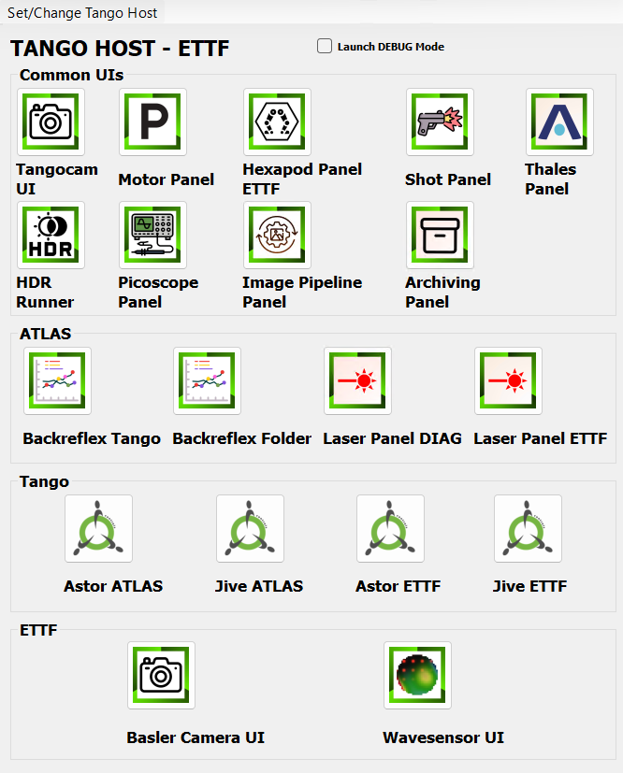
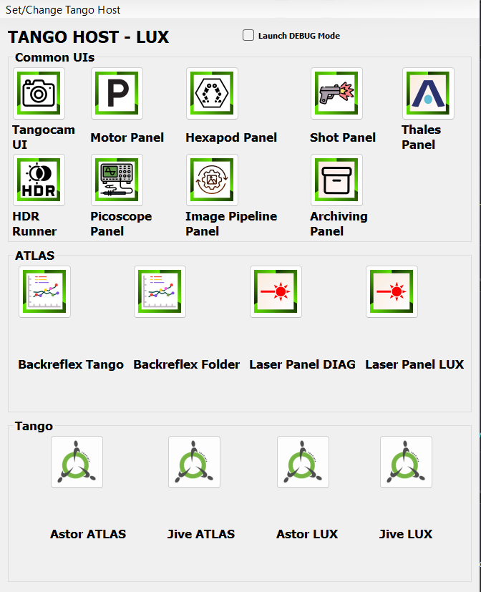
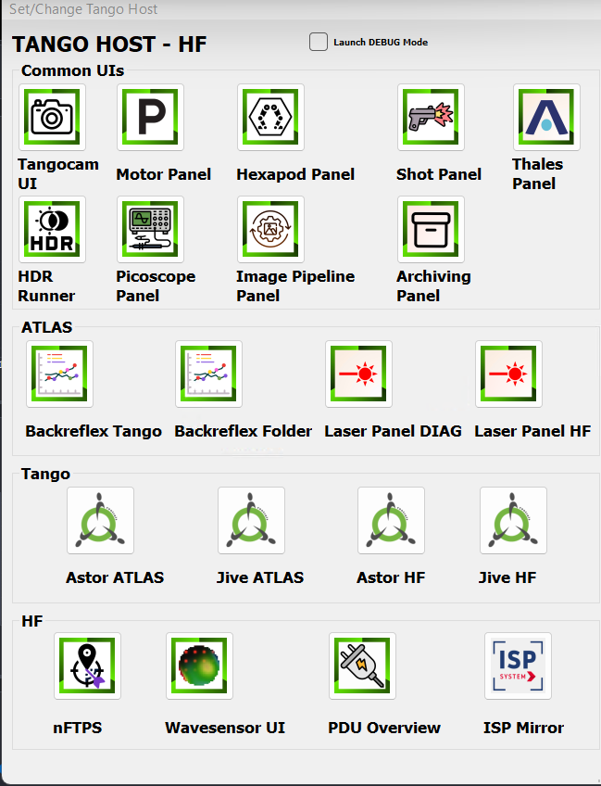
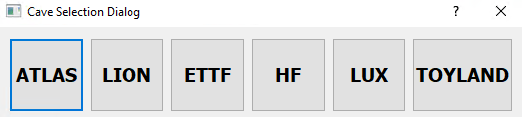
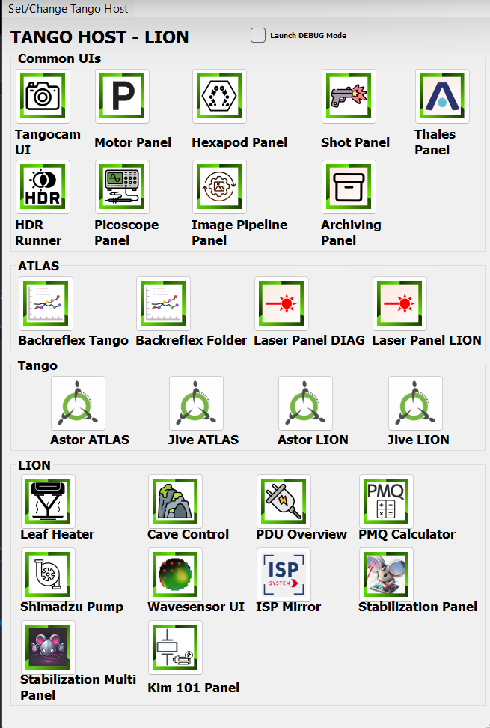
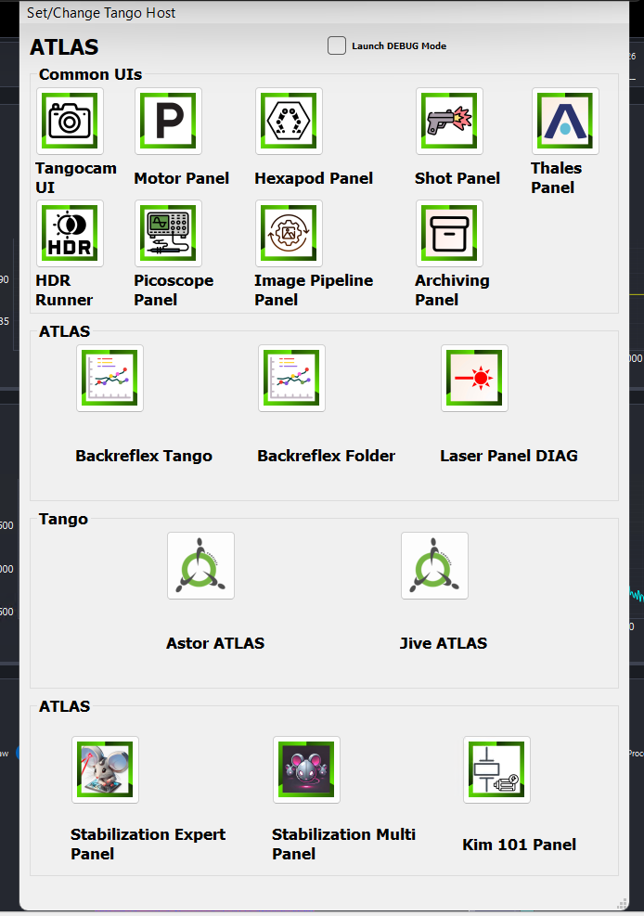
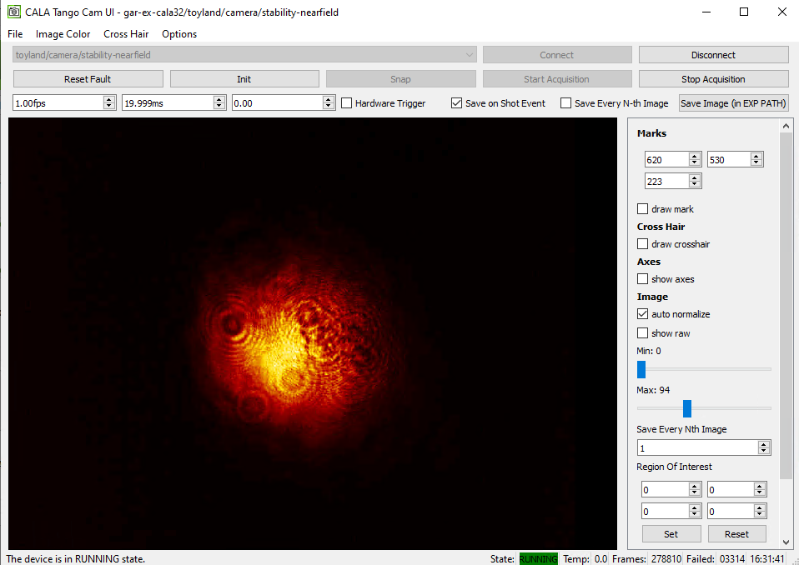
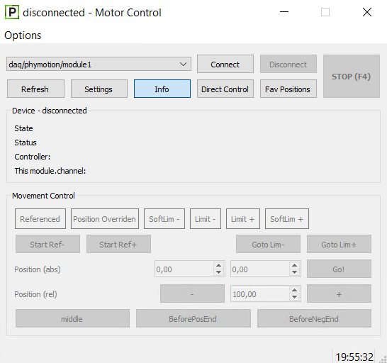

Monitoring & Control
Tango Launcher
Launches different GUI panels form network drive
User can change between different TANGO_HOST
→ specific for individual research groups but also clear separation
Notes:
In order to have a good overview over the different groups we use the Tango Launcher
Launches GUIs e.g. camera GUI
Also we have a tango host for each group and the Laser
Konkrette andere beispiel mit screenshots
Build with pyqt with partialy taurus + Logos

Slide 14
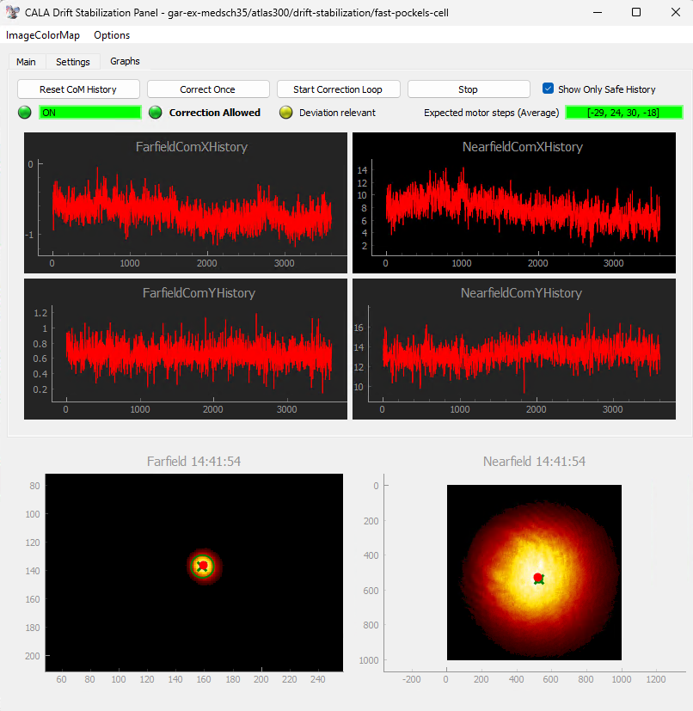
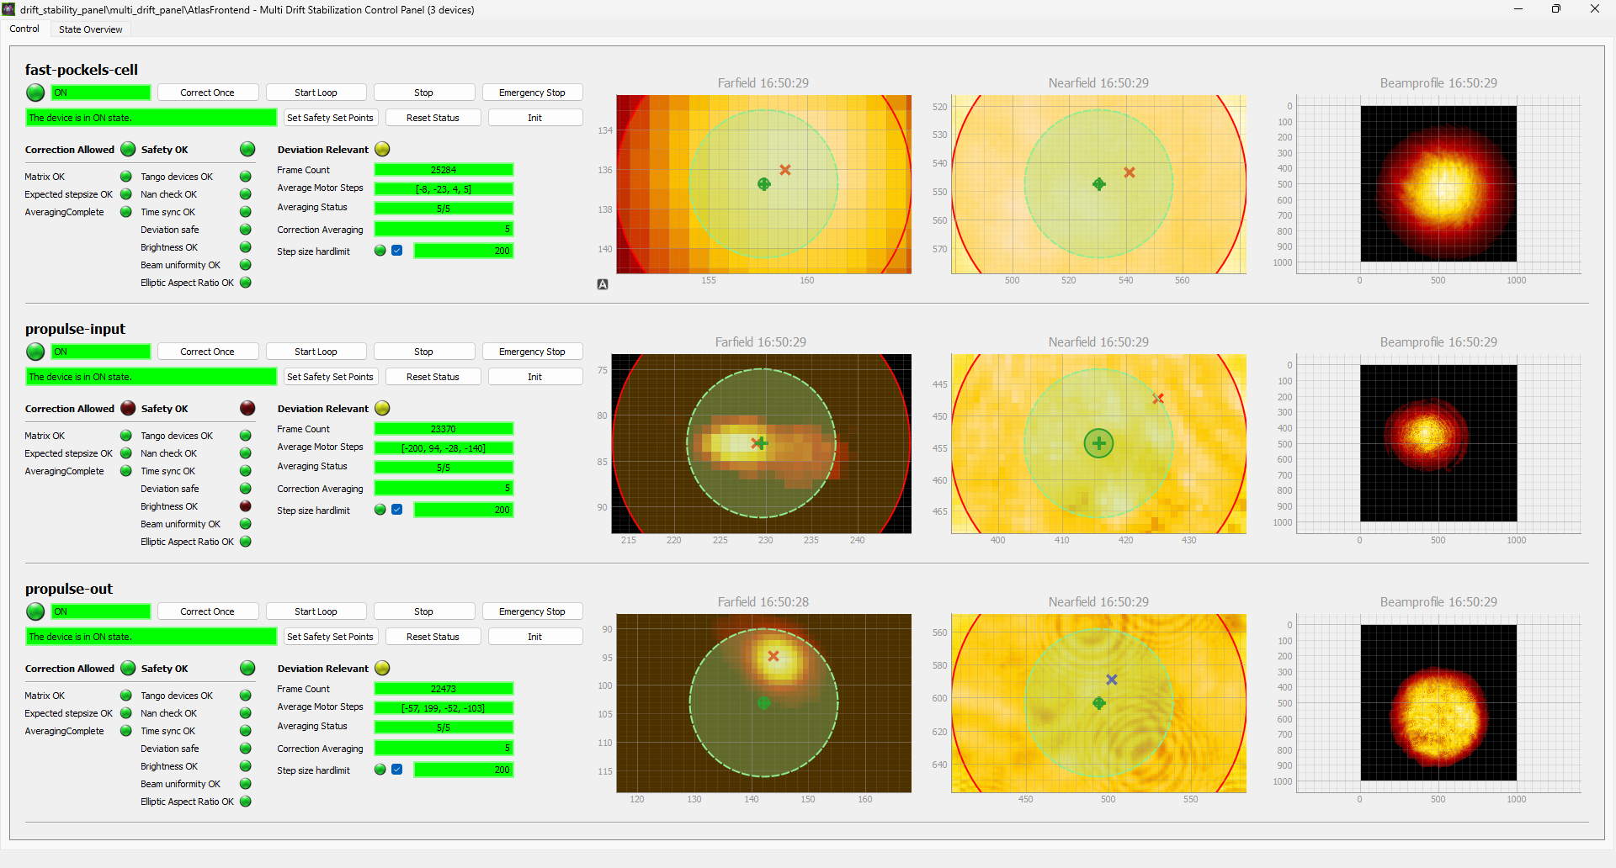
Monitoring & Control
Notes:
Expert panel: all settings → for experts and maintenance
Multipoanel: daily use, and overview → hide settings shich should not be changed in normal betrieb

Slide 15
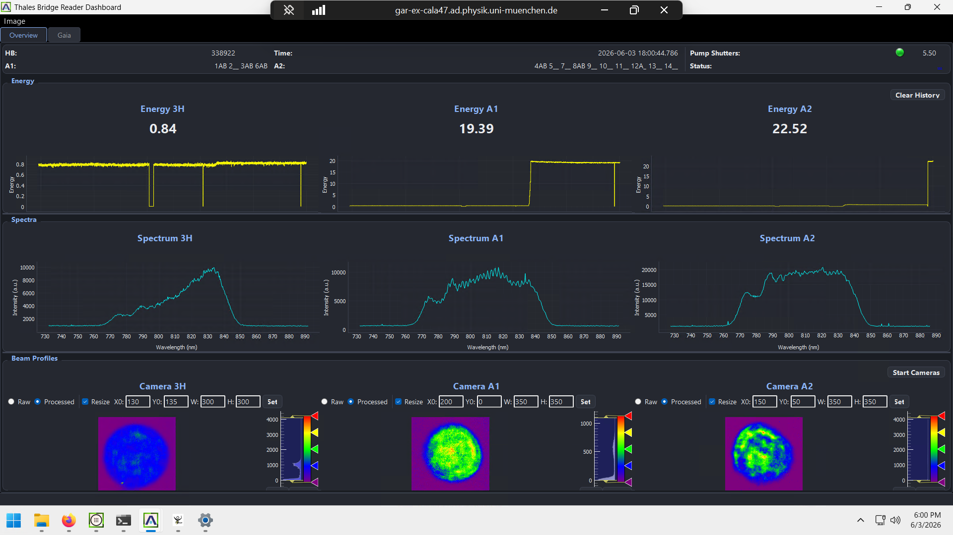
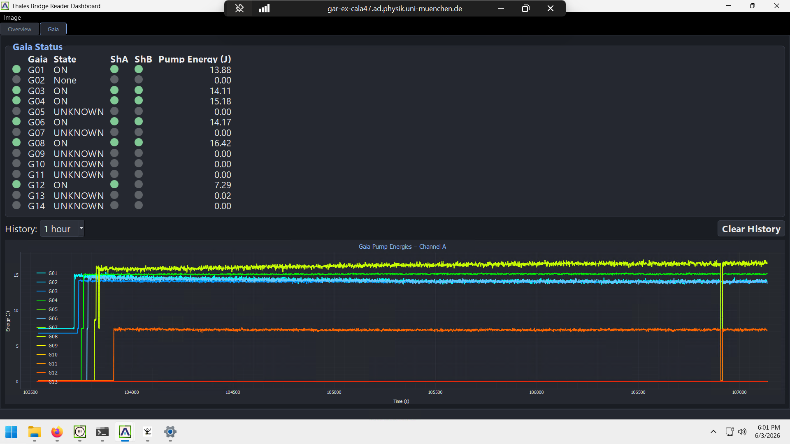
Monitoring & Control
Notes:
Standarisiertung vom Lasersystem, all information in one panel → taurus is extremely usefull…
Don’t bash thales !!!!!

Slide 16
Summary
Student-Run Infrastructure:
  ATLAS-3000 laser system
  Python and PyTango-only environment
Active Laser Drift Stabilization:
  automated alignment of the laser
  counter beam drift
  reduced system turn-on times from 2–3 hours down to 1–2 hours
Streamlined Monitoring & Control:
  Custom Tango Launcher
  unified, user-friendly Tango GUI panels allowing different research groups to easily monitor and switch hosts

Slide 17

Acknowledgement
Thanks to all the people at CALA
This work has been funded by the Centre for Advanced Laser Applications and the Deutsche Forschungsgemeinschaft (DFG) under Grant No. 558546291.
Many projects and devices are publicly available in our Gitlab:
  https://gitlab.lrz.de/cala-public
Notes:
summary

Slide 18
Backup
Backup

Slide 19
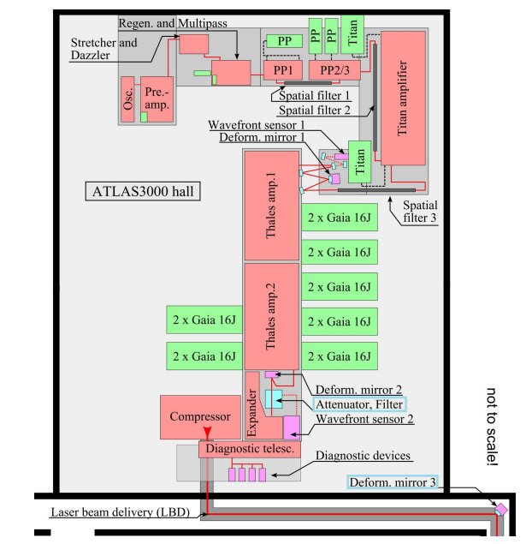
Stretcher Near Field
4
5
8 stations planned / 4 built / 3 in daily use
Present: auto alignment & supervised stabilization
  Significantly reduced turn-on of times of 2-3h by 1h
Next step:
  build more stations
6
2
3
7
8
1

Slide 21
Monitoring & Control
Special needs:
Needs to be easy to learn
Different research groups
Many different devices from different manufactures
Tango Launcher
Launches different GUI panels form network drive
User can change between different TANGO_HOST
→ specific for individual research groups but also clear separation
Notes:
In order to have a good overview over the different groups we use the Tango Launcher
Launches GUIs e.g. camera GUI
Also we have a tango host for each group and the Laser
Konkrette andere beispiel mit screenshots
Build with pyqt with partialy taurus + Logos

