Slide 1
June, 2026
Recent developments in the Libera Tango Device Server at Instrumentation Technologies
Tango Community Meeting
Robert Černe
robert.cerne@i-tech.si
www.i-tech.si

Slide 2
Outline
Company introduction
Tango Device Server for Libera instruments
Upgrade to use Tango framework 9.5.0 and recent evolution
Future improvement plans
Conclusions

Slide 3



Instrumentation
Technologies
Est. 1998
Data acquisition and signal processing
50+ employees
Work with more than 70 research institutes around the world
Off-the-shelf products and customizations, co-development of electronics

Slide 4
Research Particle Accelerators​
Medical Particle Accelerators
Nuclear Research Reactors and Fusion
Space & Defense​
Transportation Industry​
Energy Industry​
Test and Measurement
Communications
Universities​
Research​
Cold Atoms Labs
Neutral Atoms Labs
Quantum Computing
Desalination plants
Producers of RO membranes

Slide 5
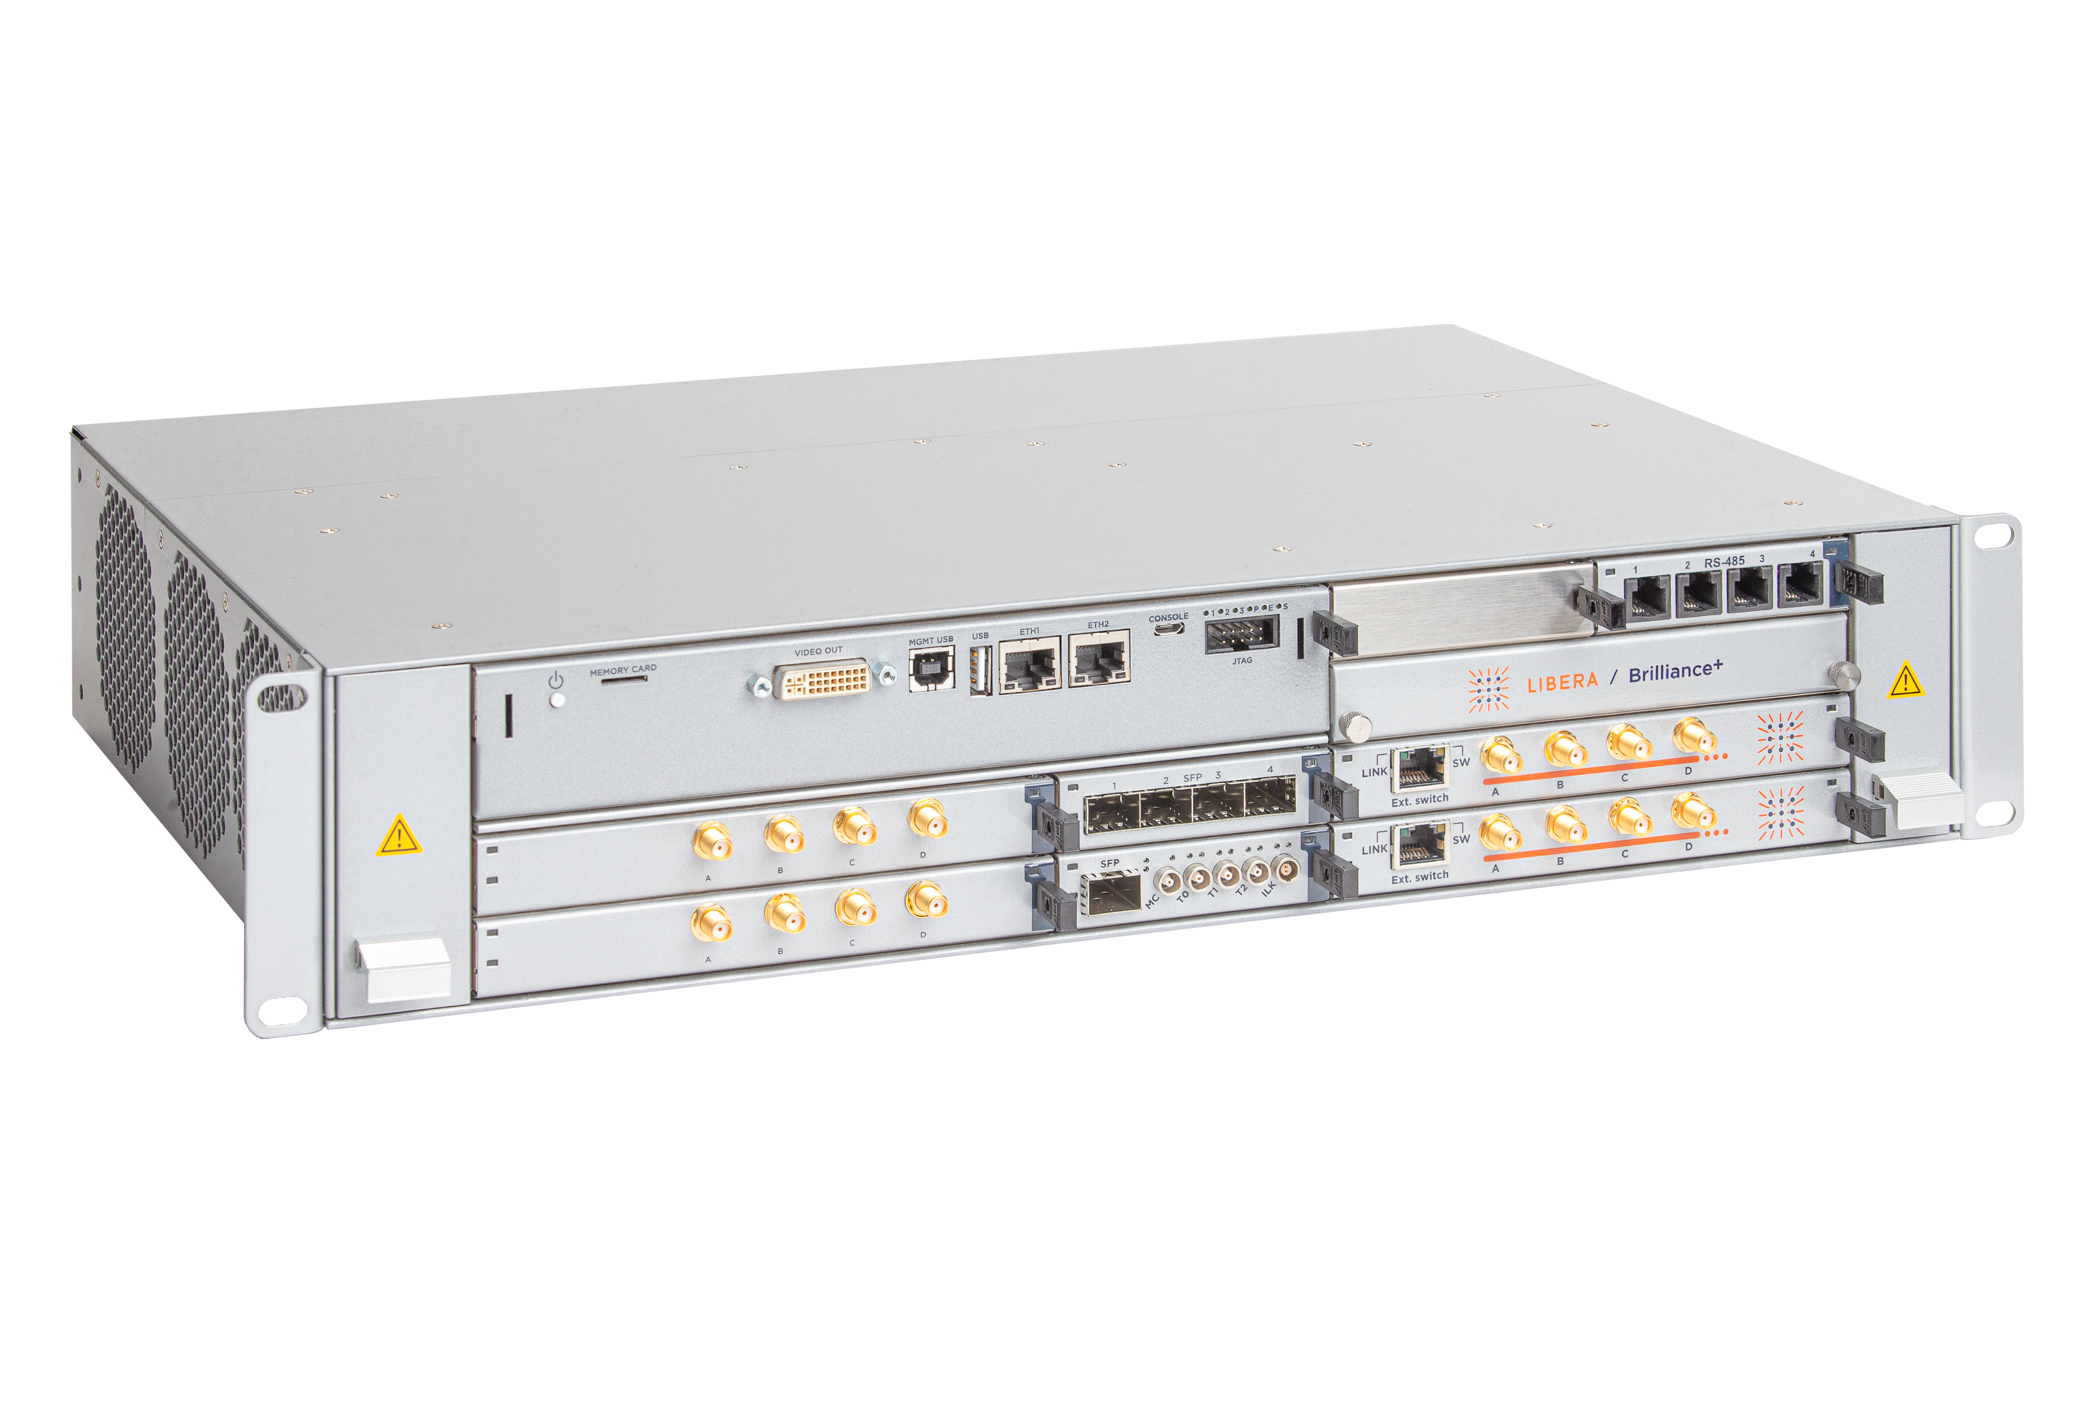
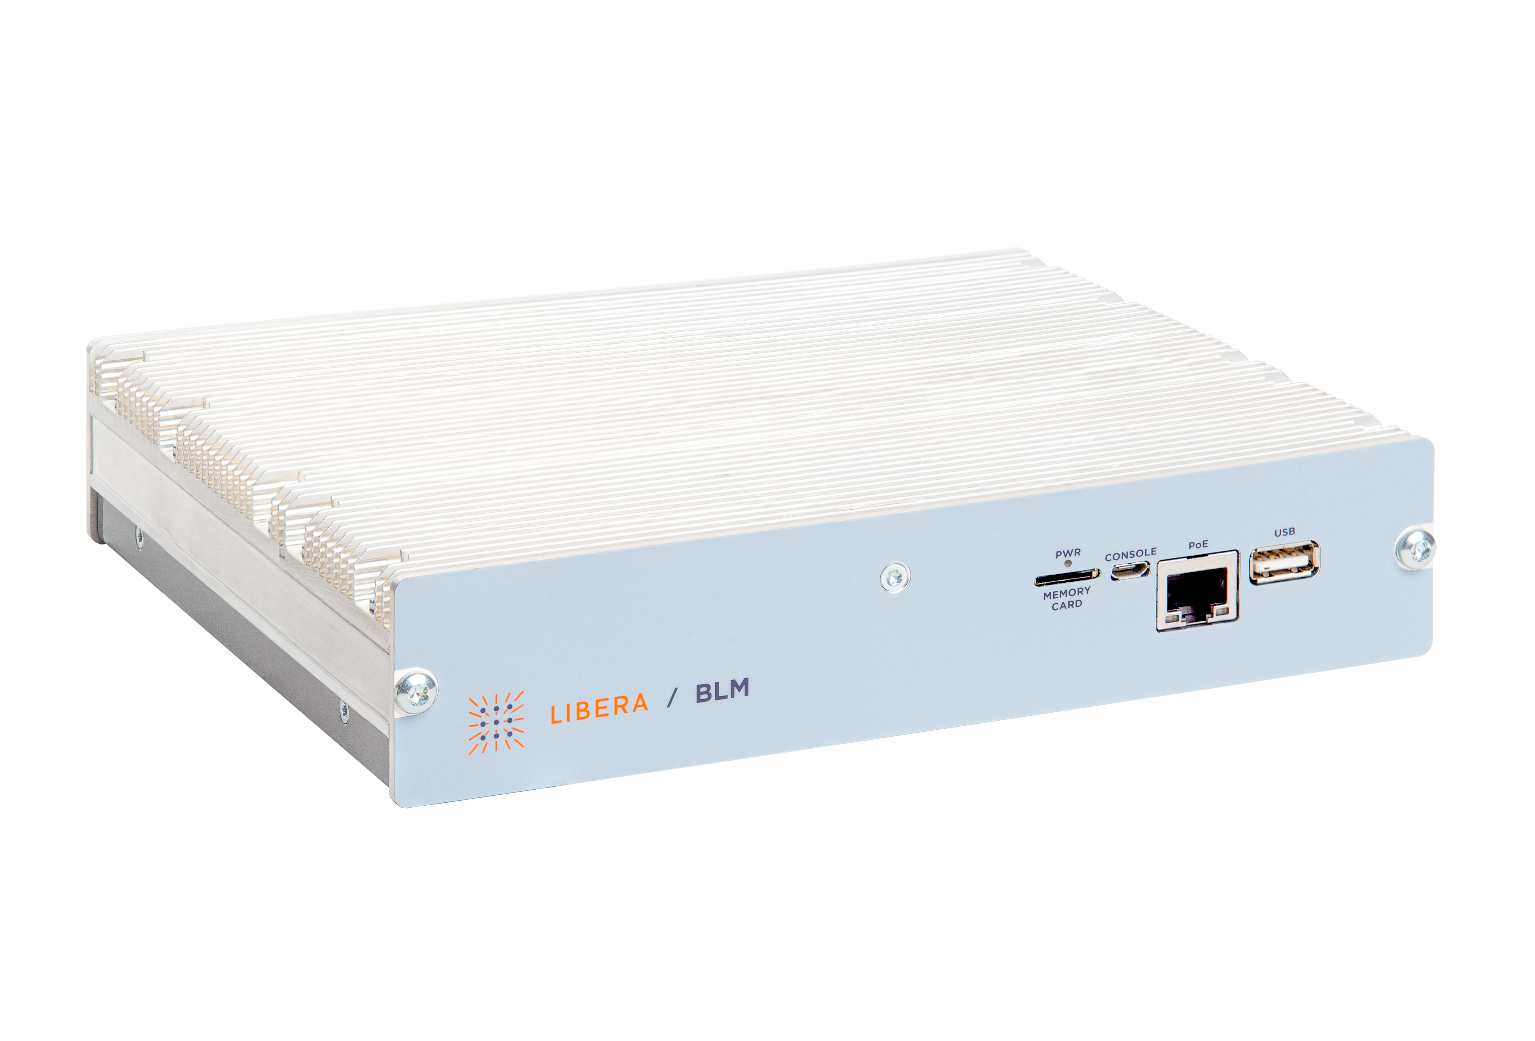
Libera - Solutions for particle accelerators
Beam Diagnostics​
Beam Position Monitoring​
Beam Loss monitoring​
Beam current / Beam phase​
​
LLRF controls​
LINAC ​
Proton synchrotrons​
​
RF generation and transfer​
Reference Master Oscillators​
RF distribution systems​
​
General Purpose​
RF Digitizers ​
Current Meters

Slide 6
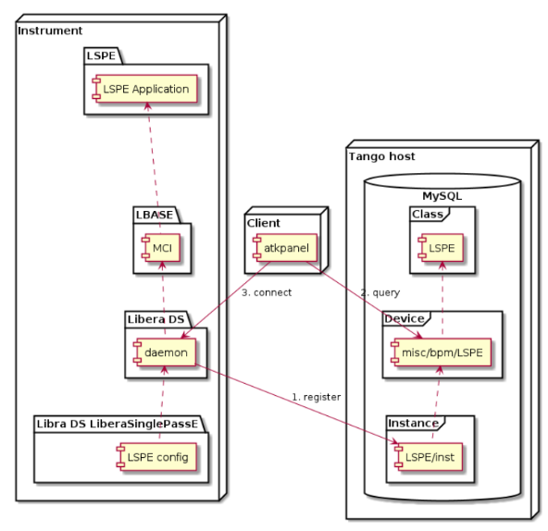
Tango Device Server for Libera instruments
One of multiple adapters for the Libera instruments.
Supports integration of Libera instruments into Tango control system.
Upgrade to Tango framework 9.2.2 performed 10 years ago.
Upgrade to Tango framework 9.5.0 finished in 2025.
Configuration driven architecture – attributes are generated based on mapping files.
Running as a separate process on the Libera instrument.
Running on a variety of CPU architectures (x86, armelx, armhf, arm64) and OS (Ubuntu, Buildroot) versions.

Slide 7
Upgrade of Tango Device Server to Tango 9.5.0 and evolution
Upgrade motivation:
Longterm support of the Tango framework.
Bug fixes in the Tango framework.
Introduction of new OS version.
Introduction of new Tango features.
Evolution and new features:
Driven by customer requirements.
Support for multiple device class types.
Introduction of states ALARM and FAULT
Support for Tango logging
New Tango commands for clearing the alarm state and log contents
Support for configurable location of the mapping file

Slide 8
Planned improvements for the Tango Device Server
Introduction of new features provided by Tango frameworks 10+:
Support for alarm and warning hysteresis
Support for Open Telemetry
Use of the latest Tango protocol version
Support for two-dimensional data type for signal attributes (DevDict)
Usage of cybersecurity and encryption provided by the Tango framework
Planned improvements:
Introduce user friendly attributes' mapping file
Add support for min/max values for alarm and warning properties to the mapping file
Support for general purpose attribute properties (description, label, unit)
Support for archive events

Slide 9
Conclusions
Configuration driven architecture serves us well
Our Tango Device Server is in constant evolution driven by external and internal factors
The Tango framework is flexible enough and has the performance required, to support the use cases needed by our customers
THANK YOU!

