Slide 1
Modernizing TANGO Archiving at Synchrotron SOLEIL
J.Guyot: database administrator
R.Girardot: developer
A.Tison: engineer apprentice, developer
G.Abeillé: developer, product owner

Slide 2
Context
A critical system for SOLEIL operations
Handles high-frequency time-series data & on-demand snapshots
In production since 2006,
Used on accelerators, 29 beamlines and 5 labs
+40k attributes collected
Originally based mostly on Oracle DB (and MySQL)
Migration to PostGreSQL/Timescale in progress

Slide 3

Legacy System Overview
Historical (HDB) and Temporary (TDB)
Collect attributes w/ TANGO polling or events
Snap
On-demand collect of a set of attributes
Compare & restore system states
TDB reset at each machine shutdown
HDB persistent data since 2006

Slide 4
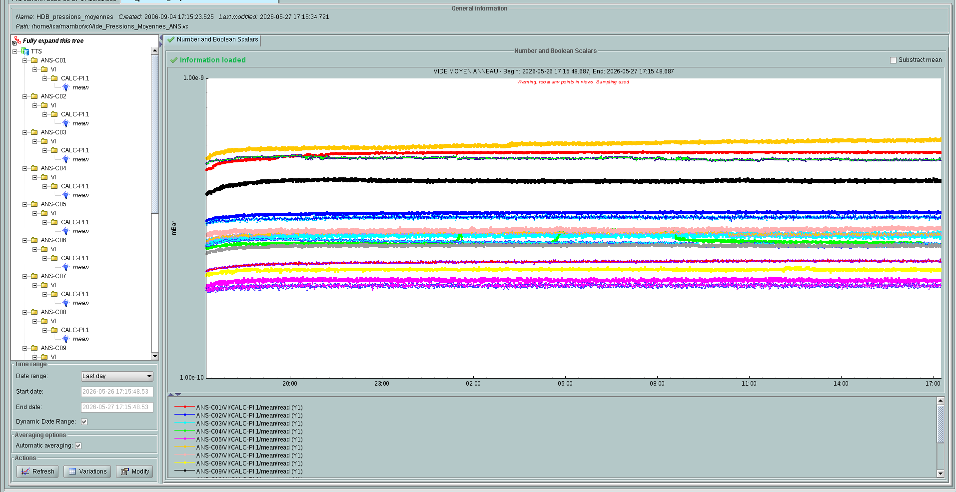


Legacy HDB/TDB architecture
Manager device
start/stop attributes
Watcher device
monitor archiver & check last inserted values
Extractor device
fetch values from db
Archiver device
collect & insert
Mambo
start/stop attributes
fetch values from db
HDB/TDB API
Insert / Fetch
GraphQL extractor API
fetch values from db
-> details on next slide
Database

Slide 5
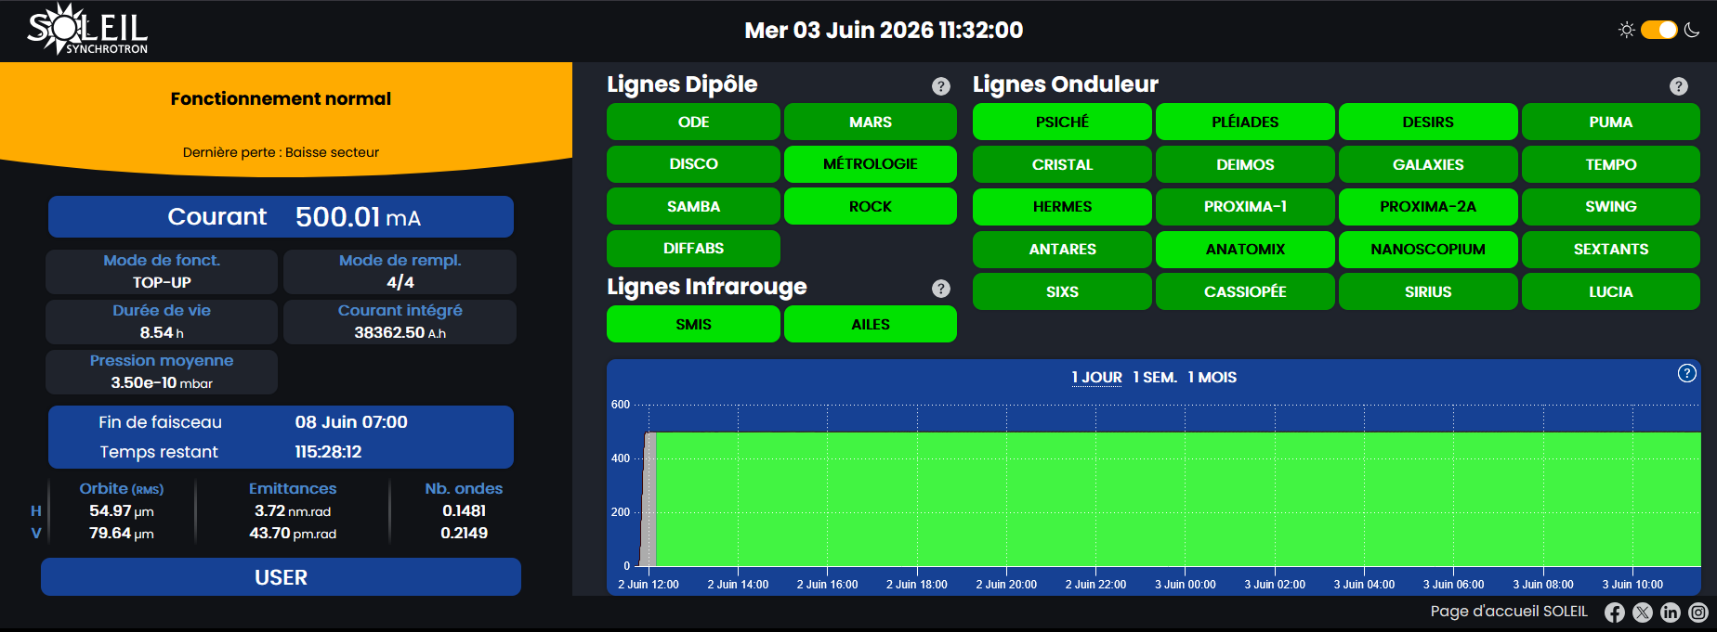
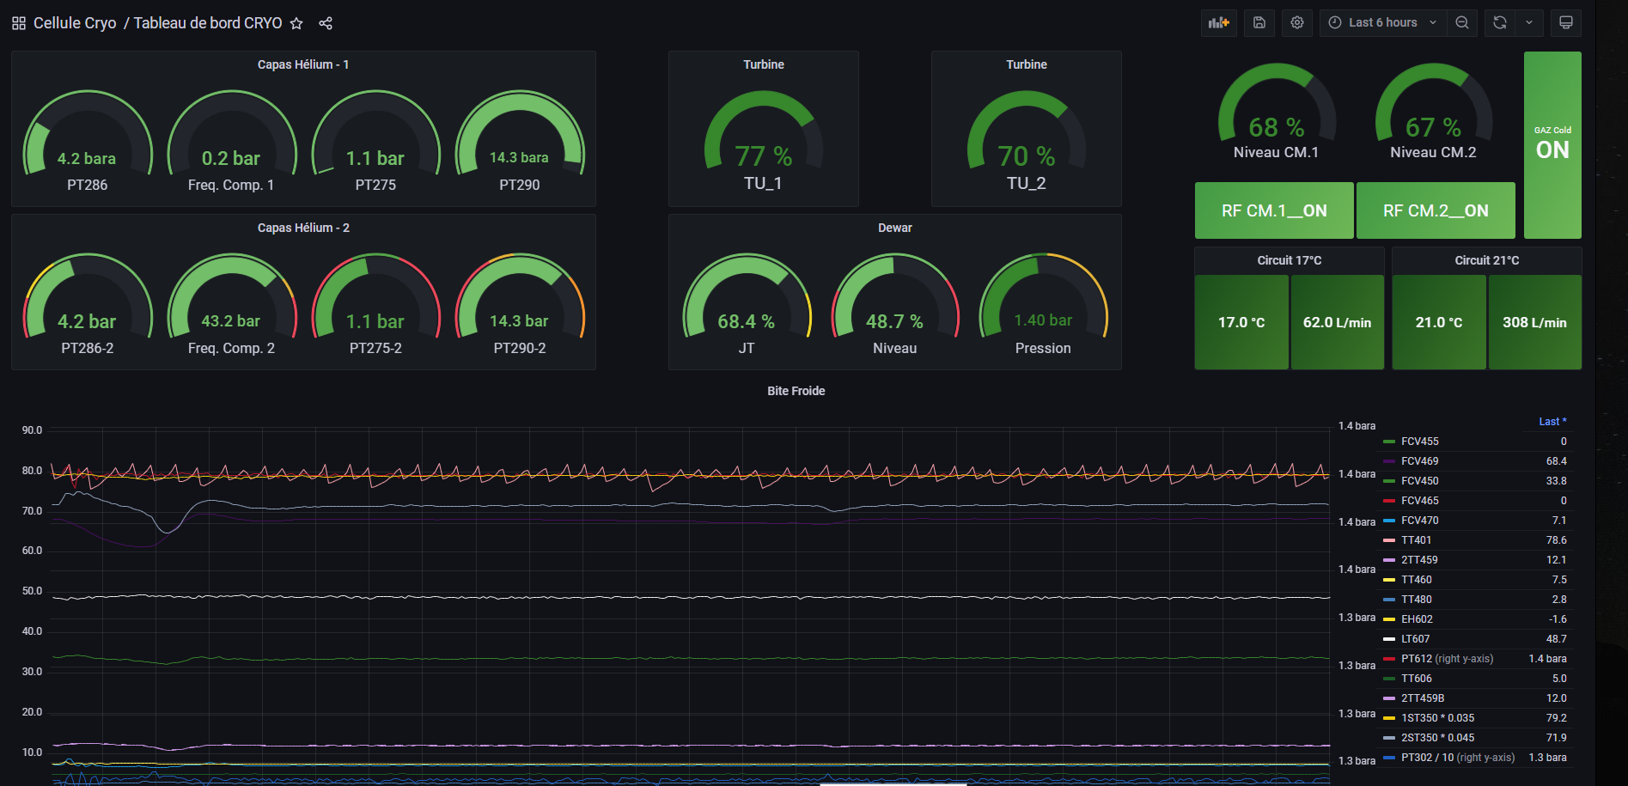



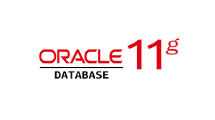

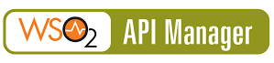

Web apps upon HDB
Machine status
Grafana dashboards
Machine
Status
HDB
accelerators
GraphQL API to archiving

Slide 6
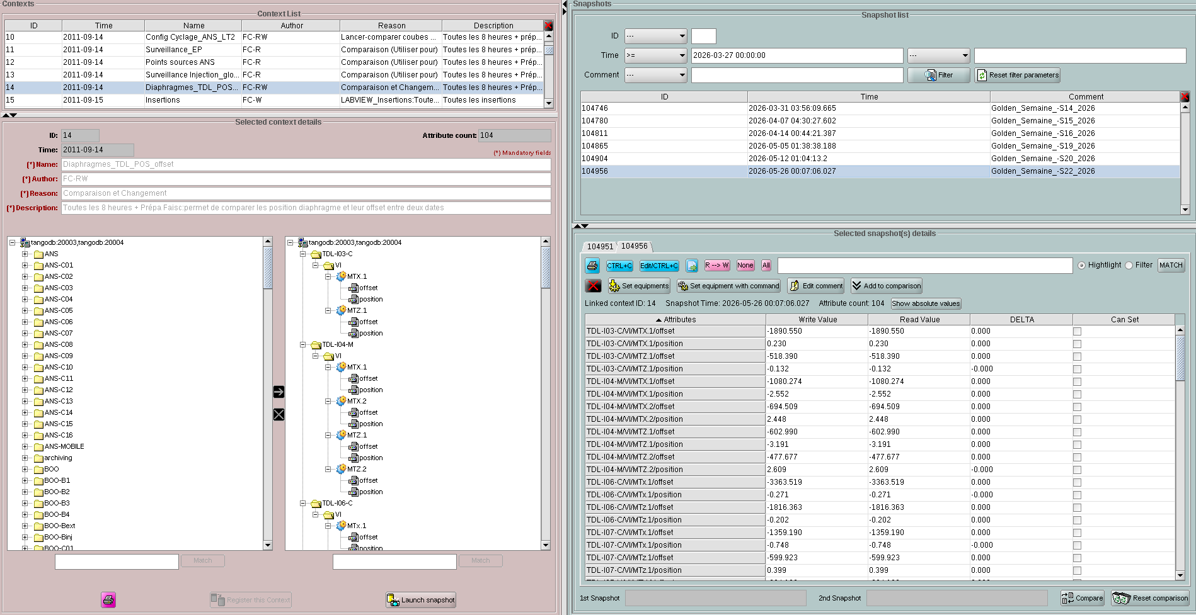
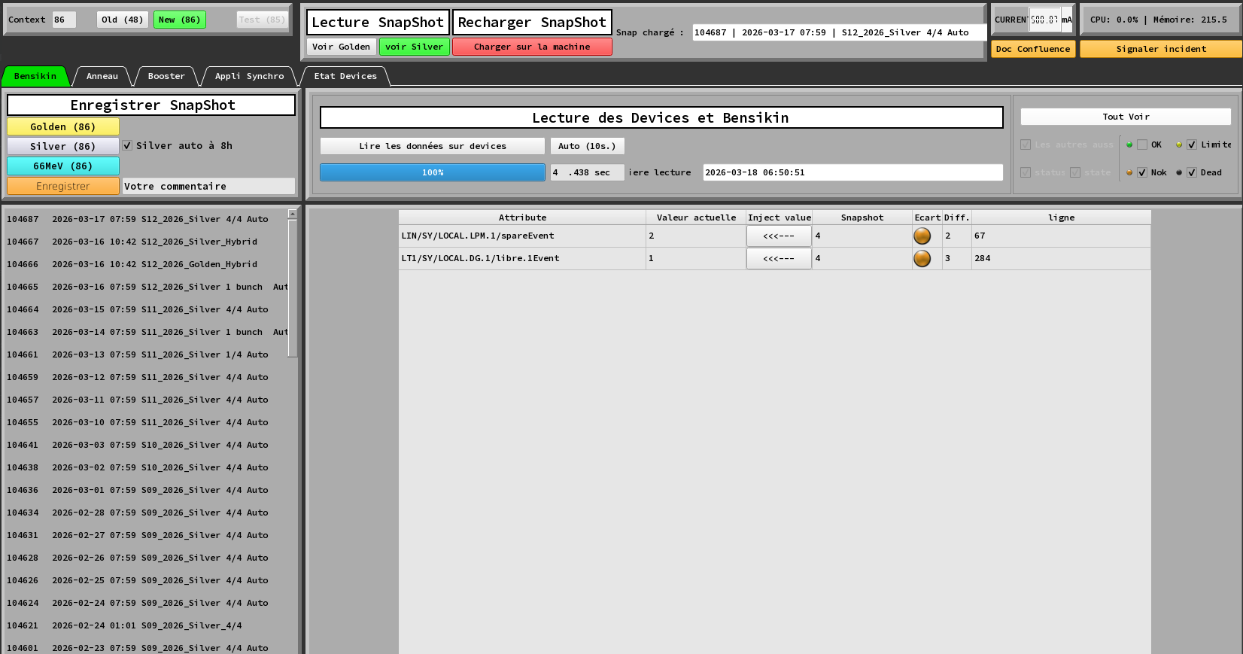
Legacy Snap architecture
Manager device
configuration
Bensikin
configuration
fetch values
Archiver device
collect & insert
Manage contexts
Extractor device
fetch values from db
Snap API
Insert / Fetch in PG
Python GUIs
Developed by operators
Database

Slide 7
Modernizing HDB/TDB

Slide 8

Key Challenges & Constraints
Why was change needed?
High Oracle licensing costs
Aging and complex codebase (especially legacy DB APIs)
Manage increasing data volume for SOLEIL II
👉 Need for modern, scalable, maintainable solution
Migration constraints:
No operational disruption demand
Maintain existing user interfaces
Migrate existing TDB/HDB configuration with polling and events.
Leverage internal expertise (SQL / DBA / Java)

Slide 9
Target Solution
Introducing Tango TimeSeries (TTS):
In place of legacy HDB and TDB → Keep interfaces, modernize backend
PostgreSQL/TimescaleDB w/ HDB++ DB schema
But with an added table « modes » for archiving configuration :
  Maintain existing HDB/TDB modes: periodic, difference, relative, theshold, event
  Allow to migrate smoothly existing conf. from TDB/HDB
New Java API layer for DB access
Add transparent access to multiple databases :
  to legacy HDB
  and different cold TTS DBs (one per year)

Slide 10


TTS software architecture
Manager device
start/stop attributes
Extractor device
fetch values from db
Mambo
start/stop attributes
fetch values from db
ArchiversMonitor device
monitor archiver & check last inserted values
GraphQL extractor API
fetch values from db
TTS API
Insert / Fetch PG
Fetch MySQL /Oracle
Multi db fetch w/ filtering on dates
Archiver device
Ingest data
Database
Database
Still in Java 8 / migration to Java 21 in progress
Database
HikariCP

Slide 11
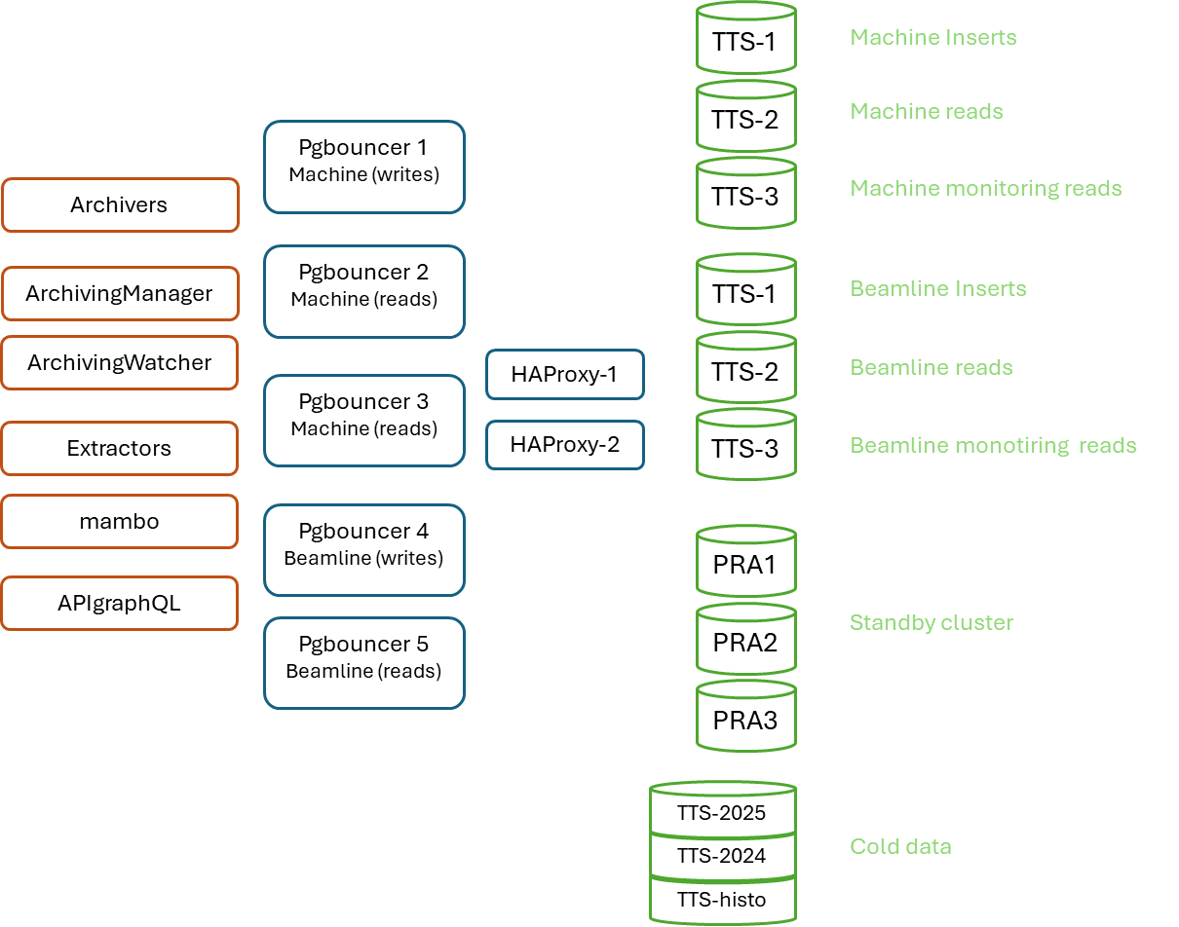


TTS infrastructure
Designed for high availability & scalability
3 clusters (VM servers):
  Machine
  Beamlines
  Standby (disaster recovery)
3-node cluster setup:
  1 write node
  2 read nodes
  Dedicated databases for cold data
Key components:
  HAProxy (failover)
  PgBouncer (connection pooling)
Backups:
  Full: weekly (300 GB, 1h45)
  Incremental: daily (10 min)
Archivers Monitor
GraphQL API
TTS API

Slide 12
TTS migration strategy
Progressive and safe transition
Coexistence of:
  Legacy systems (HDB/TDB)
  New system (TTS)
Multi-DB access layer: → transparent for users
Gradual migration: Accelerators, Labs, Beamlines
👉 Zero disruption for operations
Current situation:
  ✅ Accelerators:
    TTS in production since 2024
    HDB insertion stopped (2026)
  ✅ Labs: Fully migrated (2025–2026)
  🔄 Beamlines: 7 / 29 migrated. Migration of all beamlines expected for end of summer 2026.
  🔄 Preparing Grafana infrastructure for beamlines

Slide 13



Data Strategy: Managing data growth
Accelerator workload:
  35,700 attributes
  ~2,500 inserts/sec
  1.2 TB of data per year
Retention policies depends on each use case:
  For beamlines: one year is sufficient for some of them, some want to keep everything
  For accelerators: keep some data at vitam eternam, some for one year
  Data decimation may be used, decimation strategy has to be defined per attribute
Optimization techniques:
  Timescale compression (×7 gain)
  Pause some attributes during technical shutdowns for accelerators
  Delete some attributes older than a period of time, in accordance to user needs
  Upcoming Decimation: to be implemented (avg, lttb, asap_smooth…)

Slide 14
Modernizing Snap

Slide 15
SNAP Modernization
We have applied the same strategy as for TTS:
  Keep existing interfaces (devices and GUI)
  Exit from Oracle, and migrate to PostGreSQL DB
Improvements :
  Simplified DB schema
  Merge 2 devices (Archiver/Manager w/ code duplication)
  Replace old API and devices, keep Bensikin
  Prepared for future extensions
    Like snapshotting properties in addition of attributes values

Slide 16
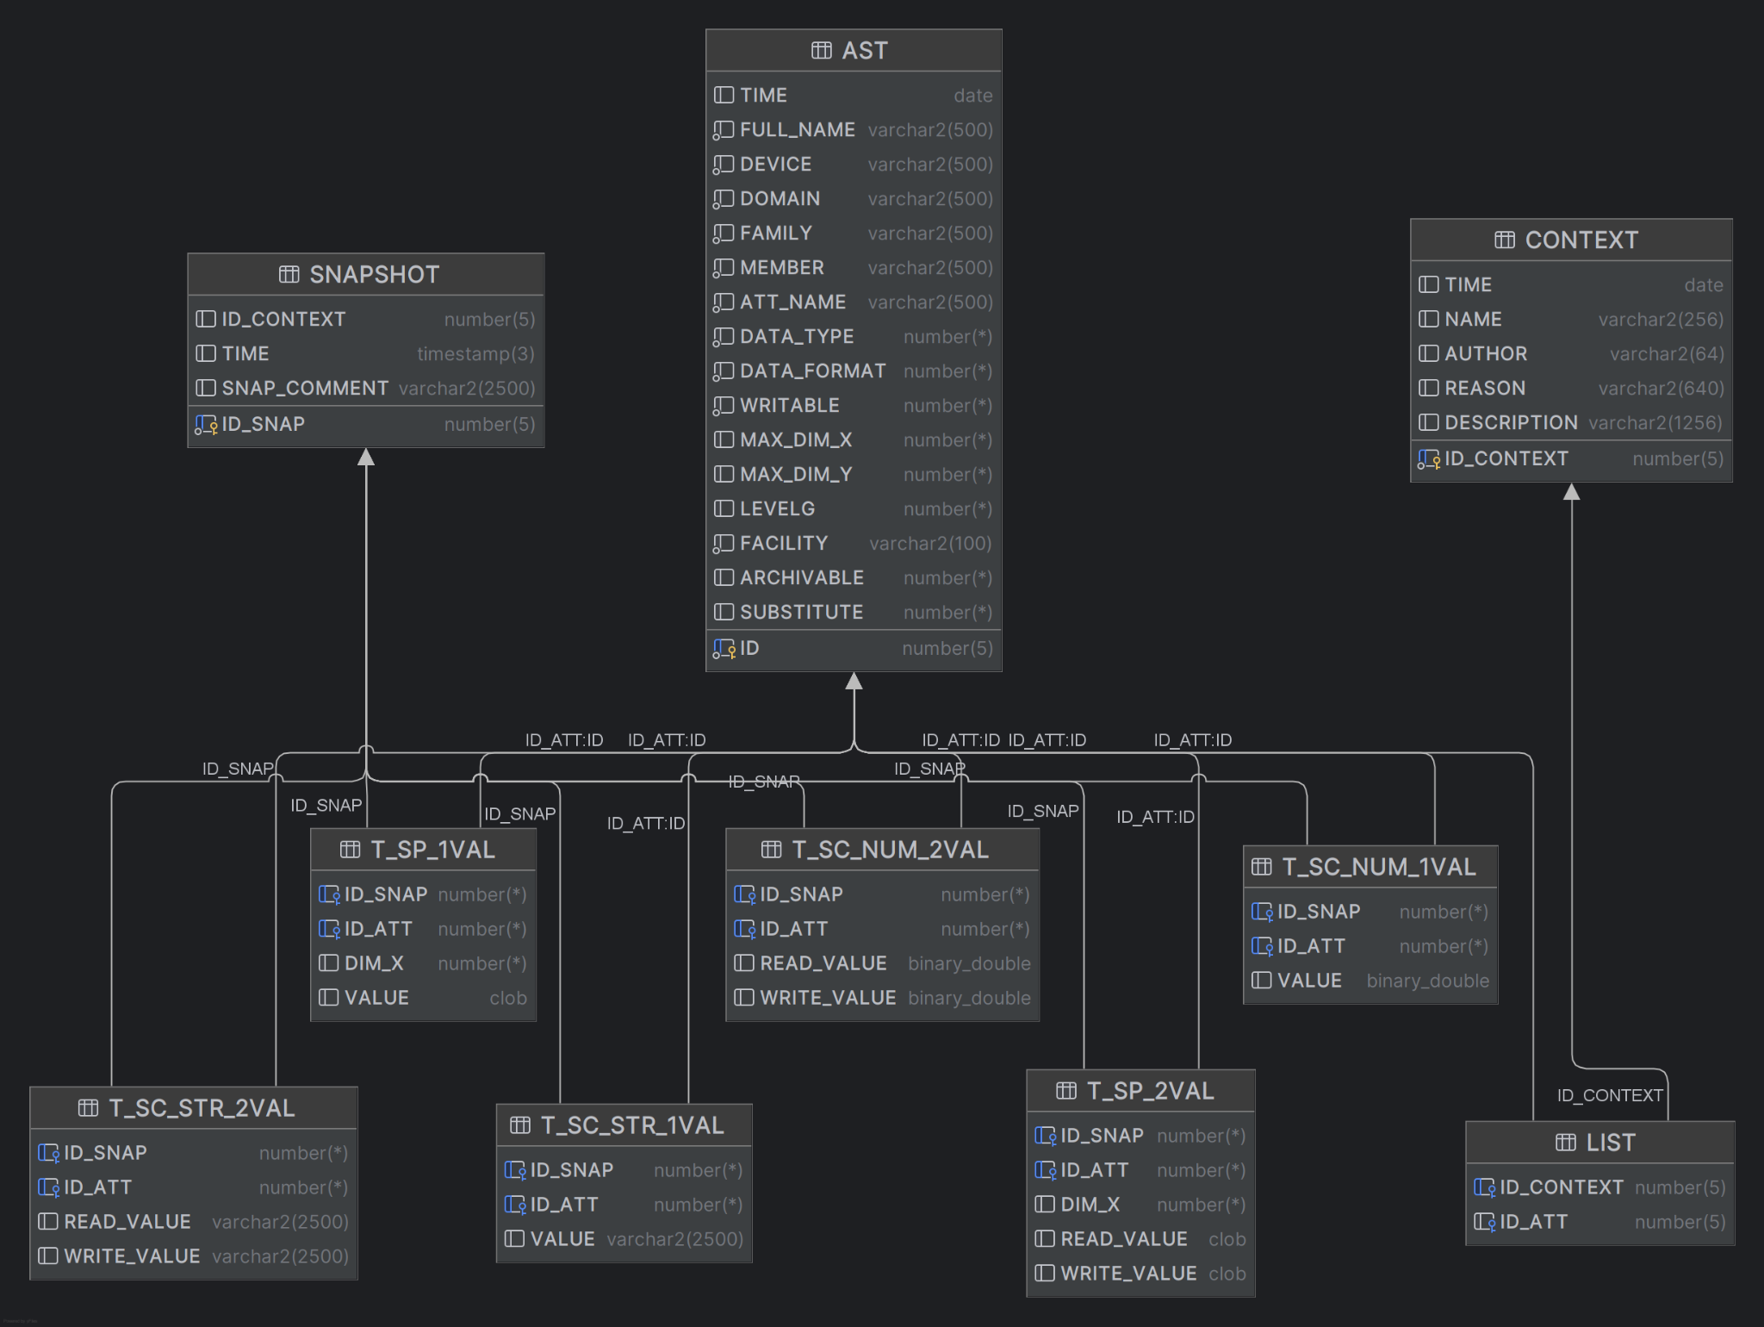
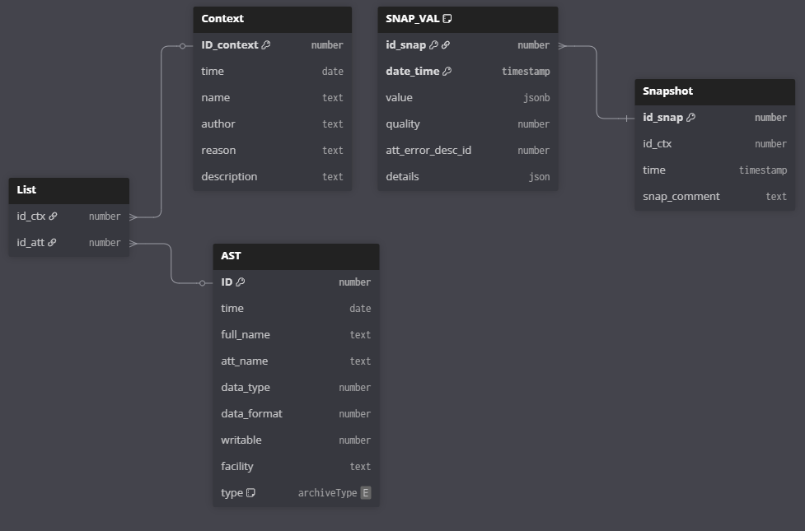
SNAP database revamping
The old DB schema was containing several tables for data
In PostGreSQL, only one table for values, using JSONB column type
Notes:
Il va s'en dire que c'est complexe
Chose importante à voir: les tables "T_" portent les données du snap et c'est infernal pour aller recup les données
Parler des différentes possibilités:
Garder le schéma et faire évo le code => Problème long terme
Changer le schéma pour mettre les données d'une snapshot dans un JSON
Changer le schéma pour mettre les données et leur configuration dans un JSON

Slide 17
Snap Software architecture
Device Extractor
fetch values from db
Bensikin
start/stop attributes
fetch values from db
Device Archiver
collect & insert
Manage contexts
Snap API
Insert / Fetch in PG
Database
21
HikariCP

Slide 18
SNAP Status
Current progress
✅ Development complete
🔄 Testing on accelerators
Next steps:
  Fix remaining issues
  User validation
  Production rollout on accelerators & beamlines

Slide 19
Conclusion

Slide 20
Next Steps
Complete TTS beamline migration
Implement TTS data decimation
Validate SNAP in accelerators, and migrate beamlines afterwards
Improve CI/CD pipelines
  Jenkins → GitLab CI
  Java 21 upgrade in progress
  But binaries are still on an internal repository (artifactory)
  Meanwhile, manual publication of a zip package containing all binaries and scripts
Code:
  https://gitlab.synchrotron-soleil.fr/software-control-system/tango-controls-archiving
Package:
  https://gitlab.synchrotron-soleil.fr/software-control-system/packaging/archivingroot/-/releases

Slide 21
Acknowledgments
SOLEIL:
  Acceleratos: Thomas Marion, Xavier Delétoille, Laurent Nadolski
  Experiments: Alina Vlad, Sebastian Schoader, Denis Menut
  Controls: Patrick Madela, Hiba Kendi, S.Lê, Yves-Marie Abiven
And the TANGO community

