Slide 1
Archiving Sardana elements
40th Tango Community meeting
Jun 8 – 12, 2026
ALBA Synchrotron
Dmitry Egorov

Slide 2
Sardana (heavily simplified) structure
Sardana Device Server
MotorController class source file
Motor X
Device: motor/ctrl/1
Controller logic:
Hardware connection, configuration, etc.
Sardana elements
belong to Controller
Motor Y
Device: motor/ctrl/2
Axes logic:
Mapping values and commands to channels - position, limits, state, stop(), etc.
Motor Controller
Device: controller/motor_ctrl/1
Motor Z
Device: motor/ctrl/3
Dynamically loaded packages
Pool device
Device: ctrl_sys/Pool/1
…
Motor XYZ
Device: motor/ctrl/123
Init Controller device with SardanaDevice structure
(dynamic attributes, commands)

Slide 3
Tango attributes read
MotorController class source file
Motor X
Device: motor/ctrl/1
Controller logic:
Hardware connection, configuration, etc.
Position attribute
polling
Motor Y
Device: motor/ctrl/2
Axes logic:
Mapping values and commands to channels - position, limits, state, stop, etc
Motor Z
Device: motor/ctrl/3
Read_attribute() * N
read_position()
read_position()
read_position()
Get position value
Check state value
Other
Sardana
“magic”
Get position value
Check state value
Other
Sardana
“magic”
Get position value
Check state value
Other
Sardana
“magic”
Hardware communication

Slide 4
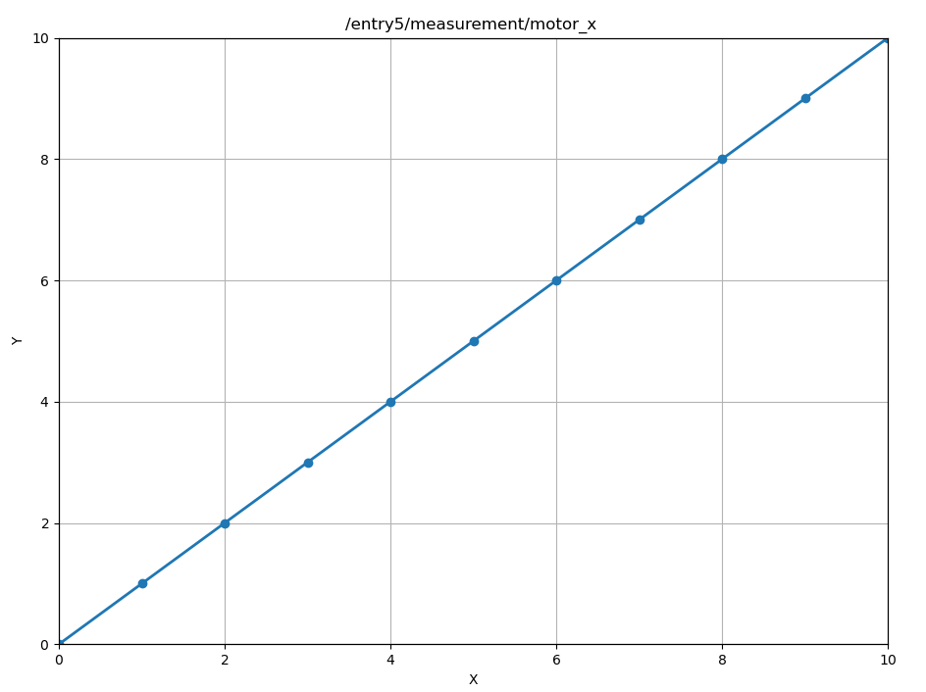
Tango attributes read (during a scan)
Absolute scan for specified motor:
ascan motor_x 0 10 10 0.1
<motor> <start_pos> <final_pos> <nr_interv> <integ_time>
PyDs_PythonError: Exception: Cannot move: already in motion
Hint: in Spock execute `www` to get more details
motor_x
1
motor_x
2
Motion failed due to: DevFailed[
DevError[
desc = Exception: Cannot move: already in motion
All motors polling
…
Hardware communication

Slide 5
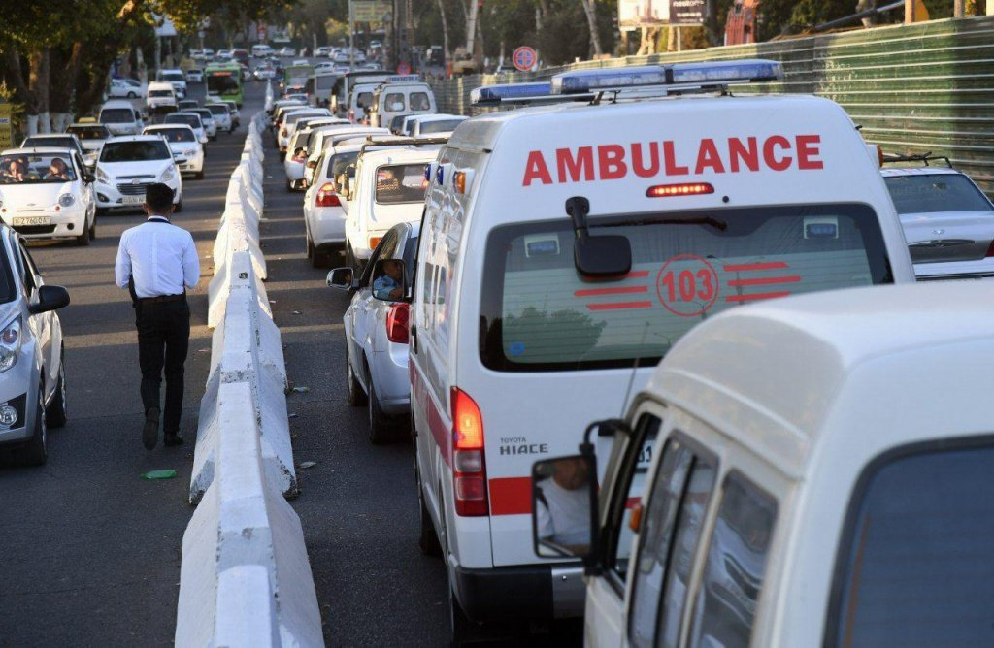

Queuing issues…
It’s difficult to control priorities or sort the queue with requests from different devices

Slide 6
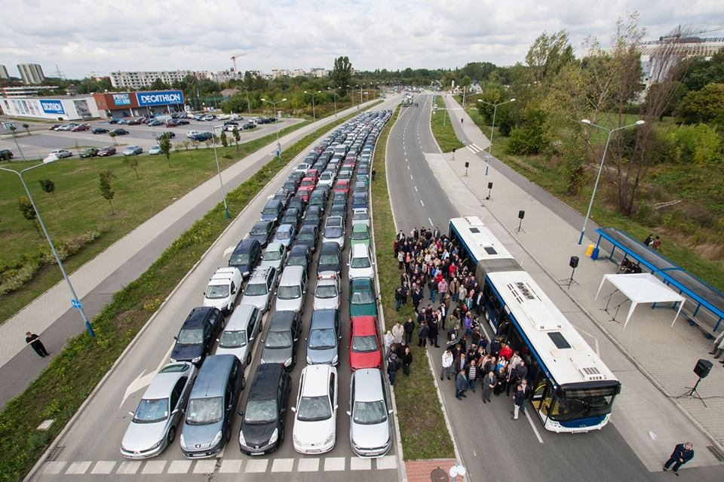
Queuing issues…
…

Slide 7
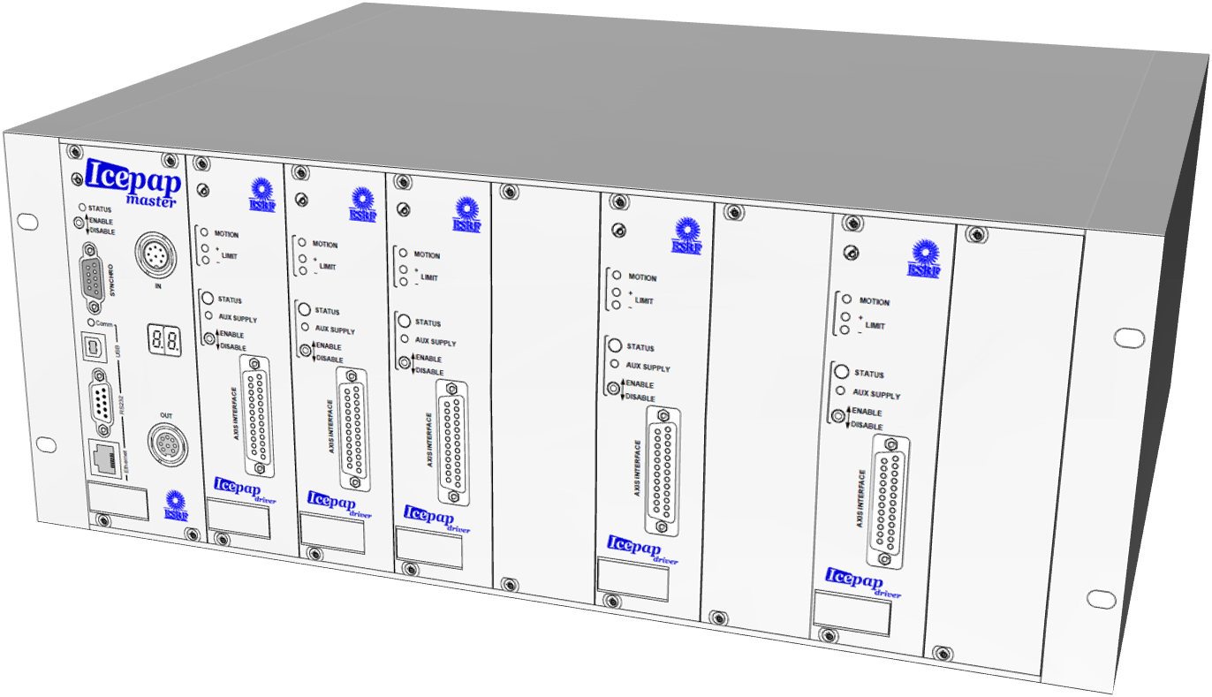
How can we read values in batches?
Motor X
Device: motor/ctrl/1
MotorController class source file
Get all
positions
Motor Controller
Device: controller/motor_ctrl/1
Controller logic:
Hardware connection, configuration, etc.
Motor Y
Device: motor/ctrl/2
Axes logic:
Mapping values and commands to channels - position, limits, state, stop, etc
Motor Z
Device: motor/ctrl/3
Push updated values
cmd ?FPOS [register] addr [addr … ] → value [value … ]
Returns the positions for the specified axes.
The ?FPOS query is intended to be used for frequent polling from the control host

Slide 8
IcePAP Sardana controller modifications
MotorController class source file
Controller logic:
Hardware connection, configuration, etc.
Axes logic:
Mapping values and commands to channels - position, limits, state, stop, etc
New properties to configure which axes to read
Controller attributes to poll them to read data from hardware
“Read_attribute” creates background thread to not lock the polling thread
Background thread updates Dial Position (if motor is not Moving)

Slide 9
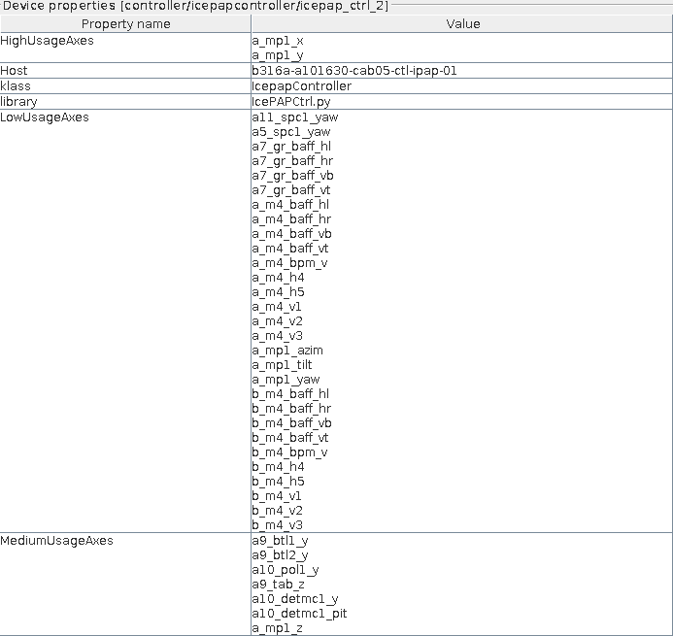
IcePAP Sardana controller modifications
Polling Status
Polled attribute name = HighUsagePositions
Polling period (mS) = 5000
Polling ring buffer depth = 10
Time needed for the last attribute reading (mS) = 0.492
Data not updated since 2 S and 886 mS
Delta between last records (in mS) = 5000, 5000, 4994, 5005
Polled attribute name = LowUsagePositions
Polling period (mS) = 60000
Polling ring buffer depth = 10
Time needed for the last attribute reading (mS) = 14.662
Data not updated since 44 S and 875 mS
Delta between last records (in mS) = 60010, 59984, 60019, 59999
Polled attribute name = MediumUsagePositions
Polling period (mS) = 10000
Polling ring buffer depth = 10
Time needed for the last attribute reading (mS) = 1.183
Data not updated since 4 S and 997 mS
Delta between last records (in mS) = 10009, 10007, 10000, 9990
Code modifications are in the end of presentation
https://gitlab.com/dmiego/sardana/-/tree/motor-archiving
https://gitlab.com/dmiego/sardana-icepap/-/tree/motor-archiving
New properties with lists of axes
New polled attributes to query data

Slide 10
Subscribe to archiving events
Physical motor
EventData[
attr_name = 'tango://b-v-veritas-csdb-0.maxiv.lu.se:10000/b316a-o02/opt/mono-01-m2pit/position'
attr_value = DeviceAttribute(data_format = tango._tango.AttrDataFormat.SCALAR, dim_x = 1, dim_y = 0, has_failed = False, is_empty = False, name = 'position', nb_read = 1, nb_written = 1, quality = tango._tango.AttrQuality.ATTR_VALID, r_dimension = AttributeDimension(dim_x = 1, dim_y = 0), time = TimeVal(tv_nsec = 0, tv_sec = 1780661934, tv_usec = 101238), type = tango._tango.CmdArgType.DevDouble, value = 3.0446556158196554, w_dim_x = 1, w_dim_y = 0, w_dimension = AttributeDimension(dim_x = 1, dim_y = 0), w_value = 3.0446494033420493)
device = Motor(b316a-o02/opt/mono-01-m2pit)
err = False
errors = ()
event = 'archive'
reception_date = TimeVal(tv_nsec = 819, tv_sec = 1780661934, tv_usec = 103010)]
PseudoMotor
EventData[
attr_name = 'tango://b-v-veritas-csdb-0.maxiv.lu.se:10000/pm/mono_energy_calib_ctrl/1/position'
attr_value = DeviceAttribute(data_format = tango._tango.AttrDataFormat.SCALAR, dim_x = 1, dim_y = 0, has_failed = False, is_empty = False, name = 'Position', nb_read = 1, nb_written = 1, quality = tango._tango.AttrQuality.ATTR_VALID, r_dimension = AttributeDimension(dim_x = 1, dim_y = 0), time = TimeVal(tv_nsec = 0, tv_sec = 1780662392, tv_usec = 806433), type = tango._tango.CmdArgType.DevDouble, value = 576.5995760672288, w_dim_x = 1, w_dim_y = 0, w_dimension = AttributeDimension(dim_x = 1, dim_y = 0), w_value = 576.6000000000165)
device = PseudoMotor(pm/mono_energy_calib_ctrl/1)
err = False
errors = ()
event = 'archive'
reception_date = TimeVal(tv_nsec = 903, tv_sec = 1780662392, tv_usec = 808568)]

Slide 11
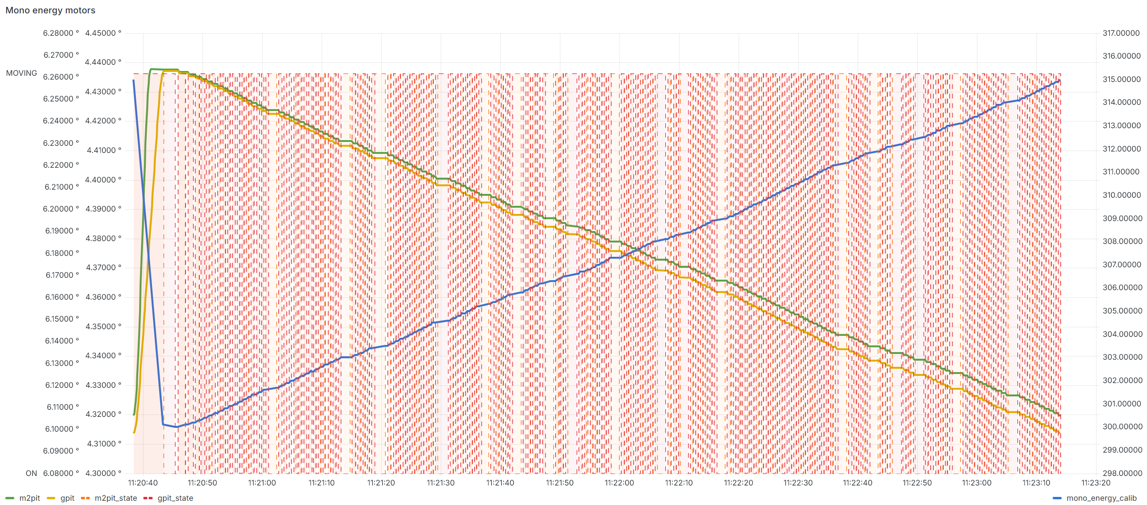
How It Has Already Helped
Green and yellow – physical motors positions, blue – pseudomotor position,
Orange and red – physical motors states

Slide 12
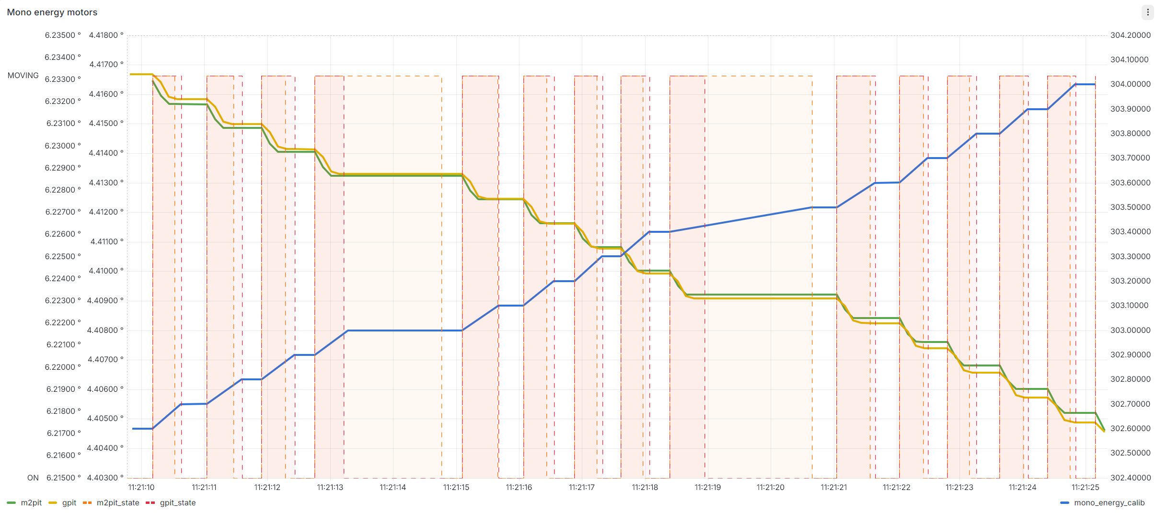
How It Has Already Helped
One of the motors is still busy
Target positions are reached
Green and yellow – physical motors positions, blue – pseudomotor position,
Orange and red regions – physical motors states

Slide 13
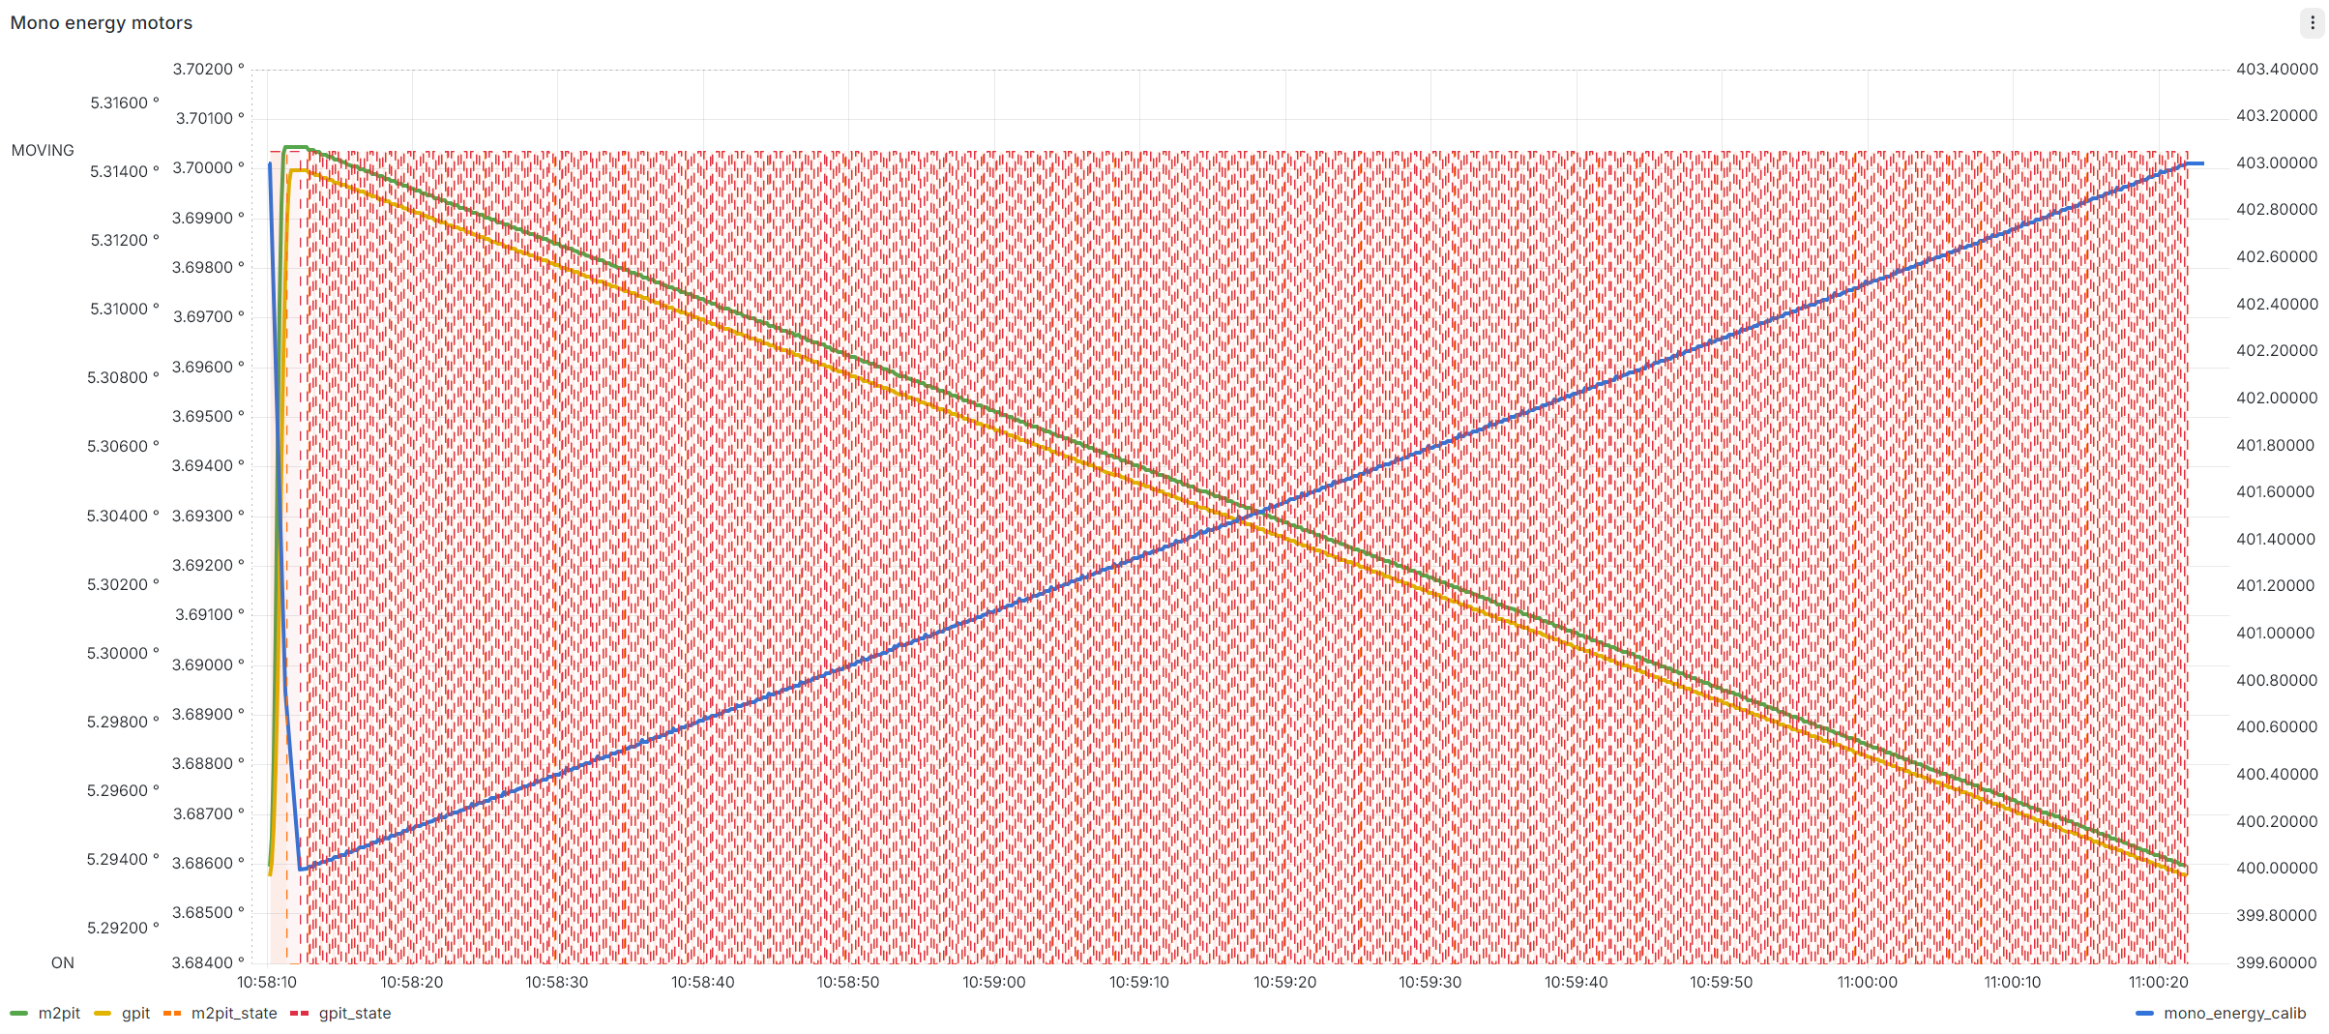
How It Has Already Helped
Before tuning
After tuning

Slide 14
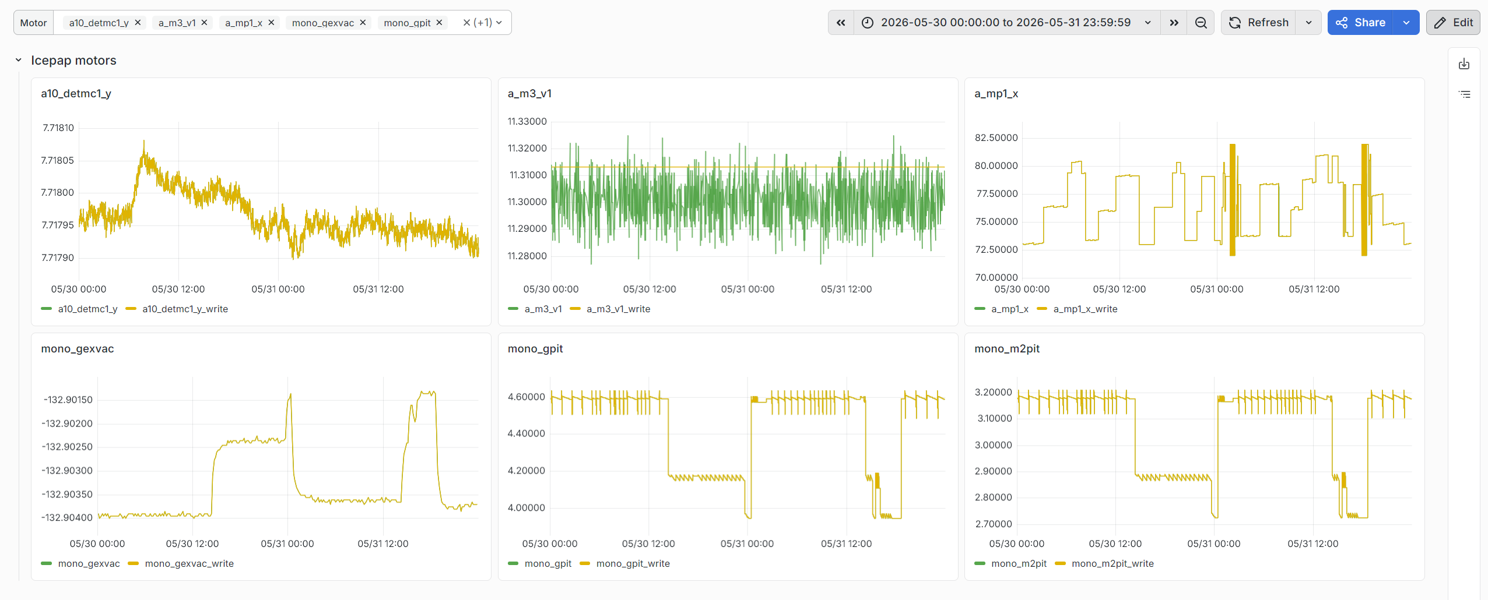
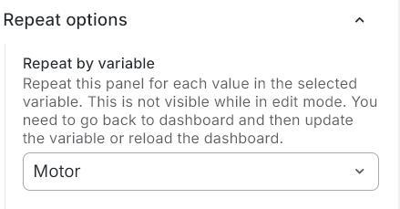
Grafana dashboard

Slide 15
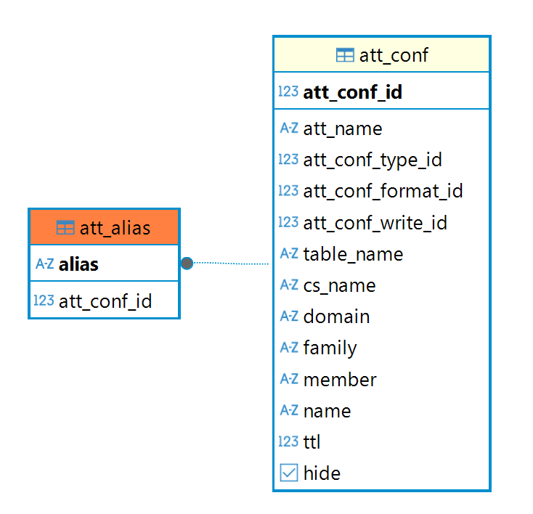
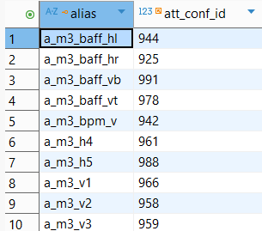
Bonus: a naive attempt to add aliases to the HDB++
SELECT
data_time AS "time",
value_r as "$Motor",
value_w as "${Motor}_write"
FROM att_scalar_devdouble
WHERE
$__timeFilter(data_time)
AND
att_conf_id = (select att_conf_id from att_alias where alias = '$Motor')
ORDER BY data_time

Slide 16
Thank you!

Slide 17
Sardana and IcePAP controller modifications
sardana/pool/poolelement.py
Notify listeners when element attributes are initialized and values are assigned
def init_attribute_values(self, attr_values: Optional[Dict[str, Any]] = None) -> None:
"""Initialize attributes with (default) values. """
………
self.controller.fire_event(EventType("init_attribute_values"), self._axis)
sardana_icepap/ctrl/IcePAPCtrl.py
Listen to “init attributes” event to check if axis is archived
def ctrl_event(self, ev_src, ev_type, ev_val):
if ev_type.name == "init_attribute_values":
axis, axis_name = ev_val, self.GetAxisName(ev_val)
self._elements[axis] = self.pool_ctrl.get_element(axis=axis)
self._check_if_archived(axis, axis_name, self.attributes[axis]['use_encoder_source'])
Sort axes by “type” and encoder usage
def _check_if_archived(self, axis_id, axis_name, use_enc_source):
if use_enc_source:
if axis_name in self.HighUsageAxes:
self.archived_enc_axes["high_usage"].add(axis_id)

Slide 18
IcePAP controller modifications
sardana_icepap/ctrl/IcePAPCtrl.py
“read_attribute” function
def getHighUsagePositions(self):
return self.readPositions(self.archived_enc_axes["high_usage"])
Split list of axes to batches and read them in background thread
def readPositions(self, axes_to_read):
for chunk in self.divide_by_chunks(axes_to_read):
if chunk:
t = threading.Thread(target=self.read_in_background, args=(chunk, "MEASURE"))
t.start()
return str({axis: self.attributes[axis]['position_value'] for axis in axes_to_read})
The original list is split up to ensure that each request to the hardware takes less than 10 ms, which is the Sardana scan reading interval.

Slide 19
Sardana modifications
sardana_icepap/ctrl/IcePAPCtrl.py
“read_attribute” function
def read_in_background(self, axes, register):
ans = self.ipap.get_fpos(
axes,
register=register
)
for axis, value in zip(axes, ans):
eval_globals = numpy.__dict__
spu = float(self.attributes[axis]['step_per_unit'])
eval_locals = {'VALUE': value, 'value': value,
'SPU': spu, 'spu': spu}
enc_src_formula = self.attributes[axis]['encoder_source_formula']
dial_pos = eval(enc_src_formula,
eval_globals,
eval_locals)
self.attributes[axis]['position_value'] = float(dial_pos)
last_state_value = self.attributes[axis]["last_state_value"]
# if axis is Moving - it's managed by PoolMotion
# we don't want to push data from here, because it comes from another thread
# it might come later and has old value, which can be confusing
if last_state_value != State.Moving:
self._elements[axis].put_dial_position(SardanaValue(dial_pos), propagate=2)
Query raw values from hardware
Calculate position from raw values
Push new values to Motor Devices

Slide 20
Sardana modifications
sardana/tango/pool/Motor.py + sardana/tango/pool/PseudoMotor.py
Configure devices to push archive events from code
def initialize_dynamic_attributes(self):
attrs = PoolElementDevice.initialize_dynamic_attributes(self)
……
self.set_archive_event("position", True, True)
self.set_archive_event("state", True, True)
sardana/tango/core/SardanaDevice.py
put_dial_position() triggers _set_attribute_push(), which already pushes change events
def _set_attribute_push(self, attr, value=None, w_value=None, timestamp=None,
quality=None, error=None, priority=1):
……
args = attr_name, value, timestamp, quality
self.push_change_event(*args)
if attr_name == 'position':
self.push_archive_event(*args)

